Slide 1
Communication Protocols part1
Nasif M.

Slide 2

Serial communication
In Telecommunication and Computer Science, serial communication is the process of sending/receiving data in one bit at a time.

Slide 3
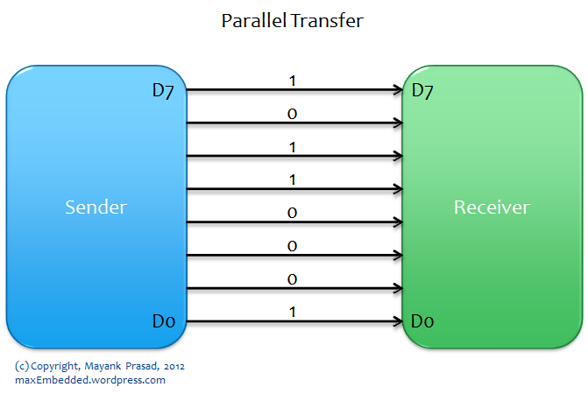
Parallel communication
Parallel communication is the process of sending/receiving multiple data bits at a time through parallel channels.

Slide 4

Serial communication

Slide 5

Parallel communication

Slide 6
Serial vs Parallel Communication
Serial Communication | Parallel Communication
1. One data bit is transceived at a time | 1. Multiple data bits are transceived at a time
2. Slower | 2. Faster
3. Less number of cables required to transmit data | 3. Higher number of cables required

Slide 7
Major Factors Limiting Parallel Communication
Speed: Clock skew phenomenon reduces the speed of every link to the slowest of all of the links.
Cable length: Crosstalk phenomenon creates interference between the parallel lines, and the effect only magnifies with the length of the communication link. This limits the length of the communication cable that can be used.
Phenomenon : a fact or situation that is observed to exist or happen, especially one whose cause or explanation is in question.

Slide 8
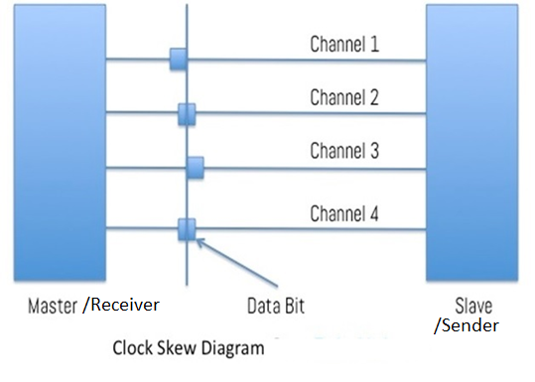
Terminology
Clock Skew: In a parallel circuit, clock skew phenomenon is observed, which is the time difference in the arrival of two bits sequentially in adjacent registers. There is a time lag in the data bits through different channels of the same bus. Clock skew is inevitable due to differences in physical conditions of the channels, like temperature, resistance, path length, etc
For example, around 5 people are firing at the same time, there is bound to be a time difference in the arrival of the bullet from the first shooter and that from the second shooter and so on. This time difference is what we call clock skew.

Slide 9
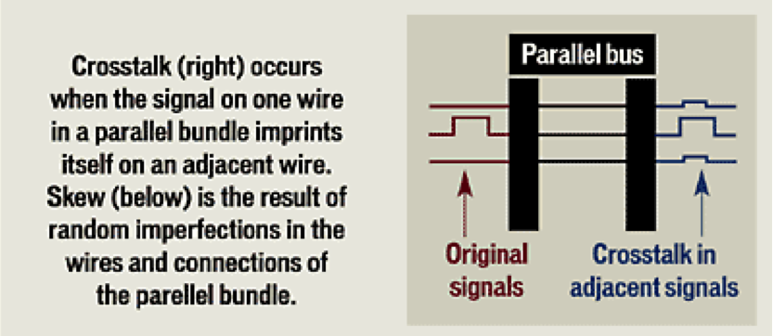
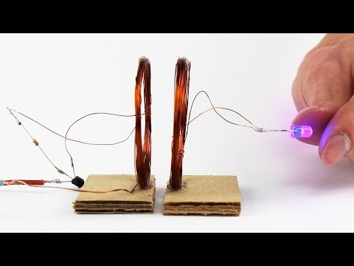
Terminology
Crosstalk: This phenomenon is observed in parallel circuit when a signal transmitted on one channel of a transmission bus creates an undesired effect in another channel. Undesired capacitive, inductive, or conductive coupling is usually what is called crosstalk, from one circuit, part of a circuit, or channel, to another.

Slide 10
Advantages of Serial over Parallel
Although a serial link may seem inferior to a parallel one, since it can transmit less data per clock cycle, it is often the case that serial links can be clocked considerably faster than parallel links in order to achieve a higher data rate. A number of factors allow serial to be clocked at a higher rate:
Clock skew between different channels is not an issue
A serial connection requires fewer interconnecting cables (e.g. wires/fibers) and hence occupies less space. The extra space allows for better isolation of the channel from its surroundings.
Crosstalk is not a much significant issue, because there are fewer conductors in proximity.

Slide 11
UART
UART stands for Universal Asynchronous Receiver Transmitter,
They are basically just a piece of computer hardware that converts parallel data into serial data and vice-versa.
The UART, or Universal Asynchronous Receiver / Transmitter, is a feature of the microcontroller which is useful for communicating serial data (text, numbers, etc.) to the PC. The device changes incoming parallel information (within the microcontroller/PC) to serial data which can be sent on a communication line.

Slide 12
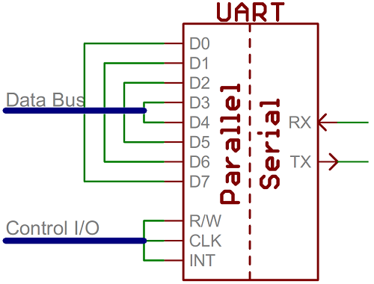
Microcontroller
Super-simplified UART interface. Parallel on one end, serial on the other

Slide 13
USART
USART stands for Universal SynchronousAsynchronous Receiver Transmitter.
In synchronous transmission, the clock data is recovered separately from the data stream and no start/stop bits are used. This improves the efficiency of transmission on suitable channels since more of the bits sent are usable data and not character framing.

Slide 14
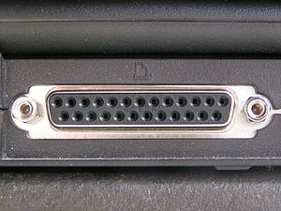
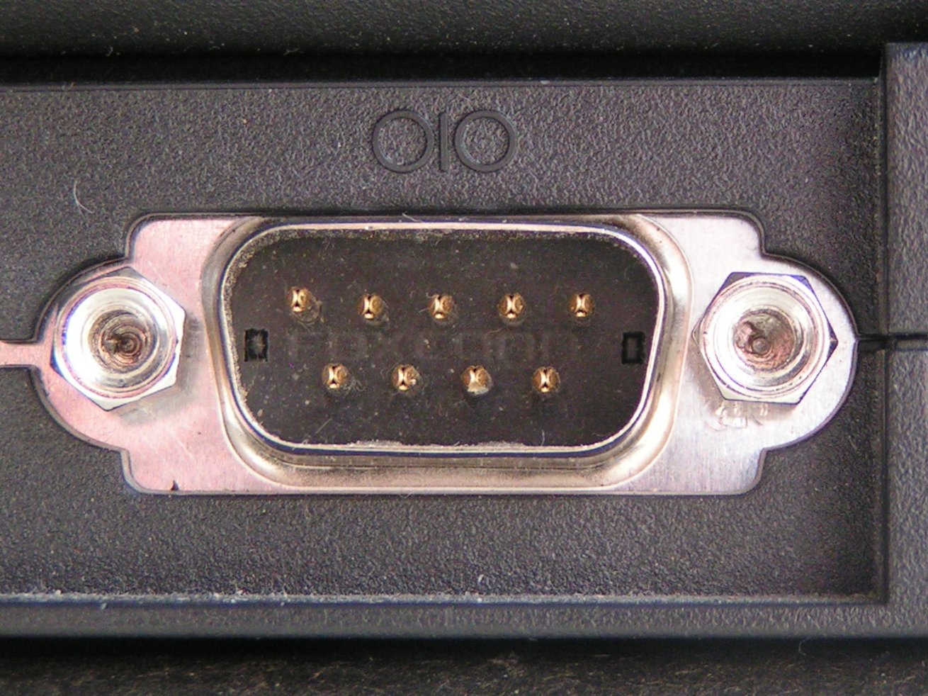
Serial - Serial

