Slide 1
Fog-Assisted Smart Waste Monitoring
A Serverless Pipeline from Simulated Edge to AWS
Wasiullah Khan
Fog and Edge Computing· x24217760
National College of Ireland · Fog & Edge Computing
~5 minute presentation

Slide 2
Why this project?
Urban waste operations need timely, accurate bin state: how full bins are, unusual heat, and how busy they are—not raw sensor noise.
Sending every reading straight to the cloud wastes bandwidth and money, and makes it harder to decide what actually needs attention.
Fog computing fits here: validate readings, smooth spikes, score and prioritize bins, then send structured summaries and alerts instead of endless raw streams.
Edge + cloud together: process and reason near the data, persist and serve durable state in AWS, and give operators a clear dashboard (zones, critical bins, history).

Slide 3
What we built?
Edge: simulated fleet (zones/bins), NDJSON readings; optional MQTT path to AWS IoT.
Fog: moving averages, priority score, combined status (incl. fire risk / probable fire), periodic summaries + alerts.
Cloud: API + queue + Lambdas + DynamoDB (latest + history + query by zone).
Frontend: React (TypeScript) dashboard—fleet, attention, zones, bin detail + history.

Slide 4
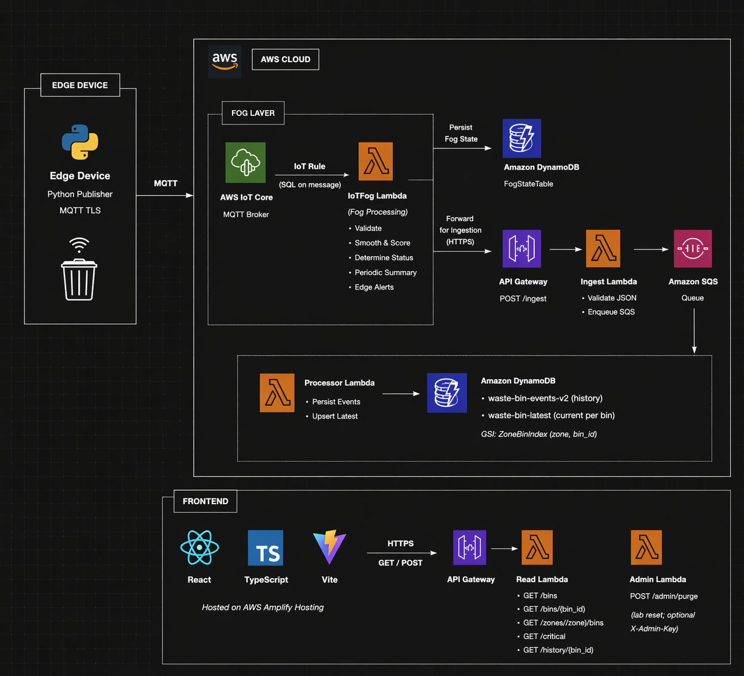
System Architecture
Edge: Device / simulator publishes MQTT over TLS to AWS IoT Core (bin readings from the “field”).
Fog: (IoT Rule → IoTFog Lambda: validate, smooth, score, status; FogStateTable holds fog state between runs..
Cloud: API Gateway (POST /ingest, read/admin routes) → Ingest Lambda → SQS → Processor Lambda → DynamoDB (events + latest + zone GSI), plus Read/Admin Lambdas for the dashboard and lab purge.
Frontend: React + TypeScript + Vite (e.g. on Amplify) calls the HTTP API to show bins, zones, critical, and history.

Slide 5
Hardest challenge & how we addressed it
Fog needs memory — We don’t only look at the latest reading; we smooth readings over time, send summaries on a timer, and fire alerts when something gets worse, so the code must remember past values and previous alert levels.
Lambdas don’t keep memory — Each run can be a new, empty process, so anything we only stored in RAM would be lost between MQTT messages.
We save fog state in DynamoDB — After each run we store a snapshot of that memory (smoothing buffers, timers, last alert levels) in FogStateTable, and load it back at the start of the next run so behaviour stays continuous.
Same messages as HTTPS — What we send to the queue is the same JSON as POST /ingest, so MQTT and HTTPS both use one downstream pipeline (SQS → processor → storage).

Slide 6
Project Demo

