Slide 1

Sommaire
1
Introduction
2
Before DevOps
3
After Devops
4
Global Architect Solution
5
Jobs Description
6
Annexes

Slide 2
Introduction
Continuous Integration (CI) is a development practice where developers integrate code into a shared repository frequently, preferably several times a day. Each integration can then be verified by an automated build and automated tests. While automated testing is not strictly part of CI it is typically implied
Continuous Delivery doesn't mean every change is deployed to production ASAP. It means every change is proven to be deployable at any time

Slide 3
Before DevOps
Compilation , build and generate EAR in developer machine :(
Upload external JBoss configuration files in S3 by developer ( config.zip and modules.zip)
SNAPSHOT version deployed in QA and production Environments
You have not a repository manager Nexus or Artifactory for save artifacts EVHC application versions
No metric source code delivered after push code branch in git repository.
Manual tasks when you deploy EVHC application in JBoss Server

Slide 4
After DevOps
Started build and compile source code after every push branch
build compile and generate package by Jenkins
generate automatically a tag version when you generate a release version
Deploy EVHC in JBoss by Jenkins
Deploy EVHC configuration in S3 bucket and nexus repository.
deployment snapshots and releases versions in Nexus
generate a metric source code every build and saved in SonarQube plate-forme execute test and generate results

Slide 5








Global Architect Solution
Digram software
Generate a junit reports
Generate a metric source code
Pull/Tag/Push
Pull/Push source code
Deploy artifacts
Deploy evhc

Slide 6
Jobs Description: EVHC_AUTO_BUILD
The EVHC_AUTO_BUILD job does not have a Jenkins file, this is a freestyle type job that is based on the SCM polling plugin that allows you to detect the various updates on all branches of GIT repository if it found after 5 minutes it automatically launches a BUILD «mvn clean install » and sends a mail in case the branch is unstable

Slide 7
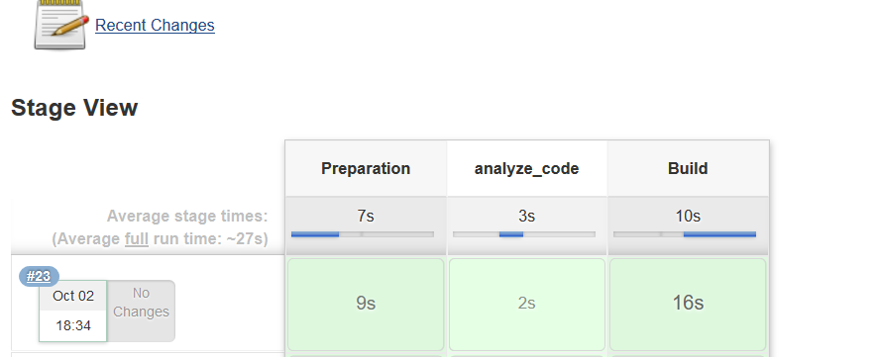
Jobs Description: EVHC_BUILD
EVHC_BUILD: This is a job that takes as a parameter the name of a branch then it performs a set of tasks described in a Jenkins file
below a JenkinsPipeline execution for EVHC_BUILD

Slide 8
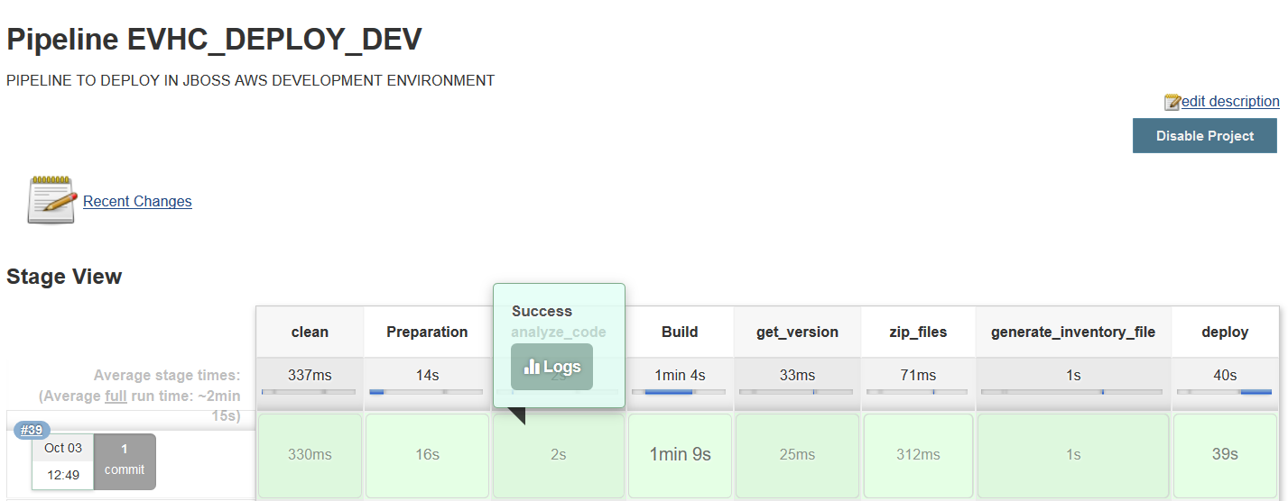
Description Jobs: EVHC_DEPLOY_DEV
It is a job that allows to deploy the "dev" branch under the development environment
Below a JenkinsPipeline execution for EVHC_DEPLOY_DEV

Slide 9
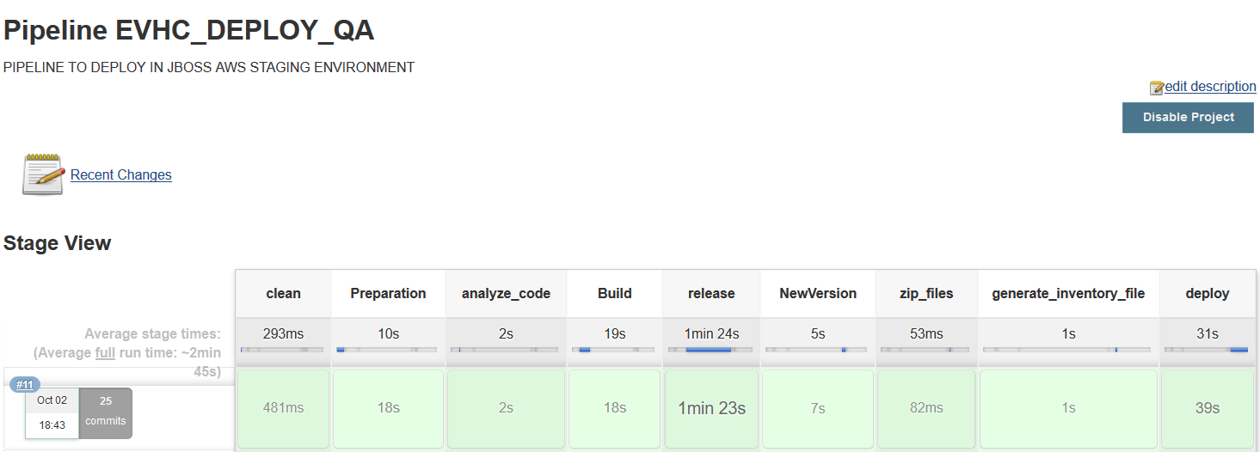
Description Jobs: EVHC_DEPLOY_QA
This is a job that takes in parameter the release version of the application and the new SNAPSHOT version below a screen copy of the settings of the job EVHC_DEPLOY_QA
Below a JenkinsPipeline execution for EVHC_DEPLOY_QA

Slide 10
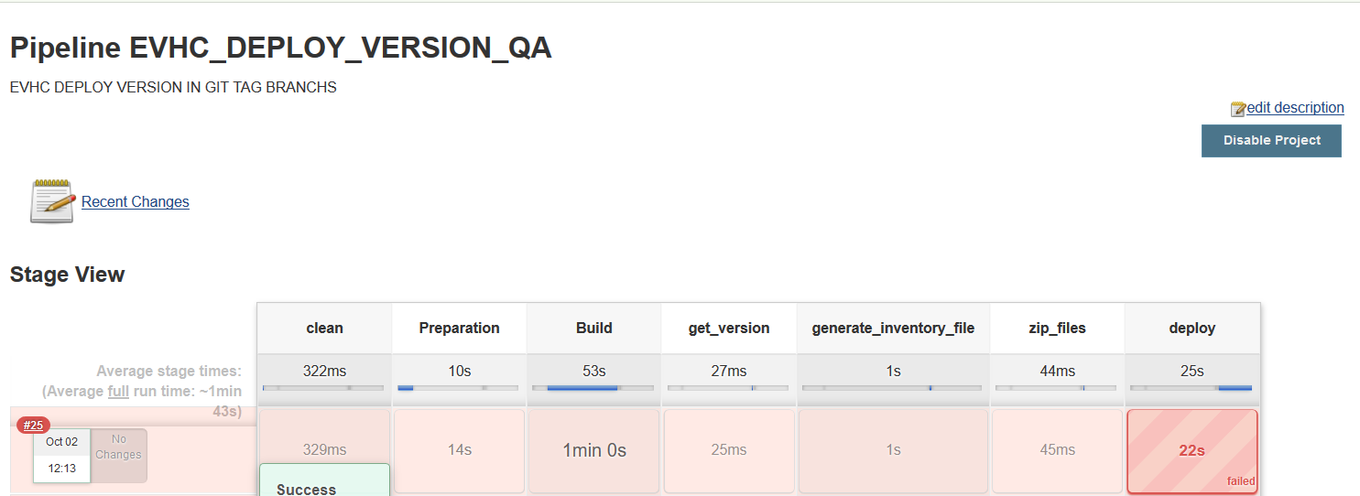
Description Jobs: EVHC_DEPLOY_VERSION_QA
This is a job that takes in parameter the name of a branch and the version of the tag to be deployed under the qualification environment.
Below a JenkinsPipeline execution for EVHC_DEPLOY_VERSION_QA

Slide 11
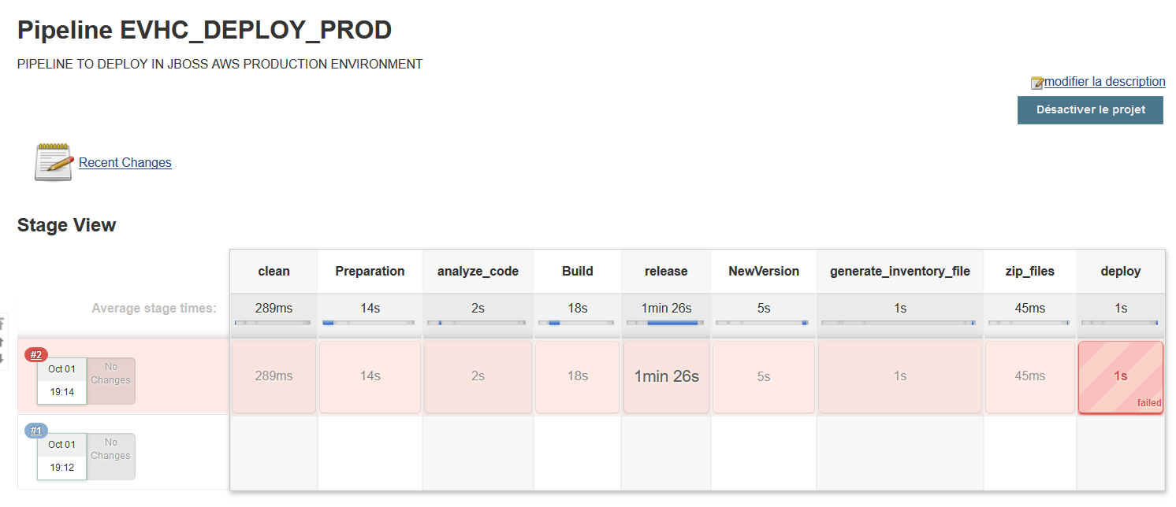
Description Jobs: EVHC_DEPLOY_PROD
This is a job parameterized that takes the new development version of the master branch and the release version below the setup of the job EVHC_DEPLOY_PROD
Below a JenkinsPipeline execution EVHC_DEPLOY_PROD

