Slide 1
Project Alpha
Presentation #1

Slide 2
Our Team
Audrey
Kevin
Philip
Wassim

Slide 3
Our Client
Alaine Hudlin
Kansas Department of Wildlife, Parks, and Tourism (KDWPT)
Former research ecologist
Manages distribution/reclamation of learning kits to KC Metro Schools
Delivers kits in person
Keeps track in day planner
Shares her resource list with another resource provider, Shelby Stevens

Slide 4
Our Project
Build a checkout system for KDWPT
Why?
Two distributors, one webpage, too many mix-ups
In short, reduce human error

Slide 5
Managing Human Error
Ease of Use
For users
Separate resource selection
Separate resource notifications
For administrators
Joint resource selection
Separate resource notifications

Slide 6
Technology
PHP (Hypertext Preprocessor)- Web Development Scripting Language
MySQL - Database
Both already in use by KDWPT
Needed for portability.

Slide 7
Database Information
Location based item code (already in place) [PK]
Description of kit
Items in kit
Number of kits
Check out Date
Due Date

Slide 8
Client View
Select Resource Library based on geographic location in State of Kansas
Browse Items in Catalog
Request to Check Out items
Place Hold on items already checked out
See when items are available if checked out

Slide 9
Admin View
Check out requests/holds
Browse Items checked out
Browse Items due in
See items past due

Slide 10
Email Notifications
Reminder for item to be returned 3 days before check in date to client/admin

Slide 11
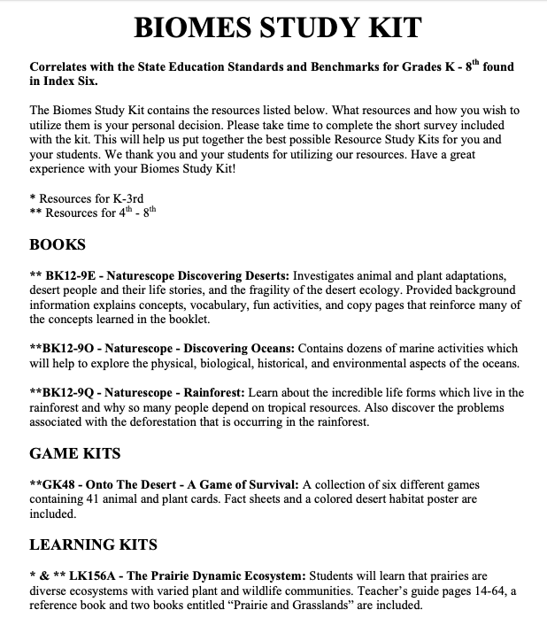

Slide 12
