Slide 1
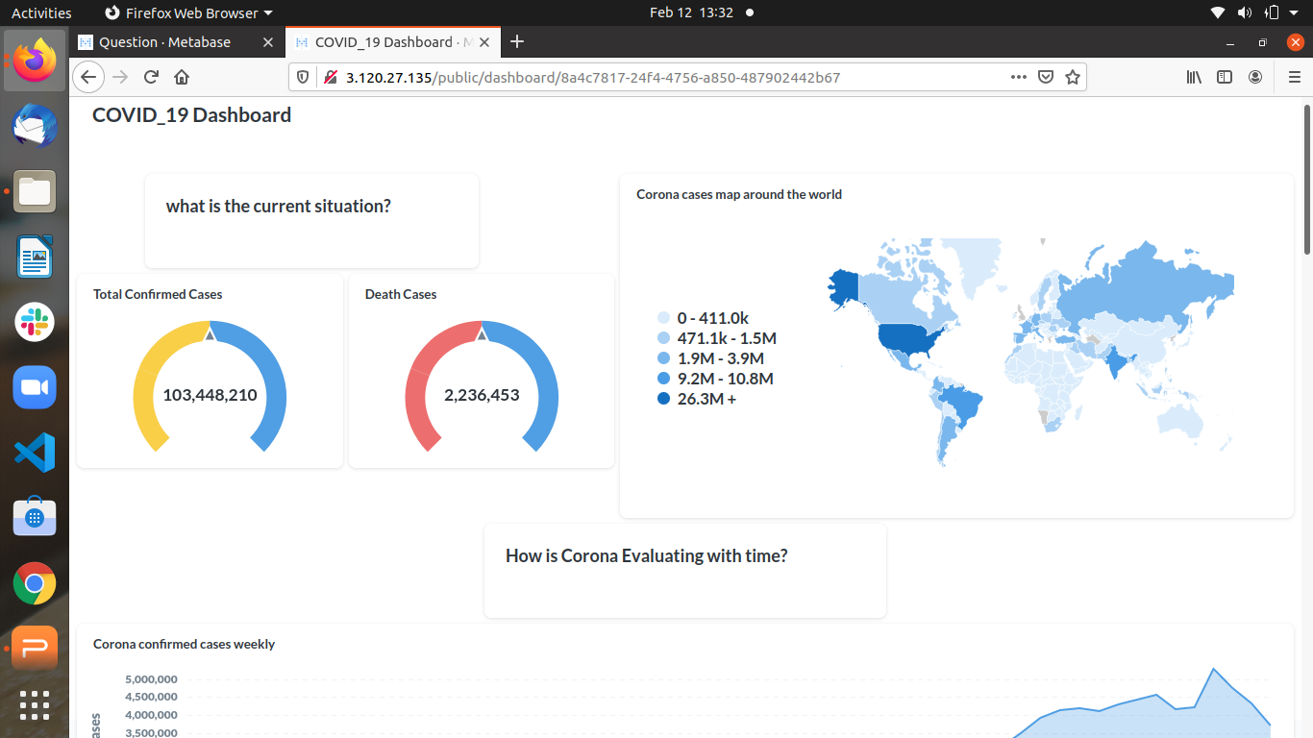
PROJECT 5: Dashboard
COVID_19 Dashboard

Slide 2
Main WorkFlow:
Get the Data:
https://data.europa.eu/euodp/en/data/dataset/covid-19-coronavirus-data
based on weekly measurment.
in csv File.
Data Modeling:
create a Database covid_19db
create a table : weekly_case
Modifying Table.
Import COVID_19 data into databse.

Slide 3

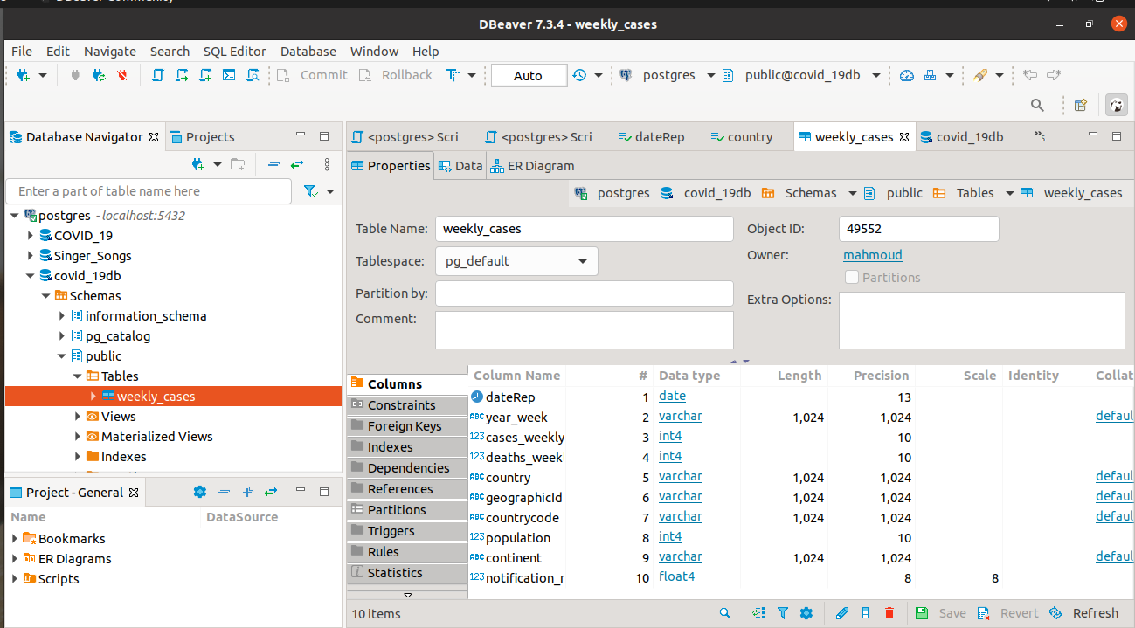
COVID_19DB

Slide 4
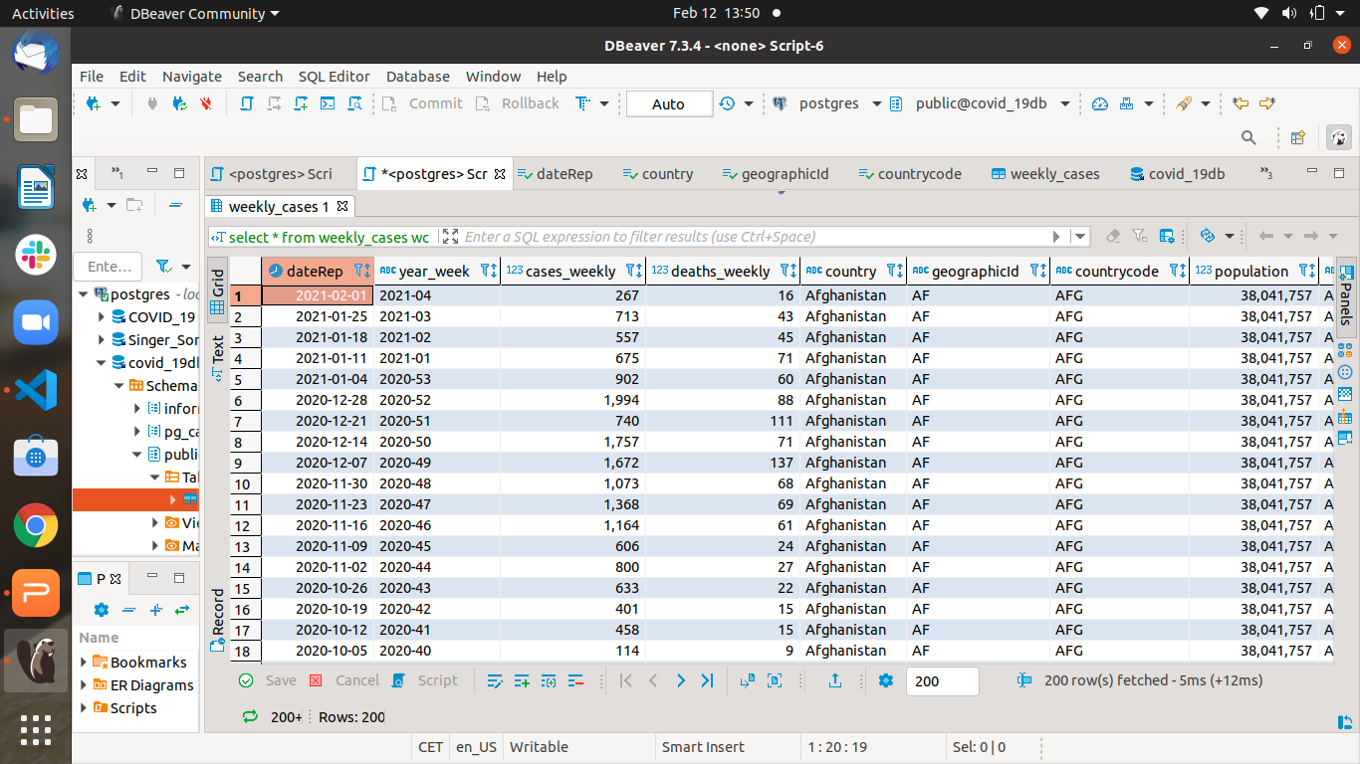
COVID_19DB

Slide 5
Main WorkFlow:
Create RDS instancs on AWS.
Deploy the local database to RDS.
Create Elastic Cloud instance IC2 on AWS.
Install METABASE server on EC2.

Slide 6

Build a Dashboard:
build a public Dashboard on METABASE server.
deploy Dashboard.
http://3.120.27.135/public/dashboard/8a4c7817-24f4-4756-a850-487902442b67

Slide 7
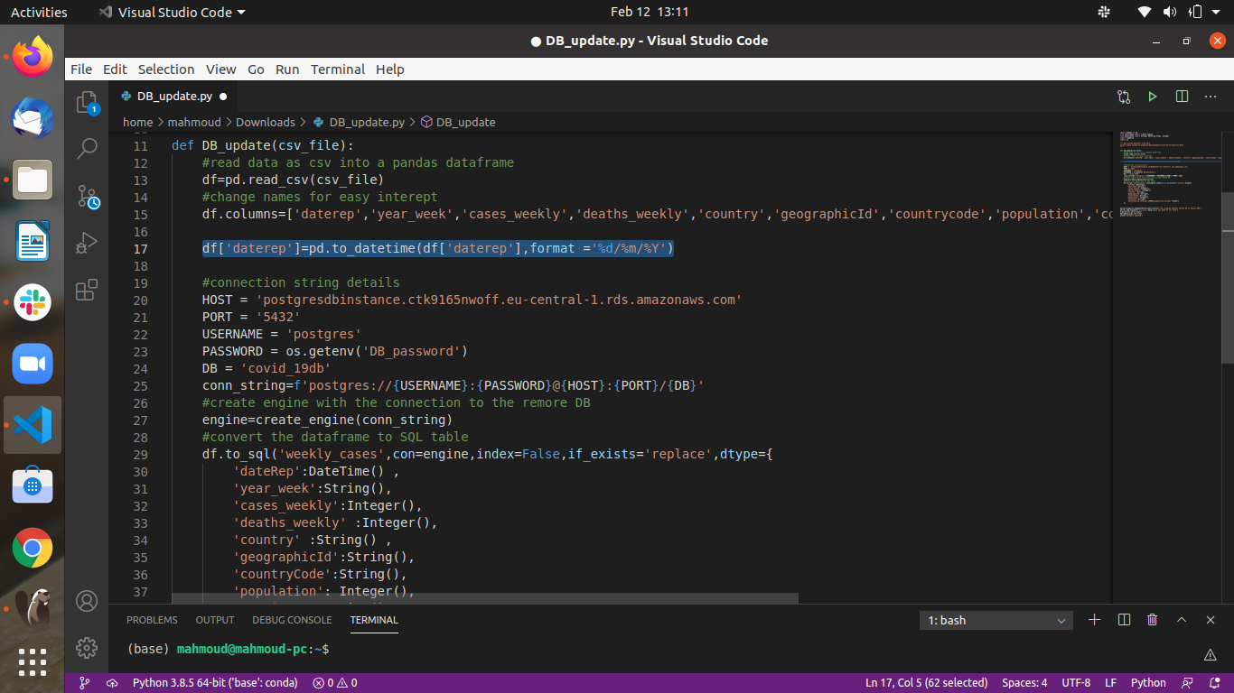
Update Dashboard
Update DB on RDS DB_update.py

Slide 8
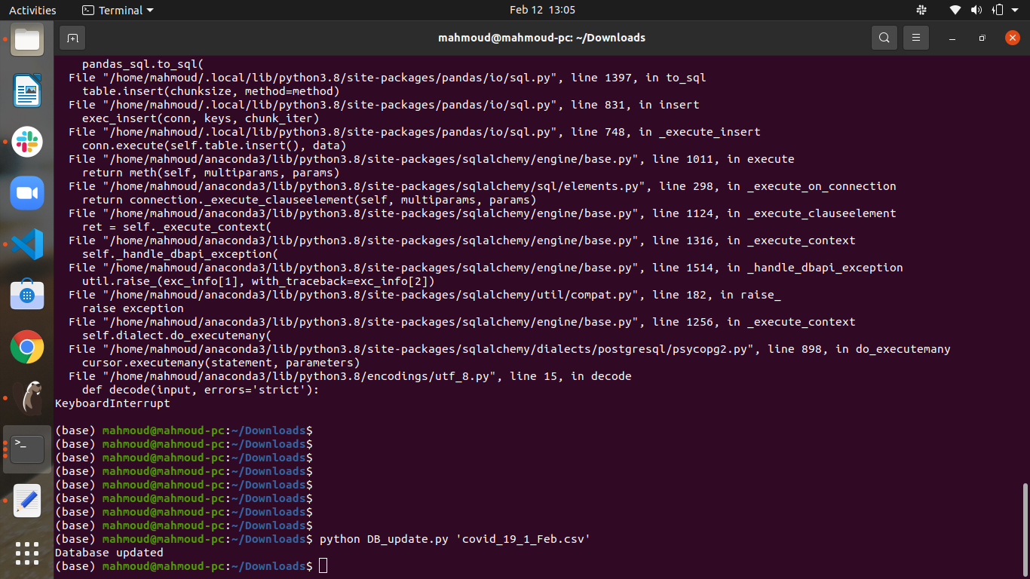
Update Dashboard

