Slide 1

Slides for Analyst

Slide 2
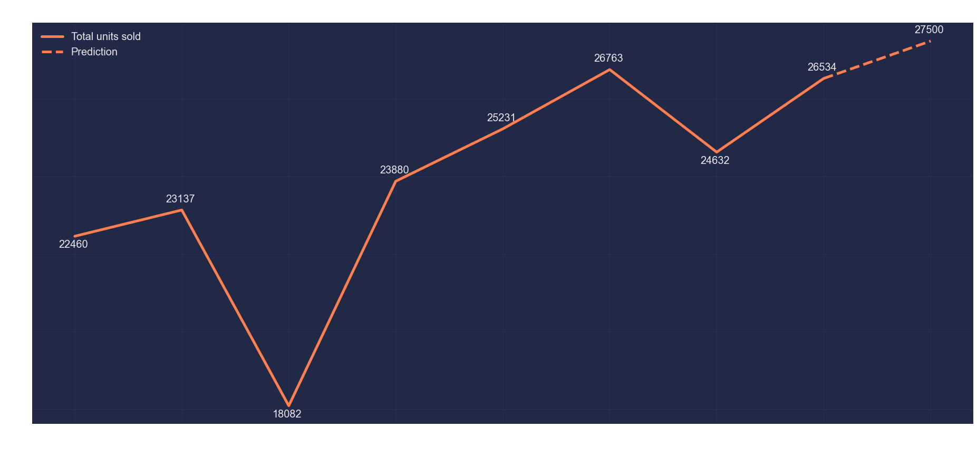
Units sold

Slide 3
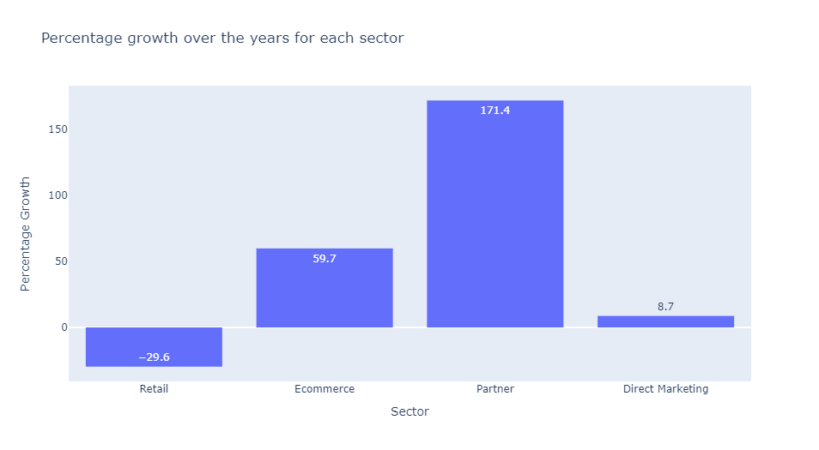

Slide 4
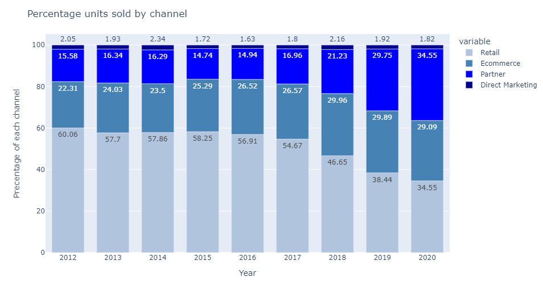

Slide 5

Slides for an Audience

Slide 6
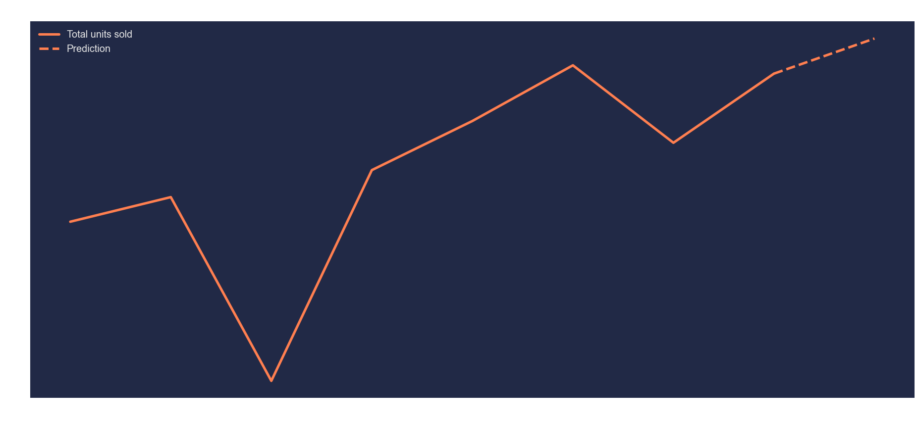
Production issues in 2014, not enough units made

Slide 7
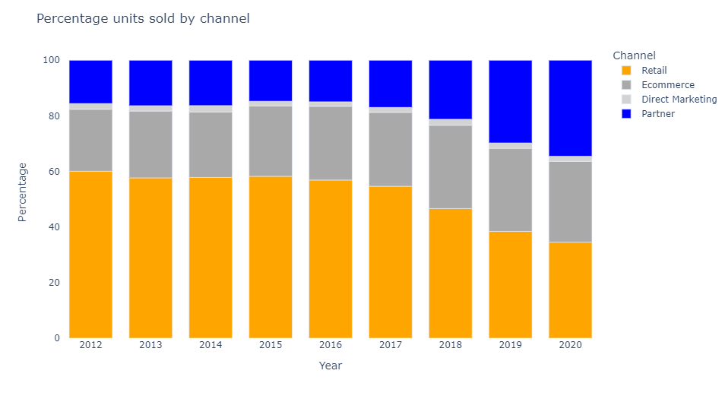
2017: Decision to start shifting volume from retail to partners

