Slide 1

Introduction to API
Presented by Daniel Olagunju

Slide 2
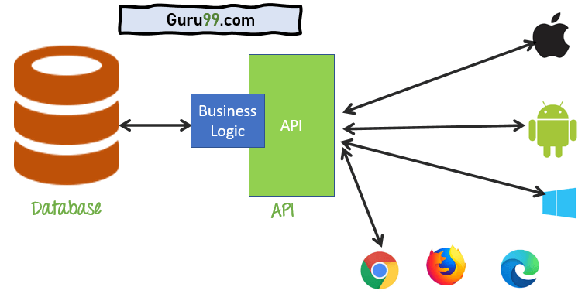
What is an API?
Server
Clients
It is an abbreviation for
A
pplication
P
rogramming
I
nterface
It is a collection of communication protocols and subroutines used by various programs to communicate between them
It is simply an intermediary that allows two applications to talk to each other usually a client and a server.

Slide 3
Summary
The key terms we learned were:
Server: A computer that runs a software logic and houses the Database
API: The middleman and communicator between the Client and Server
Client: A computer, laptop, phone that exchanges data with a server through an API

Slide 4
Q & A
?

Slide 5
Next Week
Types of Web APIs
Presented by Daniel Olagunju

Slide 6
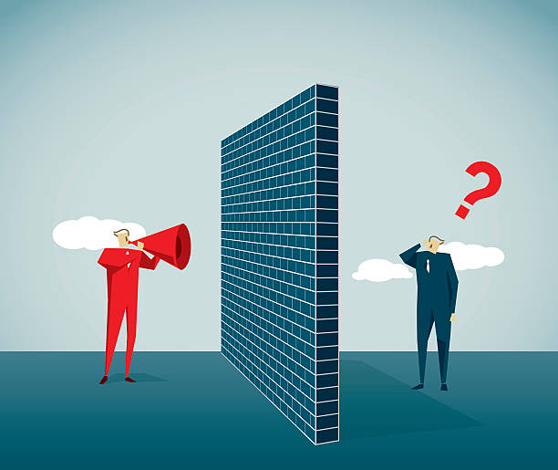
Why do we need an API/an Intermidiary
Because the client and server does not speak same language.
However, API has its own language in which both server and client can understand thus making it
improved data quality review
greater flexibility in delivering services
faster and easier data migration

Slide 7
Types of Web APIs
SOAP (SIMPLE OBJECT ACCESS PROTOCOL): It defines messages in XML format used by web applications to communicate with each other.
REST (Representational State Transfer): It makes use of HTTP to GET, POST, PUT, or DELETE data. It is basically used to take advantage of the existing data.
JSON-RPC: It use JSON for data transfer and is a light-weight remote procedural call defining few data structure types.
XML-RPC: It is based on XML and uses HTTP for data transfer. This API is widely used to exchange information between two or more networks.

