Slide 1

UdaPeople
CI/CD: Why we need it
Presented by Daniel Olagunju

Slide 2
What is CI/CD?
It is an abbreviation for
C
ontinous
CI refers to an approach of automating the integration of code changes from multiple contributors
I
ntegration
C
ontinous
CD refers to the automation of deployments in order to deliver value
D
eployment

Slide 3
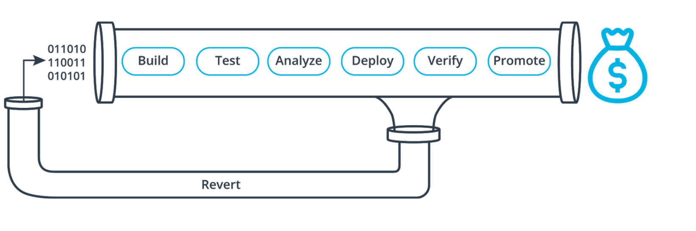
What is CI/CD? (Cont’d)
Continuous Integration
Continuous Deployment
Continuous Delivery
+
=

Slide 4


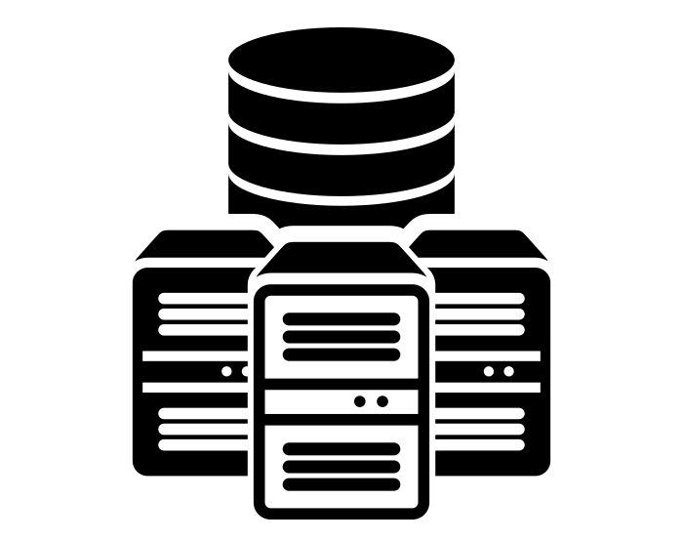



Why Udapeople needs it?
Technical Value | Business Value
Better code quality | Protect Revenue
Faster bug fixes | Avoid Extra Cost
Efficient infrastructure | Avoid Extra Cost
Measurable progress/Less time to Market | Increase Revenue
Collaboration and Communication | Avoid Extra Cost
Maximized creativity | Protect Revenue

Slide 5
Conclusion
The gains of CI/CD is being enjoyed across board in the Industry.
And as a world-class technology company, it is critical to leverage on the value added by CI/CD to scale our products and continually add quality value to our users.

