Slide 1
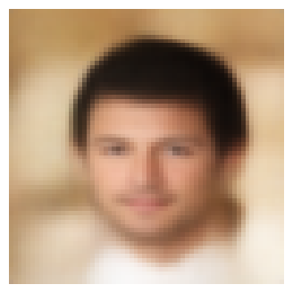
Conditional Face Generation
using CVAE
Generating and editing faces from facial attributes

Slide 2
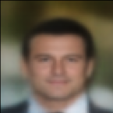
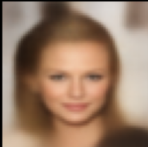
Project Goals
The main objective is to investigate whether a CVAE can:
generate realistic face images conditioned on facial attributes.
Reconstruct input images while preserving important facial features.
Modify selected attributes (e.g. gender, eyeglasses, hair color) while maintaining the identity of the person.

Slide 3
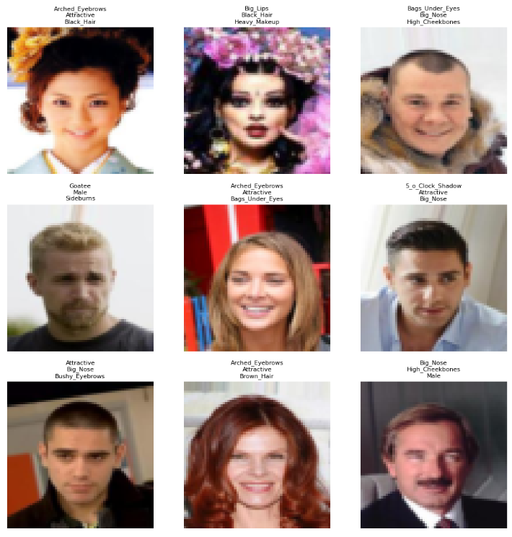
Dataset: CelebA
Centered face crops with binary attributes make conditional generation possible.
200k images
40 attributes
Original size 178 × 218
Scale it to 64x64

Slide 4
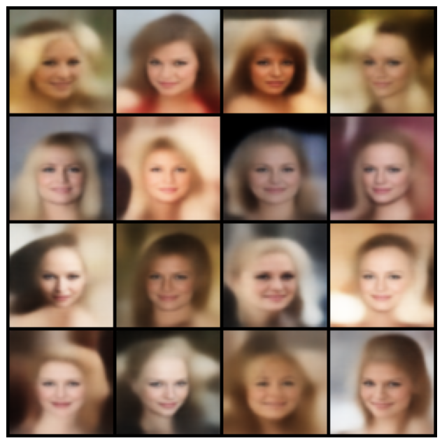
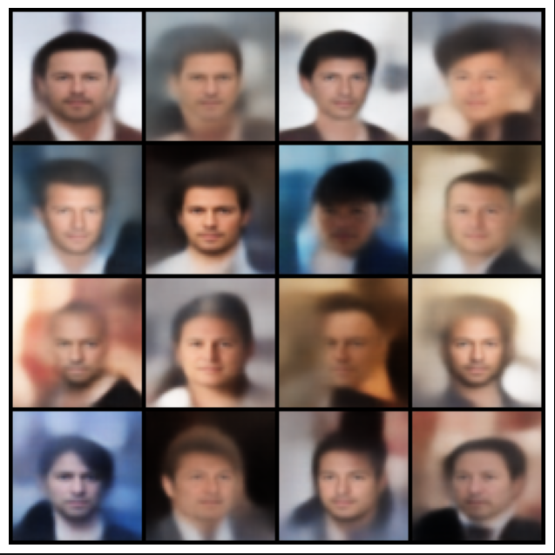
Generation
The model generates more realistic faces when the selected attributes commonly occur together in the training data. Consistent attribute combinations, such as young female with blond hair or older male with black hair, produce more coherent and visually plausible results.
Female,
Blond Hair,
Young,
Smilling,
Rosy Cheeks
Male,
Old,
Black Hair

Slide 5
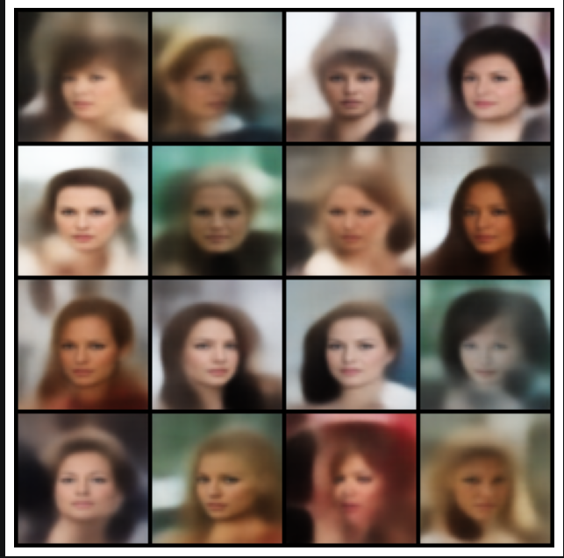
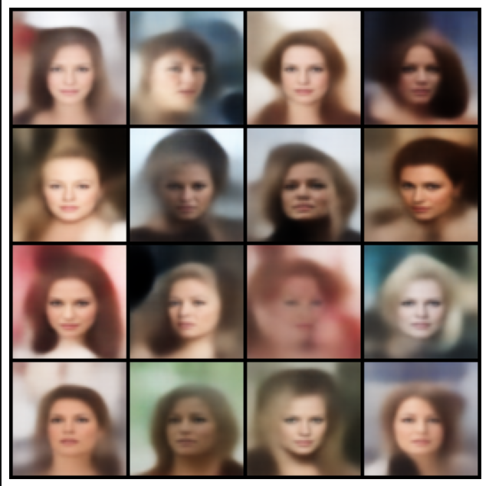
Generation - Limitations
Small and infrequent attributes, such as earrings, are often not generated reliably. The model appears to focus on dominant facial features and may ignore details that occupy only a small region of the image.
Conflicting attribute combinations are also challenging. For example, requesting a female face with a mustache often produces weak or inconsistent results because such combinations are rare or absent in the training dataset.
Female,
Wavy hair,
Earings
Female,
Mustache

Slide 6
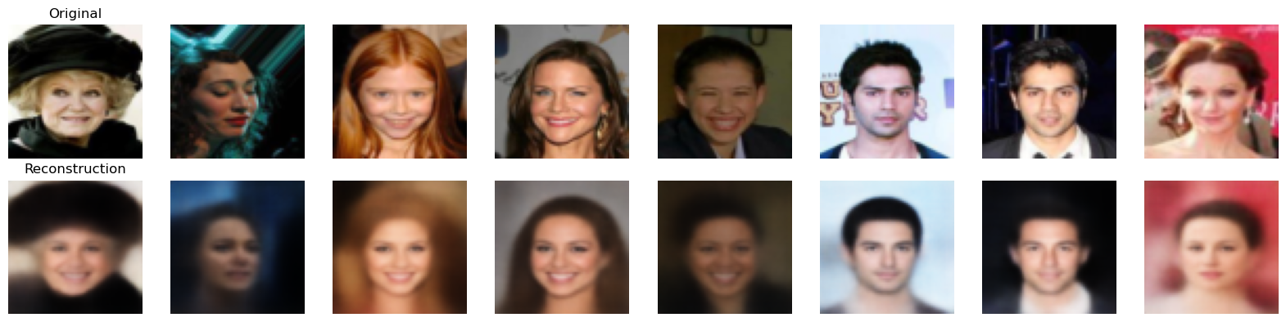
Reconstruction
The model successfully preserves the overall identity and structure of the face. Reconstructed images remain visually similar to the originals, but fine details become blurred or simplified. Hair texture, eye details, and facial contours are often less sharp, indicating that the latent space captures global appearance more effectively than subtle visual features.

Slide 7
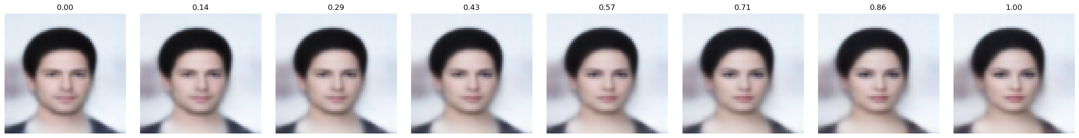
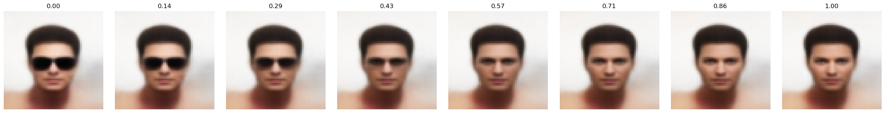
Attribute manipulation
Same latent code, changing only the attribute vector.
Male 1 → -1
Eyeglasses 1 → -1
This is the proof that the CVAE is not just generating faces, but also moving along a controllable attribute direction.

Slide 8
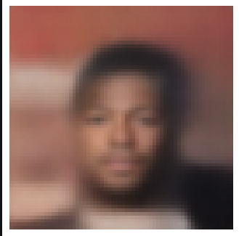
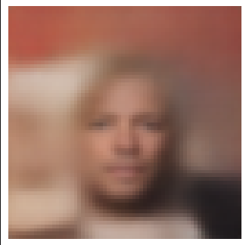
Limitations - Attribute manipulation
Changing a single attribute can affect more than the intended feature. In this example, switching Black Hair to Blond Hair changes not only hair color, but also skin tone and the overall appearance of the face.
Male, Black hair
Male, Blond hair
The main story is visible even when the attribute is not perfectly isolated: the output still changes, but not always cleanly.

Slide 9
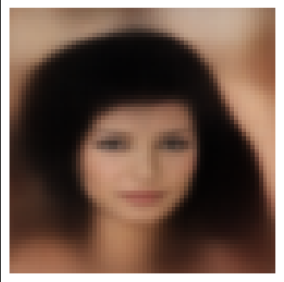
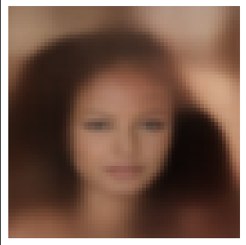
Limitation: Incomplete Attribute Understanding
The model does not truly understand the concept of "baldness". Instead of removing hair, it mainly changes the appearance of the upper hair region.
Female, Black hair
Female, Bald

Slide 10
Final Conclusions
1. Conditional generation was successful
The CVAE learned meaningful relationships between facial attributes and image appearance.
Generated faces generally matched the requested attribute combinations.
Common attribute combinations produced the most realistic results.
2. The latent space allows controllable editing
Modifying the attribute vector changes specific visual characteristics of a face.
Smooth transitions were observed for attributes such as gender and eyeglasses.
This demonstrates that the model learned interpretable attribute directions in latent space.
3. Model limitations remain significant
Fine image details are lost during reconstruction.
Rare or conflicting attributes are generated less reliably.
Some concepts (e.g. baldness) are only partially understood by the model.

