Slide 1
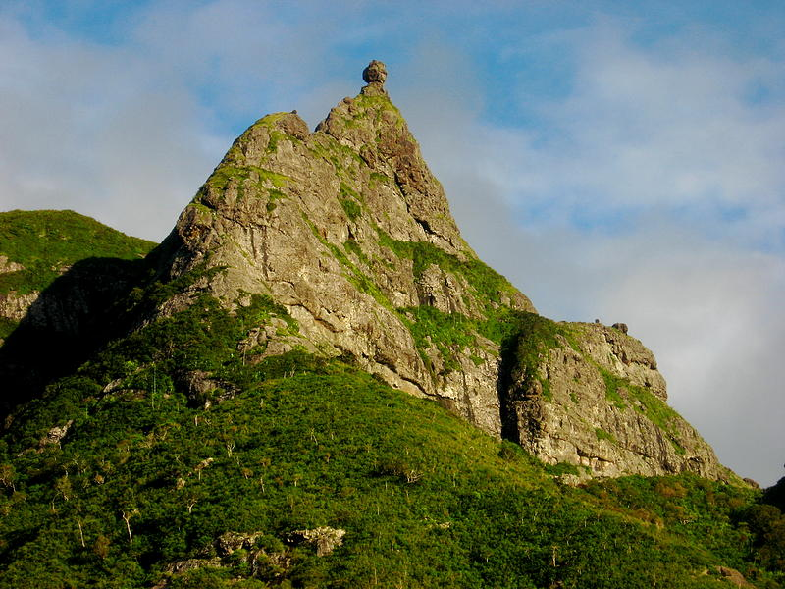

Digital Elevation Models to 3D Prints
Process and Applications for FEMA Community Outreach

Slide 2
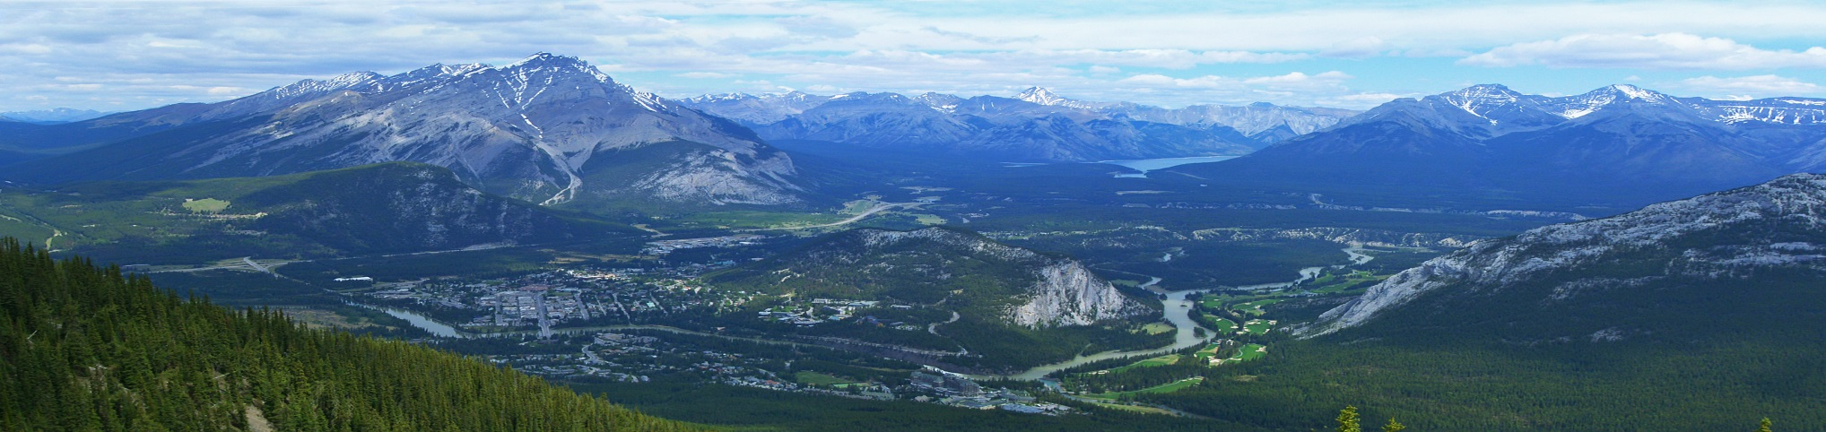
Why 3D Print?
People aren’t influenced by facts.
3D models are engaging and fun.
A model + animated flooding makes abstract concepts relatable and more credible to the public.

Slide 3
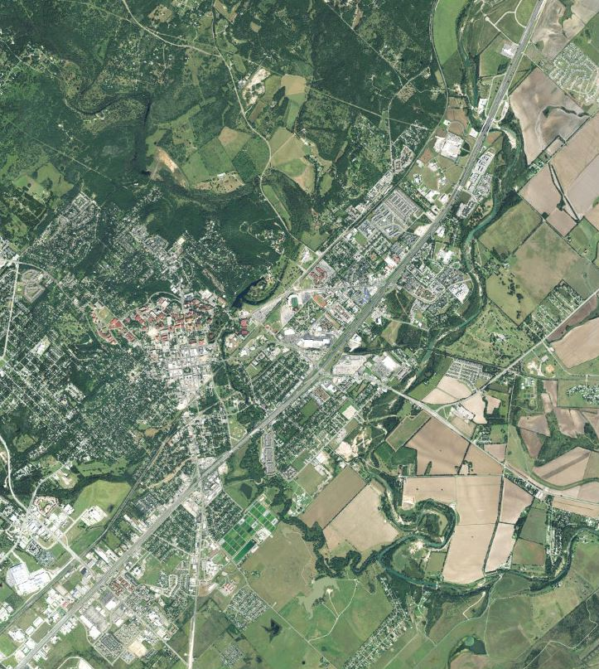
Project Details
Recognizable features
Mix of elevations
Major roads

Slide 4
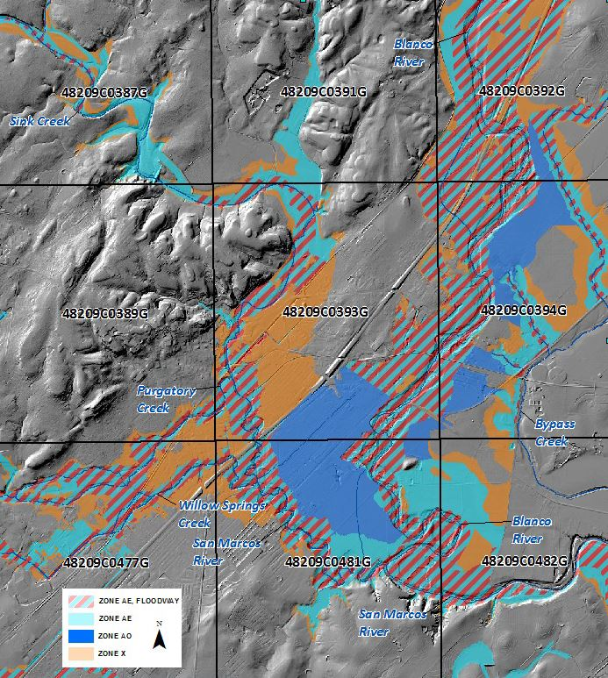
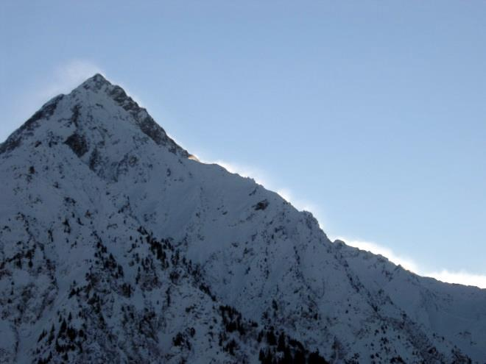
Project Details
Approximately 9
FIRM panels
5.7 x 5 miles
Scale = 1: 36,000
Elevation extruded
by 3.5x

Slide 5




Project Details
Short-throw projector
Animation: Created in InfoWorks ICM.
Complex 2D model that is used as the basis of flow depth estimation for overbank flooding.
Especially useful for flat urban areas.
Provides flood depth vs. time.
Tailor to audience: depth grids, flood hazard area, or simple imagery with roads.

Slide 6
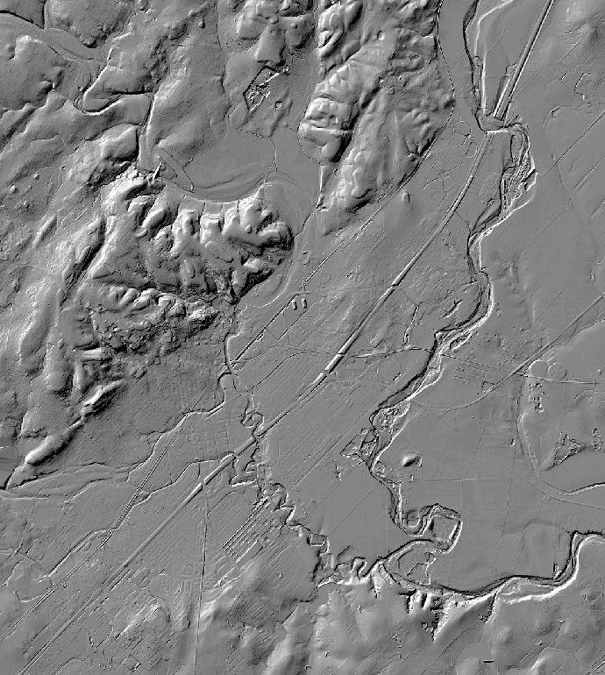

Process
Select area of interest in DEM

Slide 7

Process
Import to open source GIS software of choice.
Convert DEM to STL file using DEM to 3D extension.
Open STL in MeshLab to preview.
Reduce file size.
Hollow out base of model.
Upload to Shapeways and select printing medium.
For more info, reference the YouTube video “DEM to 3D Print File.”

Slide 8
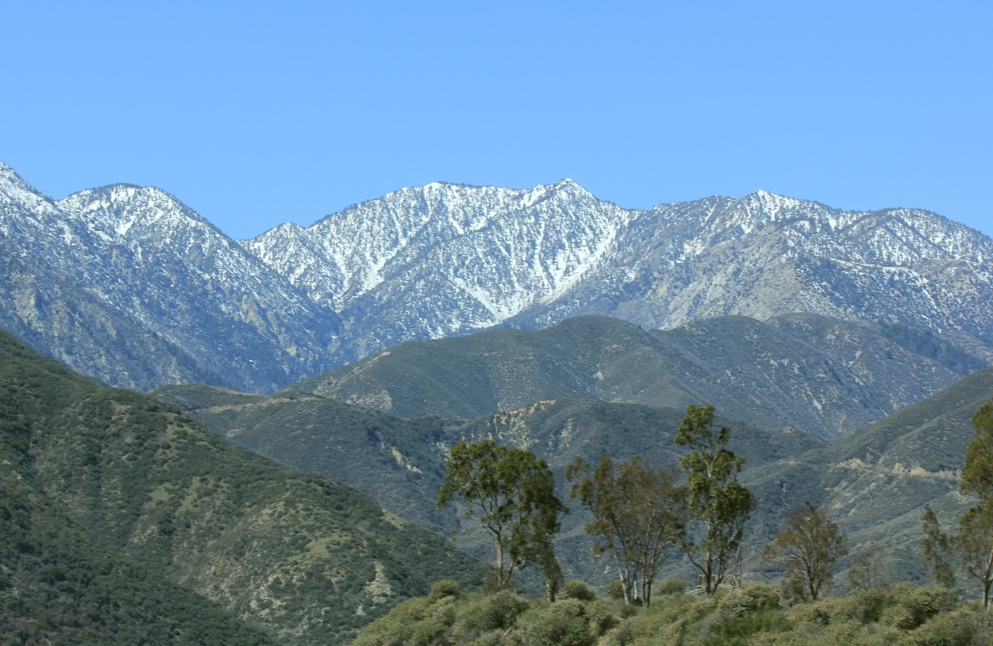


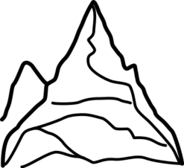

Challenges
Price: $1,400
Open source software
Learning 3D modeling software
Accuracy in flat areas
Projector alignment

Slide 9
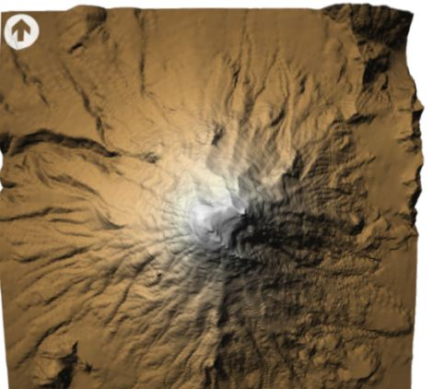
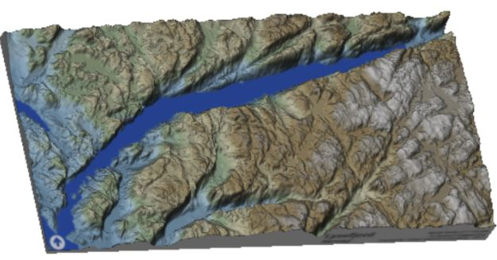
Next Steps
Reduce pricing by hollowing model base.
Choose other materials – full color sandstone.
Build projector mount.
Imagery courtesy of Ian Grasshoff, SmartMaps

