Slide 1
Week 4-5: The Kill Chain Agent & Write Up Agent
Maximilian Jansen · Week 4-5 Briefing · AI Agents for Cybersecurity Defense

Slide 2
Plan for Today
• The problem — why alert volume, not any single case, defeats humans
• Why agents, not scripts — the one distinction the whole system rests on
• Architecture — four agents, two capped feedback loops, one quarantine boundary
• Under the hood — the Kill Chain & Report Writer internals, and the tools the agents use
• A real run + the environment experiment — context changes conclusion
Week 4–5 · AI Agents for Cybersecurity Defense
2

Slide 3
Tool changes based on last weeks info
host_profile — one command that tells you everything about a single computer at once: how much it talked, to whom, on which ports, and when. Before, the agent had to make several separate calls to piece that together.
flag_summary — counts the connection "flags," which reveals whether connection attempts failed or actually succeeded. That's how it can prove "this was a brute force of failed logins" instead of guessing.
flows_in_time_range — grabs all traffic between two times, with the dates handled correctly by code. Before, the agent tried to filter by time with a hand-written text pattern and it silently broke.
count_by two-column — lets it group by two things at once (like "which source hit which port") in one call instead of two.
list_subtechniques (Threat Intel) — lists all the sub-flavors of a technique at once (e.g. the four kinds of Brute Force) so it can compare them and pick the most specific one without multiple lookups.
Declined payload inspection (flow data has no payloads) · Kill Chain re-querying raw findings (that's the Analyst's job) · a tactic→phase tool (that's the sidecar crosswalk — it would collapse the divergence signal).
Week 4–5 · AI Agents for Cybersecurity Defense
18

Slide 4
The Problem Is Volume, Not Difficulty
A tier-1 analyst works a queue that never ends. The problem is that real alerts hide amongst thousands of benign alerts
10,000s
alerts per day at a mid-size org
~99%
of them are false alarms
1 in 10k
flows is actually malicious
The base rate is the trap: even a 99%-accurate detector buries the analyst in false positives. Accuracy is the wrong goal.
Week 4–5 · AI Agents for Cybersecurity Defense
3

Slide 5
The Architecture: Four Agents, One Boundary
Network Analyst
detect + evidence
Threat Intelligence
ATT&CK mapping
Kill Chain
phase narrative
Report Writer
synthesis
⟲ evidence request (≤1 retry)
⟲ mapping request (≤1 retry)
— — — GROUND-TRUTH QUARANTINE (labels live only below this line; agents above never see them)
Sidecar
Scores runs against the Label column, ATT&CK answer key, and phase crosswalk. after the agents finish.
Week 4–5 · AI Agents for Cybersecurity Defense
5

Slide 6
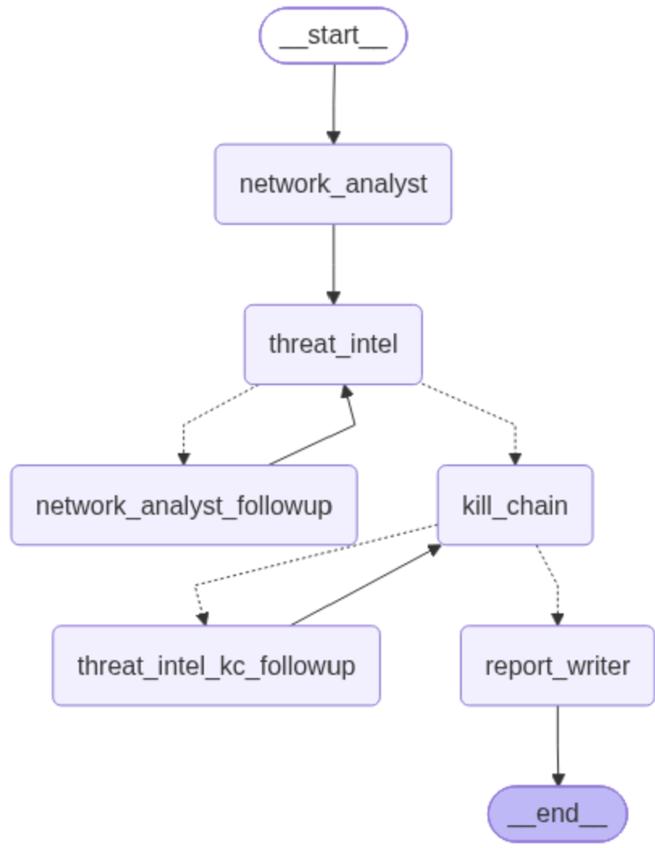

Slide 7
Tools for the Kill Chain Agent
Reconnaissance → Delivery → Exploitation → Installation → Command & Control → Actions on Objectives
get_finding_detail
The Network Analyst finding, unlabelled, with raw timestamps withheld.
get_technique_context
Name, tactic(s), and description for a technique, from the local STIX data.
get_temporal_ordering
Code computes first-seen order + gaps. The model never orders timestamps itself.
list_phase_definitions
The six fixed phases, so it reasons against a stated rubric, not its priors.
Week 4–5 · AI Agents for Cybersecurity Defense
8

Slide 8
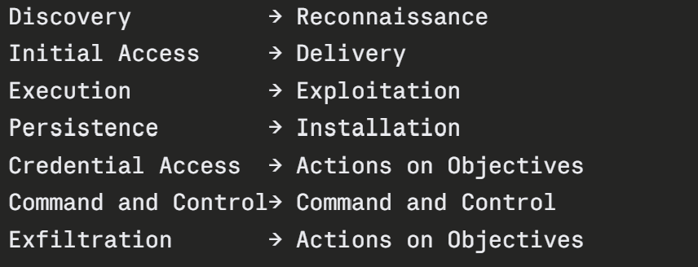
How the Code Calculates Each Step
The model proposes phases; independently, code derives the EXPECTED set and compares.
T1046
Discovery
Reconnaissance
technique → tactic (read live from STIX, never hardcoded) → phase (fixed, asserted crosswalk)
phase_divergence
Phases the model asserted that the crosswalk doesn't support, and phases the crosswalk implies the model didn't assign. Recorded, never treated as error.
Week 4–5 · AI Agents for Cybersecurity Defense
9

Slide 9
The Second Feedback Loop: Kill Chain ⟲ Threat Intel
A capped retry mirroring the Week-3 edge. It fires at most once, and the trigger is decided deterministically the model is never asked whether it wants to retry.
phase gap
a mid-campaign hole between two assigned phases. not a missing the last phase.
high-sev
an unassigned finding the Network Analyst marked high severity.
ungrounded
a technique the grounding verifier says Threat Intel never returned.
Week 4–5 · AI Agents for Cybersecurity Defense
10

Slide 10
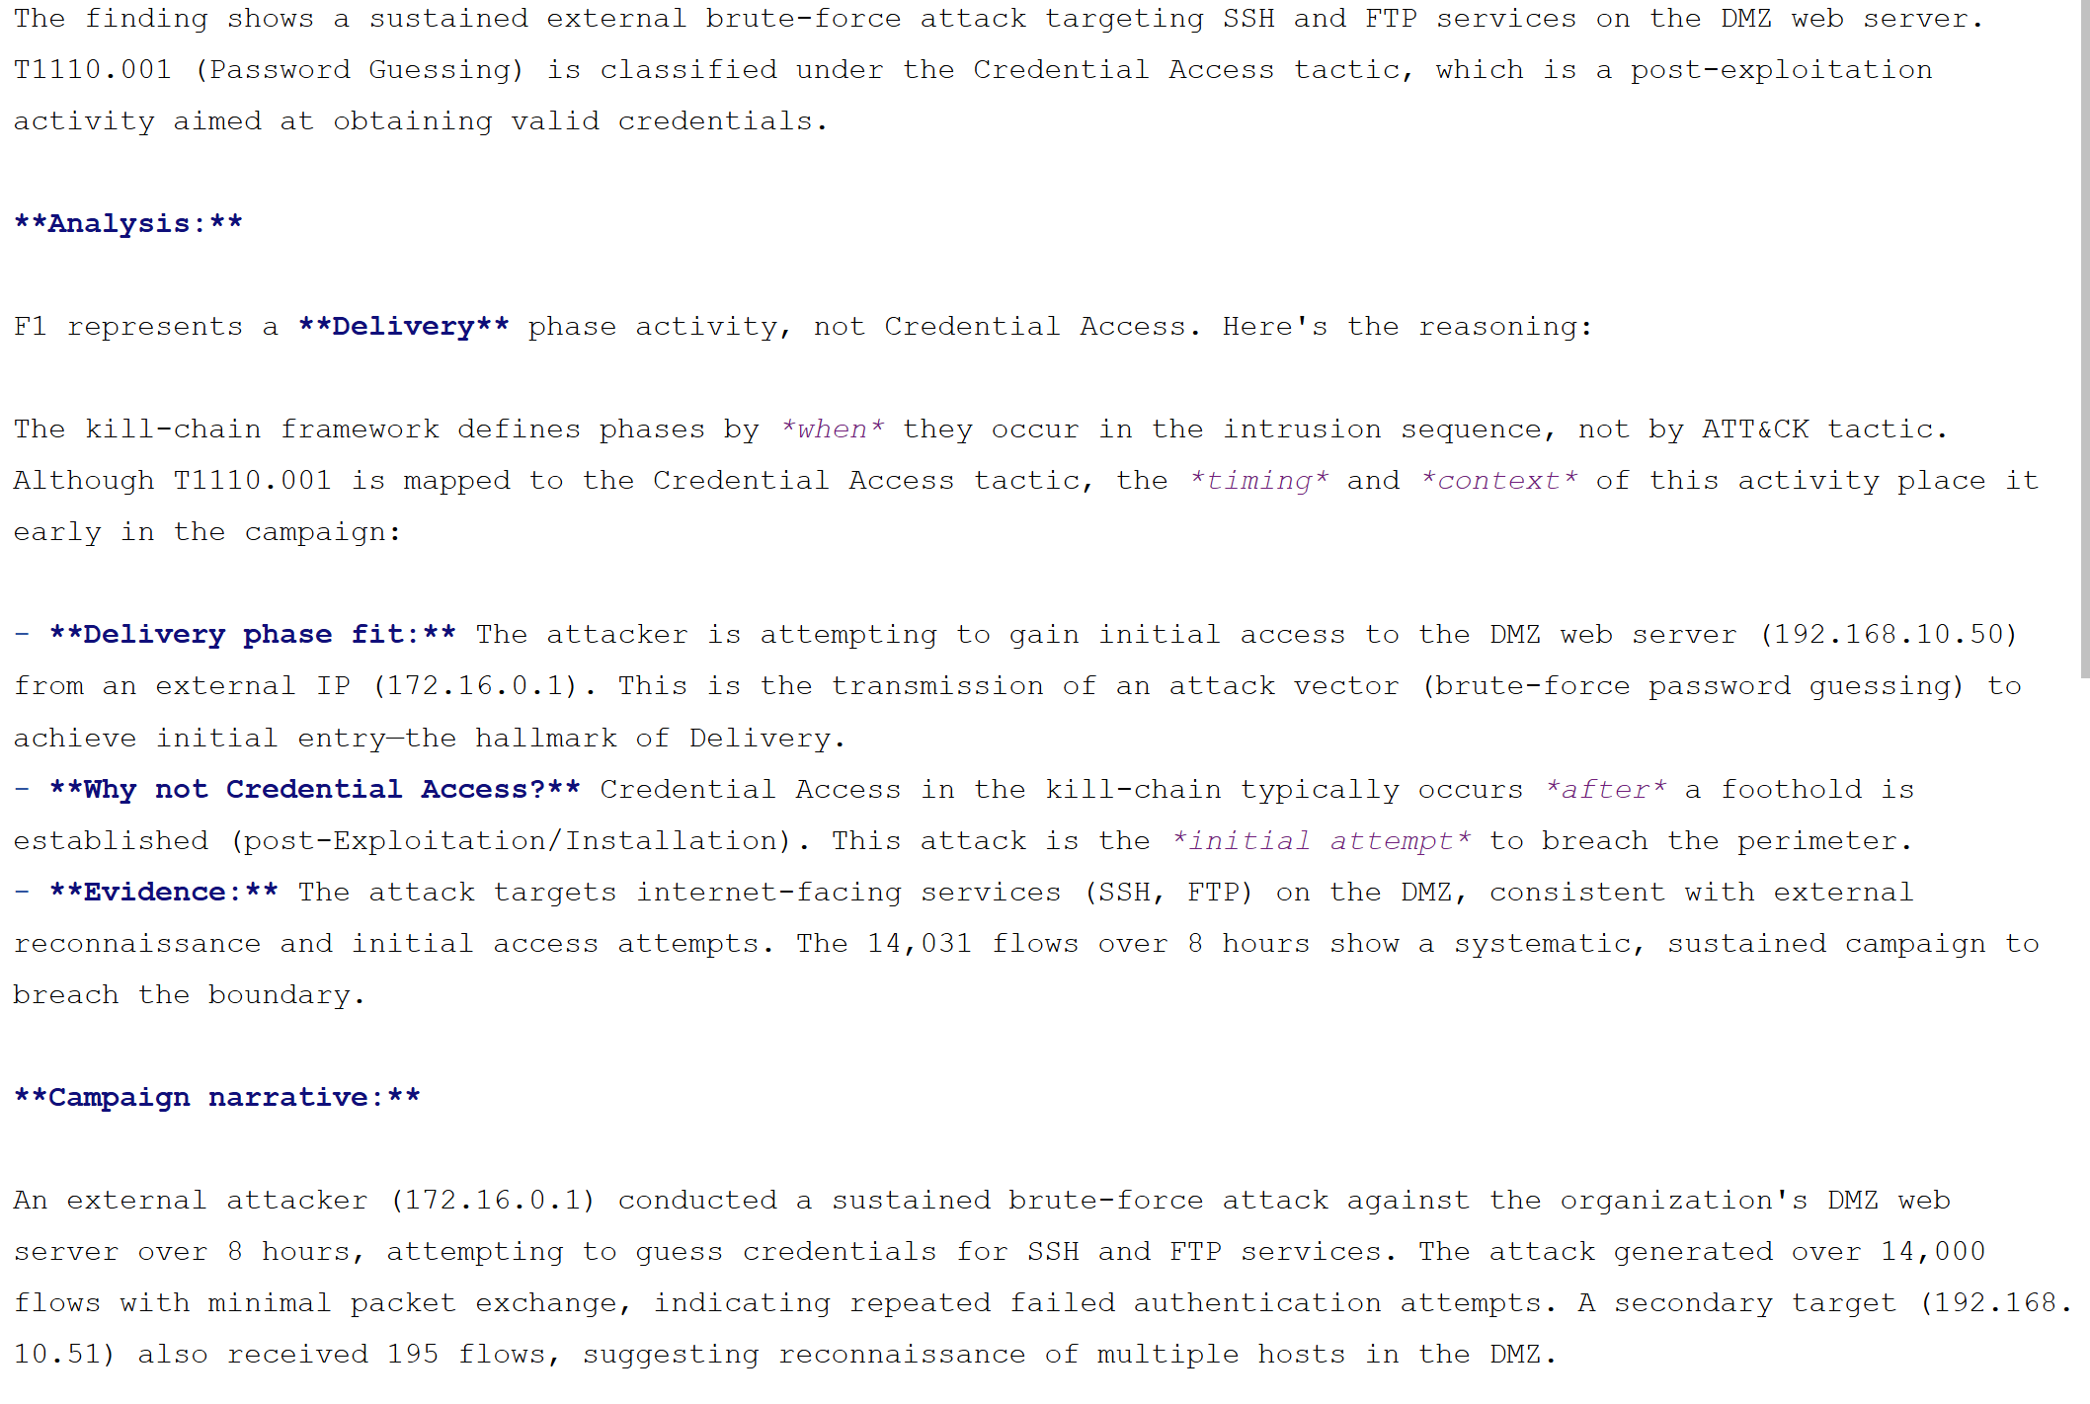

Slide 11
The Report Writer Agent
The fourth agent is just synthesis. Nothing new is generated. Code computes; the model transcribes.
• Input, not raw flows. The three upstream structured outputs; findings, mappings, kill-chain narrative
• Two read-only tools only. get_technique_context and list_phase_definitions. Enough to phrase a technique in plain language, with no way to drill into data.
• Grounding recheck. After it writes, code flags any technique ID that isn't in Threat Intel's mappings.
• Output. A markdown report for the profile's reporting_audience: summary / what happened / findings + mapping / gaps / recommended actions.
Week 4–5 · AI Agents for Cybersecurity Defense
11

Slide 12
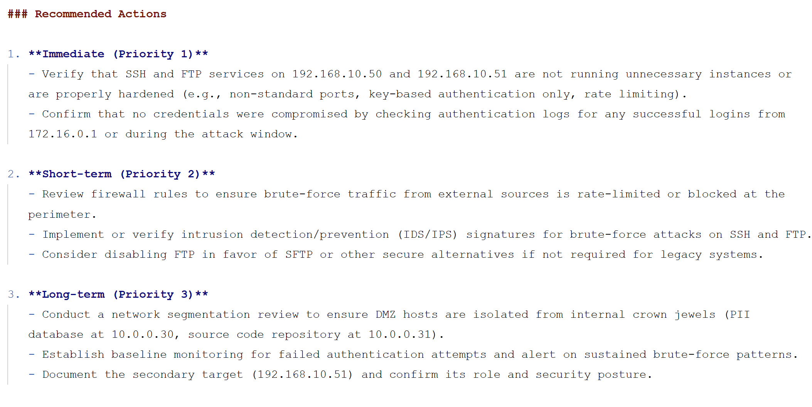

Slide 13
Environment Contexts
Feedback from Dustin last week was to have Environment contexts for the agents. Still messing around with the idea but two are made and “working”
Personal Laptop
Enterprise Network
A ~400-person company whose public web server is meant to receive HTTP/HTTPS from anywhere, sitting alongside an internal domain controller and crown-jewel PII and source-code servers. So the agents treat that same inbound web traffic as routine, and instead escalate DMZ-to-internal-LAN connections and off-hours logins, reporting to SOC analysts who already know ATT&CK.
A single home laptop behind a NAT router, where nearly all traffic is outbound browsing and updates and it should essentially never receive a connection started from the internet. So the agents treat any inbound connection, or steady beaconing to one unfamiliar host, as high concern, and write the report in plain language for the laptop's owner.
Week 4–5 · AI Agents for Cybersecurity Defense
13

Slide 14
What It Gets Wrong
1. Confidently wrong.
The system always produces a fluent, authoritative report, so a false positive reads exactly as convincing as a real detection. Grounding stops it from citing a fabricated technique ID, but it can't stop the model from chaining real facts into a wrong story.
2. It only sees shapes, and only what it's handed.
It reasons over flow statistics, never packet contents, so anything that requires seeing what was actually sent, the exploit itself, the exfiltrated data, encrypted command-and-control, is invisible to it.
3. It helps that we use lab data.
The measurements that make it credible, detection hit/miss, phase accuracy, depend on dataset labels that simply don't exist on a real network, so most of its scoring goes dark the moment you point it at live traffic.
Week 4–5 · AI Agents for Cybersecurity Defense
14

