Slide 1
Week 2: Building the Network Analyst Agent
Maximilian Jansen · Week 2 Briefing · University of Utah · July 2026

Slide 2
Outline of Week 2
Built:
The Network Analyst Agent
- Reads real network logs, finds attacks, explains them in plain language
Questions Answered:
Can an LLM agent find real attacks in real logs without being shown the answers?
What does it take to go from “runs” to “right”? (five runs, five lessons)
Reflection Question
What observations can the agent make reliably?
Roadmap for Today:
The data → architecture → five runs to working → measuring it → what’s reliable → week 3
Week 2 · AI Agents for Cybersecurity Defense
2

Slide 3
Progress for full Agent
Network Analyst Agent
→
DONE (this week) — reads logs, finds attacks, reports
Threat Intelligence Agent
→
map behavior to MITRE ATT&CK — week 3, input contract ready
Kill Chain Reasoning Agent
→
build the timeline & classify the stage — week 4
Report Agent
→
produce the incident summary — week 5
3

Slide 4
The Data: CIC-IDS2017
A full week of realistic enterprise traffic with labeled, real attacks (Canadian Institute for Cybersecurity)
  benign traffic modeled on real users; attacks run with real tools (Patator, Hulk)
Why CIC-IDS2017?
  KDD99 is from 1999; Zeek samples lack labels; PCAPs need parsing, low CSVs just work
GeneratedLabelledFlows, not the anonymized MachineLearningCSV
  Keeps IPs and timestamps. The columns needed to name an attacker
The “Label” is stripped before I feed it to the agent so it doesn't have the answer key
445,909
84
13,835
flows in Tuesday’s file
(one day analyzed at a time)
columns per flow
(after Label is removed)
labeled attack flows
(FTP + SSH brute force)
Week 2 · AI Agents for Cybersecurity Defense
4

Slide 5
Why Python Script instead of Alternatives
Did not want to use Open AI’s Agents or Claude’s Agents
  Most of the “apps” are locked behind U of U IT anyways
  Not really learning anything and if going to make a class on this its a black box
  Doesn’t mesh well once I have many agents running at the same time
  Open AI can change their agents policy at any time
Week 2 · AI Agents for Cybersecurity Defense
4

Slide 6
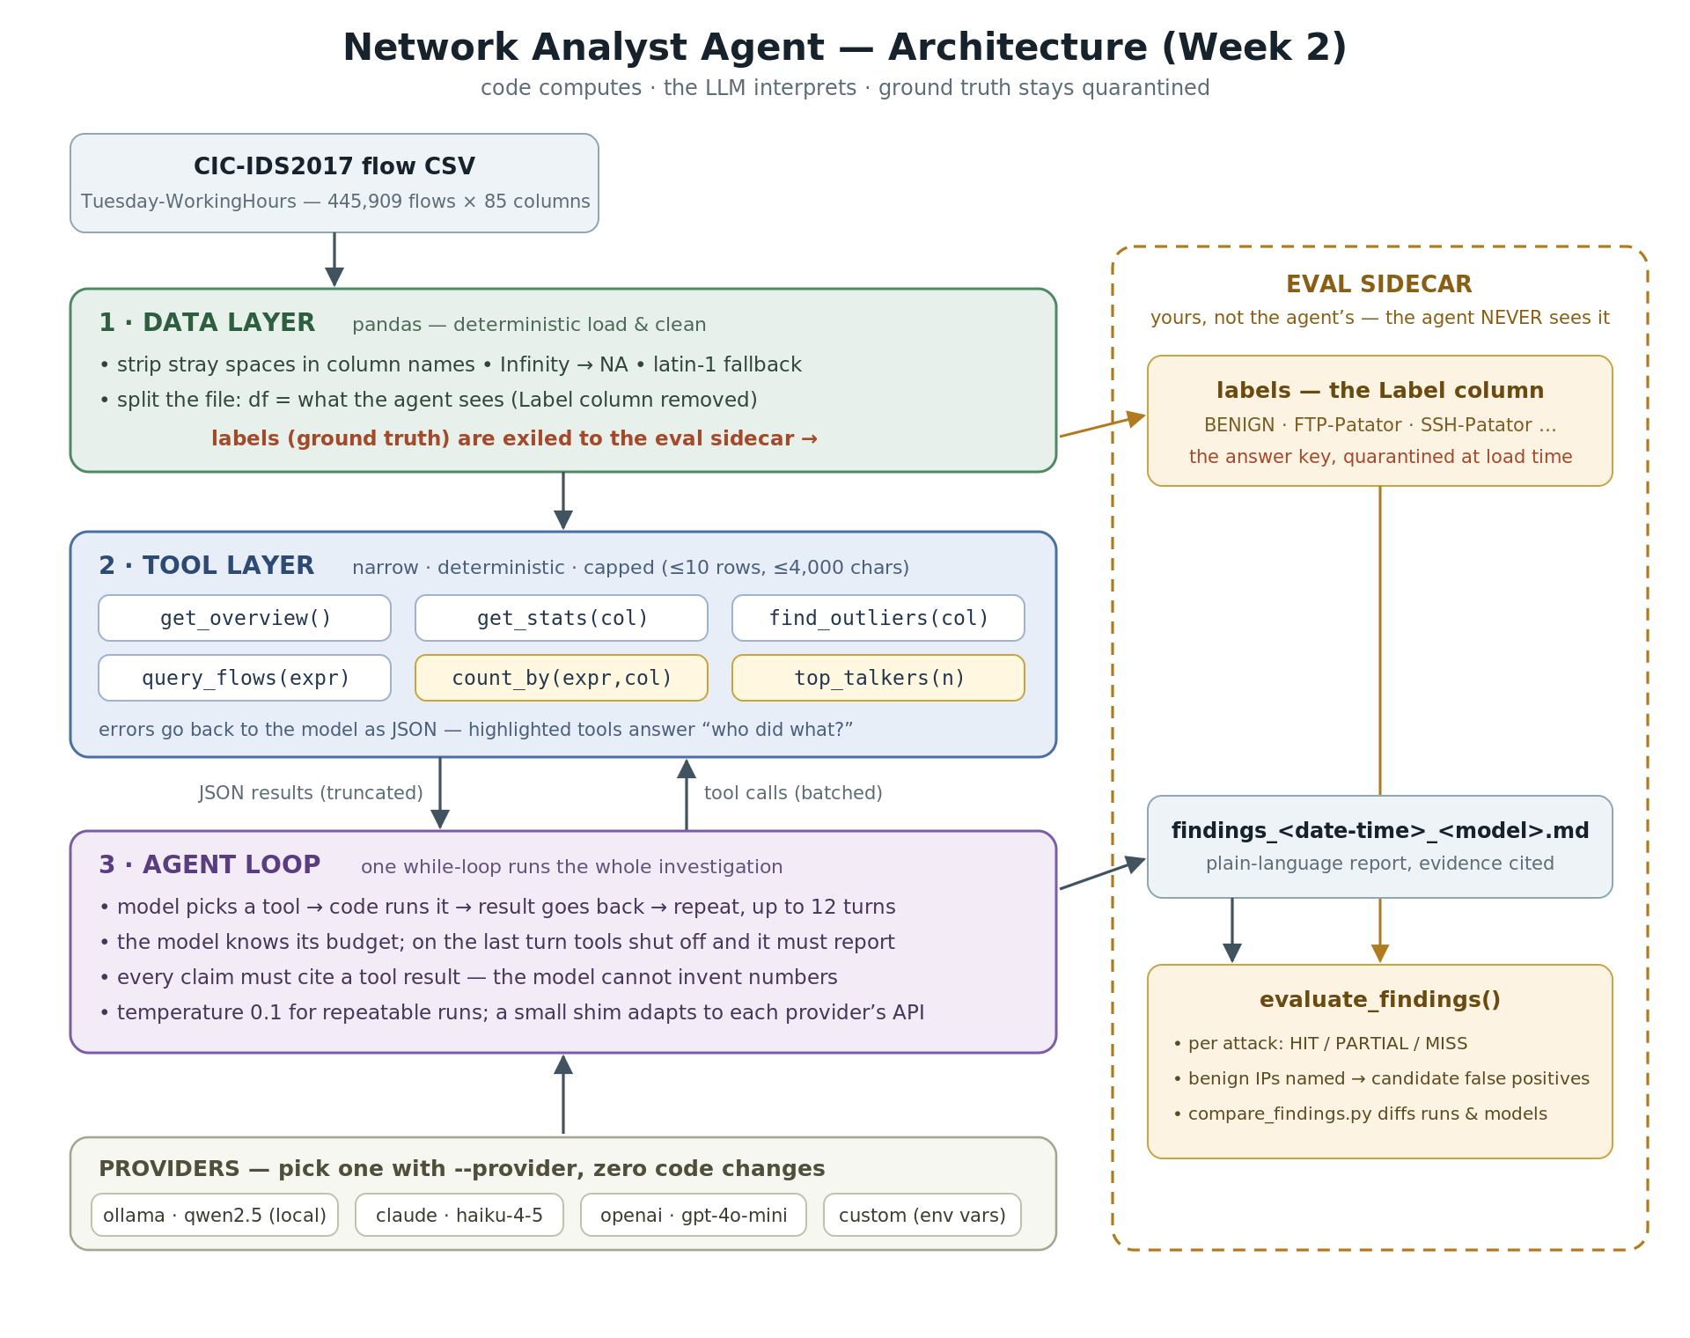
How It Works: 3 Layers + an Eval Sidecar
Design principles
6 tools the agent can use
LLM interprets — never sees raw rows
Every claim cites tool evidence
Provider-agnostic
one flag: ollama · claude · openai
same loop for weeks 3–5
Week 2 · AI Agents for Cybersecurity Defense
5

Slide 8
Tool breakdown
get_overview() — First look at the dataset: how many flows, what columns exist, busiest destination ports. "What am I working with?“
get_stats(column) — Summary statistics for any one column (averages, percentiles, most common values). Used to establish what normal looks like before hunting for weird. "What does typical traffic look like?“
find_outliers(column) — Returns the rows with the most extreme values in a column, with row numbers so the report can cite them. "What are the weirdest flows here?“
query_flows(filter) — Drills into the raw flows matching any condition, returning a few example rows plus the total match count. "Show me the actual traffic on port 22.“
count_by(filter, column) — Counts every matching flow, grouped however you ask. "Who is hitting port 22, and how many times?“
top_talkers(n) — The busiest source IPs: flow counts, how many distinct ports and destinations each one touched, total bytes. Port scans and brute force light up here. "Who's making the most noise?"
All six are ordinary pandas code. Deterministic, output-capped, and error-safe. The model chooses which to call; it never touches the data directly.
Week 2 · AI Agents for Cybersecurity Defense
5

Slide 9
Steps to get it working
1
qwen2.5-14b, local Lot of trouble getting the model tuned correctly, outputs in Chinese and Thai
2
qwen2.5-14b again right method, 6 tokens/sec — model spills out of 12 GB VRAM
3
claude-haiku-4.5 investigated well for 12 turns, ran out the clock — no report
4
+ forced final report report on time — but named the wrong attacker from 20 sample rows
5
+ count_by tool both attacks found — exact attacker, victim, and flow counts
6
Main Takeaway turn judgment calls into computations the LLM can only cite
all runs: Tuesday CIC-IDS2017 file (FTP + SSH brute force)
Week 2 · AI Agents for Cybersecurity Defense
6

Slide 10
A Real Run: Findings in 44 Seconds
[turns 0–1] get_overview → baseline stats → top_talkers: the 15 busiest source IPs
[turns 2–3] checks the busiest hosts — busy alone is not guilty (DNS server cleared)
[turn 4] count_by: who is hitting SSH (port 22)? who is hitting FTP (port 21)?
[turns 5–6] answer: one IP dominates both — drills into 172.16.0.1 vs 192.168.10.50
  [turn 8] FINDINGS — SSH brute force: 172.16.0.1 → 192.168.10.50, 5,898 flows (truth: 5,897)
  FTP brute force: 172.16.0.1 → 192.168.10.50, 7,937 flows (truth: 7,938)
44 seconds, ~$0.03 — all of these calls are from a cited tool. The model should not be guessing
Week 2 · AI Agents for Cybersecurity Defense
7

Slide 11
The Key Fix: Attribution by Computation
20 rows
445,909
Before: query_flows showed the model the FIRST 20 matching rows. It generalized from that sample and confidently accused the wrong host.
After: count_by groups and counts EVERY flow, “who hits port 22?” is now a computation over all 445,909 flows, not a guess from a sample.
The principle: code computes, the LLM interprets
Week 2 · AI Agents for Cybersecurity Defense
8

Slide 12
Measuring It: Every Run Gets Graded
evaluate_findings() runs after every analysis, grading the report against the hidden Label column
HIT = true attacker IP named · PARTIAL = only the victim · MISS = neither
every benign IP the report accuses is listed as a candidate false positive
Best run scored: FTP-Patator → HIT · SSH-Patator → HIT · 2 candidate false positives
  the 2 FPs: the network’s own DNS server, and Windows Update traffic to a Microsoft IP
  both are world-knowledge gaps, not counting errors — the kind a human analyst clears in minutes
Findings are timestamped + model-stamped; compare_findings.py diffs any set of runs
Week 2 · AI Agents for Cybersecurity Defense
9

Slide 13
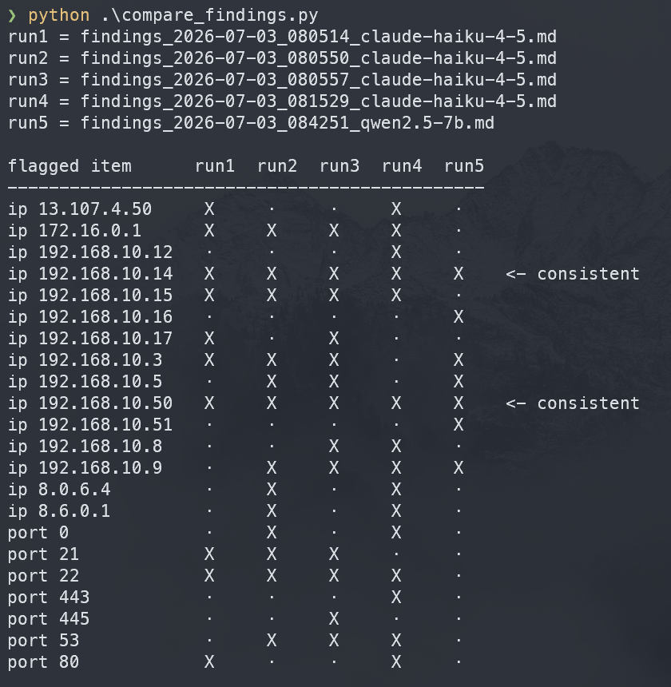
Attacker:
172.16.0.1
Defender:
192.168.10.50

Slide 14
Same Agent, Different Models
2/2
0/2
6 tok/s
attacks detected by claude-haiku-4.5 with exact attribution. 44-second runs, roughly $0.03 each — a $5 minimum API credit covers ~100 runs.
attacks found by local qwen2.5 on the identical task — it flagged the four loudest benign hosts instead and never followed the port 21/22 trail.
local 14b generation speed — the model doesn’t fit in 12 GB of laptop VRAM, so runs took 30+ minutes
Week 2 · AI Agents for Cybersecurity Defense
10

Slide 15
Reflection: What Can It Observe Reliably?
Reliable: observing
Unreliable: judging
Counts, statistics, outliers
Attribution via aggregation (count_by)
Investigation strategy (baseline → drill down)
Plain-language reporting with cited evidence
Generalizing from partial samples
World knowledge (what a DNS server is)
Recognizing benign services (Windows Update)
Malicious-vs-normal intent calls
Giving more context will help in results. All I fed was data, would be more reliable with more context on what its looking for
Week 2 · AI Agents for Cybersecurity Defense
11

