Slide 1
Week 1 Presentation
Maximilian Jansen · Week 1 Briefing · University of Utah · June 2026

Slide 2
Outline of Week 1
Studied:
Security Operations Centers (SOC), MITRE ATT&CK, Cyber Kill Chain, AI Agents
Questions Answered:
How a human analyst investigates an incident
How AI agents might assist
Reflection Question
What tasks performed by human analysts could be delegated to AI agents?
Roadmap for Today:
Landscape → AI in cyber → the human workflow → why it matters → where agents fit
Week 1 · AI Agents for Cybersecurity Defense
2

Slide 3
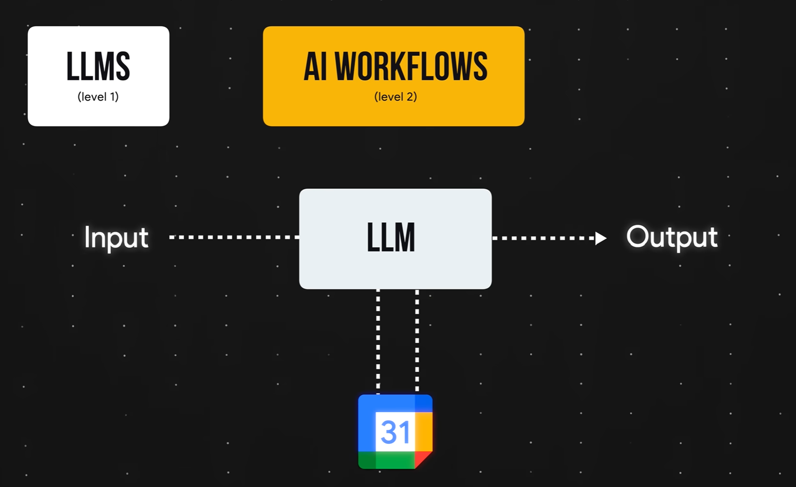
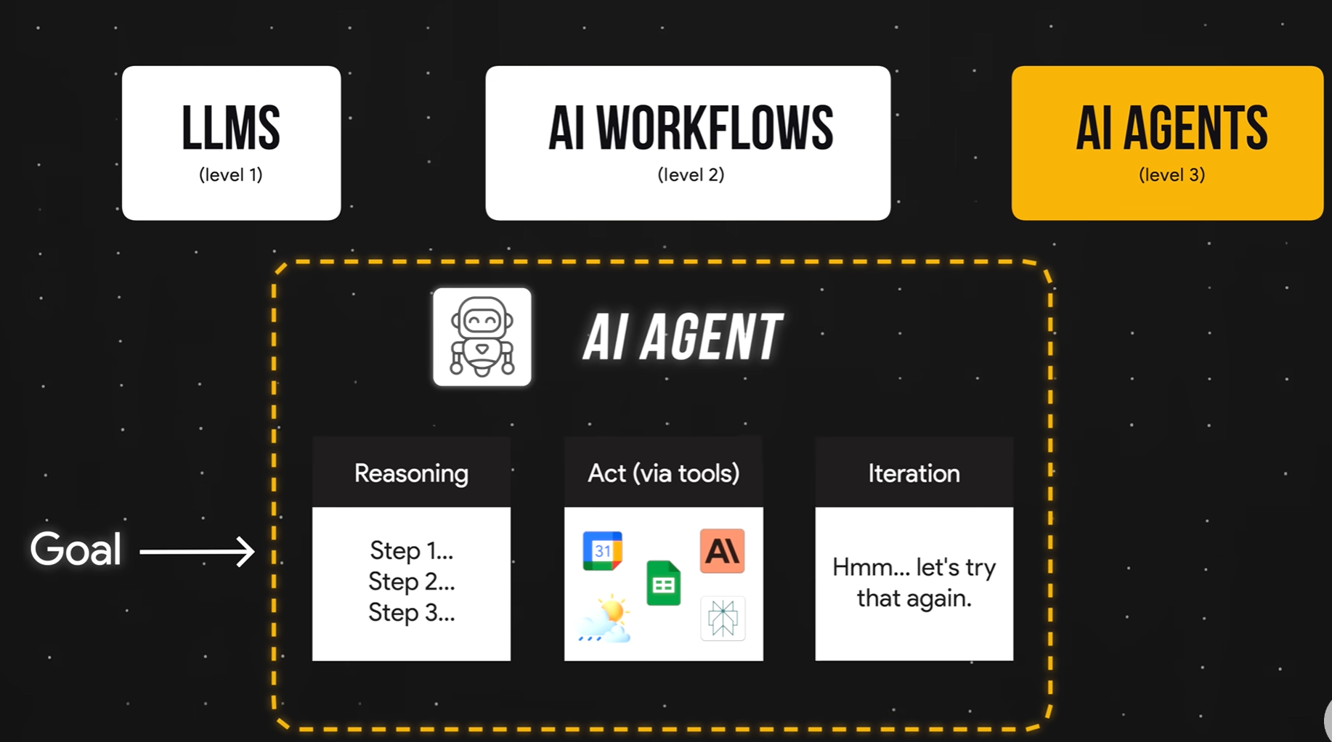
AI agents
AI agent = goal + tools + planning + action
Week 1 · AI Agents for Cybersecurity Defense
4

Slide 4
AI in Cyber: Attacks
Attacks: lowers the barrier to entry; accelerates attacker operations
  e.g. PROMPTFLUX / PROMPTSTEAL — malware that rewrites itself using LLMs mid-execution to evade detection
Source: Mandiant / Google frontline incident-response data
  Skews toward sophisticated enterprise breaches
QUIETVAULT
  Attackers abusing AI tools inside compromised environments to steal NPM tokens
2026 breaches were not directly caused by AI; humans and unpatched systems still are
14 days
22 sec
6%
median dwell time
(up from 11)
attacker handoff
(8 hrs in 2022)
email phishing
(now #2: voice)
Week 1 · AI Agents for Cybersecurity Defense
3

Slide 5
AI in Cyber: Defense
Agentic SOC:
  AI agents triage and investigate alerts at machine speed Google's triage agent: a ~30-minute investigation down to ~1 minute.
  Detection-engineering agents auto-draft and test new detection rules
Big Sleep (Google DeepMind / Project Zero):
  AI agent that finds unknown vulnerabilities Caught a SQLite zero-day (CVE-2025-6965) attackers were about to use; first time an AI agent foiled an in-the-wild exploit
Arms race, AI accelerates both attack and defense
Week 1 · AI Agents for Cybersecurity Defense
4

Slide 6
How a Human Analyst Investigates
1
Alert fires flagged exe, suspicious login, reported phish
2
Triage real threat or false positive? worth pursuing?
3
Gather context pull logs, endpoint, network, identity, threat intel
4
Scope which users, hosts, systems? isolated or spreading?
5
Build timeline reconstruct attacker actions in order; lateral movement?
6
Map to frameworks classify the behavior — next slide
7
Contain & document stop the attacker, write the report, improve
- Microsoft Incident Report
Week 1 · AI Agents for Cybersecurity Defense
5

Slide 7
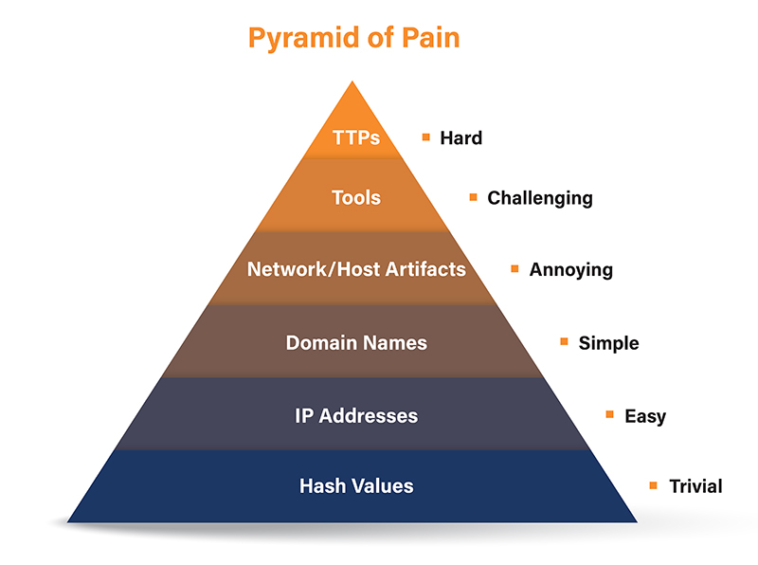
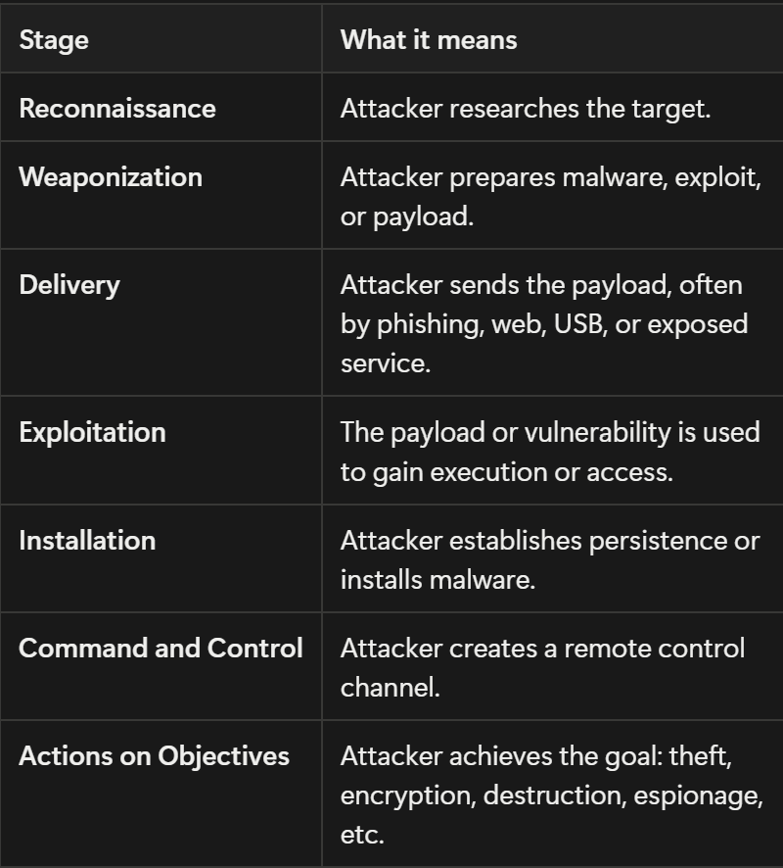
Mapping Behavior: Kill Chain & ATT&CK
MITRE ATT&CK
Cyber Kill Chain
14 tactics (the “why”) + techniques & sub-techniques (the “how”)
  Example: suspicious PowerShell → T1059.001
A non-sequential matrix of real-world behaviors
Lockheed Martin — 7 stages
  Recon → Weaponize → Deliver → Exploit → Install → C2 → Actions on Objectives
The linear story of an attack — high level
Used together, not one replacing the other.
Week 1 · AI Agents for Cybersecurity Defense
6

Slide 8
Why This Matters
46%
1,000s
55%
of alerts are false positives (Microsoft/Omdia State of the SOC 2026). 73% of teams call false positives their #1 detection challenge (SANS 2025).
of alerts per day, with a large share never investigated. Target 2013: a real alert was buried under the false ones.
of security teams are understaffed, according to ISACA’s 2025 State of Cybersecurity report
The throughline: too many alerts, too many false, too few people
Week 1 · AI Agents for Cybersecurity Defense
7

Slide 9
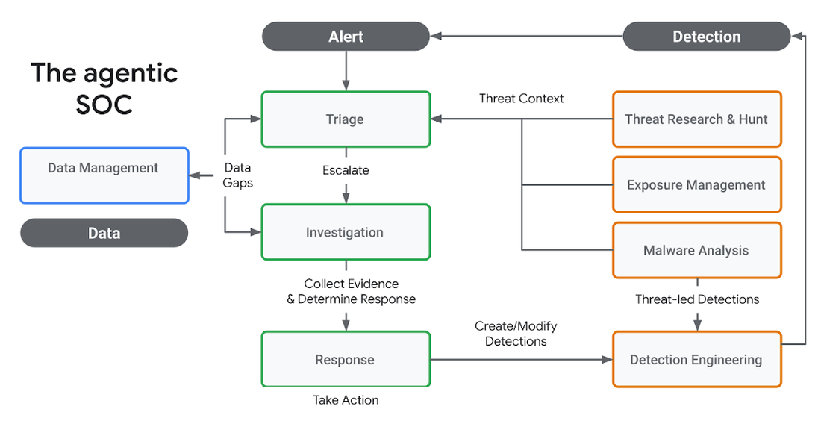
Where AI Agents Fit
The SOC tier model is a natural automation gradient:
Tier 1 — triage + enrichment: most automatable
Tier 2 — investigation: AI-assisted
Tier 3 — hunting + judgment: stays human
Current solutions:
Google AI Threat Defense
Agentic-SOC vendors: Dropzone AI, Prophet Security
Week 1 · AI Agents for Cybersecurity Defense
8

Slide 10
Limitations & Risks
Hallucination: confident but wrong mappings or conclusions
Automation bias: analysts over-trust the AI and stop verifying
Prompt injection: our agents will read attacker-controlled logs (indirect injection)
OpenClaw crisis (2026): RCE CVEs, a malicious-skill supply chain;
  Microsoft: don’t run it on a standard work machine
  Bitdefender estimated roughly 17% of skills they analyzed early on carried malicious payloads
Takeaway: gate high-impact actions behind a human
Week 1 · AI Agents for Cybersecurity Defense
9

Slide 11
What Can We Delegate?
Automate
Keep human
Alert triage
Enrichment & log queries
Timeline drafting
Summarization & reporting
Containment approval
Business-impact calls
Legal / notification decisions
Final incident conclusions
Week 1 · AI Agents for Cybersecurity Defense
10

Slide 12
The build: the 4 agents and how they tie together
Network Analyst Agent
→
gather context & scope the incident
Threat Intelligence Agent
→
map behavior to MITRE ATT&CK
Kill Chain Reasoning Agent
→
build the timeline & classify the stage
Report Agent
→
produce the incident summary
11

