Slide 1
Week 3: The Threat Intel Agent & Connecting the Team
Maximilian Jansen · Week 3 Briefing · University of Utah · July 2026

Slide 2
Outline of Week 3
Built:
The Threat Intelligence Agent
- Maps Network Analyst findings to real MITRE ATT&CK techniques, with grounded citations
Questions Answered:
Can an agent cite ATT&CK techniques without hallucinating IDs?
Can two agents talk to each other without losing determinism?
Reflection Question
What should agents share with each other?
Roadmap for Today:
the refactor → the new agent → grounding → the workflow → our tools vs LangGraph’s → grading it → week 4
Week 3 · AI Agents for Cybersecurity Defense
2

Slide 3
Progress for full Agent
Network Analyst Agent
→
DONE (week 2) — reads logs, finds attacks, reports
Threat Intelligence Agent
→
DONE (this week) — maps behavior to MITRE ATT&CK, grounded citations, connected via LangGraph
Kill Chain Reasoning Agent
→
build the timeline & classify the stage — week 4, state seam ready
Report Agent
→
produce the incident summary — week 5
3

Slide 4
First, a Refactor: One Engine, Two Agents
Week 2’s agent loop was about to be needed twice — the reusable machinery moved to agent_core.py
  An agent is now just a configuration: a system prompt + tool definitions + tool implementations
  Turn caps, forced final report, error feedback, compat shim — inherited by every future agent for free
  New file map: agent_core · network_analyst · threat_intel · workflow · eval_sidecar
  Regression rule: Week 2 standalone mode still works, untouched
Week 3 · AI Agents for Cybersecurity Defense
4

Slide 5
The New Agent: Threat Intel
The data layer — the real MITRE enterprise-attack.json (~50 MB STIX bundle): downloaded once, cached, deprecated entries filtered at load. "Real ATT&CK data, not model memory."
list_tactics() — the enterprise tactics in kill-chain order with one-line descriptions. Cheap orientation call. "What stages exist?"
search_techniques(query) — keyword search over technique names and descriptions. Deliberately simple scoring — no embeddings. "What matches brute force?"
get_technique(id) — full detail for one technique: description, tactics, detection notes, sub-techniques. Confirm before citing. "Tell me everything about T1110."
The input — the Network Analyst’s structured findings JSON (F1..Fn). Never the raw CSV, never the markdown report. "Each agent works at its own abstraction."
The output — a mapping per finding (technique, tactic, confidence, reasoning) plus optional evidence requests. "The Week 4 input contract."
All three tools are ordinary Python over the real ATT&CK dataset — deterministic, output-capped, error-safe. Every technique ID a tool returns is recorded for the grounding check (next slide).
Week 3 · AI Agents for Cybersecurity Defense
5

Slide 6
The Known Failure Mode: Hallucinated Technique IDs
LLMs have memorized MITRE ATT&CK — imperfectly
  Ask about “SSH brute force” and you get a confident T-number straight from memory
  Sometimes subtly wrong: wrong sub-technique, deprecated ID, or one that doesn’t exist at all
  A wrong-but-confident technique ID in a security report is the one failure we can’t ship
  The prompt says “cite only tool results” — but a prompt is a request, not a guarantee
Week 3 · AI Agents for Cybersecurity Defense
6

Slide 7
Grounding Enforcement: Code, Not Prompt
1
one exit funnel every tool result leaves through _emit(), which records every technique ID it contains
2
a run-long log by the end of a run, code holds the full set of IDs the model legitimately saw
3
audit the output regex every T-ID out of the agent’s report; check each against that log
4
loud failure any ID the tools never returned → [grounding] WARNING + flagged in the JSON
5
code stamps the verdict “verified”: true/false is written by code — the model never touches the field
6
Main Takeaway the Week 3 equivalent of hiding the Label column — citation integrity is now a computation
grounded ≠ correct — the eval sidecar measures correctness
Week 3 · AI Agents for Cybersecurity Defense
7

Slide 8
Don’t Guess — Ask: Evidence Requests
Rule 3 of the Threat Intel prompt: if evidence is too thin to map confidently, do NOT guess
  Instead it emits an evidence request — a specific, answerable question for the Network Analyst
  Each request names the finding it concerns and suggests a concrete pandas query to run
  This is the hook the workflow turns into a real conversation between the two agents
  An empty list is a valid answer — most findings map without needing one
Week 3 · AI Agents for Cybersecurity Defense
8

Slide 9
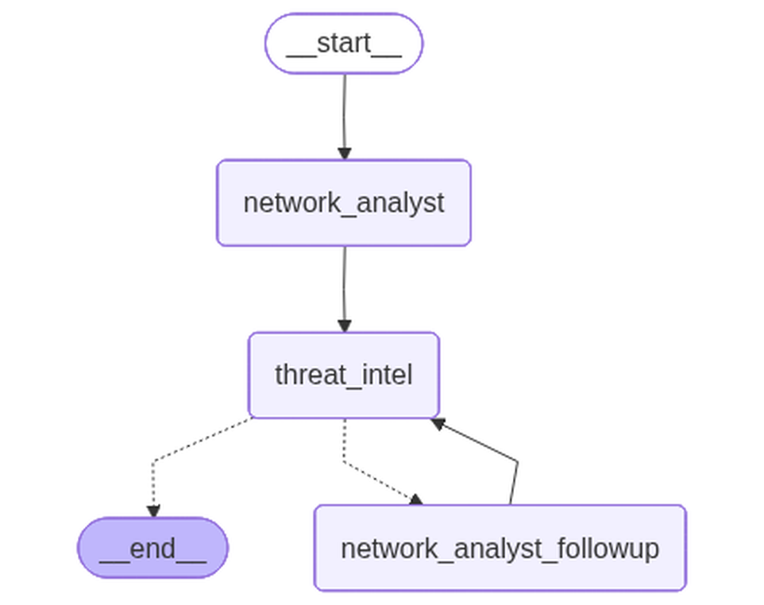
The Workflow: One Graph, No Supervisor
Deterministic between, agentic within
START → analyst → intel → END
routing is code, not an LLM
agents share findings JSON only
Diagram from code
drawn from the compiled graph
it cannot drift from the code
Week 3 · AI Agents for Cybersecurity Defense
9

Slide 10
The One Dynamic Edge: Feedback, Capped
1 pass
4 turns
If Threat Intel requests evidence, the Network Analyst gets exactly ONE targeted follow-up — the cap is enforced in the router; --force-evidence-request demos the edge on demand.
The follow-up answers only the questions asked — a short budget, not a re-investigation. Then Threat Intel re-maps once, using the new answers.
The principle: every loop in this system has a ceiling
Week 3 · AI Agents for Cybersecurity Defense
10

Slide 11
Why We Kept Our Own Tools (Build vs. Buy)
LangGraph’s job: the graph
Our job: the agents
Shared state schema between agents
Routing + the one feedback edge
Diagram generated from the graph
Seams for weeks 4–5
The week-2 run_agent loop, unchanged
Hand-written tool schemas — no @tool,
no bind_tools, no create_react_agent
Every transcript line is our own code
Adopt frameworks where they add structure (the graph), not where they replace understanding (the agents) — the same call as Week 2’s “no OpenAI / Claude Agents”.
Week 3 · AI Agents for Cybersecurity Defense
11

Slide 12
Measuring It: Now Both Agents Get Graded
Week 2 scorer unchanged: HIT / PARTIAL / MISS per attack + candidate false positives
New mapping scorer: CORRECT (ID in the acceptable set) · PLAUSIBLE (same tactic) · WRONG
A coverage gate separates blame: attacks no finding covered are the analyst’s miss, not the mapper’s
The answer key: each attack family → a SET of acceptable IDs — analysts reasonably disagree on sub-techniques
  the key lives only in the eval sidecar; agents never see it — same quarantine as the Label column
  verify_answer_key() checks every ID in the key against live ATT&CK before we trust it
Plus grounding stats per run: technique IDs cited vs. verified against tool output
Week 3 · AI Agents for Cybersecurity Defense
12

Slide 13
A Real Run: CSV → Findings → Mappings
[node] network_analyst — loads the CSV, investigates with the six pandas tools, emits findings JSON
[node] threat_intel — searches ATT&CK, confirms with get_technique, maps each finding F1..Fn
[edge] evidence requests pending? → one targeted follow-up pass → re-map
[run] ADD RUN INFO: model · CSV · wall time · cost
  ADD RUN INFO: mappings produced — e.g. F1 → T1110.001 Password Guessing (verified: true)
  ADD RUN INFO: eval verdicts — CORRECT / PLAUSIBLE / WRONG + grounding stats
one command produced findings.md/.json, mappings.md/.json, eval.txt, and the diagram — all in one run folder
Week 3 · AI Agents for Cybersecurity Defense
13

Slide 14
Responding to Week 2 Feedback
You asked for three things after the Week 2 briefing — designed as one mechanism:
  Narrate the plan, thinking, and a self-assessment → plan mode (--plan): narration rides along with tool calls
  Learn from previous runs → a curated lessons file (--lessons) — human-gated, never auto-appended
  Agent feedback on its tools → subjective retrospective + objective tool-call log, shown side by side
  Design is complete (plan_mode_handoff.md); implementation is the next work item
Week 3 · AI Agents for Cybersecurity Defense
14

Slide 15
Reflection: What Should Agents Share?
Share: distilled findings
Never share: everything else
Structured JSON with cited evidence
IPs, ports, counts — the analyst’s abstraction
Techniques, tactics — the mapper’s abstraction
Follow-up answers, clearly labeled
Raw flows — 445k rows would blow the context
Full transcripts — noise, not signal
The Label column / answer key — quarantined
Unverified technique IDs — grounding flags them
Week 2 turned attribution into a computation (count_by). Week 3 turned citation integrity into one (the grounding log). The pattern: find the failure mode, make it a computation.
Week 3 · AI Agents for Cybersecurity Defense
15

Slide 16
Week 4 Preview: The Kill Chain Agent
1 line
ready
fan-out
swapping END → kill_chain in the router is the only graph change needed — the seam was left on purpose.
the kill_chain state key already exists, and list_tactics already returns tactics in kill-chain order for it to reuse.
a possible optimization from the handoff: map findings to techniques in parallel with LangGraph’s Send API.
Week 3 · AI Agents for Cybersecurity Defense
16

