Slide 1
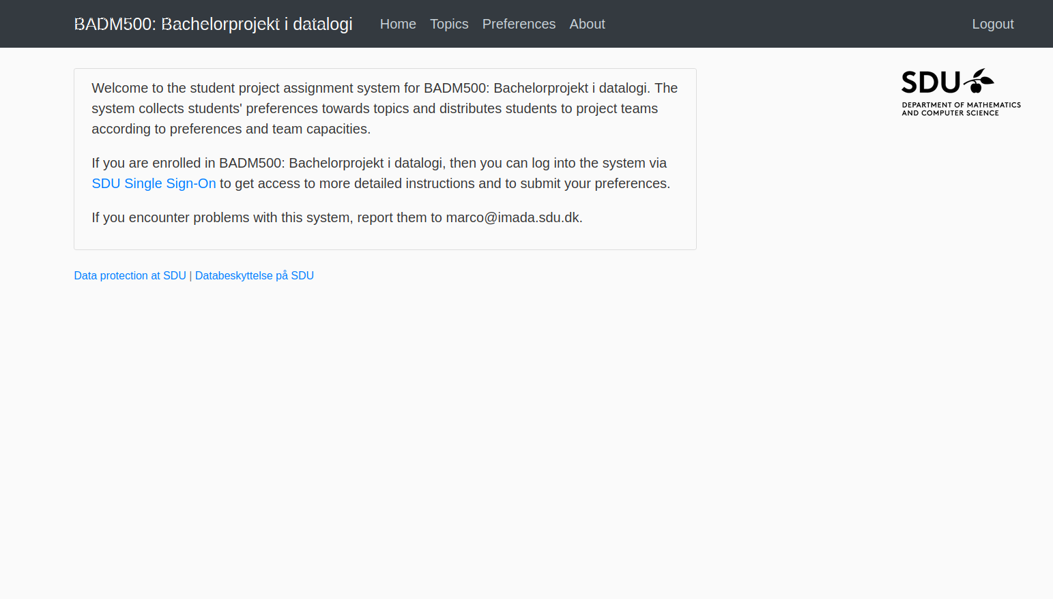
{User name}
Front Page, when logged in
keep student pages as is for now

Slide 2
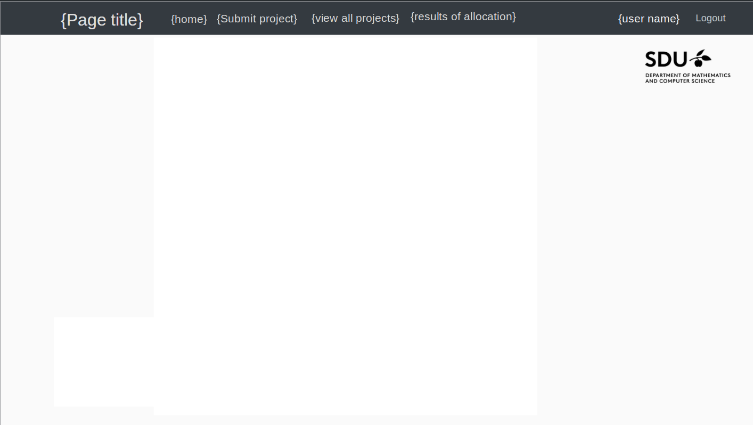
{Page title}
{Submit project}
{view all projects}
{results of allocation}
{user name}
{home}
Your project(s)
Title Project 1 | view/change properties
Title Project 2 | view/change properties
Title Project 3 | view/change properties
Teacher front Page

Slide 3
{Page title}
{Page title}
{Submit project}
{view all projects}
{results of allocation}
{user name}
{home}
User settings
such as capacity,
Default visibility for projects,
...
{Link to admin email for questions/help}
Teacher user page

Slide 4
Title:
No. Teams:
Students pr. team:
Available to:
institute
institute
Scrollable list of checkboxes
...
Desription:
Project submission page
Submit

Slide 5
Project title | Teacher
Project title | Teacher
Project title | Teacher
Project title | Teacher
Project title | Teacher
Project title | Teacher
Project title | Teacher
Project title | Teacher
Project title | Teacher
... | ...
Overview of all projects
Could be kept as the current

Slide 6
Dropdown to select version
Dropdown to select table
Tables includes:
Advisor stats,
Projects allocated to,
Student stats,
...
Table is sortable on all columns
Try alternative
Results of allocation page

Slide 7
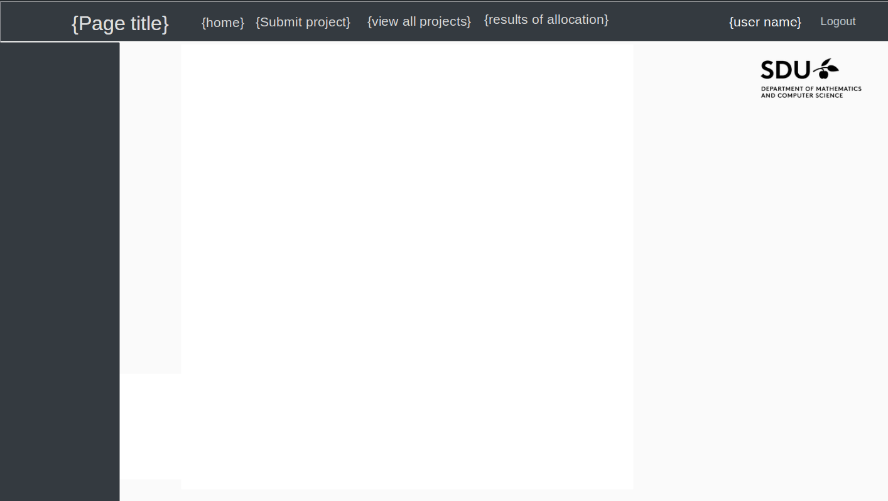
{admin}
{users add/remove}
{allocation process}
{...}
Only present when logged in user is administrator
Settings for given entry in sidebar
Admin Page

