Slide 1
SVO
0716074

Slide 2
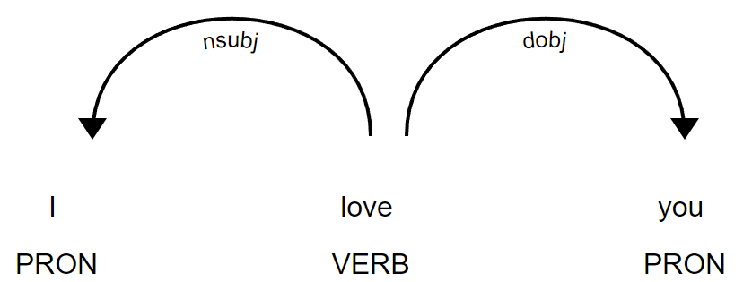
 | POS | DEP
S | PRON | nsubj
V | VERB
O | PRON | dobj

Slide 3
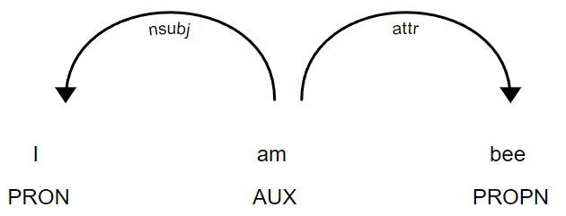
 | POS | DEP
S | PRON | nsubj
V | VERB, AUX
O | PRON, PROPN | dobj, attr

Slide 4
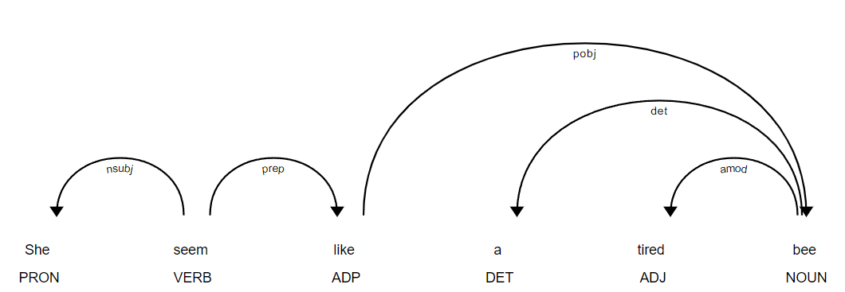
 | POS | DEP
S | PRON | nsubj
V | VERB, AUX
O | PRON, PROPN, NOUN | dobj, attr, pobj
Extend O
prep

Slide 5
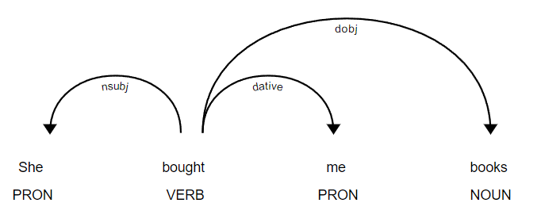
 | POS | DEP
S | PRON | nsubj
V | VERB, AUX
O | PRON, PROPN, NOUN | dobj, attr, pobj, dative
Extend O
prep

Slide 6
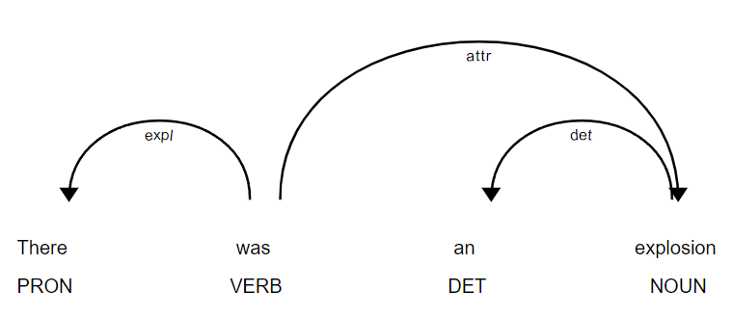
 | POS | DEP
S | PRON | nsubj, expl
V | VERB, AUX
O | PRON, PROPN, NOUN | dobj, attr, pobj, dative, attr
Extend O
prep

Slide 7
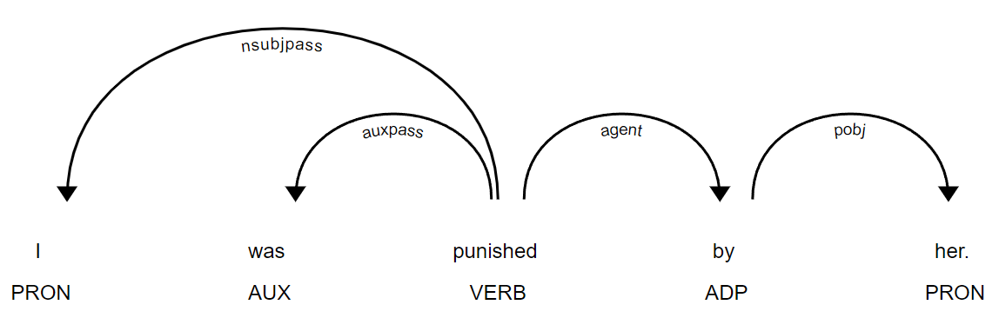
 | POS | DEP
S | PRON | nsubj, expl, nsubjpass
V | VERB, AUX
O | PRON, PROPN, NOUN | dobj, attr, pobj, dative, attr
Extend O
prep, agent

Slide 8
Advanced

Slide 9
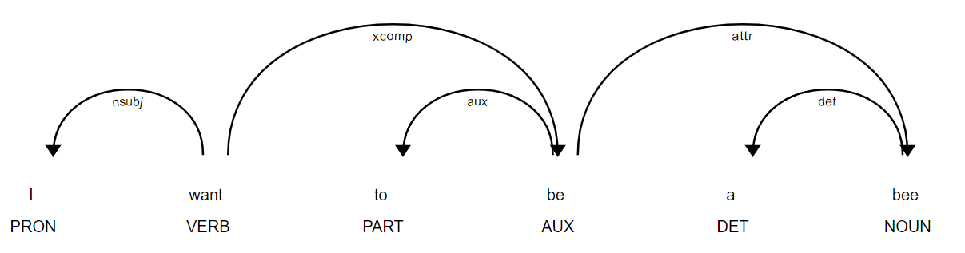
 | POS | DEP
S | PRON | nsubj, expl, nsubjpass
V | VERB, AUX
O | PRON, PROPN, NOUN | dobj, attr, pobj, dative, attr
Extend O
prep, agent, xcomp
O? S?

Slide 10
 | POS | DEP
S | PRON | nsubj, expl, nsubjpass
V | VERB, AUX
O | PRON, PROPN, NOUN | dobj, attr, pobj, dative, attr
Extend O
prep, agent, xcomp
Extend S
S < V … … Verb
?

Slide 11
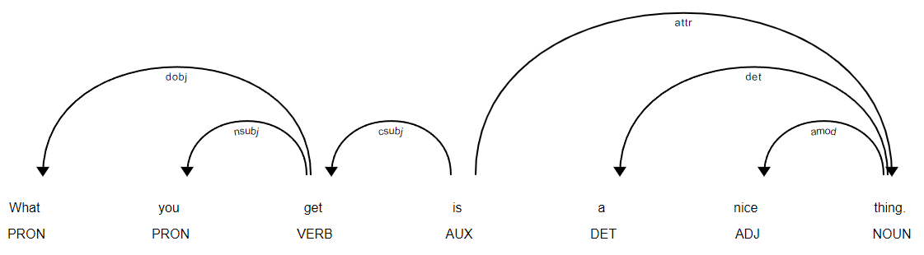
 | POS | DEP
S | PRON | nsubj, expl, nsubjpass, csubj
V | VERB, AUX
O | PRON, PROPN, NOUN | dobj, attr, pobj, dative, attr
Extend O
prep, agent, xcomp
Extend S
S < V … … Verb

Slide 12
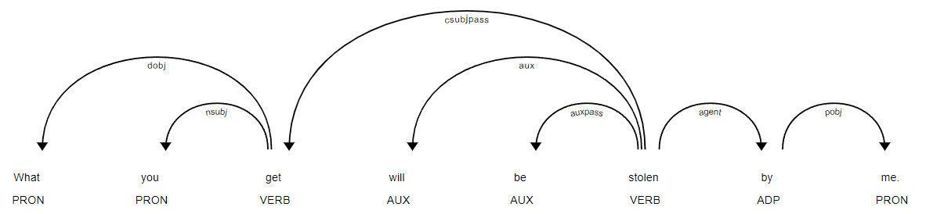
 | POS | DEP
S | PRON | nsubj, expl, nsubjpass, csubj, csubjpass
V | VERB, AUX
O | PRON, PROPN, NOUN | dobj, attr, pobj, dative, attr
Extend O
prep, agent, xcomp
Extend S
S < V … … Verb

Slide 13
 | POS | DEP
S | PRON | nsubj, expl, nsubjpass, csubj, csubjpass
V | VERB, AUX
O | PRON, PROPN, NOUN | dobj, attr, pobj, dative, attr
Extend O
prep, agent, xcomp
Extend S
S < V … … Verb

Slide 14
 | POS | DEP
S | PRON, PROPN, NOUN | nsubj, expl, nsubjpass, csubj, csubjpass
V | VERB, AUX
O | PRON, PROPN, NOUN | dobj, attr, pobj, dative, attr
Extend O
prep, agent, xcomp
Extend S
S < V … … Verb
Extend S
S < V … … Verb

Slide 15
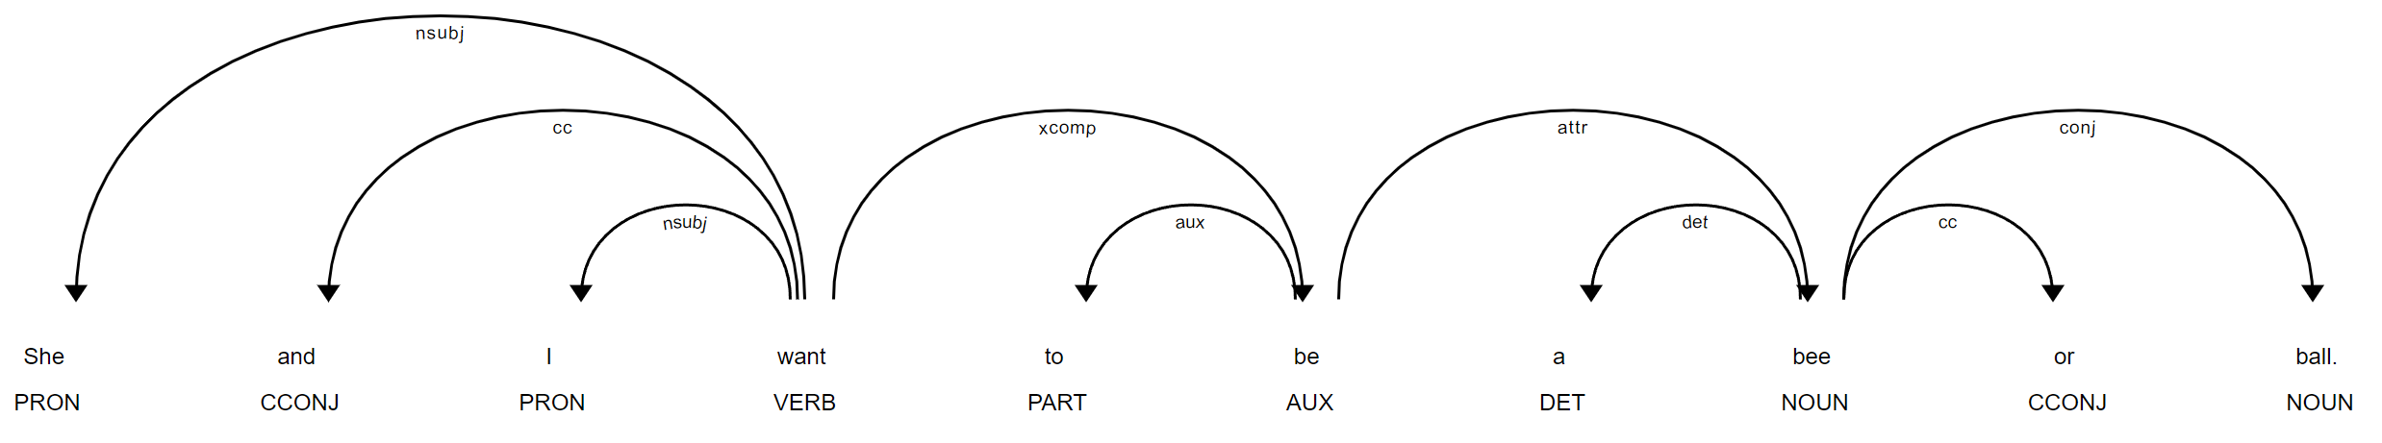
 | POS | DEP
S | PRON, PROPN, NOUN | nsubj, expl, nsubjpass, csubj, csubjpass
V | VERB, AUX
O | PRON, PROPN, NOUN | dobj, attr, pobj, dative, attr
?
?
Extend O
prep, agent, xcomp, conj
Extend V
conj
Extend S
S < V … … Verb, conj

Slide 16
 | POS | DEP
S | PRON, PROPN, NOUN | nsubj, expl, nsubjpass, csubj, csubjpass
V | VERB, AUX
O | PRON, PROPN, NOUN | dobj, attr, pobj, dative, attr
Extend O
prep, agent, xcomp, conj
Extend V
conj
Extend S
S < V … … Verb, conj

Slide 17
Now we get …
('who', 'finished', 'siesta'),
('official', 'finished', 'siesta') ('official', 'seemed', 'tense') ('who', 'seemed', 'tense'), ('facilities', 'were', 'service')
A Spanish official , who had just finished a siesta and seemed not the least bit tense , offered what he believed to be a perfectly reasonable explanation for why the portable facilities were n't in service .
A Spanish official, seemed, not the least bit tense
the portable facilities, were n't in, service
A Spanish official,had just finished,a siesta
a siesta,and seemed,not the least bit tense

Slide 18
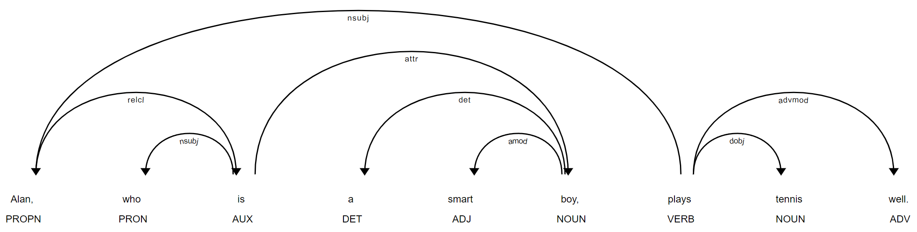
relcl
Extend O
prep, agent, xcomp, conj
Extend V
conj
Extend S
S < V … … Verb, conj, relcl

Slide 19
 | POS | DEP
S | PRON, PROPN, NOUN | nsubj, expl, nsubjpass, csubj, csubjpass
V | VERB, AUX
O | PRON, PROPN, NOUN | dobj, attr, pobj, dative, attr
Extend O
prep, agent, xcomp, conj
Extend V
conj
Extend S
S < V … … Verb, conj, relcl

Slide 20
TKS

