Slide 1


Slide 2
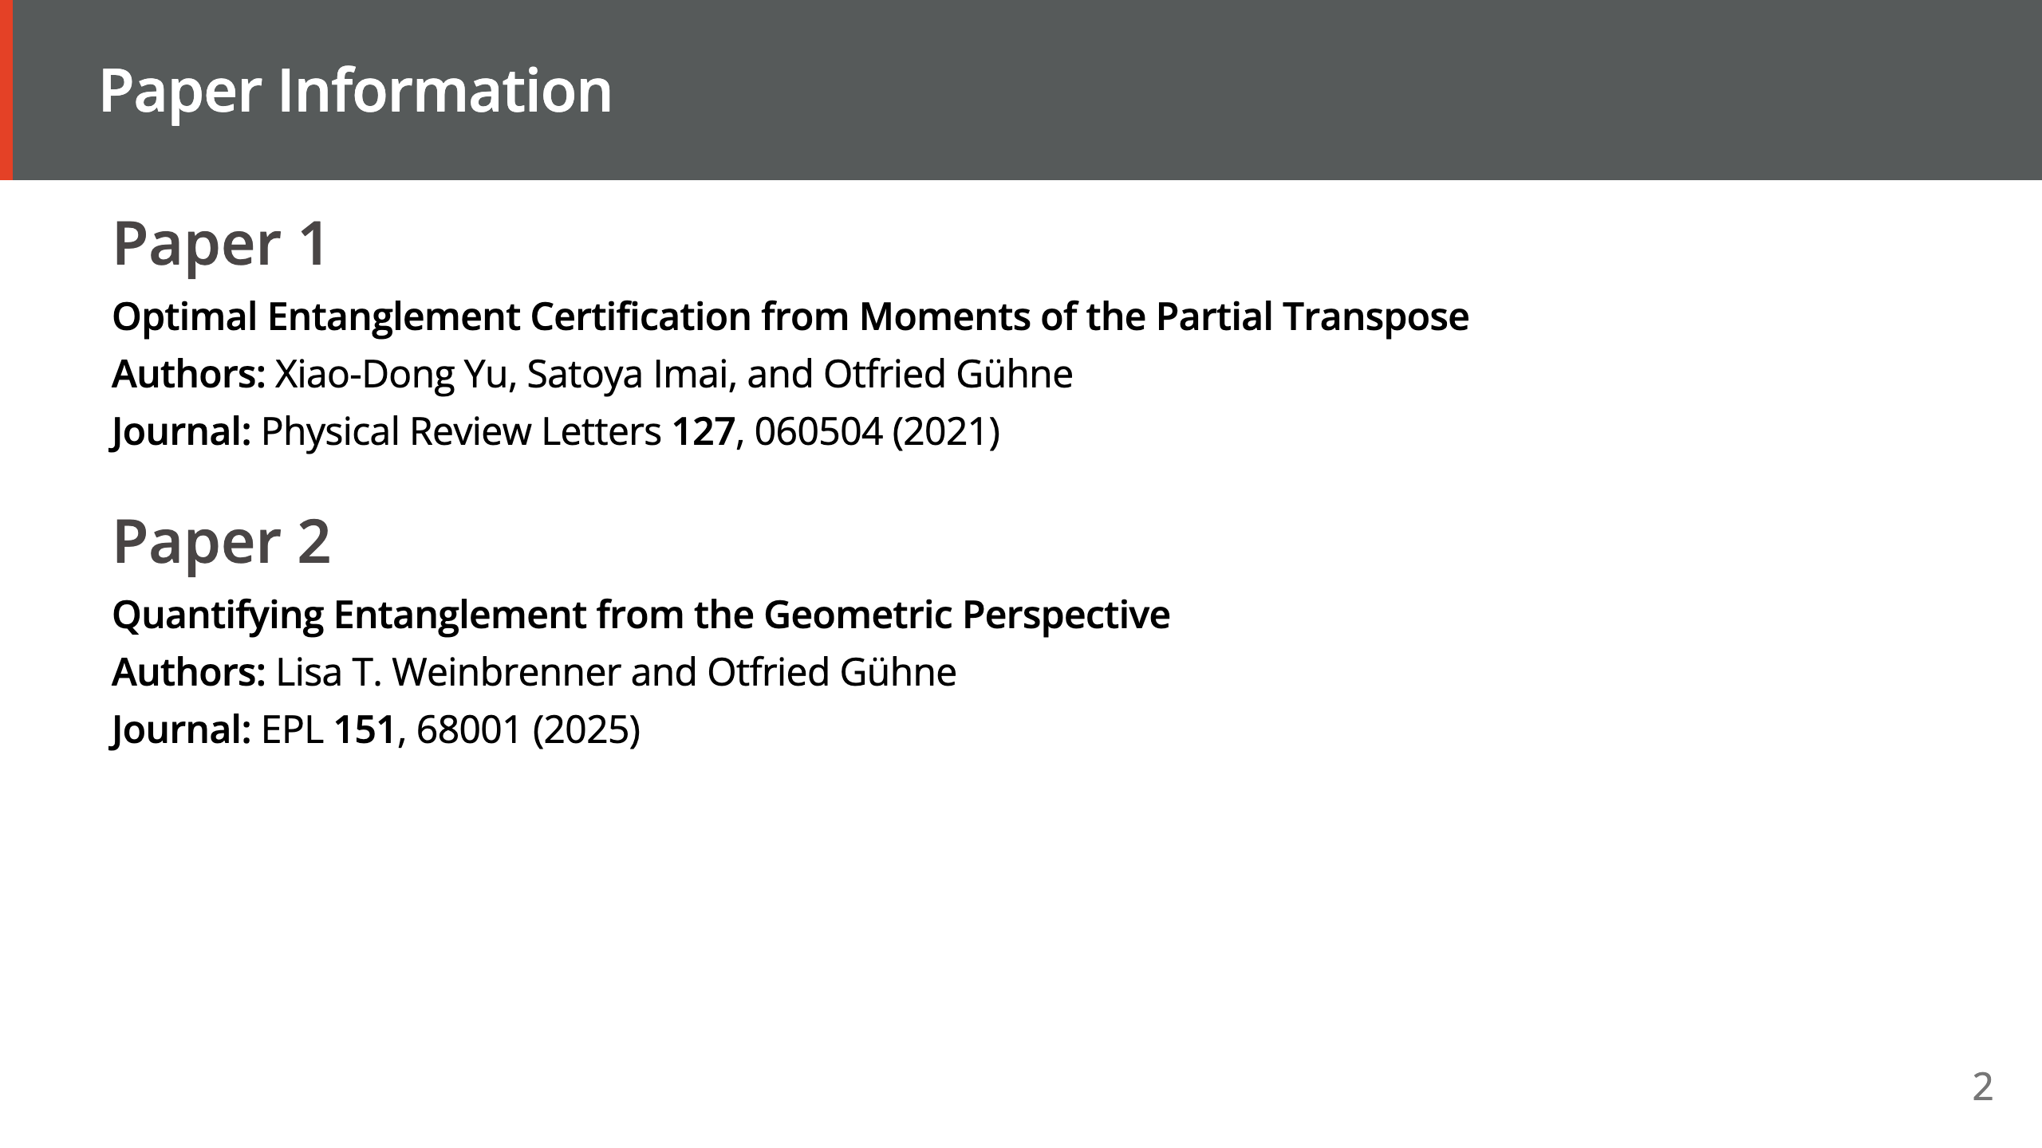

Slide 3
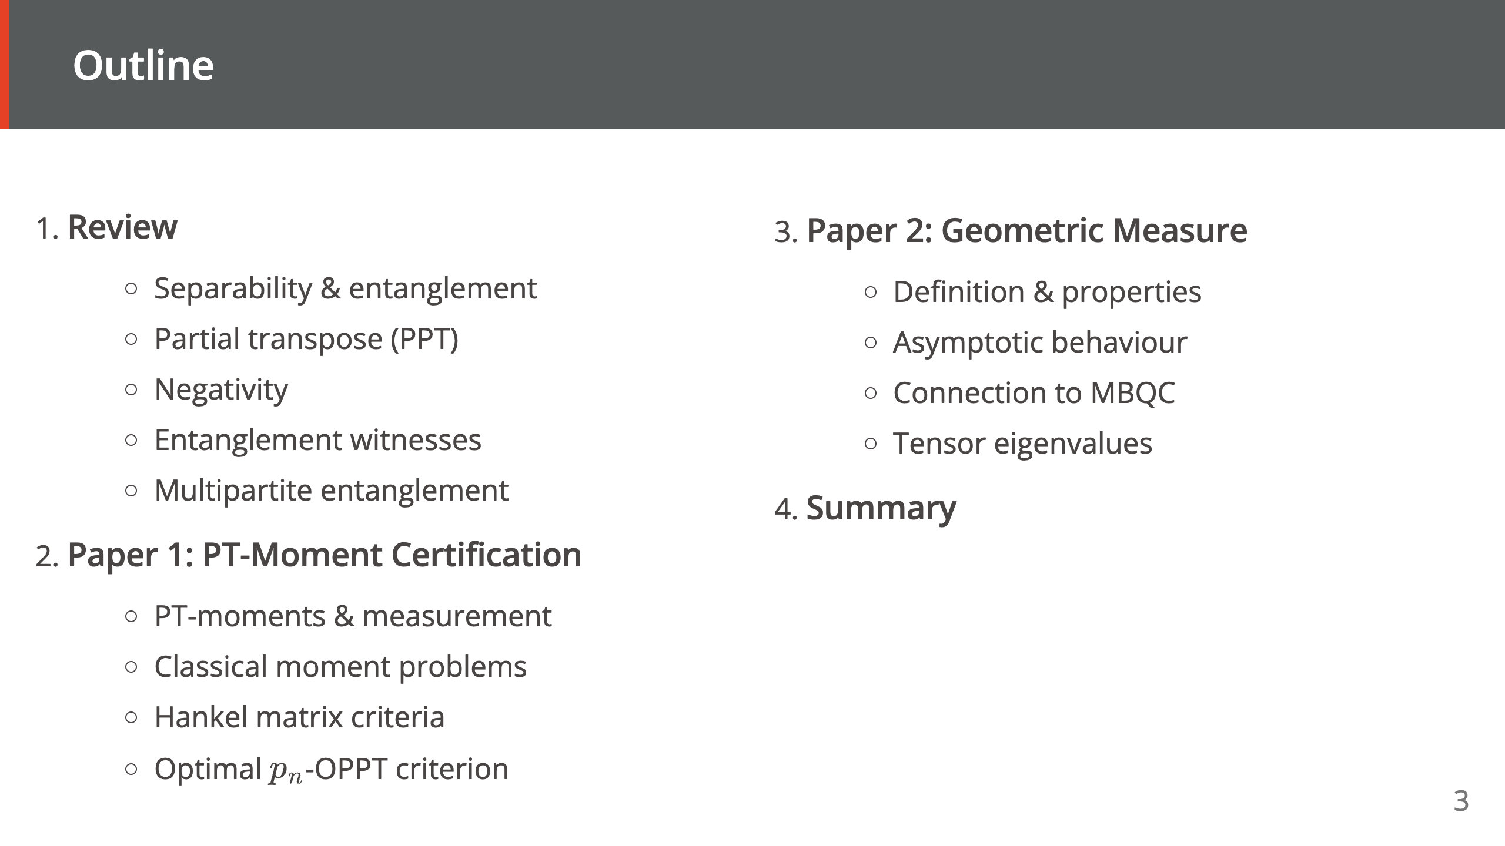

Slide 4


Slide 5
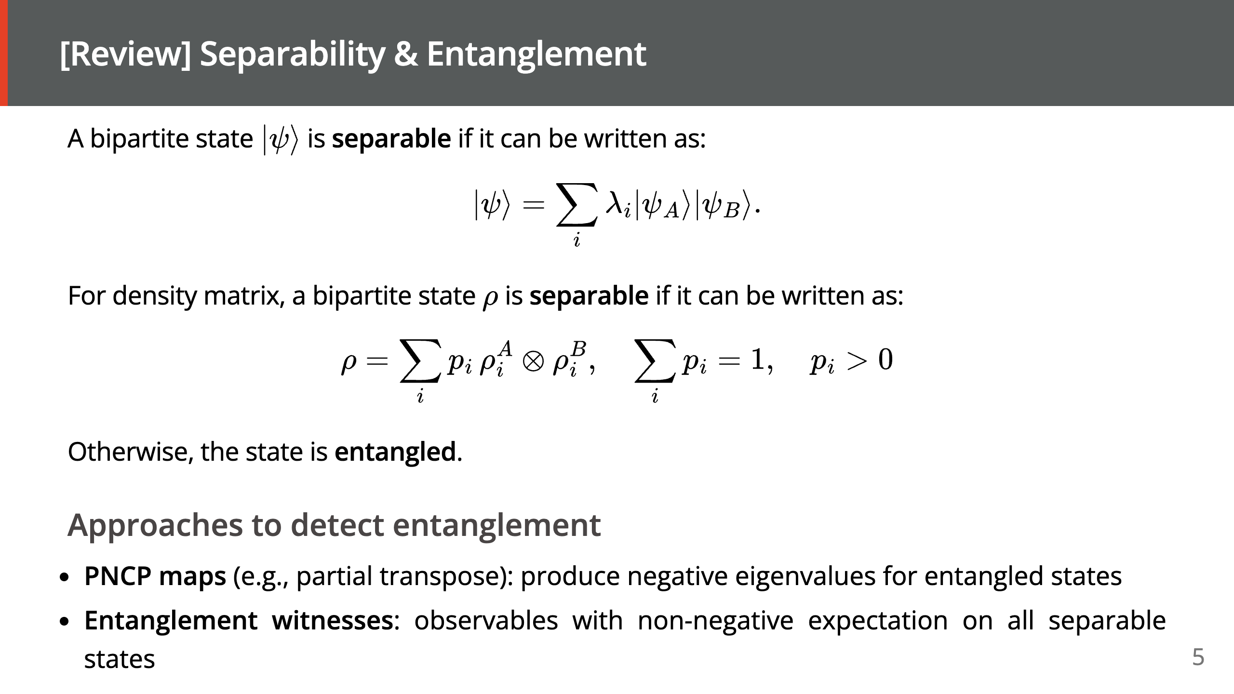
Notes:
- **Entanglement measures**: quantify the degree of entanglement (negativity, geometric measure, ...)

Slide 6
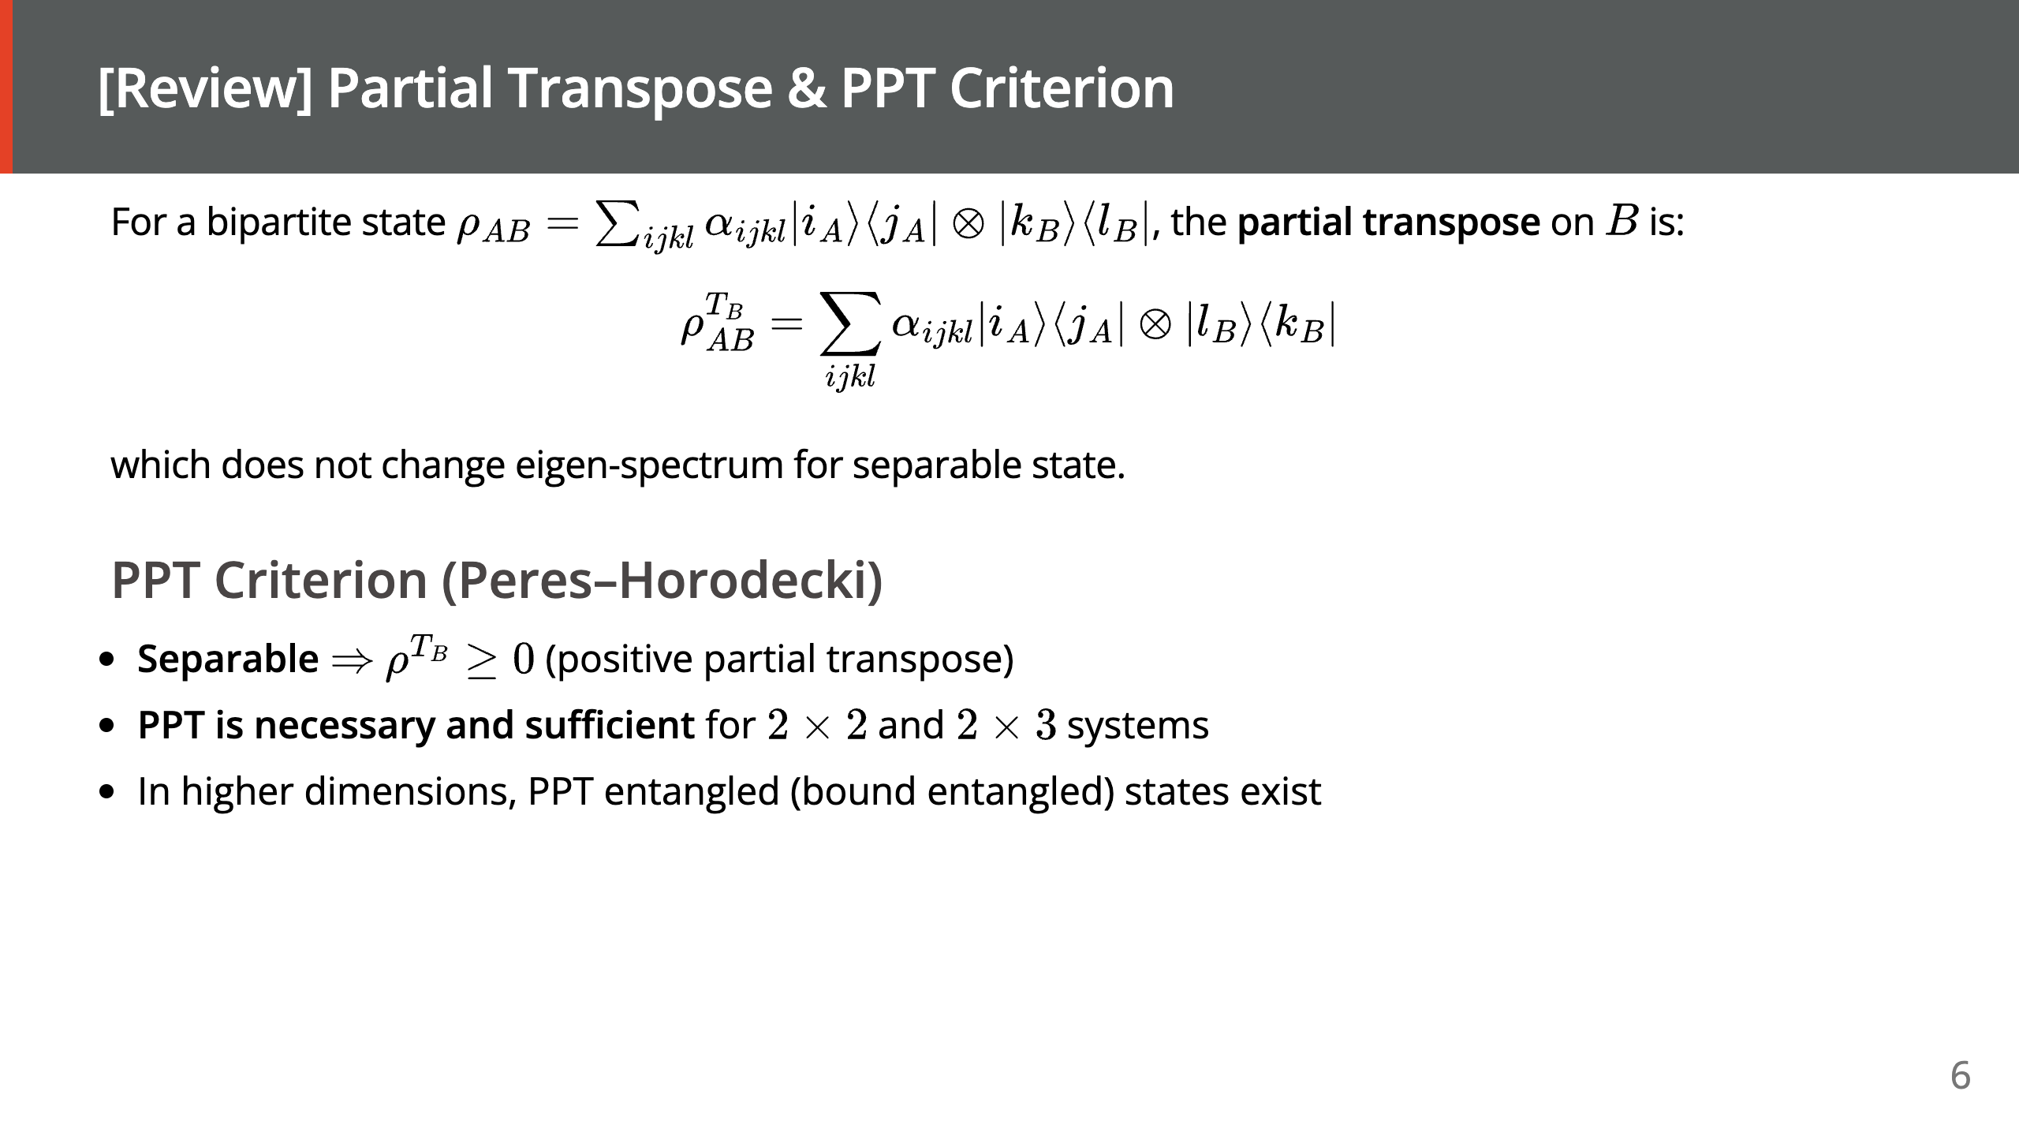
Notes:
For a single-qubit subsystem, this decomposes as: $$ T(\rho) = \frac{1}{2}(\rho + X\rho X - Y \rho Y + Z \rho Z) $$

Slide 7
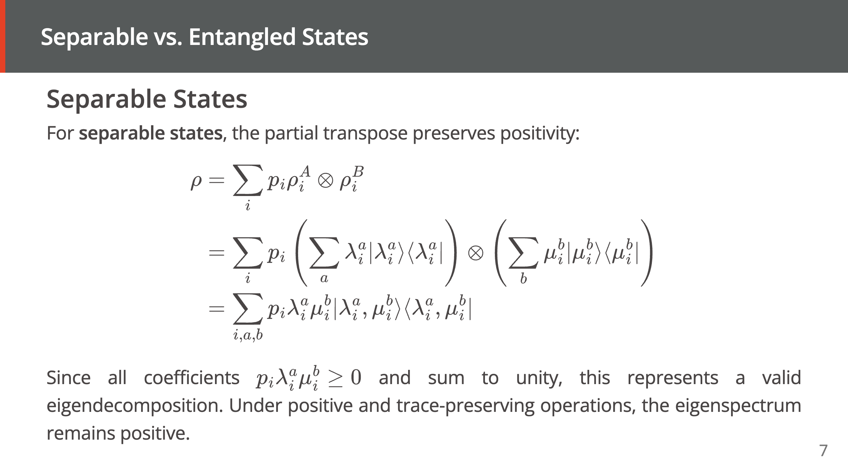

Slide 8
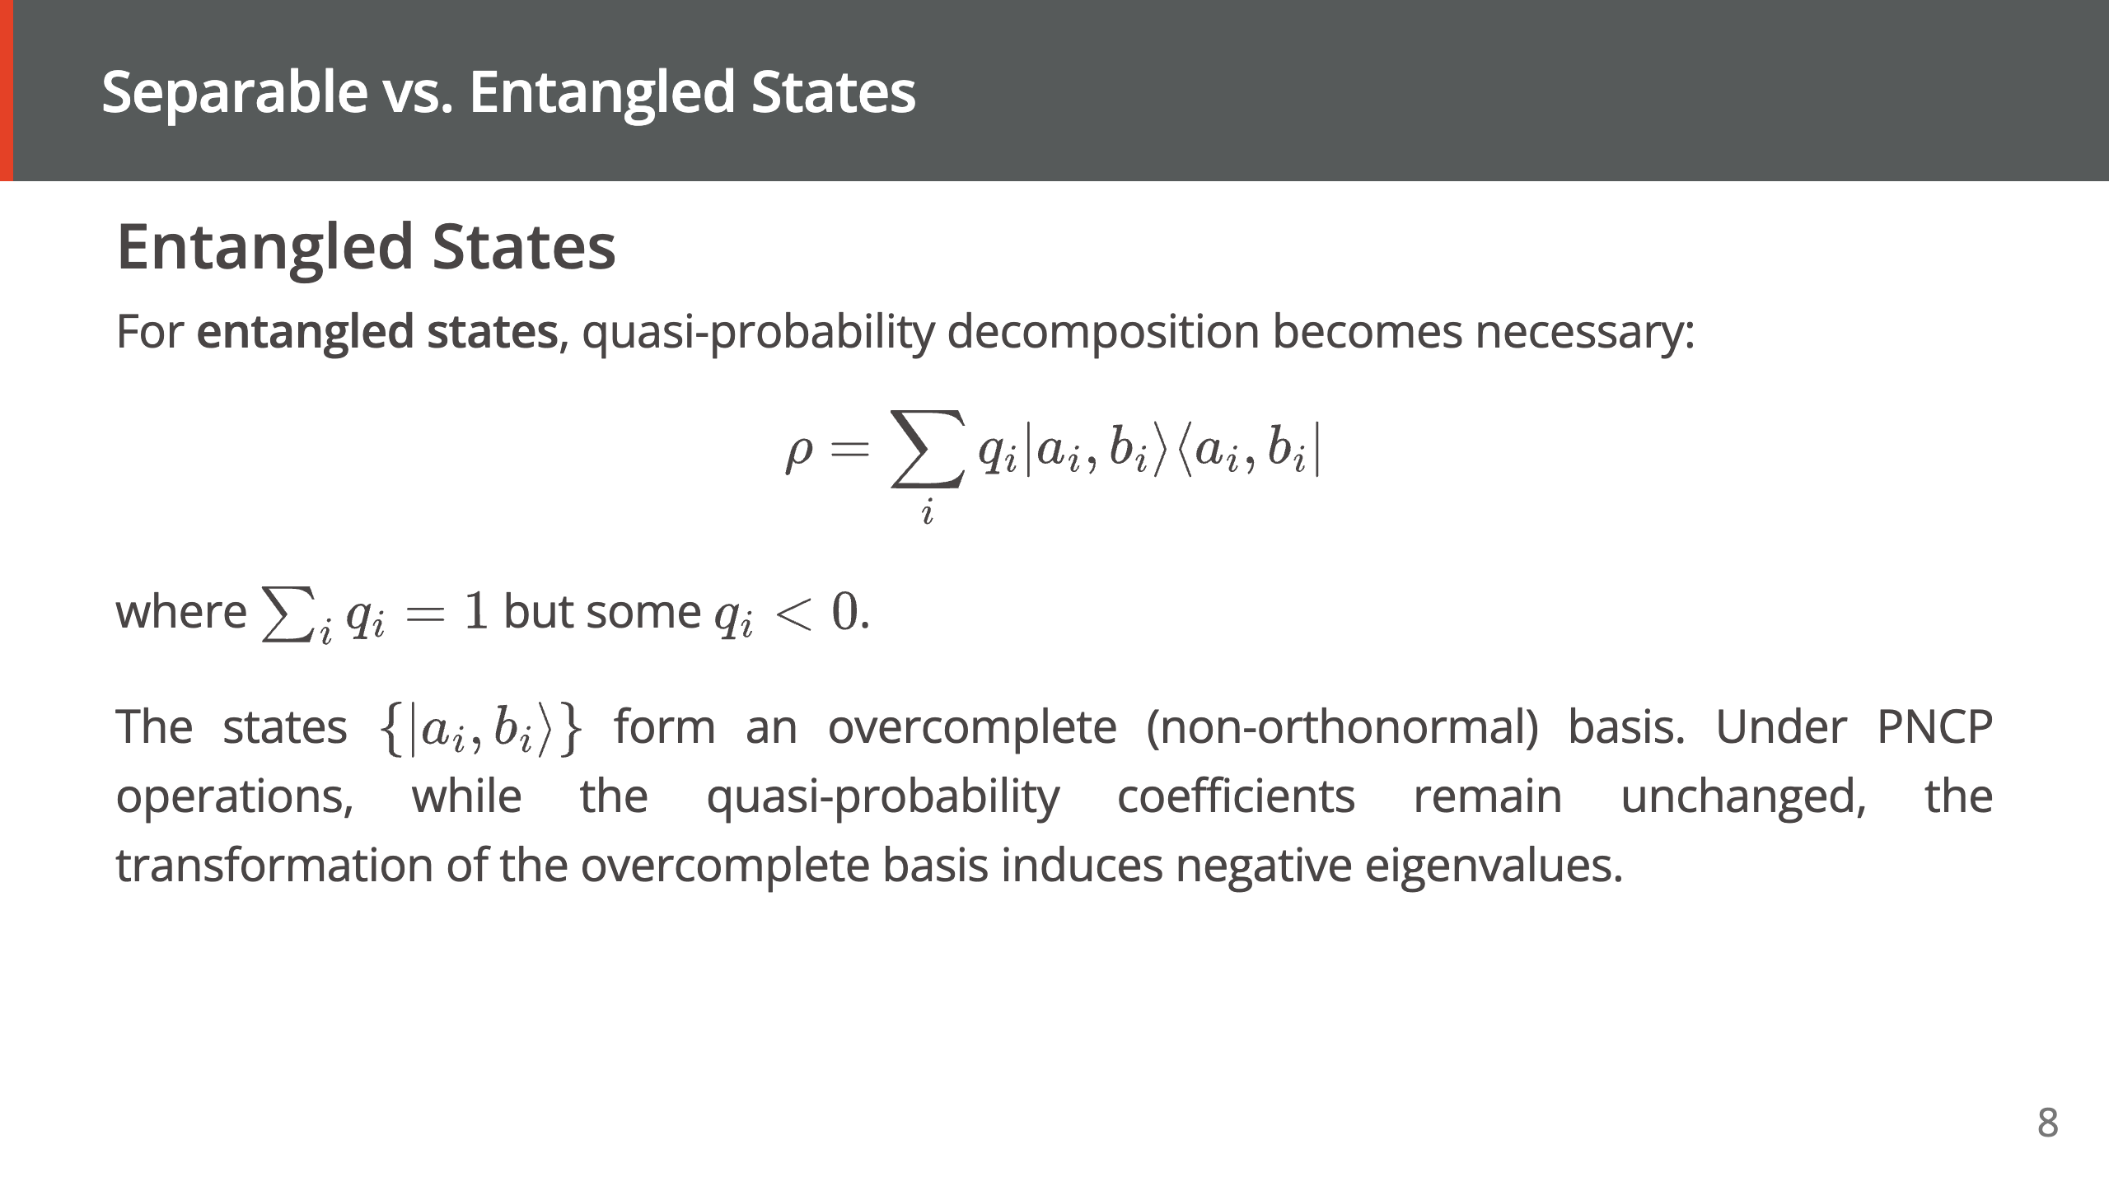

Slide 9
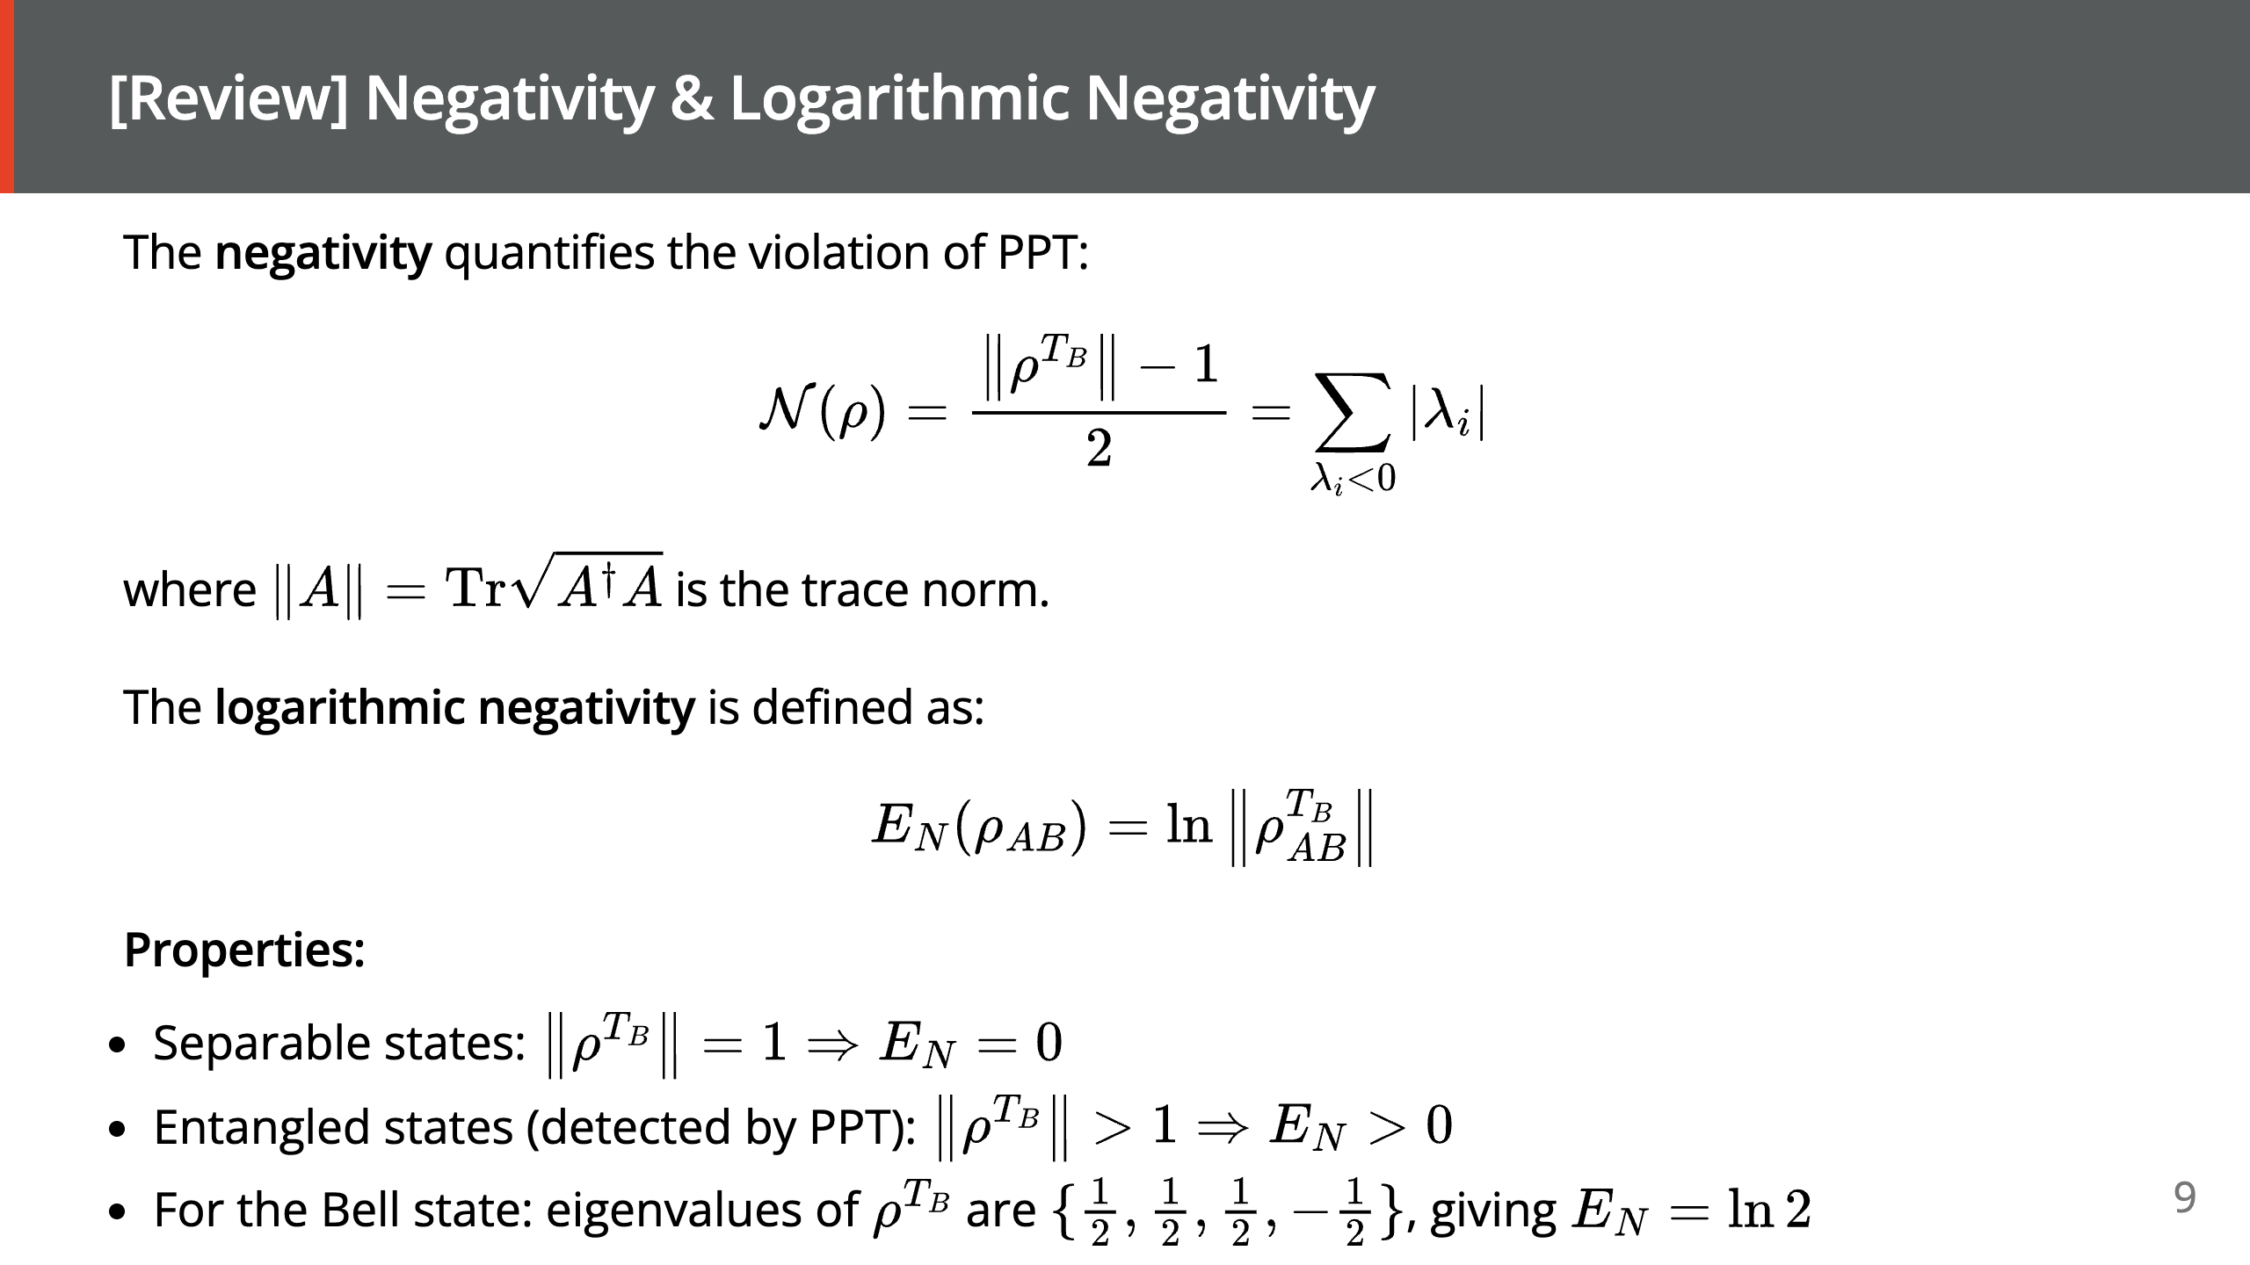

Slide 10
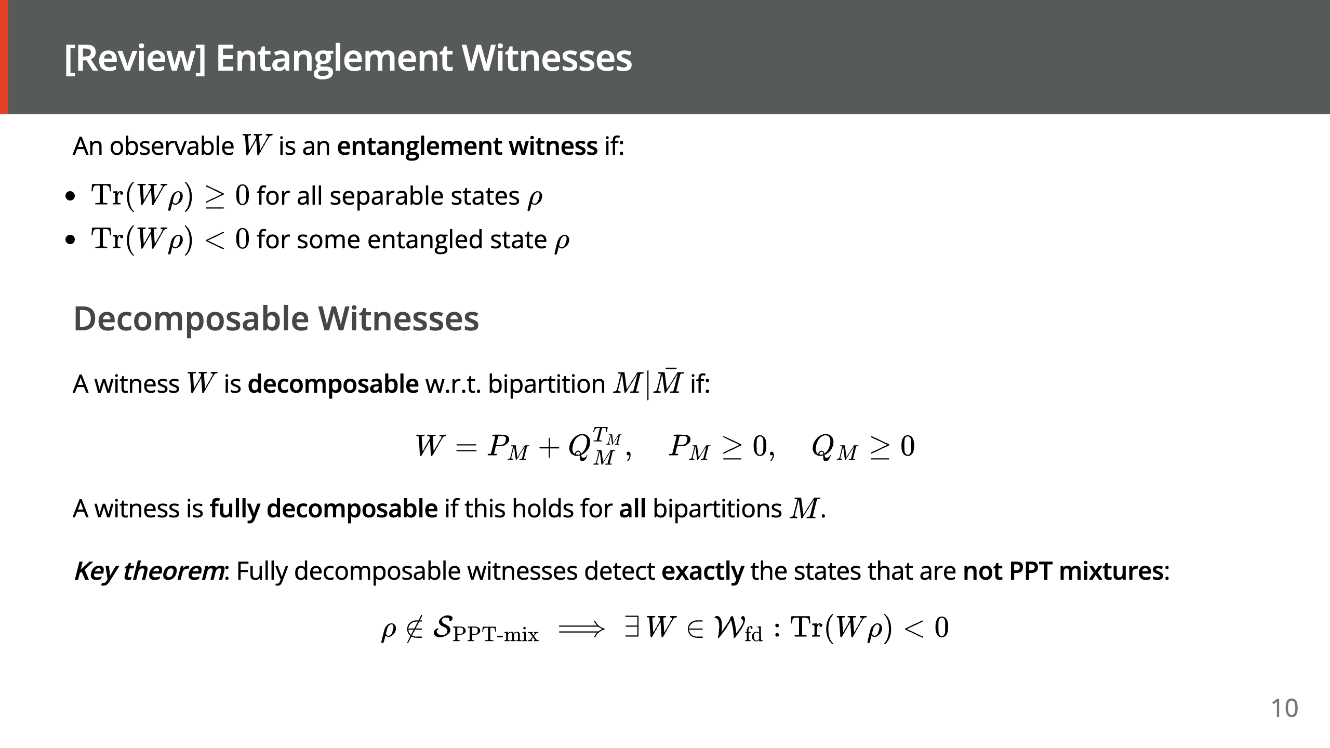

Slide 11
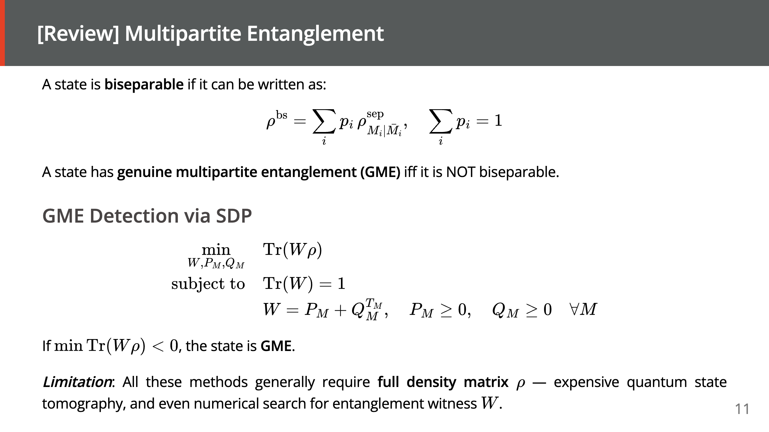

Slide 12
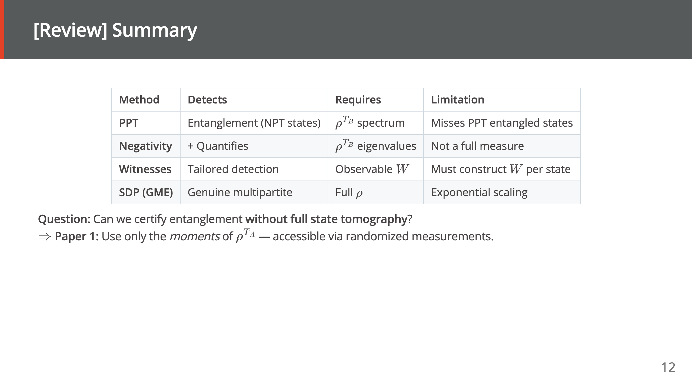
Notes:
================================================================================ FIGURE 1 — STATE-SPACE HIERARCHY DIAGRAM ================================================================================ CONTEXT FOR IMAGE GENERATOR: In quantum information, the set of all bipartite density matrices ρ on H_A ⊗ H_B has a nested structure. The innermost set is "separable states" (ρ = Σ p_i ρ^A_i ⊗ ρ^B_i). Containing it is the set of "PPT states" (states whose partial transpose ρ^{T_B} is positive semidefinite). Surrounding that is the set of all density matrices. The region between PPT and all-states is "NPT entangled" (detectable by the partial transpose). The region between separable and PPT is "bound entangled" / "PPT entangled" (NOT detectable by PPT — requires witnesses). Different entanglement-detection techniques cover different regions. This is one of the most iconic diagrams in the field. WHAT TO DRAW: - Three nested rounded rectangles (or ellipses) — NOT a Venn diagram, but strict containment (one fully inside the other). - Outermost rectangle: light gray fill. Label inside near its top edge: "All density matrices ρ ∈ D(H_A ⊗ H_B)". - Middle rectangle: light blue fill. Label near top: "PPT states (ρ^{T_B} ≥ 0)". - Innermost rectangle: light green fill. Label inside center: "Separable states ρ = Σ p_i ρ^A_i ⊗ ρ^B_i". - In the gray "NPT entangled" annulus between outer and middle: italic label "NPT entangled — detected by PPT, negativity, p_n-PPT, p_n-OPPT". - In the blue "bound entangled" annulus between middle and inner: italic label "PPT-entangled (bound) — requires entanglement witnesses". - Four arrows drawn from OUTSIDE the outer rectangle pointing at the regions they detect, each with a small text label at its base: (1) "PPT / Negativity" → NPT annulus (2) "p_n-OPPT (Paper 1)" → NPT annulus (draw to a different spot) (3) "Witnesses" → a cut plane slicing across the separable boundary (draw as a straight dashed line tangent to the inner rectangle) (4) "SDP hierarchy" → bound-entangled annulus STYLE: - Flat academic diagram, sans-serif, pastel fills, thin black borders. - No 3D, no shading, no gradients. Clean and publication-ready. - Approximate aspect ratio 4:3. Text legible at 14pt minimum. ================================================================================

Slide 13


Slide 14
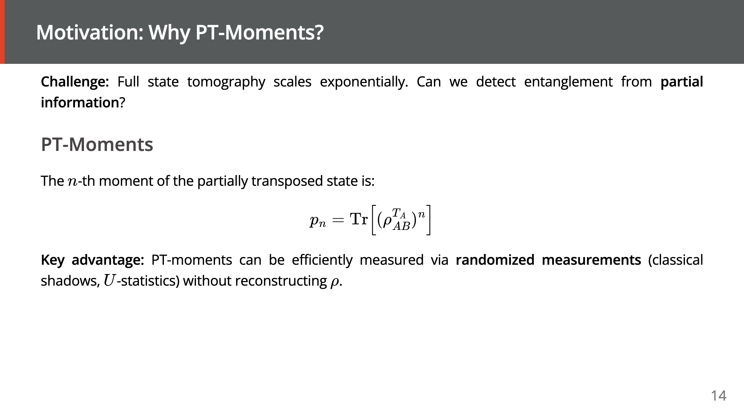

Slide 15
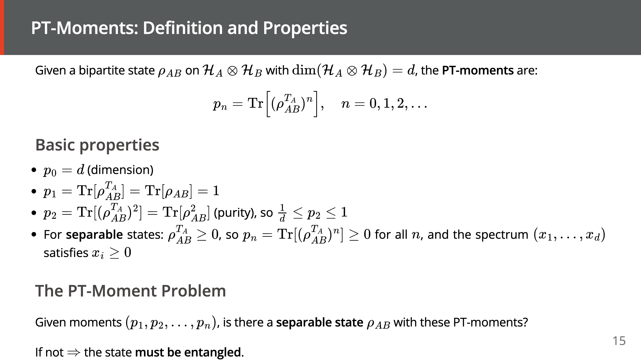

Slide 16
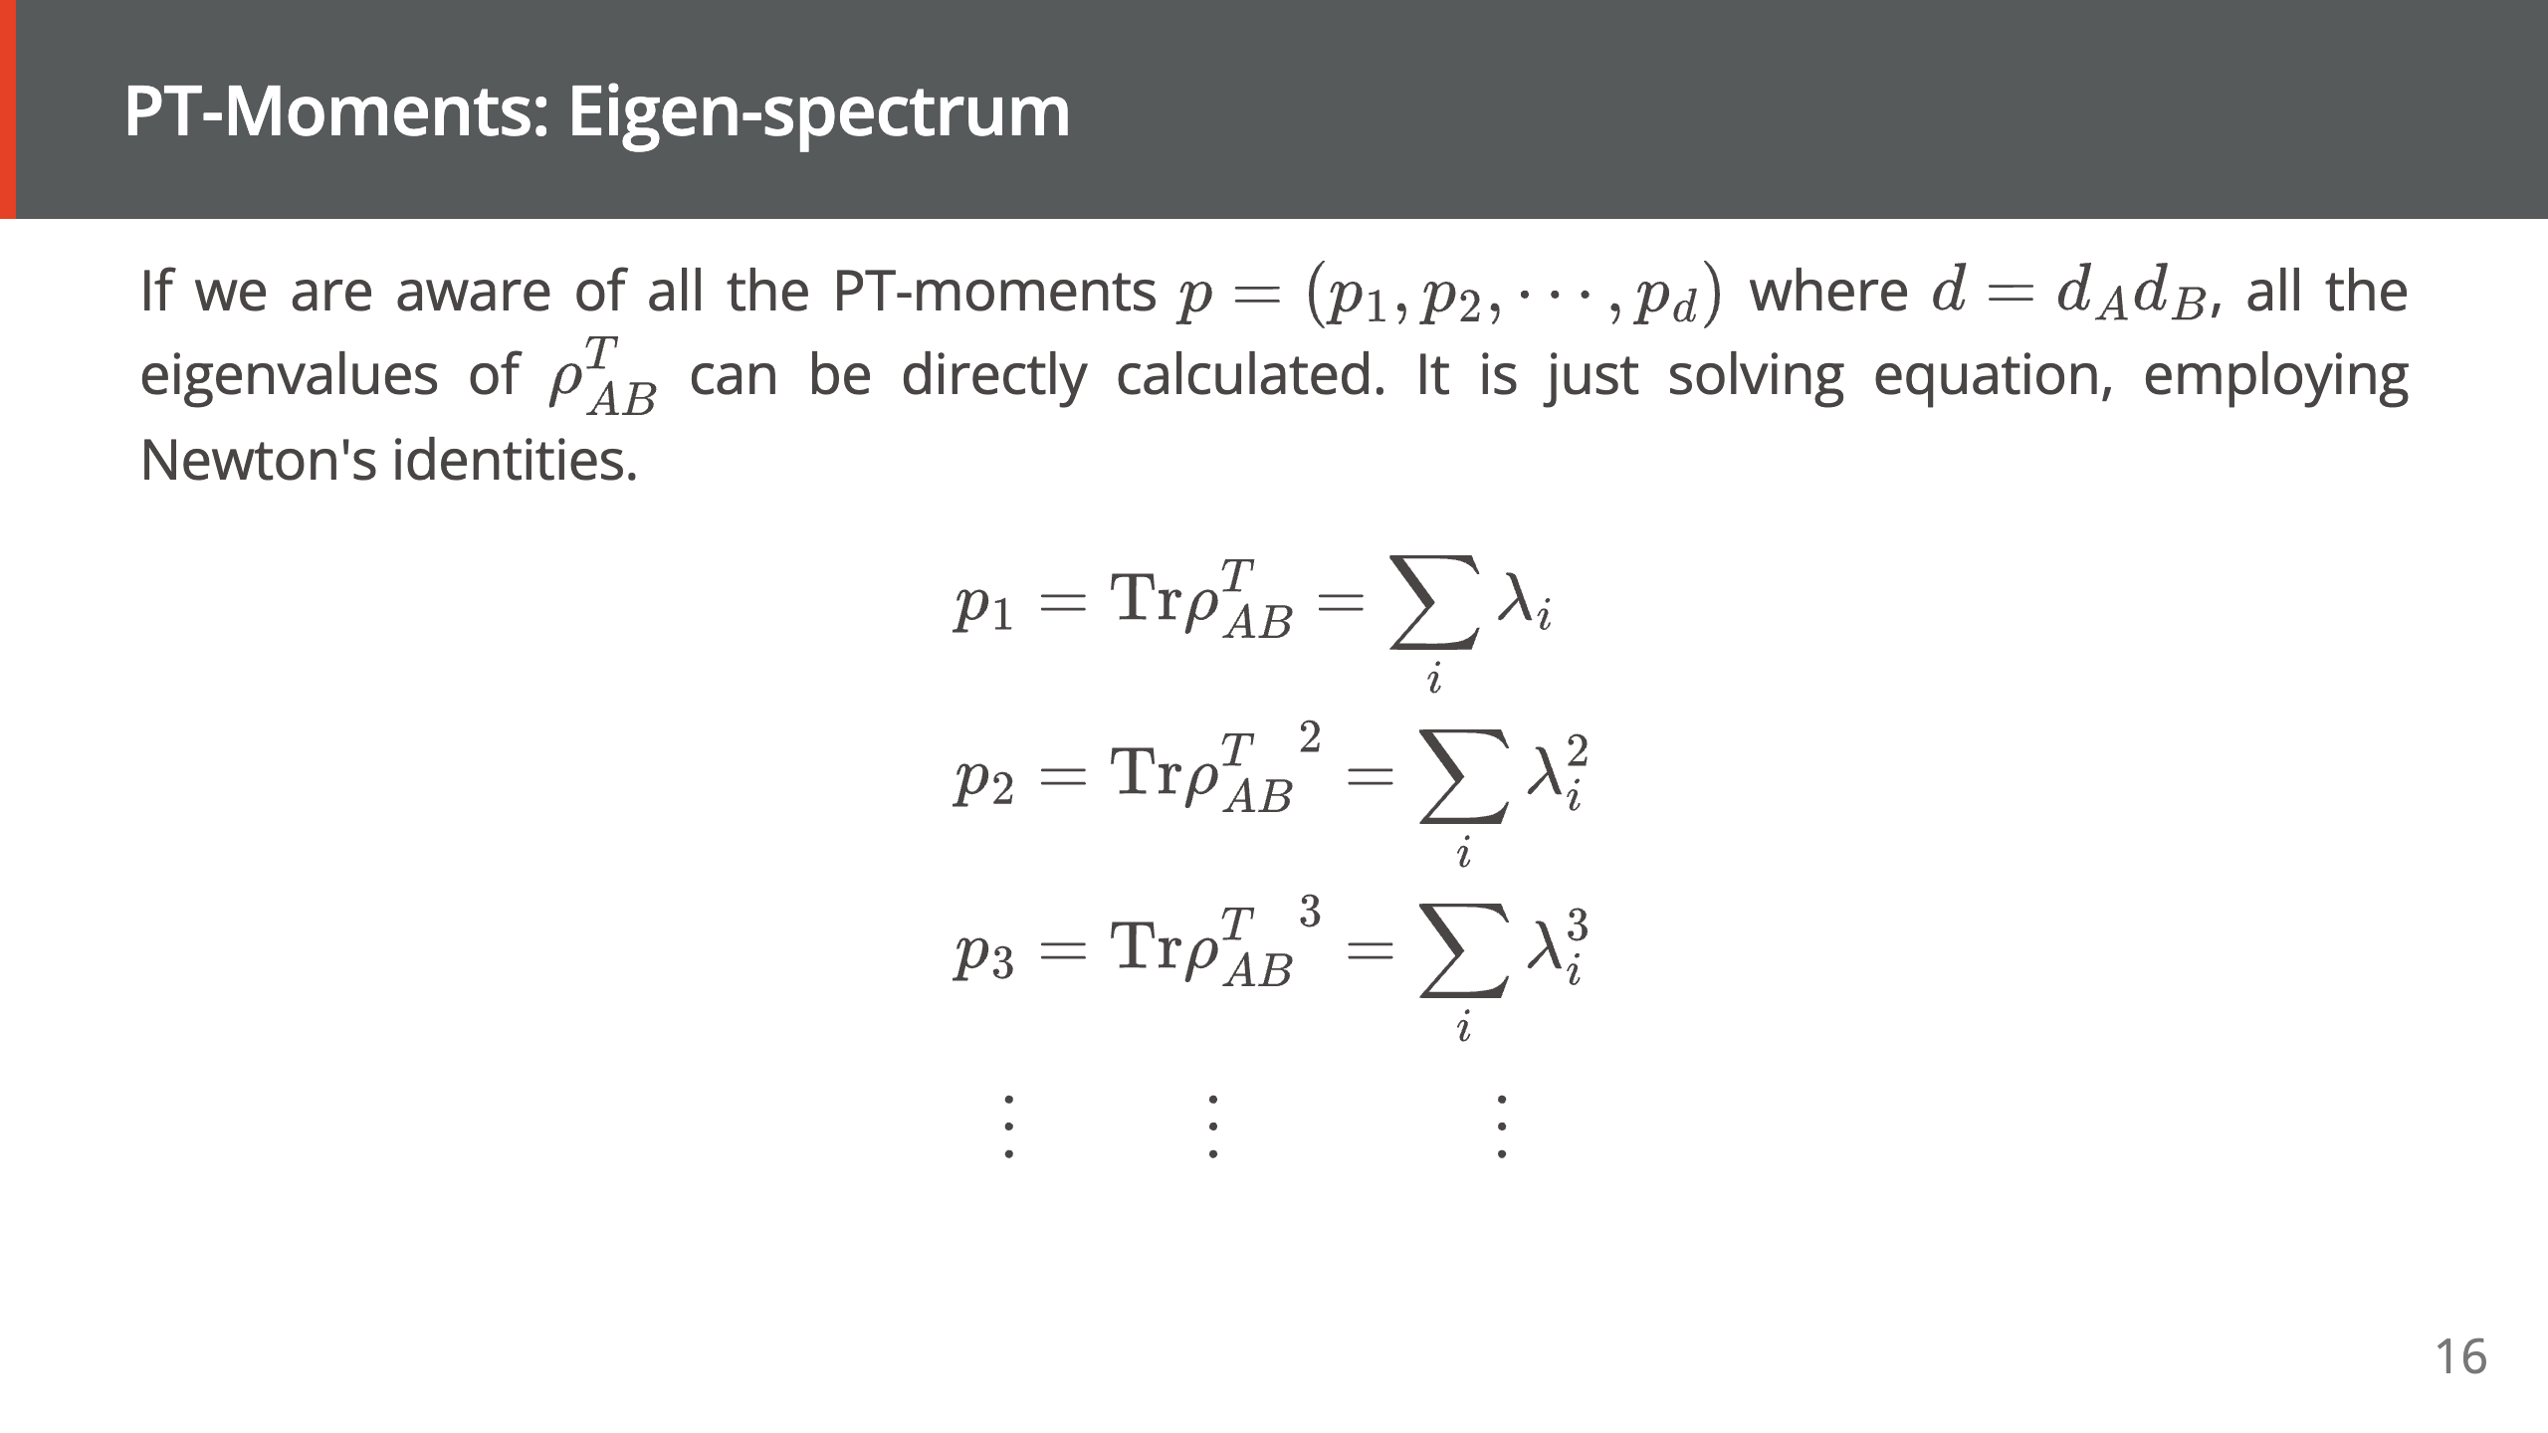

Slide 17
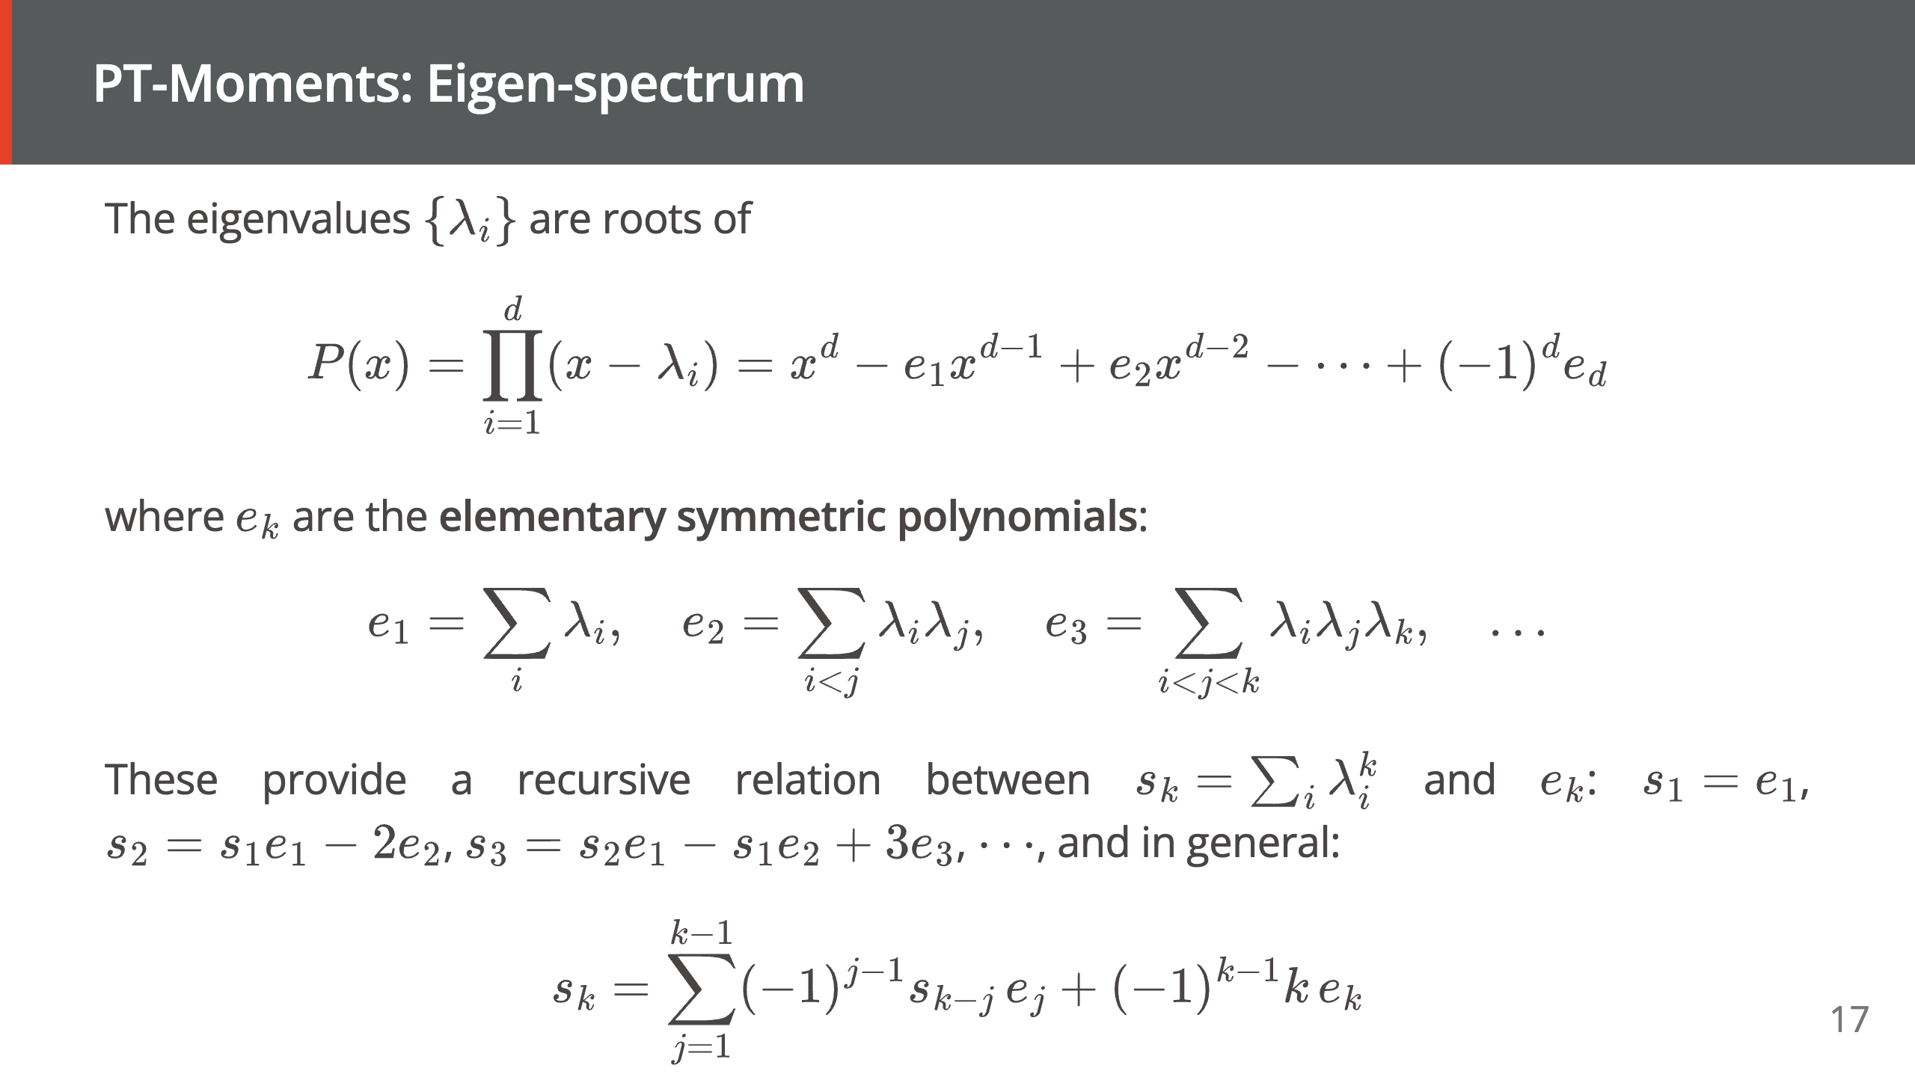

Slide 18
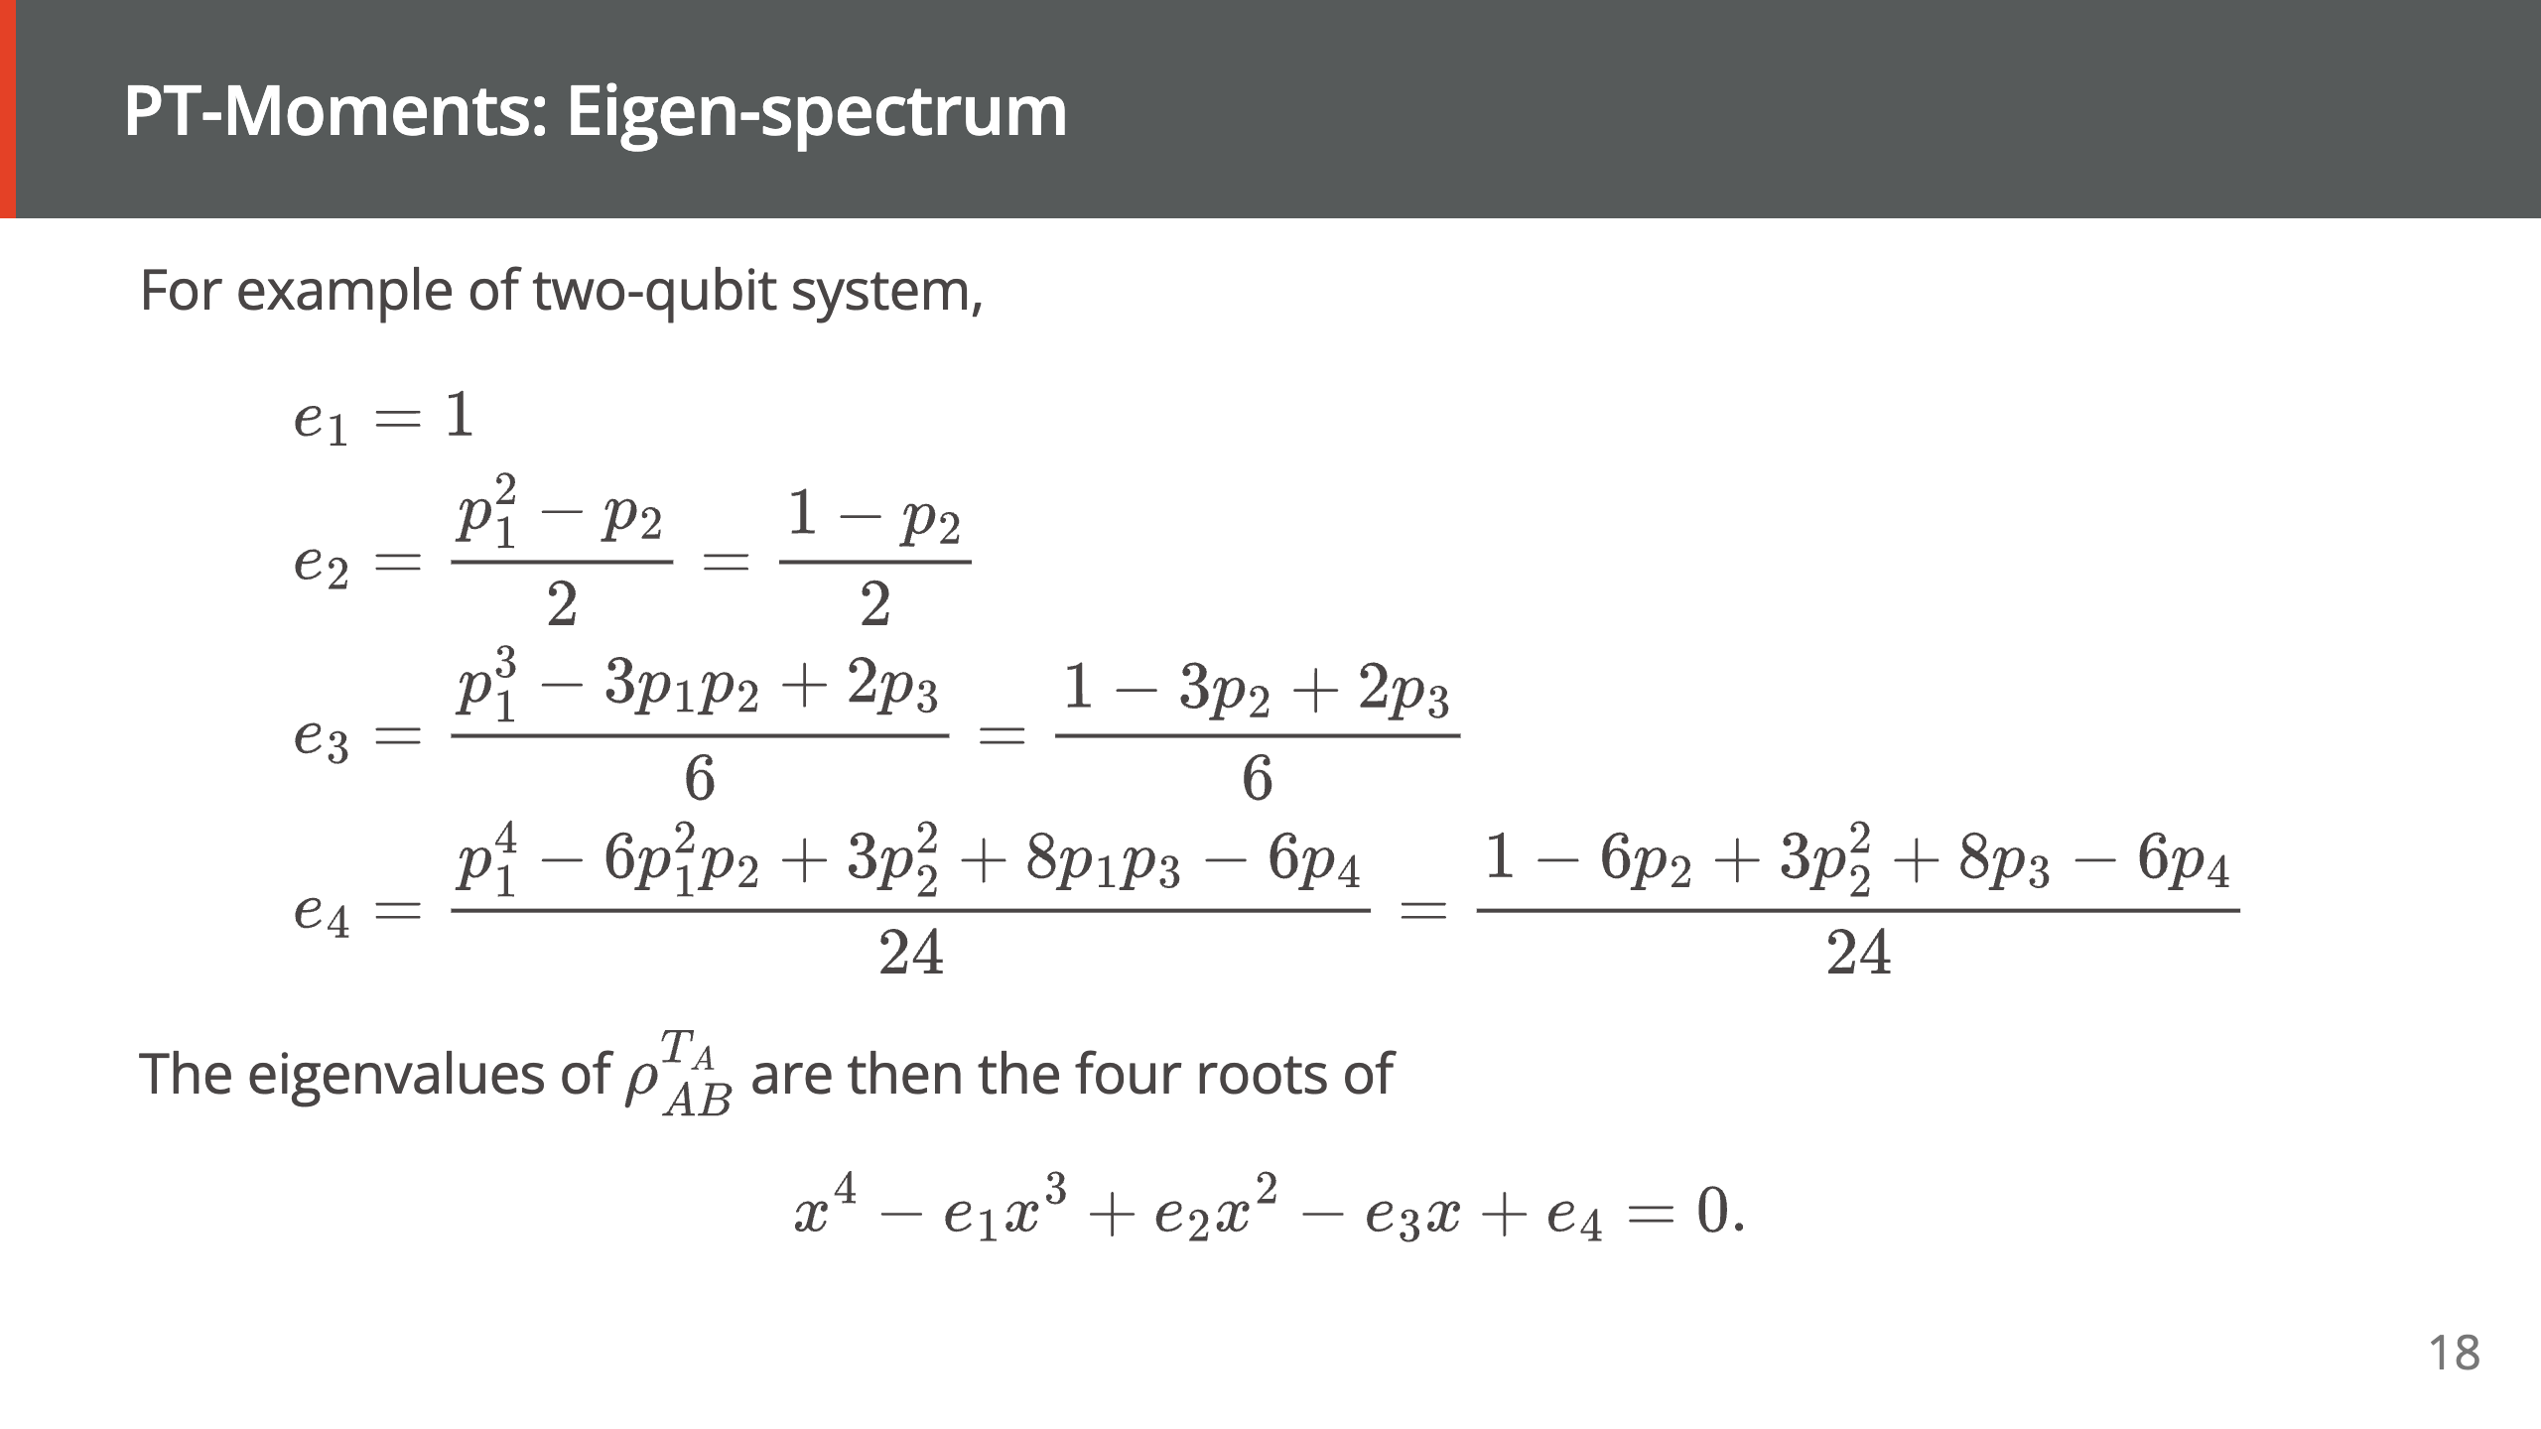

Slide 19
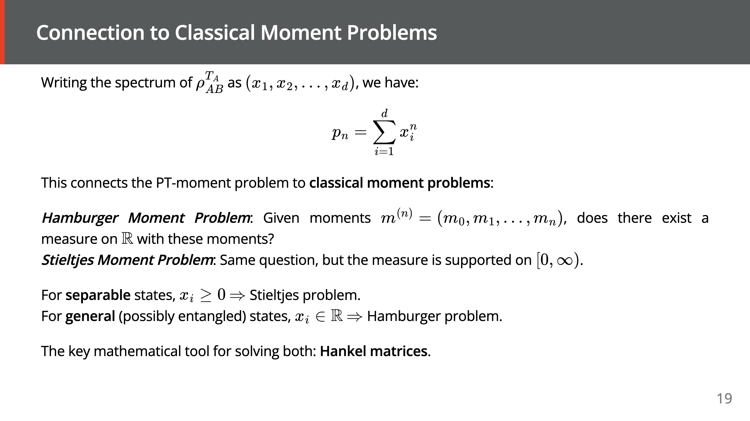

Slide 20
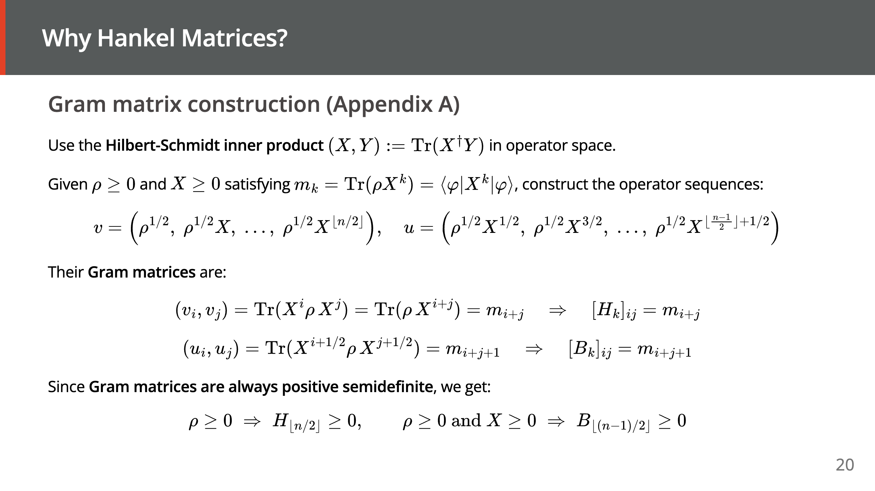

Slide 21
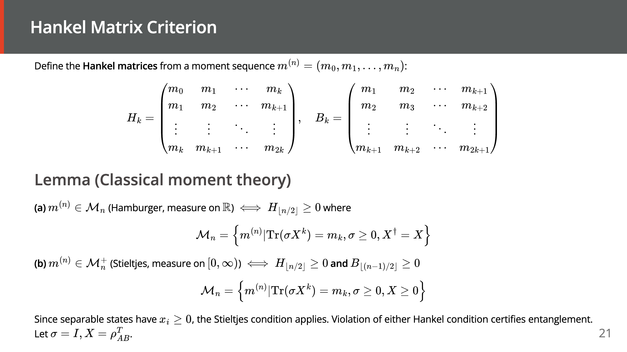
Notes:
================================================================================ FIGURE 2 — HANKEL MATRIX ANATOMY ================================================================================ CONTEXT FOR IMAGE GENERATOR: A Hankel matrix is a square matrix whose anti-diagonals are constant — that is, the (i, j) entry depends only on the SUM i+j. When the entries are the moments p_0, p_1, p_2, ... of a probability measure on the real line (in our case, the moments of the partial transpose), the positive semidefiniteness (PSD) of this matrix characterizes whether the sequence could have come from a legitimate probability distribution. A separable quantum state always produces a PSD Hankel matrix; if the Hankel matrix is NOT PSD, then the state must be entangled. This diagram should make the "anti-diagonal structure" visually obvious — that is the entire point of calling it a Hankel matrix. WHAT TO DRAW: - A 4×4 square matrix drawn as a grid with thin black borders. - Entries from top-left, reading row by row: Row 0: p_0 p_1 p_2 p_3 Row 1: p_1 p_2 p_3 p_4 Row 2: p_2 p_3 p_4 p_5 Row 3: p_3 p_4 p_5 p_6 - CRUCIAL: color each anti-diagonal (cells sharing the same i+j) with the SAME soft pastel color. There are 7 anti-diagonals (i+j = 0 through 6). Use 7 distinct pastel hues — e.g., pale yellow (i+j=0), peach, pink, lavender, mint, sky blue, pale teal (i+j=6). The visual repetition is the pedagogical point. - Draw a curved arrow outside the matrix pointing to one anti-diagonal (say, the one filled with p_2 entries in positions (0,2),(1,1),(2,0)) with a label: "Anti-diagonal: constant entry p_{i+j}". - Below the matrix, centered, write in italic: "H ≥ 0 ⟺ moments come from a valid measure on ℝ" - To the right of the matrix, a callout box: "Violation of H ≥ 0 ⟹ state is entangled" - Top-left corner: small label "H_3 (order-3 Hankel matrix)" STYLE: - Clean academic schematic. Matrix cells roughly 60×60 px. Entry text in serif math font (LaTeX-like), at least 18pt. Annotations in italic sans-serif. No 3D, no shadows, no gradients on cells — just flat fills. - Approximate canvas 4:3 aspect ratio. ================================================================================

Slide 22
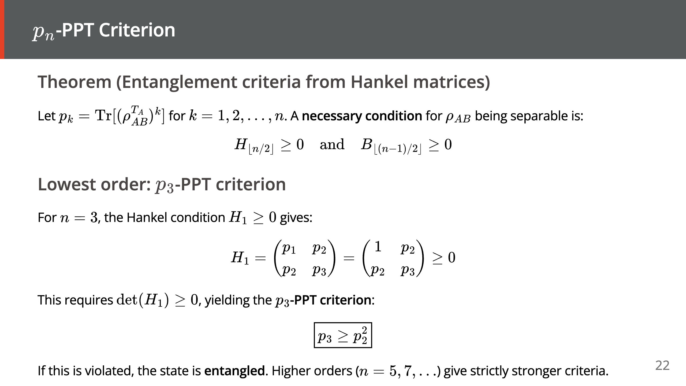

Slide 23
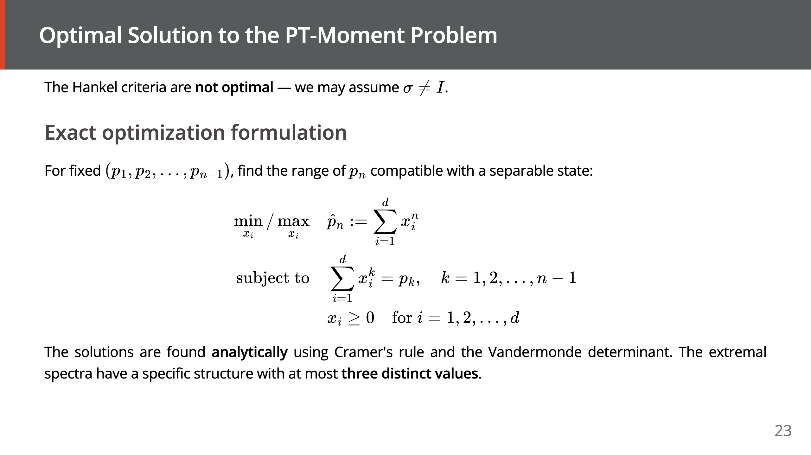

Slide 24
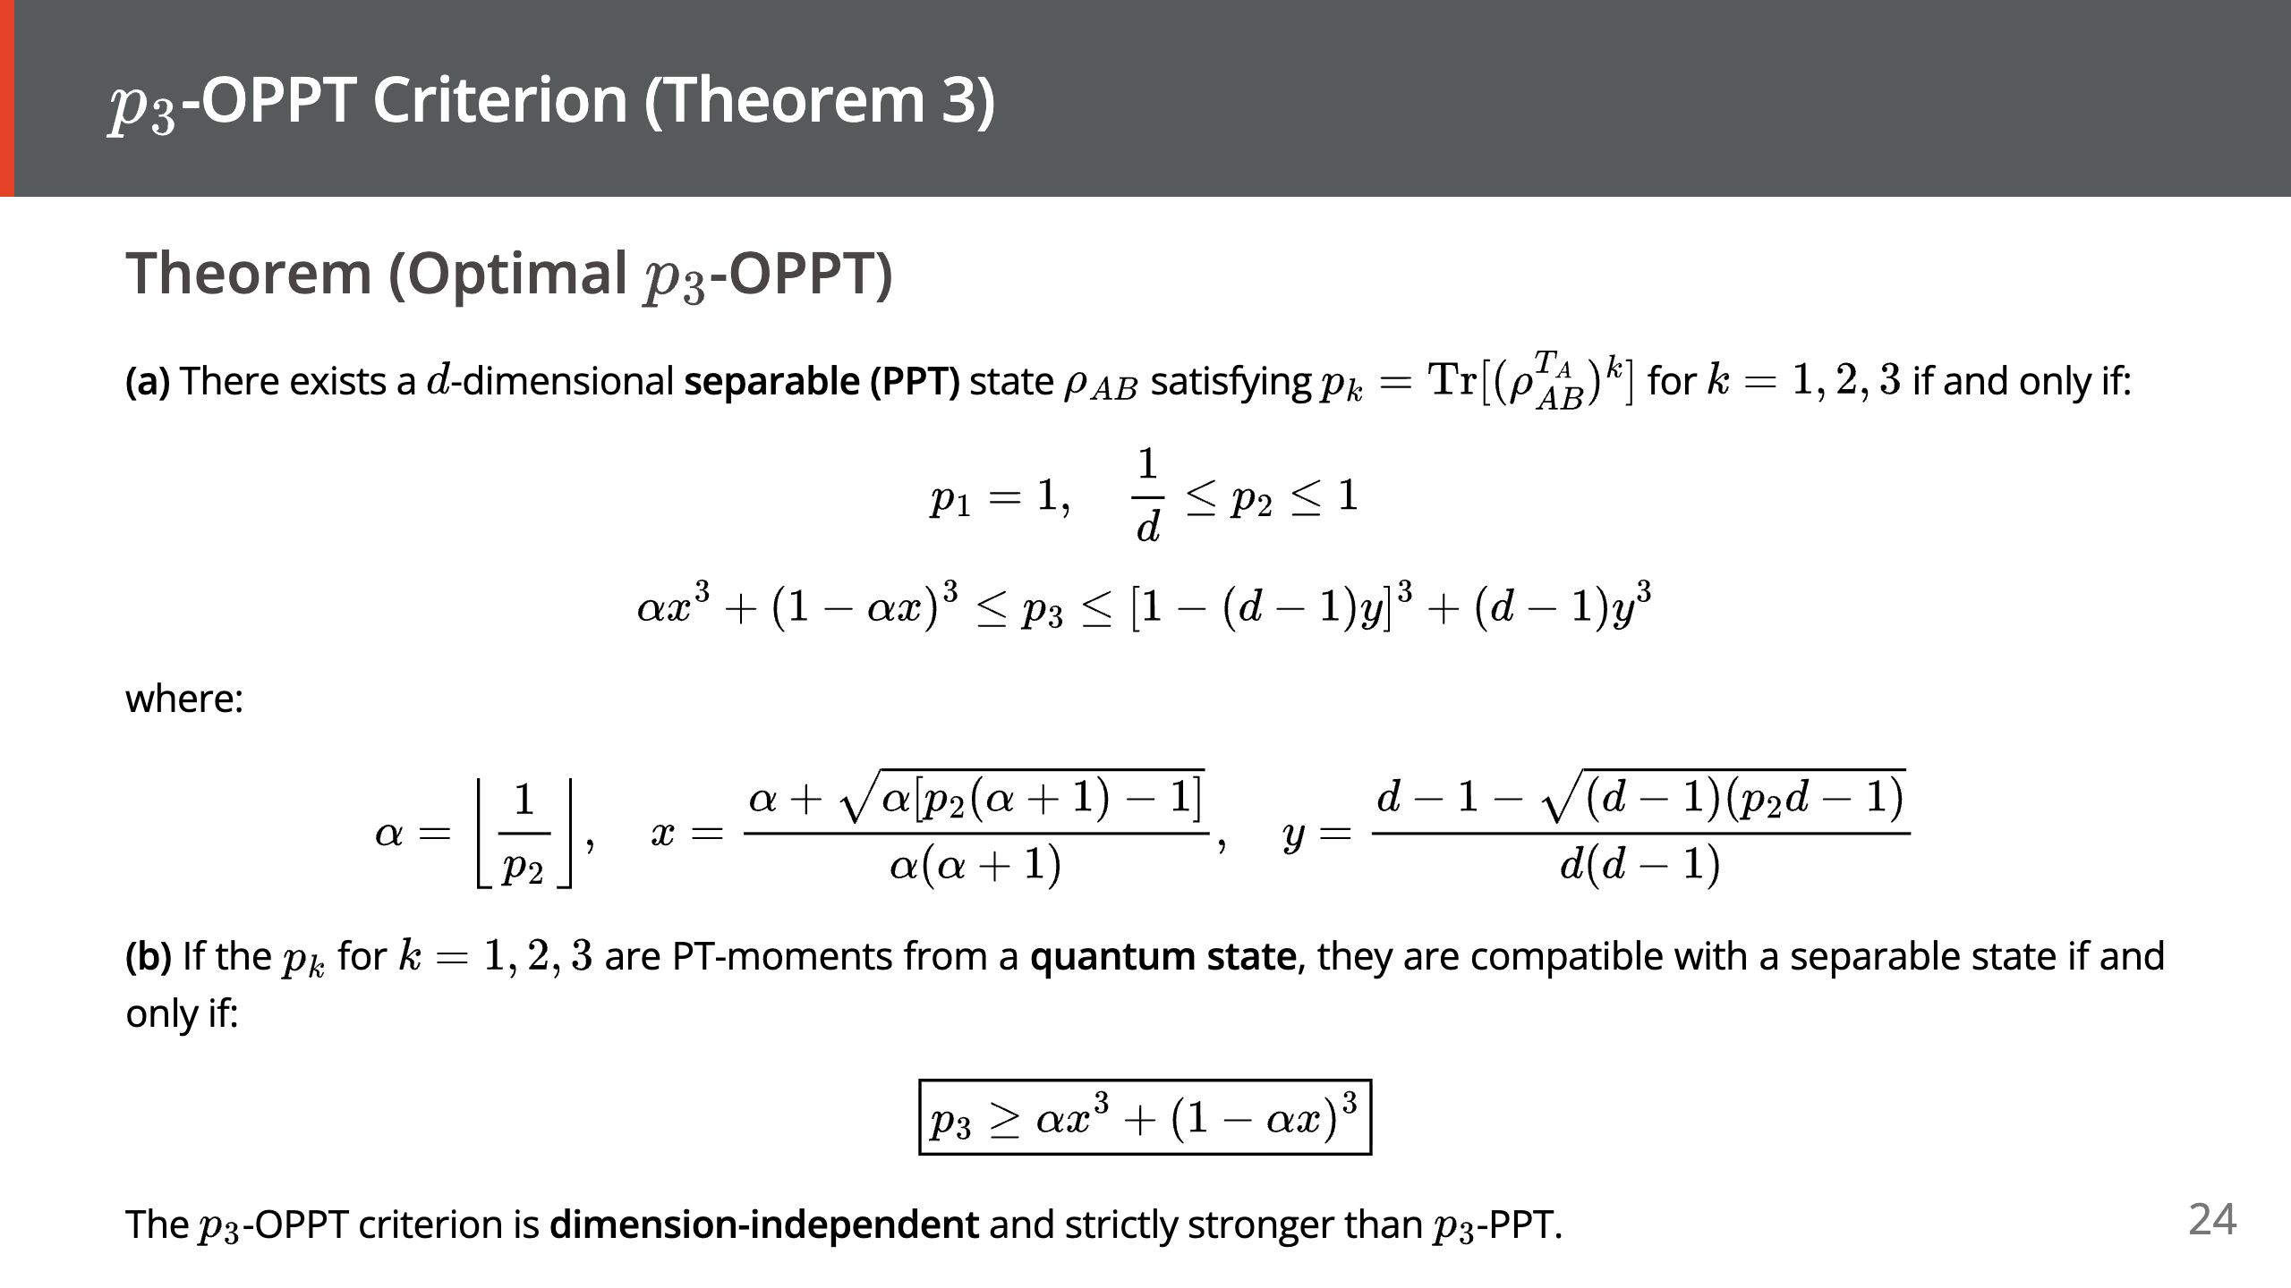
Notes:
--- # Theorem 3(b): Quantum Refinement <style scoped> p, li { font-size: 18pt; color: #000000; } </style> ### Why is the lower bound sufficient? For PT-moments from a quantum state, we always have: - $p_1 = \text{Tr}[\rho_{AB}^{T_A}] = 1$ - $p_2 = \text{Tr}[\rho_{AB}^2]$ (purity), satisfying $1/d \leq p_2 \leq 1$ The **upper bound** on $p_3$ is automatically satisfied by any (separable or entangled) state. Thus only the **lower bound** matters for entanglement detection: $$ p_3 \geq \alpha x^3 + (1 - \alpha x)^3 $$ ### Remarks - When $\alpha = 1$ (i.e., $p_2 \geq 1/2$): criterion reduces to $p_3 \geq p_2^2$, recovering $p_3$-PPT - When $\alpha \geq 2$ (i.e., $p_2 < 1/2$, high-dimensional or mixed states): the optimal criterion is **strictly stronger** - The criterion is **dimension-independent**: the same formula works for any $d$

Slide 25
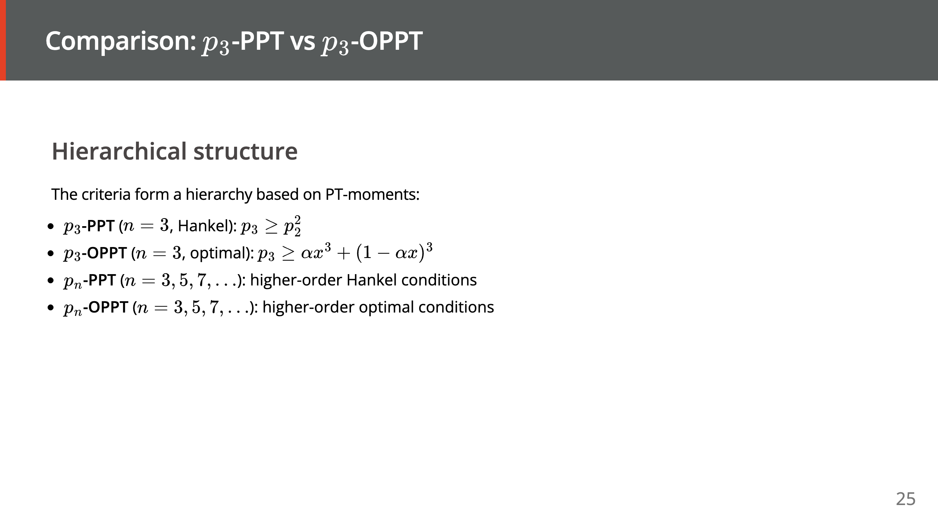

Slide 26
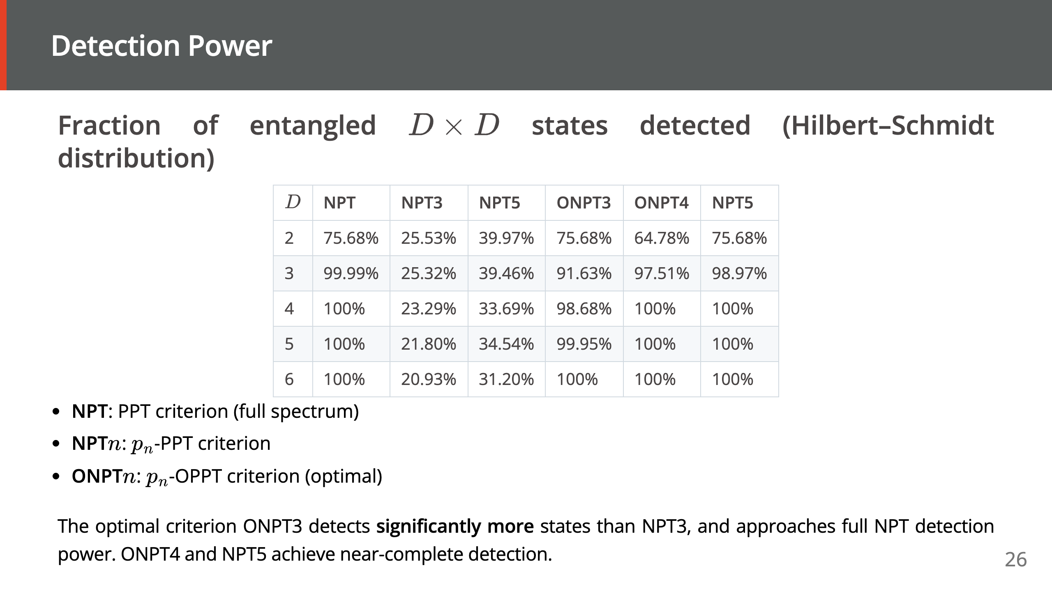

Slide 27
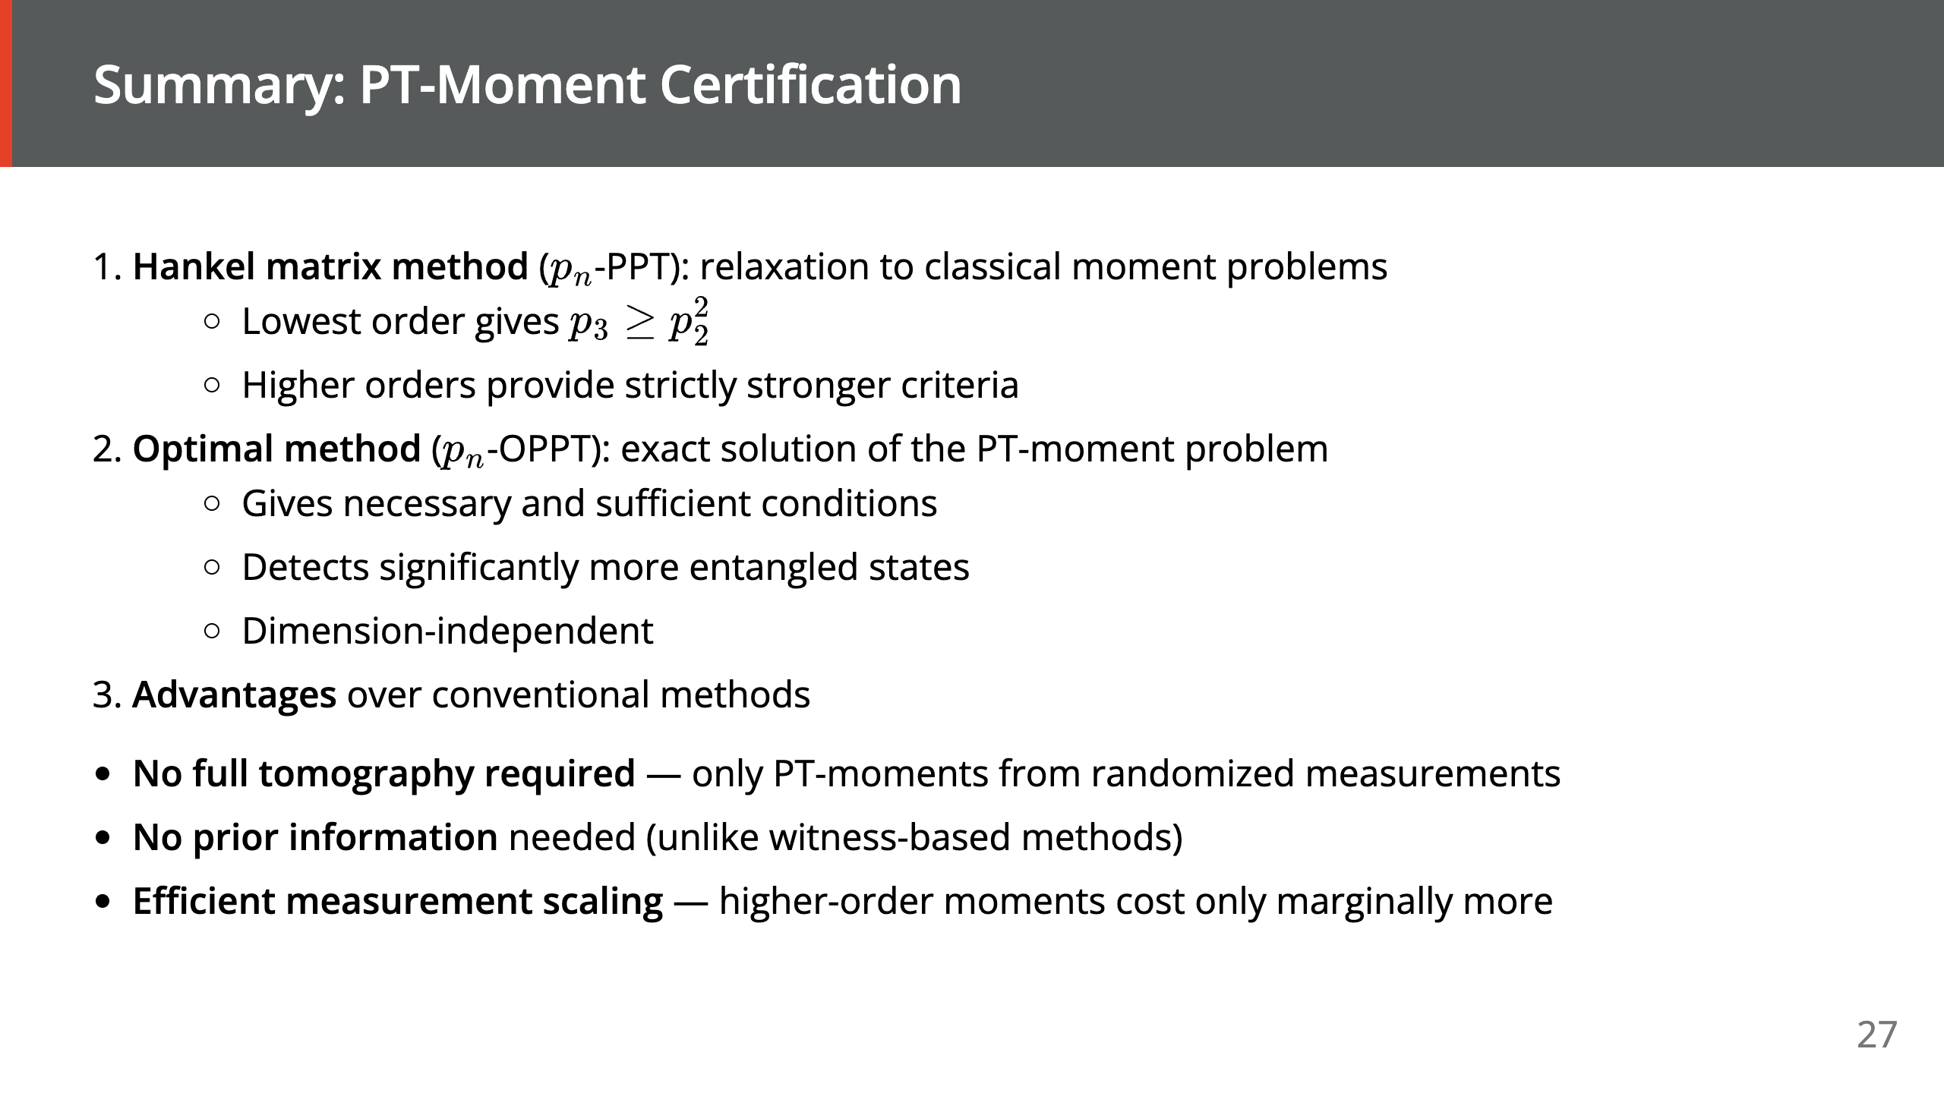

Slide 28


Slide 29
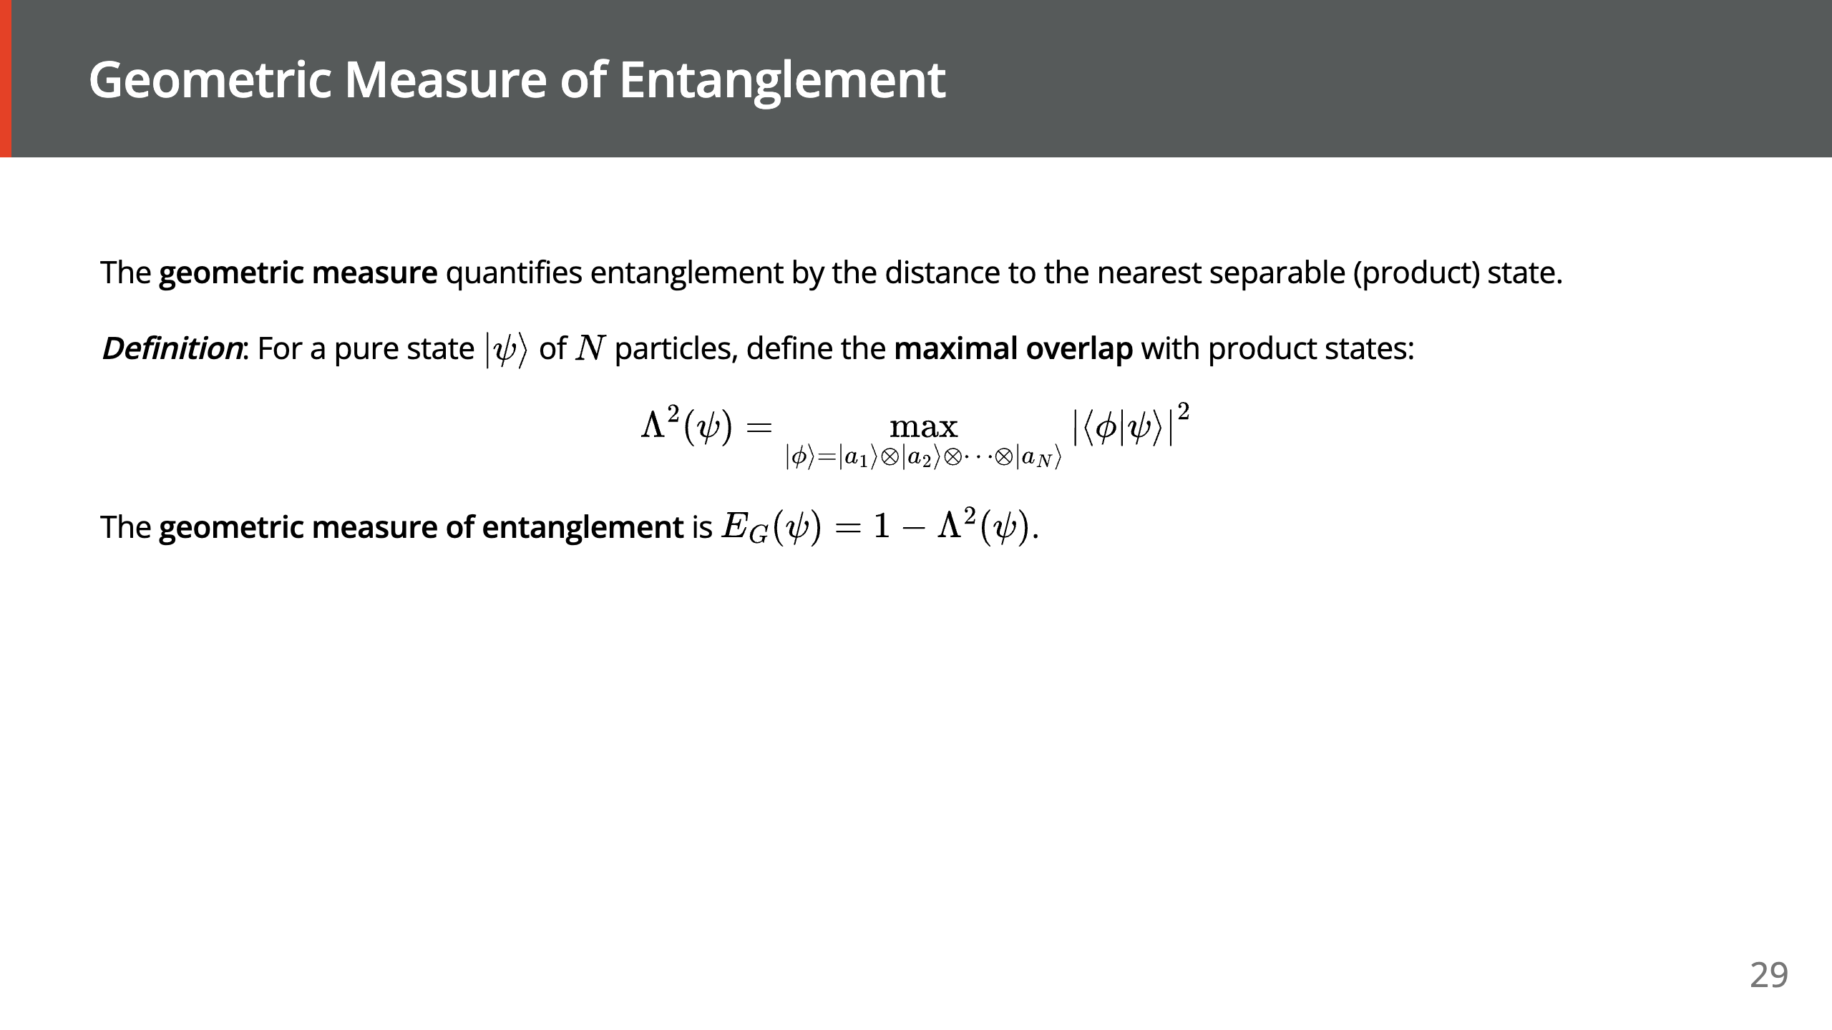

Slide 30
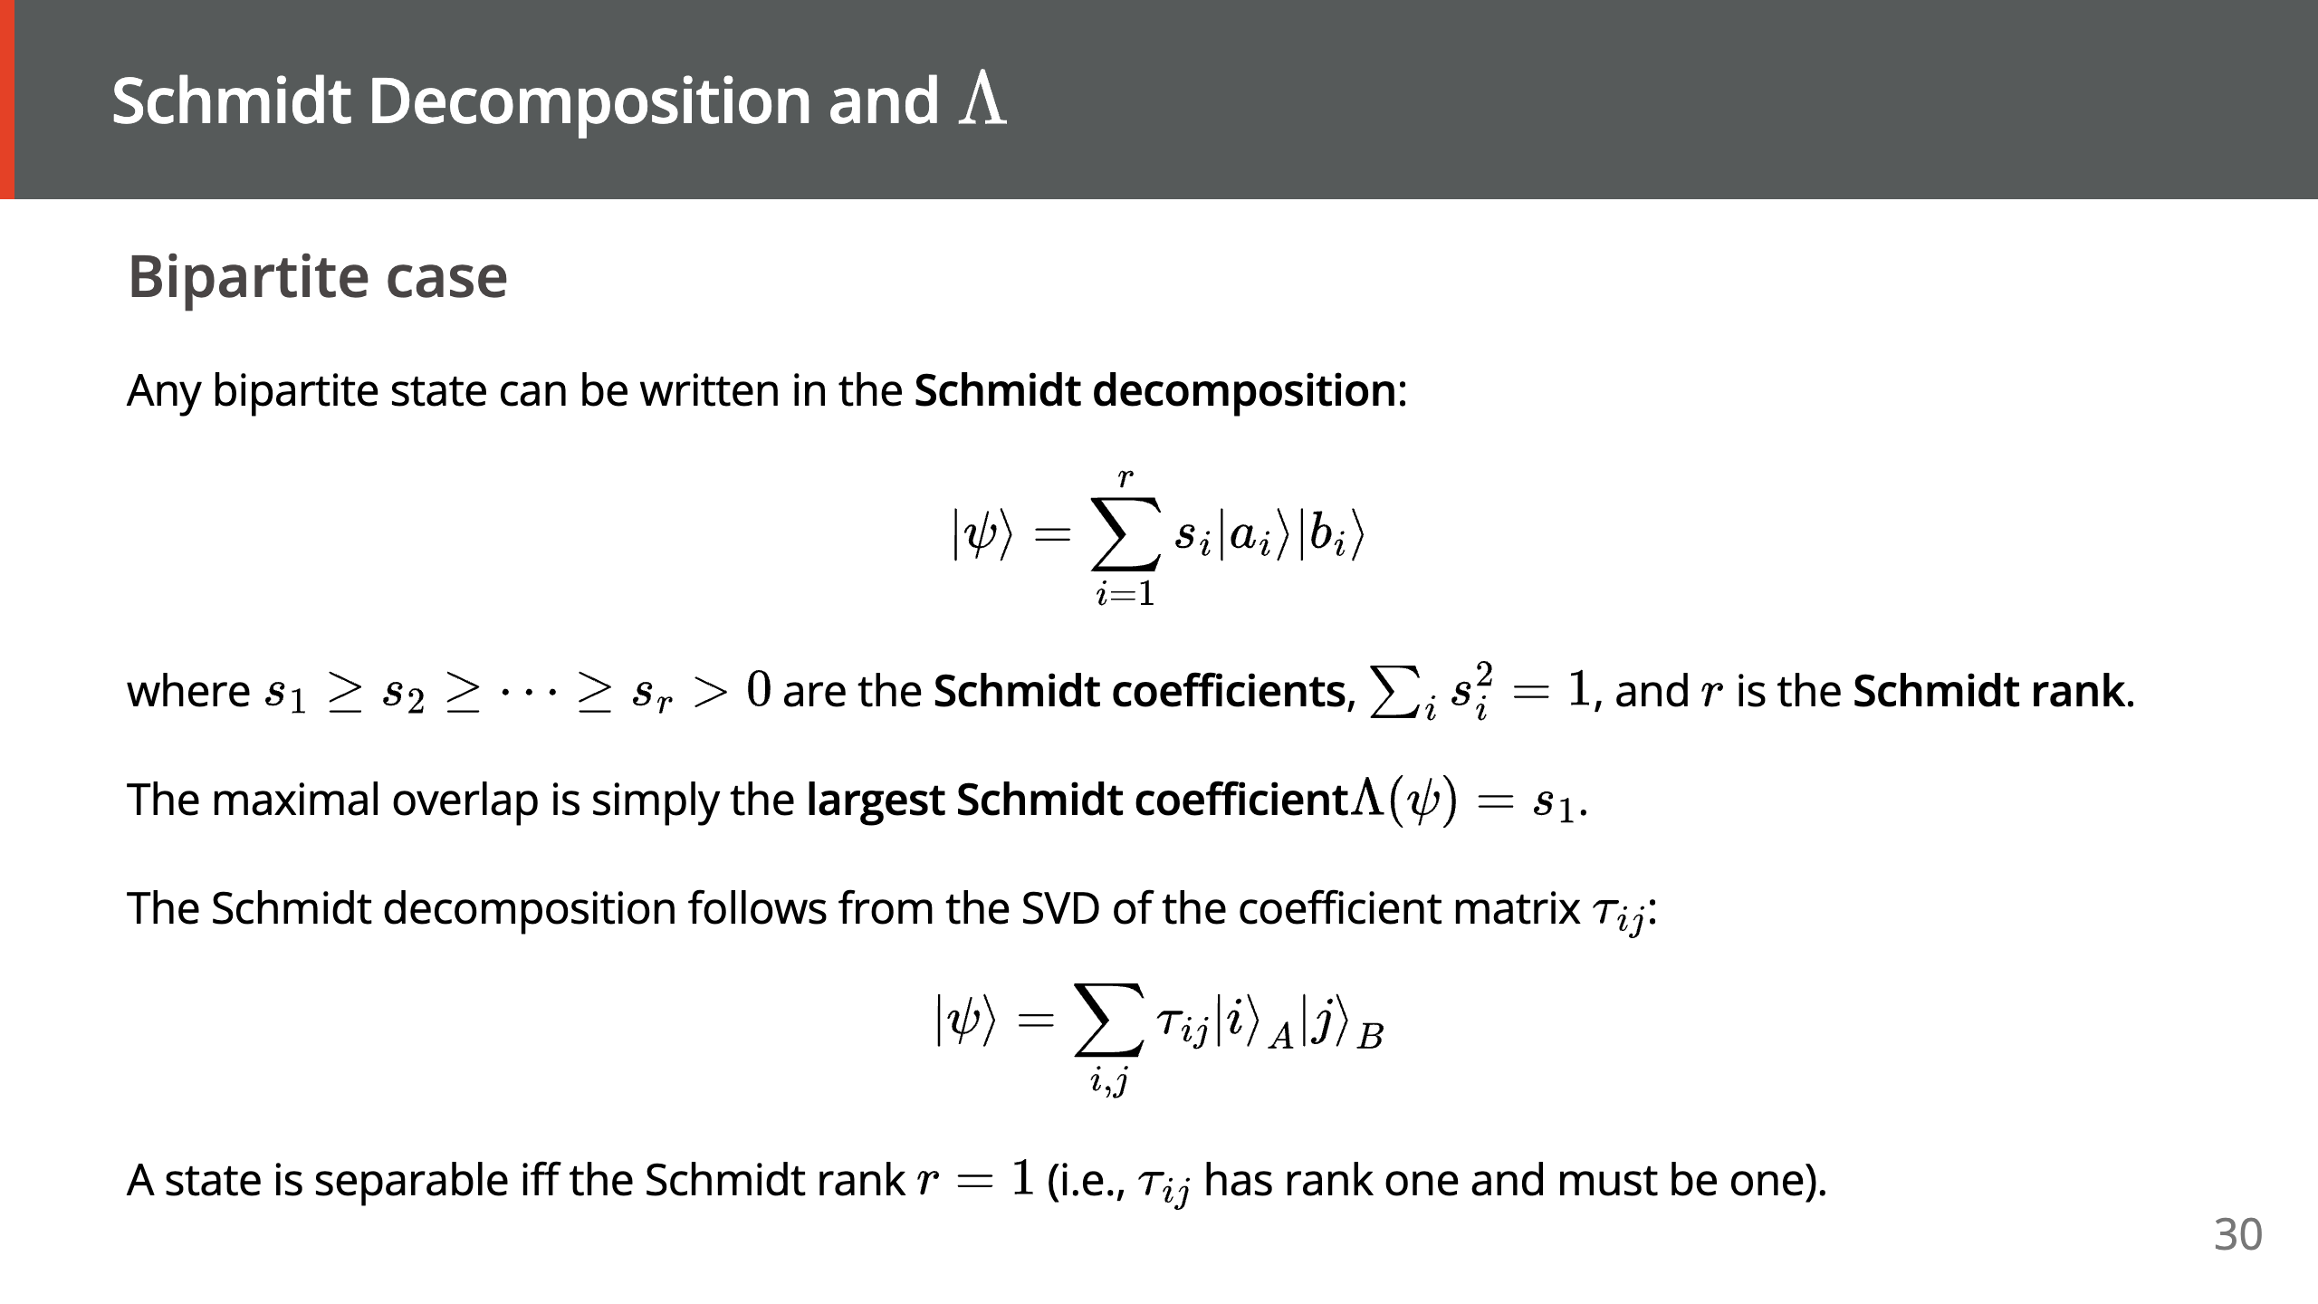

Slide 31
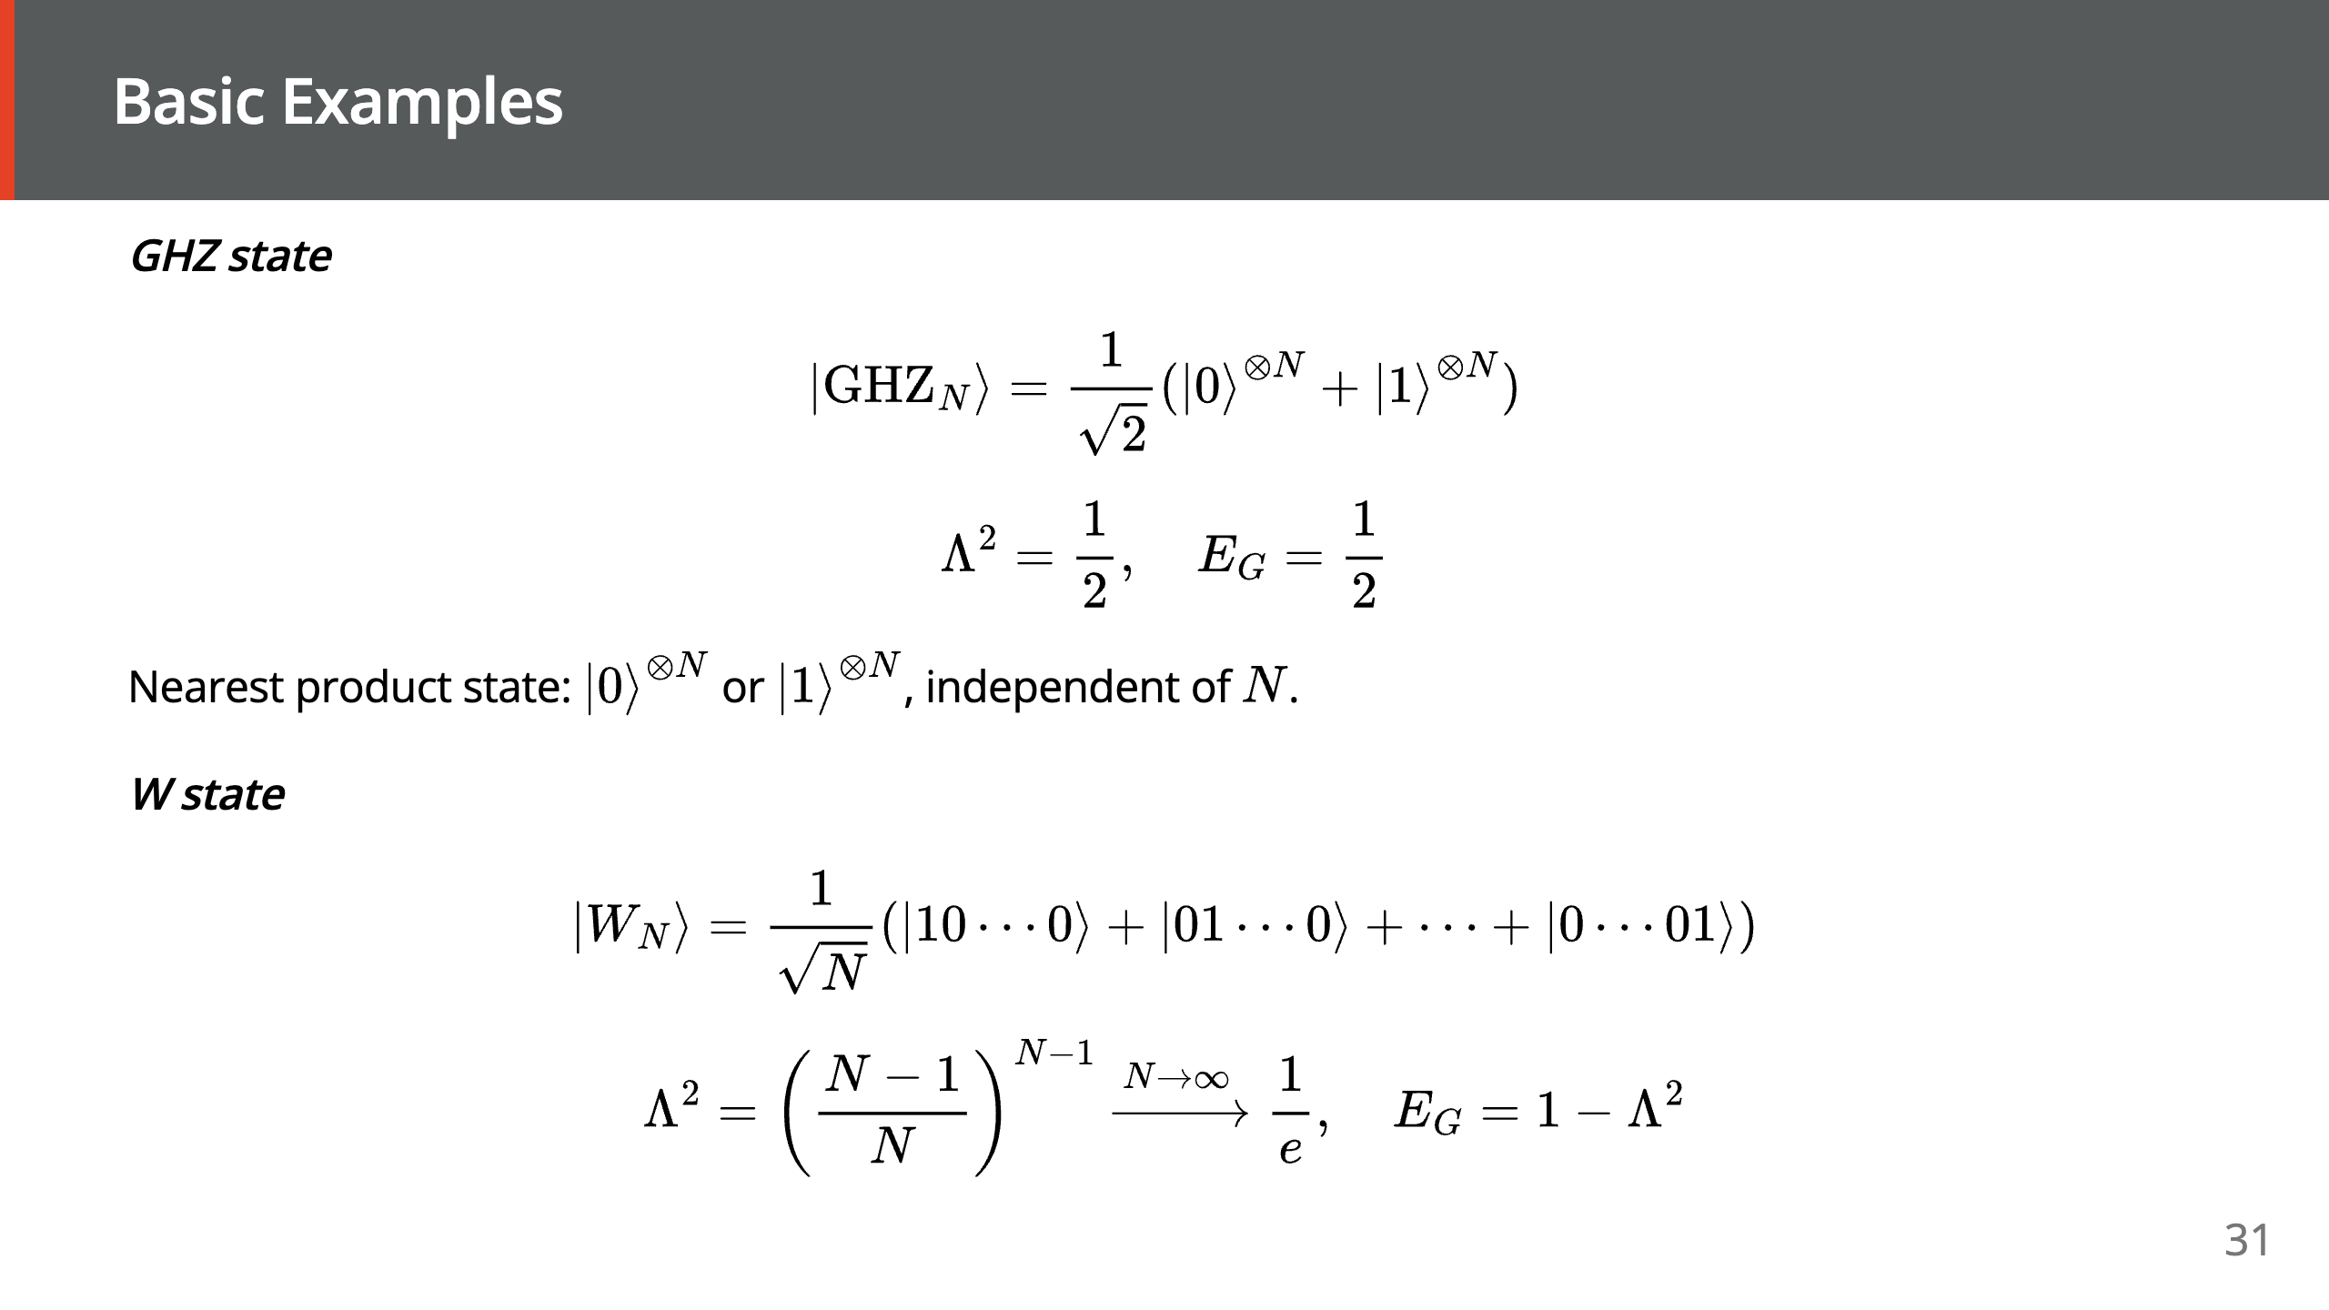

Slide 32
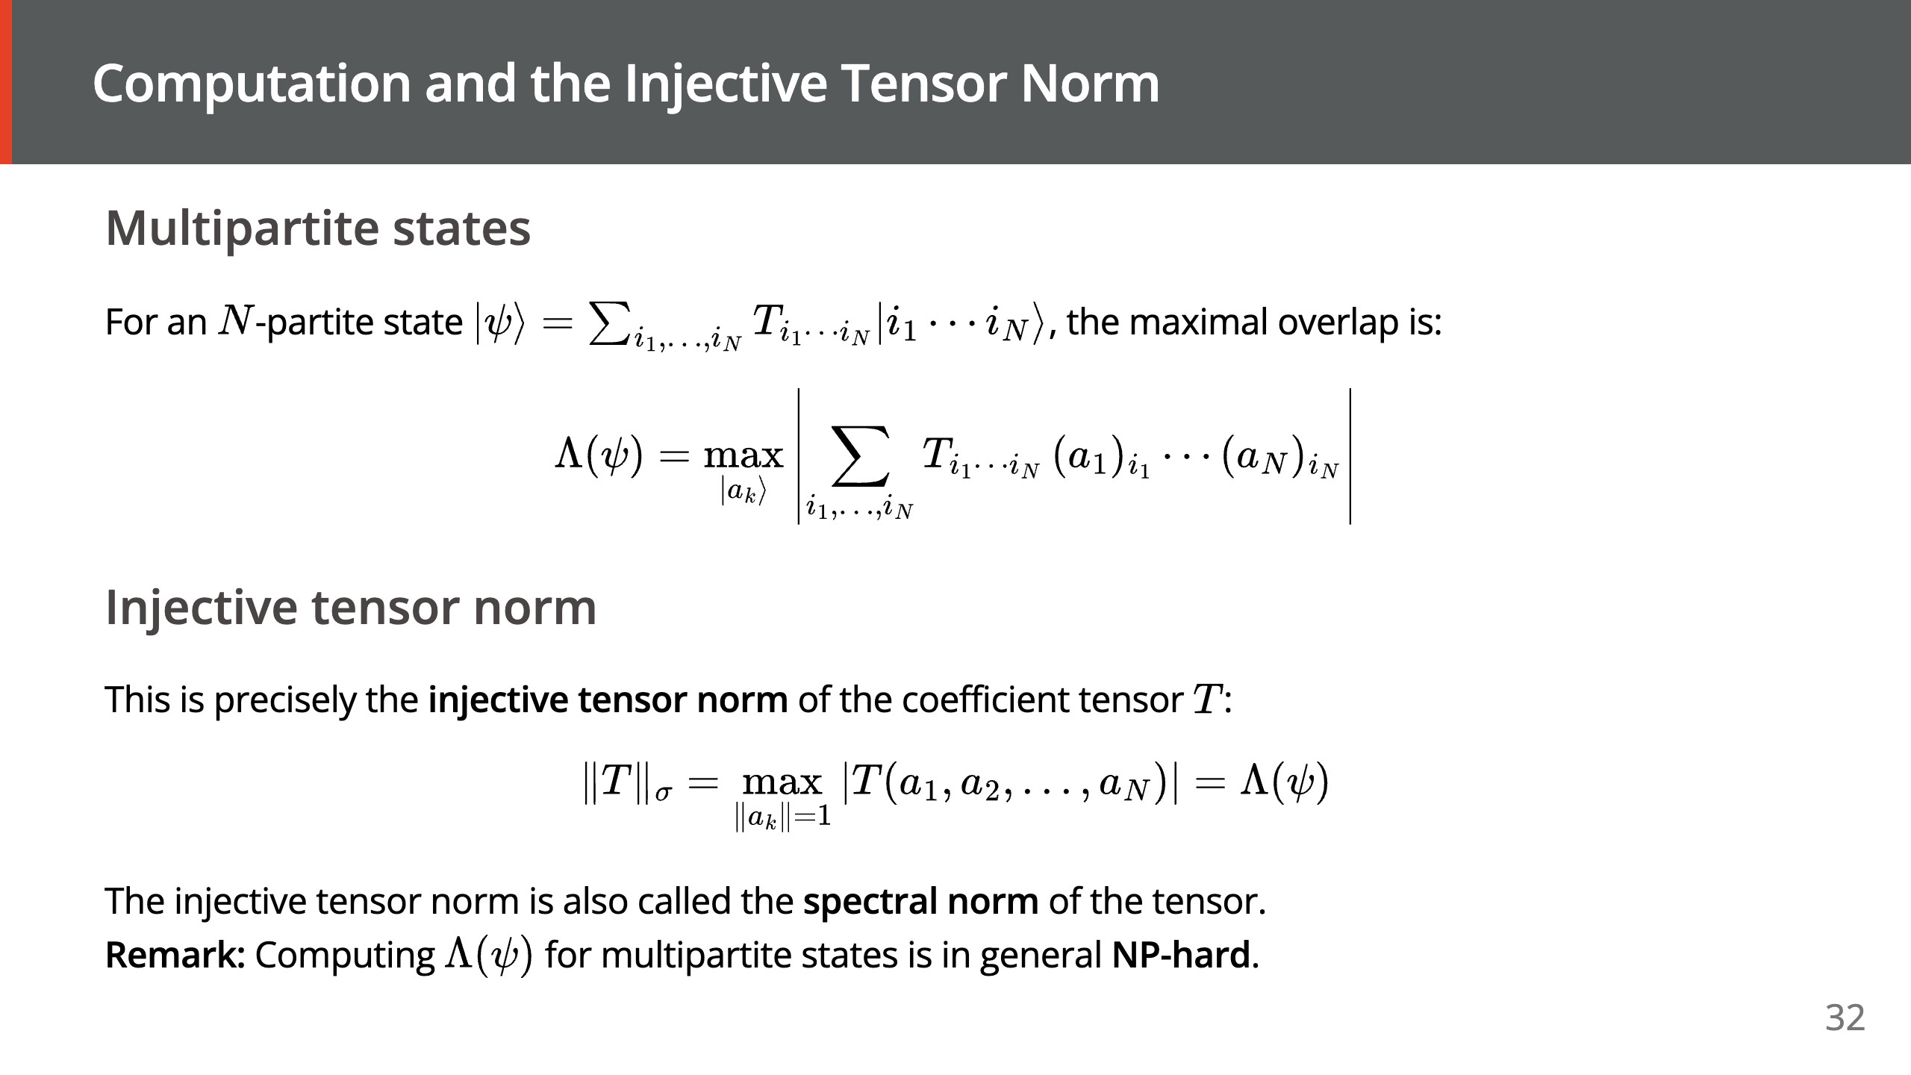

Slide 33
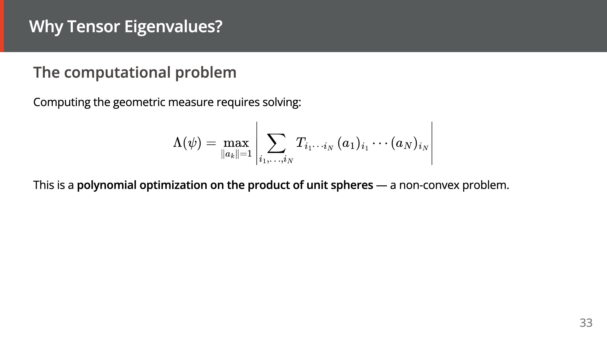

Slide 34
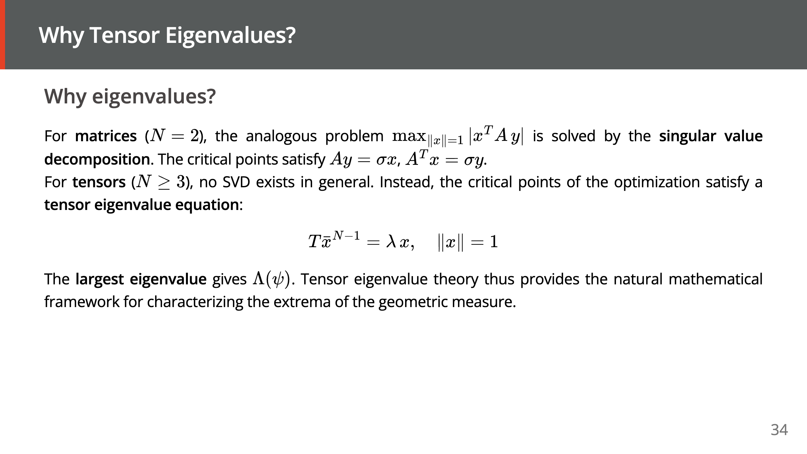

Slide 35
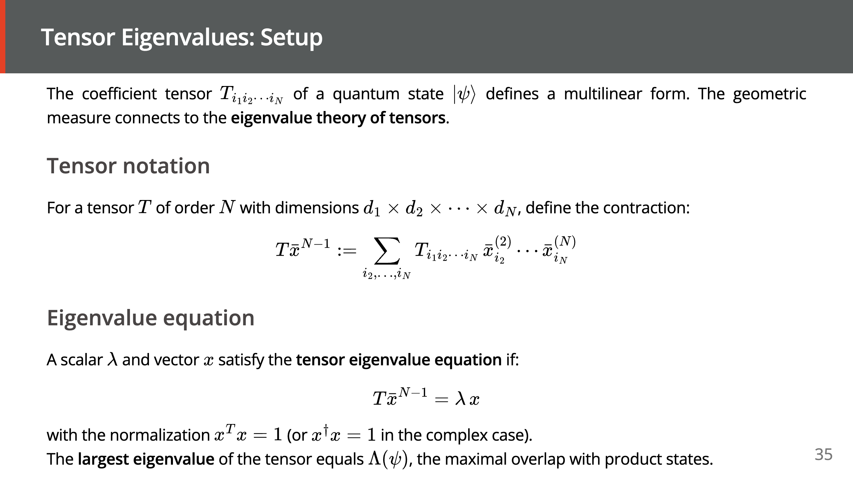

Slide 36
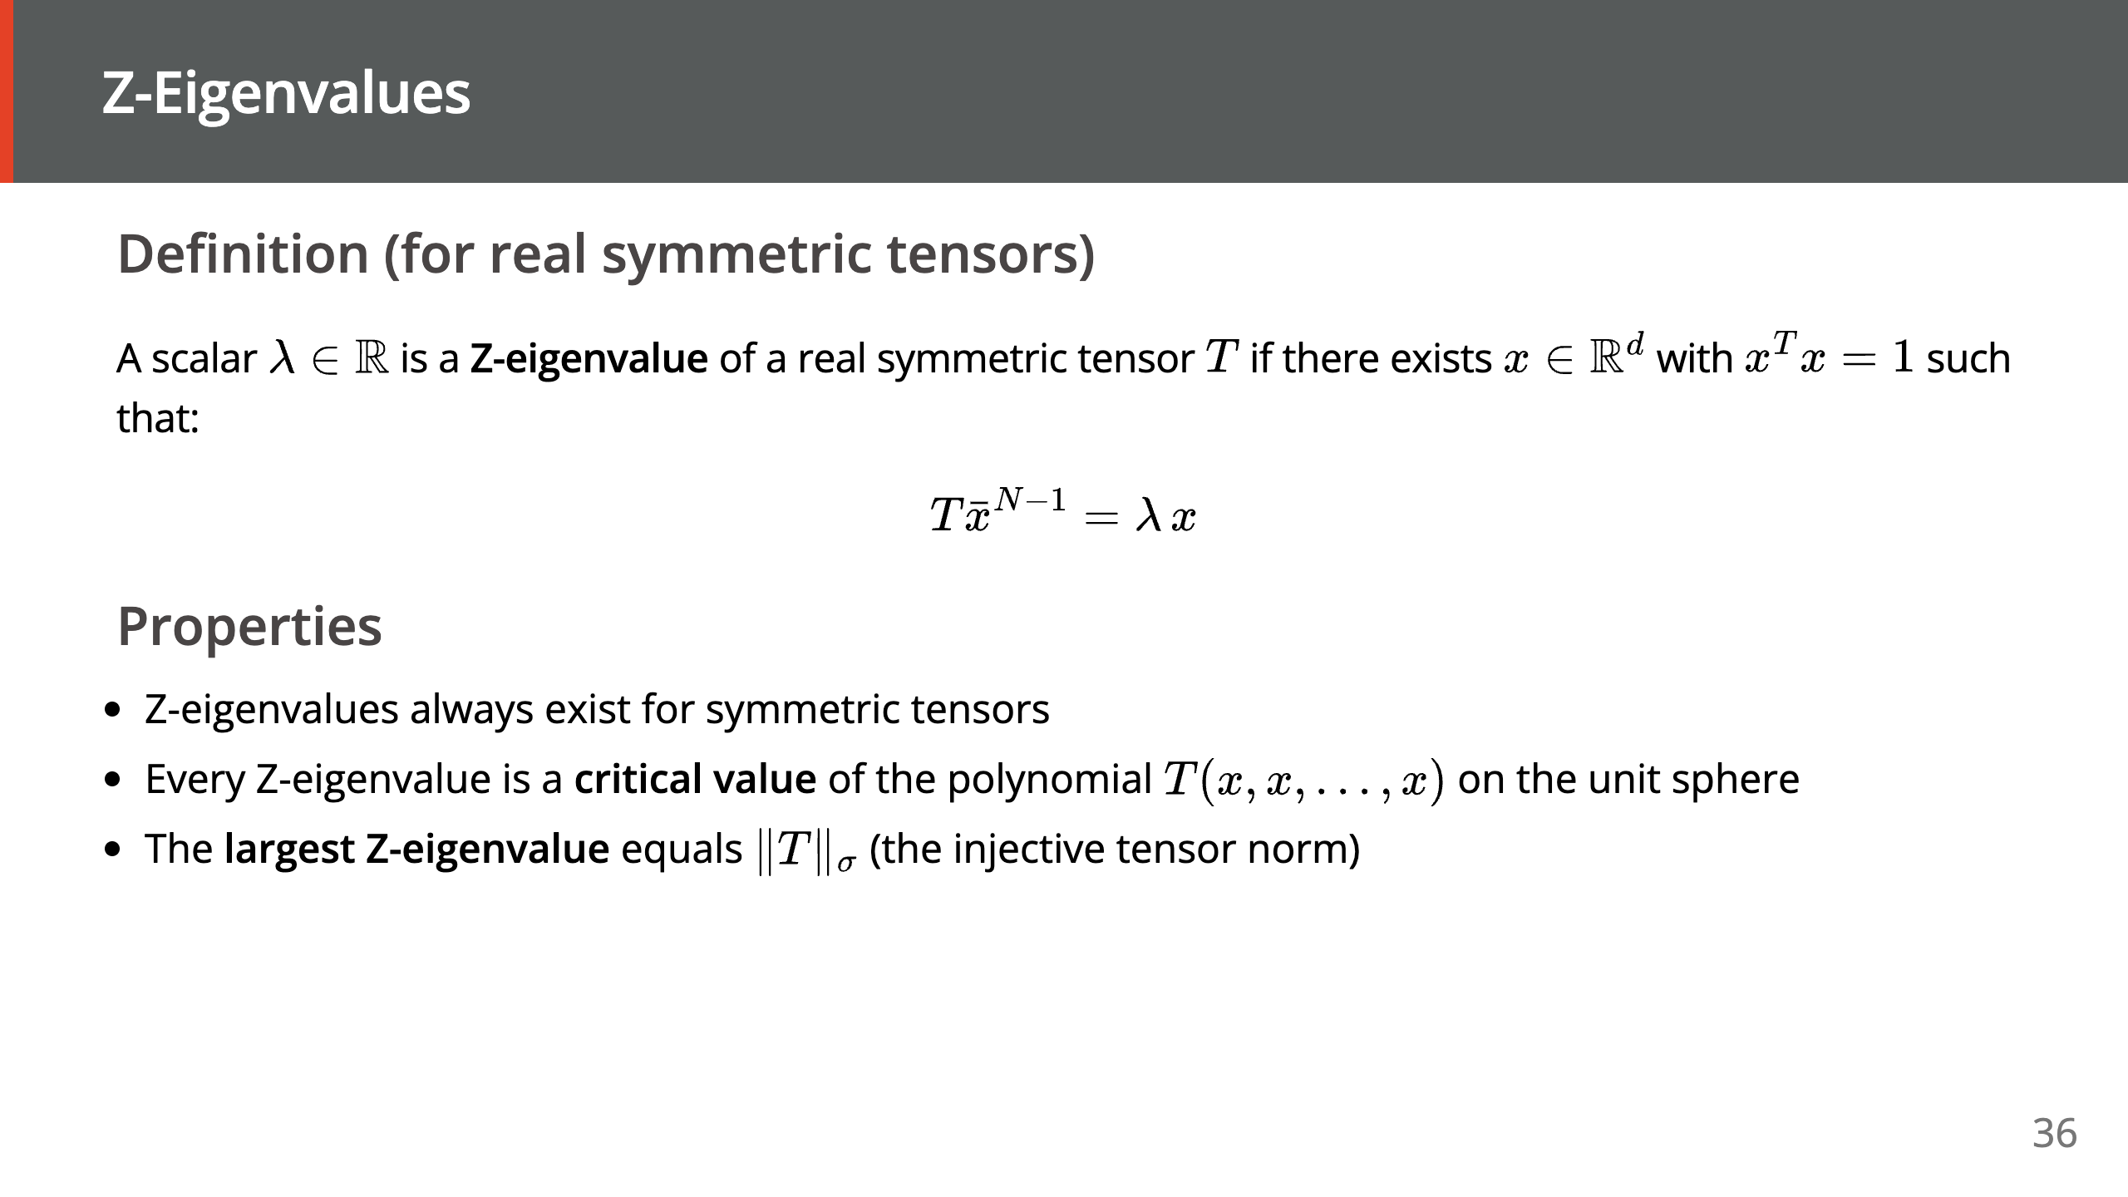

Slide 37
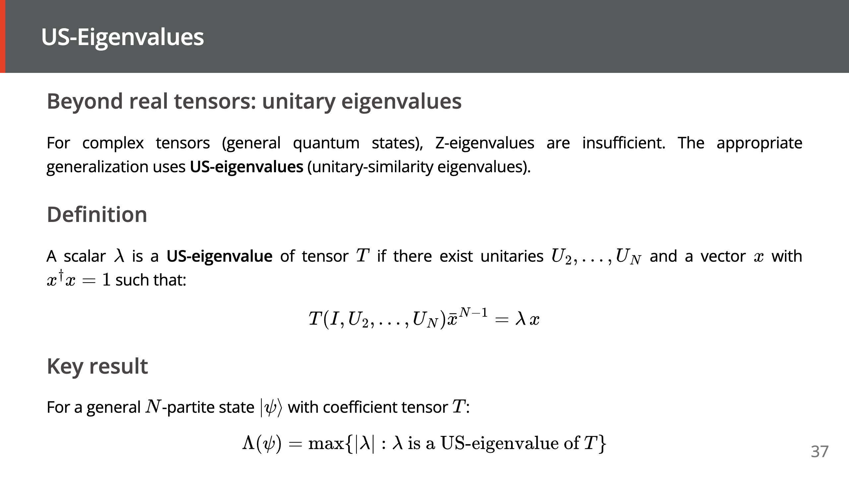

Slide 38
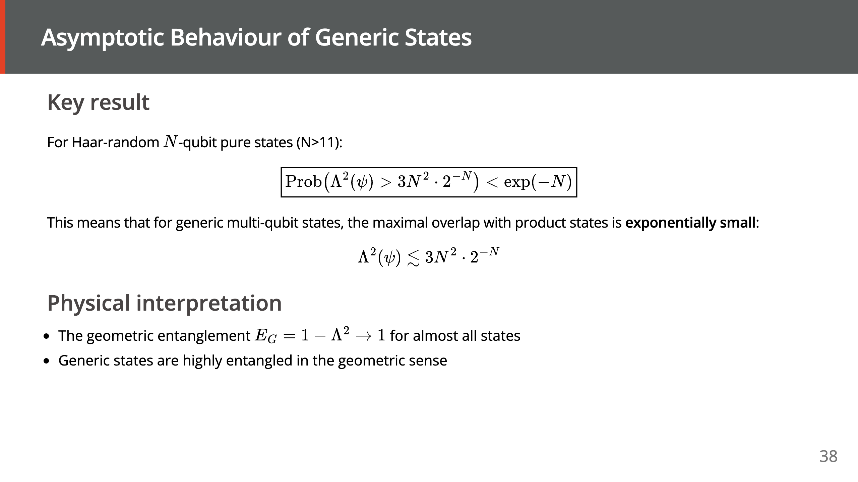

Slide 39
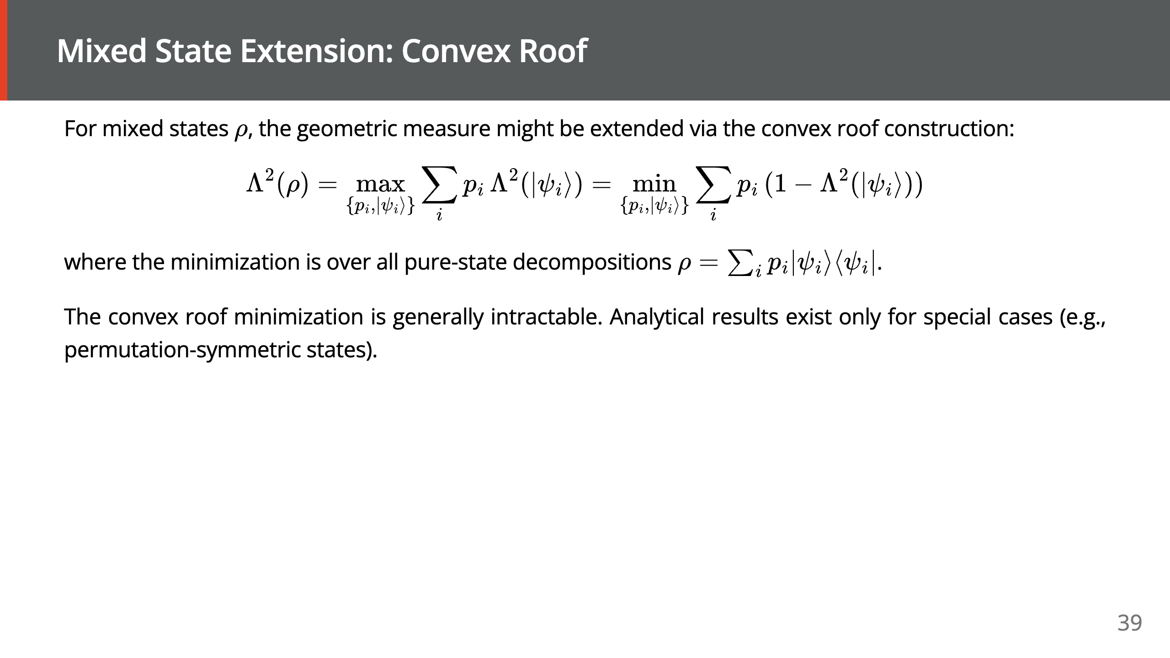

Slide 40
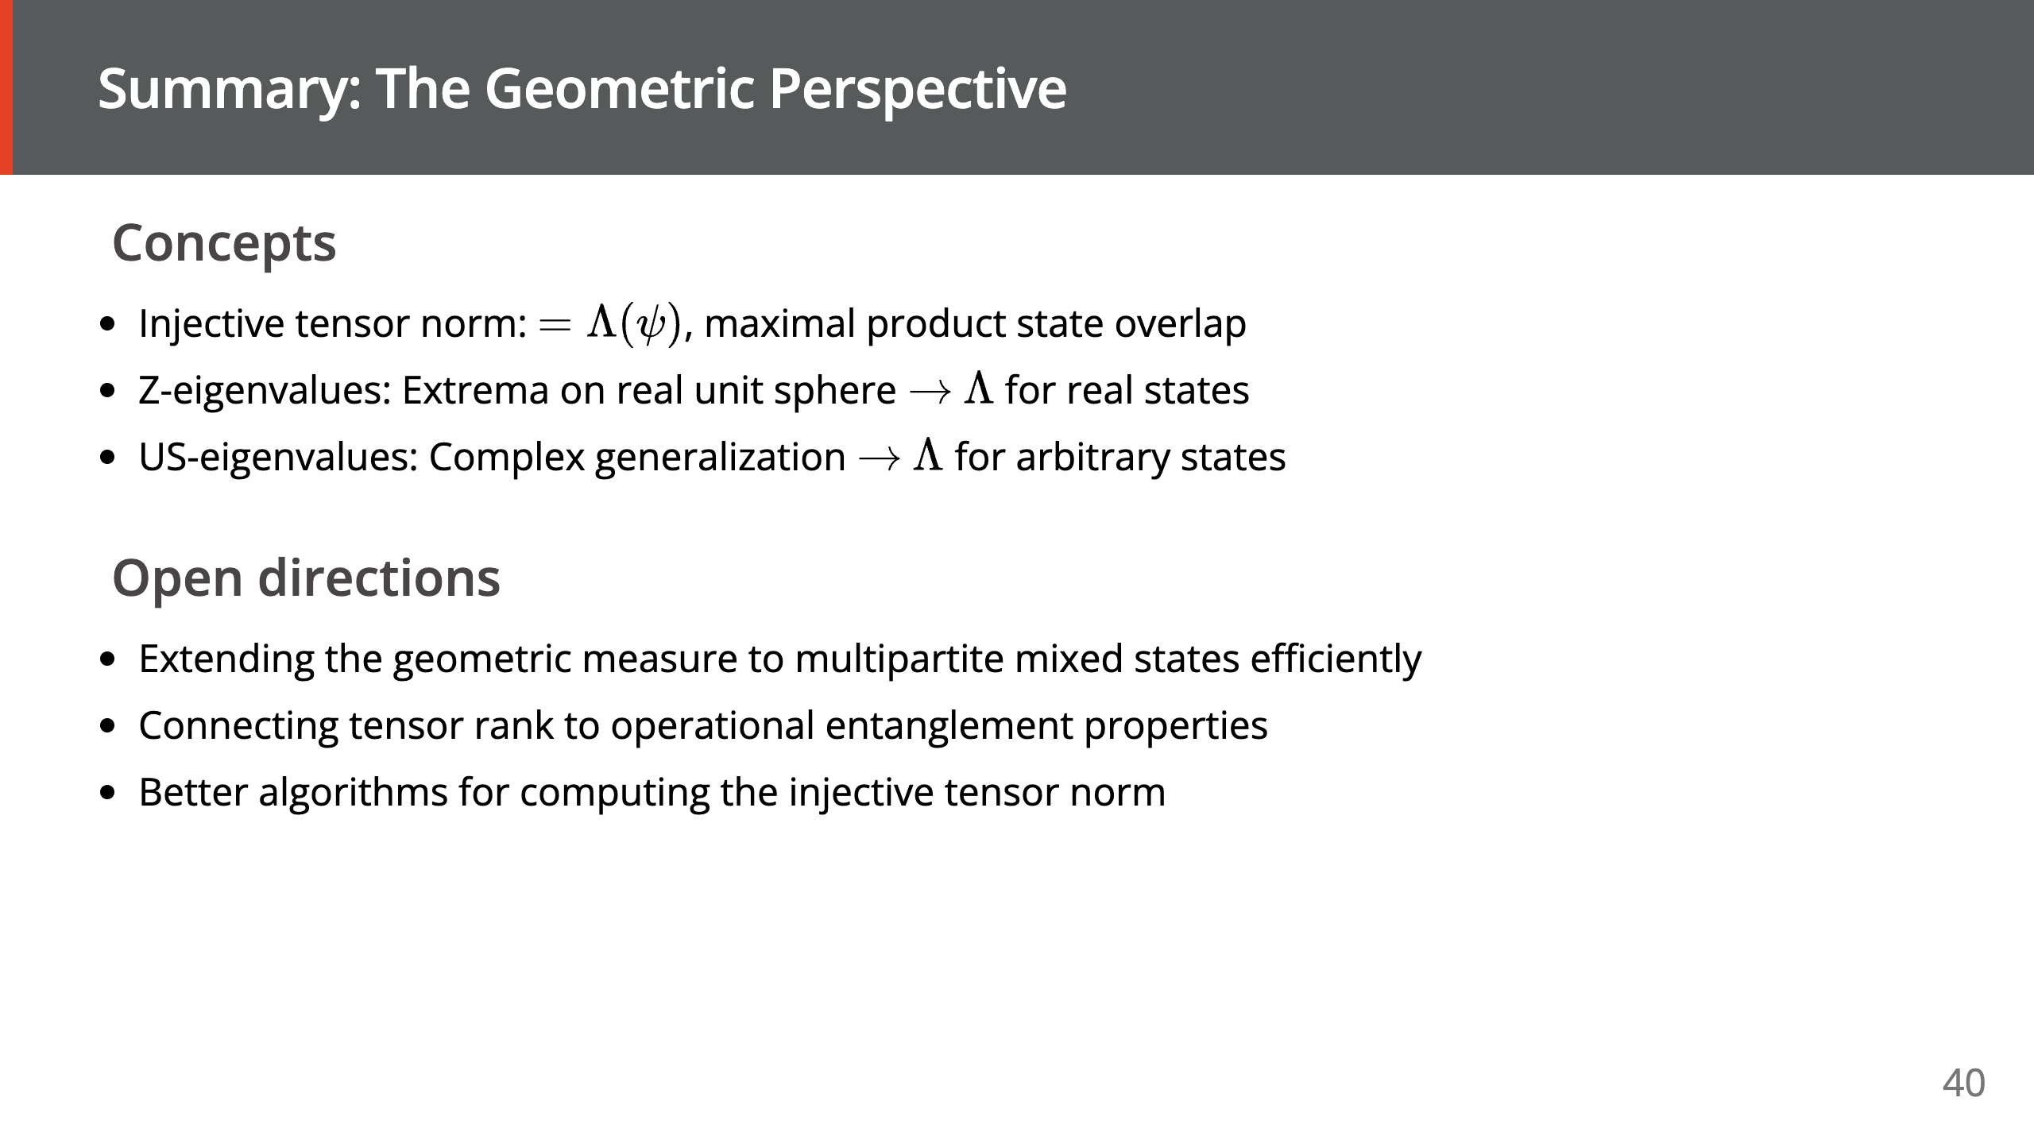

Slide 41


