Slide 1
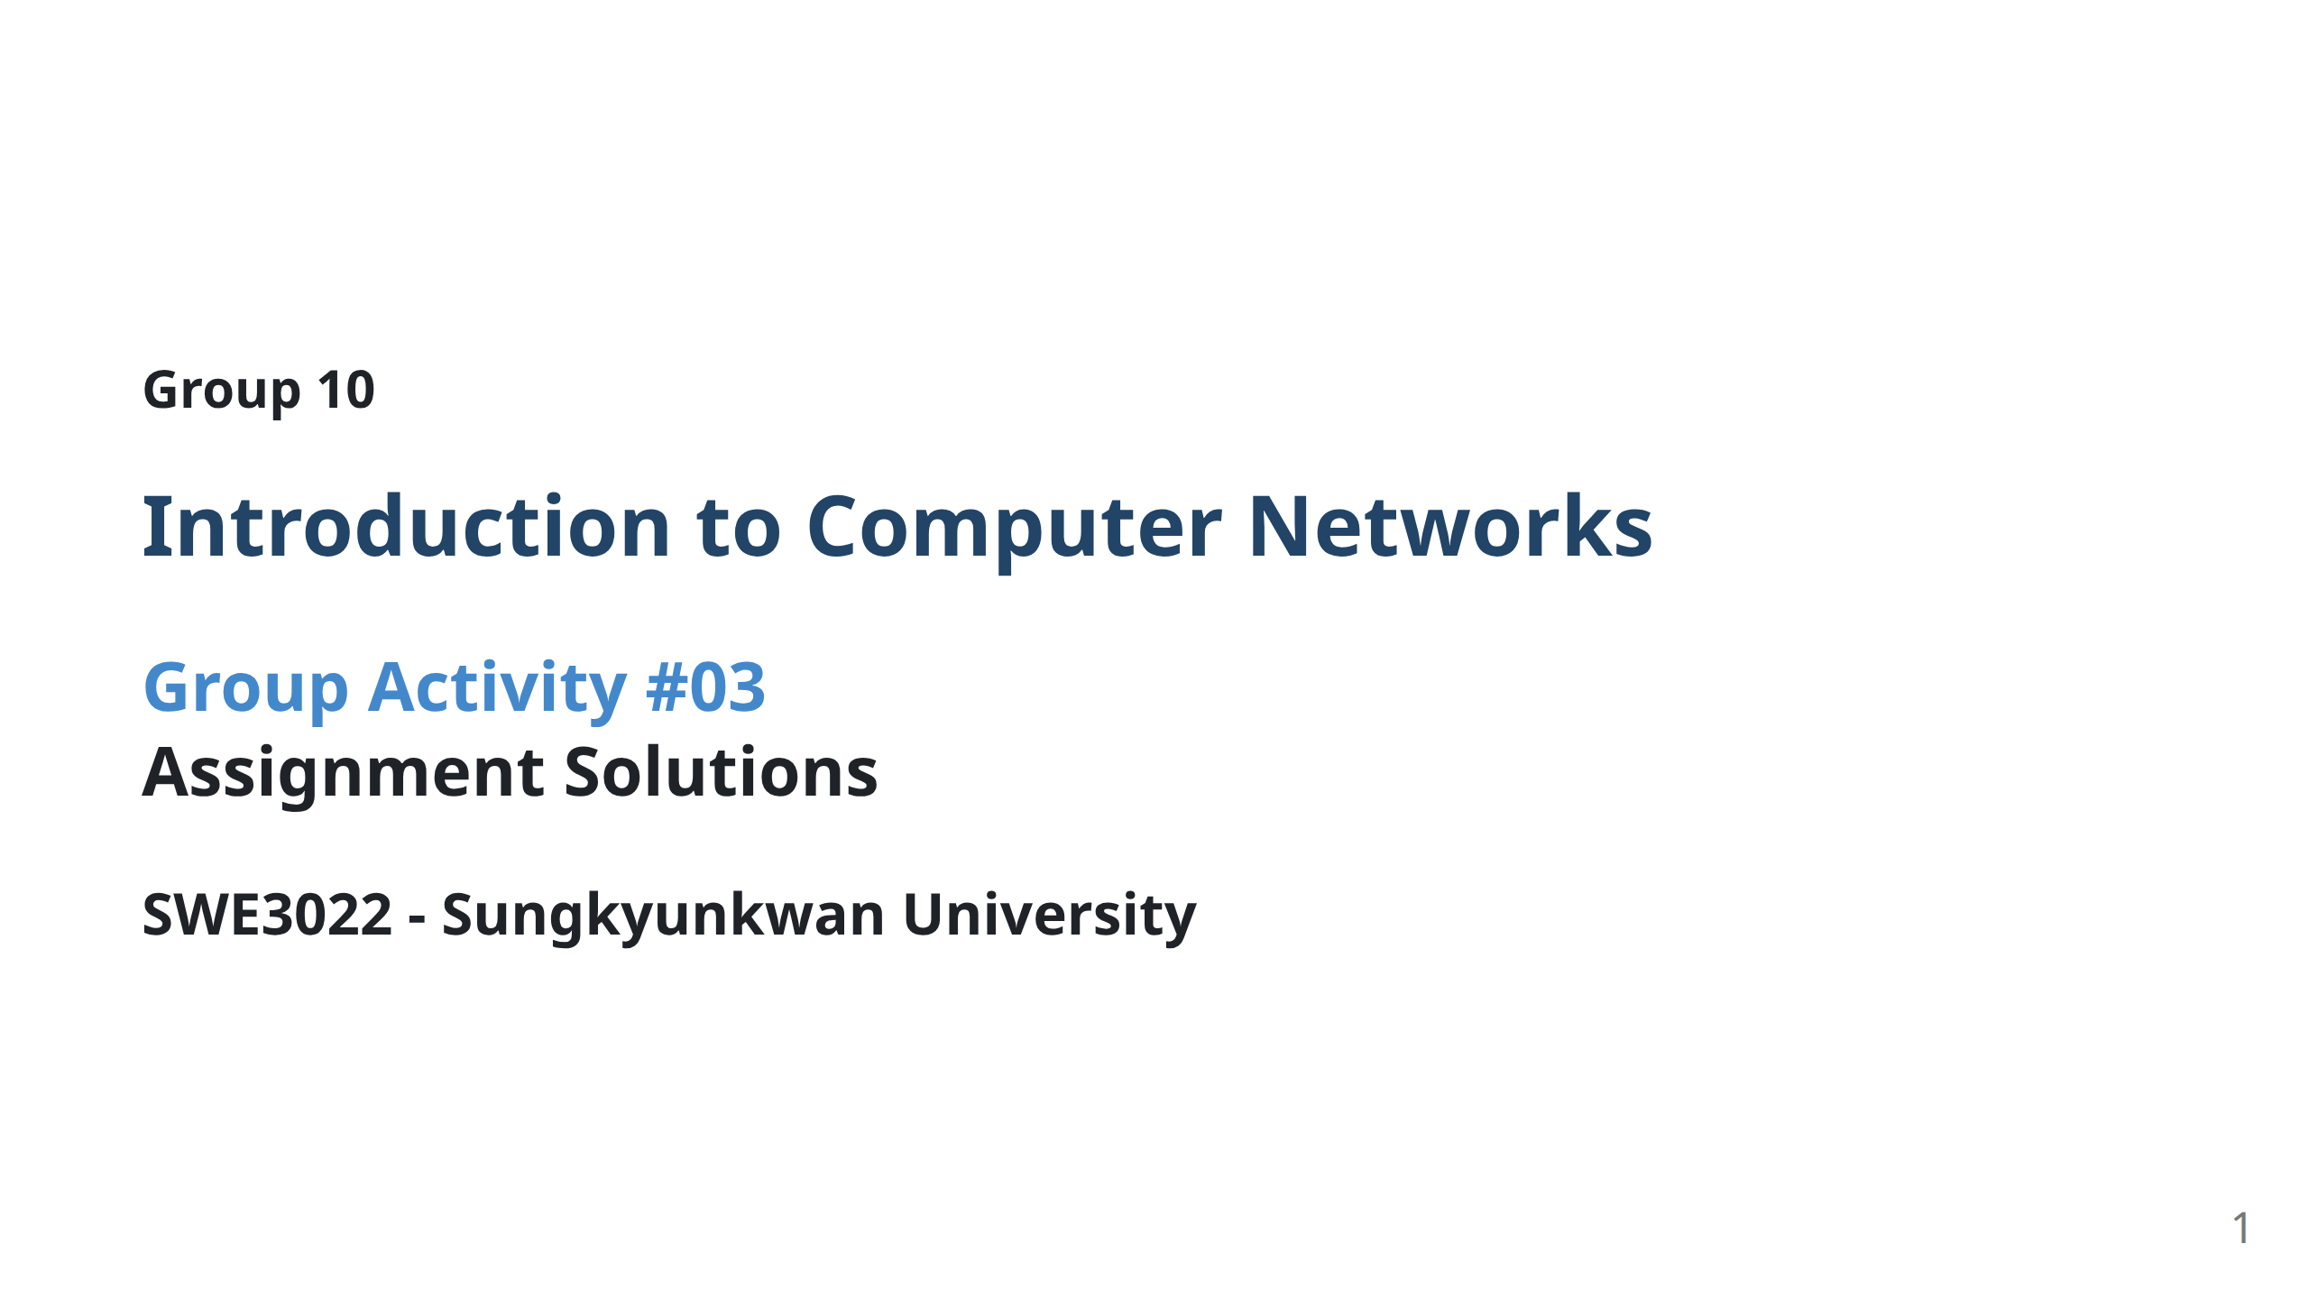
Notes:
--- marp: true theme: default paginate: true ---

Slide 2
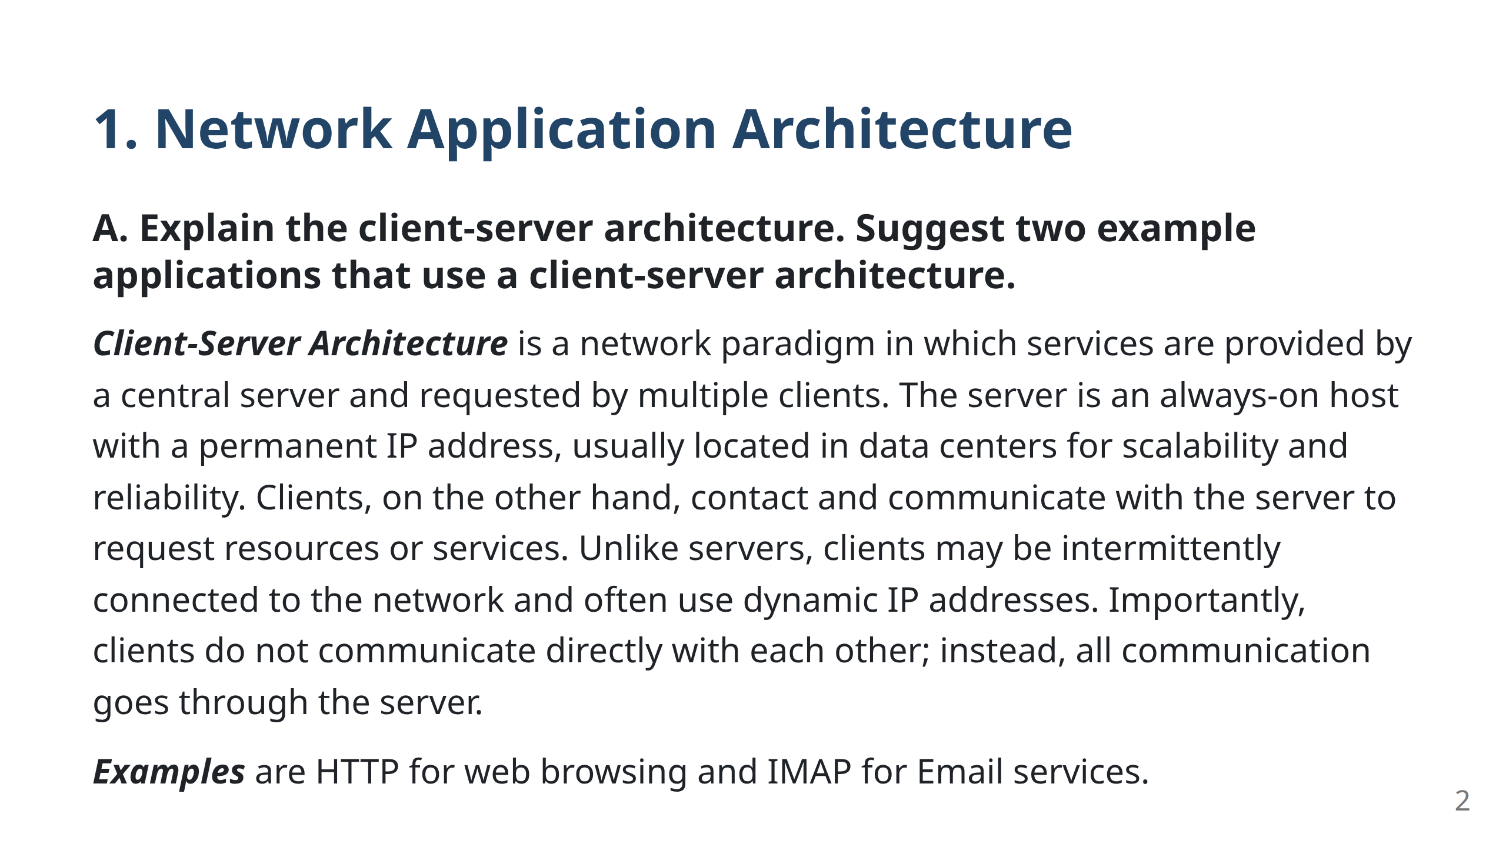
Notes:
--- marp: true theme: default paginate: true --- Bok JaeMin

Slide 3
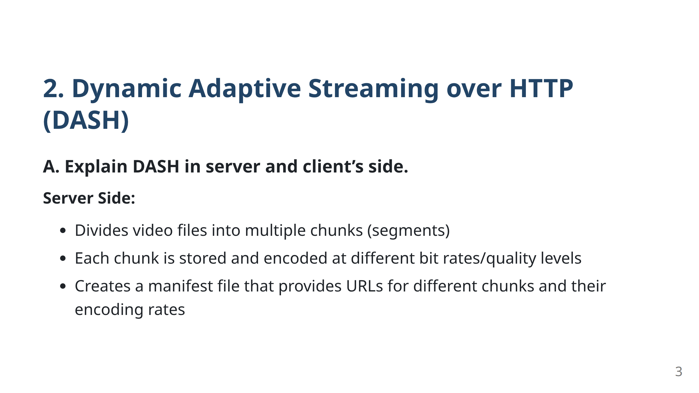
Notes:
--- marp: true theme: default paginate: true ---

Slide 4
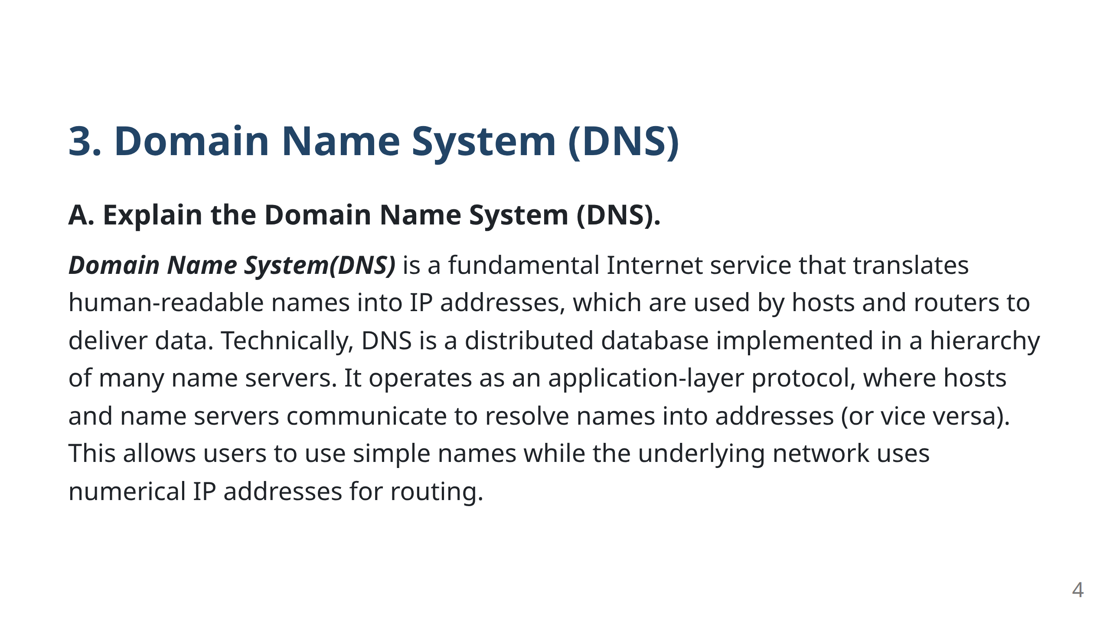
Notes:
--- marp: true theme: default paginate: true ---

Slide 5
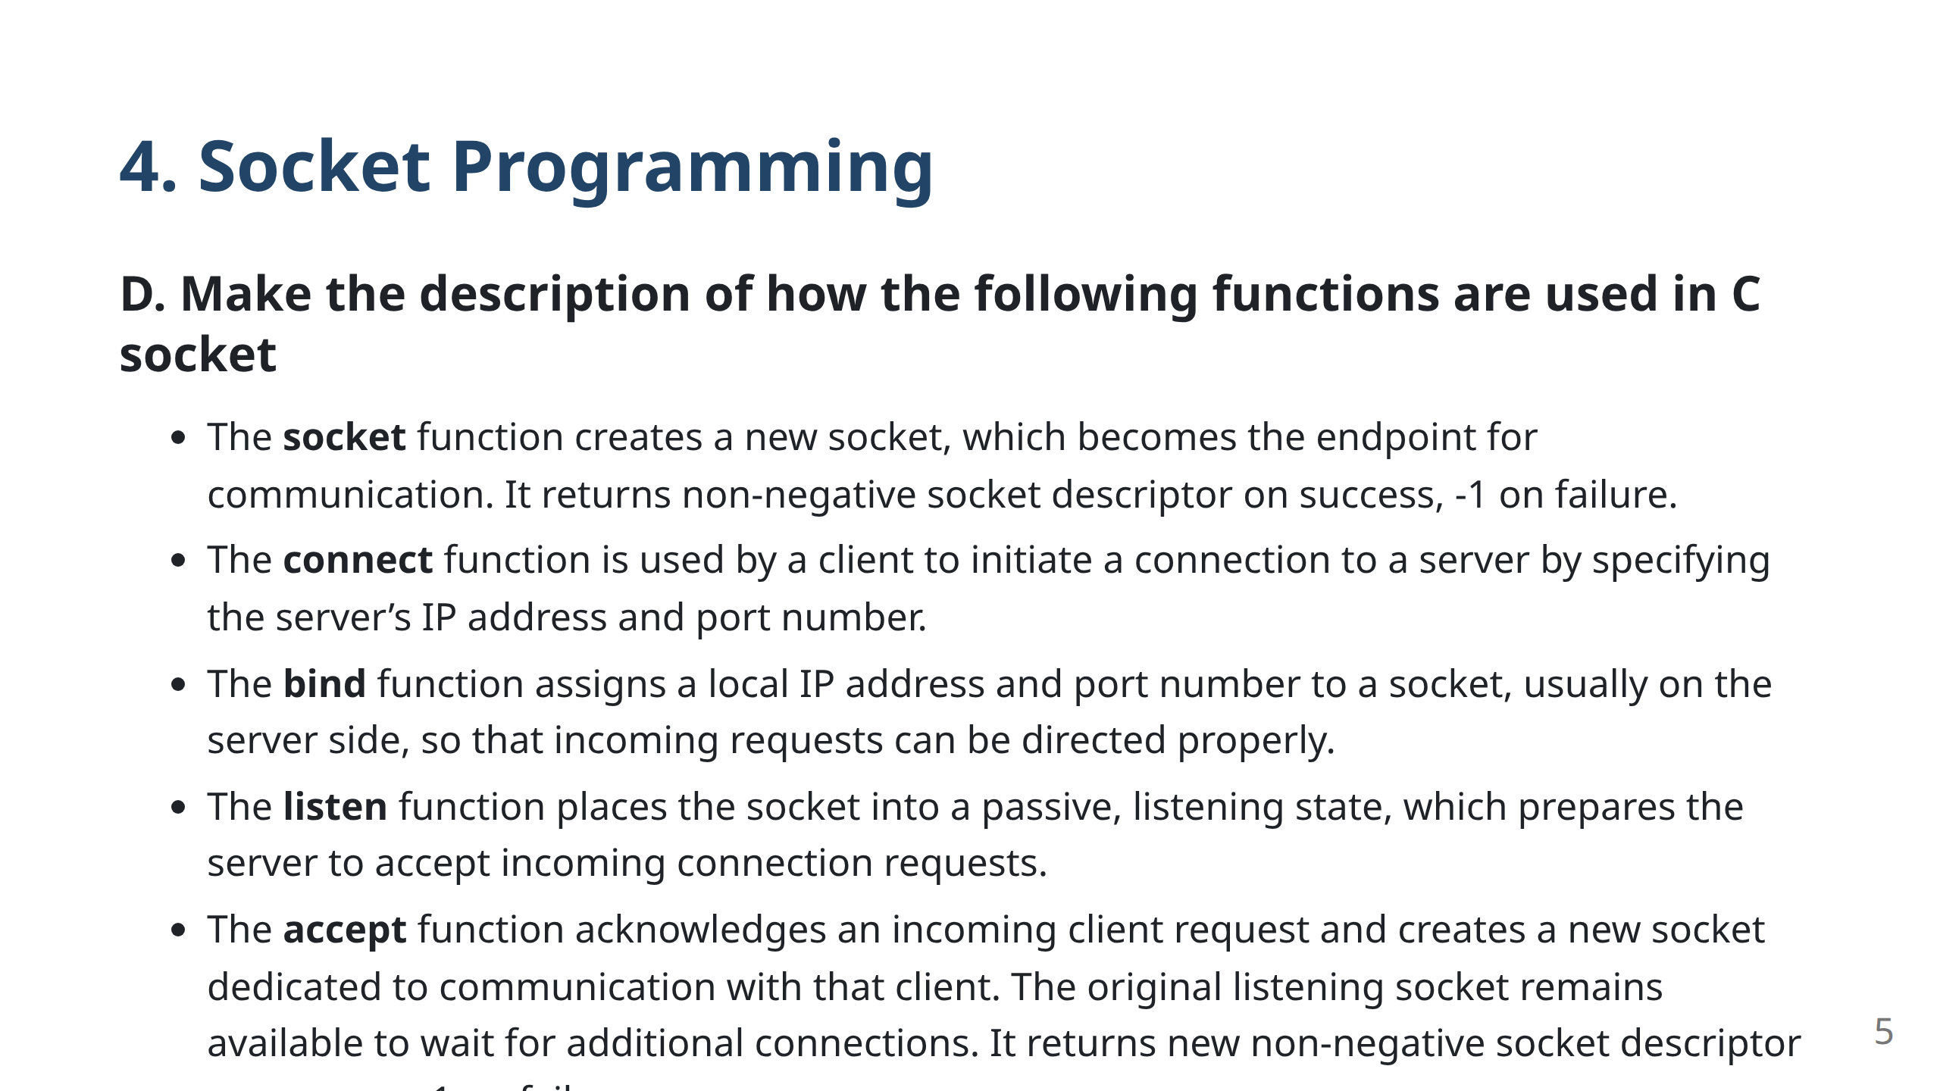
Notes:
--- marp: true theme: default paginate: true --- Lee Taeyeong

