Slide 1
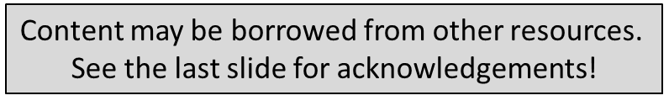
Distributed Systems - Assignment

Slide 2
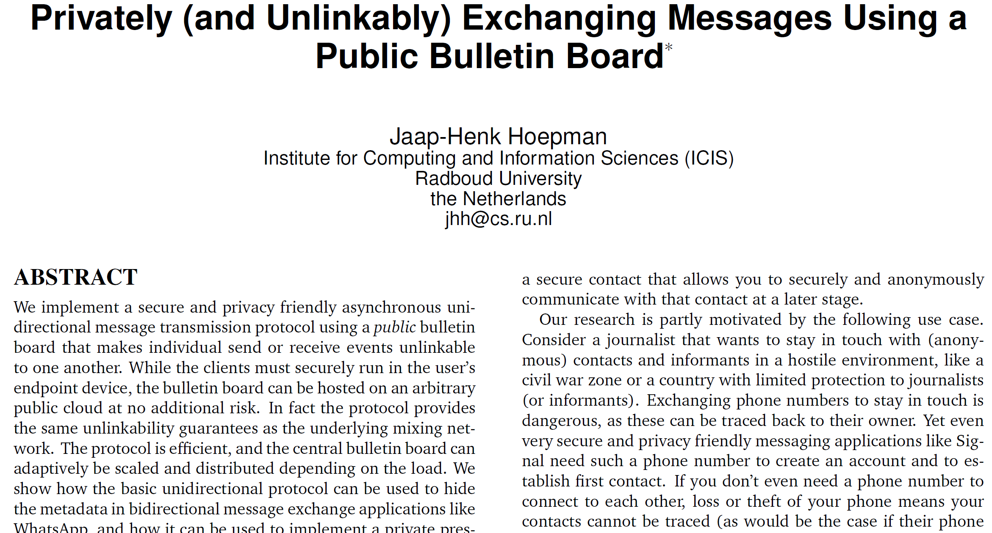

Slide 3
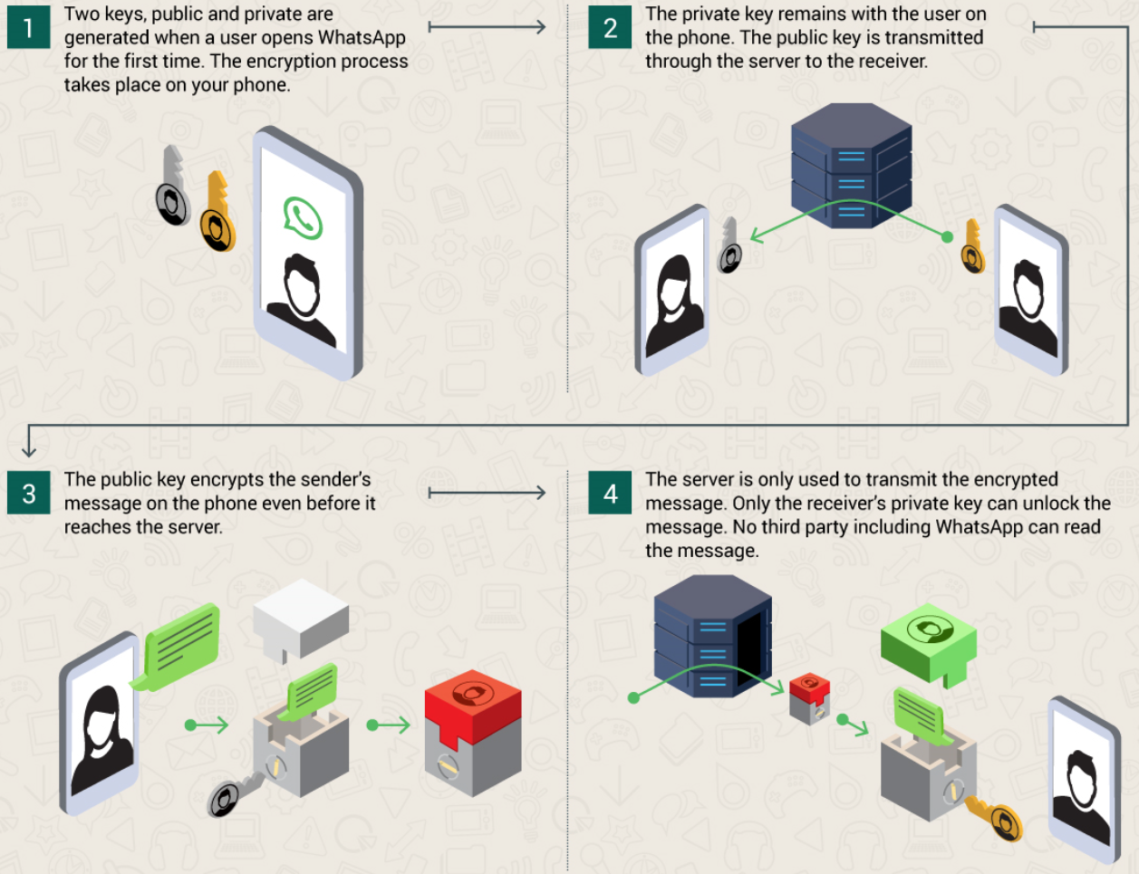


Slide 4
WhatsApp security and privacy properties
WhatsApp hides the content of the communication
WhatsApp does not hide the sender and recipient (~metadata)
The social graph should be protected against externals and service provider
Social graph = who is connected to whom
Alternative: implementing a peer-to-peer protocol
BUT: phones do not have fixed IP addresses
Proposed solution → centralized + asynchronous messages

Slide 5





A Simple, but Bad Idea
(k_{AB}, K_{AB})
(s_{AB}, S_{AB})
Bob: S_{BA},K_{BA,}
pqzvqupnbqpmup
(k_{BA}, K_{BA})
(s_{BA}, S_{BA})
Alice: S_{AB},K_{AB,}
apreiqonvcpaeece
{Sign(Message,s_{AB})} K_{BA}
pseudonymous
mail boxes
In the cloud
apreiqonvcpaeece
pqzvqupnbqpmup
Assumption: mix network between users and bulletin board service
Server will notice conversations between pseudonymous entities
Alice checks mails at morning → server can link all mailboxes of same user
Social graph
reconstruction

Slide 6
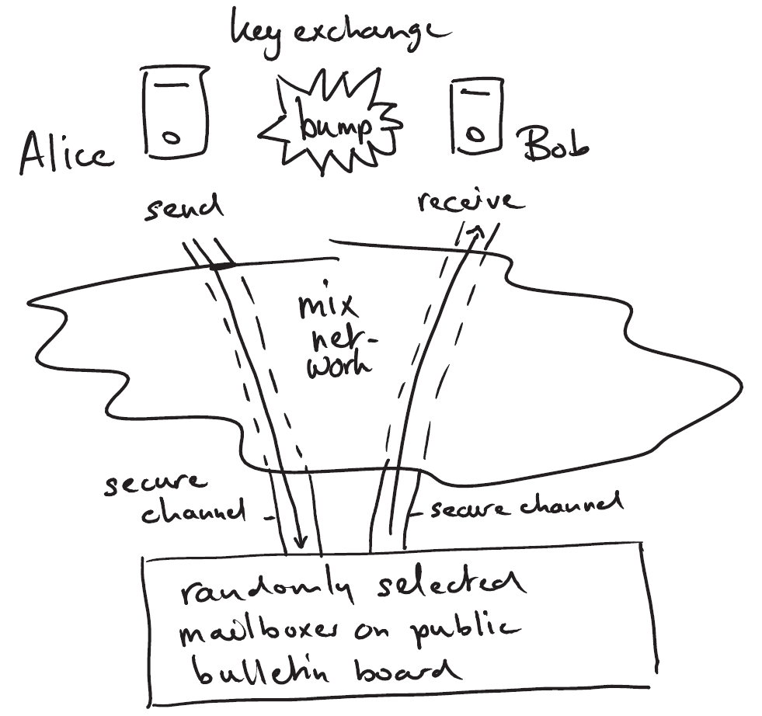
Privately (and Unlinkably) Exchanging Messages Using a Public Bulletin Board
Requirements
Confidentiality
Integrity
Authenticity
Unlinkability of events
Unlinkability of relationships
Forward secrecy
Availability

Slide 7
Crypto functions
Authenticated encryption scheme (confidentiality, integrity, authenticity)
{[m||idx||tag]}_{AB}
m||idx||tag ← open_{AB}({[m||idx||tag]} _{AB})
Key deriviation function (generating new keys)
KDF(.): K → K
Perfect forward secrecy
Cryptographic hash function (preventing deletion of values at will)
B(.): T → T

Slide 8
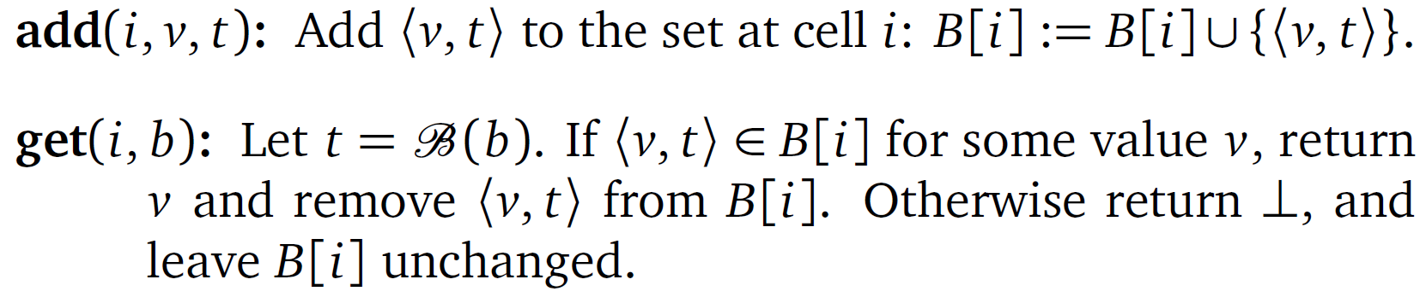
Operations on BB
Bulletin Board B[] is an array of n cells, indexed by arbitrary integers modulo n
Each cell B[i] contains a set of value/tag pairs <v,t>

Slide 9

setup_{AB}
K_{AB},idx_{AB},tag_{AB}
K_{BA},idx_{BA},tag_{BA}
K_{AB},idx_{AB},tag_{AB}
K_{BA},idx_{BA},tag_{BA}

Slide 10
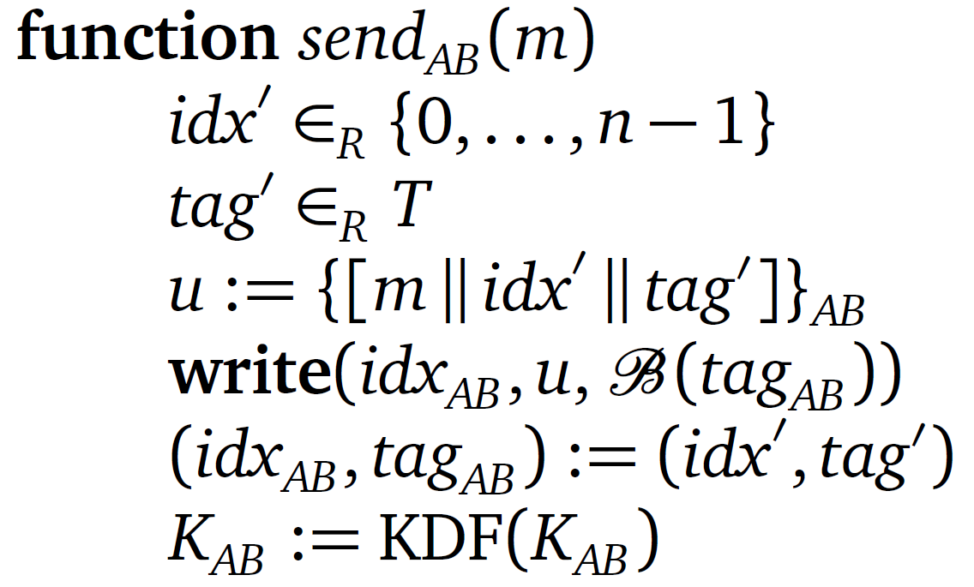
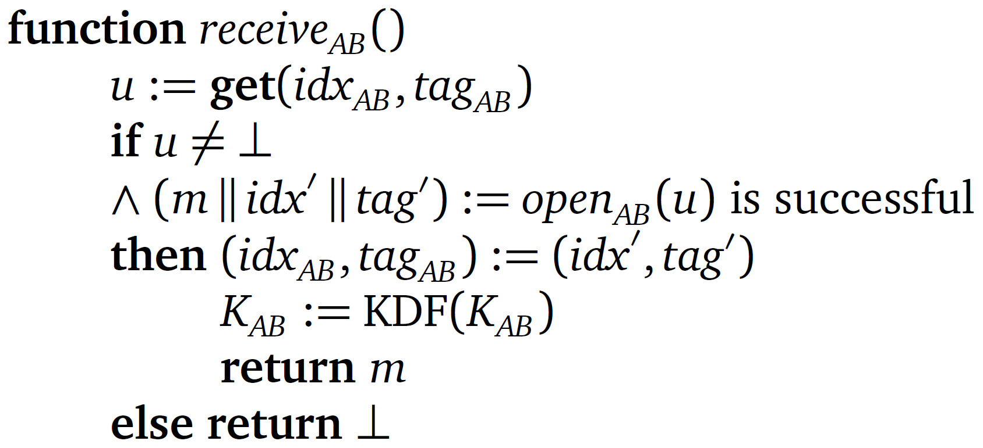
send_{AB} -- receive_{AB}
KDF(.)
B(.)
KDF(.)
B(.)
K_{AB},idx_{AB},tag_{AB}
K_{BA},idx_{BA},tag_{BA}
K_{AB},idx_{AB},tag_{AB}
K_{BA},idx_{BA},tag_{BA}

Slide 11
Advanced features
Supporting recoverability of corrupted states
Increasing scalability → partitioning the BB in chunks
Tackling Denial-of-Service attacks

Slide 12
Assignment
Implement the proposed Privacy-Friendly Bulletin Board (Client + Server application)
Java RMI as communication technology
Java JCA/JCE to realise crypto protocols
Submit code on github
Submit a report -- max 2 pages -- including following aspects
Relevant design decisions (+ extensions) (0,5 pages)
Detailed SWOT analysis (1,5 pages)
Link to code on github

Slide 13
Assignment
Deadline code and report submission: 11 december 2023
Oral evaluation (date: 14 december 2023)
Slide presentation [max. 15 slides – max. 20 minutes] containing:
Overview of functionality and architecture
Overview design decisions + some implementation details
(Possible extensions)
Critical reflection
Demonstration
Q&A

