Slide 1
Project Overview
Purpose and team goals
UWBC Liquidity App
Architecture & Progress So Far
System Design, Service Integrations, and Progress So Far
Next Steps
Goals for the rest of the term

Slide 2
Project Overview
Liquidity Monitoring Application for Aave
1. Integrate with Aave to listen to transaction events of all users
2. Store and manipulate data into useful forms for quantitative analysis and scenario simulation
3. Display that data in a user-friendly manner to analysts
Project Milestones
Build skills in Blockchain & Web3 Development, as well as knowledge of the space
Create a project that can be utilized in the future by UWBC analysts
Learn, learn, learn
Team Goals

Slide 3
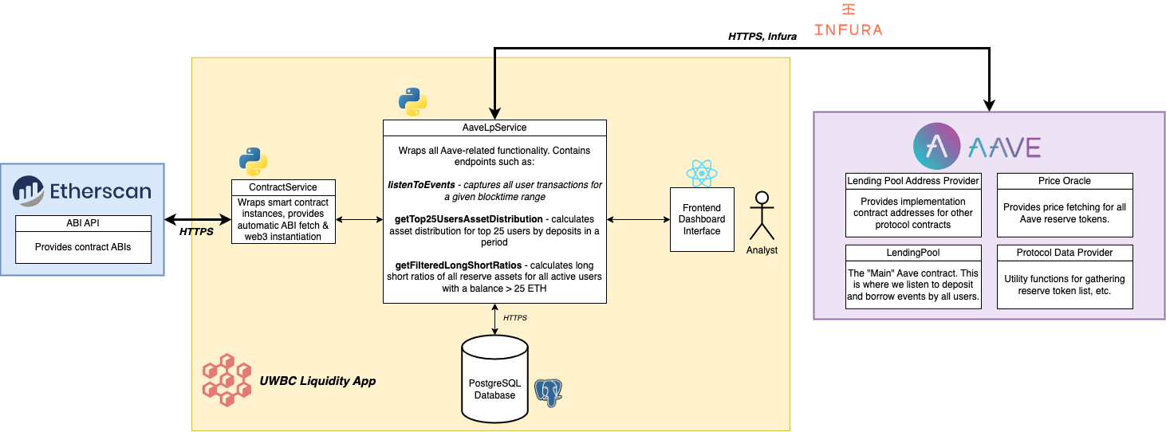
System Design

Slide 4
Progress so far
1
COMPLETE: Integrate with Aave, create data pipeline
2
IN PROGRESS: Data analysis functionality
3
UP NEXT: Dashboard

Slide 5
Next Steps
Adding functionality to calculate the health factor of all users
Adding support for scenario analysis (if price of X changes, how does that effect health factors?)
Migrating to the Flask framework to support the frontend application
Increasing Backend Complexity
Creating a design spec for the frontend dashboard
Building out interfaces to aid analysts in their research projects
Developing the web app in React
Building out the Dashboard

