Slide 1


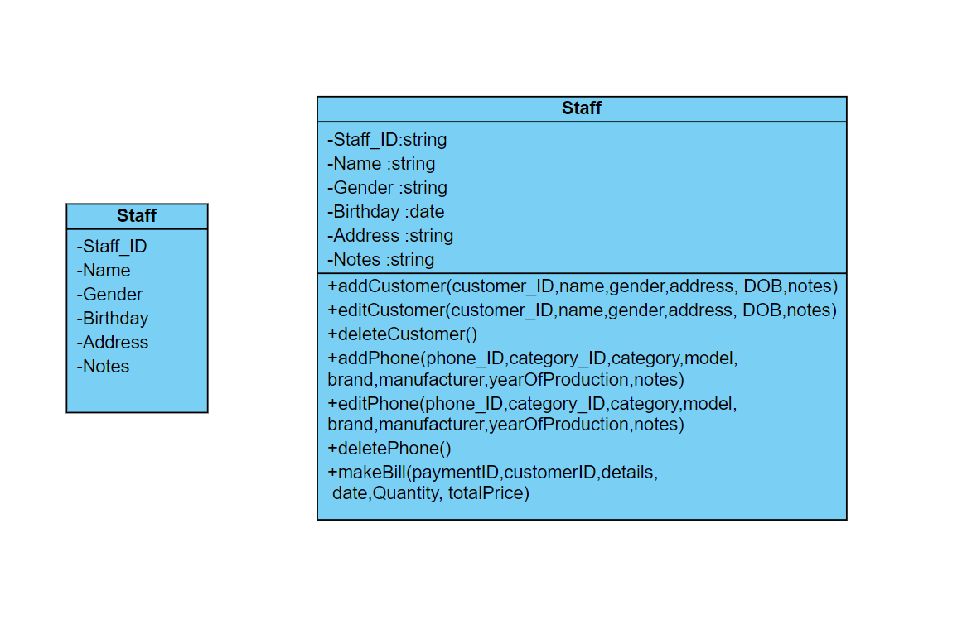


DESIGN CLASS
IN
DETAILED
DESIGN

Slide 2
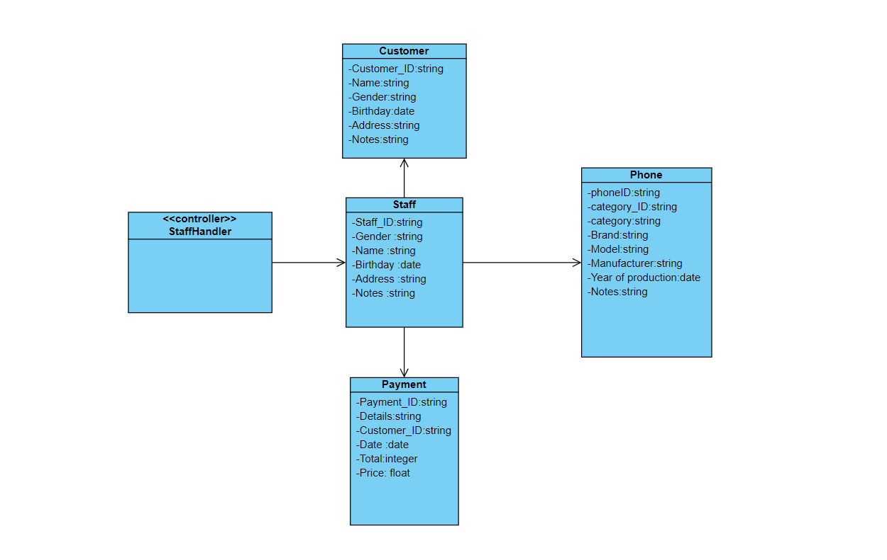
DOMAIN
DESIGN
CLASS

Slide 3
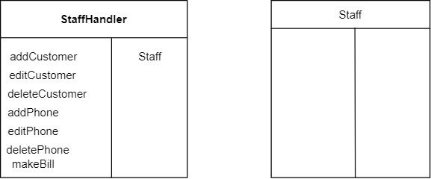
CONTROLLER

Slide 4
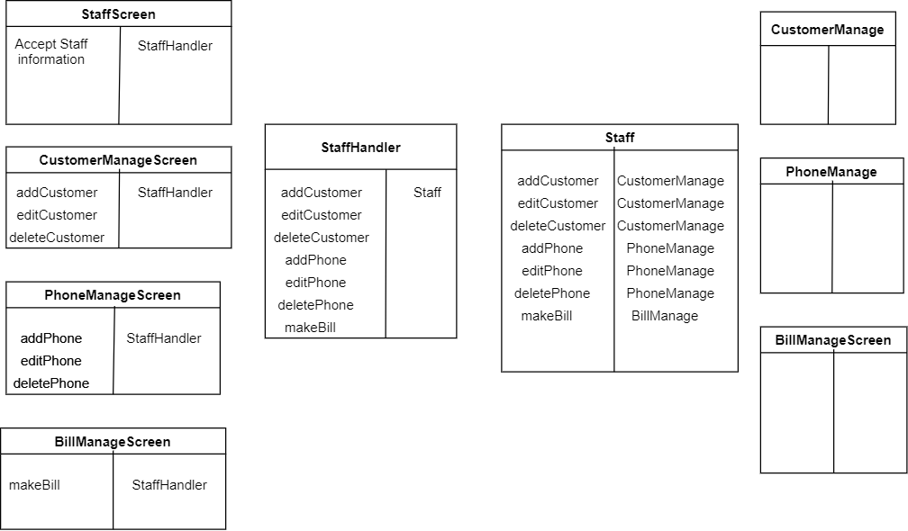
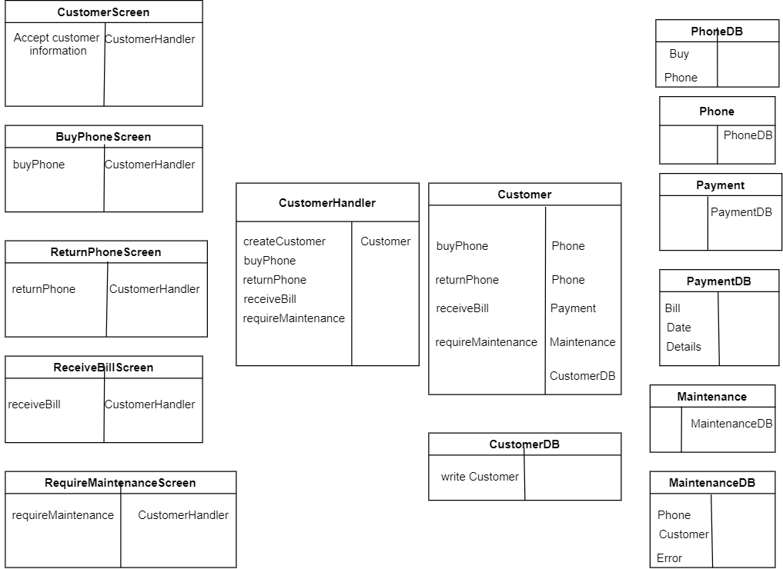
UI

Slide 5
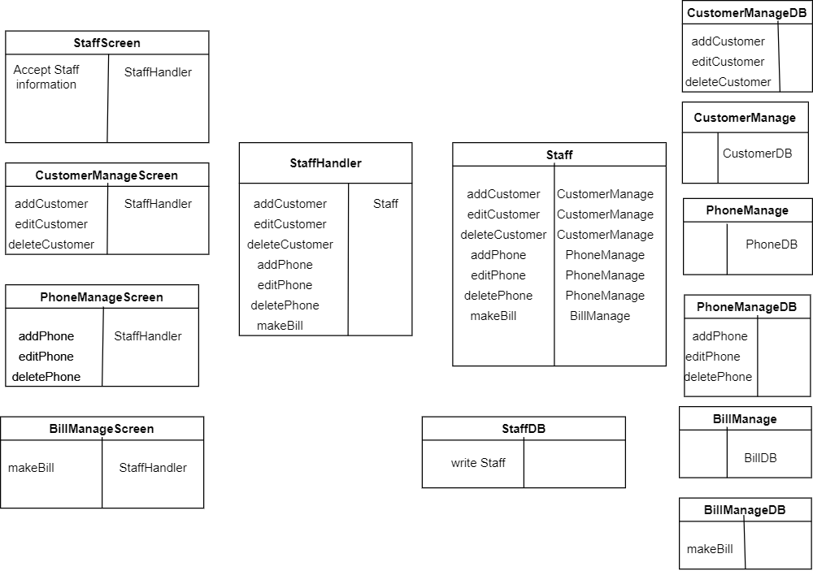
DATA
ACCESS

Slide 6
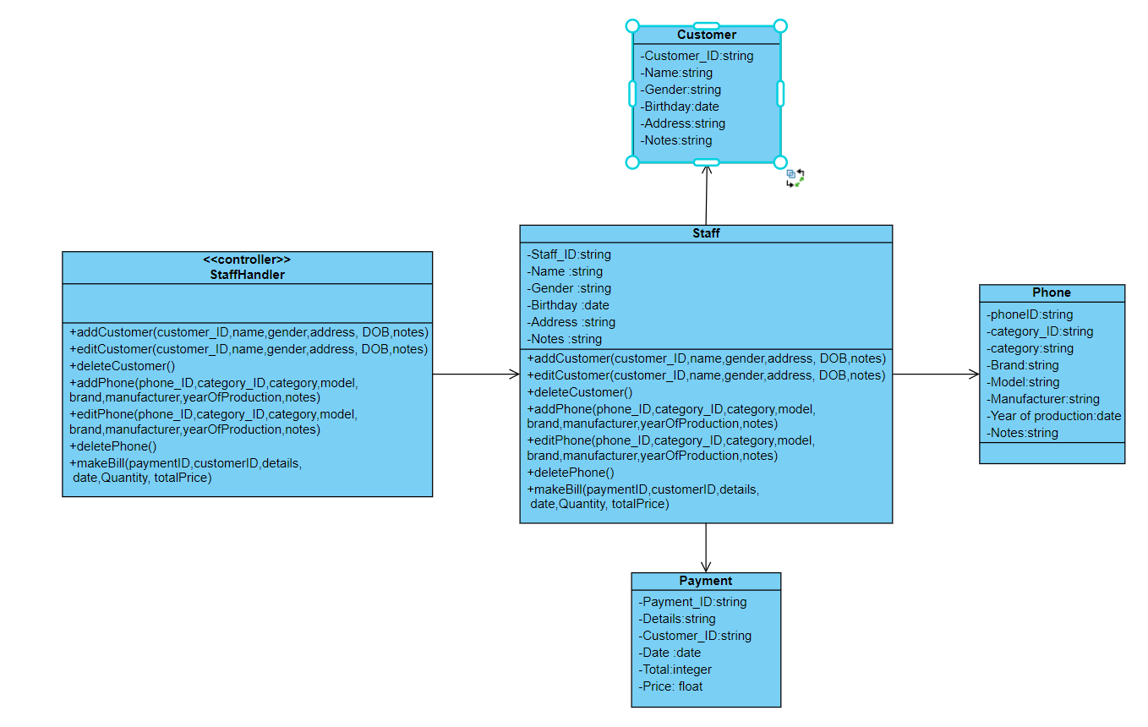
DESIGN
CLASS

Slide 7
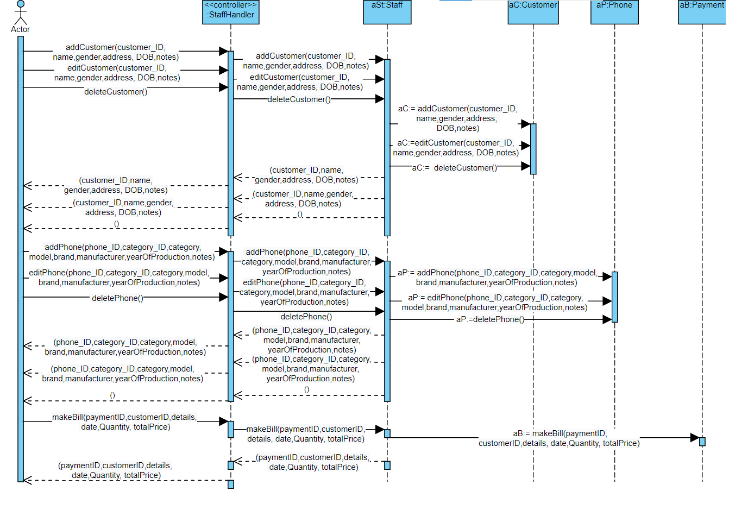
OOD WITH
SEQUENCE
DIAGRAM

Slide 8
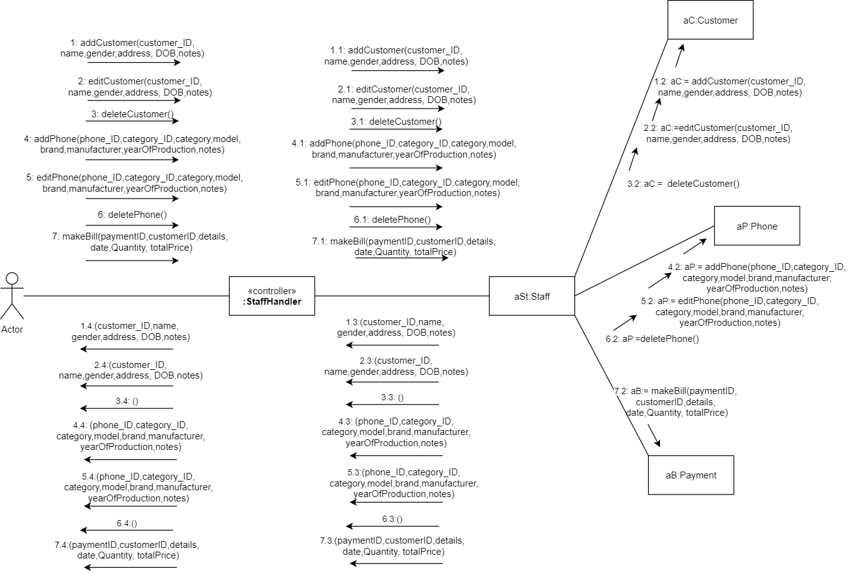
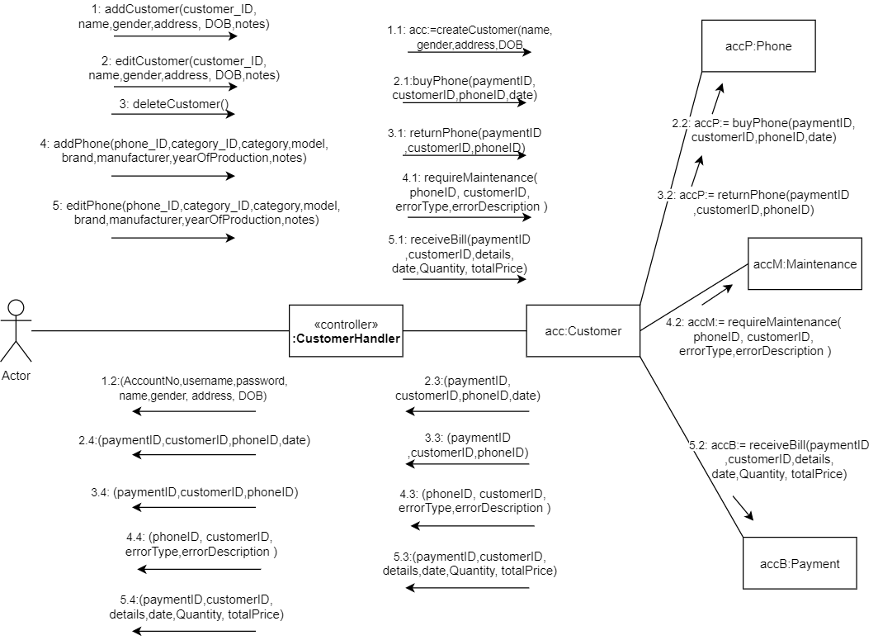
OOD WITH
COMMUNICATION

Slide 9
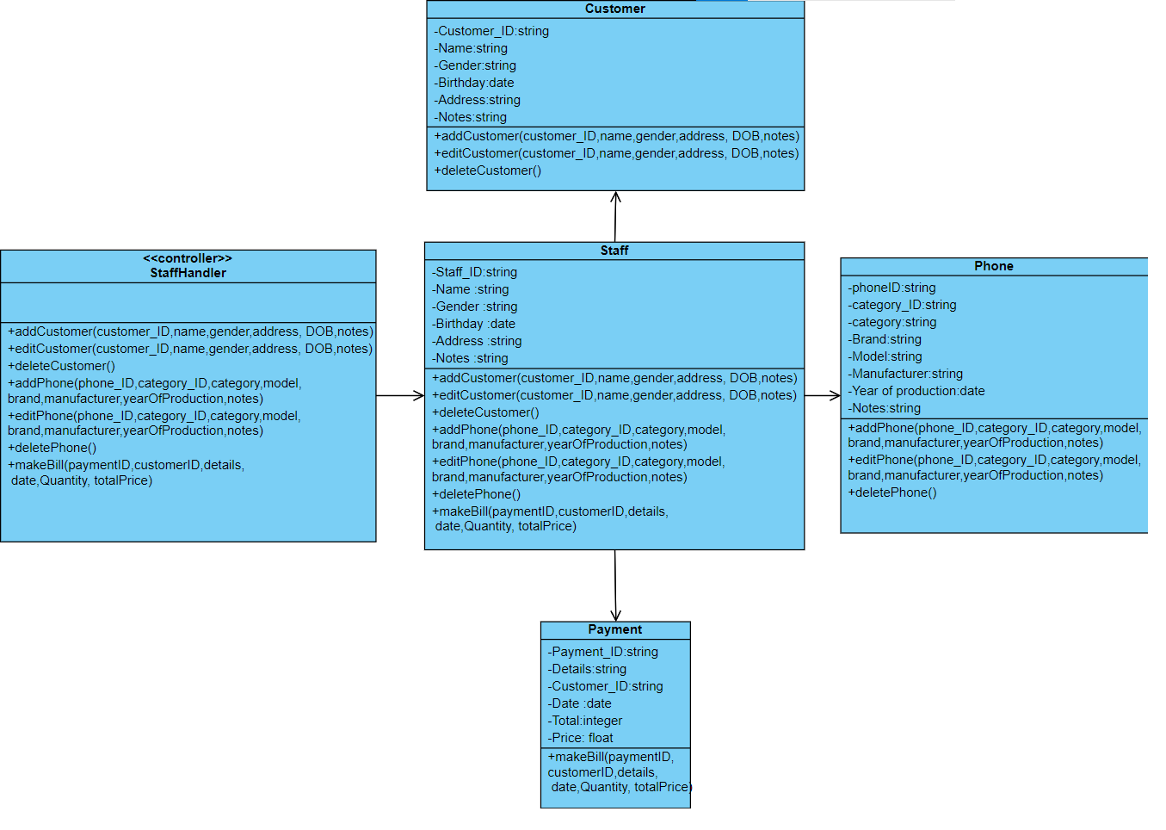
FINAL DESIGN
CLASS DIAGRAM

