Slide 1
The Key Factors of Successful Internet Crowdfunding Projects
—— An Empirical Study Based on Different Platforms
Zhiyuan TIAN
Lei Guan
Meilin SHI

Slide 2
PART 01 Introduction
PART 03 Methodology
Contents
PART 04 Results
PART 05 Implication & Future Research

Slide 3
01
Introduction

Slide 4
Three participants in crowdfunding
Customers
As investors, they invest sometimes as little as $1 in a product. The customers then promote the product by many means. Finally they can get profit from the product^{[1]}.
Founder
As designers, they hope to obtain financial support with lower financing costs. A part of founders want to conduct market research through crowdfunding.
Platform
As the intermediate of customers and founders.
[1] A. Ordanini, “Crowd funding: Customers as investors,” The Wall Street Journal, Vol. 253, pp. 3-4, March 2009.

Slide 5
Crowdfunding classification
Equity-based
Lending-based
Reward-based
Donation-based
Donation-based and reward-based crowdfunding generally attract less funding per project than equity-based or lending-based crowdfunding. However, the reward-based category is the largest crowdfunding category in terms of number of CFPs, and also grew at the high rate of 79% CAGR.
Massolution, “Crowdfunding industry report: Market trends, composition and crowdfunding platforms,” 2014, [Online]. Avaliable: http://crowdsourcing.org/document/14277.

Slide 6
Crowdfunding mechanisms
AON
KIA
All or nothing
Keep it all

Slide 7
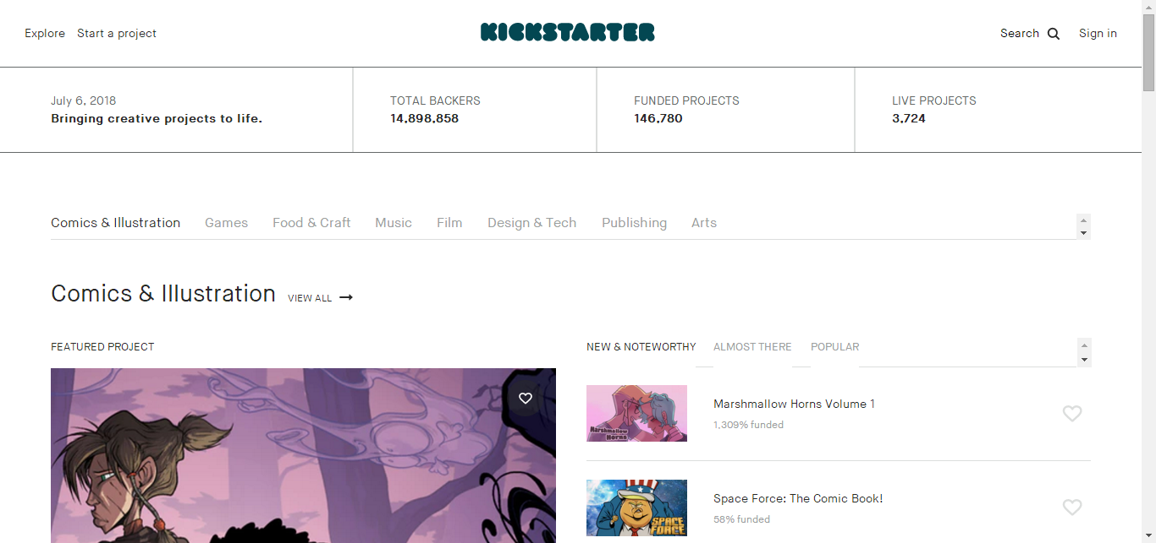
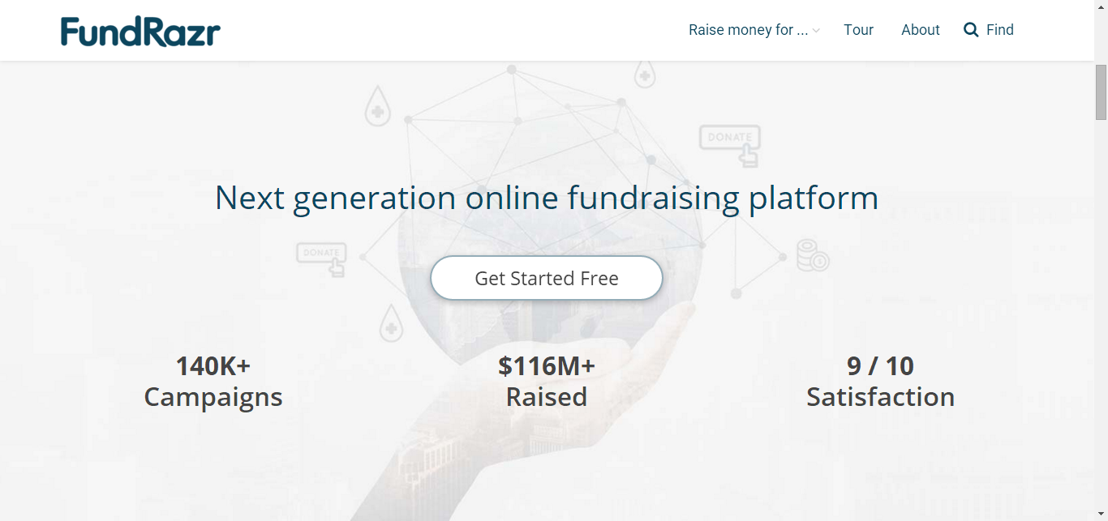
Examples of crowdfunding
Kickstarter
Fundrazr

Slide 8


Research objects
&

Slide 9
02
Research Approach

Slide 10
Research approach
Data collection
Pre-scrape + formal scrape
Empirical
regression
Binary logistic regression model
Results and discussion

Slide 11
03
Methodology

Slide 12
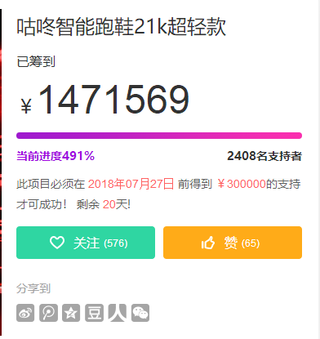
Data collection
Pre-scrape
Formal scrape
To determine the crawler cycle (40 days)

Slide 13
Data collection
Fundraising progress
Reward menu
Data set
714 projects from JD
360 projects from TB
Product introduction
Founder’s information

Slide 14
Variable definition
Quality signal
Reward menu
Data set
714 projects from JD
360 projects from TB
Popularity
Founder’s information

Slide 15
Descriptive statistics
JD
TB
80%
Success rate
93%
5000-2000000
5000-1000000
Fundraising goal
37%
Video
55%

Slide 16
Logistic model

Slide 17
04
Results

Slide 18
Quality signal
Goal
-
Success
The effect has diminished in JD.
No longer significant when factors related to money (FLP,etc.) exist.
Represent the effect of different mechanism.

Slide 19
Mechanisms
AON
backers
KIA
founders

Slide 20
Quality signal
Video
+
Success
The effect is more significant in TB.
Different website layout of different platforms.

Slide 21

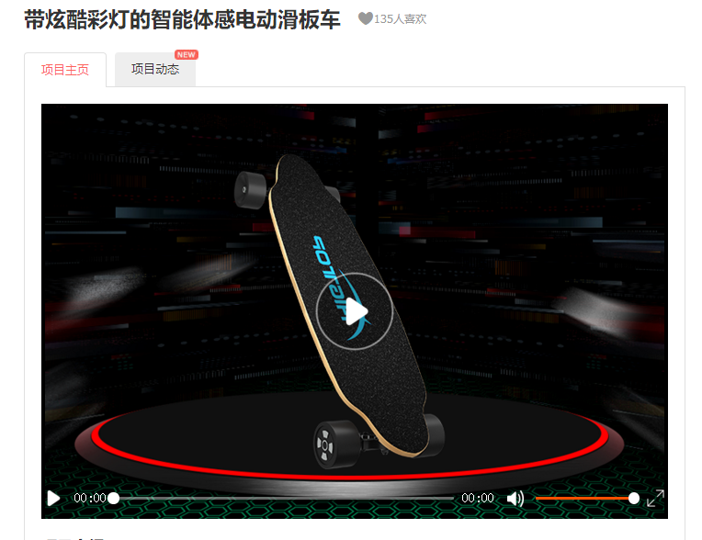
Website layout

Slide 22
Popularity
Popularity
+
Success
More attractive.
Only people who are really interested in the project will click “like”.

Slide 23
Founder
Seller
-
Success
Projects that TaoBao sellers found are easier to get success compared with TMall seller.

Slide 24
Reward menu
Level
+
Success
More levels, more potential backers can the reward attract.
Diversified product choice is a beneficial practice.

Slide 25
Reward menu
FLP
-
Success
Attract price sensitive customers.
It has quantity limitation, contribute slightly to final success.

Slide 26
05
Implication & Future Research

Slide 27
Implication
Founder:
choose platforms that fit them best
set their factors carefully
Platform:
design their websites appropriately
choose suitable mechanism

Slide 28
Future research
More samples
Comparison between countries on platforms

Slide 29
Thank you
Reporter：Zhiyuan TIAN
Beijing Institute of Technology

