Slide 1
The Key Factors of Successful Internet Crowdfunding Projects
—— An Empirical Study Based on Different Platforms
Zhiyuan TIAN
BIT
Lei Guan
BIT
Meilin SHI
BIT

Slide 2
PART 01 Introduction
PART 02 Literature Review
Outline
PART 03 Methodology
PART 04 Results
PART 05 Implication & Future Research

Slide 3
01
Introduction

Slide 4
The definition of crowdfunding
A new business model in which the customers play an unaccustomed role – as investors.
——Ordanini（2009）

Slide 5
Three participants in crowdfunding
Customers
As investors, they invest sometimes as little as $1 in a product. The customers then promote the product by many means. Finally they can get profit from the product.
Founder
As designers, they hope to obtain financial support with lower financing costs. A part of founders want to conduct market research through crowdfunding.
Platform
As the intermediate of customers and founders.

Slide 6
Crowdfunding classification
Equity-based
Lending-based
Reward-based
Donation-based
Donation-based and reward-based crowdfunding generally attract less funding per project than equity-based or lending-based crowdfunding. However, the reward-based category is the largest crowdfunding category in terms of number of CFPs (crowdfunding platforms), and also grew at the high rate of 79% CAGR (Compound Annual Growth Rate).

Slide 7
Research approach
Literature review
Data collection
Pre-scrape + formal scrape
Empirical
regression
Binary logistic regression model
Results and discussion

Slide 8
02
Literature Review

Slide 9
Crowdfunding mechanisms
AON
KIA
AON (All or nothing) means that the founders set a fundraising goal and keep nothing unless the goal is achieved, thereby the risk is shifted to the founder. KIA (Keep it all) means that the founders set a fundraising goal and keep the entire amount raised, regardless of whether or not they meet their goal, thereby allocates the risk to the crowd (Marwell, 2015).
AON can act as a screening mechanisms to attract higher quality projects. When the investment is not protected enough (KIA), backers are more careful of invest amount (Kim et al., 2015).

Slide 10
Factors affecting success
Mollick (2014) investigates the factors including goal, financing rate, backers, comments, videos, etc., based on the Kickstarter platform. These factors become the basis of the studies afterwards.
Frydrych et al. (2014) find that shorter fundraising time and modest goals are more conductive to project success, while rich project presentations and frequent updates of media use of project information can increase the success rate of financing.
Ward and Ramachandran (2017) first discuss the effect of platform information integration. Results show that backers are affected by the strategy of information integration, such as top-5 popularity lists.
Kuppuswamy and Bayus (2017) find that the collective attention effect is produced from platform sorting options.

Slide 11
Factors affecting success
Kim et al. (2015) find the visible information such as the fundraising process rate and the number of backers show positive effect on the success rate.
Li and Duan (2014) discuss the impact of financing process rate and remaining time. The former has positive influence, while the latter has a negative effect.
Robertson and Wooster (2015) make an empirical study towards Kickstarter and find that the invest amount of the first day has positive effect on the project success.
Other factors influencing the success of projects also include gender (Greenberg et al., 2014; Kuppuswamy et al., 2017), geographical location (Mollick, 2014; Agrawal et al., 2015; Lin et al., 2016) and social capital (Zheng et al., 2014).

Slide 12


Research object
&
Existing empirical researches are mainly based on the visible financing factors generally set on the crowdfunding website, but studies involving the amount of reward level, amount of money are scarce.
Reward menu is import reference factor that attracts investors. We put emphasis on reward menu and other visible factors, investigate the impact of them on the success of crowdfunding projects, and discuss the mechanisms different platforms use.

Slide 13
03
Methodology

Slide 14
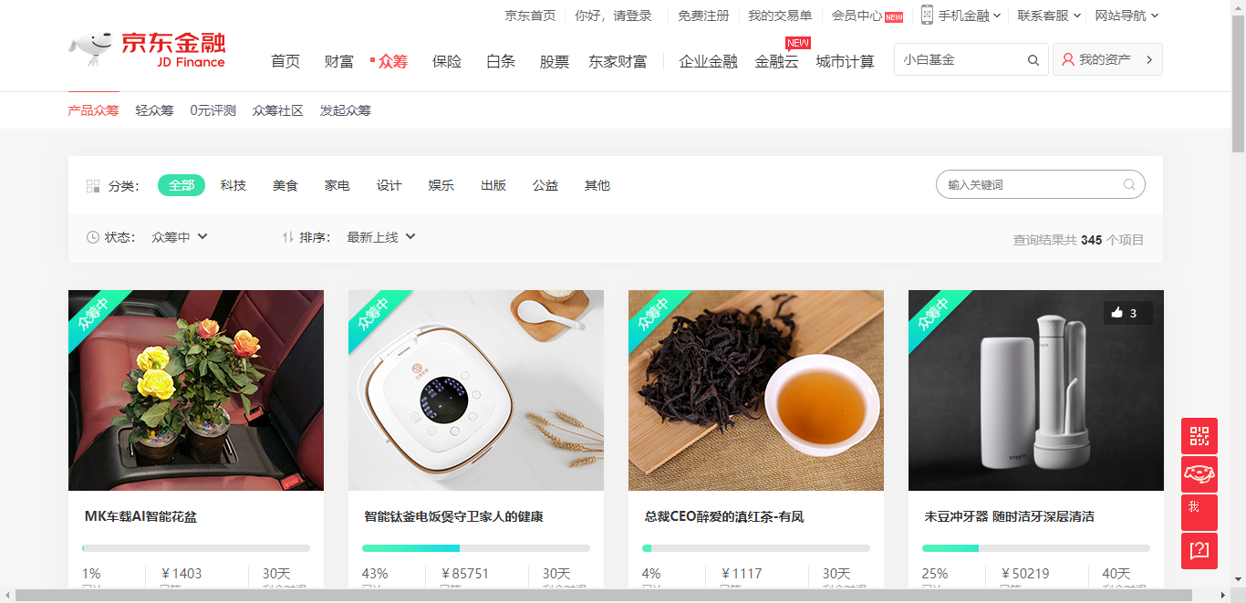
Data collection
Pre-scrape
Formal scrape

Slide 15
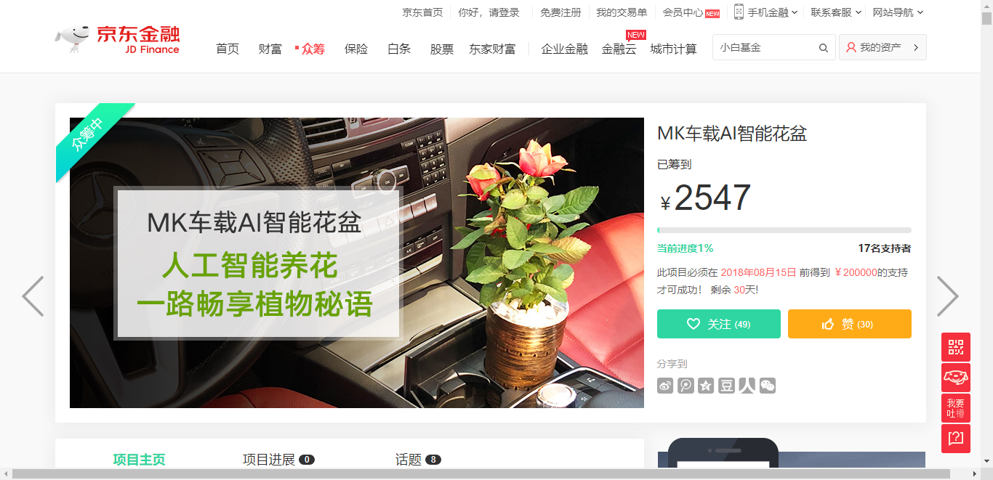
Data collection
Pre-scrape
Formal scrape

Slide 16
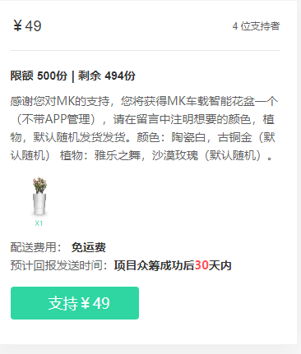
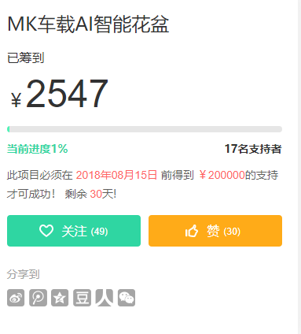
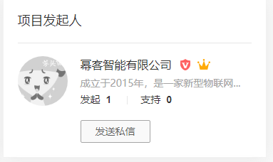
Data collection

Slide 17
Variable definition
Data set
714 projects from JD
360 projects from TB
Quality signal
(Goal Updates
Video Pictures)
Reward menu
(Level FLP SLP)
Popularity
(Likes)
Founder’s information
(Created)

Slide 18
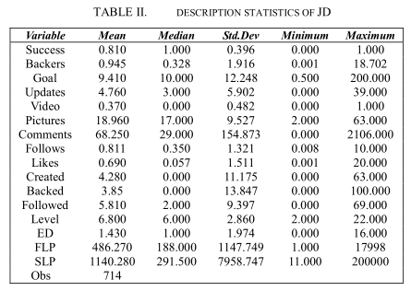
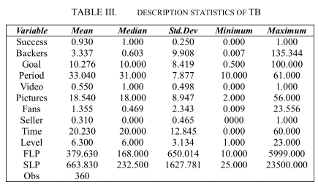
Descriptive statistics

Slide 19
Descriptive statistics
 |  | Mean
Success | JD | 0.810
 | TB | 0.930
Nearly 80% of the samples from JD crowdfunding platform achieved their goal while the number in TB is 93%. Both platforms get a high success rate of crowdfunding projects in our samples.

Slide 20
Descriptive statistics
 |  | Mean | Median | Min | Max
Goal | JD | 9.410 | 10.000 | 0.500 | 200.000
 | TB | 10.276 | 10.000 | 0.500 | 100.000
The range of goals of JD is from 5 thousand to 2 million RMB, while this number of TB is from 5 thousand to 1 million RMB. The most commonly used goal of TB is 100 thousand RMB, which is consistent with the sample of JD.

Slide 21
Descriptive statistics
 |  | Mean
Video | JD | 0.370
 | TB | 0.550
Videos are more widely used in TB.

Slide 22
Logistic model

Slide 23
04
Results

Slide 24
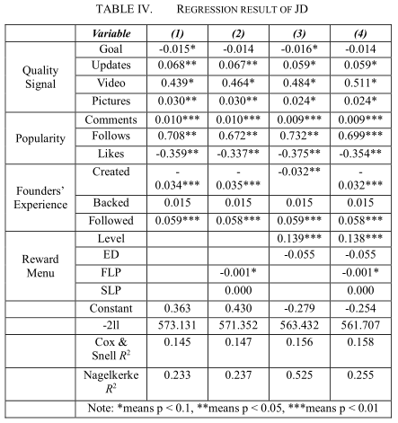
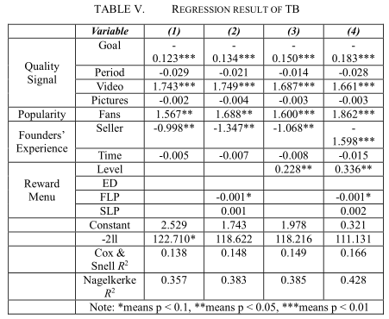
Regression results

Slide 25
Quality signal
Goal
Success
 |  | (1) | (2) | (3) | (4)
Goal | JD | -0.015* | -0.014 | -0.016* | -0.014
 | TB | -0.123*** | -0.134*** | -0.150*** | -0.183***
The effect has diminished in JD.
No longer significant when factors related to money (FLP,etc.) exist.
Represent the effect of different mechanism.

Slide 26
Quality signal
Video
Success
 |  | (1) | (2) | (3) | (4)
Video | JD | 0.439* | 0.464* | 0.484* | 0.511*
 | TB | 1.743*** | 1.749*** | 1.687*** | 1.661***
The effect is more significant in TB.
Different website layout of different platforms.

Slide 27
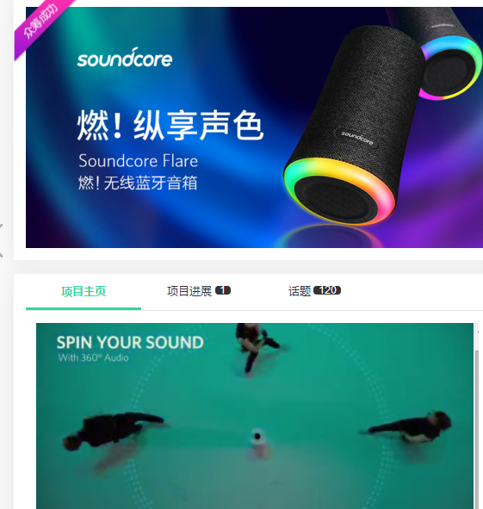
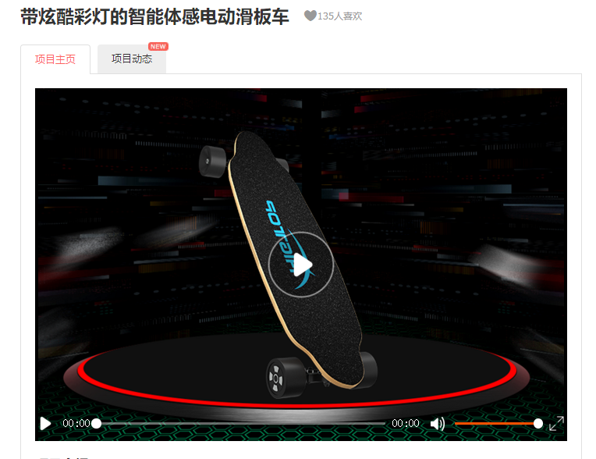
Website layout

Slide 28
Popularity
Popularity
Success
 |  | (1) | (2) | (3) | (4)
Follows/Likes | JD | 0.708** | 0.672** | 0.732** | 0.699***
 | TB | 1.567** | 1.688** | 1.600*** | 1.862***
More attractive.
Only people who are really interested in the project will click “like”.

Slide 29
Founder
Seller
Success
 |  | (1) | (2) | (3) | (4)
Seller | TB | -0.998** | -1.347** | -1.068** | -1.598***
Projects that TaoBao sellers found are easier to get success compared with TMall seller.

Slide 30
Reward menu
Level
Success
 |  | (3) | (4)
Levels | JD | 0.139*** | 0.138***
 | TB | 0.228** | 0.336**
More levels, more potential backers can the reward attract.
Diversified product choice is a beneficial practice.

Slide 31
Reward menu
FLP
Success
 |  | (2) | (4)
FLP | JD | -0.001* | -0.001*
 | TB | -0.001* | -0.001*
Attract price sensitive customers.
It has quantity limitation, contribute slightly to final success.

Slide 32
05
Implication & Future Research

Slide 33
Implication and future research
Founder:
choose platforms that fit them best
set their factors carefully
Platform:
design their websites appropriately
choose suitable mechanism
More samples
Comparison between countries on platforms

Slide 34
Thank you
Zhiyuan TIAN
BIT
Lei Guan
BIT
Meilin SHI
BIT

