Slide 1
EasyVisa Project 5
Walter Efird

Slide 2
Contents
Executive Summary
Business Problem / Solution Approach
Statistical Summary
EDA Results
Data Preprocessing
Model Performance Summary
Insights and Recommendations

Slide 3
Summary
The Office of Foreign Labor Certification has seen increases in the amount of job certification applications each year, they and need a more efficient way to approve or deny applicants for acquiring a visa certification.
In 2016, OFLC saw a 9% increase in the overall number of processed applications from the previous year.
Being able to review every case is becoming very difficult; as a result, they are seeking help through a Machine Learning based solution.

Slide 4
Problem Statement
OFLC has hired the firm EasyVisa for data-driven solutions. As the data scientist, the goal is to analyze the data provided and with the help of a classification model:
1. Facilitate the process of Visa approvals
2. Recommend a suitable profile for the applicants for whom the visa should be certified
or denied based on the drivers that significantly influence the case status

Slide 5
Data Description
The data contains the different attributes of the employee and the employer.
case_id: ID of each visa application
continent: Information of continent the employee
education_of_employee: Information of education of the employee
has_job_experience: Does the employee has any job experience? Y= Yes; N = No
requires_job_training: Does the employee require any job training? Y = Yes; N = No
no_of_employees: Number of employees in the employer's company
yr_of_estab: Year in which the employer's company was established
region_of_employment: Information of foreign worker's intended region of employment in the US.
prevailing_wage: Average wage paid to similarly employed workers in a specific occupation in the area of intended employment. The purpose of the prevailing wage is to ensure that the foreign worker is not underpaid compared to other workers offering the same or similar service in the same area of employment.
unit_of_wage: Unit of prevailing wage. Values include Hourly, Weekly, Monthly, and Yearly.
full_time_position: Is the position of work full-time? Y = Full-Time Position; N = Part-Time Position
case_status: Flag indicating if the Visa was certified or denied

Slide 6
Statistical Summary
There are 12 features in the dataset, with “case_status” being the target variable.
There are 25,480 rows and 12 columns.
Asia is the most frequent continent value.
Most applicants have a Bachelor’s degree
Most applicants do have job experience.
The average number of employees is 5,667.04.
Most of the applicants work for a company that was established in 1979.
Most common region applicants work in is the Northeast region.
The mean prevailing_wage is $74,455.81 with a min of $2.13 and max of $107,735.51
Most applicants’ unit_of_wage is yearly.
Most applicants are employed full-time.
The majority of applicants’ case_status are certified.

Slide 7
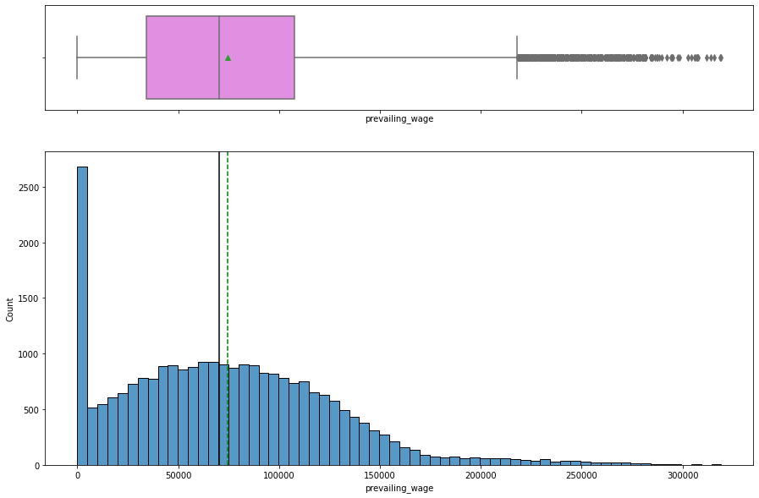
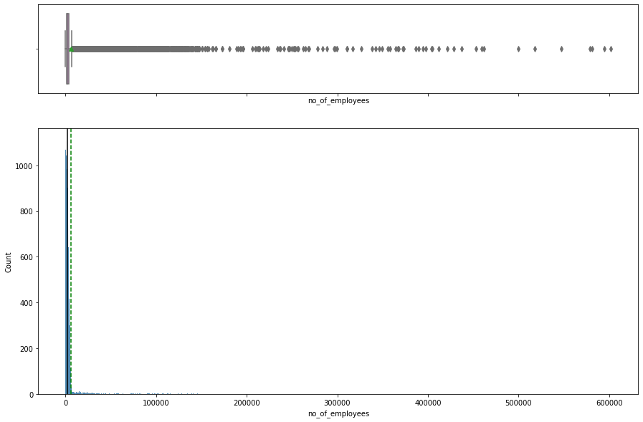
Exploratory Data Analysis
Prevailing_wage
no_of_employees
Prevailing_wage is right-skewed with outliers at end of the right tail and outliers where prevailing_wage is close to $0.
Though difficult to see, no of employees is also right-skewed with many outliers to the right end.

Slide 8
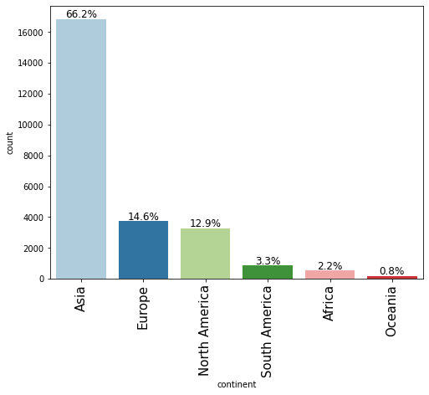
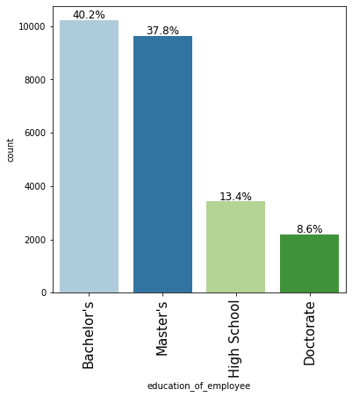
EDA cont.
continent
Education of employee
Most applicants are from Asia, making up 66.2%
Europe and then US are the next largest groups, making up just 14.6% and 12.9%.
Oceania is the smallest at 0.8%
40.2% of applicants have a Bachelor’s and 37.8% have a Master’s degree
Only 13.4% had just high school education and 8.6% had a doctorate.

Slide 9
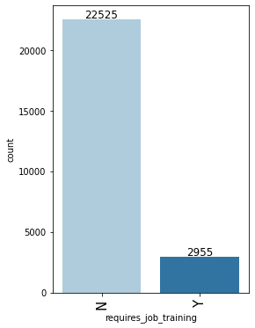
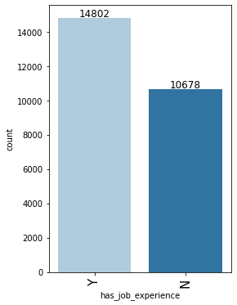
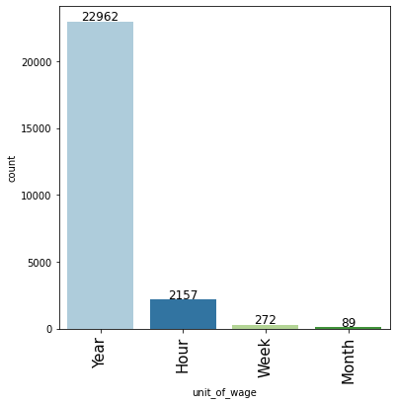
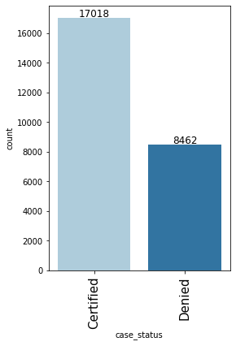
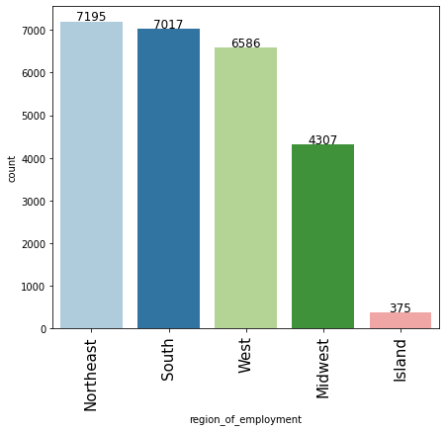
EDA cont.
For the most part, applicants intend on working all over the United States, with just a small portion of applicants intending to work in the islands (i.e. Hawaii).
This makes sense as the biggest cities, such as, New York, Atlanta, LA are in those regions.
Approximately 67% of applicants were certified
Almost all applicants will not require job training.
Additionally, 14,802 out of 25,480 have job experience.
Nearly all applicants are on or intend on being paid salary.
Overall, it appears that almost all applicants are well-qualified for work, which is a good indication that many will be certified.

Slide 10
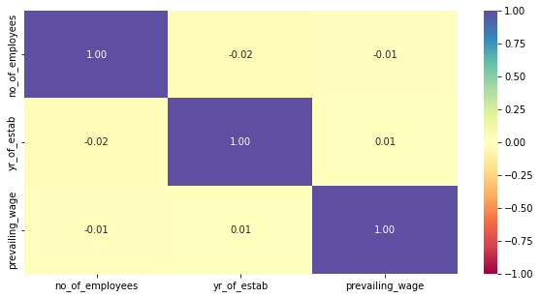
EDA-Bivariate
A very weak correlation exists among the numeric variables prevailing_wage, yr_of estab, and no_of_employees.
There is a weak negative correlation among yr_of_estab and no_of_employees.
A weak negative correlation exists between no_of_employees and prevailing_wage.
A weak positive correlation exists among prevailing_wage and yr_of_estab.

Slide 11
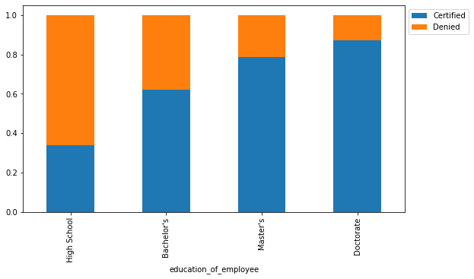
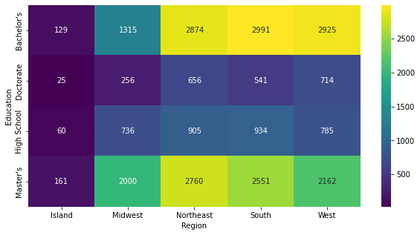
EDA - Bivariate
Education, Region, and Case status
There appears to be a strong correlation among employee education and case status.
The higher the degree of education, the more likely an applicant will get certified.
Approximately 30% of applicants with high school level education became certified.
Approximately 85% of applicants with Doctorate and 78% with a Masters were certified.
Employees with Bachelors and Master’s degrees are highly concentrated in the South, West, and Northeast Regions.
There is a large number of employees with a Masters located in the Midwest region also.
Overall, education does have an impact on visa certification

Slide 12
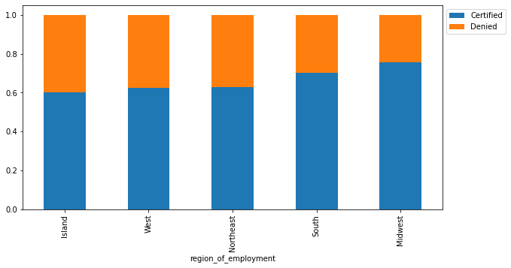
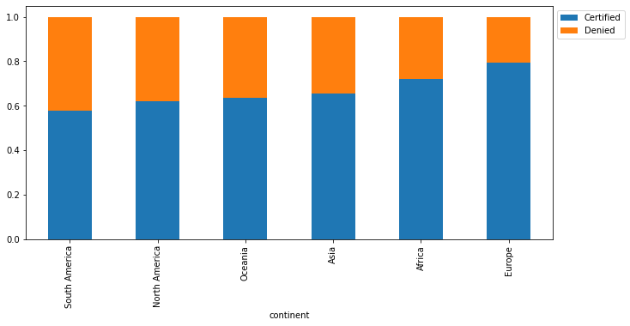
EDA – Bivariate
Visa certification by region and by continent
Midwest and the South have the highest % of certified employees with 78% and 75% respectively
Island, West and Northeast are all about 60%.
In regards to continent, Europe has the highest % of certified applicants at approximately 80%.
Surprisingly, US is second to last in certified case status with roughly 60%.

Slide 13
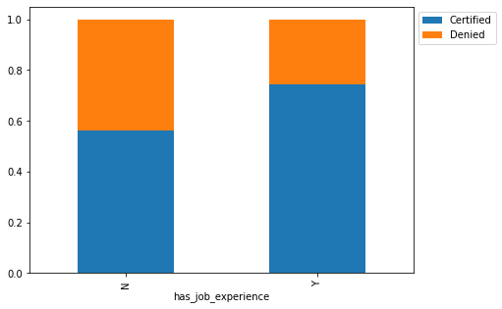
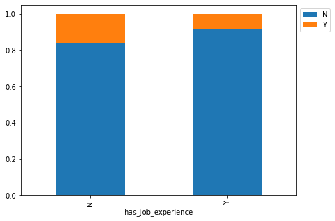
EDA - Bivariate
Having job experience does not significantly impact whether one requires job training
Approximately 80% of applicants without job experience do not require job training and roughly 85% of applicants that do have job experience also do not require training.
Job experience does have an impact on getting certified.
About 75% of applicants with job experience were certified while %55 of applicants that didn’t have job experience were also certified.

Slide 14
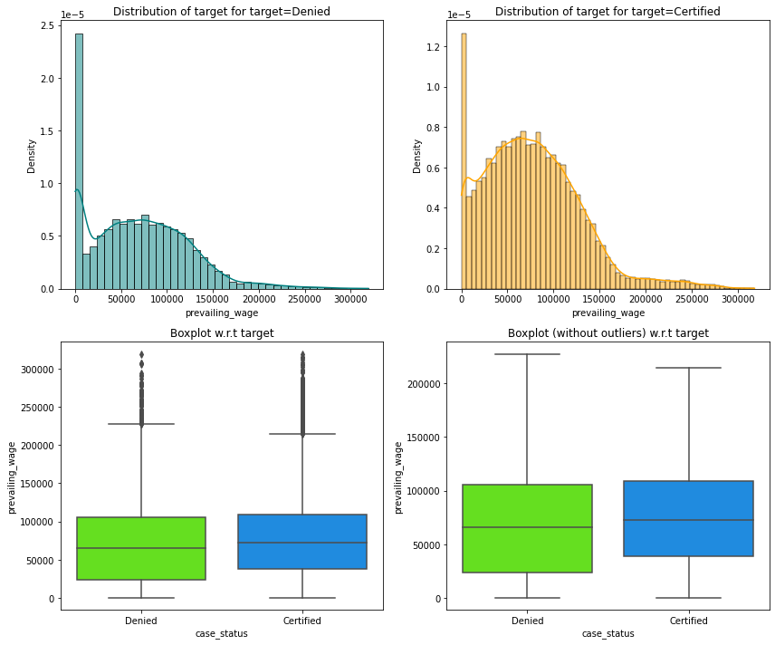
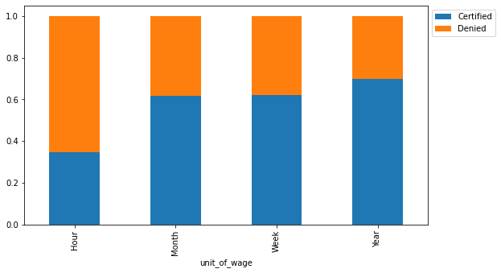
EDA - Bivariate
Prevailing wage, unit of wage and case status

Slide 15
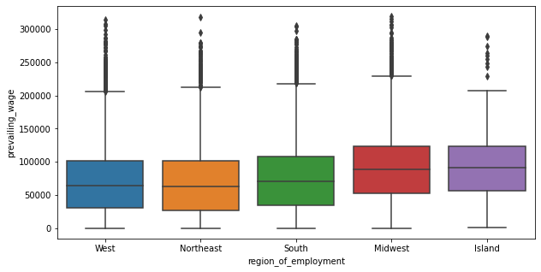
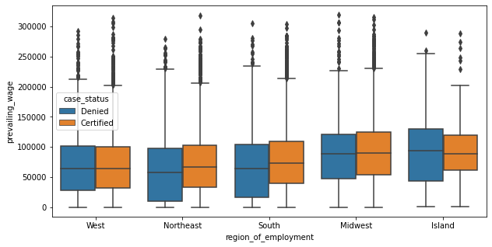
EDA - Bivariate
Prevailing wage and case status in US
Variance is larger for those not certified.
Outliers exist on both of those certified and not certified.
The Midwest have Island regions have the highest average prevailing wage, but just slightly.
There is more variance in prevailing wage for those denied visa certification.

Slide 16
Data Preprocessing
Duplicate Value check - 0 duplicate values exist in the dataset
Missing Values – no missing values exist
Outlier Detection – see next slide
Data preparation for modeling – Used pd.get_dummies for categorical variables
Shape of the training and test sets:
Shape of Training set: (19110, 21)
Shape of Test set: (6370, 21)
Percentage of classes in training set
1 -- 0.66787
0 -- 0.33213
Percentage of classes in test set
1 -- 0.667975
0 -- 0.332025

Slide 17
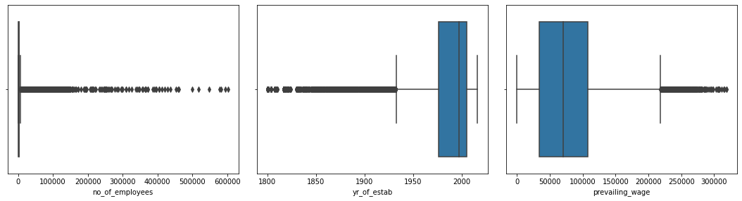
Data Preprocessing – Outlier Detection
Outliers are present for all three features no_of_employees, yr_of_estab, and prevailing_wage. I chose not to treat outliers, keeping them as proper values.

Slide 18
Model Summary
Models that were used
Decision Tree Classifier
Bagging Classifier
Random Forest Classifier
AdaBoost Classifier
Gradient Boosting Classifier
XGBoost Classifier
For hyperparamter tuning, GridSearch was used on each of the models to improve its performance.

Slide 19
Training and Testing Key Performance Measures
Training Set
 | Decision Tree | Tuned Decision Tree | Bagging Classifier | Tuned Bagging Classifier | Random Forest | Tuned Random Forest | Adaboost Classifier | Tuned Adaboost Classifier | Gradient Boost Classifier | Tuned Gradient Boost Classifier | XGBoost Classifier | XGBoost Classifier Tuned | Stacking Classifier
Accuracy | 1 | 0.711983 | 0.985139 | 0.999843 | 0.9999 | 0.772946 | 0.739403 | 0.719362 | 0.759236 | 0.76269 | 0.757457 | 0.756201 | 0.768446
Recall | 1 | 0.931599 | 0.984486 | 1 | 1 | 0.905822 | 0.889446 | 0.780224 | 0.881454 | 0.880357 | 0.882003 | 0.880671 | 0.878398
Precision | 1 | 0.71969 | 0.993202 | 0.999765 | 0.99984 | 0.78657 | 0.760807 | 0.795622 | 0.784628 | 0.788823 | 0.782497 | 0.781859 | 0.79601
F1 | 1 | 0.812048 | 0.988825 | 0.999882 | 0.99992 | 0.841994 | 0.820113 | 0.787848 | 0.830228 | 0.832081 | 0.829275 | 0.828328 | 0.835177
Testing Set
 | Decision Tree | Decision Tree Estimator | Random Forest Estimator | Random Forest Tuned | Bagging Classifier | Bagging Estimator Tuned | Adaboost Classifier | Adabosst Classifier Tuned | Gradient Boost Classifier | Gradient Boost Classifier Tuned | XGBoost Classifier | XGBoost Classifier Tuned | Stacking Classifier
Accuracy | 0.652433 | 0.707064 | 0.72292 | 0.740502 | 0.69686 | 0.722606 | 0.727473 | 0.715228 | 0.740502 | 0.740973 | 0.740502 | 0.740659 | 0.742386
Recall | 0.73678 | 0.93161 | 0.847239 | 0.888132 | 0.77462 | 0.896357 | 0.883901 | 0.783549 | 0.873325 | 0.872385 | 0.877321 | 0.877321 | 0.86745
Precision | 0.74131 | 0.715653 | 0.763771 | 0.76251 | 0.77226 | 0.742023 | 0.751749 | 0.788739 | 0.769358 | 0.770284 | 0.767475 | 0.767633 | 0.774119
F1 | 0.739038 | 0.809475 | 0.803343 | 0.820541 | 0.77344 | 0.811921 | 0.812486 | 0.786135 | 0.818052 | 0.818162 | 0.81873 | 0.81882 | 0.818131

Slide 20
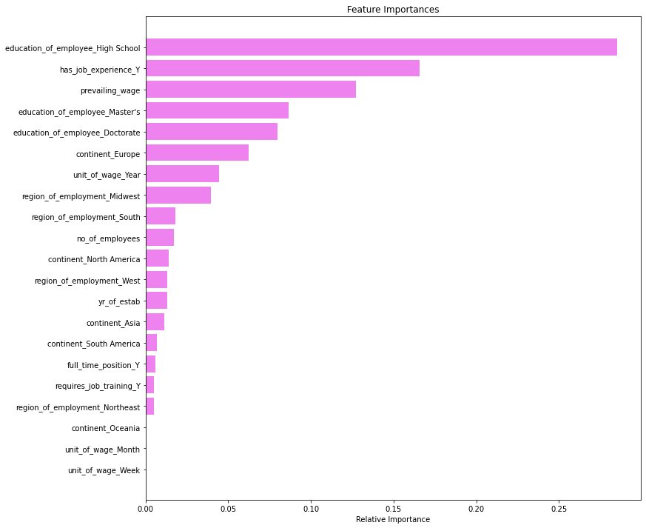
Overview of Final Model and Parameters
Random Forest gives the highest F1 score of all the models on the test data, but it is overfitting on the training data.
The majority of the models are overfitting on the training data
Gradient boost is the most consistent in terms of comparing training and test scores.
XGBoost also has consistent scores and has a slightly higher F1 score compared to Gradient Boost
Employees/applicants with High School level is the most important feature followed by whether or not an applicant has job experience in determining whether an applicant will be certified.

Slide 21
Business Observations
The most important feature is employees with high school level education. Most of the employees with only high school level education were not certified; however, job experience should also be taken into consideration when deciding the employee’s certification status as this was the 2nd most important feature.
The employees with job experience is the second most important factor in whether the applicants will be certified. Those with job experience are more likely to become certified.
Focusing on feature importance, three of the top 5 most important features are based on an employees education, which include High School level, Master’s and Doctorate

Slide 22
Appendix

Slide 23
Data Background and Contents
Goal → Build a model that predicts whether applicant will get certified
Before building, the categorical data has to be encoded, which was accomplished with pandas get_dummies.
Data was then split into train and test sets.
Model Evaluation Criterion
We want to reduce False Negatives and False Positives
To do this, we use F1 score as the metric evaluation of the model. Greater the F1 score the higher the chances of reducing False Negative and False Positive
Next, the steps in building the Decision Tree, Random Forest and Bagging Classifier will be discussed

Slide 24
Model Building – Overview & Decision Tree
We will discuss the model building of the Decision Tree, Random Forest and Bagging Classifier
We first build the models using default parameters and then include hyperparameter tuning afterwards.
The metrics calculated are → Accuracy, Precision, Recall and F1 Score
F1 score is the metric used for evaluation of the model
GridSearch is used in hyperparameter tuning---it utilizes cross-validation over the parameter criteria of each model.
We want to achieve the maximum F1 score since the greater the F1 score the greater the chances of reducing False Negatives and False Positives
False Positive = Model predicts that visa will get certified, but it should get denied
False Negative = Model predicts visa will not get certified when it should get certified
2 functions are created to calculate these metrics and we will display a confusion matrix for the number of True Positives, True Negatives, False Positive, False Negatives.
Decision Tree Model
Hyperparameters
Max depth
Min_samples_leaf
Max_leaf_nodes
Min_impurity_decrease
Hyperparameter – Post-tuning results
Set the class weight to balanced for hyperparameter tuning.
Grid search is used in tuning to find optimum values of hyperparameters
The tuned model has reduced overfitting and increased F1.
Post-tuning test performance
Accuracy – 0.707064
Recall – 0.93161
Precision – 0.715653
F1 – 0.809475
For default parameters, the gini index criteria is used to split data
Pre-tuning training set performance resulted in 100% for all scores.
This is evidence of overfitting.
Pre-tuning test set performance resulted in
Accuracy – 0.652433
Recall – 0.73678
Precision – 0.74131
F1 – 0.739038

Slide 25
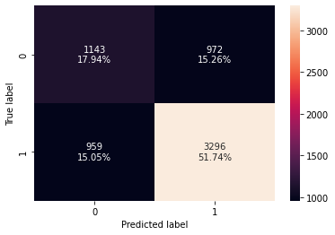
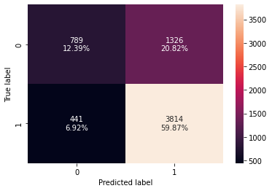
Model Building - Bagging
Pre-tuned is the first matrix and Post-tuned the second
The model predicts those who should be denied certification best.
With precision decreasing after tuning, the model saw an increase in predicting applicants for certification when in fact they should have been denied (False Positives)
Pre-tuned Model (Default)
Base estimator is Decision Tree by default
Model is overfitting on training set and test performance is not great
The test performance on the tuned model improved significantly from the test data on default (pre-tuned) except precision fell to 0.74
Pre-tuned
Tuned Model
Parameters used:
Bootstrap features – this is set to True which chooses features with replacement
Max_features –max features provided per tree
Max samples – max number of samples from training data to train each tree
N estimators – number of base estimators
Model is still overfitting on the training data after hyperparameter tuning, but overall the model has improved
Accuracy | Recall | Precision | F1
0.985139 | 0.984486 | 0.993202 | 0.988825
Accuracy | Recall | Precision | F1
0.69686 | 0.774618 | 0.772259 | 0.773437
Post-tuned
Accuracy | Recall | Precision | F1
0.999843 | 1 | 0.999765 | 0.999882
Accuracy | Recall | Precision | F1
0.722606 | 0.896357 | 0.742023 | 0.811921

Slide 26
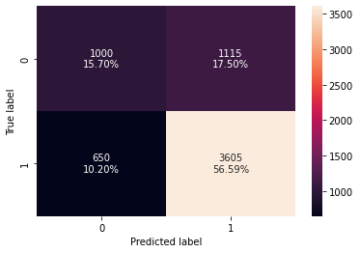
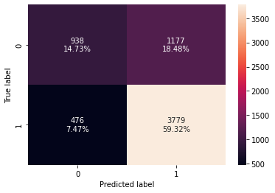
Model Building – Random Forest
Pre-tuned
Pre-tuned model
class weight parameter is set to balanced. This parameter specifies the weights associated to each class-default value is one.
For this model we set it to ‘balanced’ for pre-tuned model.
The model is suffering from overfitting on the training data.
On the test data, the model seems to generalize well
Based on the class weights, the model is better at identifying the applicants that should be denied certification.
Post-tuned
Model has improved overall compared to pre-tuned as it does not appear to be suffering from overfitting.
The training data performed better than test data but both models are comparable.
The post-tuned model improved its accuracy in predicting applicants that should be denied certification by 3% compared to the pre-tuned model.
The F1 score did improve from pre-tuning to post-tuning from 0.803343 to 0.820541 which is the best score so far.
Post-tuned
Pre-tuned
Accuracy | Recall | Precision | F1
0.999895 | 1 | 0.999843 | 0.999922
Accuracy | Recall | Precision | F1
0.722292 | 0.847239 | 0.763771 | 0.803343
Post-tuned
Accuracy | Recall | Precision | F1
0.772946 | 0.905822 | 0.78657 | 0.841994
Accuracy | Recall | Precision | F1
0.740502 | 0.888132 | 0.76251 | 0.820541

Slide 27

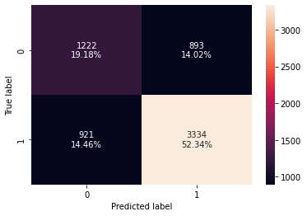
AdaBoost Model
Pre-tuned
Pre-tuned model generalizes best at identifying the applicants that shouldn’t be certified.
The training and test performance are very similar with almost equal Recall , Accuracy and Precision scores.
The training data had a slightly better F1 score of 0.820113 compared to 0.812486 for the test data.
Tuned model shows a decrease in identifying applicants that should be denied (True Negative) however, it better identified applicants that should be certified (True Positives).
The tuned model has almost identical performance scores among the training and testing data.
Post-tuned
Pre-tuned
Post-tuned
Accuracy | Recall | Precision | F1
0.739403 | 0.889446 | 0.760807 | 0.820113
Accuracy | Recall | Precision | F1
0.727473 | 0.883901 | 0.751749 | 0.812486
Accuracy | Recall | Precision | F1
0.719362 | 0.780224 | 0.795622 | 0.787848
Accuracy | Recall | Precision | F1
0.715228 | 0.783549 | 0.788739 | 0.786135

Slide 28
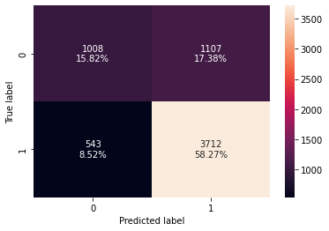
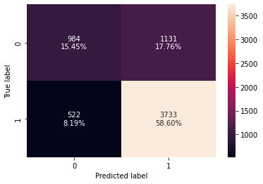
Gradient Boost Model
Pre-tuned
Both models were better at identifying the applicants that should be denied.
Training data in both the default and tuned models scored slightly better than the testing data.
Either model does not appear to be suffering from overfitting.
After hyperparameter tuning there is not much difference between either of the two models.
Tuned
Pre-tuned
Tuned
Accuracy | Recall | Precision | F1
0.759236 | 0.881454 | 0.784628 | 0.830228
Accuracy | Recall | Precision | F1
0.740502 | 0.873325 | 0.769358 | 0.818052
Accuracy | Recall | Precision | F1
0.76269 | 0.880357 | 0.788823 | 0.832081
Accuracy | Recall | Precision | F1
0.740973 | 0.872385 | 0.770284 | 0.818162

Slide 29

XGBoost Model
Pre-tuned
There is not much of a difference between the models after tuning.
All scores are almost identical and the models do not appear to be suffering from overfitting.
F1 Score is 0.818 in both the default and tuned models.
The model also generalizes the best at identifying the applicants that should be denied.
This makes sense as the most important feature is the employee high school level of education
Tuned
Pre-tuned
Tuned
Accuracy | Recall | Precision | F1
0.757457 | 0.882003 | 0.782497 | 0.829275
Accuracy | Recall | Precision | F1
0.740502 | 0.877321 | 0.767475 | 0.81873
Accuracy | Recall | Precision | F1
0.756201 | 0.880671 | 0.781859 | 0.828328
Accuracy | Recall | Precision | F1
0.740659 | 0.877321 | 0.767633 | 0.81882

