Slide 1
interpreting program impact
Fundamentals of
PROGRAM EVALUATION
JESSE LECY

Slide 2
Which model is the “right” one?

Slide 3
Interpreting program impact

Slide 4
Which bet would
you prefer?
Bet #1
The bet costs $1,000 to place There is a 75% chance you win $1,500
There is a 25% chance you win $1,100
Bet #2
The bet costs $1,000 to place There is a 75% chance you win $4,000
There is a 25% chance you lose $2,000

Slide 5
Which bet would
you prefer?
Bet #1
The bet costs $1,000 to place There is a 75% chance you win $1,500
There is a 25% chance you win $1,100
Expected value =
(0.75)(1500) + (0.25)(1100) =
$1,400
Bet #2
The bet costs $1,000 to place There is a 75% chance you win $4,000
There is a 25% chance you lose $2,000
Expected value =
(0.75)(4000) – (0.25)(2000) =
$2,500

Slide 6
Which bet would
you prefer?
Bet #1
The bet costs $1,000 to place There is a 75% chance you win $1,500
There is a 25% chance you win $1,100
Expected value =
(0.75)(1500) + (0.25)(1100) =
$1,400
$1,100
$1,500

Slide 7
Which bet would
you prefer?
Bet #2
The bet costs $1,000 to place There is a 75% chance you win $4,000
There is a 25% chance you lose $2,000
Expected value =
(0.75)(4000) – (0.25)(2000) =
$2,500
– $2,000
$4,000
$0
1 in 4 chance of losing money
3 in 4 chances of winning money

Slide 8
Which bet would
you prefer?
Bet #1
100% chance of positive return
Expected value =
(0.75)(1500) + (0.25)(1100) =
$1,400
Bet #2
75% chance of a positive return
Expected value =
(0.75)(4000) – (0.25)(2000) =
$2,500

Slide 9
Coefficient plots
STATISTICAL SIGNIFICANCE (N.S. IF C.I. CONTAINS ZERO)
SLOPE ESTIMATE
(BEST GUESS)
b₁
b₁ = 0
CONFIDENCE INTERVAL
NULL HYPOTHESIS
(NO IMPACT)

Slide 10

Which program is better?
R$eading Speed=b_{0}$ + $b_{1}Hours of Tutoring$ + e
Program 1
Program 2
b₁
b₁
b₁ = 0
b₁ = 0
(assume these are all 95% confidence intervals)
The cost of the program is the bet we are making.
The expected value of the program is represented by the point estimate of the slope (b1).
The risk (certainty) of the bet is symbolized by the confidence interval.
Preferences for bets is always a balance between expected pay-off and risk (uncertainty).

Slide 11

What about now?
R$eading Speed=b_{0}$ + $b_{1}Hours of Tutoring$ + e
Program 1
Program 2
b₁
b₁
b₁ = 0
b₁ = 0
Which model is statistically significant?
Which program has more positive impact?

Slide 12

Experiment with groups
(treated:
yes or no)
$$Heartrate=b_{0}+b_{1}∙Caffeine+ε$$
Heart Rate
Treatment (Caffeine)
Control (No caffeine)
T2
C2

Slide 13

Effects Sizes for Levels of A Treatment
$$y=β_{0}+β_{1}x$$
β₁ =140
Effect
One unit of X
Slope=0
For a one-unit change in X, we expect a β₁ change in Y.
How big is the effect?
Is it significant?

Slide 14

effect size
$$Heartrate=b_{0}+b_{1}∙Caffeine+ε$$
Positive & Significant
Impact
on Outcome
b₁
Effect
b₁ = 0
Notes:
In an experiment there is full control over the treatment variable, and it is the only thing being manipulated

Slide 15
effect size
$$Heartrate=b_{0}+b_{1}∙Potato Chips+ε$$
b₁
b₁ = 0
Not statistically significant – i.e. we can’t tell whether the program has a positive or negative impact since the confidence interval is on both sides of zero.
Notes:
Null case – the treatment has no effect

Slide 16
hypothesis testing
STATISTICAL SIGNIFICANCE (N.S. IF C.I. CONTAINS ZERO)
SLOPE ESTIMATE
(BEST GUESS)
b₁
b₁ = 0
CONFIDENCE INTERVAL
NULL HYPOTHESIS
(NO IMPACT)

Slide 17
Which program is better?
Consider two programs that are meant to improve reading comprehension. The dependent variable is a score on a reading comprehension exam (higher being better). Which program do you prefer and why?
R$eading Speed=b_{0}$ + $b_{1}Hours of Tutoring$ + e
Program 1
Program 2
b₁
b₁
b₁ = 0
b₁ = 0
(assume these are all 95% confidence intervals)

Slide 18
What about now?
R$eading Speed=b_{0}$ + $b_{1}Hours of Tutoring$ + e
Program 1
Program 2
b₁
b₁
b₁ = 0
b₁ = 0
Which model is statistically significant?
Which program has more positive impact?

Slide 19
What about now?
R$eading Speed=b_{0}$ + $b_{1}Hours of Tutoring$ + e
Program 1
Program 2
b₁
b₁
b₁ = 0
b₁ = 0
Which model is statistically significant?
Which program has more positive impact?

Slide 20

What about now?
R$eading Speed=b_{0}$ + $b_{1}Hours of Tutoring$ + e
b₁
Program 1
b₁
Program 2
b₁ = 0
Which model is statistically significant?
Which program has more positive impact?

Slide 21

What about now?
R$eading Speed=b_{0}$ + $b_{1}Hours of Tutoring$ + e
Program 1
b₁
Program 2
b₁
Program 3
b₁
b₁ = 0

Slide 22
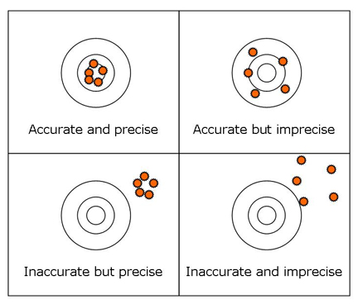

R$eading Speed=b_{0}$ + $b_{1}Hours of Tutoring$ + e
Program 1
Program 2
b₁
b₁
b₁ = 0
b₁ = 0
Model precision
Eval. of Program 1
Eval. of Program 2

Slide 23
Looking ahead
For now we are focusing on the interpretation of coefficient plots. But next week we will look at how adding control variables change models. They can shift coefficients, and change standard errors, changing the interpretations of program effectiveness.
Model 1
Model 2 w Controls
b₁
b₁
b₁ = 0
b₁ = 0
(assume these are all 95% confidence intervals)

Slide 24
What is a p-value?

Slide 25
Which of these is statistically significant?
95% CI
b₁
99% CI
b₁
b₁ = 0
These are both estimates from the same model.

Slide 26
What is the p-value in this case?
95% CI
b₁
99% CI
b₁
b₁ = 0
These are both estimates from the same model.

Slide 27
What is the p-value in this case?
97% CI
P-val = 0.03
b₁
b₁ = 0
The p-value tells you how large you can draw your confidence interval before it contains the null.

Slide 28
Which program is better?
R$eading Speed=b_{0}$ + $b_{1}Hours of Tutoring$ + e
Program 1
Program 2
b₁
b₁
b₁ = 0
b₁ = 0
95% confidence intervals

Slide 29
What about now?
R$eading Speed=b_{0}$ + $b_{1}Hours of Tutoring$ + e
Program 1
Program 2
b₁
b₁
b₁ = 0
b₁ = 0
90% confidence intervals

Slide 30
Which bet would
you prefer?
Bet #1
The bet costs $1,000 to place There is a 75% chance you win $1,500
There is a 25% chance you win $1,100
Bet #2
The bet costs $1,000 to place There is a 75% chance you win $4,000
There is a 25% chance you win $0

Slide 31
Mechanics of Confidence intervals

Slide 32
The Road Map (AGAIN)
Of the Mean:
Of the Slope:
Sampling
Variance:
(for x)
(using the residual)
Standard Deviation:
Standard Error:
Confidence Interval
(of the mean)
(of the slope)

Slide 33
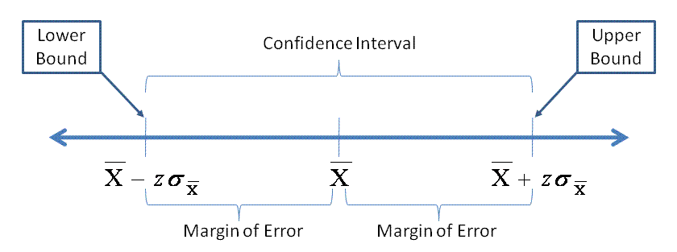
The formula
If we were sure of ourselves we wouldn’t need a margin of error! We only have a sample, though, so we can’t be certain.
The population parameters are never known, so we use t-stats and the formula for the sample standard error.
(CI of the mean)

Slide 34
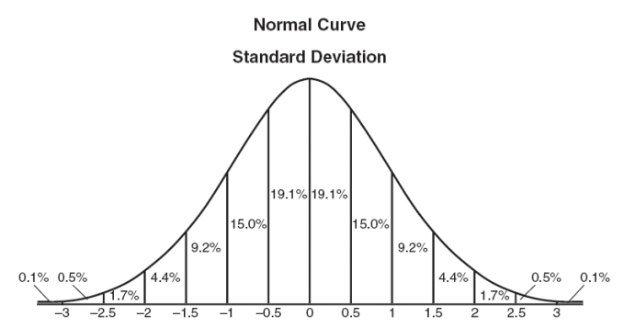
What is a t-value?
If we examine an interval that is 1 standard deviation from the mean in both directions, we know that this will include 68.2% of the cases.

Slide 35
What is a t-value?
If we examine an interval that is 1.5 standard deviations from the mean in both directions, we know that this will include 86.6% of the cases.

Slide 36
What is a t-value?
t=1.96
I want a 95% confidence interval, so I find the t-value where 95% of the data falls within the interval (in a 2-sided test).

Slide 37
Determine t-value:
Select a level of confidence
Figure out your sample size
Find a t-table
Match level of confidence to sample size
Or just use software like a normal person

Slide 38
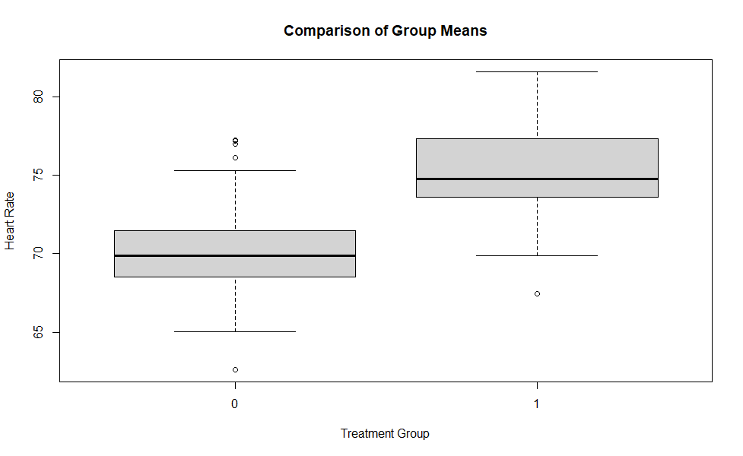
head( data.frame( y, t ) )
y t
1 67.67494 0
2 71.19501 1
3 69.81960 0
4 73.58000 1
5 65.47680 0
6 74.04290 1
# create some fake data
# y = heartrate
# t = treatment (e.g. caffeine)
t <- rep( c(0,1), 50 )
y <- 70 + rnorm(100,0,3) + 5*t
plot( factor(t), y,
+ main="Comparison of Group Means",
+ xlab="Treatment Group",
+ ylab="Heart Rate" )
mean.t <- mean( y[ t == 1 ] )
mean.c <- mean( y[ t == 0 ] )
mean.c
[1] 70.29385
mean.t
[1] 75.25103
# effect size
mean.t - mean.c
[1] 4.957187
t.test( y ~ t )
Welch Two Sample t-test
data: y by t
t = -8.1231, df = 97.927, p-value = 1.391e-12
alternative hypothesis: true difference in means is not equal to 0
95 percent confidence interval:
-6.168235 -3.746139
sample estimates:
mean in group 0 mean in group 1
70.29385 75.25103

Slide 39
How often are we wrong?
If alpha=0.05, what is our level of confidence?

Slide 40
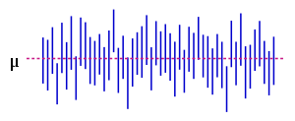
How often are we wrong?
μ
Chose an alpha-level, which determines the size of the confidence interval. This example uses alpha=0.05. We would expect five samples in one-hundred to result in confidence intervals that do not contain the true mean. We see 3 in 50 draws here, which is consistent with expectations.

Slide 41
How often are we wrong?
μ
What if we change our alpha from 0.05 to 0.10, how many of these confidence intervals would not contain the true mean?

Slide 42
How often are we wrong?
Is a 90% confidence interval bigger
or small than a 95% confidence interval?
b₁
b₁

Slide 43
Where we are going:
Regression estimates should be:
Unbiased (accurate)
Efficient (precise)

Slide 44
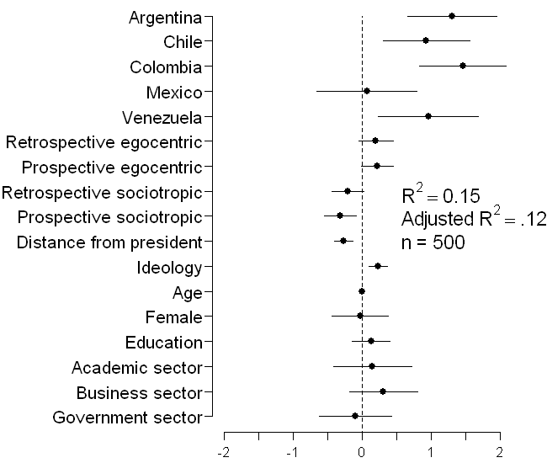
Coefficient plots as an alternative to dense regression tables
Variable | Coefficient (Standard Error)
Constant | .41 (.93)
Countries
Argentina |  | 1.31 (.33)^{### B,M}
Chile |  | .93 (.32)^{### B,M}
Colombia |  | 1.46 (.32) ^{### B,M}
Mexico |  | .07 (.32)^{A,CH,CO,V}
Venezuela |  | .96 (.37)^{## B,M}
Threat
Retrospective egocentric economic perceptions |  | .20 (.13)
Prospective egocentric economic perceptions |  | .22 (.12)#
Retrospective sociotropic economic perceptions |  | -.21 (.12)#
Prospective sociotropic economic perceptions |  | -.32 (.12)##
Ideological Distance from president
Ideology
Ideology |  | .23 (.07) ###
Individual Differences
Age |  | .00 (.01)
Female |  | -.03 (.21)
Education |  | .13 (.14)
Academic Sector |  | .15 (.29)
Business Sector |  | .31 (.25)
Government Sector |  | -.10 (.27)
R² |  | .15
Adjusted R² |  | .12
n |  | 500
###p < .01, ##p < .05, #p < .10 (two-tailed)
Table 2 from Stevens (2006): Determinants of Authoritarian Aggression
This figure has everything we need to interpret the regression. It shows the magnitude of the relationship between each variable and Y, the standard error of each coefficient (encoded in the confidence interval), and statistical significance (does it cross zero?).
Which do you prefer?

Slide 45
interpreting program impact
What should be clear in my mind?
Our interpretation of program impact involves an understanding of the “effect size” (regression slope) and the precision with which it is estimated (the confidence interval).
The level of confidence we select determines the t-value, which determines the size of the confidence interval.
For a program to be statistically significant, the confidence interval around the slope should not contain the null hypothesis (slope=0).
We can choose an arbitrary level of confidence such that our confidence interval will not contain the null.
The p-value tells us the largest confidence interval that we can draw that does not contain the null.
Program investments are bets that balance effect size plus confidence.

Slide 46
Aside: statistical power

Slide 47
Statistical power
Power: the ability to detect a program impact when it exists.
Type I Error: Claiming a program has impact when it doesn’t (false positive). This type of error is usually caused by bias in our estimate of impact.
Type II Error: Failure to detect program impact when it exists (false negative). This type of error is usually caused by a lack of adequate statistical power (large standard errors).

Slide 48
Low power
In many cases we fail to reject the null, even though our true program impact is a slope of 3.
Note that our model is unbiased – our estimates all cluster around the true slope.

Slide 49
High power
We are sure here that we have enough power to say something concrete about the program impact. We do not worry about Type II Errors in this evaluation.
What has changed?

Slide 50
What is the “cost” of gaining more confidence?
An interval with a width of of 1.5 stan. dev.’s ensures that we capture 86.6% of the data
There is an increasing marginal cost of gaining confidence.

Slide 51
What is the “cost” of gaining more confidence?
If we increase the interval to 2 standard deviations we now capture 95.4% of the data for a gain of 8.8 points of confidence.
There is an increasing marginal cost of gaining confidence.

Slide 52
What is the “cost” of gaining more confidence?
If we take another half-unit step to 2.5 standard deviations from the mean we now capture 98.8% of the data, but we gain only 3.4 points from the same increase in interval size, less than half the confidence gain as before.
Increasing the interval from 2.5 to 3 standard deviations results in only 1 more point of confidence gained.

Slide 53
What is the “cost” of gaining more confidence?
Each additional unit of confidence become more and more expensive as you approach 100%.
What is the relationship between a “unit of confidence” and a confidence interval?

Slide 54
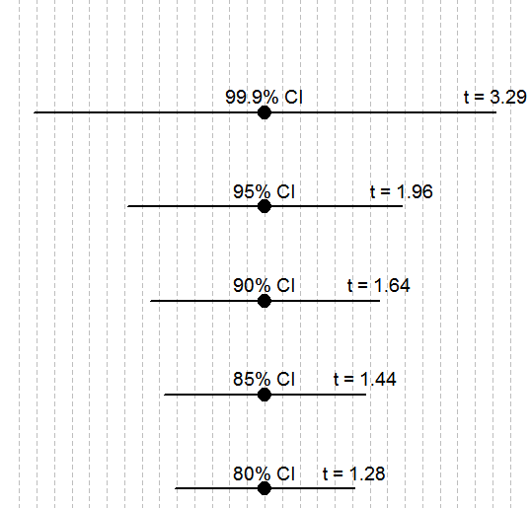
What is the “cost” of gaining more confidence?
+ 1.33 SDs
+ 0.16 SDs
There is an increasing marginal cost of gaining confidence. The

Slide 55
x.85 <- round( qnorm( 0.075, mean = 0, sd = 1 ), 2 )
x.90 <- round( qnorm( 0.05, mean = 0, sd = 1 ), 2 )
x.95 <- round( qnorm( 0.025, mean = 0, sd = 1 ), 2 )
x.999 <- round( qnorm( 0.0005, mean = 0, sd = 1 ), 2 )
ci.lower <- c(x.80,x.85,x.90,x.95,x.999)
par( mar=c(0,0,0,0) )
plot.new()
plot.window( xlim=c(-3.5,3.5), ylim=c(1,6) )
abline( v=seq(-3.5,3.5,by=0.25), lty=2, col="gray" )
points( rep(0,5), 1:5, pch=19, cex=2 )
segments( x0=ci.lower, x1=abs( ci.lower ), y0=1:5,
lwd=2 )
text( rep(0,5), 1:5, c("80% CI","85% CI","90% CI","95% CI","99.9% CI"),
cex=1.2, pos=3 )
text( abs( ci.lower ), 1:5,
paste("t = ",abs( ci.lower ),sep=""), cex=1.2, pos=3 )

