Slide 1
Interactions in Regression models

Slide 2
Interacting dummy variables: the difference-in-difference model

Slide 3
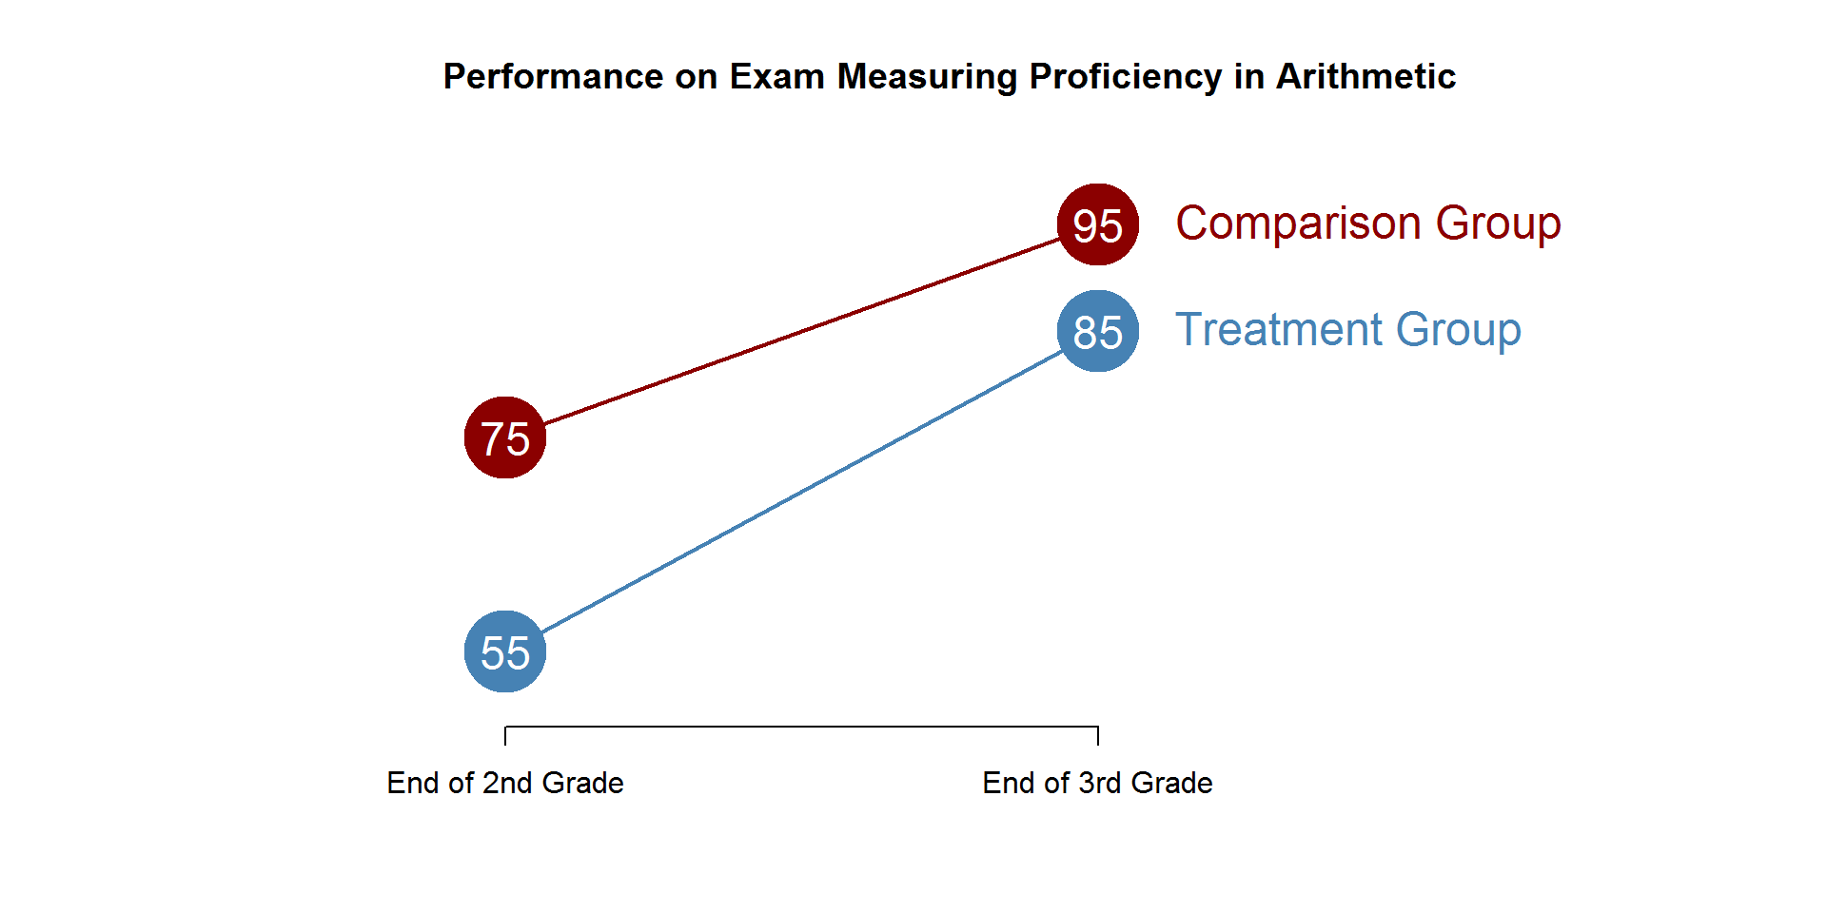

Slide 4
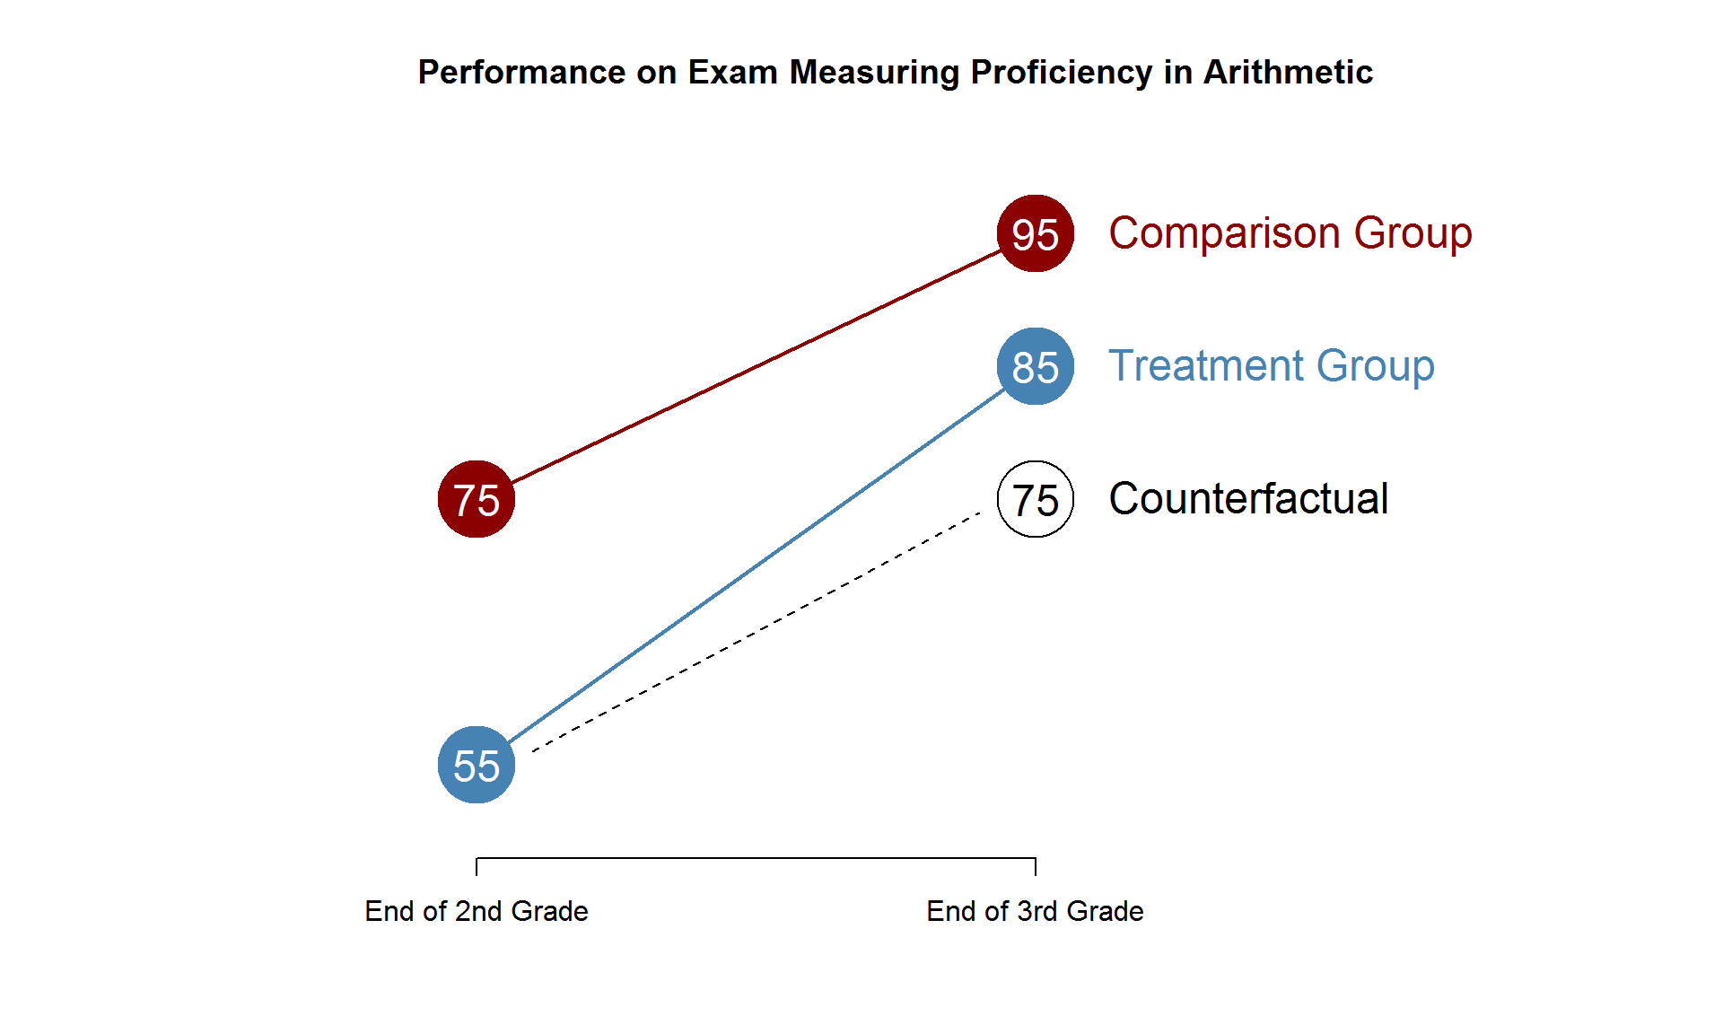

Slide 5
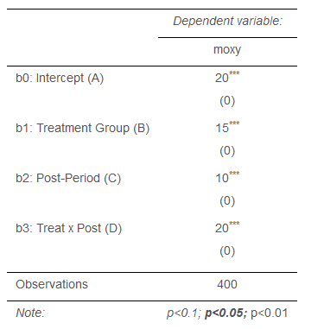
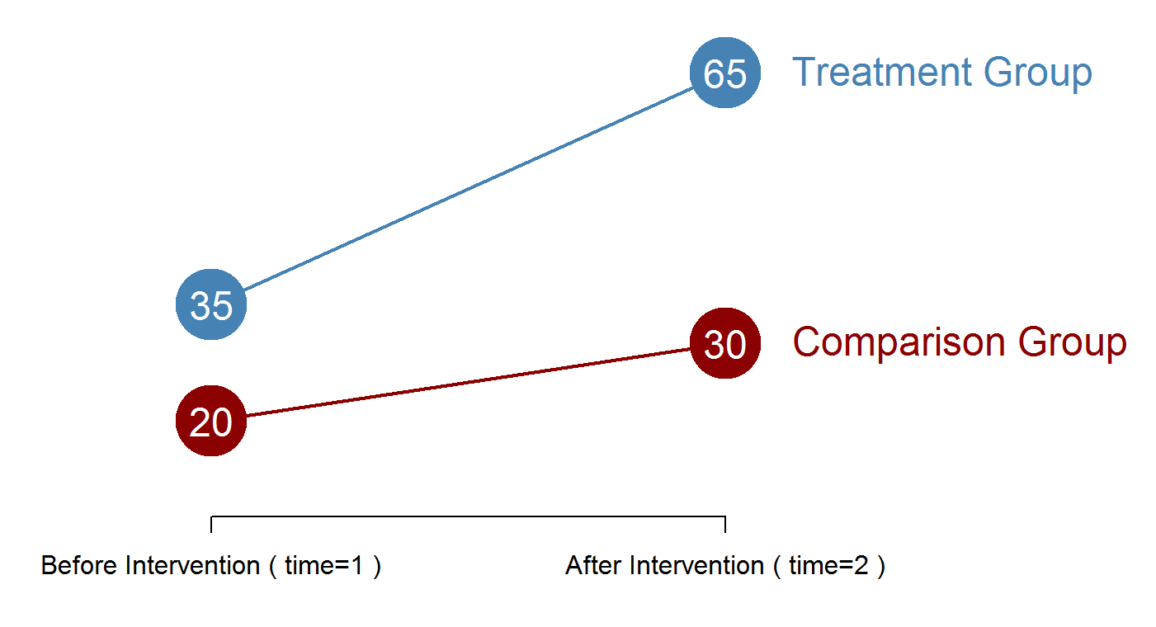

Slide 6
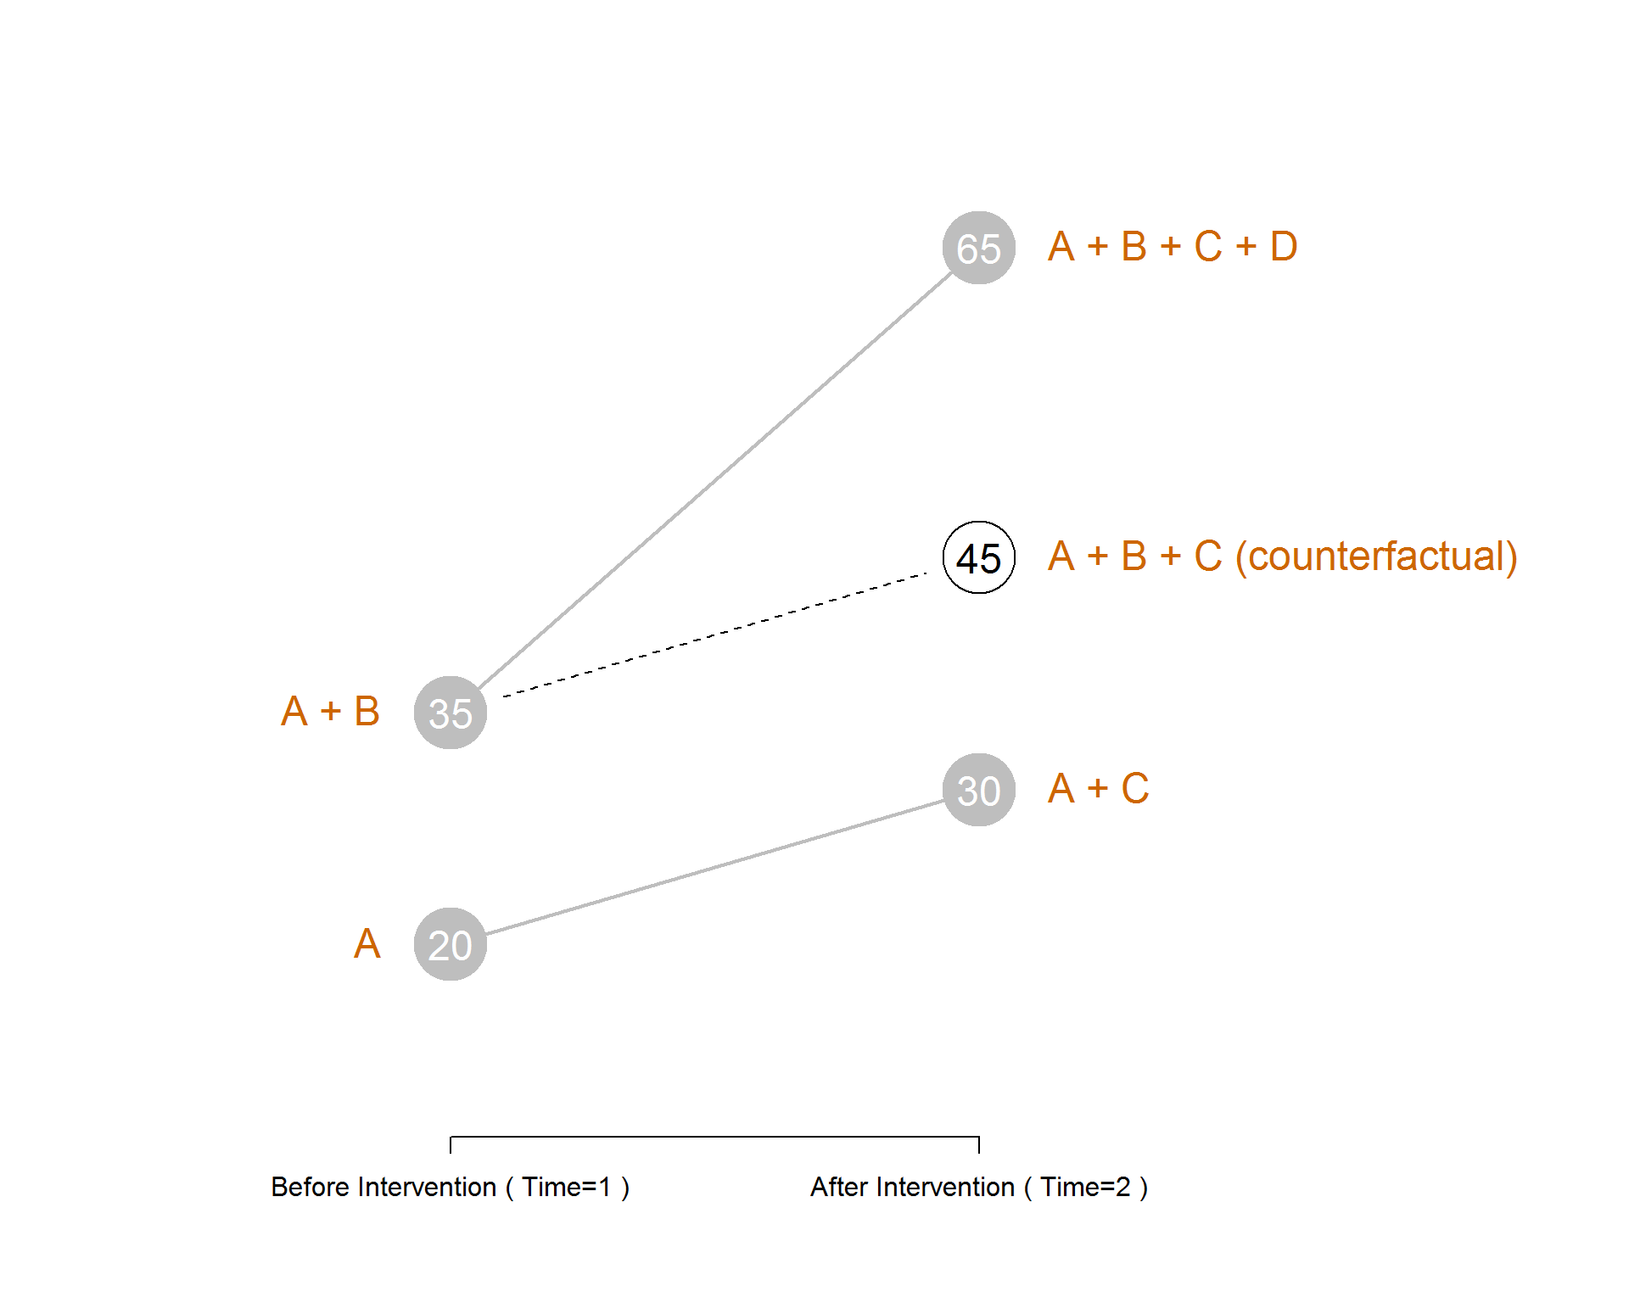

Slide 7
Interacting Slopes: Varying program impact by Group

Slide 8
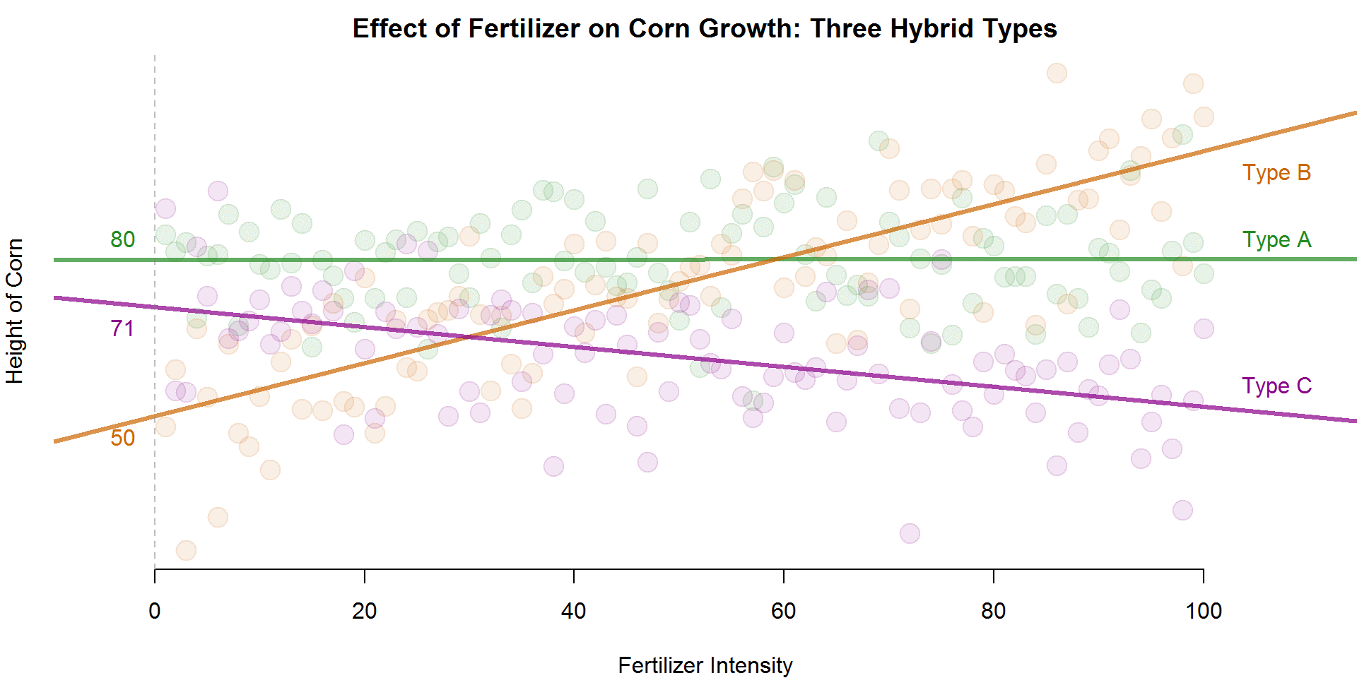
$$height= b_{0}+b_{1}dumA+b_{2}dumB+b_{3}fertilizer+b_{4}dumA∗fertilizer+b_{5}dumB∗fertilizer+e$$
Height of Type C at fertilizer=0
Height of Type A above height of Type C at fertilizer=0

Slide 9
$$height= b_{0}+b_{1}dumA+b_{2}dumB+b_{3}fertilizer+b_{4}(dumA∙fertilizer)+b_{5}(dumB∙fertilizer)+e$$
Impact of fertilizer intensity on height for Type C
Difference in fertilizer slope between Type A and Type C
Fertilizer slope for Type A: b₃ + b₄

Slide 10
C1
C2S
C2L
T1
T2
T2

Slide 11
Wages ($10)

Slide 12
Test Scores

Slide 13
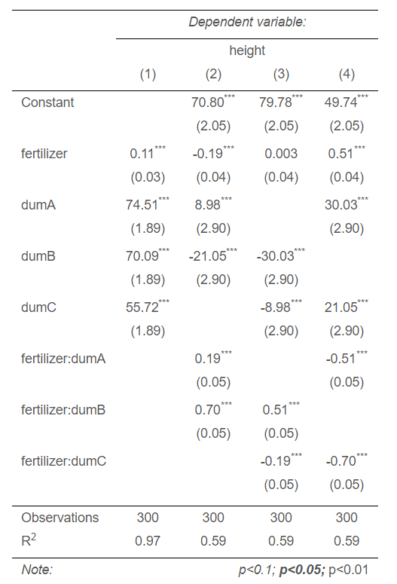
$$height= b_{0}+b_{1}dumA+b_{2}dumB+b_{3}fertilizer+b_{4}dumA∗fertilizer+b_{5}dumB∗fertilizer+e$$

