Slide 1
Testing the validity of the counterfactual
Jesse Lecy

Slide 2
Core Concepts
The Selection Problem
Tests for Group Equivalence
Tests for Nonrandom Attrition
Omnibus Test
Bonferroni Correction

Slide 3
Nature gives us correlations: The selection problem in evaluation research

Slide 4
If we reduce classroom size we should see student performance improve. Right?
10
15
20
25
30

Slide 5

The Math of cities
Listen: 4:30 – 15:30
http://www.radiolab.org/2010/oct/08/its-alive/

Slide 6

The Math of cities
Patents / Crime / Salary
( outcomes )
$$y=b_{0}+b_{1}x$$
Walking Speed?

Slide 7
The Math of cities
If you increase the WALKING SPEED of a city, would you increase the number of patents produced?

Slide 8
The Math of cities
Patents / Crime / Salary
( outcomes )
$$y=b_{0}+b_{1}x$$
Population

Slide 9
The Math of cities
If you increase the POPULATION of a city, would you increase the number of patents produced?

Slide 10
The problem with correlations:
Walking Speed
Number of Patents
Population

Slide 11
Nature gives us correlations

Slide 12
Example #1
x
y
z
X and Z both impact Y
no correlation

Slide 13
Example #2
No causal relationship but high correlation
x
y
z
Z impacts both X and Y

Slide 14
Example #3
x
y
no direct causal relationship but highly correlated
z
Causal chain

Slide 15
Reverse causality
Y = b₀ + b₁X + e
x
y
Both models are highly significant, how do we know which one is the causal relationship?
x
y
X = b₀ + b₁Y + e

Slide 16

The program evaluation framework
$$Heartrate=b_{0}+b_{1}∙Caffeine+ε$$
Treatment Effect b₁
Notes:
In an experiment there is full control over the treatment variable, and it is the only thing being manipulated

Slide 17

Discrete treatment case: model is the same except Caffeine is a dummy not a level
$$Heartrate=b_{0}+b_{1}∙Caffeine+ε$$
Heart Rate
Treatment (Caffeine)
Control (No caffeine)

Slide 18
No effect of treatment on outcome
Notes:
Null case – the treatment has no effect

Slide 19
How do we know when the interpretation is causal?
When is b₁ an impact, and when is it just a relationship in data?
Effect?
Effect?
Notes:
In one case, correlation implies causality. In another, it does not

Slide 20
The selection problem in evaluation research

Slide 21
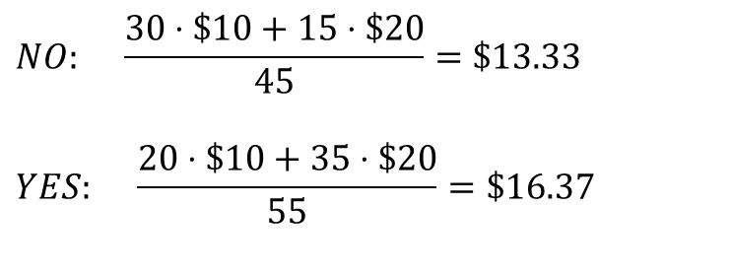
Microfinance example of bias from selection INTO a study group
You are more likely to take a loan if you know you are good at business
Number of each “type” of person in the study
 | NOT Entrepreneurial | Entrepreneurial
No Loan | 30 | 15
Takes a Loan | 20 | 35
Takes Loan?
$$NO: \frac{30⋅\$10+15⋅\$20}{45}=\$13.33$$
$$YES: \frac{20⋅\$10+35⋅\$20}{55}=\$16.37$$
Average weekly income after loan period
 | NOT Entrepreneurial | Entrepreneur
No Loan | $10 | $20
Takes a Loan | $10 | $20
The loan appears to have an impact!
Even though we know it didn’t.
Income not impacted by the loan

Slide 22
NO EVIDENCE OF IMPACT
PRE-TREAT
POST-TREAT
Takes Loan / Entrepreneurial (35 people)
NO Loan / Entrepreneurial (15 people)
Takes Loan / NOT Entrepreneurial (20 people)
NO Loan / NOT Entrepreneurial (30 people)
25
10
Loan
Distributed
The calculations above are an example of the POST-TEST ONLY estimator (T2-C2). This estimator requires that the groups are balanced or statistically equivalent prior to the intervention. Which would not be the case here (the pre-treatment calculations would be the same as post-treatment since they incomes don’t change as a result of the loan, so these differences would be present prior to the treatment as well).

Slide 23
EVIDENCE OF IMPACT
PRE-TREAT
POST-TREAT
Takes Loan / Entrepreneurial (35 people)
NO Loan / Entrepreneurial (15 people)
Takes Loan / NOT Entrepreneurial (20 people)
NO Loan / NOT Entrepreneurial (30 people)
25
10
Loan
Distributed
If we use the DIFF-IN-DIFF estimator ( [T2-T1] - [C2-C1]) then it wouldn't matter if the groups are not identical in the pre-treatment period. It will still capture the program impact correctly. Note that we need pre-treatment data for this estimator, which is often the challenge. It's more robust but also more data-intensive.
The main point is developing intuition for when you can interpret differences in the study groups as program impact or a program "effect", versus when differences arrive because of lack of study group equivalence and thus they capture selection and not impact.

Slide 24

Correlation version of last example:
Income
Selection mechanism
$$program is effective?$$
Prob. apply for a loan
Income
Probability of Taking a Loan
Business Skills

Slide 25
“Selection” Problem
Those that participate in the program are different from those that do not participate.
This is the biggest problem in impact evaluation!

Slide 26
Microfinance example of bias from selection OUT OF a study group
Reflexive design
Program causes no change in income after loan
$3.00
$2.50
$2.00
$1.50
$1.00
$3.00
$2.50
$2.00
$1.50
$1.00
Mean = $2.00
Mean = $2.00
T1
Ave household daily income before program
T2 After program
T2 - T1 = 0
causal estimate is unbiased

Slide 27
Random Attrition Example
$3.00
$2.50
$2.00
$1.50
$1.00
$3.00
$2.50
$2.00
$1.50
$1.00
Attrit
Mean = $2.00
Mean = $2.00
Attrit
T2 - T1 = 0 Impact study accurately represents program effects
Program is not determined to be effective (no change)

Slide 28
Non-Random Attrition Example
$3.00
$2.50
$2.00
$1.50
$1.00
$3.00
$2.50
$2.00
$1.50
$1.00
Mean = $2.50
Mean = $2.00
Attrit
T2 – T1 ≠ 0
We over-estimate program effects
Program appears to be effective

Slide 29
Non-Random Attrition Example
$3.00
$2.50
$2.00
$1.50
$1.00
$3.00
$2.50
$2.00
$1.50
$1.00
Attrit
Mean = $2.00
Mean = $1.50
T2 – T1 ≠ 0
We under-estimate program effects
Program appears to harm families

Slide 30
Randomized control trials (RCT’s): the “gold standard” for internal validity
Gertler, P. J., Martinez, S., Premand, P., Rawlings, L. B., & Vermeersch, C. M. (2016). Impact evaluation in practice. The World Bank.
>> Chapter 4. Randomized Selection Methods

Slide 31
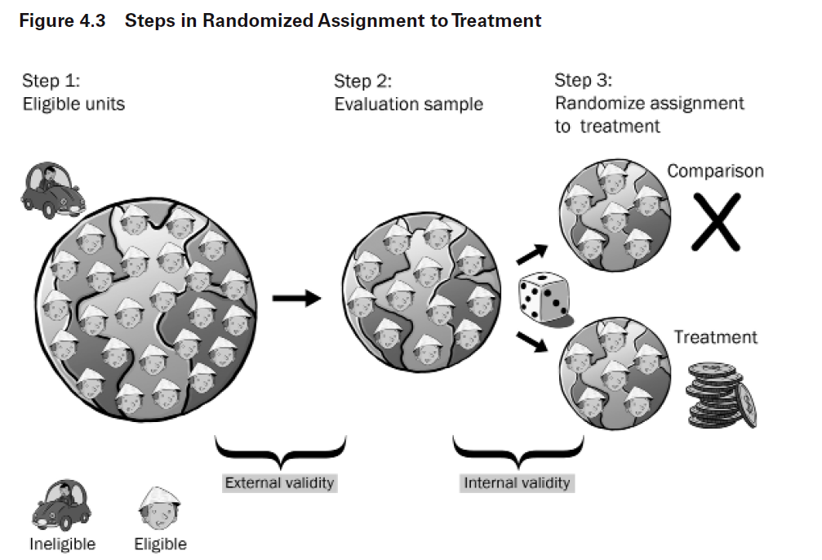

Slide 32
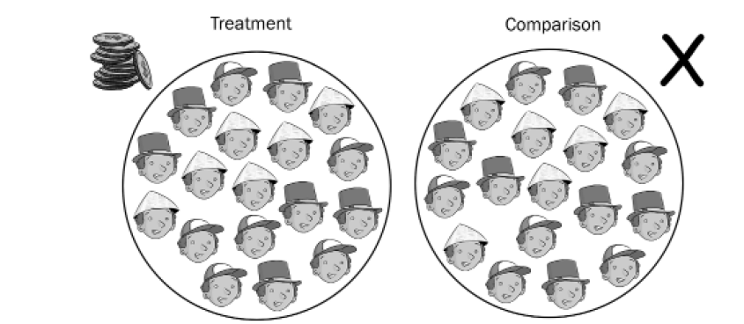
Our counterfactual framework is valid / robust when the groups only DIFFER BY THE TREATMENT but are OTHERWISE “IDENTICAL”
When true, we can interprett the differences in group outcomes after the treatment period to be caused by the treatment

Slide 33
How do we test the criteria: groups only OTHERWISE “IDENTICAL” ???

Slide 34

“Happy” randomization
Clap your hands if your treatment and control groups have no significant contrasts of measured participant traits

Slide 35
If we have a group of 100 people and we randomly assign them to two groups, 50 people each, how often would we expect the average weight of each group to differ?

Slide 36
If we have a group of 100 people and we randomly assign them to two groups, 50 people each, how often would we expect the average weight of each group to differ?
Mathematically: always !!!
weights will never be exactly identical so what do we mean by “different”?

Slide 37
If we have a group of 100 people and we randomly assign them to two groups, 50 people each, how often would we expect the average weight of each group to differ?
Statistically:
test of group means
Use a t-test and select a level of confidence that we are comfortable with

Slide 38
If we have a group of 100 people and we randomly assign them to two groups, 50 people each, how often would we expect the average weight of each group to differ?
Statistically:
test of group means
What does alpha=0.05 mean? [ --- 95% confidence interval --- ]

Slide 39
If we have a group of 100 people and we randomly assign them to two groups, 50 people each, how often would we expect the average weight of each group to differ?
Statistically:
test of group means
5 times out of 100 the two samples are drawn from the same population (or weight distribution), but we will still consider them to be different.
What does alpha=0.05 mean? [ --- 95% confidence interval --- ]

Slide 40

How often will randomization “fail”?
By definition of a test at a 95% confidence level, each measured characteristic like weight will differ
5 out of 100 times
“Unhappy Randomization”
Unhappy randomization is not failed randomization (process applied improperly), rather just bad luck of the draw

Slide 41
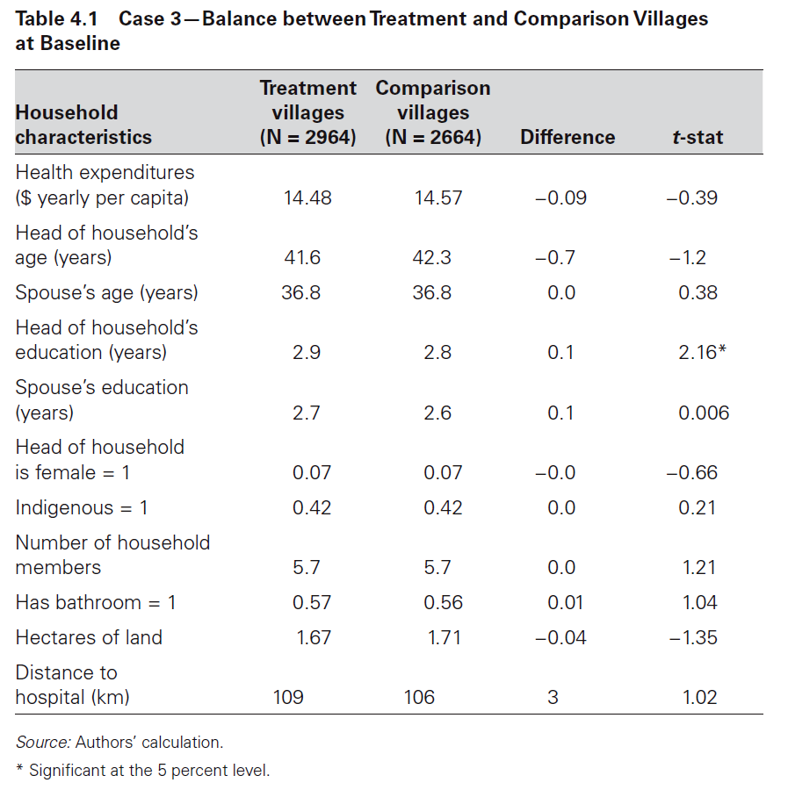
The most important table in every study: comparisons of treatment and control group characteristics For the counterfactual to be valid, the groups can ONLY differ by the treatment, not by any measured traits.
“contrasts”
Is this problematic?
What is the appropriate test for “identical” or equivalent groups?
We should observe no differences in measured traits. Assume a 95% confidence interval.

Slide 42
Bonferroni Correction:
When we want to be 95% confident that two groups are the same, and we can measure those groups using a set of contrasts, then our decision rule is no longer to reject the null (that the groups are the same) if the p-value < 0.05. A “contrast” is a comparison of means of any measured characteristic between two groups.
If we have a 5% chance of observing a p-value of less than 0.05 for each contrast, then the probability of observing at least one contrast with a p-value that small is greater than 5%! It is actually n*0.05 (minus prob of observing multiple < 0.05 at same time) where n is the number of contrasts.
So if we want to be 95% confident that the groups are different (not just the contrasts), we have to adjust our decision rule to α/n.
For example, if we have 10 contrasts, then our decision rule is now 0.05/10, or 0.005. The p-value of at least one contrast must be below 0.005 for us to conclude that the groups are different.
x1 <- rbinom( 10000, 6, 0.05 )
table( x1 ) / 10000
y1 <- rbinom( 10000, 6, 0.05/6 )
table( y1 ) / 10000

Slide 43
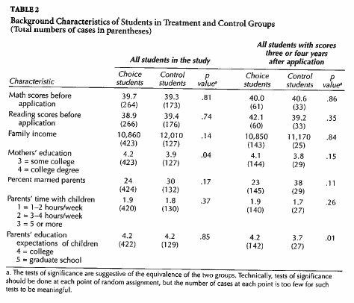
Test for Group Equivalence
seven
contrasts
reported
New alpha = ( 0.05 / 7 ) = 0.0071
Smallest p-value in table
0.04 > 0.0071 Do not reject :: Groups are equivalent

Slide 44
RCT versus Natural Experiments:
RCT assumes complete control over the assignment process
Natural Experiments often utilize randomization:
Charter School lotteries
Vietnam draft
Quasi-Experimental techniques can use other methods to create group equivalence (for example, matching)

Slide 45
Attrition

Slide 47
Tests for Selection-Into Study Group

Slide 48
Non-Random Attrition
If the people that leave a program or study are different than those that stay, the calculation of effects will be biased.
The Fix:
Examine characteristics of those that stay versus those that leave.

Slide 49
Non-Random attrition tests for selection OUT of the study group
Do group traits differ after attrition occurs?
Attrition is natural, the question is whether it is random (will not change the groups) or non-random (will change the groups)
Can also be tested by comparing traits of those that stay to those that leave.

Slide 50
Attrition Tests
Post-Treatment Period
STAY IN
STUDY
LEAVE
STUDY
C1
2
CS
CL
Test for Group
Equivalency
Time=1
Test for Group
Equivalency
Time=2
Test for
Equivalent Attrition
0
1
3
T1
TS
TL
2
Test for
Random Attrition
These 2 are typically reported

Slide 51
Most studies will report group equivalence before and after attrition occurs (tests 0 and 1 in the diagram). But you could test for random attrition in two other ways as well.
I am using the term "random attrition" a little imprecisely. You could have non-random attrition, but as long as it's non-random in the same way in both groups it would still result in balanced groups (all high performers leave from each group, for example).
Test 1 looks at group balance after attrition. It would be agnostic to the type of attrition, but as long as it did not impact balance it should not matter.
Test 2 is the only real test for random attrition. Are those that stay the same as those that left?
Test 3 would ensure that both groups experience the same type of attrition, but it does not necessarily have to be random.
For any of these tests you would subset the data to isolate the two groups, create a dummy variable for one group, then run the regression:
Y = b0 + b1(dummy) + e
If b1 is significant it means the groups are not balanced (1), attrition is non-random (2), or attrition is non-equivalent (3).
Y can be the pre-treatment outcome, or it can represent a series of study participant traits, like what you did in Lab 2.
In all cases, though, the goal is to ensure that attrition does NOT deleteriously impact the integrity of the counterfactual.

Slide 52
Test for Group
Equivalency
Time=1
Test for Group
Equivalency
Time=2
0
1

Slide 53
Microfinance example of bias from selection OUT OF a study group
Reflexive design
Program causes no change in income after loan
$3.00
$2.50
$2.00
$1.50
$1.00
$3.00
$2.50
$2.00
$1.50
$1.00
Mean = $2.00
Mean = $2.00
T1
Ave household daily income before program
T2 After program
T2 - T1 = 0
causal estimate is unbiased

Slide 54
Random Attrition Example
$3.00
$2.50
$2.00
$1.50
$1.00
$3.00
$2.50
$2.00
$1.50
$1.00
Attrit
Mean = $2.00
Mean = $2.00
Attrit
T2 - T1 = 0 Impact study accurately represents program effects
Program is not determined to be effective (no change)

Slide 55
Non-Random Attrition Example
$3.00
$2.50
$2.00
$1.50
$1.00
$3.00
$2.50
$2.00
$1.50
$1.00
Mean = $2.50
Mean = $2.00
Attrit
T2 – T1 ≠ 0
We over-estimate program effects
Program appears to be effective

Slide 56
Non-Random Attrition Example
$3.00
$2.50
$2.00
$1.50
$1.00
$3.00
$2.50
$2.00
$1.50
$1.00
Attrit
Mean = $2.00
Mean = $1.50
T2 – T1 ≠ 0
We under-estimate program effects
Program appears to harm families

Slide 57
What do we mean by “treated”? How non-compliance changes our measure of effects

Slide 58
One of The Physicists Behind The Higgs Boson Has Made an Algorithm to Replace The Pill
It's up to 99.5% effective at stopping pregnancy.
Those more effective methods are ones that don't require people to remember to take a pill, put on a condom, or record their temperature daily, such as intrauterine contraception or implants.
That's because human error can mess with things quite a lot. In fact, the UK's National Health Service (NHS) explained that when the app was used perfectly all the time, only five out of every 1,000 women would fall pregnant every year - a rate slightly better than the pill (99.5 percent).
But for "typical use" - where the app isn't used entirely correctly every day - it's more likely that seven out of every 100 women would experience accidental pregnancies, which is around 93 percent efficiency.
What is the TRUE effectiveness of the app? 99.5 percent, or 93 percent?
https://www.sciencealert.com/one-of-the-physicists-behind-the-higgs-boson-has-made-an-algorithm-to-replace-the-pill

Slide 59
Estimation of the counter-factual:
Given Bed Nets
Control Group
Given Bed Nets AND Use Them!
Program Effect = T2 – C2
Is Group T (for treatment) those that are GIVEN bed nets, or those that USE them?

Slide 60
Terminology:
“Average” treatment effects
Treatment on the Treated (TOT) Effects
Intention to Treat (ITT) Effects
“Intention
to Treat” Estimate
2 Valid
Ways to
Measure the
Treatment
Given Bed Nets
“Treatment
on the
Treated” Estimate
Given Bed Nets AND Use Them!

Slide 61
Why do we need two measures?
The TOT Measure is the optimistic or best-case scenario. It tells us how effective the program or intervention is when followed with HIGH FIDELITY.
The ITT Measure is the more cynical or realistic version. We never expect that programs work exactly as designed. The ITT is closer to a measure of how the laboratory equipment works once it’s in the field. It is also a better estimate of how much change we can expect at the population level.
The different between the TOT and the ITT tells us how many gains can be made by improving program implementation! So both are useful and important!
“Intention
to Treat” Estimate
“Treatment
on the
Treated” Estimate

Slide 62
One of The Physicists Behind The Higgs Boson Has Made an Algorithm to Replace The Pill
It's up to 99.5% effective at stopping pregnancy.
Those more effective methods are ones that don't require people to remember to take a pill, put on a condom, or record their temperature daily, such as intrauterine contraception or implants.
That's because human error can mess with things quite a lot. In fact, the UK's National Health Service (NHS) explained that when the app was used perfectly all the time, only five out of every 1,000 women would fall pregnant every year - a rate slightly better than the pill (99.5 percent).
But for "typical use" - where the app isn't used entirely correctly every day - it's more likely that seven out of every 100 women would experience accidental pregnancies, which is around 93 percent efficiency.
Which is treatment on the treated effect?
Which is the intention-to-treat effect?
https://www.sciencealert.com/one-of-the-physicists-behind-the-higgs-boson-has-made-an-algorithm-to-replace-the-pill

Slide 63
NOTE !!!
These two measures are NOT about attrition.
They are about refusing the treatment, or failing to follow the properly-prescribed treatment regiment (or one school burning down during the study).
Non-compliance means participants refuse to receive or comply with the treatment. But they do not refuse to participate in the study – we can still measure their performance in the second time period.
Attrition means people left the study. You can accept the treatment and still attrit. Or you can refuse treatment and refuse participation. Either way, attrition means we can’t measure the outcome in the post-treatment study period.
“Intention
to Treat” Estimate
“Treatment
on the
Treated” Estimate

