Slide 1
Contrasts and Effect Size
Lecy * CPP 524

Slide 2
Case Study from readings
Bingham, R., & Felbinger, C. (2002). Evaluation in practice: A methodological approach. CQ Press.
CH-05: Improving Cognitive Ability in Chronically Deprived Children [pdf]

Slide 3
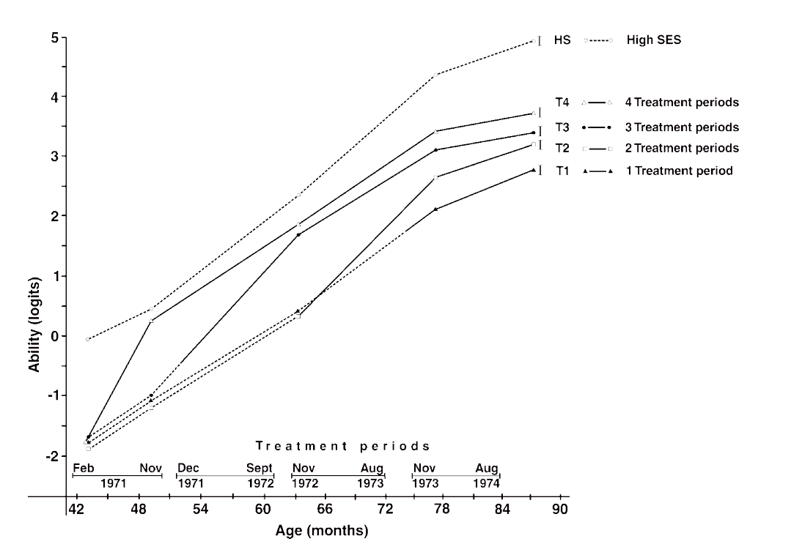
Identify the treatment
and control groups

Slide 4
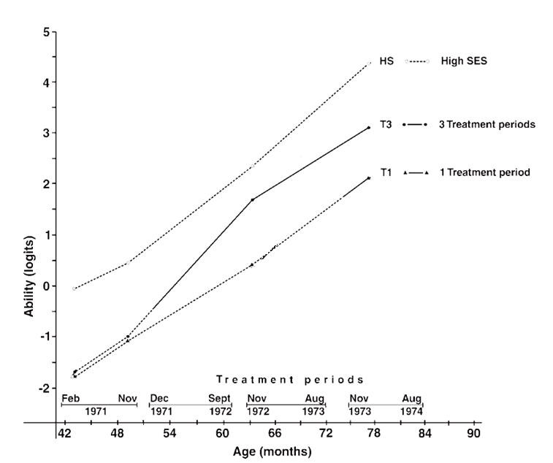
HS-3
Start of
Treatment
Periods
T3
Treatment Group
HS-2
Control Group
C3
T2
HS-1
HS-0
C2
T1
T0
C1
C0

Slide 5
Treatment Groups
x
G1_{t=0} G1_{t=1} G1_{t=2} G1_{t=3} G1_{t=4}
G2_{t=0} G2_{t=1} G2_{t=2} G2_{t=3} G2_{t=4}
G3_{t=0} G3_{t=1} G3_{t=2} G3_{t=3} G3_{t=4}
G4_{t=0} G4_{t=1} G4_{t=2} G4_{t=3} G4_{t=4}
x
x
x
Control Groups

Slide 6
Treatment Group Control Group
x
G1_{t=0} G1_{t=1} G1_{t=2} G1_{t=3} G1_{t=4}
G2_{t=0} G2_{t=1} G2_{t=2} G2_{t=3} G2_{t=4}
G3_{t=0} G3_{t=1} G3_{t=2} G3_{t=3} G3_{t=4}
G4_{t=0} G4_{t=1} G4_{t=2} G4_{t=3} G4_{t=4}
x
x
x
Specific tests: treatment gains for late treatment?

Slide 7
Treatment Dosage (program duration)
G1 = 6 months
G2-G4 = 0 months
G1 x {G2,G3,G4} would represent outcome after 6 months of treatment
Might pool data to increase statistical power
x
G1_{t=0} G1_{t=1} G1_{t=2} G1_{t=3} G1_{t=4}
G2_{t=0} G2_{t=1} G2_{t=2} G2_{t=3} G2_{t=4}
G3_{t=0} G3_{t=1} G3_{t=2} G3_{t=3} G3_{t=4}
G4_{t=0} G4_{t=1} G4_{t=2} G4_{t=3} G4_{t=4}
x
x
x
Control Group –
no treatment

Slide 8
Treatment Dosage (program duration)
6 mos
12 mos
18 mos
24 mos
Group 1
x
G1_{t=0} G1_{t=1} G1_{t=2} G1_{t=3} G1_{t=4}
G2_{t=0} G2_{t=1} G2_{t=2} G2_{t=3} G2_{t=4}
G3_{t=0} G3_{t=1} G3_{t=2} G3_{t=3} G3_{t=4}
G4_{t=0} G4_{t=1} G4_{t=2} G4_{t=3} G4_{t=4}
x
x
x
Control Groups – no treatment

Slide 9
Treatment Dosage (program duration)
6 mos
12 mos
18 mos
x
G1_{t=0} G1_{t=1} G1_{t=2} G1_{t=3} G1_{t=4}
G2_{t=0} G2_{t=1} G2_{t=2} G2_{t=3} G2_{t=4}
G3_{t=0} G3_{t=1} G3_{t=2} G3_{t=3} G3_{t=4}
G4_{t=0} G4_{t=1} G4_{t=2} G4_{t=3} G4_{t=4}
Group 2
x
x
x
Control Groups – no treatment

Slide 10
Treatment Dosage (program duration)
G1 = 12 months
G2 = 6 months
Pooled G1+G2 would represent outcome after 9 months of treatment
Might pool data to increase statistical power
x
G1_{t=0} G1_{t=1} G1_{t=2} G1_{t=3} G1_{t=4}
G2_{t=0} G2_{t=1} G2_{t=2} G2_{t=3} G2_{t=4}
G3_{t=0} G3_{t=1} G3_{t=2} G3_{t=3} G3_{t=4}
G4_{t=0} G4_{t=1} G4_{t=2} G4_{t=3} G4_{t=4}
x
x
x
Control Group – no treatment

Slide 11
Treatment Dosage (program duration)
6 months vs 0 months
but conditioned on AGE children start the program
x
G1_{t=0} G1_{t=1} G1_{t=2} G1_{t=3} G1_{t=4}
G2_{t=0} G2_{t=1} G2_{t=2} G2_{t=3} G2_{t=4}
G3_{t=0} G3_{t=1} G3_{t=2} G3_{t=3} G3_{t=4}
G4_{t=0} G4_{t=1} G4_{t=2} G4_{t=3} G4_{t=4}
x
x
x
AGE=
3 yrs
3.5 yrs
4 yrs
4.5 yrs
Control Groups – no treatment

Slide 12
Treatment Group Control Group
x
G1_{t=0} G1_{t=1} G1_{t=2} G1_{t=3} G1_{t=4}
G2_{t=0} G2_{t=1} G2_{t=2} G2_{t=3} G2_{t=4}
G3_{t=0} G3_{t=1} G3_{t=2} G3_{t=3} G3_{t=4}
G4_{t=0} G4_{t=1} G4_{t=2} G4_{t=3} G4_{t=4}
x
x
x
Specific tests: treatment gains for late treatment?

Slide 13
Discussion Questions:
Is this an RCT? Do we have an identical “control group”?
What role does the high SES group perform?
Why do we have four treatment groups?
What outcome is measured here? Is it valid and reliable?
How would I test whether two treatment periods has the same impact as three periods, but is more cost-effective?
Can you identify a weakness in the design or a threat to validity?

Slide 14
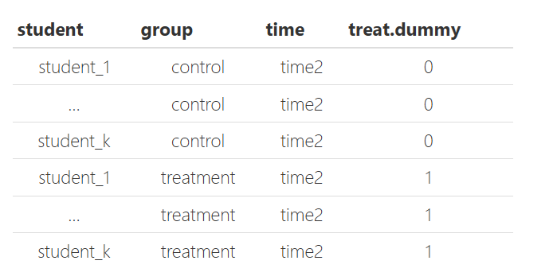
https://watts-college.github.io/cpp-524-fall-2021/labs/lab-05-diff-in-diff.html

Slide 15
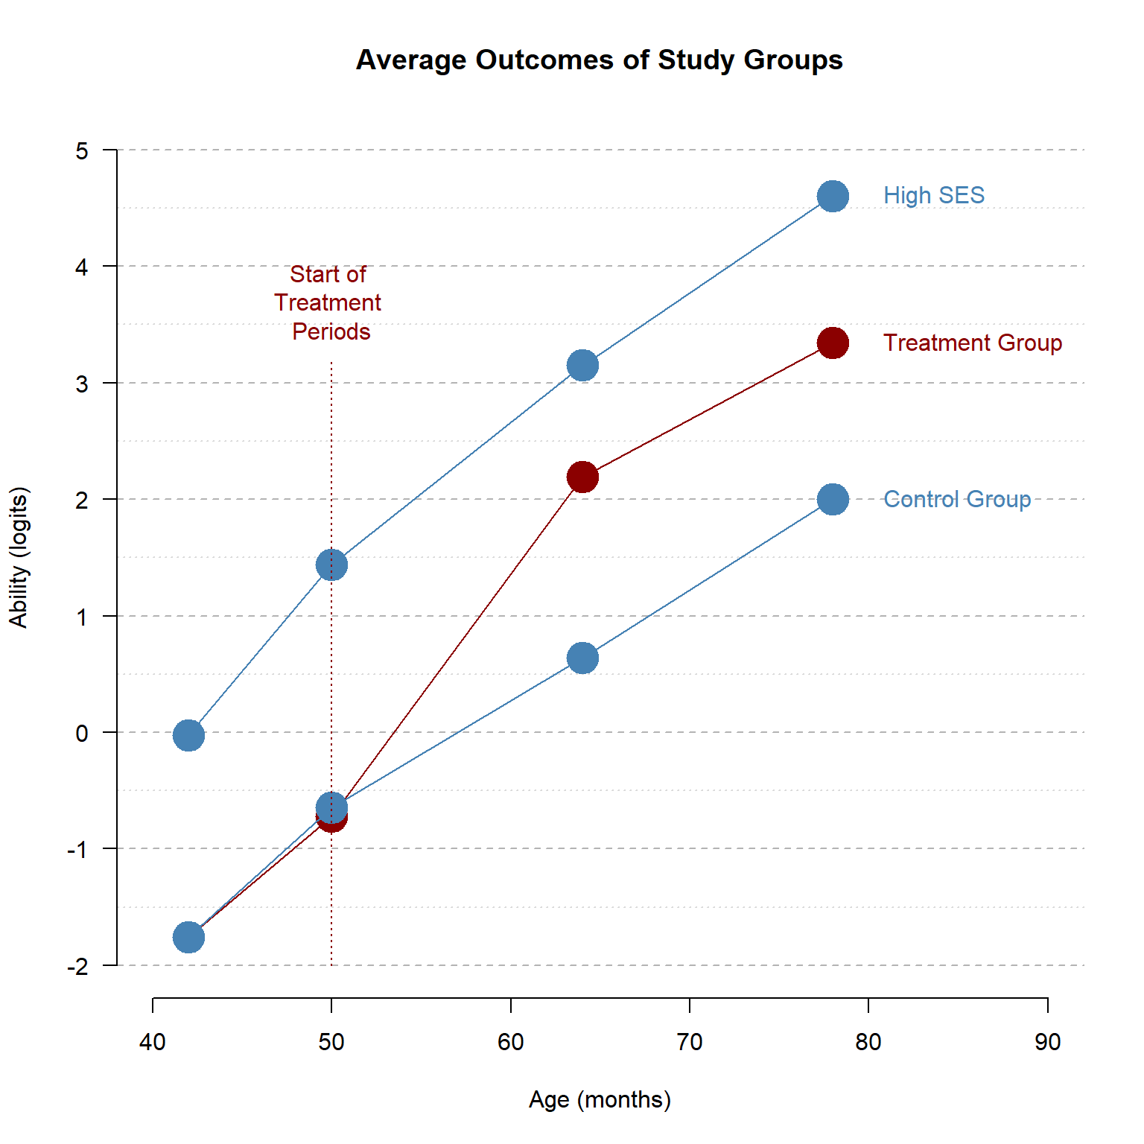
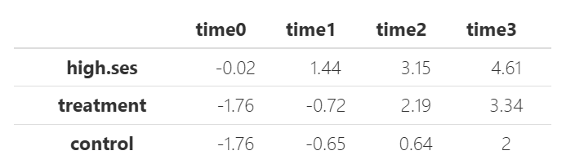

Slide 16
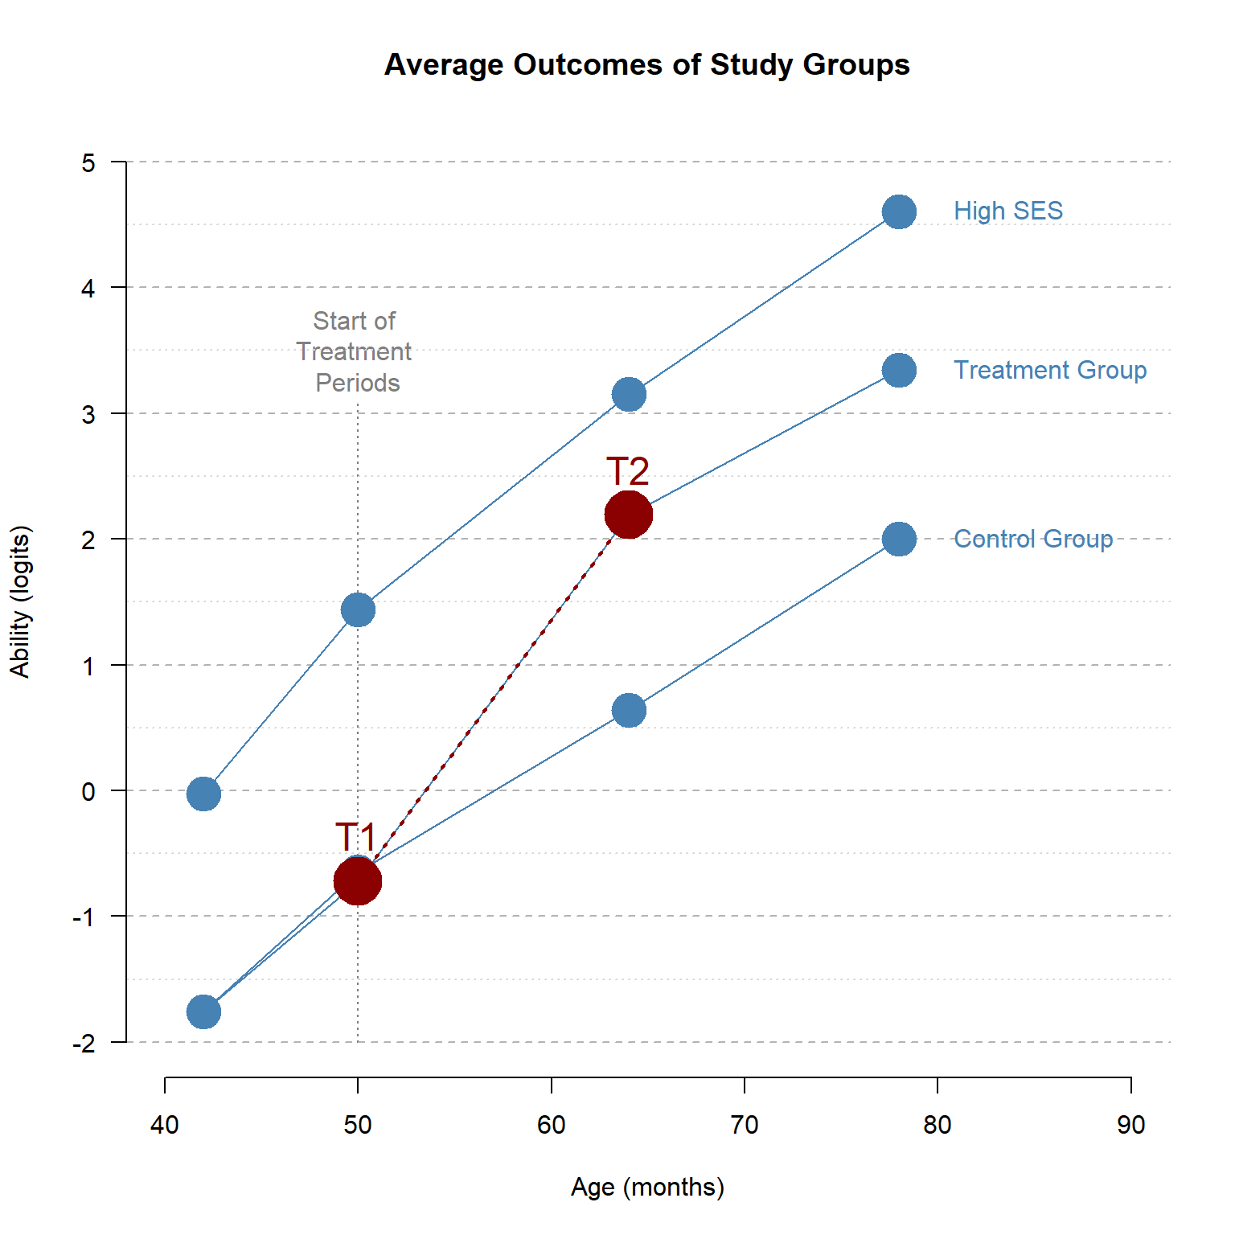
Reflexive Estimator
Estimator
Assumptions

Slide 17
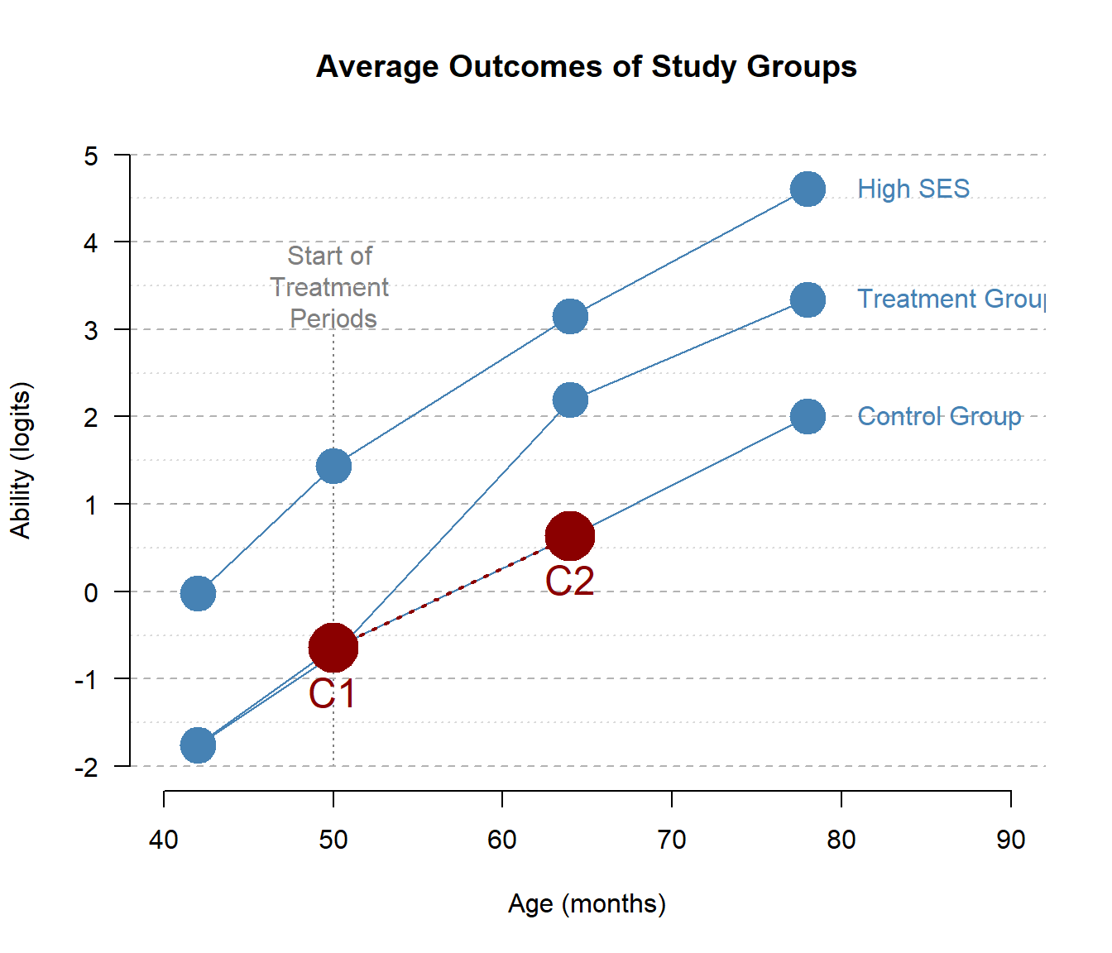
Reflexive Estimator
Estimator
Assumptions

Slide 18
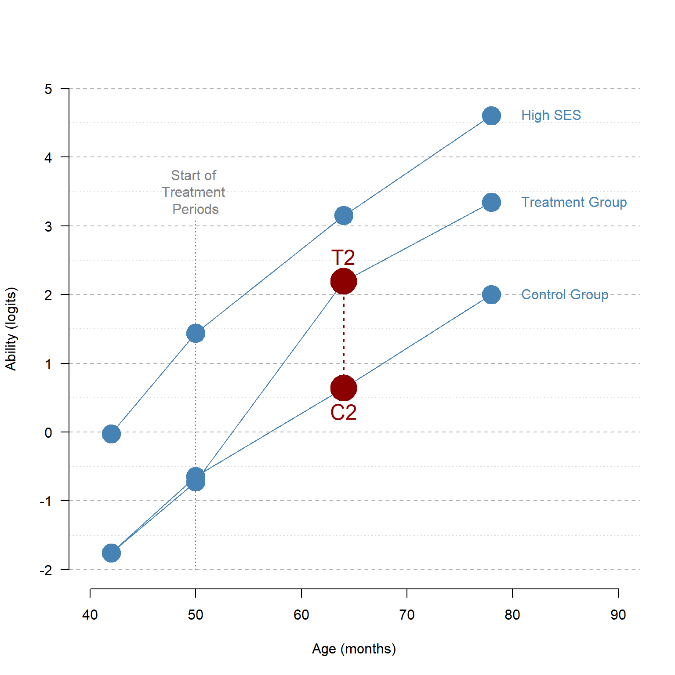
Post-Test
Only Estimator
Estimator
Assumptions

Slide 19
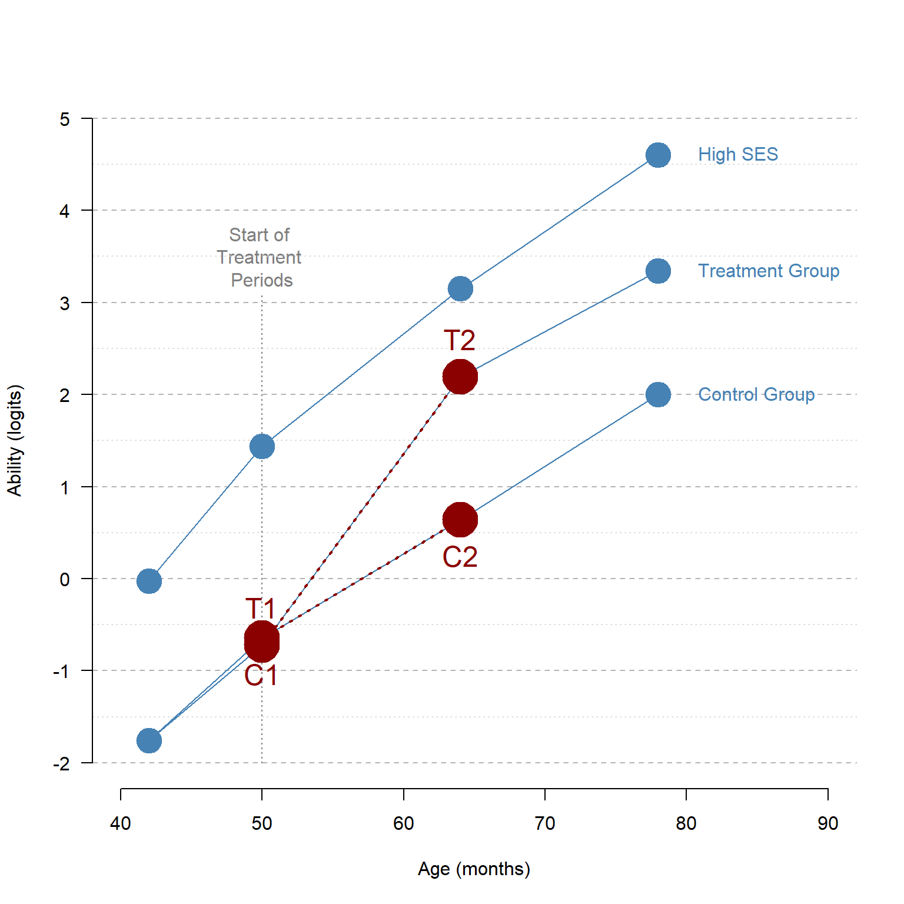
Diff-in-Diff Estimator
Estimator
Assumptions

Slide 20
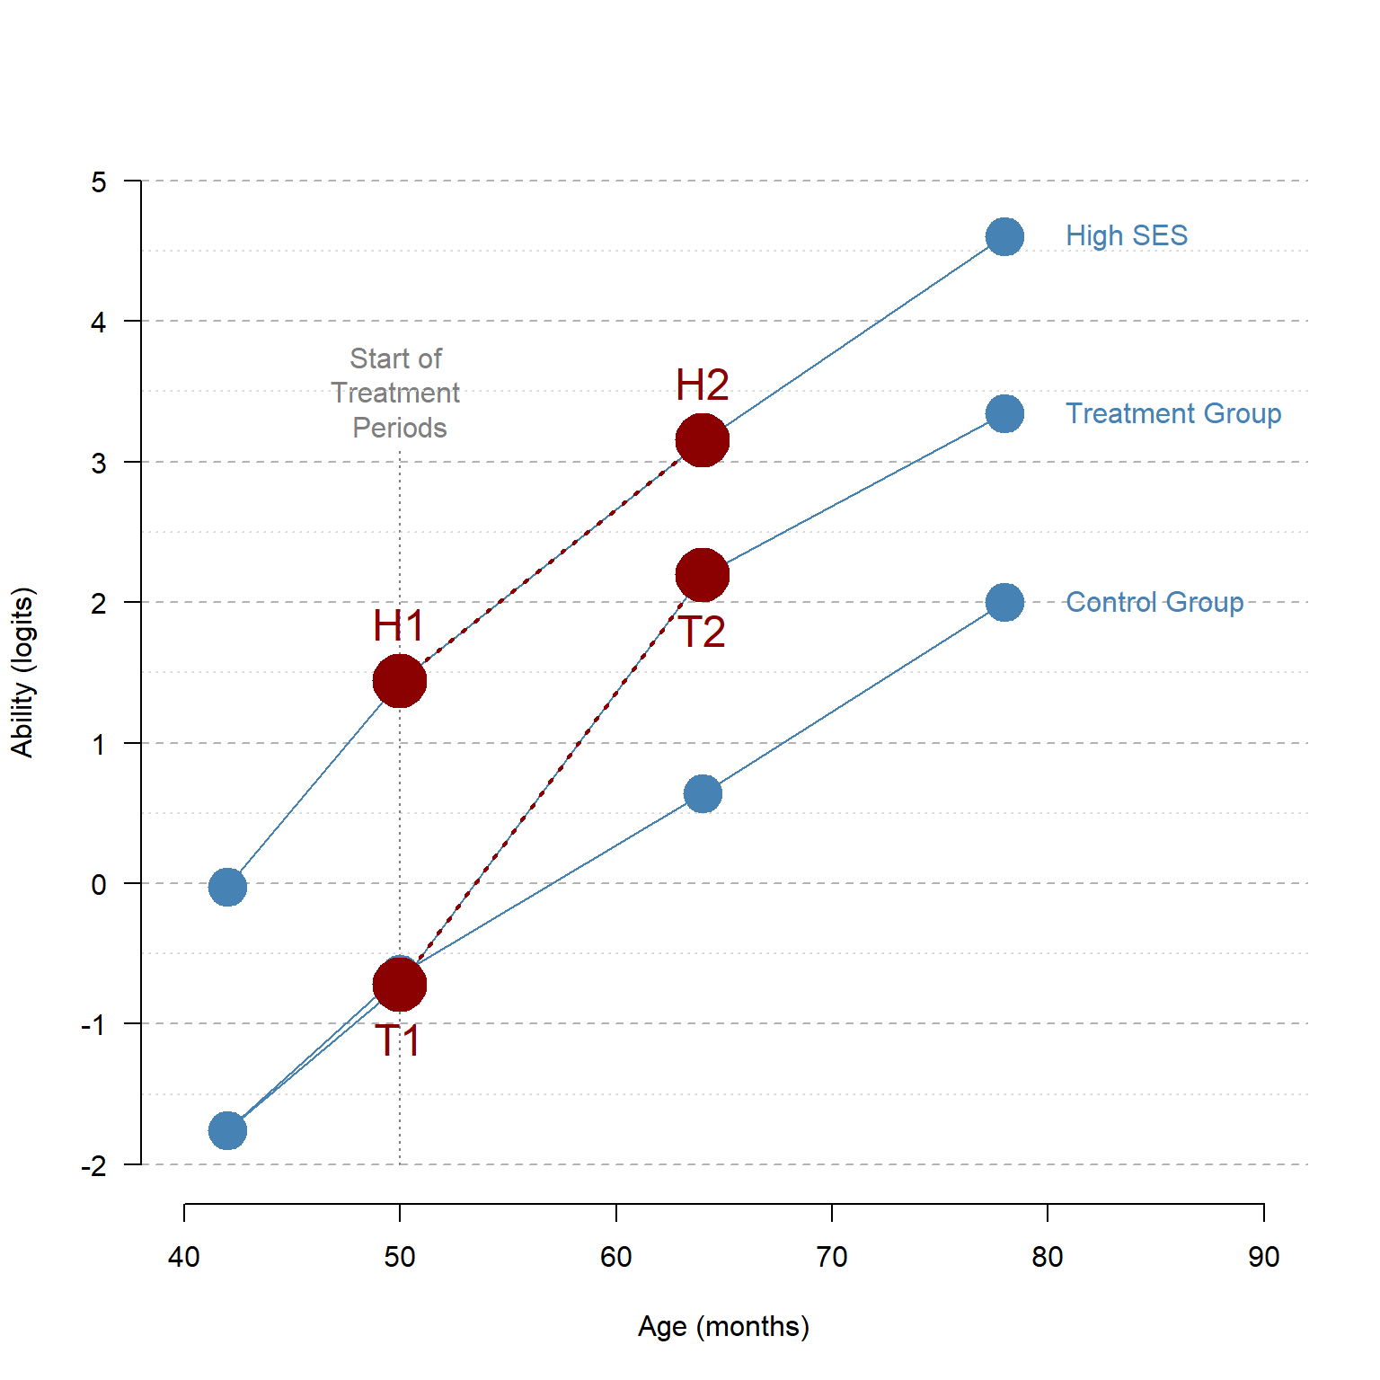
Diff-in-Diff Estimator
Estimator
Assumptions

Slide 21
Another example

Slide 22
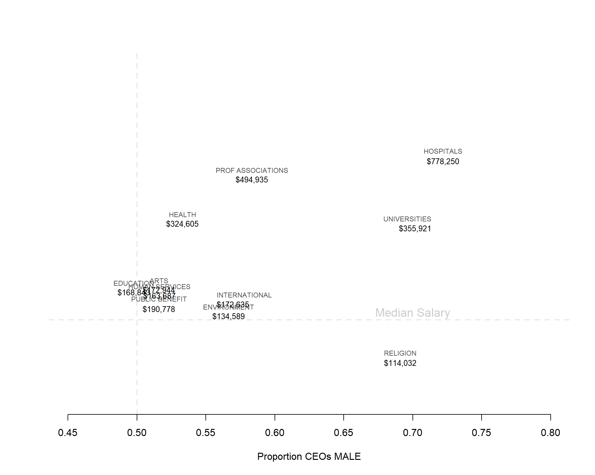

Slide 23
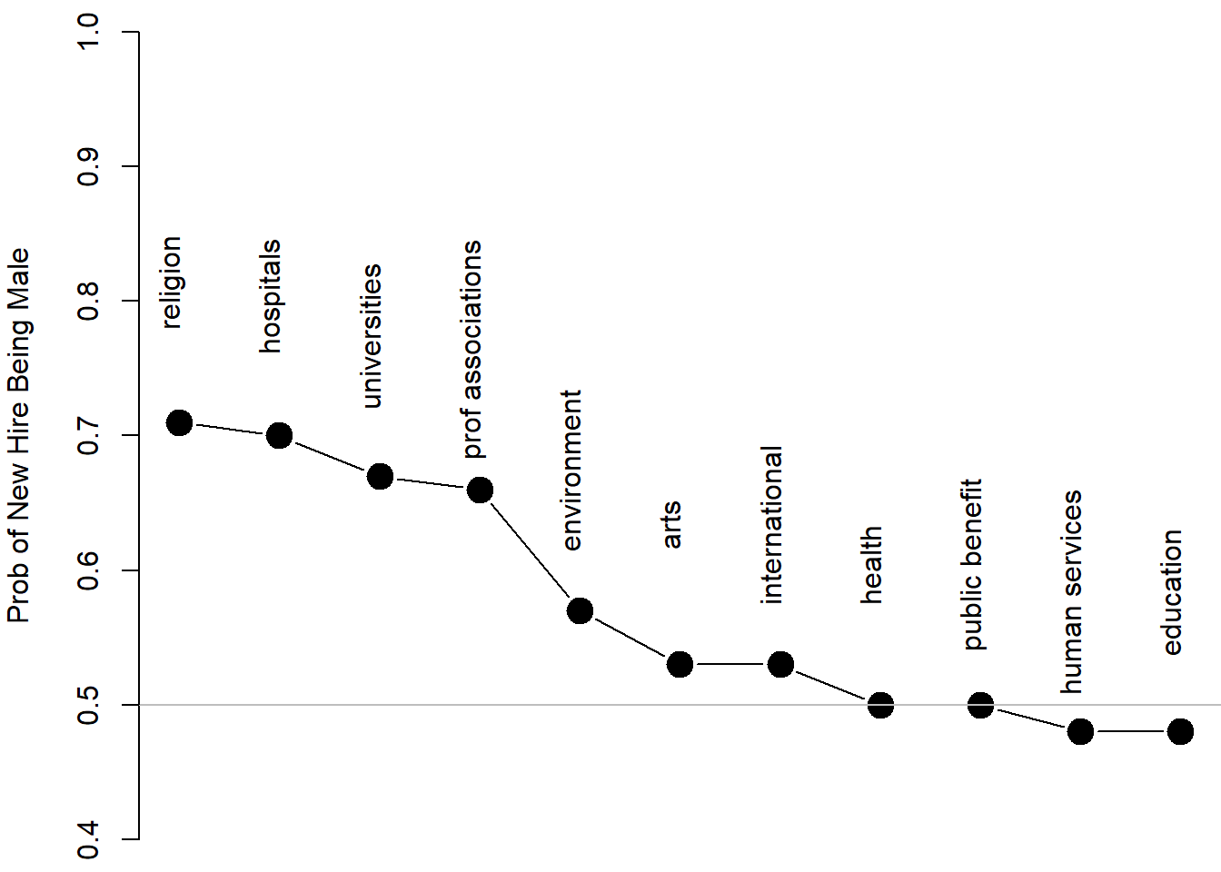

Slide 24
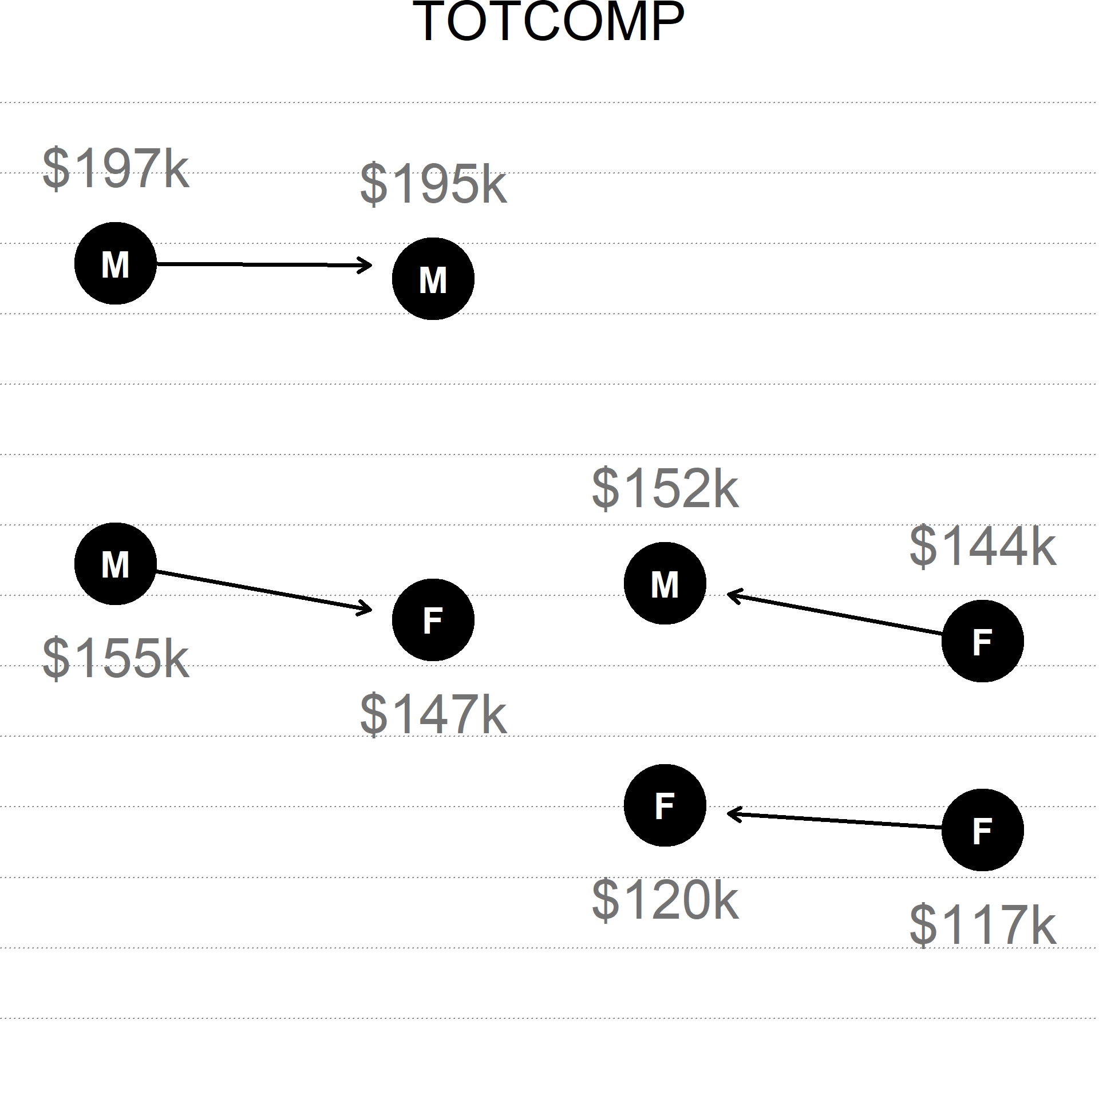
https://watts-college.github.io/cpp-524-fall-2021/labs/lab-07-gender-wage-gap.html

