Slide 1
Tests for group equivalence or “balance”

Slide 2



The program evaluation framework: “Discrete” treatment groups (yes/no)
$Mean(T2)−Mean(C2)$ $=$ $Program Effect$
Heart Rate
Treatment (Caffeine)
Control (No caffeine)
$$T2$$
$$Effect Size$$
$$C2$$

Slide 3
b₁ = MEAN_{treat} - MEAN_{control}
b₁ = T2 – C2
No Program Impact
Outcome
b₁
Control
Treatment
b₁ = 0

Slide 4
STATISTICAL SIGNIFICANCE (CONF. INT. CONTAINS ZERO?)
b₁ = MEAN_{treat} - MEAN_{control}
Heart Rate
Treatment (Caffeine)
b₁
Control (No caffeine)
b₁ = 0
SIGNIFICANT
(POSITIVE PROGRAM IMPACT)

Slide 5
STATISTICAL SIGNIFICANCE (CONF. INT. CONTAINS ZERO?)
b₁ = MEAN_{treat} - MEAN_{control}
Heart Rate
Control (No caffeine)
b₁
Treatment (Caffeine)
b₁ = 0
SIGNIFICANT
(NEGATIVE PROGRAM IMPACT)

Slide 6
b₀ will measure Y-bar of the omitted group C2
b₀ +b₁ represents the Y-bar of T2
Recall from Unit on Dummy Variable Models
Y = b₀ + b₁(TreatDummy) + e
b₁ = MEAN_{treat} - MEAN_{control}
b₁ = T2 – C2
(basic set-up for a comparison of group means in regression)
Outcome
Treatment
b₁
T2
Control
C2
b₁ = 0
(group means)
The default hypothesis test in the regression then uses b₁ to test for a meaningful difference between T2 and C2

Slide 7
b₁ = MEAN_{treat} - MEAN_{control}
heartrate
Caffeine
b₁
T2
NO Caffeine
C2
b₁ = 0
(group means)

Slide 8
When are differences causal?
Does caffeine increase heart rate?
Or do people with high stress jobs and sleep deprivation tend to drink a lot of coffee?
caffeine → heart rate
caffeine heart rate
job stress
(lurking variable)

Slide 9
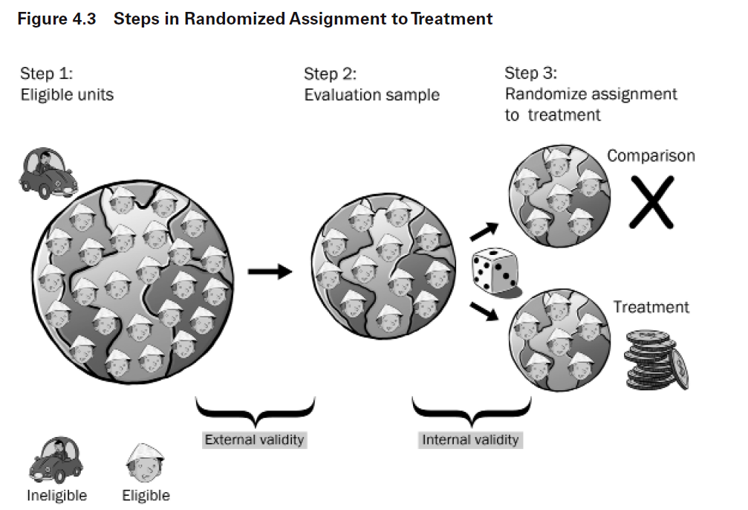

Slide 10
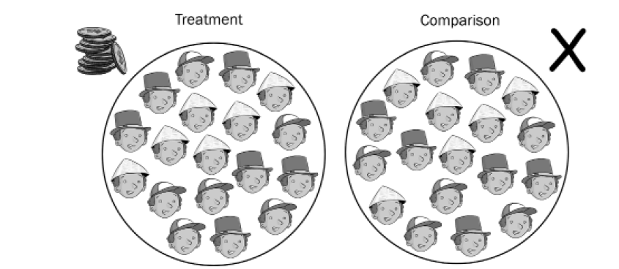
Our counterfactual framework is valid / robust when the groups only DIFFER BY THE TREATMENT but are OTHERWISE “IDENTICAL”
When true, we can interprett the differences in group outcomes after the treatment period to be caused by the treatment

Slide 11

“Happy” randomization
Clap your hands if your treatment and control groups have no significant contrasts of measured participant traits

Slide 12
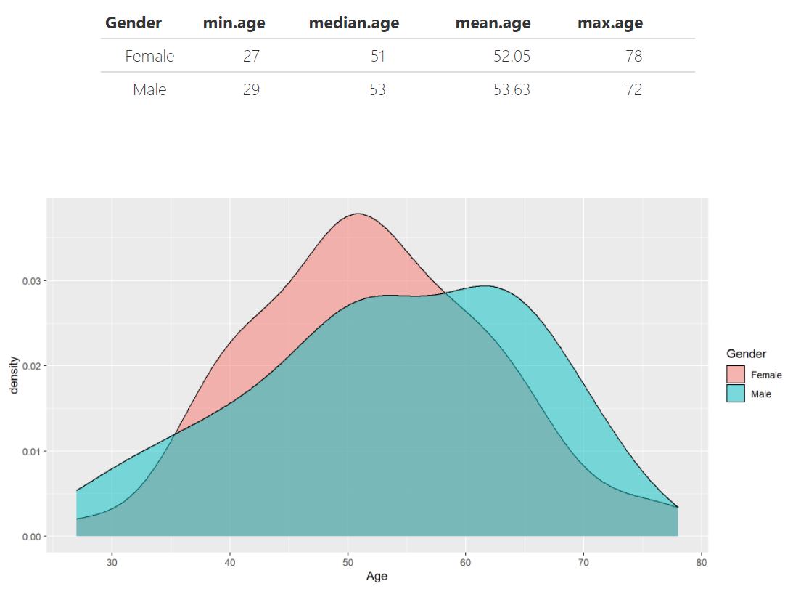

Slide 13
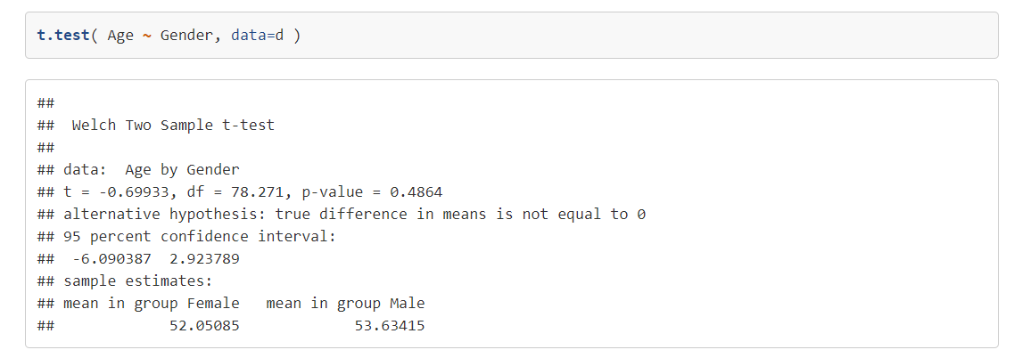
age = b₀ + b₁(gender) + e
b₁ = age_{MEN} – age_{WOMEN}
p-value > 0.05 so the study groups are NOT different
b₁
b₁ = 0

Slide 14
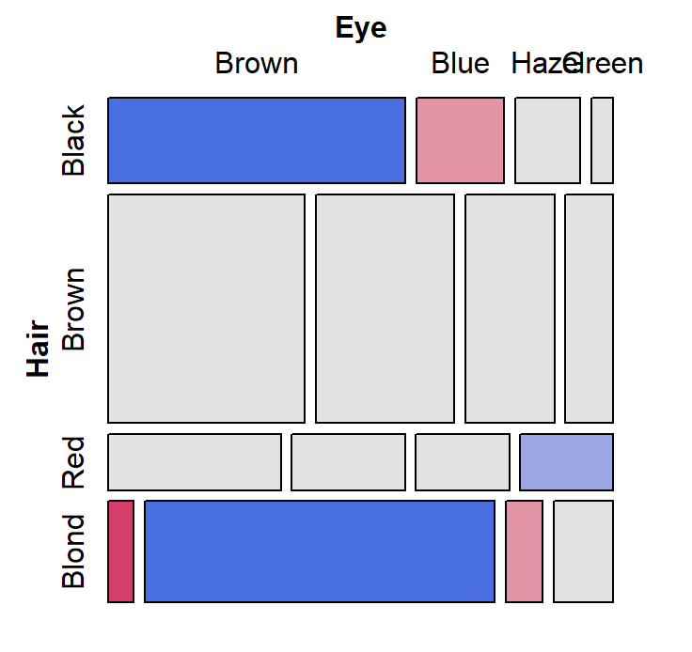
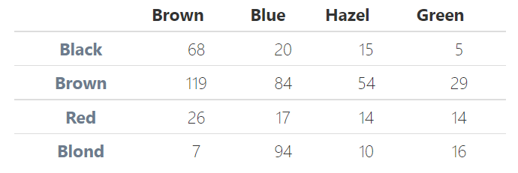
m <- table( hair.color, eye.color )

Slide 15
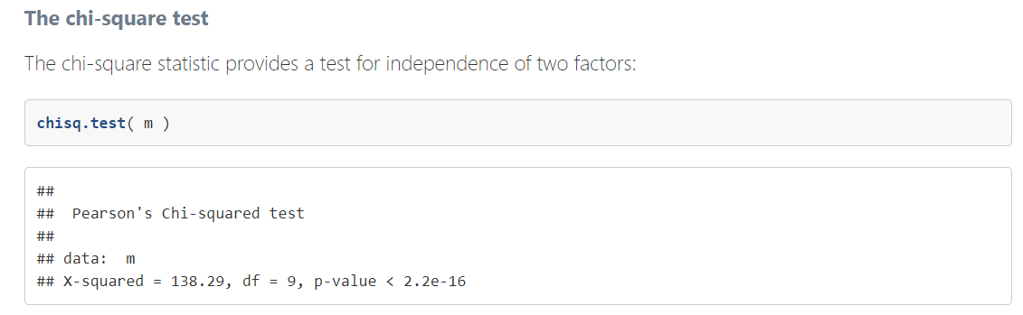
p-value < 0.05 so the factors ARE dependent upon each other,
i.e. hair color and eye color are “correlated”
table( study.group, f1 )
If we are testing for happy randomization or study group balance we want these to be independent – the proportions of each category in the factor f1 are approximately the same in the treatment and control groups

Slide 16
Bonferroni Correction:
When we want to be 95% confident that two groups are the same, and we can measure those groups using a set of contrasts, then our decision rule is no longer to reject the null (that the groups are the same) if the p-value < 0.05. A “contrast” is a comparison of means of any measured characteristic between two groups.
If we have a 5% chance of observing a p-value of less than 0.05 for each contrast, then the probability of observing at least one contrast with a p-value that small is greater than 5%! It is actually n*0.05 (minus prob of observing multiple < 0.05 at same time) where n is the number of contrasts.
So if we want to be 95% confident that the groups are different (not just the contrasts), we have to adjust our decision rule to α/n.
For example, if we have 10 contrasts, then our decision rule is now 0.05/10, or 0.005. The p-value of at least one contrast must be below 0.005 for us to conclude that the groups are different.

Slide 17
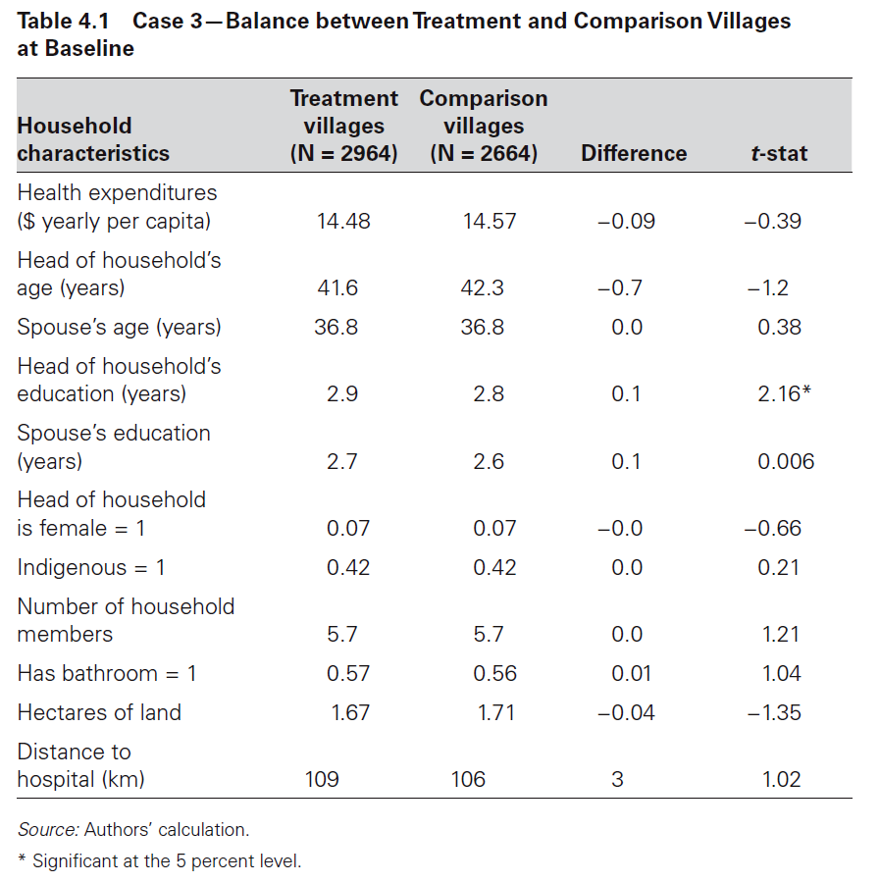
The most important table in every study: comparisons of treatment and control group characteristics For the counterfactual to be valid, the groups can ONLY differ by the treatment, not by any measured traits.
“contrasts”
Is this problematic?
What is the appropriate test for “identical” or equivalent groups?
We should observe no differences in measured traits. Assume a 95% confidence interval.

Slide 18
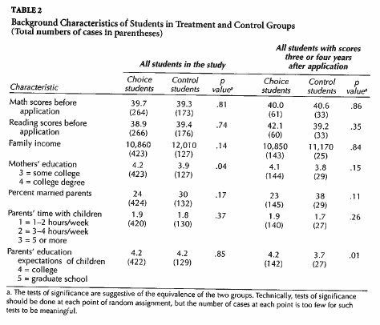
Test for Group Equivalence
seven
contrasts
reported
Bonferroni Correction:
New alpha = ( 0.05 / 7 ) = 0.0071
Smallest p-value in table
0.04 > 0.0071 Do not reject :: Groups are equivalent

Slide 19
Randomization vs study group equivalence

Slide 20
“Happy” randomization
Clap your hands if your treatment and control groups have no significant contrasts of measured participant traits

Slide 21
3 valid counterfactuals:
Each variety of counterfactual has a different formula for the program effect estimate.
Pre-Post Reflexive Estimator effect = T2-T1
Post-Only Estimator
effect = T2-C2
Pre-Post w Comparison Estimator
effect = (T2-T1) – (C2-C1)
(Diff-in-Diff)
effect
effect
A
effect:
A-B
B
t=1
t=2
t=1
t=2
t=1
t=2
Program
Program
Program
Treatment Groups, T1=before, T2=post-program measure
Control Groups, C1=before, C2=post-program measure

Slide 22
T2
Post-Test Only Measure
True Effect = T2 – C2
C2
If C1 = T1
T1
Measured effect accurately represents program impact
C1
Outcome
T2
T2 – C2 Too big
biased
T1
C1 < T1
C2
C1
T1
Measured effect overstates program impact
C1
time=1
time=2
Program
T2 – C2 Too small
C1 > T1
biased
C1
T1
Measured effect understates program impact

Slide 23



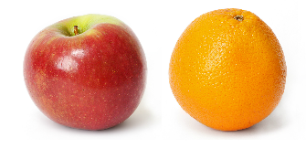

Experiments
Quasi-Experiments
Observational Studies

Slide 24
Validity of the post-test only estimator:
Post-Only
If we have confidence that the two groups are identical prior to the treatment, then mathematically T2-C2 will still account for gains independent of the treatment. This condition is necessary for the post-test only estimator to be unbiased.
In experimental design, this is usually accomplished through randomization or lottery. Observational students typically use matching models to create equivalent groups.
(T2 – T1) – (C2 – C1) = T2 – C2
IFF
C1 – T1 = 0
(equivalent at time 1)
T2
Outcome
C2
T1
C1
time=1
time=2
Program

