Slide 1
CSS: Cascading style sheets

Slide 2
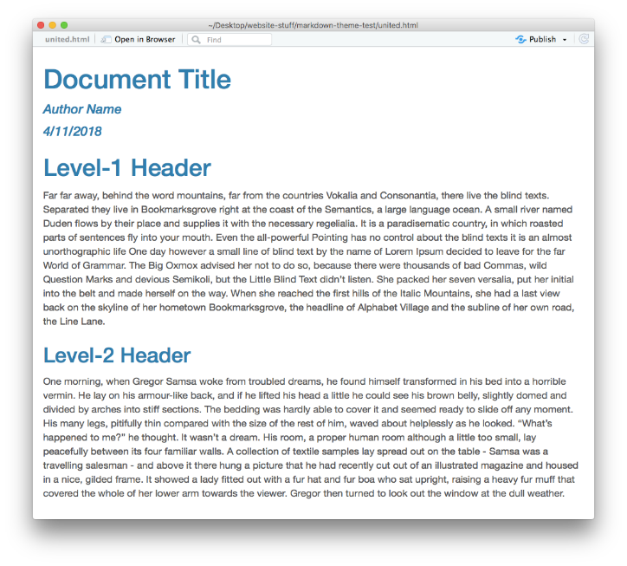
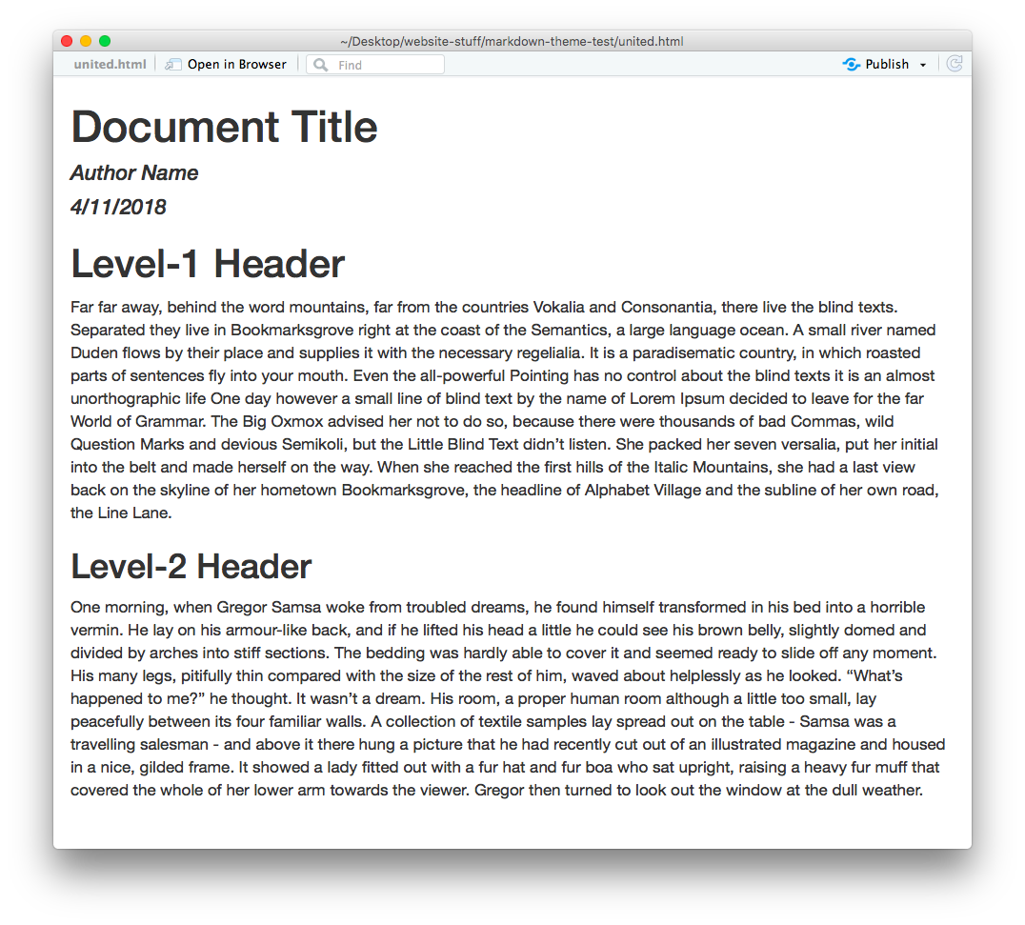
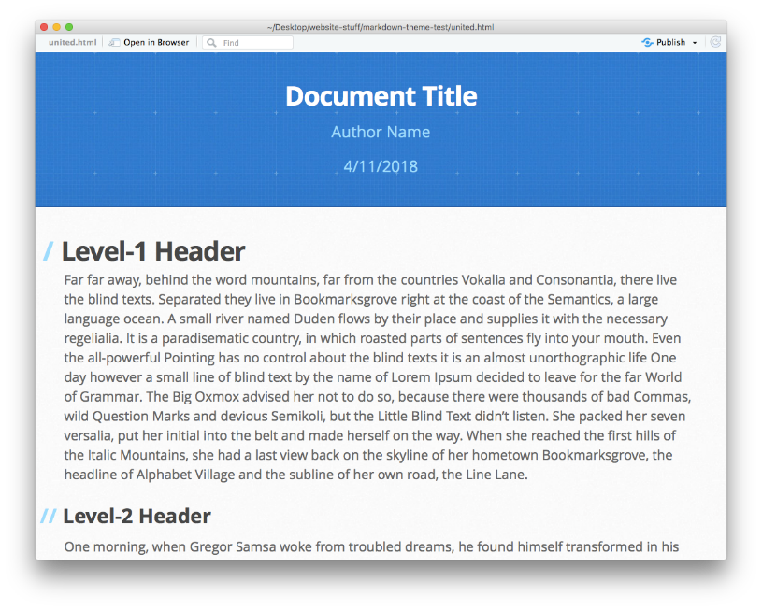
Why use CSS?
Separates the task of creating content from packaging content.
cerulean theme
readable theme
architect theme
---
output:
html_document:
theme: readable
---
You’ve been using this in RMD documents already !

Slide 3

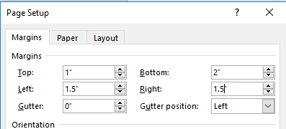
What is a STYLE?
Graphical User Interface Version of Style
h1{
font-type: arial narrow;
font-decoration: bold;
font-size: 18pt;
color: red;
}
(text style)
body {
margin-top: 1;
margin-left: 1.5;
margin-right: 1.5;
margin-bottom: 2;
}
(page style)

Slide 4
github pages

Slide 5
GitHub Page
Activating website options in a project repository
Details:
Static
Jekyll site (ruby)
Liquid tags
YAML headers

Slide 6
liquid tags

Slide 7
Generic Variables
Liquid tags allow you to reference info in your YAML header directly in your page.
---
yellowdig:
post-01: 'Monday, Aug 24th’
post-02: 'Monday, Aug 31st'
---
## Practice Problem Warmup
**Post on {{page.yellowdig.post-01}}**
Note that these are non-obvious bugs that can EASILY work there way into your code. Once you see the problem, it will seem obvious. But until you see it the code often looks fine and it's unclear why it is not working as expected.
YAML header data
Liquid tag referencing YAML field

Slide 8
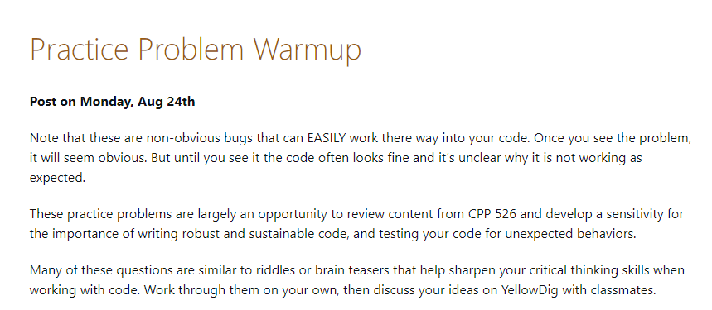
Generic Variables
(Rendered HTML Page)
Liquid tag replaced with value in YAML table

Slide 9
Html page basics

Slide 10
Anatomy of an HTML Page
Components:
Head
Header
Body
Footer
Templates / Layouts
<head>
<header>
<body>
<footer>

