Slide 1
interpreting program impact
Fundamentals of
PROGRAM EVALUATION
JESSE LECY

Slide 2
Which model is the “right” one?

Slide 3
Interpreting program impact

Slide 4
Which bet would
you prefer?
Bet #1
The bet costs $1,000 to place There is a 75% chance you win $1,500
There is a 25% chance you win $1,100
Bet #2
The bet costs $1,000 to place There is a 75% chance you win $4,000
There is a 25% chance you lose $2,000

Slide 5
Which bet would
you prefer?
Bet #1
The bet costs $1,000 to place There is a 75% chance you win $1,500
There is a 25% chance you win $1,100
Expected value =
(0.75)(1500) + (0.25)(1100) =
$1,400
Bet #2
The bet costs $1,000 to place There is a 75% chance you win $4,000
There is a 25% chance you lose $2,000
Expected value =
(0.75)(4000) – (0.25)(2000) =
$2,500

Slide 6
Which bet would
you prefer?
Bet #1
The bet costs $1,000 to place There is a 75% chance you win $1,500
There is a 25% chance you win $1,100
Expected value =
(0.75)($1,500) + (0.25)($1,100) = $1,400
expected value
$1,100
$1,500
$1,400
range of
outcomes

Slide 7
Which bet would
you prefer?
Bet #1
expected value
$1,100
$1,500
$1,400
A bet as metaphor for regression results:
In regression terms, the coefficient in the model is like the expected value. It is our best guess of the most likely outcome given all information that we have available.
The standard error allows us to build a confidence interval around that guess, which provides a range of plausible outcomes.
These values allow us to do scenario planning by thinking about the coefficient as the most likely outcome while also considering the full range of possible outcomes.
Note that the range of outcomes corresponds with our selected model tolerance, a 95% confidence range, 99% confidence range, etc.

Slide 8
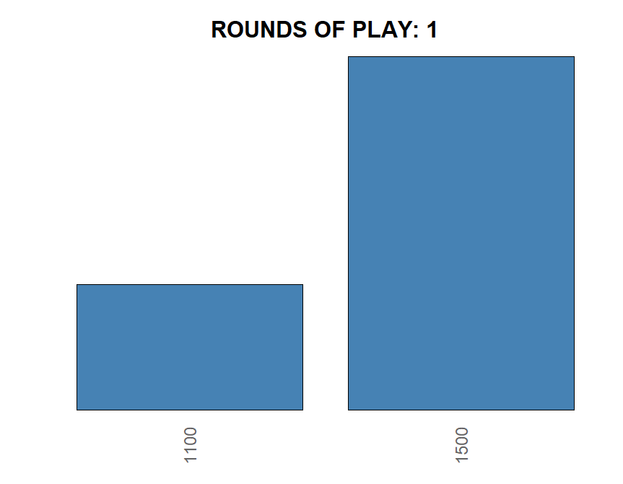
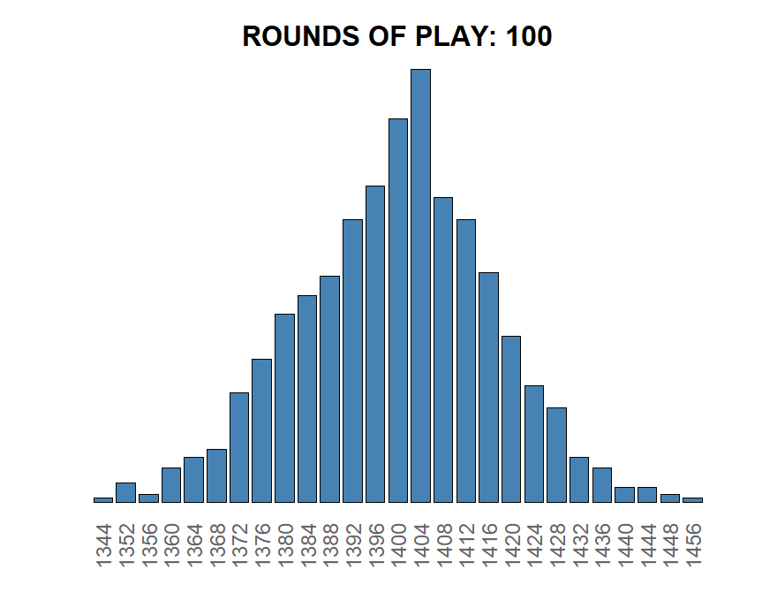
A note on the expected value metaphor of a bet:
If you a making a single bet with only two possible outcomes, then the distribution is bimodal and it’s impossible to achieve the exact expected value. The range out outcomes give you best case and worst case. The expected value is theoretical.
The idea of an expected value is easier to understand in a game that can be played many times. The outcome is then the average payoff across all plays.
As you increase the number of plays you move toward the central limit theorem with the expected value becoming the most likely outcome.
As you increase your rounds of play the range of likely outcomes also narrows. Theoretically you can still win $1,100, but you would have to roll that outcome 100 times in a row, which has the following probability: 0.0000000000000000000000000000000000000000000000000000000000006
These outcomes generated by simulations approximate a confidence intervals with the number of rounds of play acting like the sample size in a study. As you increase the sample size (number of rounds), the interval of likely outcomes (average across all games) narrows.
$1,100
$1,500
$1,340
$1,456
$1,400

Slide 9
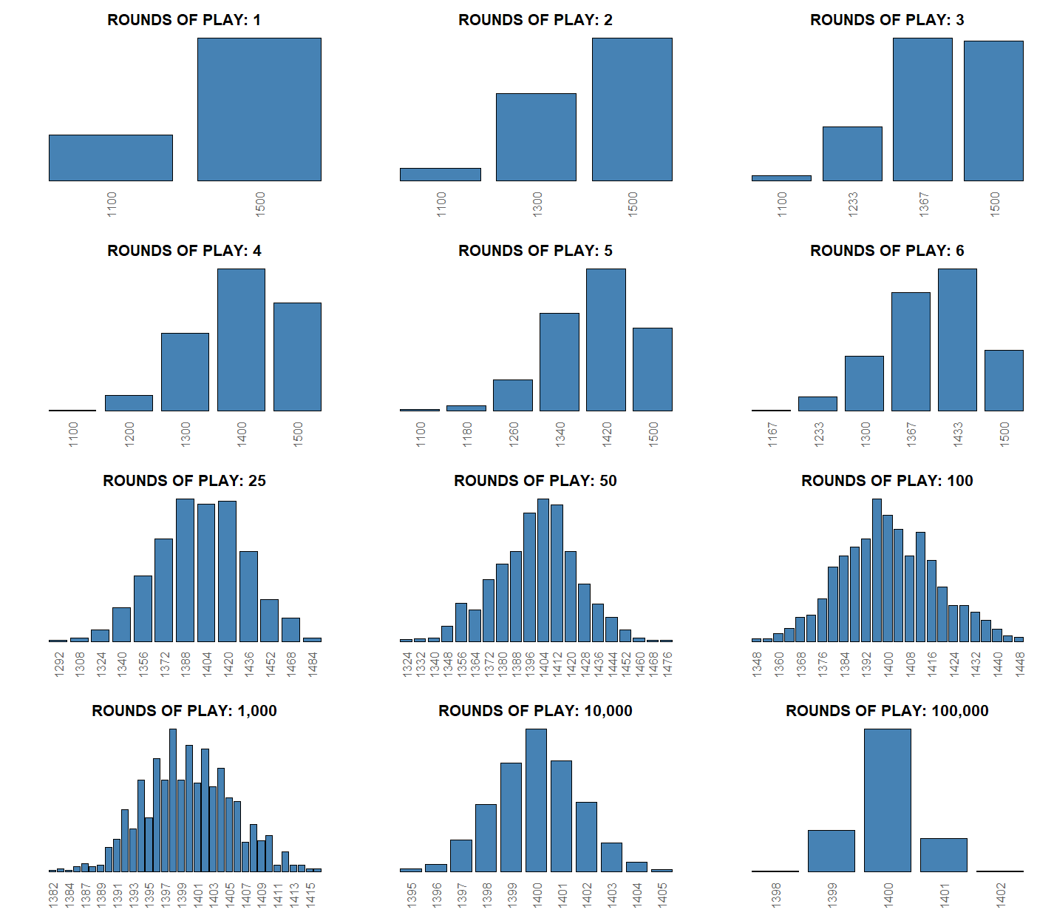

Slide 10
rep_samp <- function( N=3 ){
res <- NULL
for( i in 1:10000 ){
res[i] <- sample( c(1500,1500,1100,1500), size=N, replace=T ) |> mean() |> round(0)
}
return( res )
}
par( mfrow=c(4,3) )
table( rep_samp( 1 ) ) |> prop.table() |> barplot(col="steelblue",yaxt="n",main="ROUNDS OF PLAY: 1",cex.main=2,cex.names=1.5,las=2,col.axis="gray40")
table( rep_samp( 2 ) ) |> prop.table() |> barplot(col="steelblue",yaxt="n",main="ROUNDS OF PLAY: 2",cex.main=2,cex.names=1.5,las=2,,col.axis="gray40")
table( rep_samp( 3 ) ) |> prop.table() |> barplot(col="steelblue",yaxt="n",main="ROUNDS OF PLAY: 3",cex.main=2,cex.names=1.5,las=2,,col.axis="gray40")
table( rep_samp( 4 ) ) |> prop.table() |> barplot(col="steelblue",yaxt="n",main="ROUNDS OF PLAY: 4",cex.main=2,cex.names=1.5,las=2,,col.axis="gray40")
table( rep_samp( 5 ) ) |> prop.table() |> barplot(col="steelblue",yaxt="n",main="ROUNDS OF PLAY: 5",cex.main=2,cex.names=1.5,las=2,,col.axis="gray40")
table( rep_samp( 6 ) ) |> prop.table() |> barplot(col="steelblue",yaxt="n",main="ROUNDS OF PLAY: 6",cex.main=2,cex.names=1.5,las=2,,col.axis="gray40")
table( rep_samp( 25 ) ) |> prop.table() |> barplot(col="steelblue",yaxt="n",main="ROUNDS OF PLAY: 25",cex.main=2,cex.names=1.5,las=2,,col.axis="gray40")
table( rep_samp( 50 ) ) |> prop.table() |> barplot(col="steelblue",yaxt="n",main="ROUNDS OF PLAY: 50",cex.main=2,cex.names=1.5,las=2,,col.axis="gray40")
table( rep_samp( 100) ) |> prop.table() |> barplot(col="steelblue",yaxt="n",main="ROUNDS OF PLAY: 100",cex.main=2,cex.names=1.5,las=2,,col.axis="gray40")
table( rep_samp( 1000) ) |> prop.table() |> barplot(col="steelblue",yaxt="n",main="ROUNDS OF PLAY: 1,000",cex.main=2,cex.names=1.5,las=2,,col.axis="gray40")
table( rep_samp( 10000) ) |> prop.table() |> barplot(col="steelblue",yaxt="n",main="ROUNDS OF PLAY: 10,000",cex.main=2,cex.names=1.5,las=2,,col.axis="gray40")
table( rep_samp( 100000) ) |> prop.table() |> barplot(col="steelblue",yaxt="n",main="ROUNDS OF PLAY: 100,000",cex.main=2,cex.names=1.5,las=2,,col.axis="gray40")

Slide 11
Which bet would
you prefer?
Bet #2
The bet costs $1,000 to place There is a 75% chance you win $4,000
There is a 25% chance you lose $2,000
Expected value =
(0.75)(4000) – (0.25)(2000) =
$2,500
– $2,000
$4,000
expected
value
1 in 4 chance of losing money
3 in 4 chances of winning money

Slide 12
Which bet would
you prefer?
Bet #1
100% chance of positive return
Expected value =
(0.75)(1500) + (0.25)(1100) =
$1,400
Bet #2
75% chance of a positive return
Expected value =
(0.75)(4000) – (0.25)(2000) =
$2,500

Slide 13
Which bet would
you prefer?
RISK AND RETURN IN DECISION-MAKING:
There is no “right” answer about which bet is best. It really depends on context.
Theory would suggest that a “rational” actor would focus on the expected value. However, in the real world we also must consider consequences.
If you are betting your birthday money, then go big! The more extreme the outcomes the more adrenaline you will get from the bet, so it is more exciting either way. And since it was not money you had in your budget you will not experience the loss in the same way. You have the same likelihood of winning as BET #1, and the payoff is $2,500 better.
If you are betting your rent, then the implications of losing the $1,000 are tangible and significant. The low risk, low return option probably maximizes your utility, even if it doesn’t maximize the expected value or total returns.
low risk, low return
100% chance of positive return
Expected value =
(0.75)(1500) + (0.25)(1100) =
$1,400
HIGH risk, HIGH return
75% chance of a positive return
Expected value =
(0.75)(4000) – (0.25)(2000) =
$2,500

Slide 14
Which bet would
you prefer?
STATISTICAL SIGNIFICANCE:
People often use statistical significance as a decision criteria, which is an odd convention that has evolved in statistics because it only tells us one thing: do outcomes only include positive results?
If the range of likely outcomes spans zero, then it would NOT be statistically significant. Even if the expected value is positive.
$2,500
– $2,000
$4,000
$0

Slide 15
Which bet would
you prefer?
Bet #3
The bet costs $1,000 to place There is a 75% chance you win $3,300
There is a 25% chance you win $100
Expected value:
(0.75)(3300) + (0.25)(100) = $2,500
$2,500
– $2,000
$4,000
Bet #2
NOT “significant”: includes positive and negative outcomes
(the range of plausible outcomes contains zero)
$2,500
Bet #3
$100
$3,300
“significant”:
all outcomes
are positive
$0

Slide 16
Which bet would
you prefer?
Bet #4
The bet costs $1,000 to place There is a 50% chance you win $2,000
There is a 50% chance you win $100
Expected value:
(0.50)(2000) + (0.50)(100) = $1,050
NOT “significant”
$2,500
Bet #2
– $2,000
$4,000
$1,050
Bet #4
$100
$2,000
“significant”
$0

Slide 17
Which bet would
you prefer?
complicated meaning
of significance:
Statistical significance tells us if we can be certain about the direction of our program effects (the confidence interval does NOT contain zero).
$0
Bet #2
NOT “significant”
Bet #4
“significant”

Slide 18
Which bet would
you prefer?
complicated meaning of significance:
In some cases, we can gather more information (a larger sample size, or in this metaphor play a game repeatedly) and narrow the range of plausible outcomes (make the confidence interval smaller).
When comparing bets with similar expected values a narrower range of outcomes might help hedge the risk of “making the bet” (or investing in a program).
$0
Bet #2
$2,500
– $2,000
NOT “significant”
$4,000
$2,500
“significant”
Bet #3
$100
$3,300

Slide 19
Which bet would
you prefer?
complicated meaning of significance:
It is only one piece of information, though. And a somewhat arbitrary criteria in the world of expected values.
Which bet has the higher payoff (both in max payout and in expected value terms)?
Which is “significant”?
Statistical significance should NOT be the first or only piece of information to consider.
Bet #2
$2,500
– $2,000
NOT “significant”
$4,000
$1,050
“significant”
Bet #4
$100
$2,000
$0

Slide 20
Regression
Coefficient plots
STATISTICAL SIGNIFICANCE (N.S. IF C.I. CONTAINS ZERO)
SLOPE ESTIMATE
(BEST GUESS)
b₁
b₁ = 0
CONFIDENCE INTERVAL
NULL HYPOTHESIS
(NO IMPACT)

Slide 21

Which program is better?
R$eading Speed=b_{0}$ + $b_{1}Hours of Tutoring$ + e
Program 1
Program 2
b₁
b₁
b₁ = 0
b₁ = 0
(assume these are all 95% confidence intervals)
The cost of the program is the bet we are making.
The expected value of the program is represented by the point estimate of the slope (b1).
The risk (certainty) of the bet is symbolized by the confidence interval.
Preferences for bets is always a balance between expected pay-off and risk (uncertainty).

Slide 22

What about now?
R$eading Speed=b_{0}$ + $b_{1}Hours of Tutoring$ + e
Program 1
Program 2
b₁
b₁
b₁ = 0
b₁ = 0
Which model is statistically significant?
Which program has more positive impact?

Slide 23

Experiment with groups
(treated:
yes or no)
$$Heartrate=b_{0}+b_{1}∙Caffeine+ε$$
Heart Rate
Treatment (Caffeine)
Control (No caffeine)
T2
C2

Slide 24

Effects Sizes for Levels of A Treatment
$$y=β_{0}+β_{1}x$$
β₁ =140
Effect
One unit of X
Slope=0
For a one-unit change in X, we expect a β₁ change in Y.
How big is the effect?
Is it significant?

Slide 25

effect size
$$Heartrate=b_{0}+b_{1}∙Caffeine+ε$$
Positive & Significant
Impact
on Outcome
b₁
Effect
b₁ = 0
Notes:
In an experiment there is full control over the treatment variable, and it is the only thing being manipulated

Slide 26
effect size
$$Heartrate=b_{0}+b_{1}∙Potato Chips+ε$$
b₁
b₁ = 0
Not statistically significant – i.e. we can’t tell whether the program has a positive or negative impact since the confidence interval is on both sides of zero.
Notes:
Null case – the treatment has no effect

Slide 27
hypothesis testing
STATISTICAL SIGNIFICANCE (N.S. IF C.I. CONTAINS ZERO)
SLOPE ESTIMATE
(BEST GUESS)
b₁
b₁ = 0
CONFIDENCE INTERVAL
NULL HYPOTHESIS
(NO IMPACT)

Slide 28
Which program is better?
Consider two programs that are meant to improve reading comprehension. The dependent variable is a score on a reading comprehension exam (higher being better). Which program do you prefer and why?
R$eading Speed=b_{0}$ + $b_{1}Hours of Tutoring$ + e
Program 1
Program 2
b₁
b₁
b₁ = 0
b₁ = 0
(assume these are all 95% confidence intervals)

Slide 29
What about now?
R$eading Speed=b_{0}$ + $b_{1}Hours of Tutoring$ + e
Program 1
Program 2
b₁
b₁
b₁ = 0
b₁ = 0
Which model is statistically significant?
Which program has more positive impact?

Slide 30
What about now?
R$eading Speed=b_{0}$ + $b_{1}Hours of Tutoring$ + e
Program 1
Program 2
b₁
b₁
b₁ = 0
b₁ = 0
Which model is statistically significant?
Which program has more positive impact?

Slide 31

What about now?
R$eading Speed=b_{0}$ + $b_{1}Hours of Tutoring$ + e
b₁
Program 1
b₁
Program 2
b₁ = 0
Which model is statistically significant?
Which program has more positive impact?

Slide 32

What about now?
R$eading Speed=b_{0}$ + $b_{1}Hours of Tutoring$ + e
Program 1
b₁
Program 2
b₁
Program 3
b₁
b₁ = 0

Slide 33
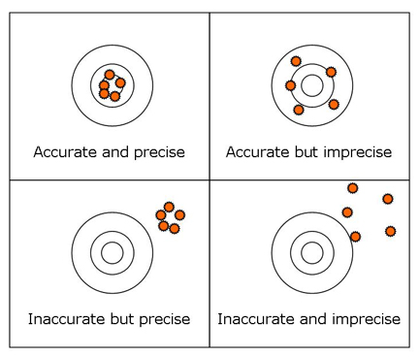

R$eading Speed=b_{0}$ + $b_{1}Hours of Tutoring$ + e
Program 1
Program 2
b₁
b₁
b₁ = 0
b₁ = 0
Model precision
Eval. of Program 1
Eval. of Program 2

Slide 34
Looking ahead
For now we are focusing on the interpretation of coefficient plots. But next week we will look at how adding control variables change models. They can shift coefficients, and change standard errors, changing the interpretations of program effectiveness.
Model 1
Model 2 w Controls
b₁
b₁
b₁ = 0
b₁ = 0
(assume these are all 95% confidence intervals)

Slide 35
What is a p-value?

Slide 36
Which of these is statistically significant?
95% CI
b₁
99% CI
b₁
b₁ = 0
These are both estimates from the same model.

Slide 37
What is the p-value in this case?
95% CI
b₁
99% CI
b₁
b₁ = 0
These are both estimates from the same model.

Slide 38
What is the p-value in this case?
97% CI
P-val = 0.03
b₁
b₁ = 0
The p-value tells you how large you can draw your confidence interval before it contains the null.

Slide 39
Which program is better?
R$eading Speed=b_{0}$ + $b_{1}Hours of Tutoring$ + e
Program 1
Program 2
b₁
b₁
b₁ = 0
b₁ = 0
95% confidence intervals

Slide 40
What about now?
R$eading Speed=b_{0}$ + $b_{1}Hours of Tutoring$ + e
Program 1
Program 2
b₁
b₁
b₁ = 0
b₁ = 0
90% confidence intervals

Slide 41
Which bet would
you prefer?
Bet #1
The bet costs $1,000 to place There is a 75% chance you win $1,500
There is a 25% chance you win $1,100
Bet #2
The bet costs $1,000 to place There is a 75% chance you win $4,000
There is a 25% chance you win $0

Slide 42
Mechanics of Confidence intervals

Slide 43
The Road Map (AGAIN)
Of the Mean:
Of the Slope:
Sampling
Variance:
(for x)
(using the residual)
Standard Deviation:
Standard Error:
Confidence Interval
(of the mean)
(of the slope)

Slide 44
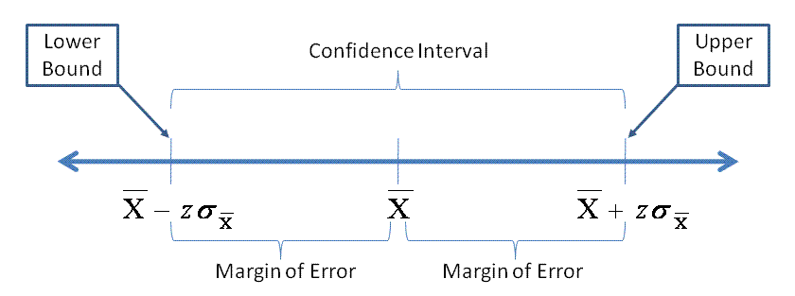
The formula
If we were sure of ourselves we wouldn’t need a margin of error! We only have a sample, though, so we can’t be certain.
The population parameters are never known, so we use t-stats and the formula for the sample standard error.
(CI of the mean)

Slide 45
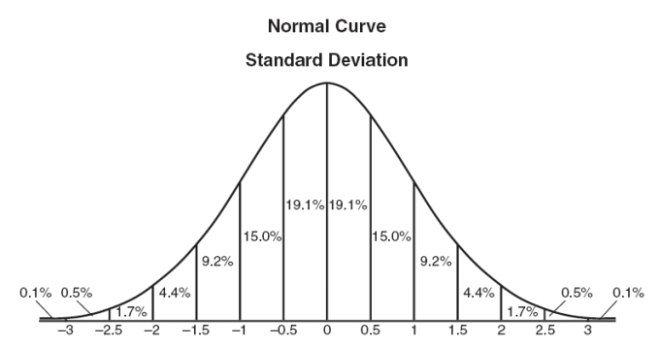
What is a t-value?
If we examine an interval that is 1 standard deviation from the mean in both directions, we know that this will include 68.2% of the cases.

Slide 46
What is a t-value?
If we examine an interval that is 1.5 standard deviations from the mean in both directions, we know that this will include 86.6% of the cases.

Slide 47
What is a t-value?
t=1.96
I want a 95% confidence interval, so I find the t-value where 95% of the data falls within the interval (in a 2-sided test).

Slide 48
Determine t-value:
Select a level of confidence
Figure out your sample size
Find a t-table
Match level of confidence to sample size
Or just use software like a normal person

Slide 49
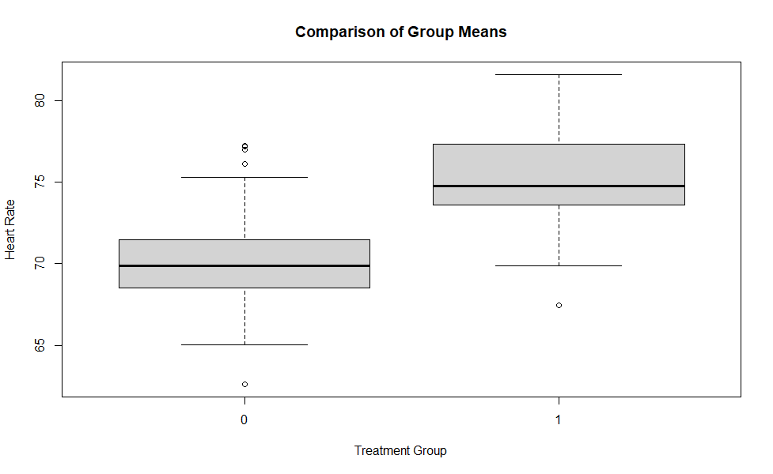
head( data.frame( y, t ) )
y t
1 67.67494 0
2 71.19501 1
3 69.81960 0
4 73.58000 1
5 65.47680 0
6 74.04290 1
# create some fake data
# y = heartrate
# t = treatment (e.g. caffeine)
t <- rep( c(0,1), 50 )
y <- 70 + rnorm(100,0,3) + 5*t
plot( factor(t), y,
+ main="Comparison of Group Means",
+ xlab="Treatment Group",
+ ylab="Heart Rate" )
mean.t <- mean( y[ t == 1 ] )
mean.c <- mean( y[ t == 0 ] )
mean.c
[1] 70.29385
mean.t
[1] 75.25103
# effect size
mean.t - mean.c
[1] 4.957187
t.test( y ~ t )
Welch Two Sample t-test
data: y by t
t = -8.1231, df = 97.927, p-value = 1.391e-12
alternative hypothesis: true difference in means is not equal to 0
95 percent confidence interval:
-6.168235 -3.746139
sample estimates:
mean in group 0 mean in group 1
70.29385 75.25103

Slide 50
How often are we wrong?
If alpha=0.05, what is our level of confidence?

Slide 51
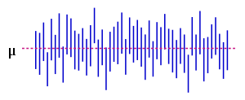
How often are we wrong?
μ
Chose an alpha-level, which determines the size of the confidence interval. This example uses alpha=0.05. We would expect five samples in one-hundred to result in confidence intervals that do not contain the true mean. We see 3 in 50 draws here, which is consistent with expectations.

Slide 52
How often are we wrong?
μ
What if we change our alpha from 0.05 to 0.10, how many of these confidence intervals would not contain the true mean?

Slide 53
How often are we wrong?
Is a 90% confidence interval bigger
or small than a 95% confidence interval?
b₁
b₁

Slide 54
Where we are going:
Regression estimates should be:
Unbiased (accurate)
Efficient (precise)

Slide 55
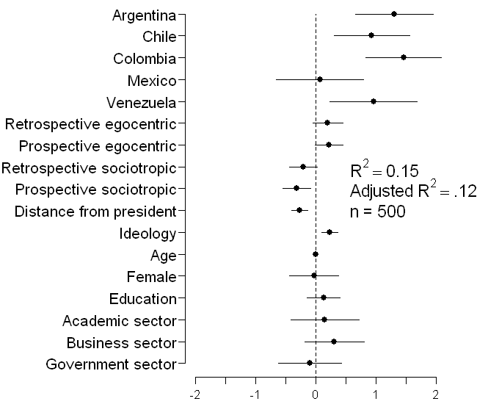
Coefficient plots as an alternative to dense regression tables
Variable | Coefficient (Standard Error)
Constant | .41 (.93)
Countries
Argentina |  | 1.31 (.33)^{### B,M}
Chile |  | .93 (.32)^{### B,M}
Colombia |  | 1.46 (.32) ^{### B,M}
Mexico |  | .07 (.32)^{A,CH,CO,V}
Venezuela |  | .96 (.37)^{## B,M}
Threat
Retrospective egocentric economic perceptions |  | .20 (.13)
Prospective egocentric economic perceptions |  | .22 (.12)#
Retrospective sociotropic economic perceptions |  | -.21 (.12)#
Prospective sociotropic economic perceptions |  | -.32 (.12)##
Ideological Distance from president
Ideology
Ideology |  | .23 (.07) ###
Individual Differences
Age |  | .00 (.01)
Female |  | -.03 (.21)
Education |  | .13 (.14)
Academic Sector |  | .15 (.29)
Business Sector |  | .31 (.25)
Government Sector |  | -.10 (.27)
R² |  | .15
Adjusted R² |  | .12
n |  | 500
###p < .01, ##p < .05, #p < .10 (two-tailed)
Table 2 from Stevens (2006): Determinants of Authoritarian Aggression
This figure has everything we need to interpret the regression. It shows the magnitude of the relationship between each variable and Y, the standard error of each coefficient (encoded in the confidence interval), and statistical significance (does it cross zero?).
Which do you prefer?

Slide 56
interpreting program impact
What should be clear in my mind?
Our interpretation of program impact involves an understanding of the “effect size” (regression slope) and the precision with which it is estimated (the confidence interval).
The level of confidence we select determines the t-value, which determines the size of the confidence interval.
For a program to be statistically significant, the confidence interval around the slope should not contain the null hypothesis (slope=0).
We can choose an arbitrary level of confidence such that our confidence interval will not contain the null.
The p-value tells us the largest confidence interval that we can draw that does not contain the null.
Program investments are bets that balance effect size plus confidence.

Slide 57
Aside: statistical power

Slide 58
Statistical power
Power: the ability to detect a program impact when it exists.
Type I Error: Claiming a program has impact when it doesn’t (false positive). This type of error is usually caused by bias in our estimate of impact.
Type II Error: Failure to detect program impact when it exists (false negative). This type of error is usually caused by a lack of adequate statistical power (large standard errors).

Slide 59
Low power
In many cases we fail to reject the null, even though our true program impact is a slope of 3.
Note that our model is unbiased – our estimates all cluster around the true slope.

Slide 60
High power
We are sure here that we have enough power to say something concrete about the program impact. We do not worry about Type II Errors in this evaluation.
What has changed?

Slide 61
What is the “cost” of gaining more confidence?
An interval with a width of of 1.5 stan. dev.’s ensures that we capture 86.6% of the data
There is an increasing marginal cost of gaining confidence.

Slide 62
What is the “cost” of gaining more confidence?
If we increase the interval to 2 standard deviations we now capture 95.4% of the data for a gain of 8.8 points of confidence.
There is an increasing marginal cost of gaining confidence.

Slide 63
What is the “cost” of gaining more confidence?
If we take another half-unit step to 2.5 standard deviations from the mean we now capture 98.8% of the data, but we gain only 3.4 points from the same increase in interval size, less than half the confidence gain as before.
Increasing the interval from 2.5 to 3 standard deviations results in only 1 more point of confidence gained.

Slide 64
What is the “cost” of gaining more confidence?
Each additional unit of confidence become more and more expensive as you approach 100%.
What is the relationship between a “unit of confidence” and a confidence interval?

Slide 65
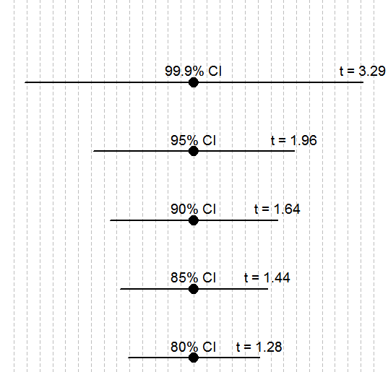
What is the “cost” of gaining more confidence?
+ 1.33 SDs
+ 0.16 SDs
There is an increasing marginal cost of gaining confidence. The

Slide 66
x.85 <- round( qnorm( 0.075, mean = 0, sd = 1 ), 2 )
x.90 <- round( qnorm( 0.05, mean = 0, sd = 1 ), 2 )
x.95 <- round( qnorm( 0.025, mean = 0, sd = 1 ), 2 )
x.999 <- round( qnorm( 0.0005, mean = 0, sd = 1 ), 2 )
ci.lower <- c(x.80,x.85,x.90,x.95,x.999)
par( mar=c(0,0,0,0) )
plot.new()
plot.window( xlim=c(-3.5,3.5), ylim=c(1,6) )
abline( v=seq(-3.5,3.5,by=0.25), lty=2, col="gray" )
points( rep(0,5), 1:5, pch=19, cex=2 )
segments( x0=ci.lower, x1=abs( ci.lower ), y0=1:5,
lwd=2 )
text( rep(0,5), 1:5, c("80% CI","85% CI","90% CI","95% CI","99.9% CI"),
cex=1.2, pos=3 )
text( abs( ci.lower ), 1:5,
paste("t = ",abs( ci.lower ),sep=""), cex=1.2, pos=3 )

