Slide 1
the Markdown to html pipeline

Slide 2
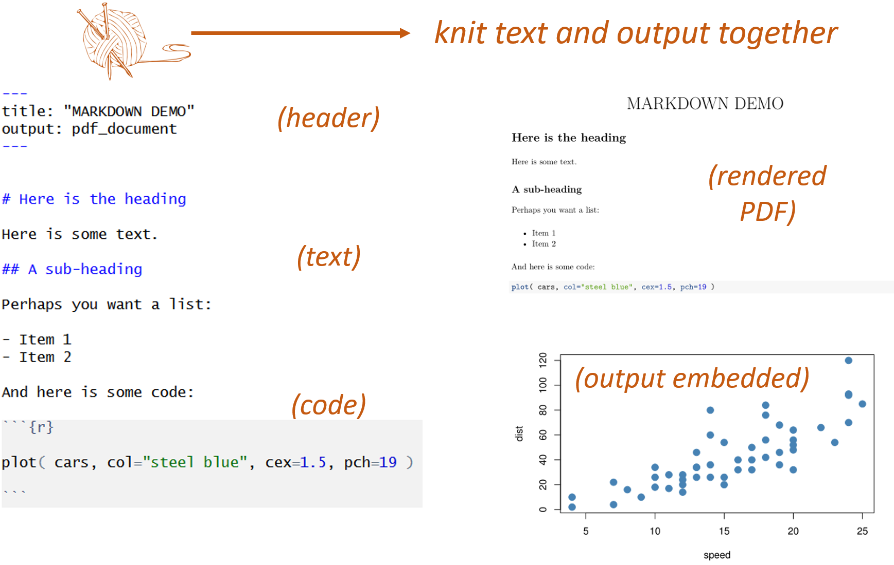
( you are now familiar with these steps )

Slide 3
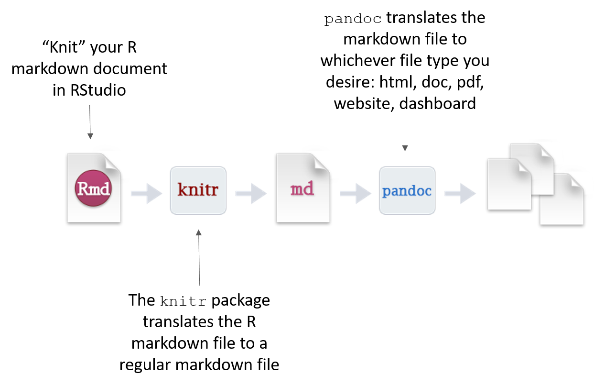
DOC
PDF
HTML
Anatomy of the R Markdown workflow when you knit a file in RStudio

Slide 4

One reason RMD docs are powerful is Pandoc can render content into a variety of content types including HTML docs, word docs, slide decks, dashboards, and PDFs (to name a few)

Slide 5
MARKDOWN TO HTML
MARKDOWN
When knitting, markdown text is converted to the proper text elements (titles, paragraphs, lists, tables, links, etc.) and each element is nicely formatted to create a readable and professional HTML document.
MD+R
=RMD
HTML
RStudio
KNITR
PANDOC

Slide 6
github pages

Slide 7
MARKDOWN TO HTML
MARKDOWN
JEKYLL
GH Pages
YAML settings
Liquid Tags
HTML
Tags
Style (CSS)
Page elements (head, header, body, footer)
GitHub
MD+R
=RMD
RStudio
KNITR
PANDOC
Now, instead of knitting RMD docs, we will be converting Markdown files to HTML using GitHub pages. Jekyll is equivalent to the KnitR/Pandoc framework used to render RMD files into HTML.

Slide 8
MARKDOWN TO HTML
MARKDOWN
JEKYLL
GH Pages
YAML settings
Liquid Tags
HTML
Tags
Style (CSS)
Page elements (head, header, body, footer)
GitHub
In order to start building page templates, you will need to understand a few simple rules about how GitHub pages work, a few simple rules about how HTML files are organized, and some basic CSS.

Slide 9
CSS: Cascading style sheets

Slide 10
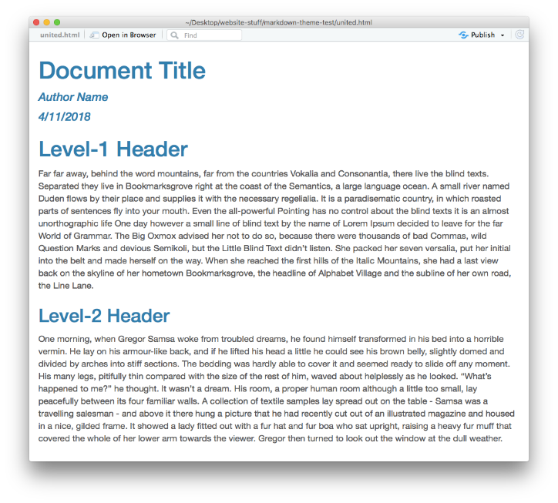
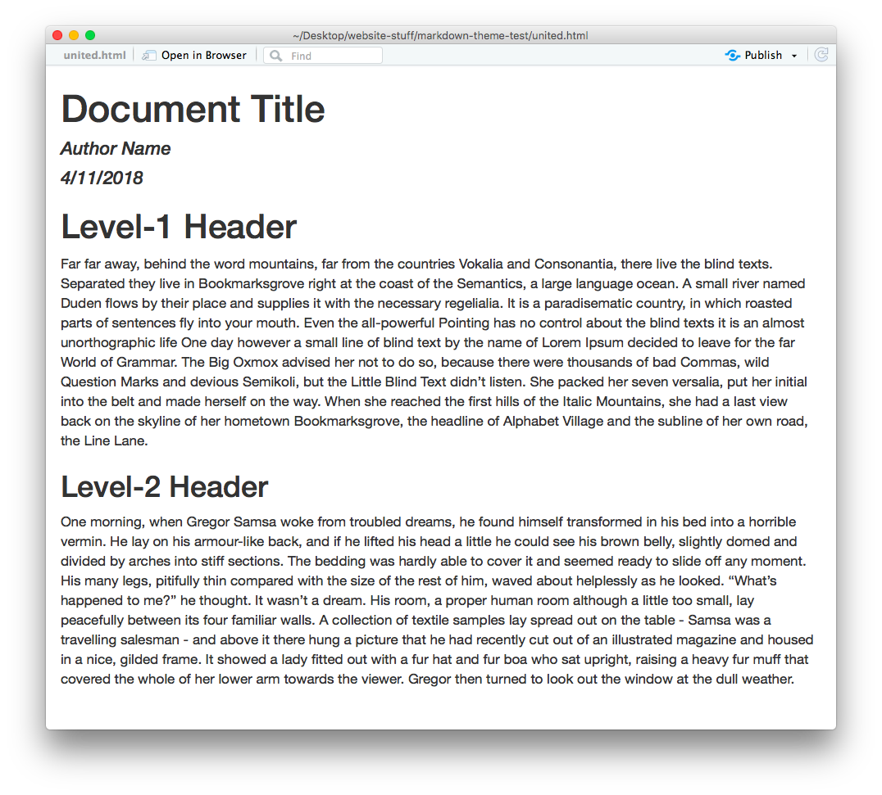
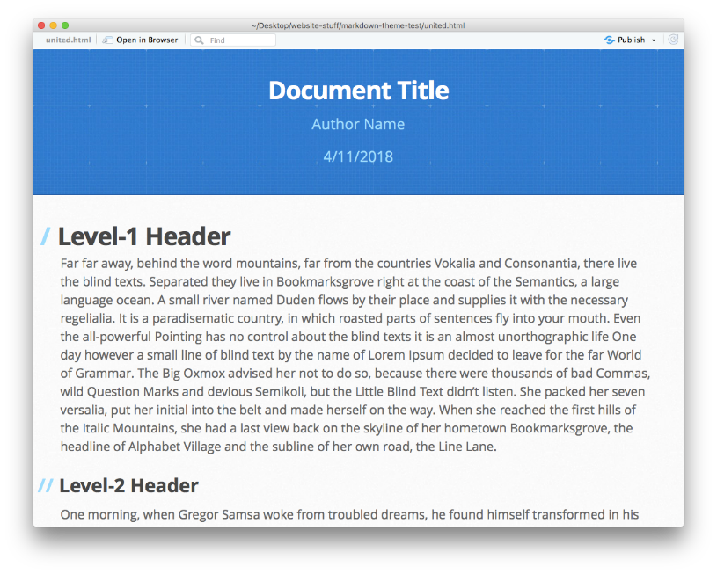
Why use CSS?
Separates the task of creating content from packaging content.
cerulean theme
readable theme
architect theme
---
output:
html_document:
theme: readable
---
You’ve been using this in RMD documents already !

Slide 11

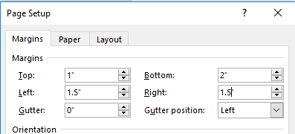
What is a STYLE?
Graphical User Interface Version of Style
h1{
font-type: arial narrow;
font-decoration: bold;
font-size: 18pt;
color: red;
}
(text style)
body {
margin-top: 1;
margin-left: 1.5;
margin-right: 1.5;
margin-bottom: 2;
}
(page style)

Slide 12
the CSS defines the aesthetics of each type of content on the page
h2 = ## header 2 style
h2 {
color: #333333; /* Changes text color to a dark gray */
font-size: 1.5rem; /* Sets the font size */
font-family: Arial, sans-serif; /* Specifies the font */
margin-top: 1em; /* Adds space above the heading */
margin-bottom: 0.5em; /* Adds space below the heading */
border-bottom: 2px solid #333333; /* Adds a border to the bottom */
}

Slide 13
Html page basics

Slide 14
HTML PAGE
First you must understand the bare minimum elements you need on an HTML page.
HEAD: load html packages, fonts, and other resources needed for the page
BODY: start of page content
HEADER: top of a page that often contains the page title and navigation bars
MAIN or ARTICLE: section that contains the actual text
FOOTER: elements at the bottom of a page
Note that elements are hierarchical – the body section contains the header, main, and footer sections.
<html>
<head>…</head>
<body>
<header>…</header>
<p> ... </p>
<footer>…</footer>
</body>
</html>

Slide 15
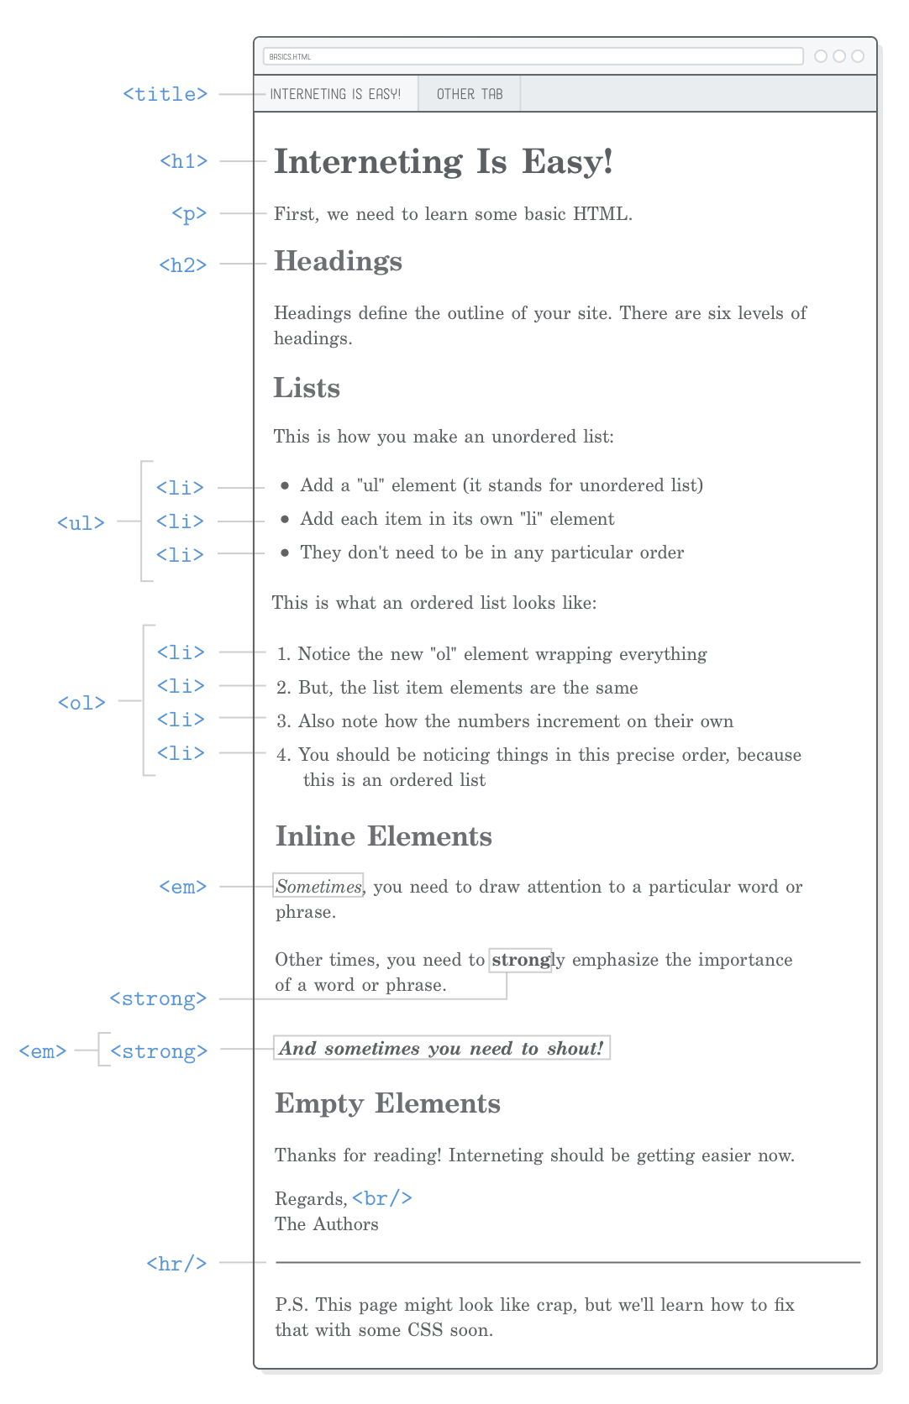
PAGE ELEMENTS
CONTENT ELEMENTS
<html>
<head>…</head>
<body>
<header>…</header>
<p> ... </p>
<footer>…</footer>
</body>
</html>
titles
tags that organize content into sections
text
lists
tags that define content types and formatting
tables
bold
italics

Slide 16
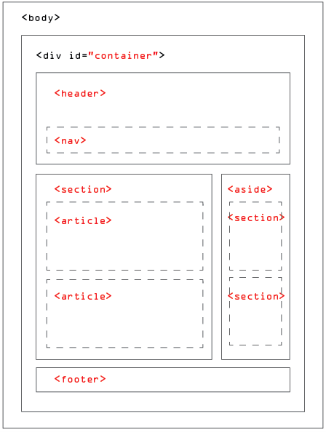
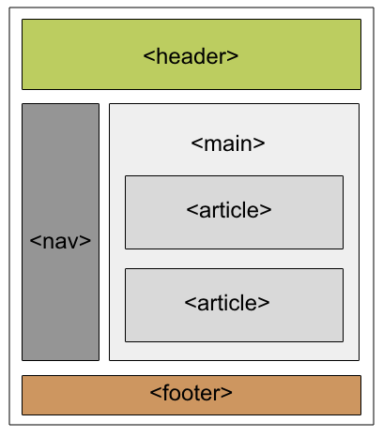
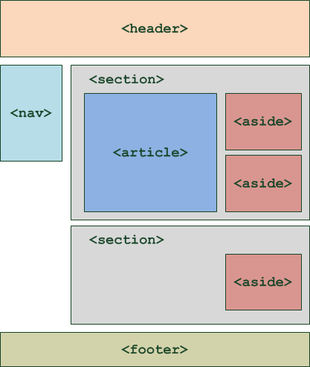
As you get more comfortable with HTML you can create more sophisticated layouts and add new page elements. Page layout is an advanced CSS skill and also an easy task to contract out to someone that specializes in website design.

Slide 17
the Jekyll framework

Slide 18
/includes folder
header.html
Generic page elements that are reused throughout the site are defined and saved as separate files. They are imported wherever needed. These are the templated elements.
Page content comes from the text contained in the markdown file itself and is specific to the page. Content is NOT templated.
nav.html
footer.html

Slide 19
LIQUID / JEKYLL
HTML
<html>
{% include head.html %}
<body>
{% include header.html %}
{{ content }}
{% include footer.html %}
</body>
</html>
<html>
<head>…</head>
<body>
<header>…</header>
<p> ... </p>
<footer>…</footer>
</body>
</html>

Slide 20
LIQUID / JEKYLL
HTML
The {% include %} liquid tag is the way that Jekyll combines page elements by replacing the tag with the actual HTML code contained within the referenced file
header.html file content:
<html>
<body>
{% include header.html %}
</body>
</html>
<header>
<div class="navbar">
<a id="site-title" href="index"> {{ site.title }} </a>
<a href="index"> Home </a>
<a href="page1"> Layout Example </a>
<a href="page2"> Table Example </a>
<a href="about"> About </a>
</div>
</header>

Slide 21
liquid tags

Slide 22
Generic Variables
Liquid tags allow you to reference info in your YAML header directly in your page.
---
yellowdig:
post-01: 'Monday, Aug 24th’
post-02: 'Monday, Aug 31st'
---
## Practice Problem Warmup
**Post on {{page.yellowdig.post-01}}**
Note that these are non-obvious bugs that can EASILY work there way into your code. Once you see the problem, it will seem obvious. But until you see it the code often looks fine and it's unclear why it is not working as expected.
YAML header data
Liquid tag referencing YAML field

Slide 23
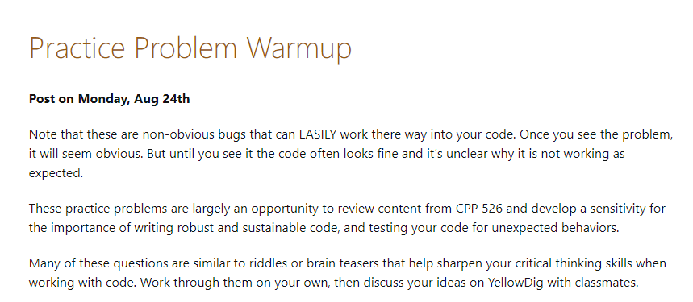
Generic Variables
(Rendered HTML Page)
Liquid tag replaced with value in YAML table

