Slide 1
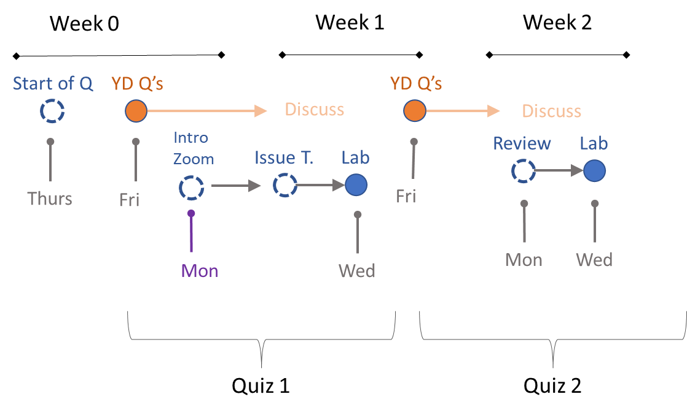

Slide 2
AI Policies

Slide 3
What is a computer?

Slide 4
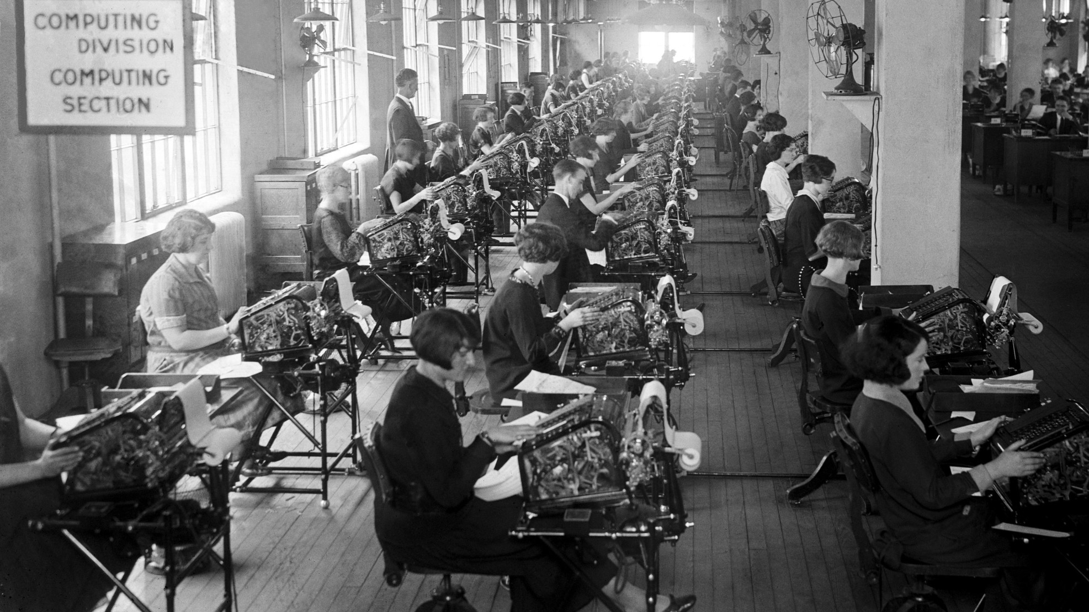
Computing Division of the US Veterans Bureau, 1924.
Notes:
https://kartsci.org/kocomu/computer-history/human-computers/

Slide 5
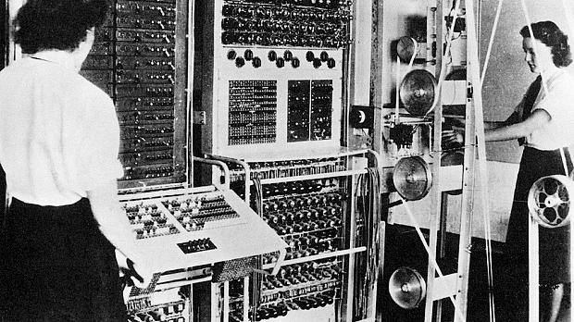
Notes:
During World War II, many women in England were involved in the efforts to break German military codes at Bletchley park. They were involved in programming the earliest computers, the “Bombe” & the “Colossus” (image below) to decrypt codes like the “Enygma” code (You can read an interesting account of life of the codebreakers in the book “The Secret Lives of Codebreakers”, ref.8). Women in the US were calculating ordnance and trajectory tables using electromechanical calculators. They were also employed Los Alamos, to perform calculations for the Manhattan Project on the nuclear bomb (ref.7). A few were physicists or engineers and a number were wives of scientists. Amongst these were some of the human computers were Mary Frankel, Josephine Elliot, Beatrice “Bea” Langer, Augusta “Mici” Teller, Jean Bacher, and Kay Manley.

Slide 6
What is a Computer?
ORIGINAL: one who computes, or a mathematically skilled individual that can solve complex numeric problems
EVENTUAL: one who runs a computing machine that solves numeric problems
CONTEMPORARY: a computing machine that solves numeric problems

Slide 7
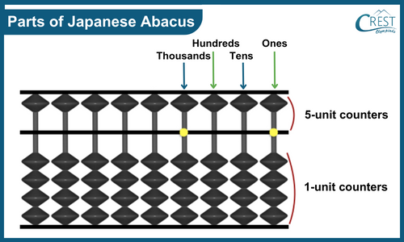

Slide 8
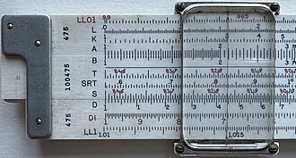
Slide Rule

Slide 9
Paradigm Shifts in Engineering Curriculum as a Result of New Technology (the Calculator)
At West Point the time devoted to slide-rule instruction in first-year math “varied from five to nine classes”—time that simply vanished from the syllabus once calculators took over.
Slide rules disappeared fast (1972–1976). After the HP-35 (1972), handhelds spread and slide-rule use collapsed during the mid-1970s.
The curriculum shifted from emphasizing calculations that humans are good at (well studied numerical approximation techniques that rely on tables and tricks) to calculations that computers are good at (matrix algebra, numeric integration).
Structural analysis: Hardy Cross’s moment distribution dominated because it was doable by hand; it was supplanted in teaching by the stiffness/matrix methods and then FEM as computing spread.
Fluids: Students long used the Moody chart to avoid nasty algebra; with calculators it became normal to solve the Colebrook/Haaland relations directly and to use the chart mainly for intuition.

Slide 10

Changes to Data Science Curriculum

Slide 11
Changes to Data Science Curriculum
Writing code well requires putting in your 10,000 hours of practice to:
become familiar with packages
reading documentation
memorizing functions and arguments
spending hours on discussion boards when code is not working
To put skill acquisition in perspective:
Part Time: 10 hours / week ~ requires 20 years of practice
Full Time: 40 hours / week ~ requires 5 years of practice

Slide 12
Changes to Data Science Curriculum
Syntactic Skills in Computer Science:
A programmer's ability to correctly use the grammar and structural rules of a specific programming language. This mastery allows a programmer to write code that can be properly interpreted or compiled by a computer, i.e. executing without producing errors.
These are analogous to “computing” skills in the engineering profession prior to the advent of calculators:
Math skills took time to develop, and thus were valuable
Once calculators were introduced, simply doing the math no longer added value. It was knowing which math equations to solve (theory and modeling skills), and which types of problems align with priorities of an organization.

Slide 13
Changes to Data Science Curriculum
Junior Engineering Mindset A junior engineer requires detailed instructions, focuses on completing specific tasks, and relies on seniors for checking the accuracy of work.
Senior Engineering Mindset A senior engineer, in contrast, possesses significant experience and in-depth knowledge, can identify and solve problems with less direction, can translate a poorly-specified problem into a concrete plan by designing and prototyping a workflow, outline technical requirements, and proving the documentation needed for others to execute. Senior engineers tend to think in terms of long-term business value and synergies across projects.

Slide 14
Changes to Data Science Curriculum
Shift from an emphasis on writing code to using AI to write a first draft for you
Requires a clear understanding of the problem you are trying to solve
Break the problem into discrete tasks
Use appropriate prompts to produce code for each task
Shift from writing code to designing workflows
Integrate all of the discrete parts into a single coherent workflow
Become skillful at debugging workflows
Learn to check the accuracy of your own code
Emphasis on documentation and unit testing
It’s not enough to show your boss the code runs, must also demonstrate that it works as expected
Shift from writing a single working script to scaling your work
Turn a script into a package so code is properly documented, and it can be reused
Eventually be able to architect solutions that others can execute (members of your team or consultants)

Slide 15
Changes to Data Science Curriculum
The goal is to use the time you gain in mastering syntax and writing first drafts of code to practice higher-level skills
You still need to learn what the code means and how it works! You just don’t have to memorize all of the functions and arguments yourself.
Instead of thinking at the syntax level (which functions do I need) you should be thinking at the workflow level (what problem am I trying to solve, what does the final deliverable look like, and can I work backwards to identify all discrete steps in the solution?).
Learning to write pseudocode is analogous to good prompt engineering – they both operate at a similar level of abstraction.

Slide 16
Changes to Data Science Curriculum
You still need to learn what the code means and how it works! You just don’t have to memorize all of the functions and arguments yourself. Rule of thumb: if you don’t understand what your code is doing, then don’t give it to your boss or sell it to your client (also don’t turn in assignments with code you don’t understand). AI is good at creating first drafts quickly, but it rarely gets it right the first time. You need to review the code, which requires you to understand the code.

Slide 17
Changes to Data Science Curriculum
AI makes A LOT of mistakes. Never take a solution at face value.
Any code written by humans or by AI should be stress-tested to ensure it is working as expected. You need to learn how to write unit tests for your code.
The way a unit test is created, independent of running any code, demonstrates whether you understand the problem.
Executing unit tests ensure the code is working as expected AND is also robust to real world cases (for example, data contains special values or inputs are the wrong data type).

Slide 18
What is a Data Scientist?
Before GUI-based operating systems (Mac in 1984, Windows in 1990) users had to learn Unix commands (basic programming) in order to turn a computer on, install programs, and use apps.
The visual user interface democratized personal computers by making them accessible to teachers, students, and non-technical experts. This led to a wider adoption and a more productive workforce.
AI similarly removes key barriers to programming by making it more accessible to the average user.

Slide 19
What is a Data Scientist?
ORIGINAL: one who has deep expertise in some domain (business, policy, medicine, etc.) and solves hard problems that require data, programming, and statistical modeling
EVENTUAL: more emphasis on domain expertise and statistical modeling, less expertise needed in programming to be a competent data scientist.
Democratization of data science approaches to problems
Programming skills become commoditized, thus more competitive, but at the same time the ability to apply the skills will become more valuable

Slide 20
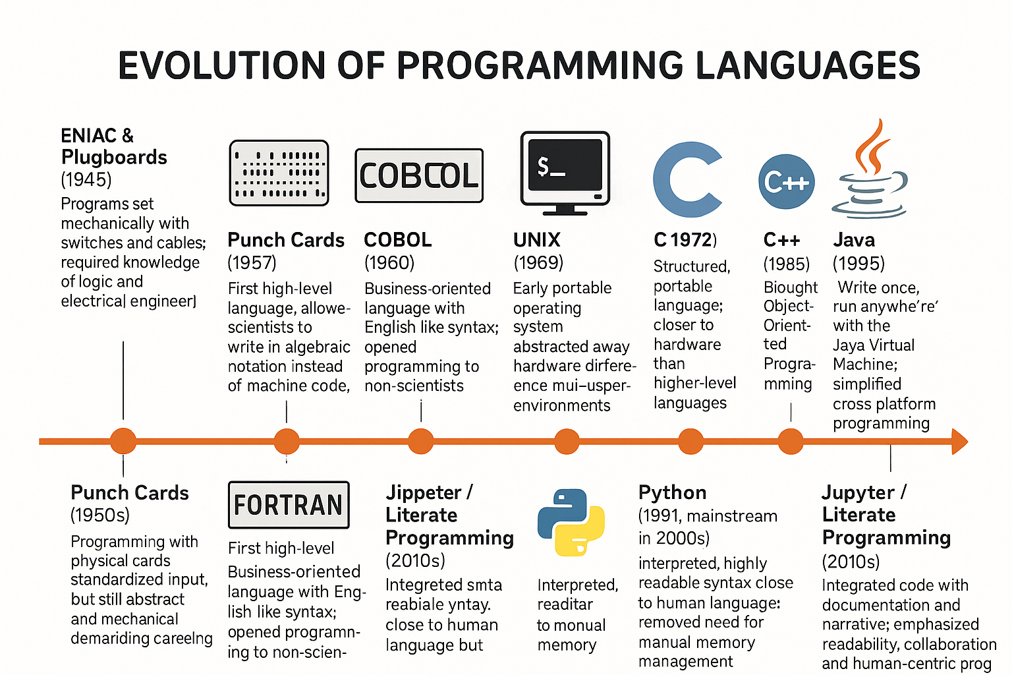
GenAI Advent (2022): prompt-based programming

Slide 21
Innovation (Year) | Significance / Advance
ENIAC & Plugboards (1945) | Programs set mechanically with switches and cables; required knowledge of logic and electrical engineering.
Punch Cards (1950s) | Programming with physical cards standardized input, but still abstract and mechanical, demanding careful sequencing.
FORTRAN (1957) | First high-level language; allowed scientists to write in algebraic notation instead of machine code.
COBOL (1960) | Business-oriented language with English-like syntax; opened programming to non-scientists.
UNIX (1969) | Early portable operating system; abstracted away hardware differences and supported multi-user environments.
C (1972) | Structured, portable language; closer to hardware than higher-level languages but still more abstract than assembly.
C++ (1985) | Brought Object-Oriented Programming to the mainstream; enabled abstraction through classes, inheritance, and automatic handling of many low-level details.
Java (1995) | “Write once, run anywhere” with the Java Virtual Machine; simplified cross-platform programming.
Python (1991, mainstream in 2000s) | Interpreted, highly readable syntax close to human language; removed need for manual memory management.
Jupyter / Literate Programming (2010s) | Integrated code with documentation and narrative; emphasized readability, collaboration, and human-centric programming.

