Slide 1
Mathematical Foundations of Control Engineering
控制工程数学基础
Dr. Bohao ZHU (朱博浩)
School of Automation and Intelligent Manufacturing
Southern University of Science and Technology
Lecture 1
Coutesy of Dr. Xiang XU

Slide 2
Outline
1
Introduction of SDM234
2
Complex Numbers
3
Geometric Representation
4
Polar and Exponential Form

Slide 3
1
Introduction of SDM234

Slide 4
Self-Introduction
Personal information:
Office: Room 506, Building 9, Chuangyuan
Email: zhubh@sustech.edu.cn
Homepage: https://www.sustech.edu.cn/zh/faculties/bohaozhu.html

Slide 5
About SDM234
Prerequisite course
Calculus
  We will frequently use the knowledge on trigonometricfunction, series, differentiation and integration, Taylor expansion, etc
Linear Algebra
  We will be using the concepts of eigenvectors and eigenvalues.
General Physics
Notes:
假设大家已经掌握了这些内容

Slide 6
About SDM234
Two parts of this course
Functions of a complex variable and integral transforms
  Complex numbers, complex functions, complex integration and complex series
Differential equations
  Ordinary differential equations and partial differential equations
Textbook
Advanced Engineering Mathematics, 10th edition, Erwin Kreyszig, Herbert Kreyszig and Edward J. Norminton.

Slide 7
About Engineering Mathematics
Why study Engineering Mathematics?
For practical use: it is a foundation for your future study
  After many years you may forget what we learn in this class(highly possible), but at least you know where to find it when it is needed! And you can pick it up quickly!
For interest: Mathematics exists solely for the honour of the human mind —— Carl Jacobi

Slide 8
About Engineering Mathematics
How to study Engineering Mathematics?
Preview the course materials for the coming week
Attend class on time
Take your own notes, do not just rely on the course materials
Ask questions if you don't understand - don't be shy!
Consult with your classmates, instructor (me), or TA for help
Do homework, and if necessary, extra exercises
Do NOT cheat!
Make summary after each chapter

Slide 9
About SDM234
Additional remarks on SDM234
This course will be taught in both Chinese (major) and English (minor)
  The slides will be mainly made in English, while the instructor will mainly speak Chinese at class
Students of Automation are all required to study this course
For any of your questions, please write “SDM234” in your email subject/title for our ease of recognition; otherwise, your emails may be “sunk” in our email flooding every day.
Please stay behind after class for any of your questions, as teachers would be engaged by other duties in office hours. Appointment with teachers/tutors could be made via email.

Slide 10
About SDM234
Course assessment:
 | Percentage
Assignments | 20
Mid-Term Test | 30
Final Exam | 50
Attendence | 5
Bonus Problems | 20

Slide 11
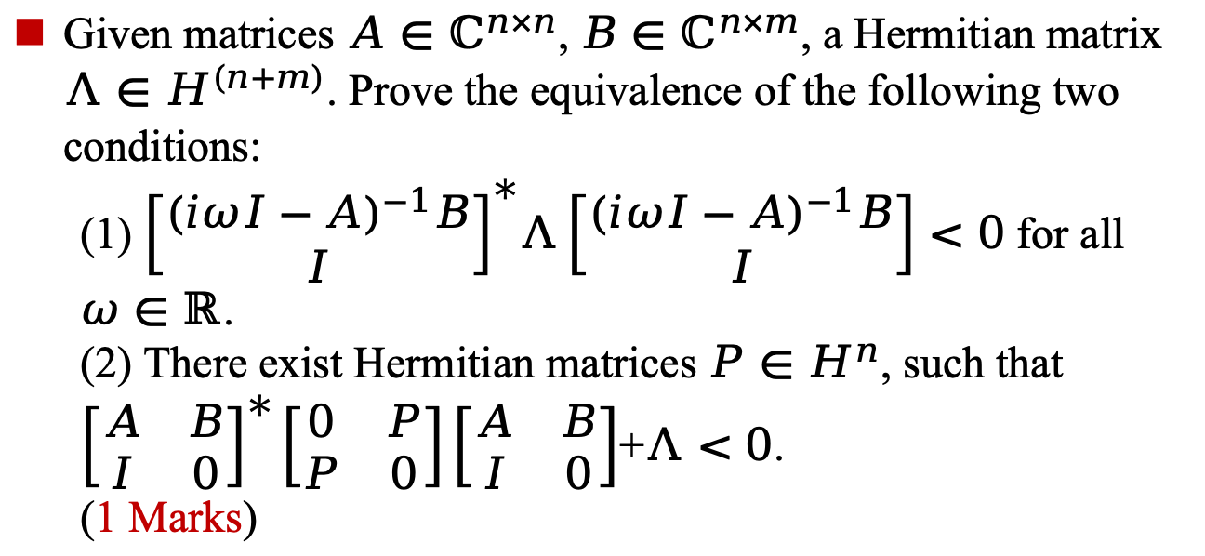
Bonus Problem 1-1
Problem Description
Given matrices $A∈ℂ^{n×n}$, $B∈ℂ^{n×m}$, a Hermitian matrix $Λ∈Η^{(n+m)}$. Prove the equivalence of the following two conditions:
  (1) ${\left[\begin{matrix}{(iωI−A)}^{−1}B \\ I\end{matrix}\right]}^{∗}Λ\left[\begin{matrix}{(iωI−A)}^{−1}B \\ I\end{matrix}\right]<0$ for all $ω∈ℝ$.
  (2) There exist Hermitian matrices $P∈Η^{n}$, such that ${\left[\begin{matrix}A & B \\ I & 0\end{matrix}\right]}^{∗}\left[\begin{matrix}0 & P \\ P & 0\end{matrix}\right]\left[\begin{matrix}A & B \\ I & 0\end{matrix}\right]$+$Λ<0$.
  (1 Marks)

Slide 12
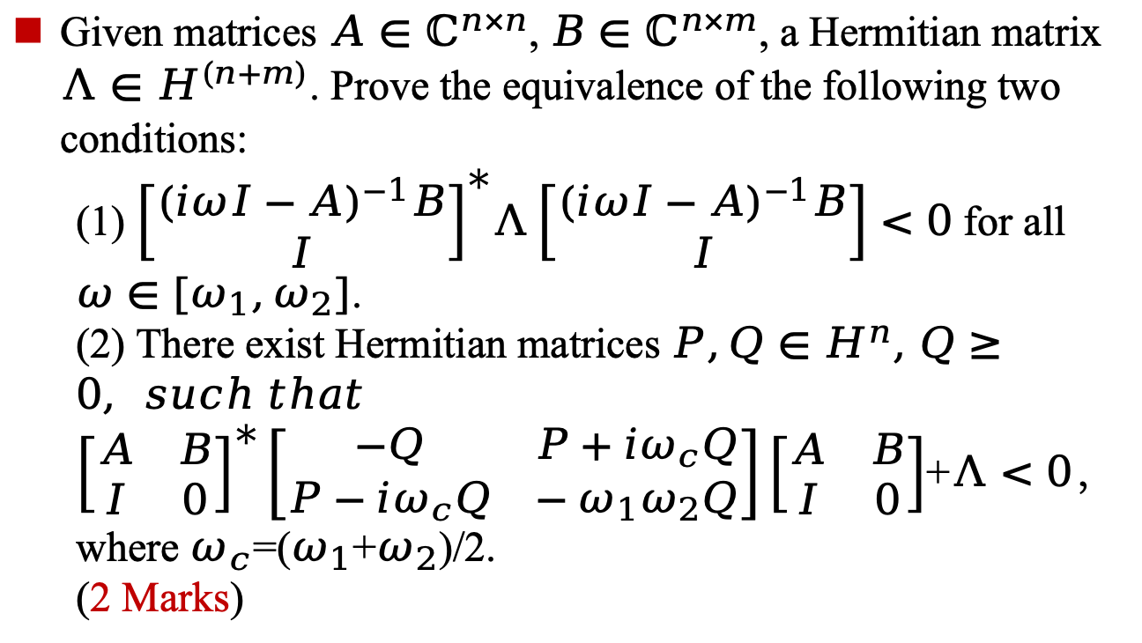
Bonus Problem 1-2
Problem Description
Given matrices $A∈ℂ^{n×n}$, $B∈ℂ^{n×m}$, a Hermitian matrix $Λ∈Η^{(n+m)}$. Prove the equivalence of the following two conditions:
  (1) ${\left[\begin{matrix}{(iωI−A)}^{−1}B \\ I\end{matrix}\right]}^{∗}Λ\left[\begin{matrix}{(iωI−A)}^{−1}B \\ I\end{matrix}\right]<0$ for all $ω∈[ω_{1},ω_{2}]$.
  (2) There exist Hermitian matrices $P,Q∈Η^{n}, Q≥0, such that$ ${\left[\begin{matrix}A & B \\ I & 0\end{matrix}\right]}^{∗}\left[\begin{matrix}−Q & P+iω_{c}Q \\ P−iω_{c}Q & −ω_{1}ω_{2}Q\end{matrix}\right]\left[\begin{matrix}A & B \\ I & 0\end{matrix}\right]$+$Λ<0$，
  where $ω_{c}$=($ω_{1}$+$ω_{2}$)/2.
  (2 Marks)

Slide 13
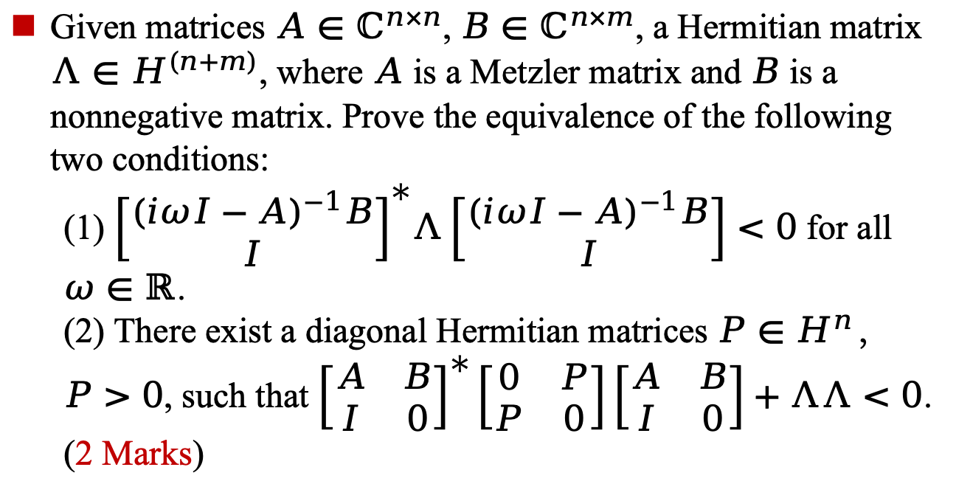
Bonus Problem 1-3
Problem Description
Given matrices $A∈ℂ^{n×n}$, $B∈ℂ^{n×m}$, a Hermitian matrix $Λ∈Η^{(n+m)}$, where $A$ is a Metzler matrix and $B$ is a nonnegative matrix. Prove the equivalence of the following two conditions:
  (1) ${\left[\begin{matrix}{(iωI−A)}^{−1}B \\ I\end{matrix}\right]}^{∗}Λ\left[\begin{matrix}{(iωI−A)}^{−1}B \\ I\end{matrix}\right]<0$ for all $ω∈ℝ$.
  (2) There exist a diagonal Hermitian matrices $P∈Η^{n}$，$P>0$, such that ${\left[\begin{matrix}A & B \\ I & 0\end{matrix}\right]}^{∗}\left[\begin{matrix}0 & P \\ P & 0\end{matrix}\right]\left[\begin{matrix}A & B \\ I & 0\end{matrix}\right]+ΛΛ<0$.
  (2 Marks)

Slide 14
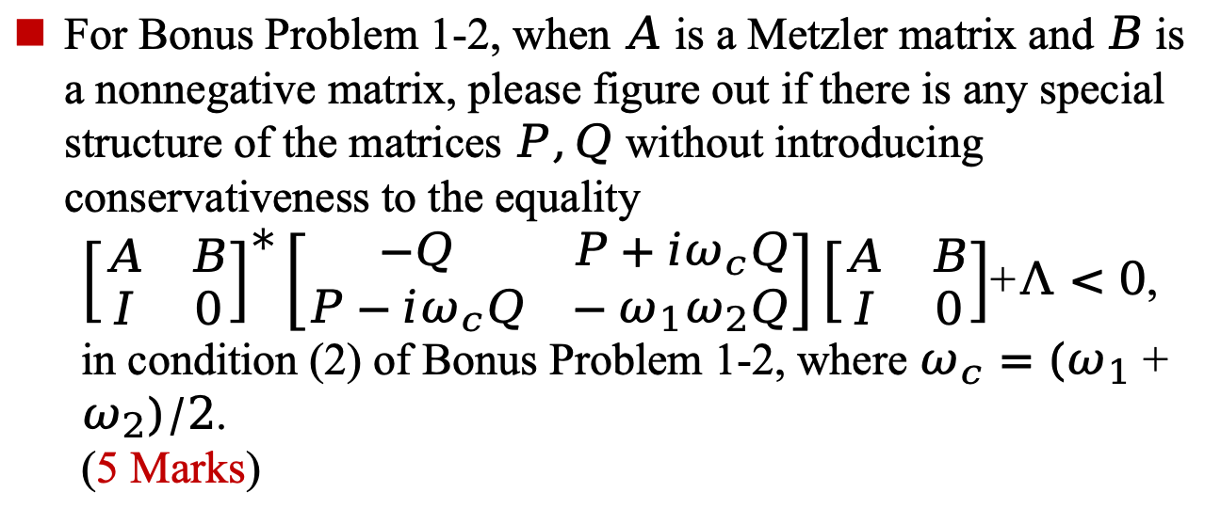
Bonus Problem 1-4
Problem Description
For Bonus Problem 1-2, when $A$ is a Metzler matrix and $B$ is a nonnegative matrix, please figure out if there is any special structure of the matrices $P,Q$ without introducing conservativeness to the equality
  ${\left[\begin{matrix}A & B \\ I & 0\end{matrix}\right]}^{∗}\left[\begin{matrix}−Q & P+iω_{c}Q \\ P−iω_{c}Q & −ω_{1}ω_{2}Q\end{matrix}\right]\left[\begin{matrix}A & B \\ I & 0\end{matrix}\right]$+$Λ<0$,
  in condition (2) of Bonus Problem 1-2, where $ω_{c}=(ω_{1}+ω_{2})/2$.
  (5 Marks)

Slide 15
Bonus Problem 1
Problem Description
There are two bonus problems in total for this course
Bonus points will be awarded to the first eight students who solve them.
You may work individually or in pairs (at most two students per team).
In addition to submitting your solutions, you must attend a brief interview to explain your methodology.

Slide 16

Wechat Course Group

Slide 17
2
Complex Numbers

Slide 18
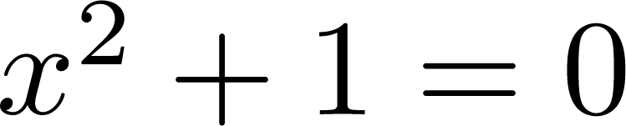
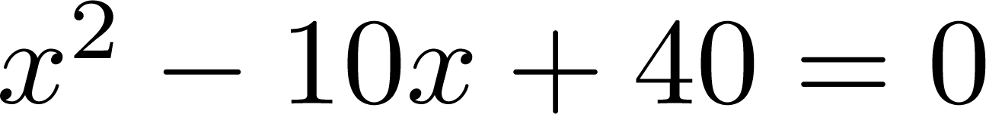
Basic Concepts
Why introduce complex numbers
No real solution for equations such as
To get a complete number field
To simplify the problem

Slide 19
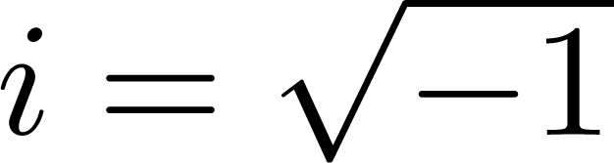
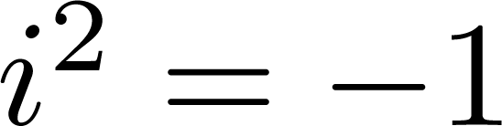
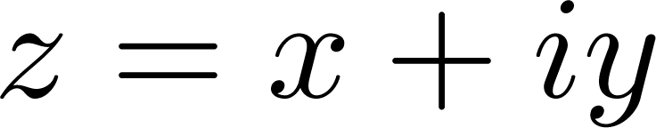

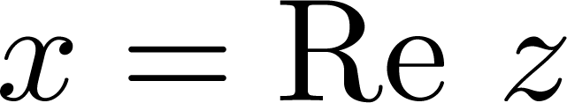

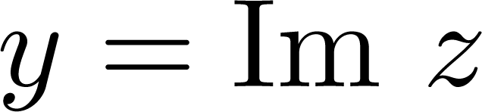

Notations and Operations
Basic definition
Imaginary number(虚数)
Complex numbers
  is called the real part
  is called the imaginary part
  It is called a pure imaginary if

Slide 20

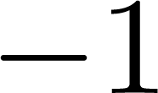
Example
True or false?
The real and imaginary parts of 15 + 9i are 15 and 9?
The imaginary part of a complex number is a pure imaginary number?
Real numbers are a subset of complex numbers?
is the only square root of ?

Slide 21
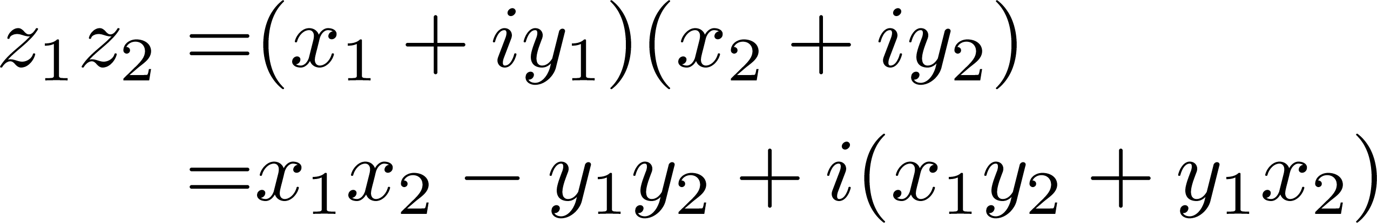
Notations and Operations
For any two complex numbers
Addition
Multiplication

Slide 22
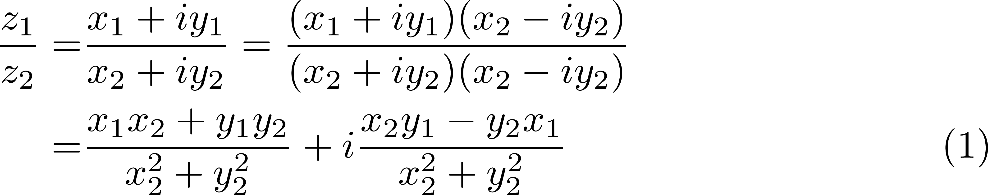
Notations and Operations
For any two complex numbers
Subtraction: Inverse operation of addition
Division: Inverse operation of multiplication

Slide 23
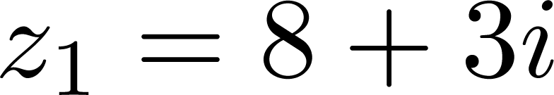
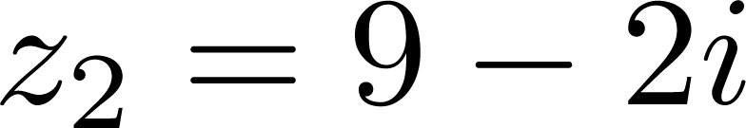
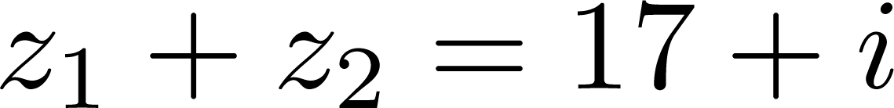
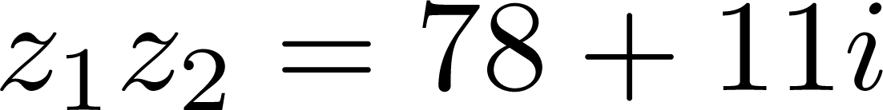
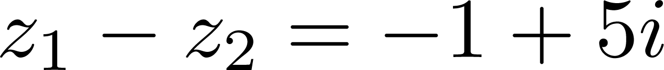
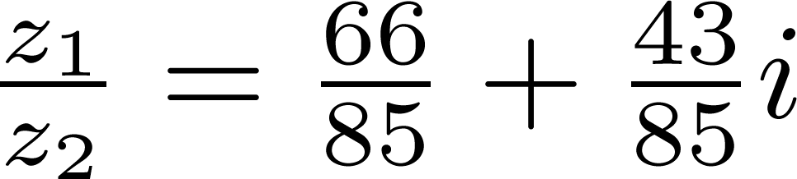
Example
For and , calculate their addition, multiplication, subtraction and division
Addition
Multiplication
Subtraction
Division

Slide 24
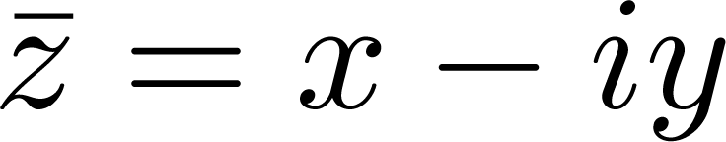



Complex Conjugate Numbers
The complex conjugate of is defined by
Notation: Both and can represent complex conjugate of

Slide 25
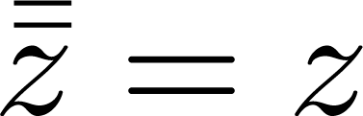
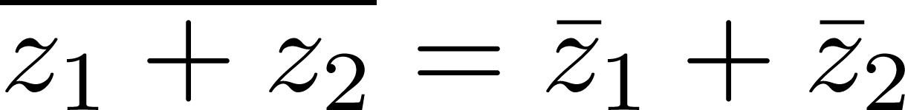

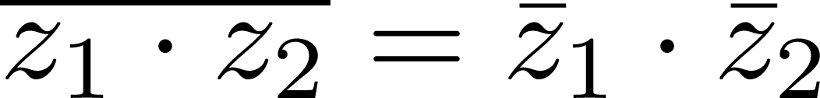
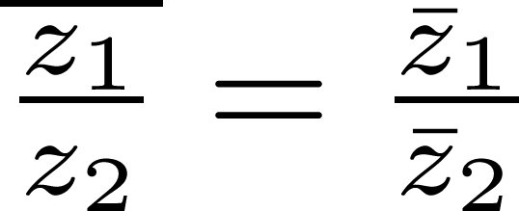
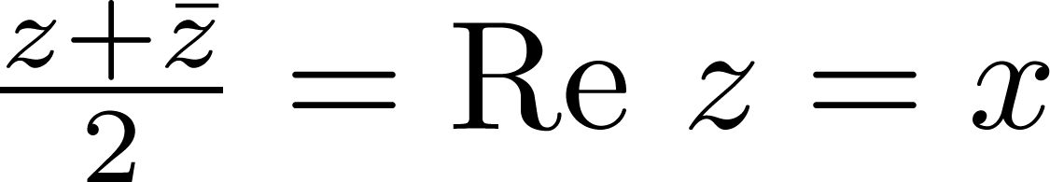
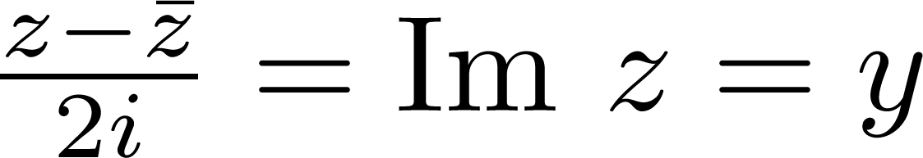
Complex Conjugate Numbers
Properties of complex conjugate
How to prove?
The complex conjugate permits us to switch from complex to real

Slide 26
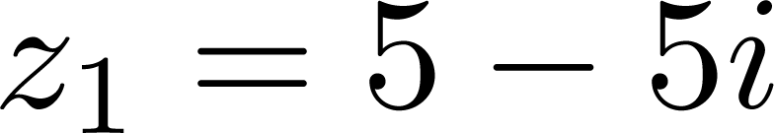
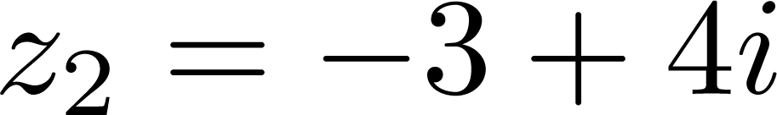
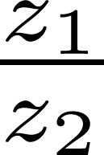
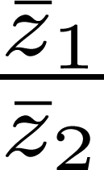
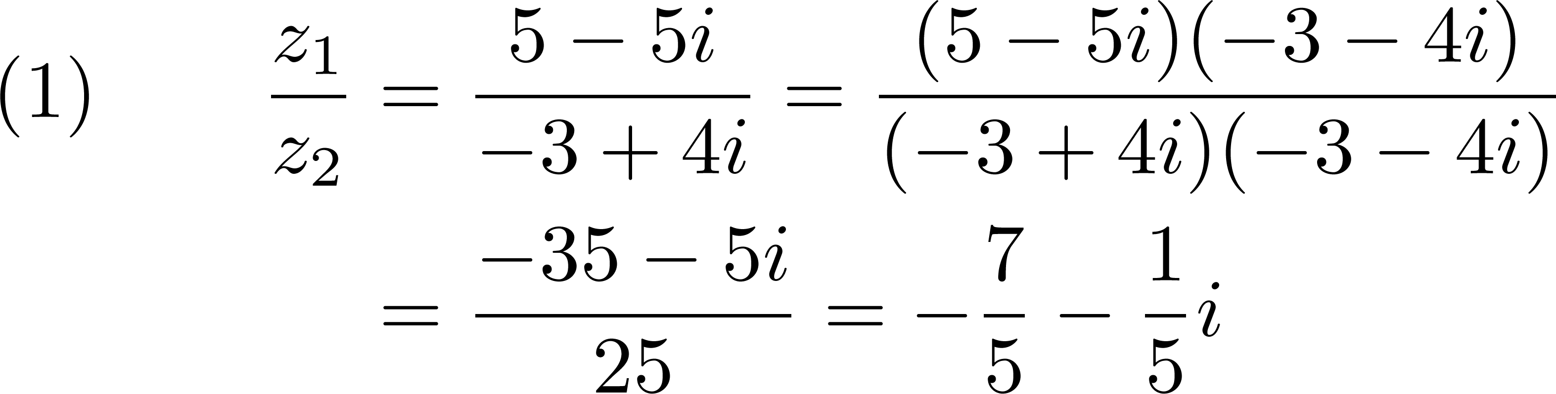
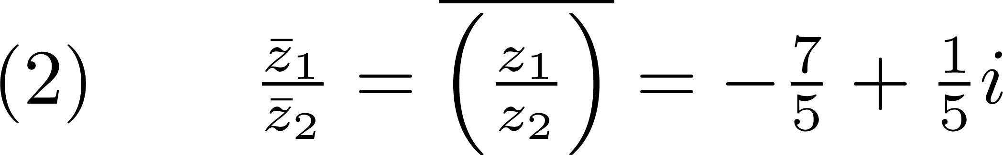
Example
For and , calculate and

Slide 27
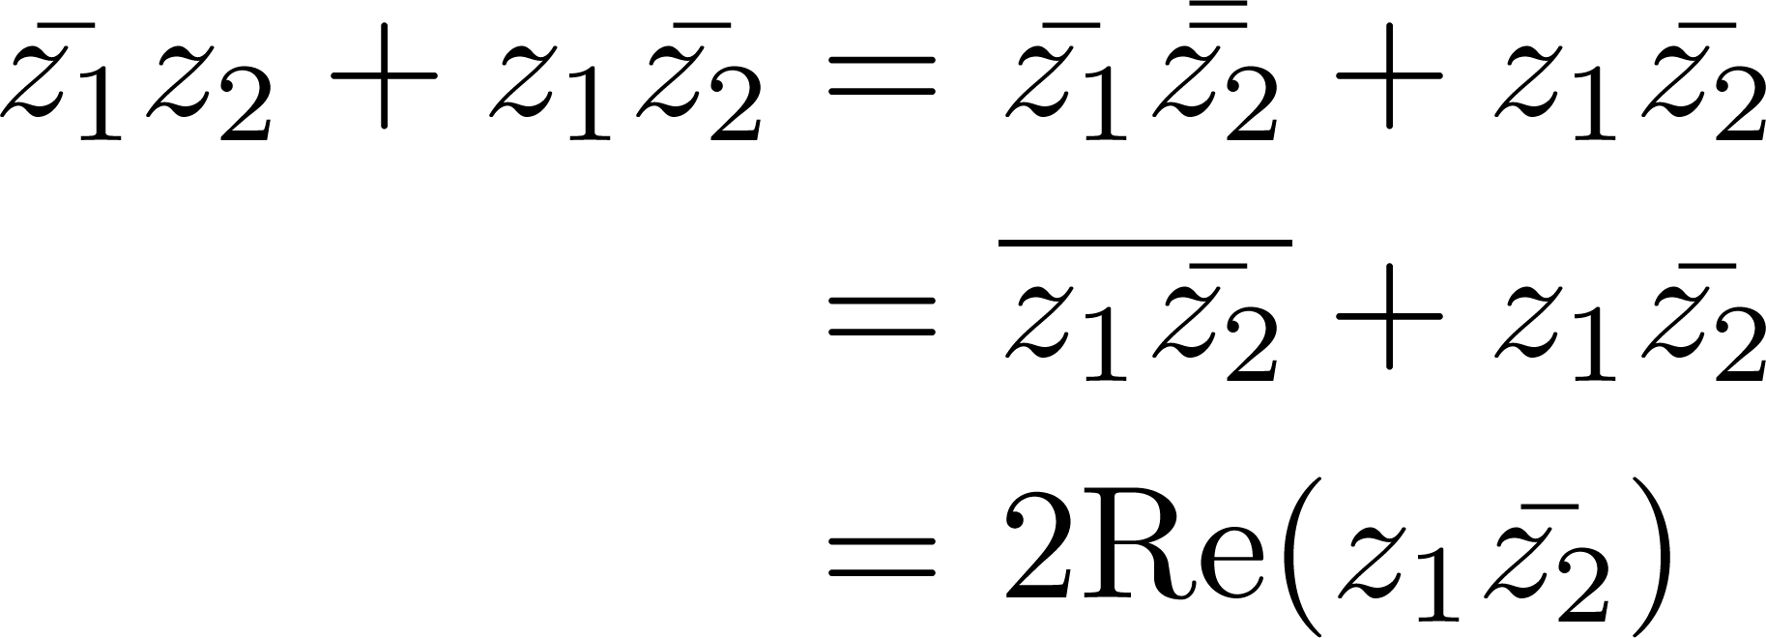
Example
Prove that

Slide 28
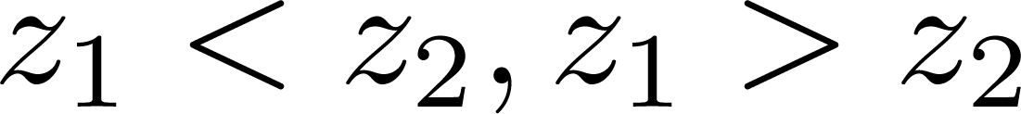


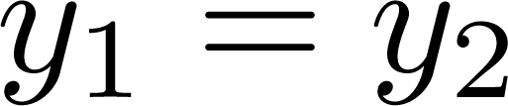
Other Properties
Properties of complex numbers
The complex numbers can NOT be compared!
Complex equation: one complex equation equals two real equations
Ill-defined!

Slide 29
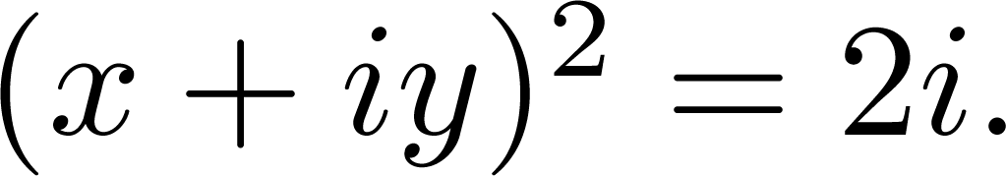
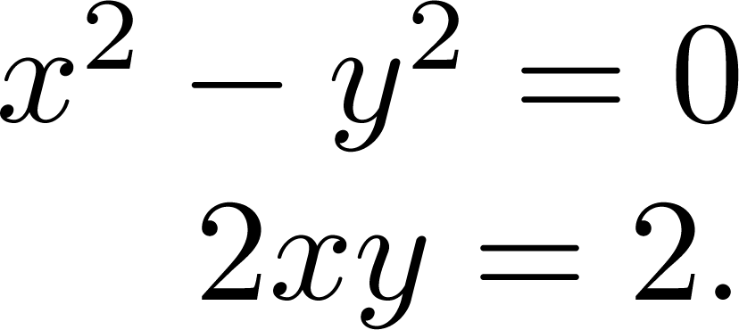
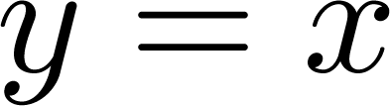
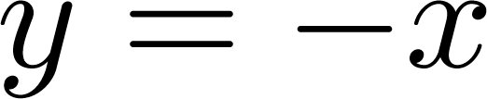
Example
Find and such that
Since , it equals the following two real equations
The first equation implies that or
Substituting these into the second equation gives:
Noting that is real, the second one is thus impossible

Slide 30
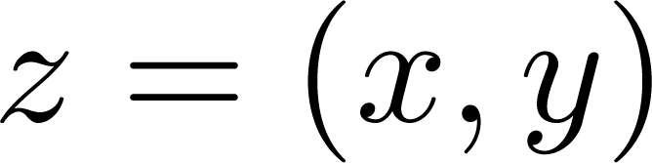
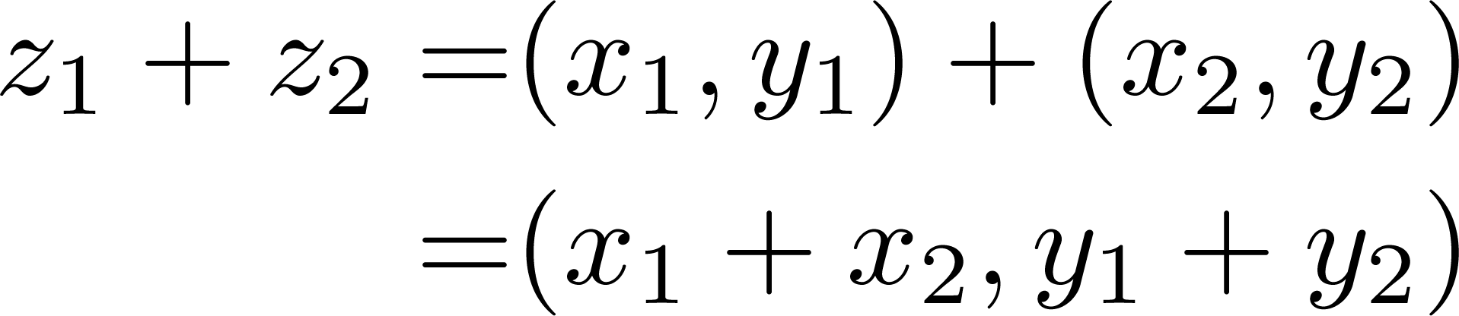
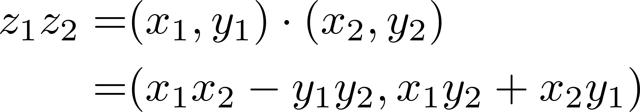
Ordered Pairs
The complex number can be also defined as an ordered pair
Addition
Multiplication

Slide 31
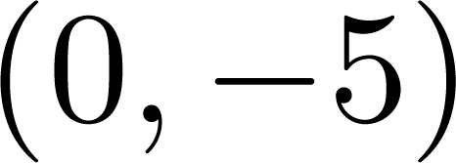
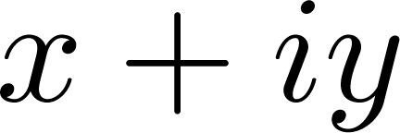
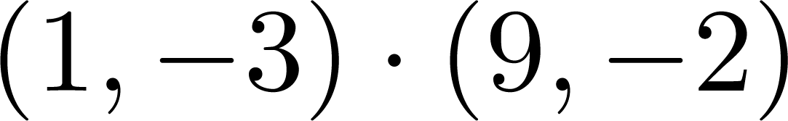
Exercise
Write in the form of
Re-express in the form of , and then calculate the result

Slide 32
3
Geometric Representation

Slide 33
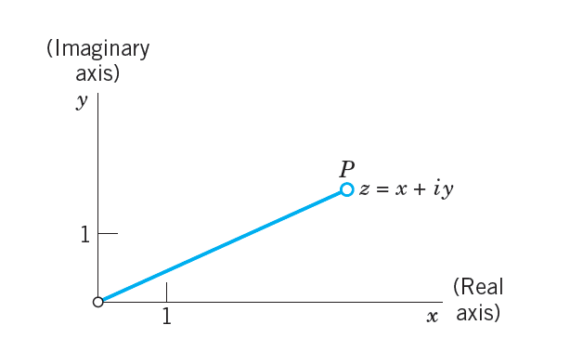
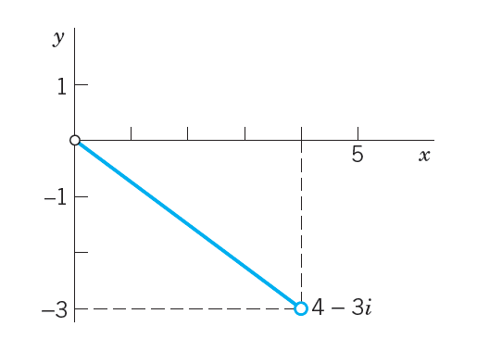
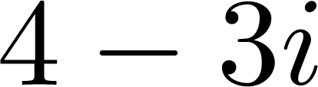
Complex Plane
Concepts of complex plane
A complex plane is a Cartesian coordinate system
Formed of the horizontal x-axis, called the real axis, and the vertical y-axis, called the imaginary axis
Any complex number can be represented as a point in the plane
The complex plane
The number in the complex plane

Slide 34
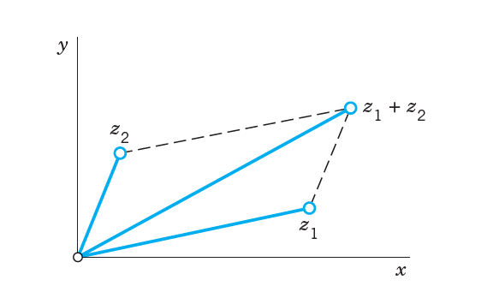

Complex Plane
Properties of complex plane
Addition and subtraction of complex numbers satisfy the parallelogram lawAlmost same to addition and subtraction of two vectors
Addition of complex numbers
Subtraction of complex numbers

Slide 35


Complex Plane
Triangle inequality is a relation for modulus
Triangle inequality:
Generalized form:
Triangle inequality

Slide 36
4
Polar and Exponential Form

Slide 37









Polar Form of Complex Numbers
In addition to the Cartesion coordinates in the complex plane, we also employ the usual polar coordinates
Let and , we see that then
takes the following polar form
: absolute value or modulus, often denoted by
: argument, often denoted by

Slide 38




Polar Form of Complex Numbers
Properties of modulus and argument
The modulus is used to represent the length of complex number
The argument is not unique, and are equivalent
Principal argument value:

Slide 39




Polar Form of Complex Numbers
How to calculate the principal argument value?
Q: Does imply ?
  No! It only holds for , i.e.,
  The principal argument value is calculated by

Slide 40

Polar Form of Complex Numbers
How to calculate the principal argument value?
One can also obtain the principal argument value through the following relations

Slide 41




Example
Calculate the principal argument value of
and write its polar form

Slide 42

Polar Form of Complex Numbers
Let’s do some math under the polar system
Multiplication:
Division:

Slide 43




Polar Form of Complex Numbers
Powers of complex numbers
We first have De Moivre’s Formula:
by the property of multiplication
De Moivre’s Theorem: let
Application: let , one has

Slide 44

Example
Prove the triple angle formula
De Moivre’s Theorem

Slide 45




Polar Form of Complex Numbers
Roots of complex numbers
Definition: is called nth root of if
Assume , by applying De Moivre’s Formula, one has
The root is not unique, nth roots have n different values

Slide 46




Example
Find and plot all values of
The modulus and argument of -64 are
For any such that
Then we have that

Slide 47


Example
Find and plot all values of
Then we have that
Plot all values, one can observe that they are all on a circle of radius

Slide 48


Example
Write the polar form of the following complex numbers and plot them in the plane

Slide 49

Example
Solve the equations

Slide 50




Exponential Form of Complex Numbers
Euler’s Formula
VERY IMPORTANT
When , we have Euler’s identity
  The identity also links five fundamental mathematical constants:
  An example of deep mathematical beauty

Slide 51
Exponential Form of Complex Numbers
The Euler’s formula is said to be
The most famous formula in all mathematics
—— Constance Reid
Most beautiful theorem in mathematics
——The Mathematical Intelligencer in 1990
Greatest equation ever
  —— Physics World in 2004
……

Slide 52




Exponential Form of Complex Numbers
The insight of Euler’s formula/identity
The animation of

Slide 53


Exponential Form of Complex Numbers
Proof of Euler’s formula
Recall the Taylor expansions you have learned
Do Taylor expansions for triangular functions around zero
Euler’s Formula

Slide 54


Exponential Form of Complex Numbers
The exponential form of complex numbers can be obtained via Euler’s formula
Exponential form:
Some properties are more easily proved under exponential form:
  Multiplication and division:
  Powers and De Moivre’s Formula :

Slide 55






Example
Write the exponential form of

Slide 56





Example
Transform into exponential form
Plot and to obtain
Then

Slide 57

Example
Find and plot all roots

