Slide 1
Mathematical Foundations of Control Engineering
控制工程数学基础
Dr. Bohao ZHU (朱博浩)
School of System Design and Intelligent Manufacturing
Southern University of Science and Technology
Lecture 2
Coutesy of Dr. Xiang XU

Slide 2
Outline
1
Sets in Complex Plane
2
Complex Functions
3
Analytic Functions
4
Cauchy–Riemann Equations

Slide 3
1
Sets in Complex Plane

Slide 4
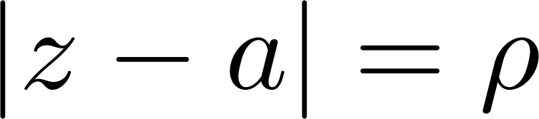
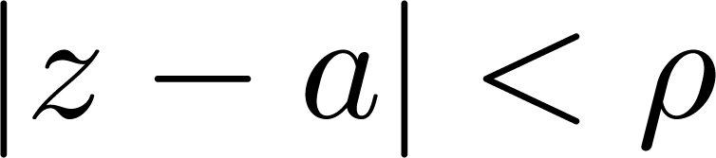
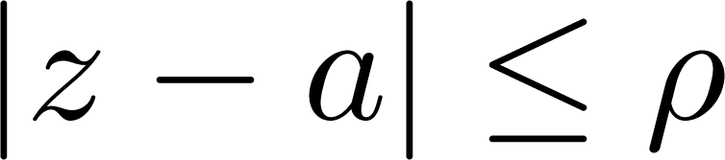
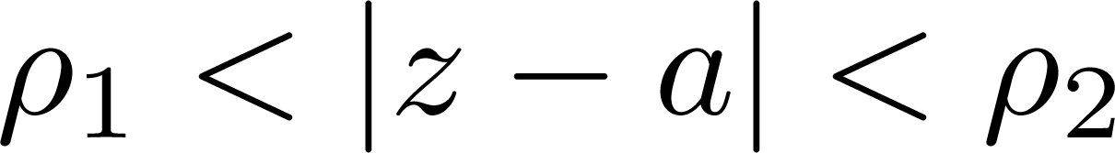
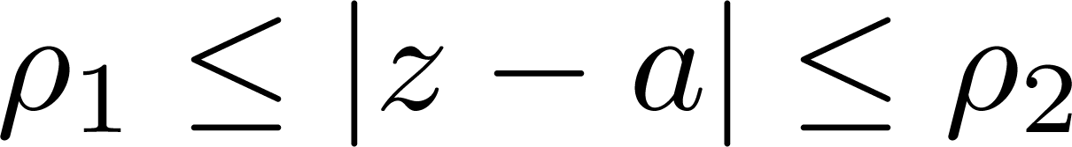


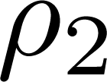



Circles and Disks
We start from the following plot in the plane
Circle:
Open disk:
Closed disk:
Open annulus:
Closed annulus:
•
•
•
•
•
•
•
$$ρ_{1}$$

Slide 5
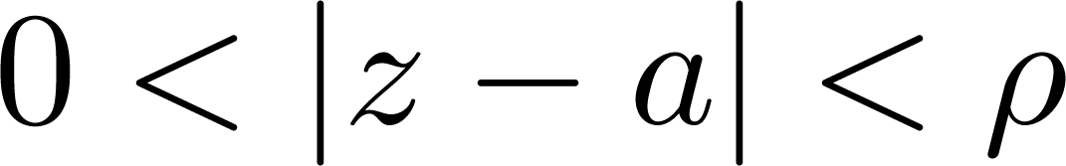
Neighborhood
Definition
Neighborhood: An open disk is also called a neighborhood of point
Deleted neighborhood: An open disk deleting its center is called a deleted neighborhood of point
•
•
Neighborhood
Deleted neighborhood

Slide 6


Interior, Exterior and Boundary point
Consider a point set , then a point is called its
Interior point if there exists a neighborhood of
contained in
Exterior point if there exists a neighborhood of contained in the complement of
Boundary point if every neighborhood of contains both points that belong to and points that do not belong to
Exterior point
Interior point
Boundary Point

Slide 7
Open and Closed Set
Consider a point set , then it is
Open if all its points are interior points
Closed if its complement is open

Slide 8
Connectivity
Consider a point set , then it is
Connected if any two of its points can be joined by a chain of finitely many straight-line segments all of whose points belong to
Connection point
Disconnnected
Connected
Connected or not?

Slide 9
Connectivity
Consider a point set , then it is called
a domain if it is open and connected
a region if it consists of a domain plus, perhaps, some or all of its boundary points
Warning: “Domain” is the modern term for an open connected set. Nevertheless, some authors still call a domain a “region” and others make no distinction between the two terms.

Slide 10
Example
Which of the following is a domain?
The circle
The annulus
The following three sets:
Connection point
(a)
(b)
(c)

Slide 11

Connectivity
Consider a domain , then it is called
simply connected if every simple closed curve (closed curve without self-intersections) encloses only points of
multi-connected if it is not simply connected

Slide 12
Example
Which of the following is a simply connected domain?
The disk
The annulus
The following three sets:
Connection point
(a)
(b)
(c)

Slide 13
Example
A 省
A 省
(Simply connected domain)
(Multi-connected domain)
B 省
B 省
(Not domain)
(Simply connected domain)
飞地

Slide 14
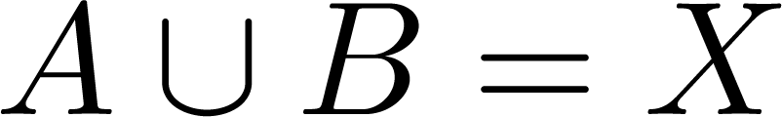
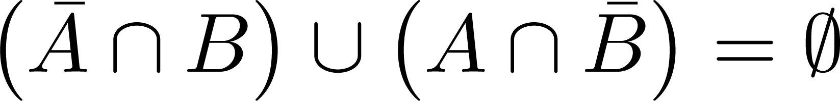
Extra Exercise 1 (Team Project, 1-3 students)
In some Topology books, the connected sets have the following different definition
Definition*: A set X is said to be disconnected if it has two nonempty subsets A and B such that
and
Please prove that, our definition of connectedness (which is often called “path-connected” in those books) implies Definition*
Please find a set which satisfies Definition* but is not “path-connected”
Please prove that if X is open, then the two definitions are equivalent

Slide 15
2
Complex Functions

Slide 16

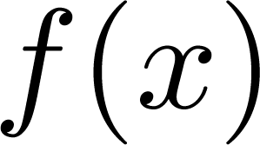
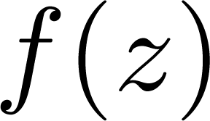
Basic Concepts
We first recall the concept of real functions
a real function defined on a set of real numbers is a rule that assigns to every in a real number , called the value of at
Similarly, we can define complex functions
a complex function defined on a set of complex numbers is a rule that assigns to every in a complex number , called the value of at
Domain:
Range: all values of

Slide 17
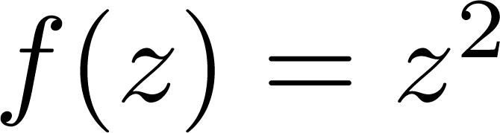
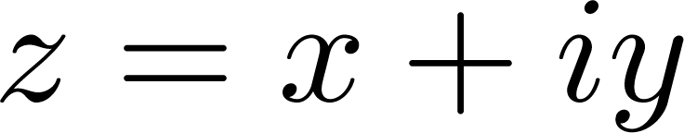
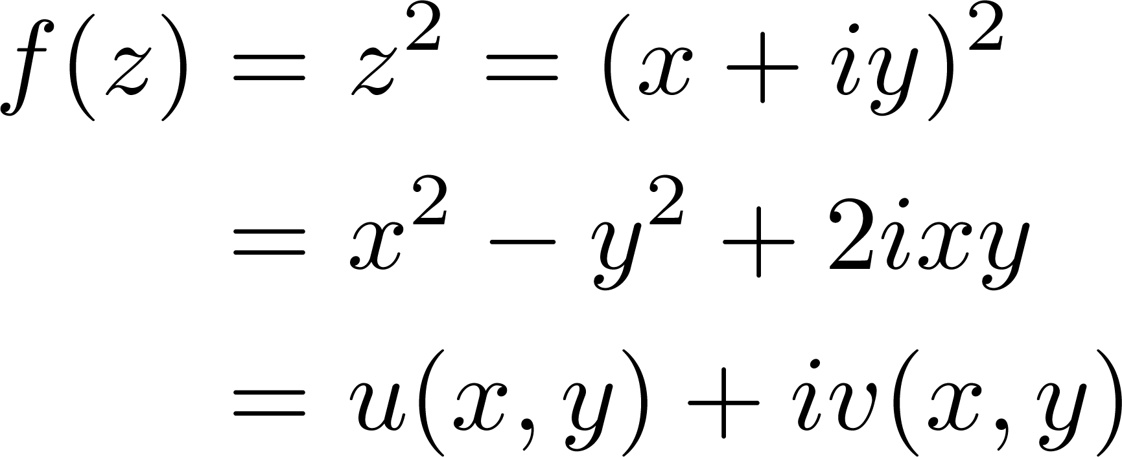
Example
Consider a complex function , write
then

Slide 18
Basic Concepts
A complex function can be written in the following form
Complex number: a pair of real numbers
Complex function: a pair of real functions
Remark: In common, we assume all functions to be single-valued relations. However, we should know there do exist “multi-valued functions”

Slide 19
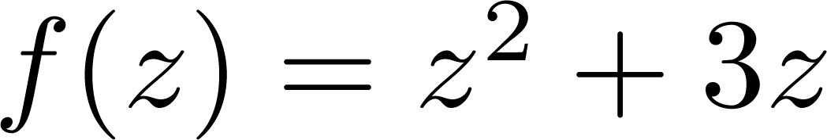
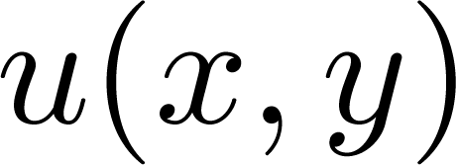
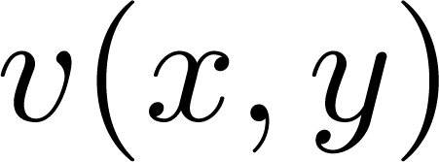
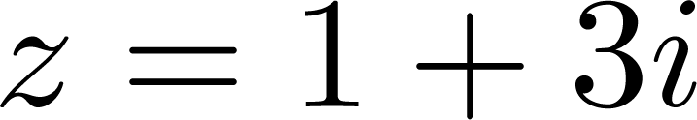
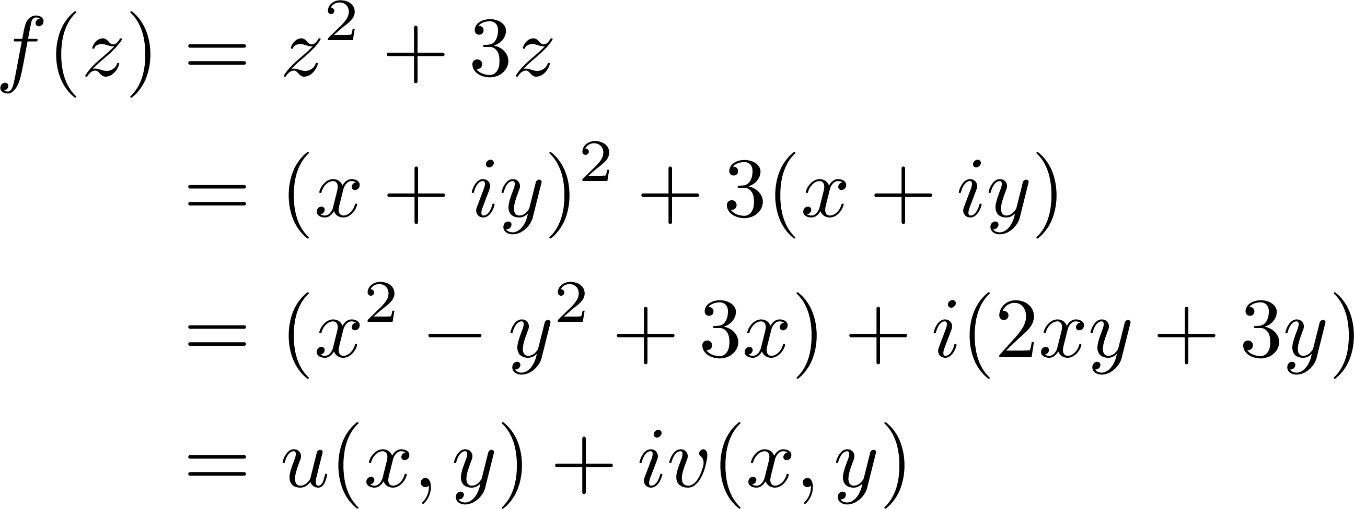
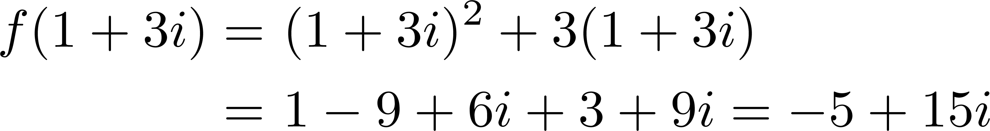
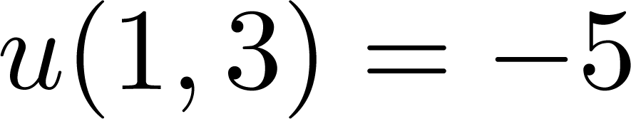
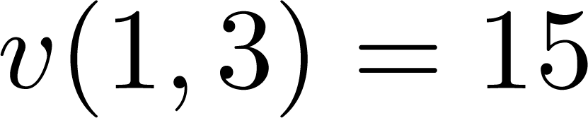
Example
Let , find and and calculate its value at
Let’s further verify and

Slide 20

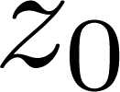
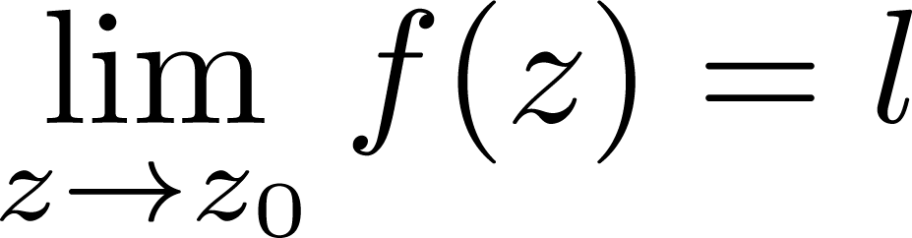
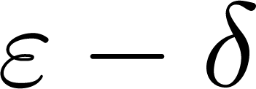
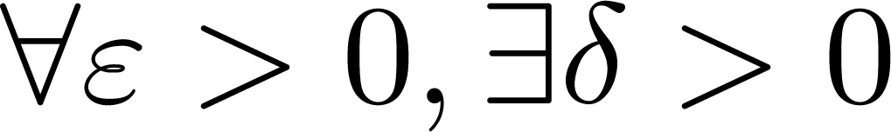
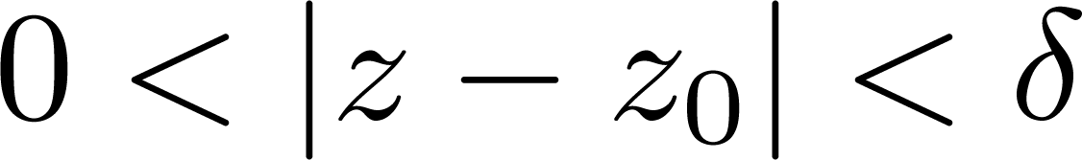
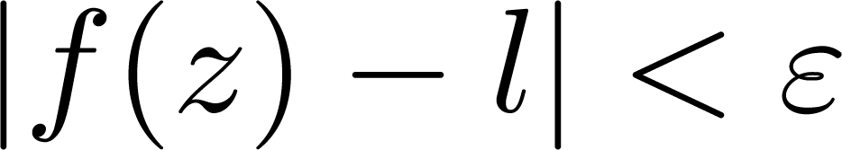
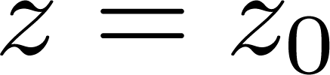
Limit
A function has a limit at point , written by
Definition(by language): such that when , the following relation holds
Remark:
  could be undefined at
  can approach in any direction

Slide 21


Limit
Geometric significance of limit
Once enters the -disk of , its value enters the -disk of
y
v
f (z)
z
δ
ε
l
z₀
x
u

Slide 22
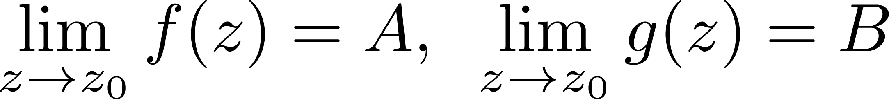
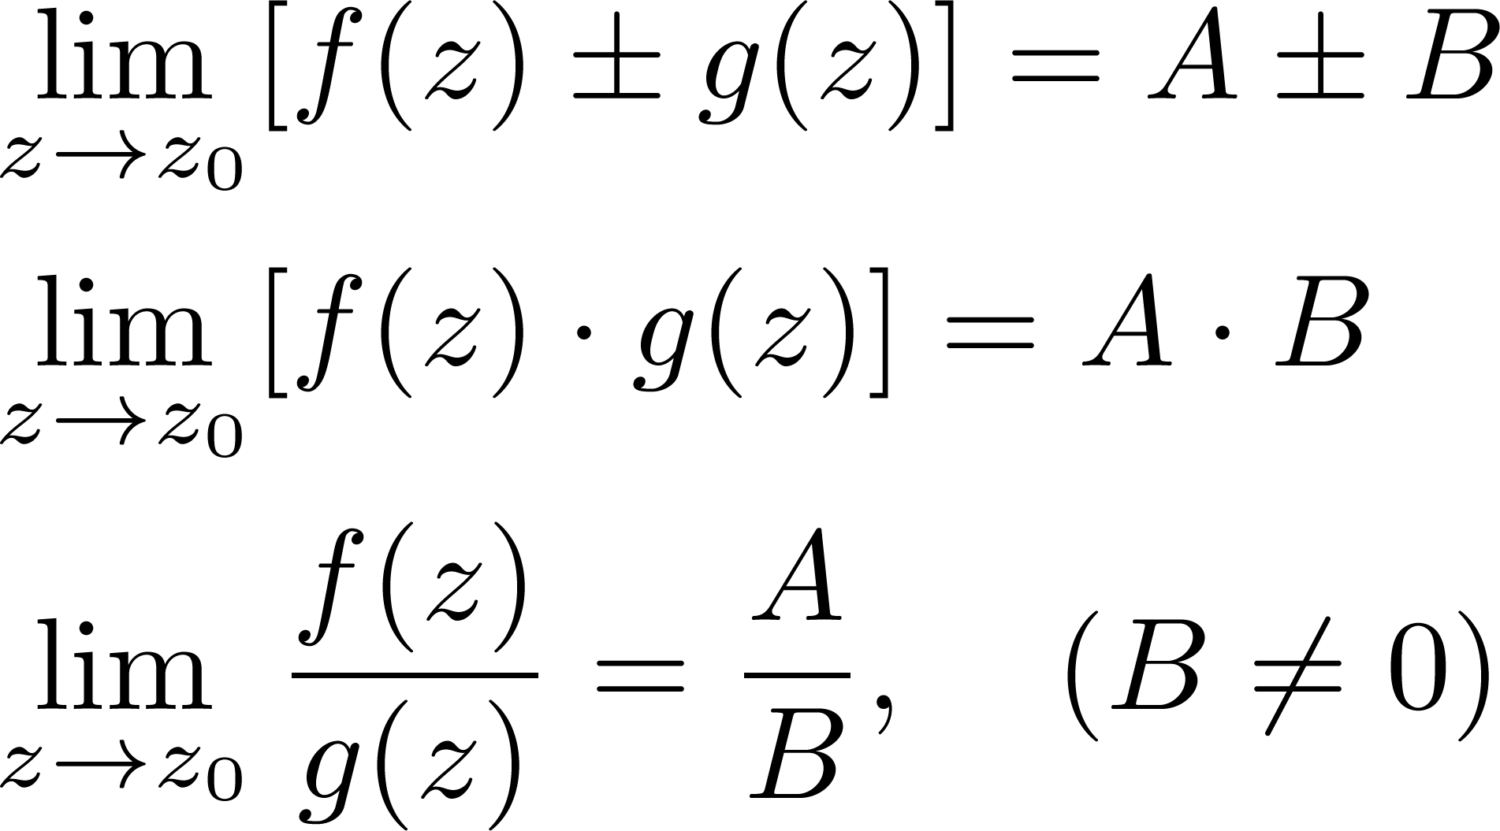
Limit
Properties
If , then
Homework: Prove the last one using language

Slide 23
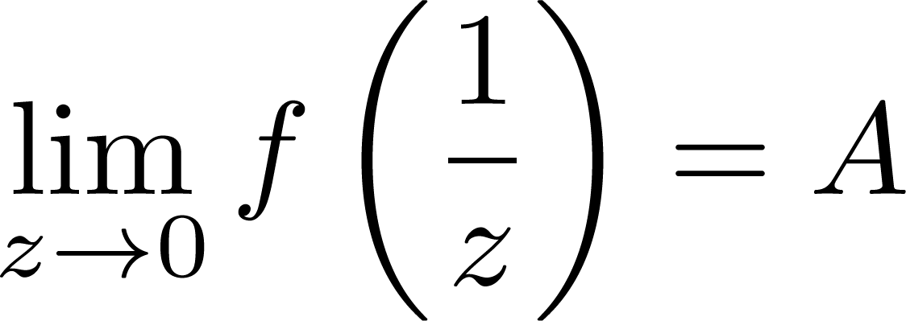
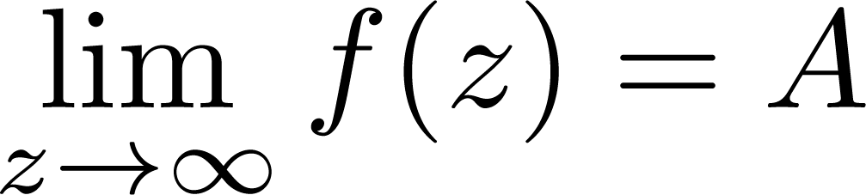
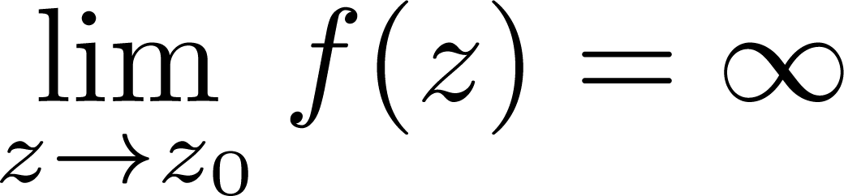
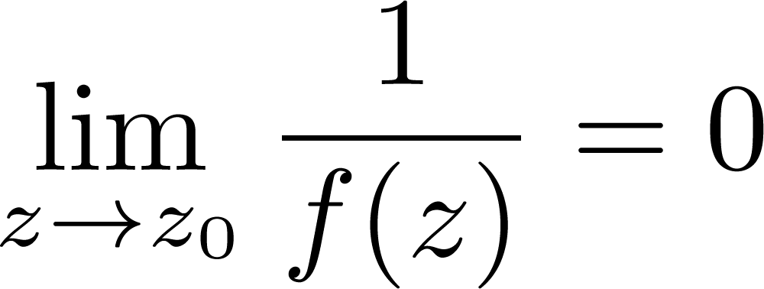
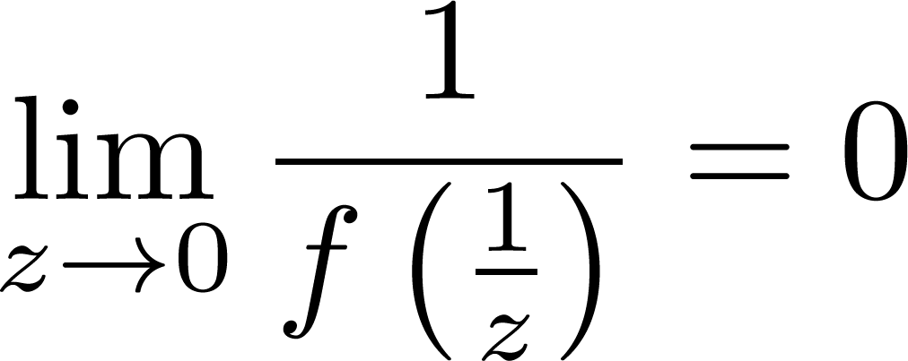
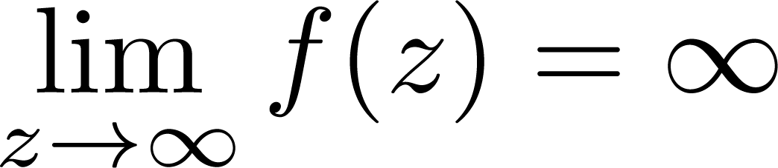
Limit
Limit related to “infinity”
We define that:

Slide 24
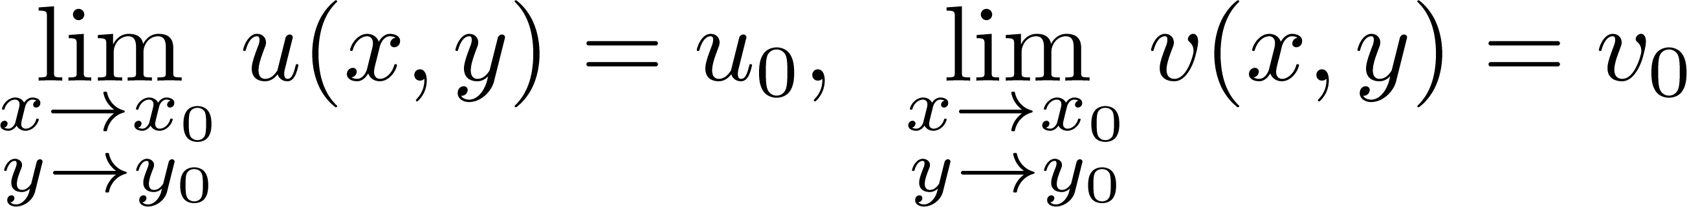
Limit
Further property
If and then if and only if
How to prove?
Limit of one complex function is equivalent to limit of two binary real functions

Slide 25
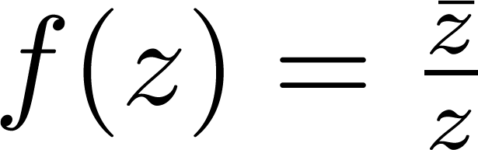
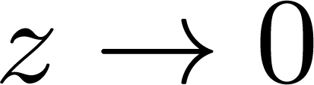
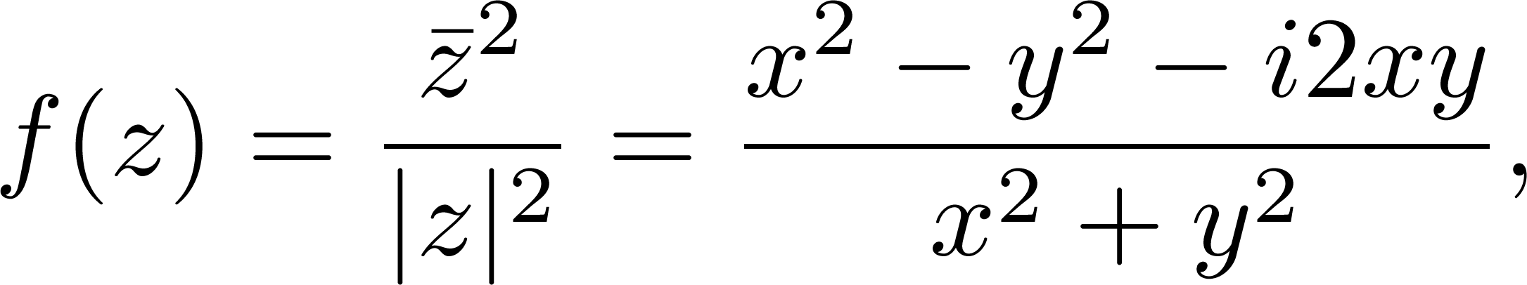
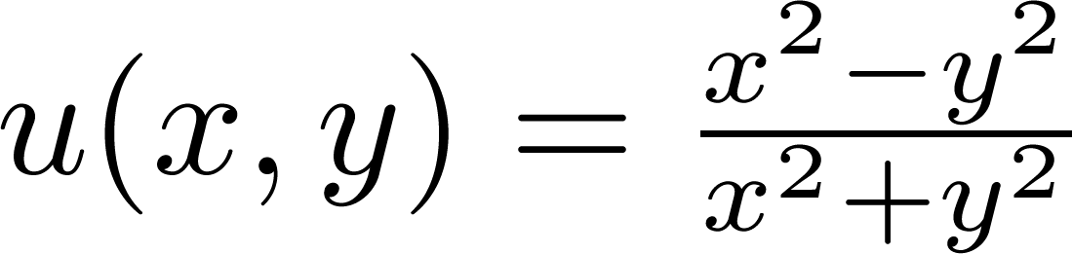
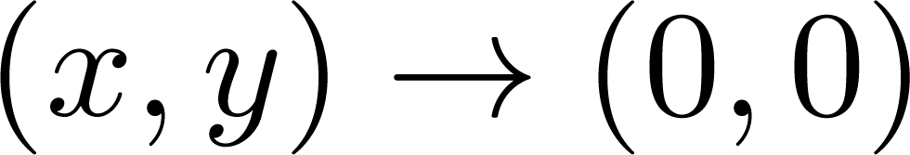
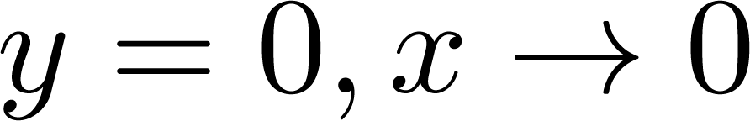
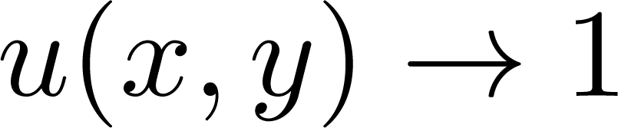
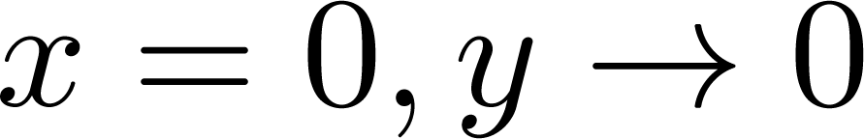
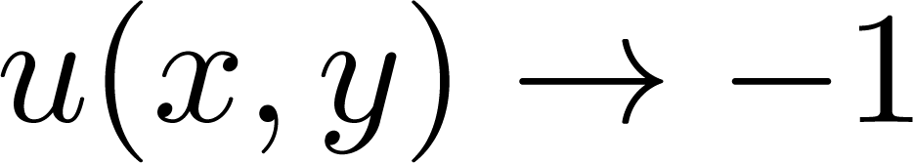
Example
Discuss the limit of complex function when
y
x
Limit of does not exist when :
  When , we have
  When , we have

Slide 26
Limit
Two important issues
How to prove that a limit exists?
  Use scaling skill
How to prove that a limit does not exist?
  “Attack” it from different directions

Slide 27
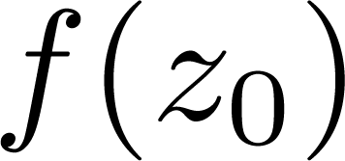
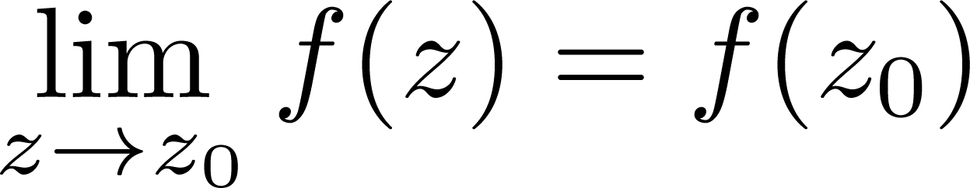
Continuity
Definition
A complex function is said to be continuous at point if is defined and
A complex function is said to continuous at a domain if it is continuous at each point in this domain

Slide 28
Continuity
Three conditions for continuity at a point:
It must be defined at that point
Its limit must exist at the point
The value of the function at that point must equal the value of the limit at that point

Slide 29
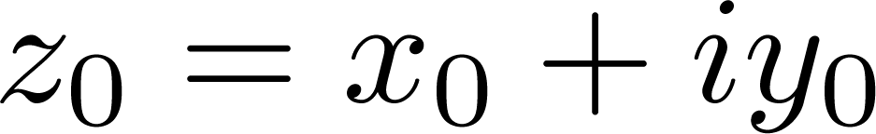

Continuity
Further property
is continuous at if and only if and are all continuous at
How to prove?

Slide 30


Example
Discuss continuity of following complex function

Slide 31
3
Analytic Functions

Slide 32



Derivative
Definition of derivative
The derivative of a complex function at point is defined by
provided this limit exists. Then is said to be derivable at .
Or if we write , then the derivative can be also defined by
If is derivable at all points in a domain , then we say it is derivable in

Slide 33




Example
Calculate the derivative of the following functions
(1) ; (2)
(1) Since
then
Homework: Use the similar method to show that
, n is a positive integer

Slide 34


Example
Calculate the derivative of the following functions
(1) ; (2)
(2) Since
then

Slide 35






Differentiation
Definition of differentiation
If is defined at , represents an arbitrary point in a neighborhood of , then is said to be differentiable at if there exists such that
is called the differentiation
Notation: or
If is differentiable at all points in a domain , then it is said to be differentiable in
Infinitesimal

Slide 36
Differentiation
Relations
A complex function is derivable if and only if it is differentiable
If a complex function is derivable, then it is continuous, but the converse is not true

Slide 37





Differentiation
Proofs:
Derivable Differentiable
Derivable Continuous: Use the first property and definition of differentiable
Continuous Derivable: Find a counterexample
Derivable
Differentiable
Differentiable
Derivable

Slide 38






Example
Show that is continuous but not derivable
Continuity:
Not derivable:
  When , we have
  When , we have
y
x

Slide 39


Think about it?
Denote , then it is derivable
if and only if and are differentiable——True or False?
if and only if the partial derivatives of and exists——True or False?

Slide 40

Rules for Derivative
Derivative rules
Sum and difference rules
Product rule
Quotient rule
Chain rule

Slide 41
Analytic Functions
Definition
A complex function is said to be analytic at point if it is derivable in a neighborhood of
A complex function is said to be analytic in a domain if it is analytic at all points of this domain
Relations
At a point: Analyticity implies derivability, but the converse is not true
In a domain: Analyticity and derivability are equivalent

Slide 42







Example
Show that is only derivable at zero; hence it is nowhere analytic
Limit not exist
  When , then
  When , then does not exist

Slide 43


Polynomials and Rational Functions
Polynomials
A complex polynomial has the following form
Polynomials are analytic in the entire complex plane
Rational functions
The quotient of two polynomials is called a rational function
Analytic except at the points where

Slide 44



Example
Find the maximum domain where is analytic and calculate the derivative in this domain
  It is a rational function, thus it is analytic except at the points
  Denote then the derivative is

Slide 45
4
Cauchy-Riemann Equations

Slide 46

Equivalent Conditions for Derivability
Theorem
A complex function is derivable at point if and only if and are differentiable and satisfy the following Cauchy-Riemann (C-R) equations

Slide 47




Equivalent Conditions for Derivability
Proof
“Only if” part: If is derivable at point , then it is also differentiable, which yields
Write and note that
Differentiable!

Slide 48




Equivalent Conditions for Derivability
Proof
“If” part: If and are differentiable at then
Recall the C-R equations and obtain
is derivable at and

Slide 49

Equivalent Conditions for Derivability
Equation for derivative
Based on the proof, we have

Slide 50
Equivalent Conditions for Analyticity
Theorem
A complex function is analytic in a domain if and only if and are differentiable in and satisfy the following Cauchy-Riemann (C-R) equations

Slide 51

Equivalent Conditions for Analyticity
Corollary: A sufficient condition
If two real functions and have continuous first partial derivatives that satisfy the C-R equations in domain , then the complex function
is analytic in domain

Slide 52




Example
Analyze derivability and analyticity of the following functions
(1) ; (2)
(1) Since
Only satisfy C-R equation at
Differentiable!

Slide 53



Example
Analyze derivability and analyticity of the following functions
(1) ; (2)
(2) Since
Does not satisfy C-R equations at any point, thus not derivable
Differentiable!

Slide 54



Example
Further analyze derivability and analyticity of the following functions
(1) ; (2)
(1) Since
Only satisfy C-R equation at

Slide 55


Example
Further analyze derivability and analyticity of the following functions
(1) ; (2)
(2) Since
Only satisfy C-R equation when x=y, thus only derivable at a line and nowhere analytic

Slide 56

Example-Exponential Function
A complex exponential function is defined as
Derivable and analytic in the entire complex plane
The first partial derivative continuous Satisfy C-R equations

Slide 57





Example-A Property of Analytic Function
If and are both analytic in a domain , prove that where c is a constant
Analytic

