Slide 1
Mathematical Foundations of Control Engineering
控制工程数学基础
Dr. Bohao ZHU (朱博浩)
School of System Design and Intelligent Manufacturing
Southern University of Science and Technology
Lecture 3
Coutesy of Dr. Xiang XU

Slide 2
Outline
1
Harmonic Functions
2
Elementary Functions 1
3
Elementary Functions 2

Slide 3
1
Harmonic Functions

Slide 4
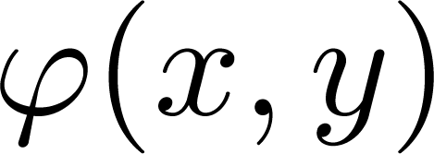

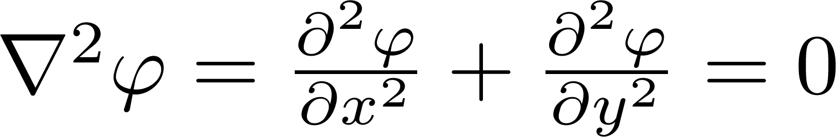
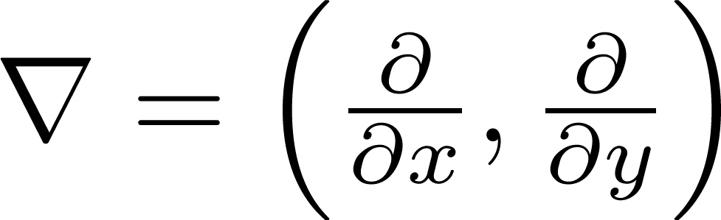
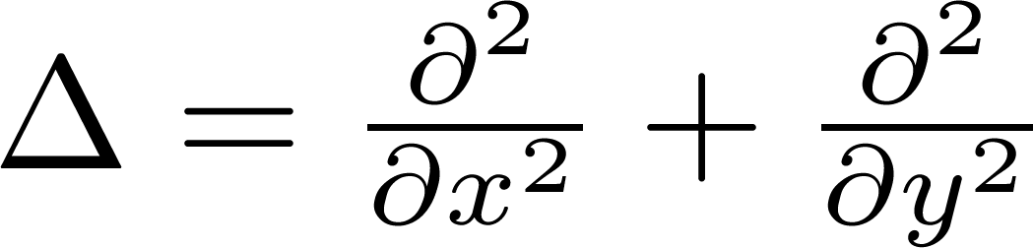
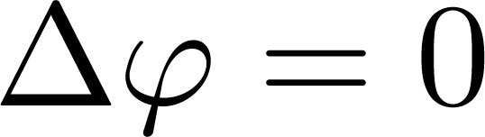
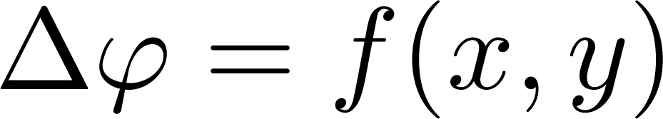
Basic Concept
Definition of harmonic functions
If a binary real function has continuous second partial derivatives in a domain and satisfies Laplace’s equation
then is a harmonic function in domain
Notation:
  Nabla operator:
  Laplace operator:
  Poisson’s equation:

Slide 5
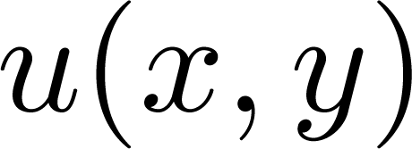
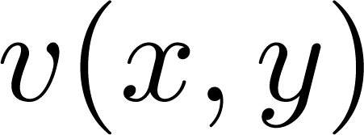
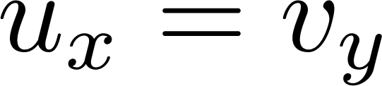
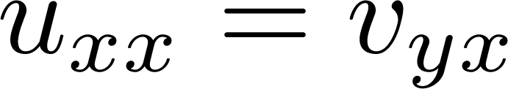
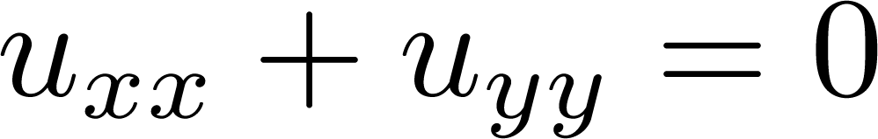
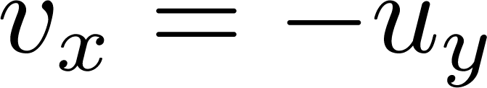
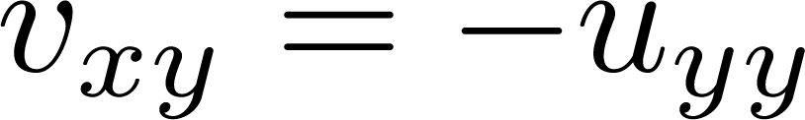


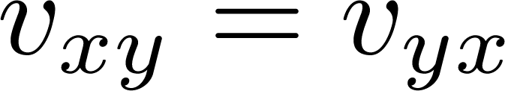
A Relation
Theorem
If a complex function is analytic in a domain , then and are both harmonic functions in domain
Proof:
Two remaining problems(we just keep it here)
  Existence of the second derivative of and ?
  holds?
?
?

Slide 6
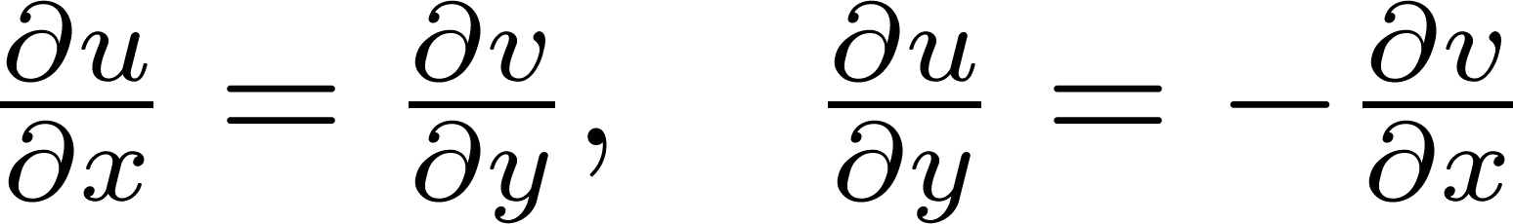
Harmonic Conjugate Function
Definition
If and are two harmonic functions in domain and satisfy the C-R equations:
then is said to be a harmonic conjugate function of
Note that: we cannot say is a harmonic conjugate of !

Slide 7
Harmonic Conjugate Function
Theorem
A complex function is analytic in a domain if and only if is a harmonic conjugate function of in domain

Slide 8
Construction of Analytic Functions
Question:
Given real(imaginary) part of an analytic function, then how to determine its imaginary(real) part?
Why can the question be solved?
  Both real and imaginary part should be harmonic
  C-R equations should be satisfied

Slide 9
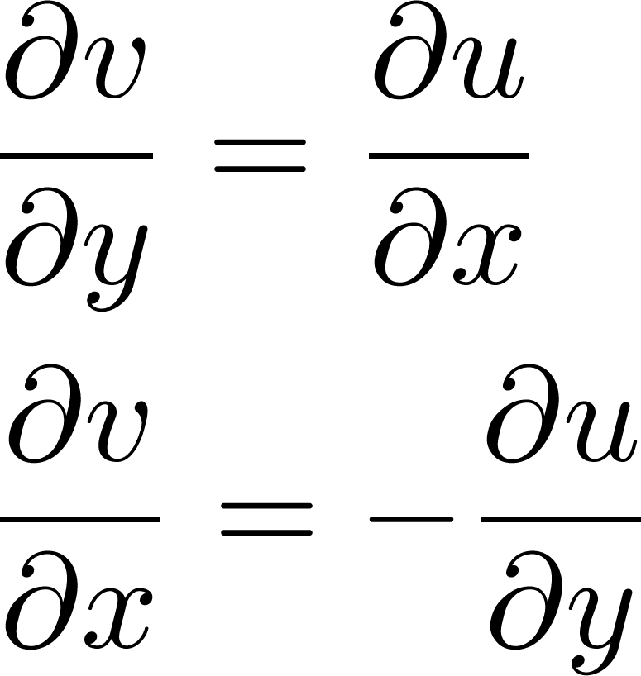
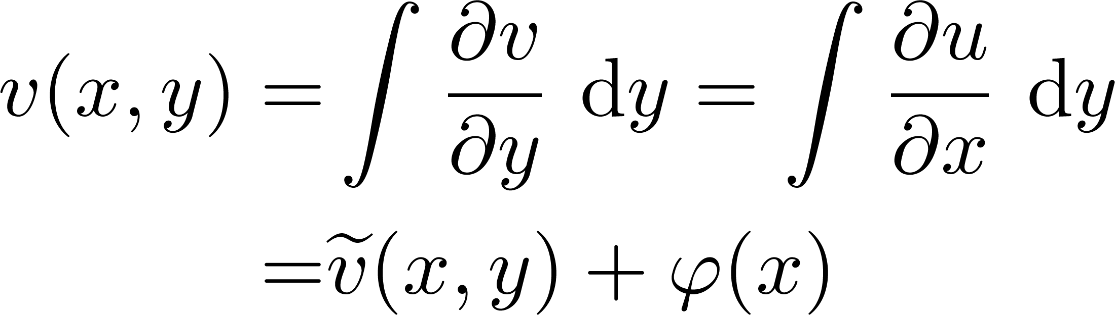
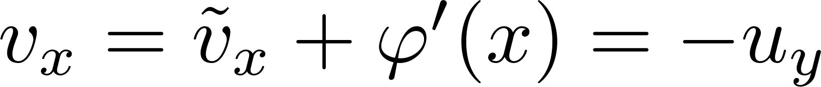
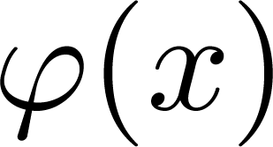
Construction of Analytic Functions
Method of partial integration:
Assume is known:
C-R
Determine

Slide 10
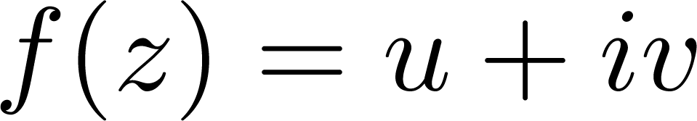
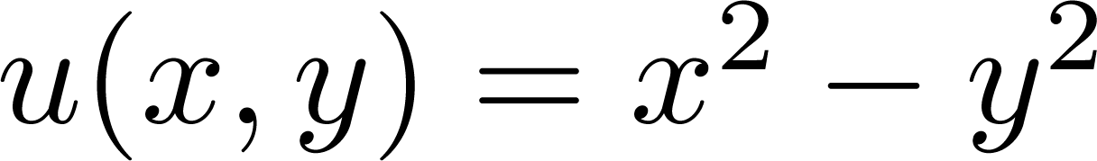
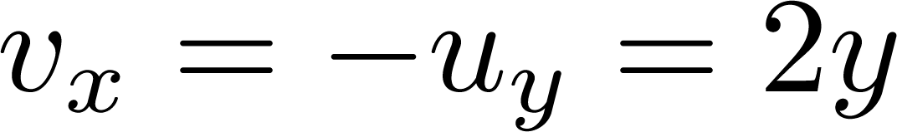
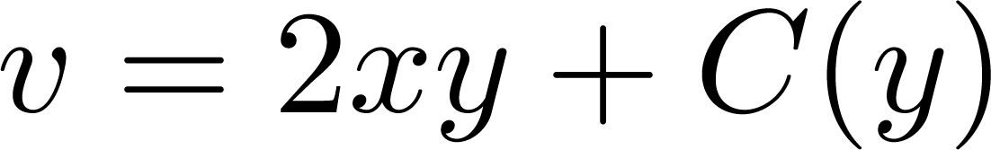
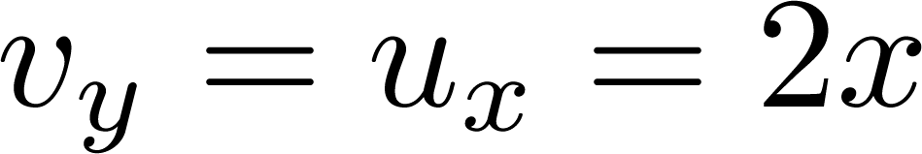
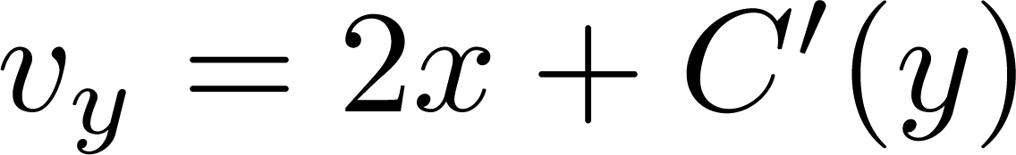
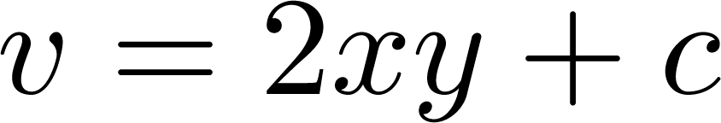
Example
If is analytic and then determine
C-R

Slide 11
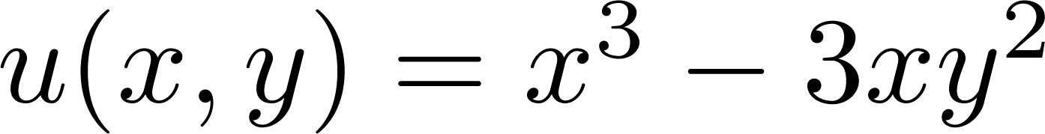

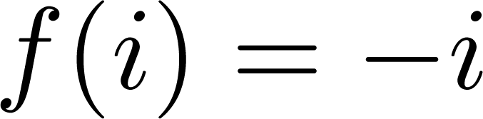
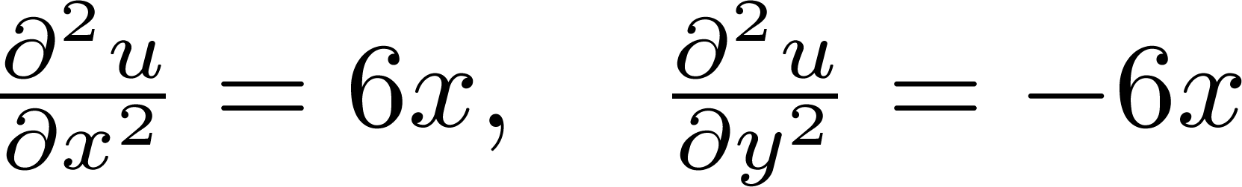
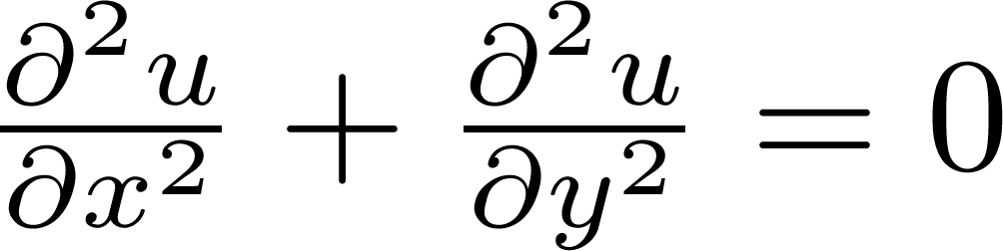
Example
Verify that is harmonic and find an analytic function with being its real part and satisfying
(1) Verify the harmonicity of :

Slide 12
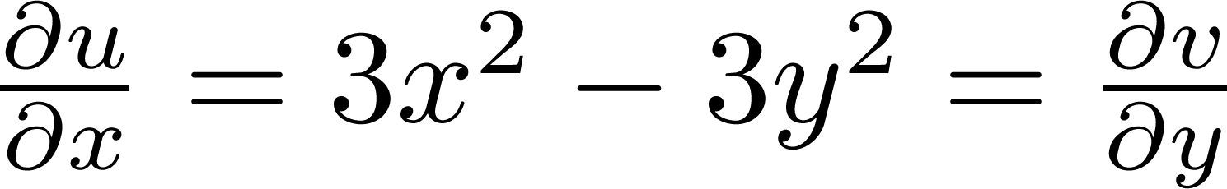
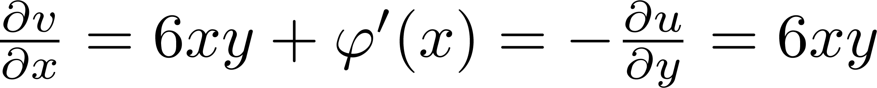
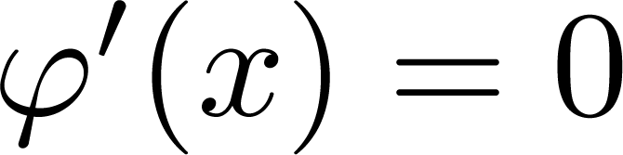
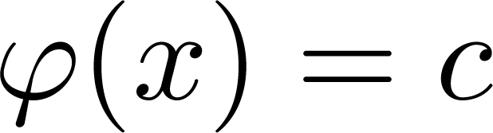
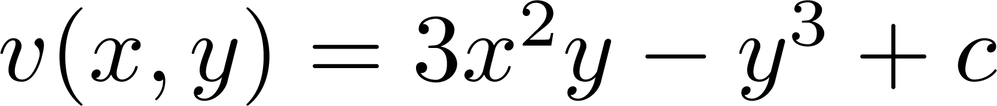
Example
Verify that is harmonic and find an analytic function with being its real part and satisfying
(2) Calculate the imaginary part:
Method of partial integration

Slide 13
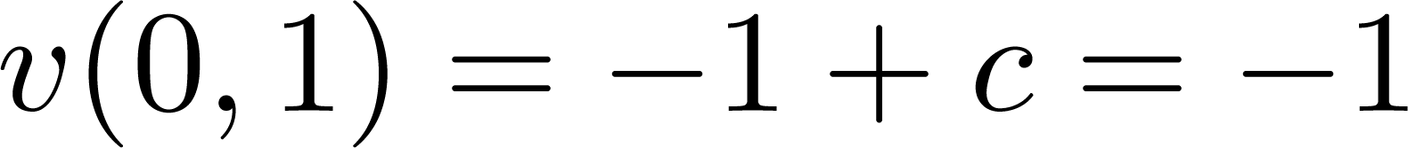

Example
Verify that is harmonic and find an analytic function with being its real part and satisfying
(3) Determine the constant c
Since , then

Slide 14
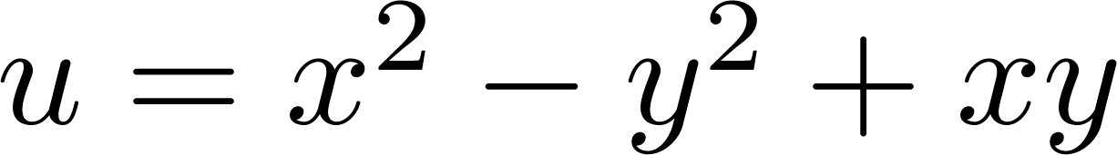
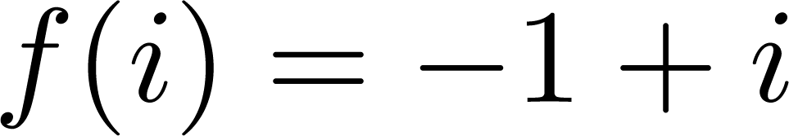
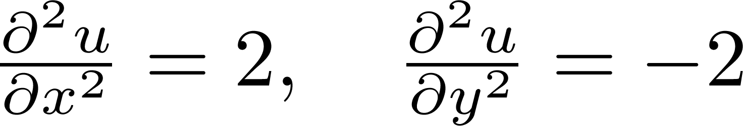
Example
Verify that is harmonic and find an analytic function with being its real part and satisfying
(1) Verify the harmonicity:

Slide 15
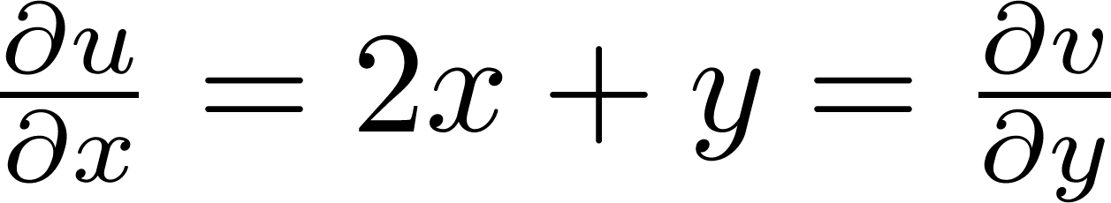
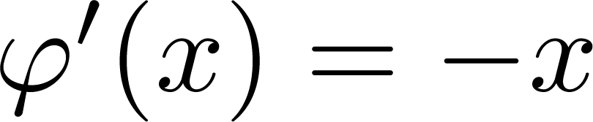
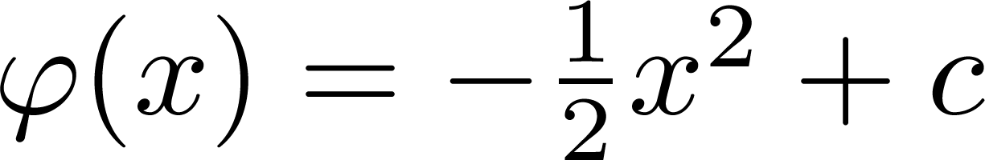
Example
Verify that is harmonic and find an analytic function with being its real part and satisfying
(2) Calculate the imaginary part:
Method of partial integration

Slide 16
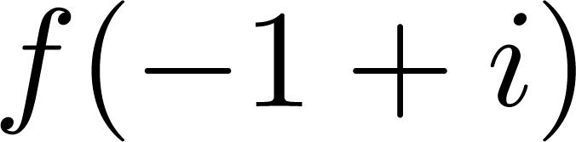
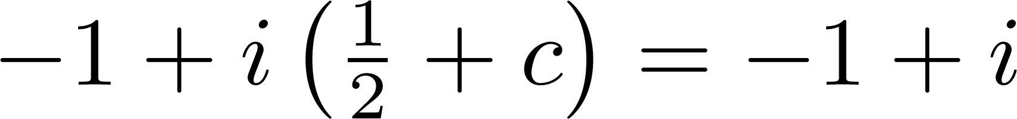
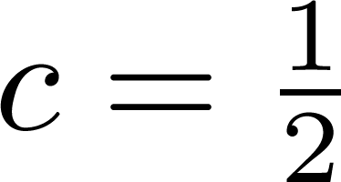
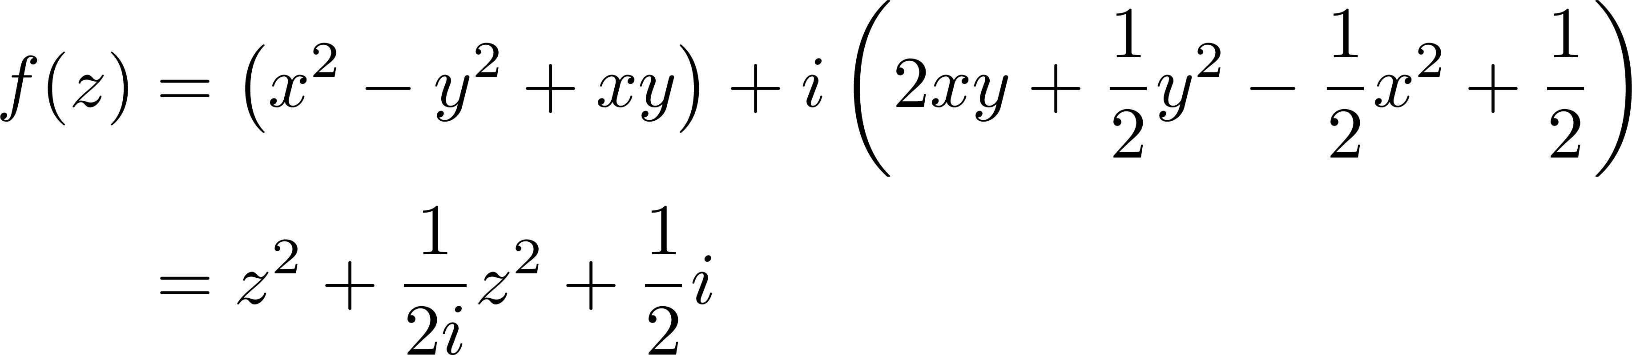
Example
Verify that is harmonic and find an analytic function with being its real part and satisfying
(3) Determine the constant c:
Since , then

Slide 17
2
Elementary Functions 1

Slide 18
Elementary Functions
Preliminaries of complex elementary functions:
Complex elementary functions are extensions of real elementary functions
The definition of complex elementary functions should be compatible with real elementary functions——looks similar
When the variable takes real values, the complex functions should reduce to their real cases

Slide 19
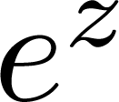
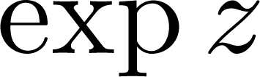
Exponential Function
Recall the definition of complex exponential function
which is often written as or
Some remarks:
Exponential function is the most important complex elementary function——other elementary functions are defined via it
By Euler’s formula, it can be also remembered as

Slide 20
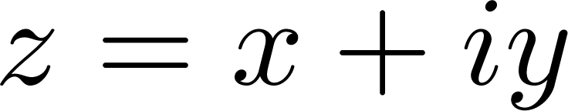
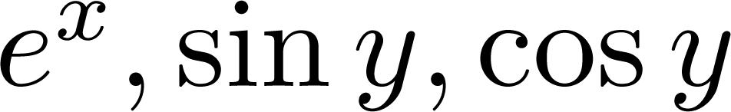





Exponential Function
Properties of exponential function
A single-valued function: for given , the functions in definition are all single-valued
is defined at all points in complex plane
Its value at infinity:
  When ,
  When ,
  . Since
  is analytic everywhere in complex plane

Slide 21





Exponential Function
Properties of exponential function
For any and , there holds
  Proof:
  It is a periodic function with periods

Slide 22


Exponential Function
Properties of exponential function
Modulus:
  Argument:
y
(z)
v
(w)
w
y
z
y
x
x
u

Slide 23







Logarithmic Function
Definition of logarithmic function
Inverse function of exponential function
If , then is called a logarithmic function, denoted as
Values of logarithmic function:
  Let then it follows from that
Real part defined by modulus of
Imaginary part defined by argument of

Slide 24







Logarithmic Function
Properties of logarithmic function
Multi-valued functions(infinitely many)
The principal value of is the one using the principal argument value, often denoted as
When (positive real), the principal value of is the real logarithmic function
For a given , is called a branch of the principal value

Slide 25


Logarithmic Function
Properties of logarithmic function
Not defined at
Continuity: Each branch of the logarithmic function is continuous except at zero and on the negative real axis——Note is only discontinuous at zero and on the negative real axis

Slide 26



Logarithmic Function
Properties of logarithmic function
Analyticity: Each branch of the logarithmic function is analytic except at zero and on the negative real axis
  Proof (using C-R equation):
Its partial derivative?
?

Slide 27



Logarithmic Function
Properties of logarithmic function
Proof of analyticity (continued)
  Maybe we can consider a different expression:

Slide 28

Logarithmic Function
Properties of logarithmic function
Similar to real logarithmic functions:
In the sense of set

Slide 29






Example
Find the value and principal value of
(1) ; (2)
(1)
Principal value:
(2)
Principal value:

Slide 30






Example
Find the value and principal value of
(1) ; (2)
(1)
Principal value:
(2)
Principal value:
Logarithmic function has values for negative reals in complex domain
In complex domain, logarithm of positive reals also has multi values

Slide 31



Example
Calculate derivatives of the following functions
(1) ;
(2)
(1)
(2)

Slide 32
3
Elementary Functions 2

Slide 33





Complex Power Functions
Definition of complex power functions
Power of a complex number is defined as
Additionally, we define that if is a positive real number and (This is mainly to make the definition compatible with real power functions)
Principal value of is defined as

Slide 34



Complex Power Functions
Properties of complex power functions
If c is a positive integer: (single-valued), is analytic everywhere in the complex plane and
If c is a negative integer: (single-valued), is analytic except zero and
If c equals zero:

Slide 35



Complex Power Functions
Properties of complex power functions
If c is a rational number: (finitely many valued), where is a positive integer. In this case, the power function is analytic except at zero and on the negative real axis with
If c is an irrational or a complex number( ): (infinitely many valued), is analytic except zero and on the negative real axis with

Slide 36






Example
Find the value and principal value of
(1) ; (2)
(1)
Principal value:
(2)
Principal value:
Power of two pure imaginaries is a positive real!
In complex domain, power of 1 may be not merely equal to 1

Slide 37



Trigonometric Functions
Trigonometric functions
Motivation: it follows from Euler’s formula that
Complex cosine function
Complex sine function
Other trigonometric functions

Slide 38

Trigonometric Functions
Properties of trigonometric functions
Periodicity: same to the real cases
Derivatives:
Most of the formula for real trigonometric functions still hold
Not bounded, i.e., does not hold for complex case

Slide 39




Example
Find the value of
(1) ; (2)
(1)
(2)

Slide 40








Example
Solve the following equations
(1) ; (2)
(1)
and
(2)
and
?

Slide 41


Example
Prove that

Slide 42

Example
Prove the following relation for complex trigonometric functions

Slide 43








Inverse Trigonometric Functions
Definition of inverse trigonometric functions
Inverse cosine function: if , then is inverse cosine function of , denoted by . The other inverse functions can be defined similarly.
Calculation:
Homework: Prove that
Both plus or minus is OK since represents complex roots

Slide 44



Hyperbolic Functions
Definition of hyperbolic functions
Hyperbolic cosine function:
Hyperbolic sine function:
Other hyperbolic functions:

Slide 45

Hyperbolic Functions
Properties of hyperbolic functions
Analytic everywhere in complex plane
Derivatives:
Connection with trigonometric functions:
Some formulas:

Slide 46
A Review
We have already learned
Complex numbers
  Complex plane, geometric representation
  Polar form and exponential form
Complex functions
  Sets in complex plane
  Limit, continuity, derivative
  Analytic functions, C-R equations
  Harmonic functions
  Elementary functions: exponential, logarithmic, complex powers, trigonometric, inverse trigonometric, hyperbolic

