Slide 1

ROOKIE CONTRACTS & TEAM STABILITY
How rookie-wage-scale spending relates to the volatility of NFL offenses
Kyle Smith
Syracuse University • 2025
EPA/PLAY VOLATILITY · ROOKIE CAP SHARE · DRAFT CAPITAL · TEAM CONTINUITY

Slide 2
The Question
The 2011 CBA introduced a rookie wage scale, fixing rookie pay to draft position before a player is ever drafted. Cheaper, standardized rookie deals could change how teams behave.
1
2
3
Rapid rebuilds
Faster resets
Reallocation
Cheap rookie QBs let teams retool their offense quickly.
Teams can afford to reset sooner after a losing stretch.
Savings at one position can be spent disproportionately elsewhere.
What “volatility” means here
The 4-year forward-looking standard deviation of EPA/play — not whether a team wins, but how consistent its offensive performance is across the length of a rookie's first contract.
Base years: 2011–2015 (rolling windows extend to 2019). 2020 is excluded — COVID introduced offensive noise league-wide that isn't a true reflection of roster construction.
Rookie Contract Allocations and Team Stability in the NFL
2

Slide 3
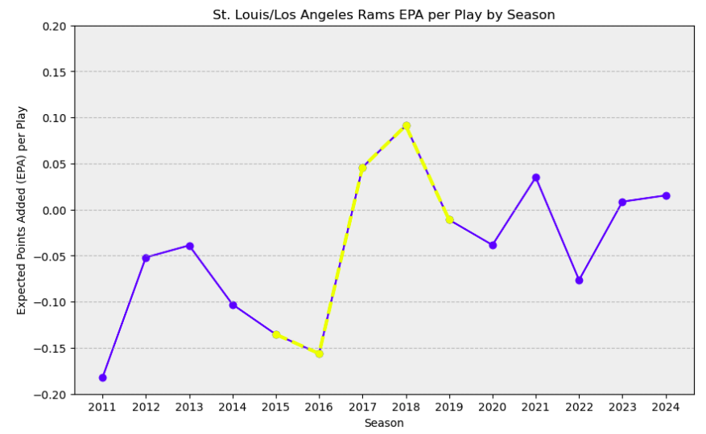
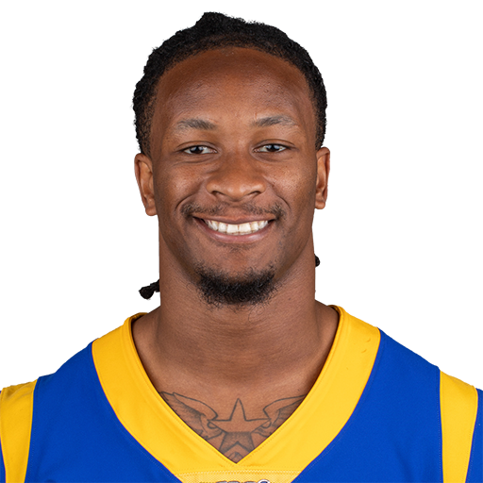
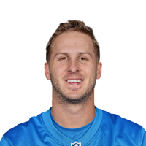
Case Study: Highest Volatility
St. Louis / Los Angeles Rams, 2015–2019
Highest offensive volatility in the sample.
2015: draft RB Todd Gurley (OROY, OPOY, 3x Pro Bowl, 3x All-Pro).
2016: draft franchise QB Jared Goff (2x Pro Bowl as a Ram).
Offensive efficiency jumps sharply in the two seasons that follow.
Takeaway
Investment in premium offensive draft picks may play a direct role in how quickly — and how sharply — an offense's performance shifts.
Rookie Contract Allocations and Team Stability in the NFL
3

Slide 4
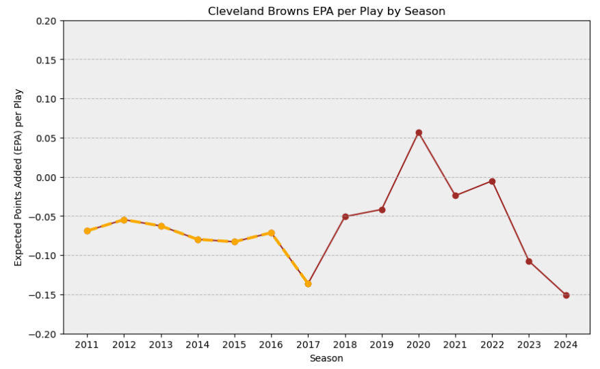
Case Study: Lowest Volatility
Cleveland Browns, overlapping windows 2011–2015 & 2013–2017
Lowest offensive volatility in the sample — but for a different reason.
Only notable offensive draftee: G Joel Bitonio (2014), later a 2x All-Pro.
Even a franchise cornerstone couldn't move the needle on a persistently subpar offensive line.
The Rams pattern doesn't repeat: stability here reflects consistent mediocrity, not a smart bet.
Note
Outside the studied window, 2018–22 Cleveland (Baker Mayfield, David Njoku — both first-round) shows more offense and more volatility, echoing the Rams pattern.
Rookie Contract Allocations and Team Stability in the NFL
4

Slide 5
Data & Variables
Sourced from nflfastR (play-by-play) and Spotrac (contracts). Volatility is modeled across three groups of predictors.
Continuity
Team Characteristics
Front Office Decisions
QBC
Same primary QB as prior season?
Age
Average age of offensive starters
DC
Draft capital spent on offensive players (1/pick, summed)
HCC
Same head coach as prior season?
QBE
Primary QB's years of experience (rookie = 0)
RS
Share of cap space paid to rookies overall
OCC
Same offensive coordinator as prior season?
OS
Share of cap space paid to all offensive players
Team and season fixed effects are included in every specification.
Rookie Contract Allocations and Team Stability in the NFL
5

Slide 6
Exploratory Data Analysis
Raw correlation of each predictor with 4-year EPA/play volatility
All weak in isolation
Every bivariate correlation is small. That's expected — and it's exactly why the model adds squared and interaction terms.
Coach continuity (HCC) shows the strongest raw pull toward higher volatility.
Rookie cap share (RS) shows the strongest pull toward lower volatility.
A weak straight-line correlation can still hide a real curved relationship.
Rookie Contract Allocations and Team Stability in the NFL
6

Slide 7
Design Matrix
Predictors are standardized (_z) and entered with squared terms to let volatility rise, peak, and fall rather than move in one direction only. Two purpose-built interactions are added.
epa_volatility_4yr ~ qbc + hcc + occ + off_dc_z (+sq) + age_z (+sq) + qb_exp_z (+sq) + rookie_prop_z (+sq) + offense_prop_z (+sq) + rookie_prop_z × offense_prop_z + rookie_prop_z × off_dc_z + team & season fixed effects
Rookie Share × Draft Capital
Rookie Share × Offensive Share
A high rookie cap share means something different depending on who it's spent on — late-round depth vs. a premium first-round pick. This term tests whether concentration matters, not just the total.
A high rookie share paired with a high offensive cap commitment is a concentrated bet on youth. Paired with a low offensive share, it may just reflect a rebuild, not a strategy.
Rookie Contract Allocations and Team Stability in the NFL
7

Slide 8
Two Estimators, One Specification
146 team-seasons · 47 predictors (df=98) · GVIF¹˸²ᵈᶠ¹ ranges 1.29–1.86 across predictors — all under the 2.0 rule of thumb after standardization
OLS
Cluster-robust by team
Huber M-Estimation
Robust regression
Team & season fixed effects absorb stable franchise/era differences. Clustering standard errors by team guards against leftover within-team correlation across seasons.
Same fixed effects and predictors — but high-residual observations are automatically downweighted during fitting instead of dominating the coefficients.
Sensitive to a small number of high-leverage team-seasons.
Fit specifically to limit the influence of outlier team-seasons.
Where the two estimators agree on sign and significance, the finding is unlikely to be driven by a handful of extreme team-seasons. Where they disagree, the robust model's estimate is the more trustworthy read.
Rookie Contract Allocations and Team Stability in the NFL
8

Slide 9
Results: OLS vs. Robust Regression
Selected coefficients — full model includes team & season fixed effects (R² = 0.686, Adj. R² = 0.535)
Variable
OLS
Robust (RLM)
Read
hcc (coach continuity)
+0.007 *
+0.006
Significant, both directions agree
qb_exp_z²
−0.006 ***
−0.006 **
Significant curvature, confirmed
offense_prop_z²
−0.003 **
−0.003 *
Significant curvature, confirmed
rookie_prop_z²
−0.002
−0.002 *
RLM finds what OLS misses
rookie_prop_z × off_dc_z
+0.004 *
+0.003
OLS-only — treat as suggestive
qbc (QB continuity)
−0.007
−0.004
Not significant either way
* p<0.1 ** p<0.05 *** p<0.01 Team fixed effects: significant. Season fixed effects: not significant.
Rookie Contract Allocations and Team Stability in the NFL
9

Slide 10
The Sweet Spots
Three predictors show a concave (rise-then-fall) relationship with volatility, not a straight line — curves computed directly from the fitted RLM coefficients
QB Experience
Rookie Cap Share
Offensive Cap Share
Peak volatility at 6.5 years
Peak volatility at 4.7%
Peak volatility at 42%
Reading the curves: extremes are stable, the middle is not.
Teams with a very green or very seasoned QB, a minimal or maximal rookie cap share, and a low or very high offensive cap commitment tend to be steadier. Volatility peaks in the middle — the zone teams often pass through mid-rebuild.
Rookie Contract Allocations and Team Stability in the NFL
10

Slide 11
Diagnostics Hold Up
1
Residuals vs. Fitted
2
Cook's Distance
Scattered evenly above and below zero — no funnel shape, no sign of heteroskedasticity.
Flagged team-seasons cluster around real QB transitions (Denver 2011–13: Tebow → Manning), not random noise — the case for using the robust model.
3
Durbin-Watson: 2.039
4
ACF of RLM Residuals
No meaningful autocorrelation despite the repeated-team panel structure.
Every lag falls within confidence bounds except lag 7, which barely crosses — reasonable evidence against residual autocorrelation.
Rookie Contract Allocations and Team Stability in the NFL
11

Slide 12
Key Takeaways
1
Coach continuity matters most
Head-coach continuity shows the strongest, most consistent link to volatility of any variable measured — confirmed by both estimators.
2
It's a curve, not a line
Rookie cap share, offensive cap share, and QB experience all show a rise-then-fall relationship with volatility — the middle of the range is the least stable place to be.
3
Draft capital's role is suggestive, not settled
A big rookie investment concentrated in a premium pick shows a possible link to more volatility under OLS, but the robust model doesn't confirm it as strongly.
4
Team identity still matters
Significant team fixed effects mean factors beyond roster spending — organizational culture, scheme, front-office philosophy — still shape offensive stability.
Rookie Contract Allocations and Team Stability in the NFL
12

