Slide 1

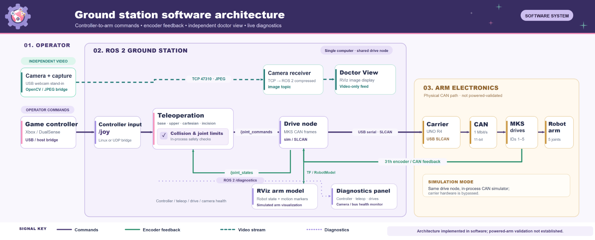
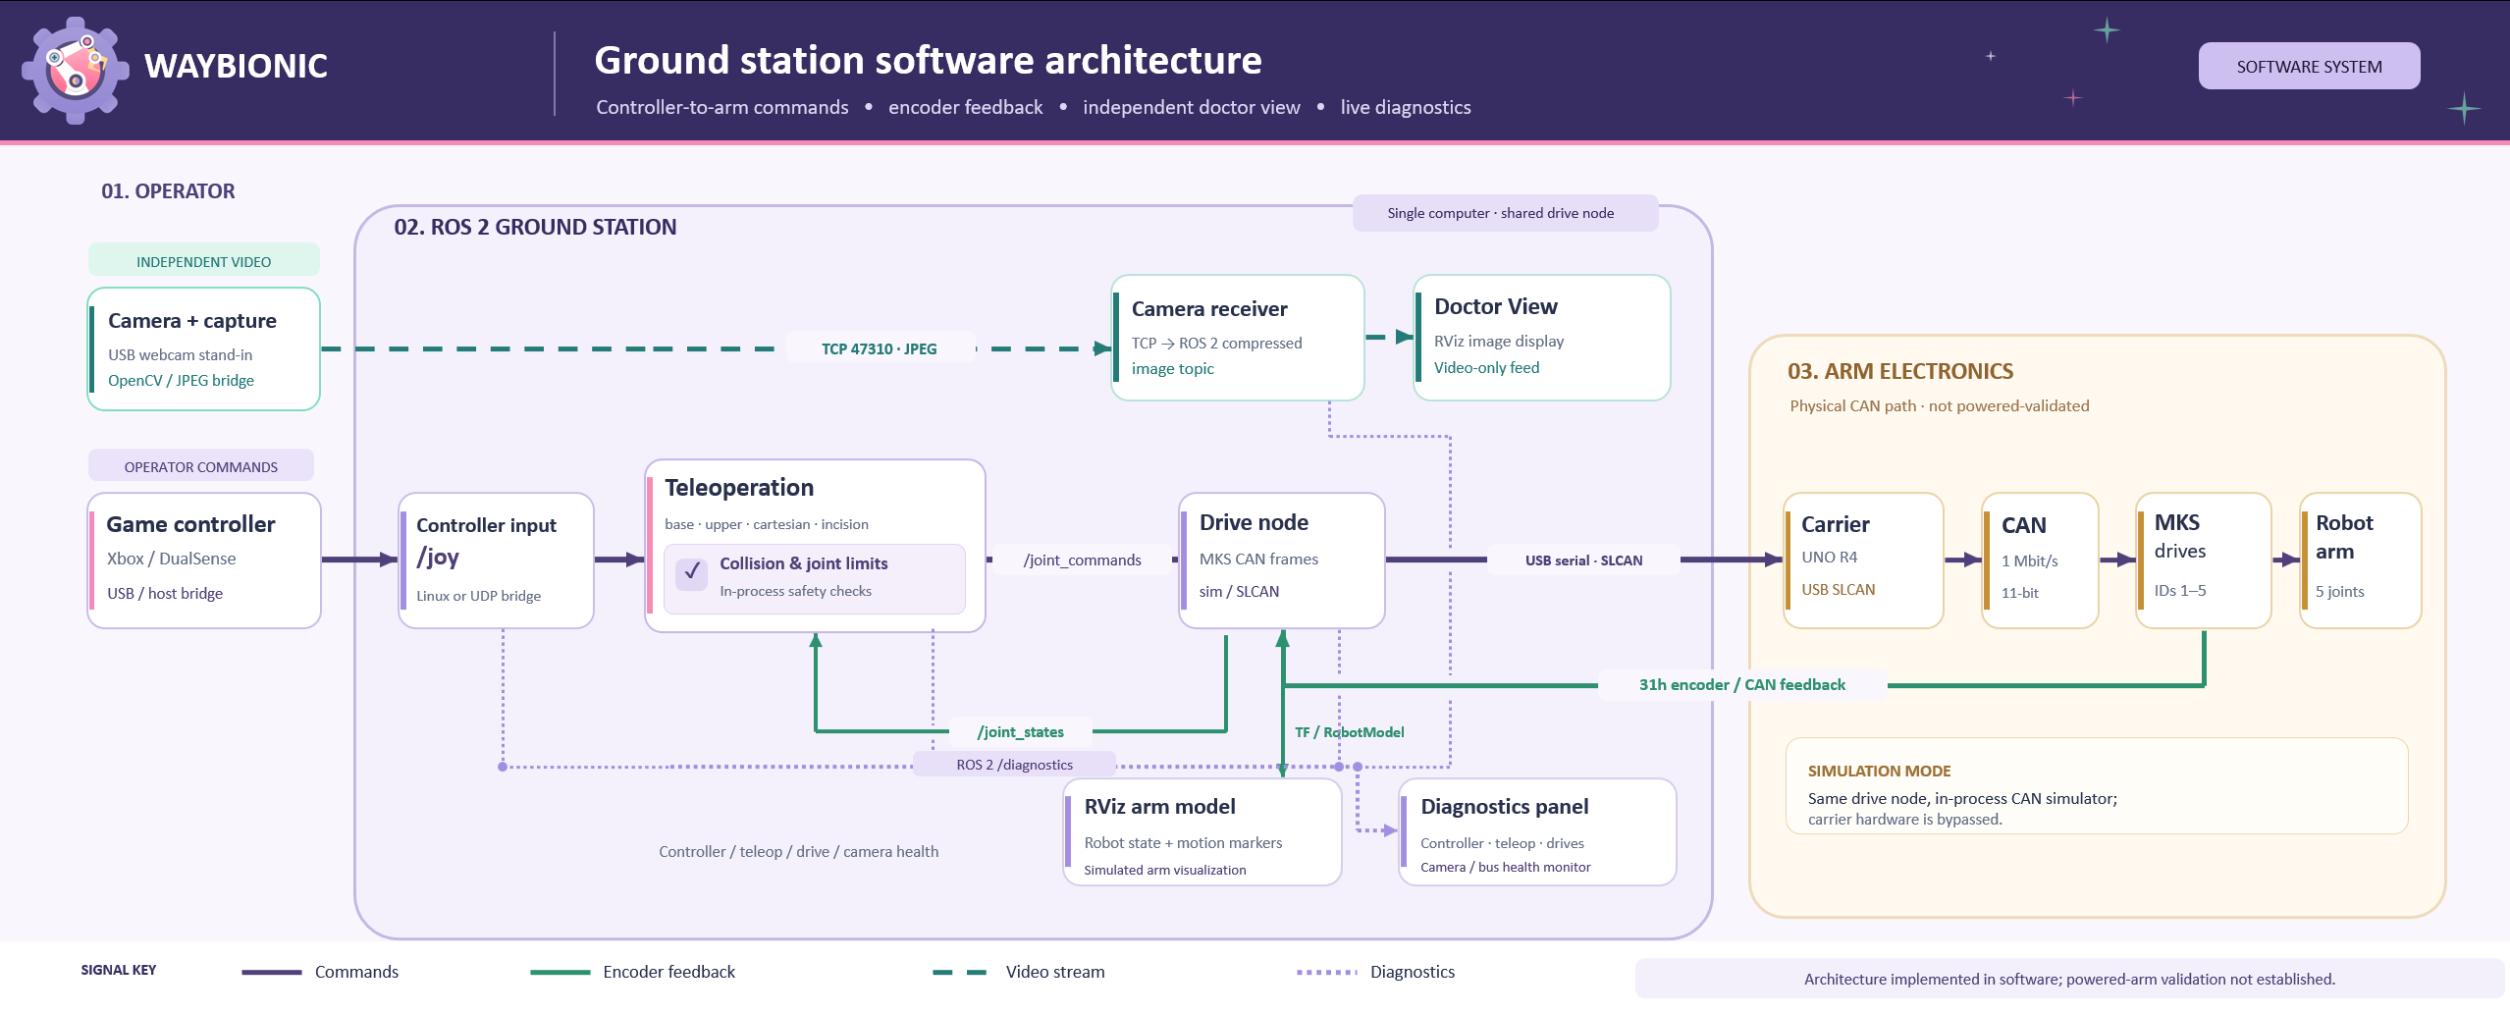
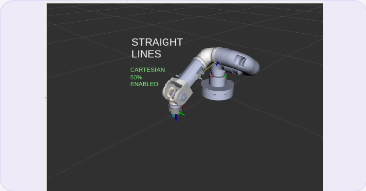
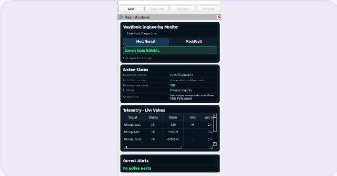
WAYBIONIC
ENGINEERING SYSTEMS
Ground station software
Operator control · software checks · CAN drive interface · live monitoring
SOFTWARE OVERVIEW
The ROS 2 ground station turns controller input into checked joint commands.
Video and diagnostics remain separate from arm motion.
The carrier link is software-implemented; powered five-drive validation is not documented.
01. SYSTEM ARCHITECTURE
Verified against the ROS 2 paths on main. The hardware connection is coded. It is not powered-validated.
02. TELEOPERATION + INCISION
03. COLLISION + JOINT LIMITS
An Xbox or DualSense controller becomes a 120 Hz stream of
Before a command is sent, the next pose is checked against
joint setpoints: base, upper, Cartesian, and incision. The
the URDF joint ranges and collision boxes on the base,
incision group stores the tip pose when selected, then only
shoulder, upper arm, forearm, wrist, and tool. A step that
inserts, withdraws, or tilts so the tool axis stays on that
would pass a limit, leave the tip out of reach, or deepen
point. Sideways homing is blocked while the tip is inserted.
contact is discarded. The controller rumbles once and the
These behaviours run in software on simulated drives, not as
label names the cause. Ranges on this model are provisional;
a clinical procedure.
the boxes come from the committed meshes, not a live CAD scan.
04. CAN + DRIVE FEEDBACK
05. DOCTOR VIEW + DIAGNOSTICS
The same drive node used in simulation sends MKS SERVO
A camera computer stamps each frame and sends JPEG images
frames through a UNO R4 carrier: USB serial to a 1 Mbit/s
over TCP. RViz shows them as Doctor View and reports frame
CAN bus. Replies become joint states. A drive that stops
rate and capture-to-arrival delay. A webcam or a video file
answering, jumps, or lags its target stops the arm. Real
stands in until a procedure camera is chosen. The delay
drives stay still until zeroed, and stop if commands go
excludes time in the sensor and on the display. The monitor
silent. The carrier e-stop input is not wired. Software tests
lists controller, teleop, drive, bus, and camera health.
and virtual CAN cover this path. A powered five-drive run is
Video does not enter the motion-control loop.
not in the merged record.
06. SOFTWARE VALIDATION
Three results safe to print. Sources rechecked against merged PR descriptions on 27 Oct 2026.
81,421
19 + 11
30 fps
cases, 0 mismatches
virtual-CAN tests passed
2 ms capture-to-arrival at 1280×720
C++ vs Python frames · software only · PR #40
vcan host + four-node · not hardware · PR #45
Test video, not a webcam · PR #36
07. OPERATOR INTERFACE
Real captures from simulated teleop on main (cf3e887), 26 Oct 2026. No generated screenshots.
PENDING
Doctor View screenshot
Not captured. A team lead needs to supply a real
RViz frame or an approved test-video capture.
RViz simulated arm
Engineering Monitor
Doctor View — pending
Cartesian autoplay · simulated drives
Live /diagnostics · simulated teleop
Do not substitute a generated image
WAYBIONIC · SOFTWARE TEAM

