Slide 1
EMOTION RECOGNITION
FROM EEG SIGNALS
USING DEEP LEARNING TECHNIQUES
2024-11-26
5052 Big Data Machine Learning
Notes:
Good morning, everyone! Thank you for having me here today. I am excited to present our report on the deep learning models for Emotion Recognition from EEG Signals.

Slide 2
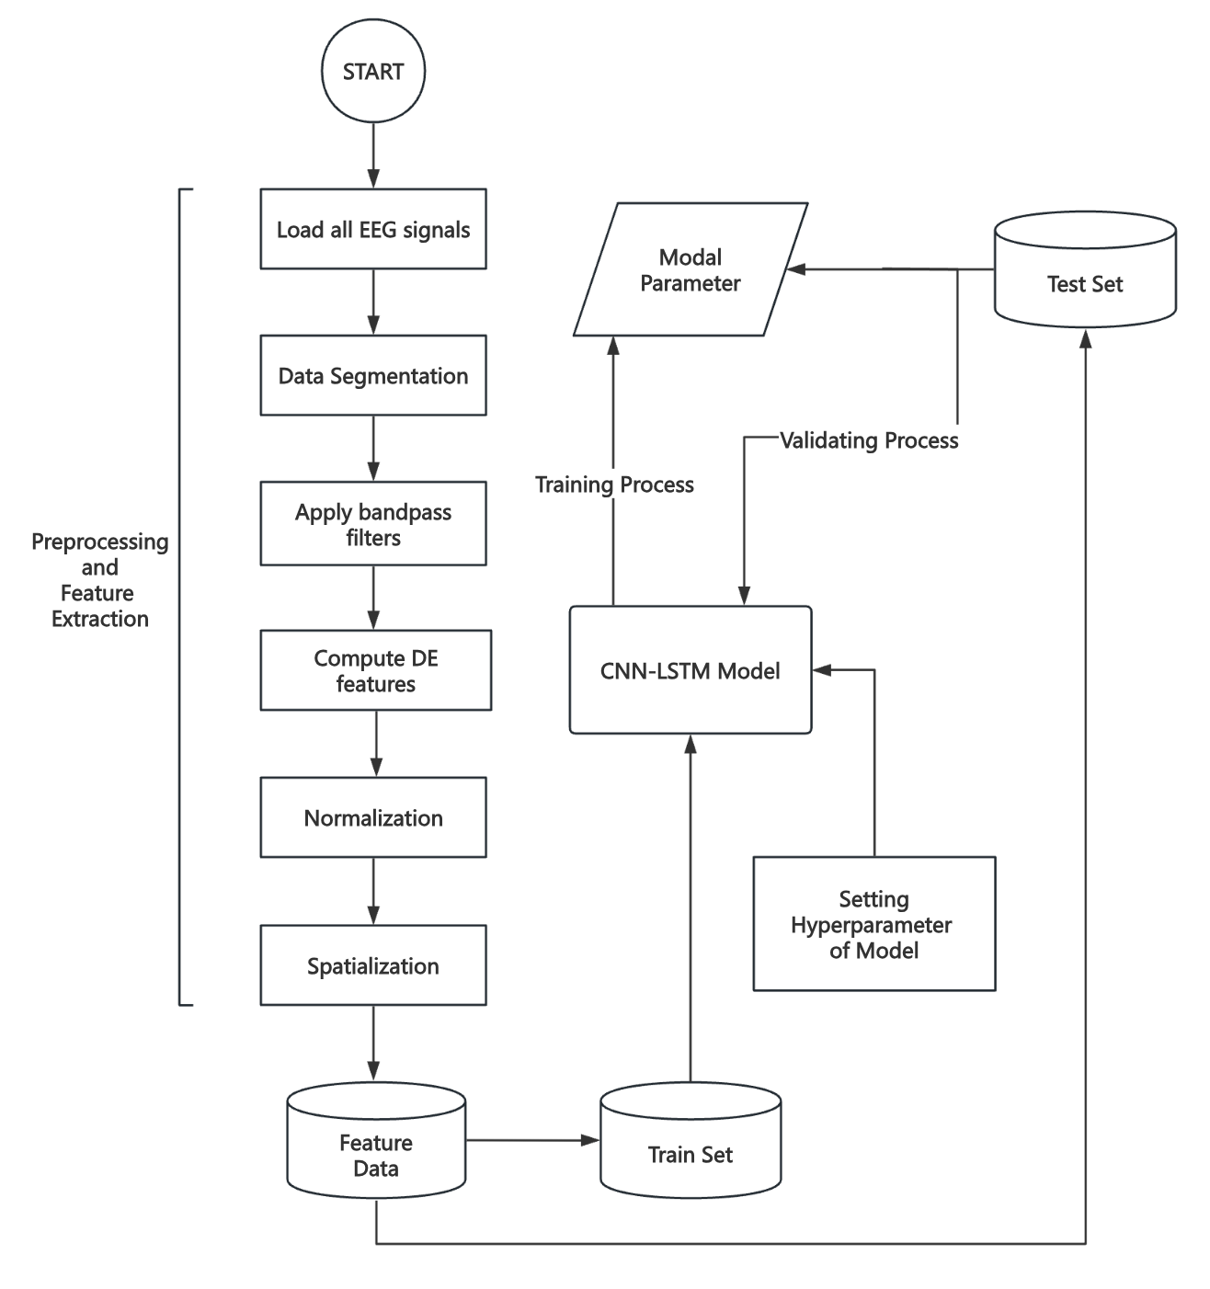
Introduction
Problem:
Classification of emotional states from multi-channel EEG signals
Dataset:
SEED-IV Raw Data
Our solution:
Multi-CNN-LSTM(Paper Solution)
Attention-BiLSTM-CNN(Model Enhanced)
ResCNN-TransGRU(Model Enhanced Plus)
Notes:
As you know, Our task is to classify four distinct emotions from EEG signals. To achieve this, we selected the SEED-IV raw data as the dataset for training and evaluation.
The solutions we propose are the Multi-CNN-LSTM, Attention-BiLSTM-CNN and ResCNN-TransGRU . Don’t worry if it sounds complex now—you will understand them as we move through this presentation.

Slide 3
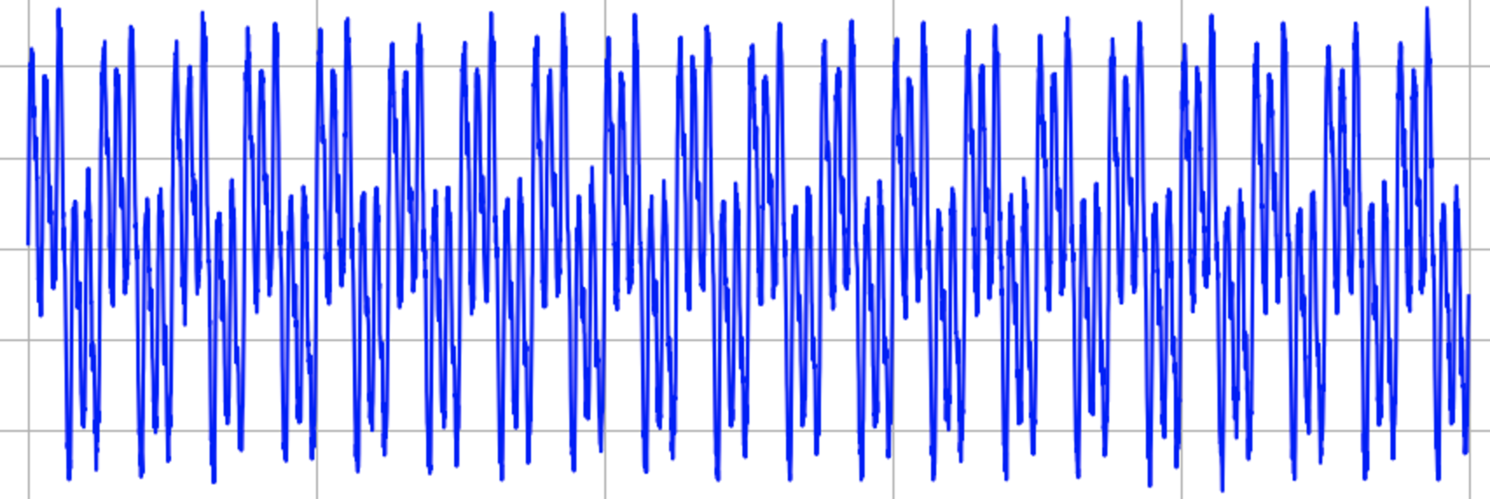
Data Preprocessing
Raw EEG Signals
Notes:
Let’s move to data preprocessing first. That’s parts of raw EEG data plotted

Slide 4
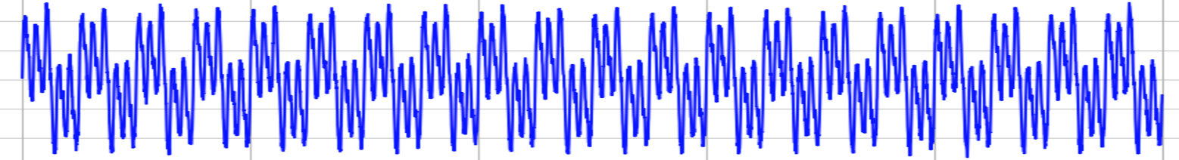
Preprocessing
Segment 1 (Ts)
Segment 2 (Ts)
Segment n (Ts)
m
Time
m
0.5s
m denotes the number of electrodes
Notes:
Then We divide raw data into n segments without overlapping, and m presents 62 electrodes

Slide 5
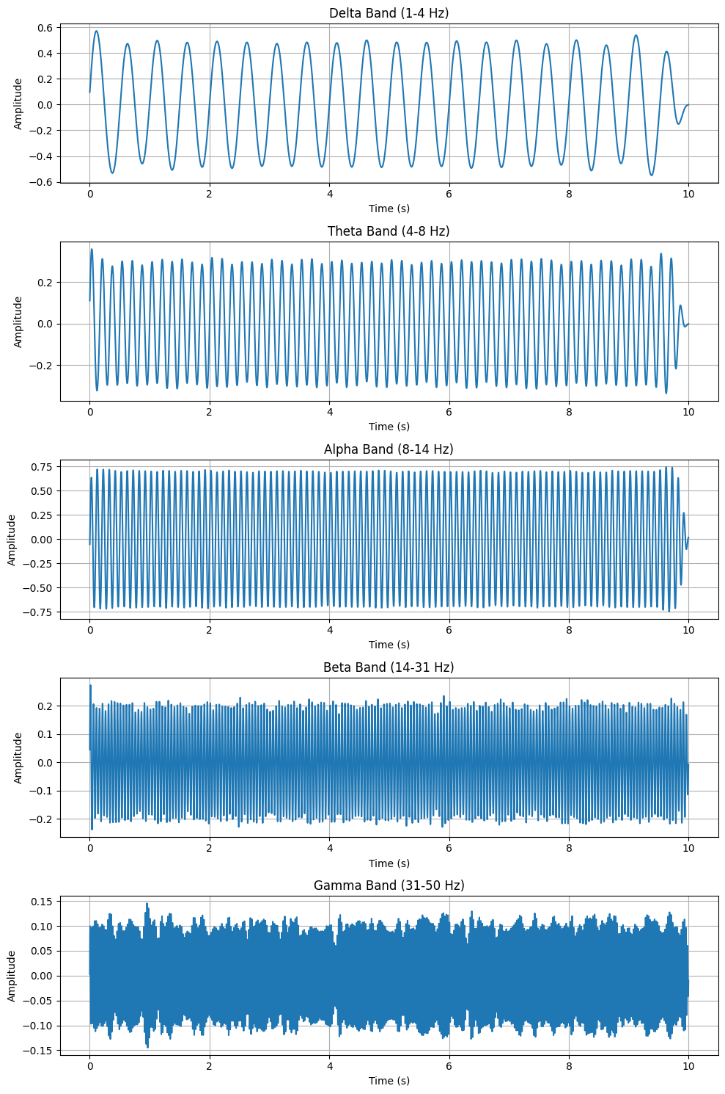
Preprocessing
δ
θ
Bandpass filter
α
β
γ
Notes:
For each segments, We decompose it with a Bandpass filter into five frequency bands. And delta is not so useful for emotion recognition, so we removed it.

Slide 6

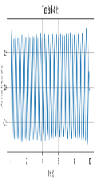




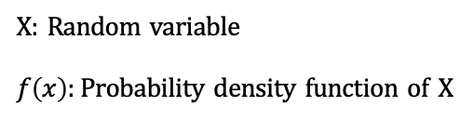
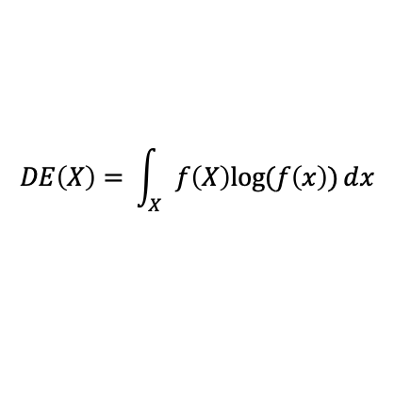
Preprocessing
θ
θ
$$DE\left(X\right)= \int_{X}{f\left(X\right)log⁡(f\left(x\right))ⅆx}$$
α
α
X: Random variable
$f\left(x\right):$ Probability density function of X
β
β
γ
γ
Notes:
we extract differential entropy (aka DE) features from each frequency band with 0.5 s window on each segments

Slide 7
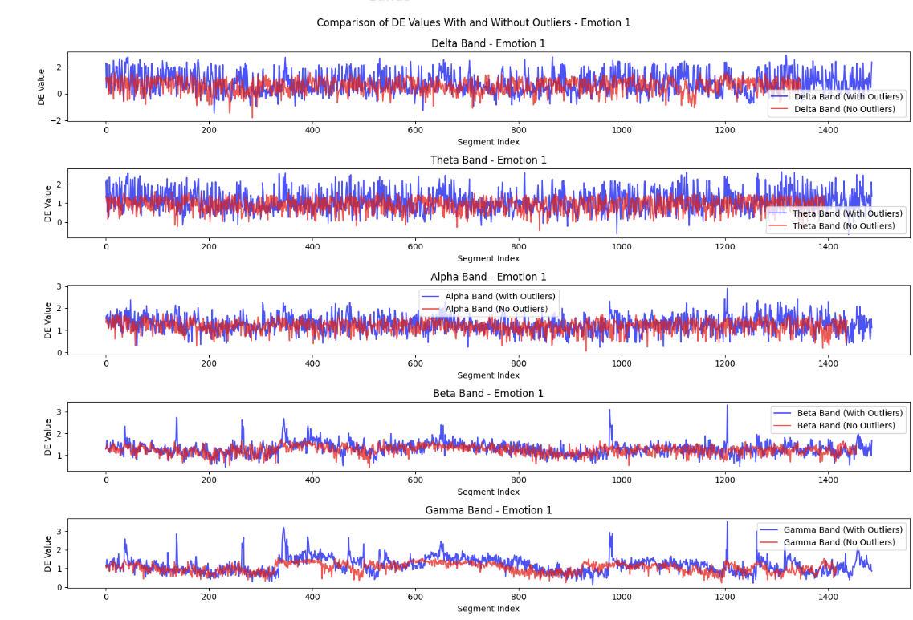
Notes:
Then DE data follows a Z score within 3 standard deviation removing outliers. Blue is signal with outliers, red one is without outliers

Slide 8
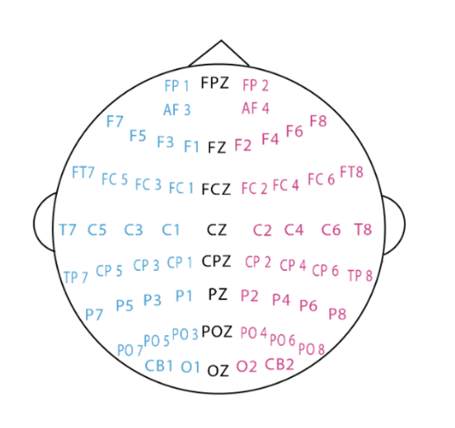
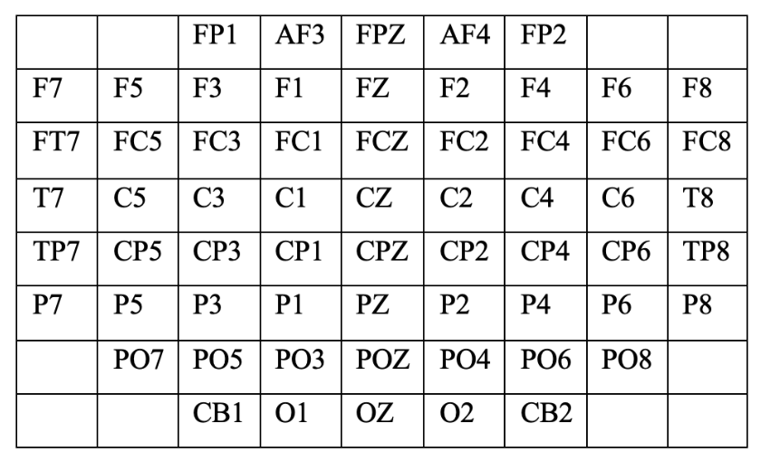
Spatialization
Electrode Arrangement :
Data recorded from 62 electrodes positioned according to the 10–20 system across the scalp.
Spatial Representation:
EEG signals transformed into a 2D map, so each 0.5-second EEG segment is represented as an 8 × 9 × 4 "image" with four frequency bands.
Motivation:
This format preserves spatial information about brain activity.
CNN can effectively leverage spatial patterns to extract features.
Notes:
Now we have clean data, We then transformed the EEG signals into a 2D map reflecting the electrode layout(you can see here), which enables CNNs to effectively extract spatial features for emotion recognition.

Slide 9

w
w
h and w are the height and width of the compact 2D map, respectively.
In this study, we set h = 8 and w = 9
h
θ
h
Segment 1
w
α
h
···
d
β
1st
2Tth
d represents the number of frequency bands
and 2T denotes twice of the segment length
γ
Notes:
We stacked the 2D frequency maps into a 3D array to integrate information from all frequency bands for model training and evaluation.

Slide 10
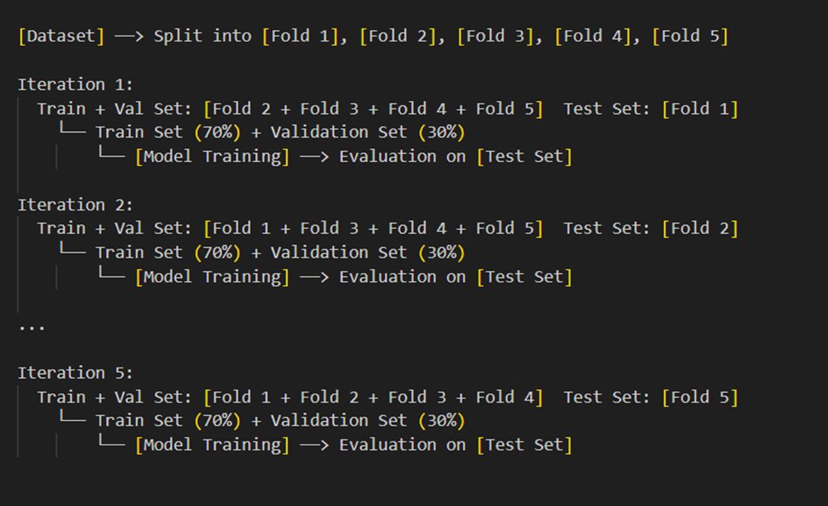
K-fold Experiment
Data Splitting with 5-Fold Cross-Validation
dividing the dataset into five parts. Each part is used as the test set once, while the others are for training, ensuring thorough evaluation.
Train/Validation/Test Split
Within each of the four training folds, we split the data into training (70%) and validation (30%) or training (50%) and validation (50%)
Model Training and Evaluation
The accuracy scores for each fold are collected and averaged to assess the model‘s generalizability. Also, We collect val_accuracy scores from epoch after a full running
Notes:
We used 5-Fold Cross-Validation experiieny, where the dataset is split into five parts, each used as a test set once, while the others are used for training

Slide 11
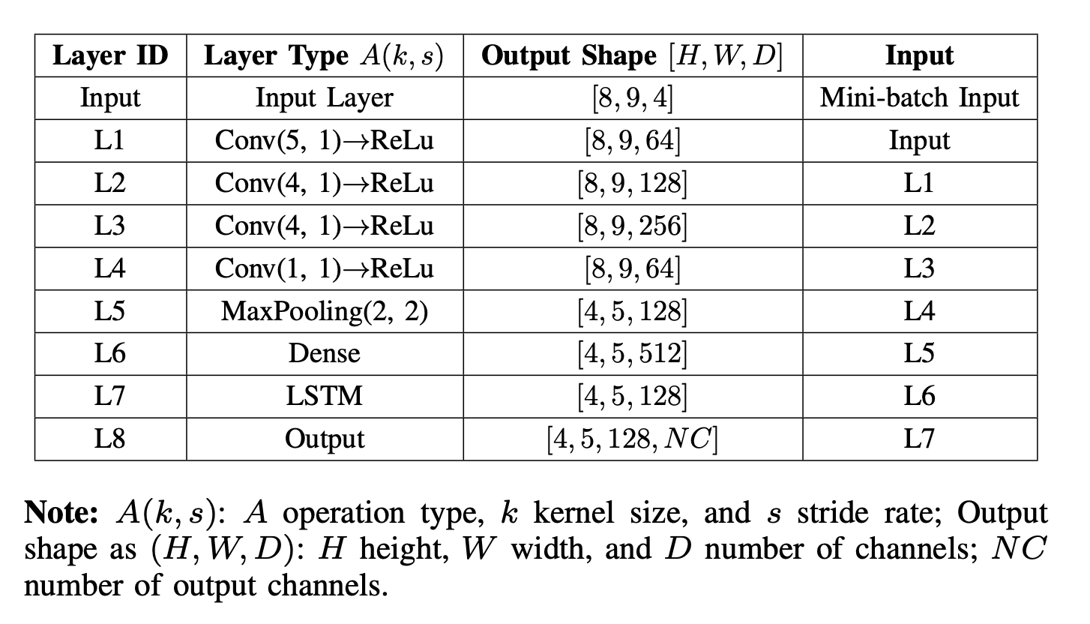
Multi-CNN-LSTM(paper solution)
Hybrid CNN-LSTM Model
CNN(Convolutional Neural Networks)
Effective in extracting the spatial features of multi-dimensional input data.
CNN has become highly established in the field of image recognition
LSTM(Long-Short Term Memory)
Designed to remember information for long periods
Hyperparameter | Value
Loss function | Cross-Entropy Loss
Optimizer | Adam Optimizer
Learning rate | 0.001
Batch size | 128
Number of epochs | 100
Notes:
Here comes the models’ part, so excited. The paper showed a hybrid CNN-LSTM model, using CNNs to extract spatial features from the 2D electrode images and LSTMs to capture temporal patterns in the EEG sequences, as shown in the model architecture and hyperparameter details.

Slide 12
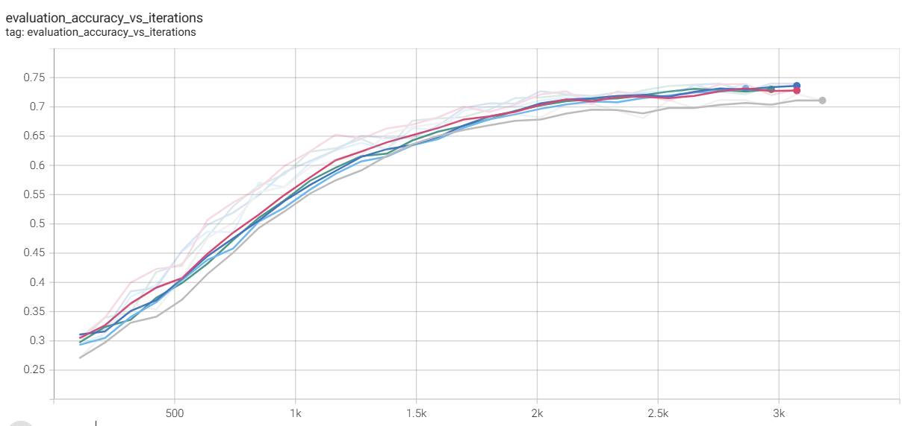
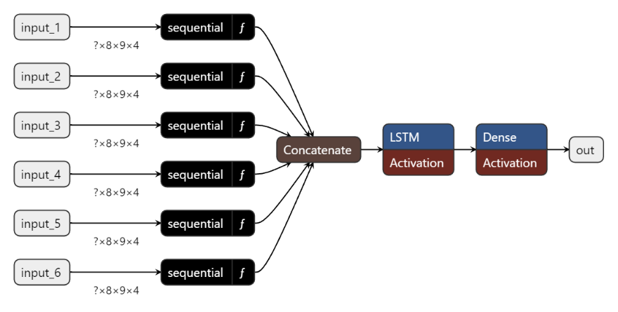
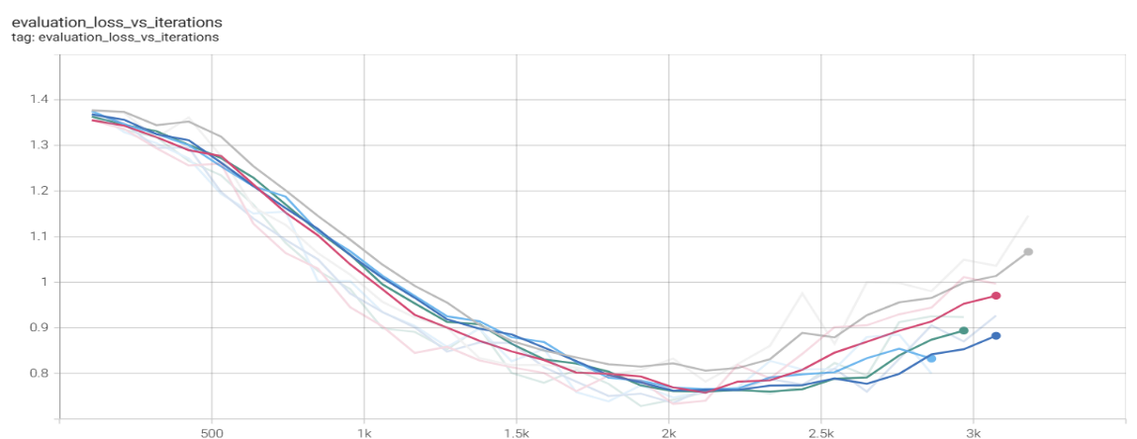
More Multi-CNN-LSTM
Best Val_acc: 72.28%
mean acc in test: 71.03%
std acc: 1.6352
Notes:
Here is the visualization of our model. As shown, there are 6 inputs, each representing a 0.5-second segment, which together make up a total period of 3 seconds. Each 0.5-second segment passes through the sequence of functions, covering all the convolutional layers depicted above.
Results showing on the right , we found that
Loss decreases initially, then increases after 2.5k iterations (it shows a strong overfitting).
Accuracy rises to 72%, but levels off after 2.5k iterations.
The model needs regularization to prevent overfitting

Slide 13
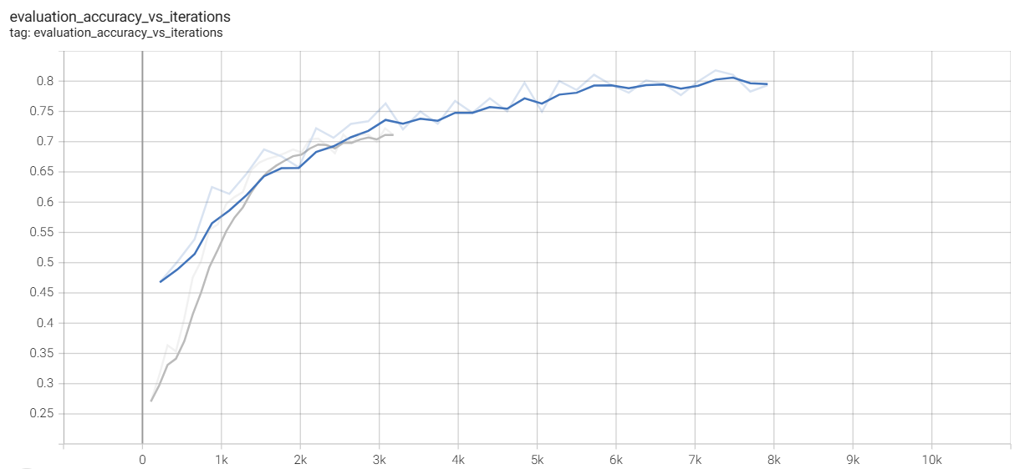
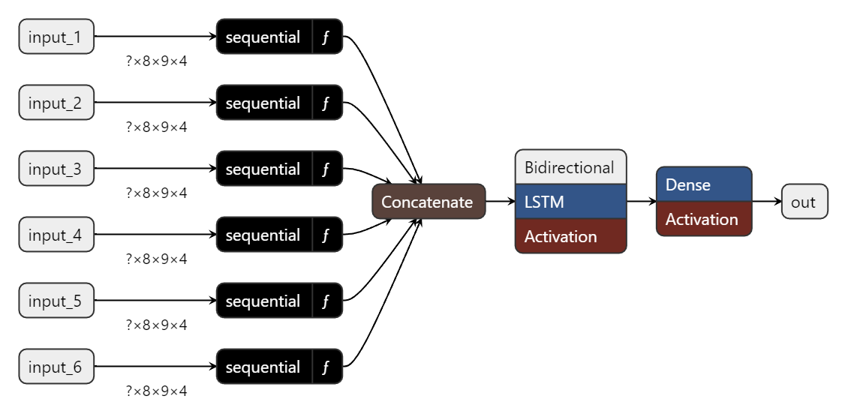
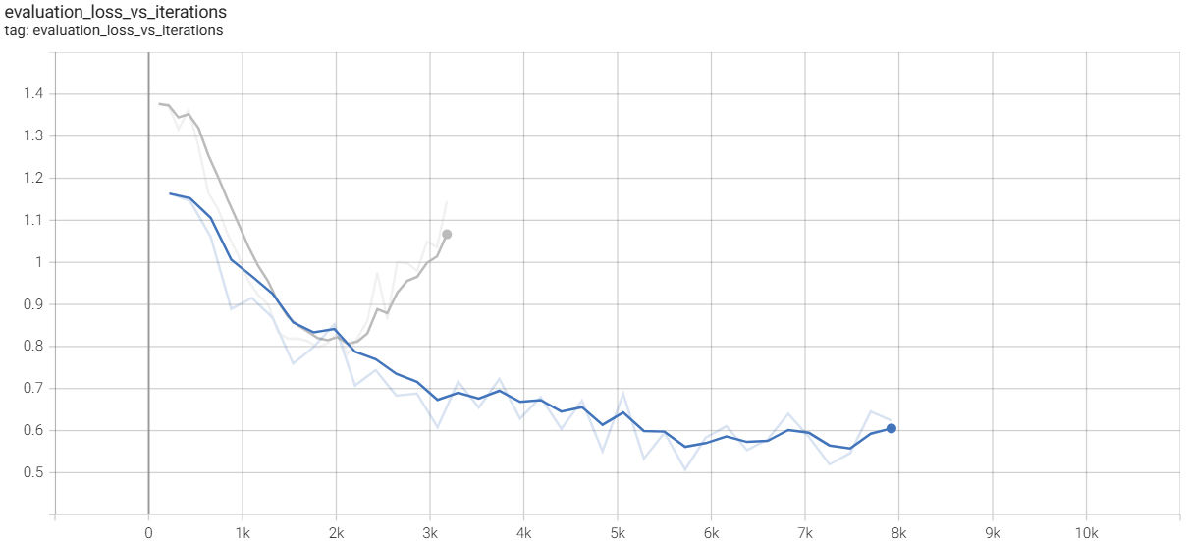



Attention-BiLSTM-CNN(Model Enhanced)
attention
Best Val_acc: 82.25%
mean acc in test: 80.38%
std acc: 1.1315
Blue: Attention-BiLSTM-CNN
Grey: Multi-CNN-LSTM
Notes:
in order To Prevent Overfitting: we add
•Dropout: Randomly deactivates neurons during training.
•Early Stopping: Stops training when validation performance stops improving.
For Regularization: we add
•Attention Layer: Focuses on key features, enhancing the model's ability to learn effectively.
For Better Learning and Stability:
•Batch Normalization: Normalizes layer output to stabilize and speed up training.
•Bidirectional LSTM: Captures dependencies in both forward and backward directions for more context.
The Attention model (blue line) shows lower evaluation loss and higher accuracy compared to the Multi-CNN model (grey line), indicating improved convergence and better generalization.

Slide 14
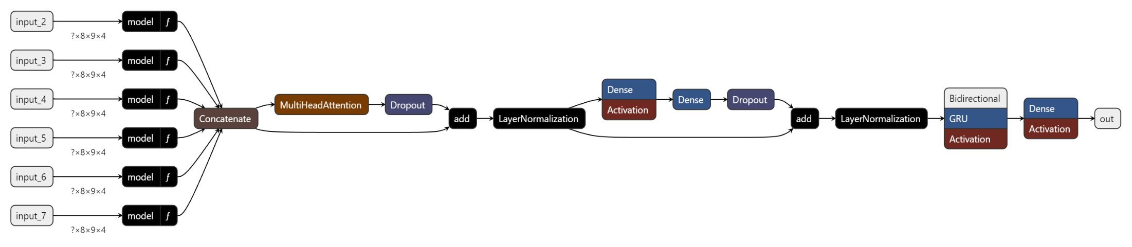

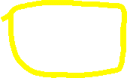

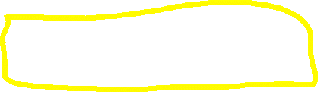

ResCNN-TransGRU(Final Version)
Residual Connections
Residual Connections
transformer encoder block: MultiHeadAttention
transformer encoder block: Feed-Forward Network (FFN)
Gated recurrent units
Notes:
Continuing from what we’ve learned so far, we drew inspiration from ResNet(residual neural network) and Vision Transformers (ViT), the New model introduces two residual connections within its base convolutional layers. These are followed by two transformer encoder blocks, consisting of multi-head attention and a Feed-Forward Network (FFN). Finally, instead of using an LSTM, the model incorporates a GRU(Gated recurrent unit), which is more efficient while still capturing essential sequence information.
The two residual connections help maintain the flow of information and gradients, enabling deeper networks to train effectively without losing important details.
The two transformer encoder blocks improve the model's ability to learn complex relationships by capturing diverse dependencies from multiple perspectives.
Additionally, the GRU offers a faster and more efficient way to learn temporal relationships compared to LSTM, making the model both powerful and computationally efficient.
===================================below are for QA===================================
Feed-Forward Network Structure
In a transformer encoder, after the Multi-Head Attention layer, the output goes through a Feed-Forward Network (FFN). This FFN is made up of two dense (fully connected) layers:
First Dense Layer: Expands the dimensionality of the output.
Second Dense Layer: Reduces the dimensionality back to the original size.
Multi-Head Attention is a key component of the transformer architecture, and it helps the model focus on different aspects of the input simultaneously. Here’s a simplified explanation of what it does:
1. Capturing Multiple Relationships Simultaneously
Multi-Head Attention takes the input and splits it into multiple smaller parts called heads. Each head independently applies the attention mechanism, which means each head focuses on different parts of the input sequence or data.
By having multiple attention heads, the model can capture different types of relationships in the input data. For example, one head might learn to focus on nearby features, while another head captures long-range dependencies.

Slide 15
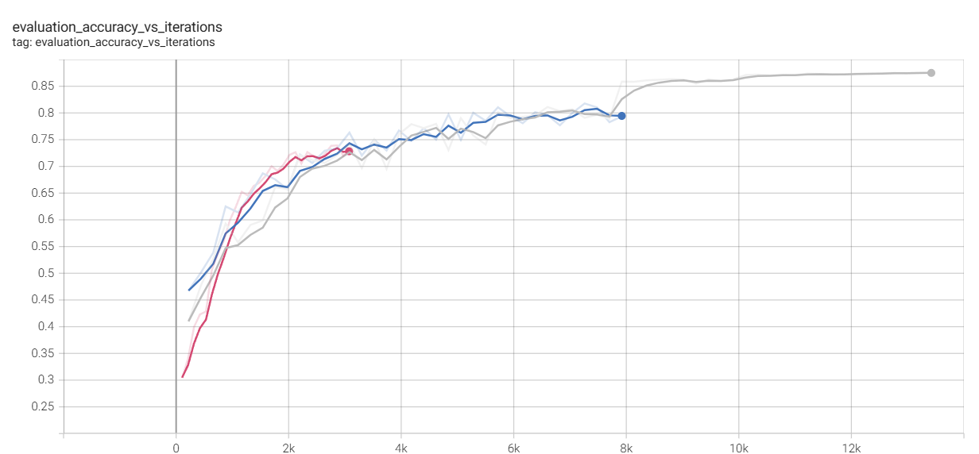
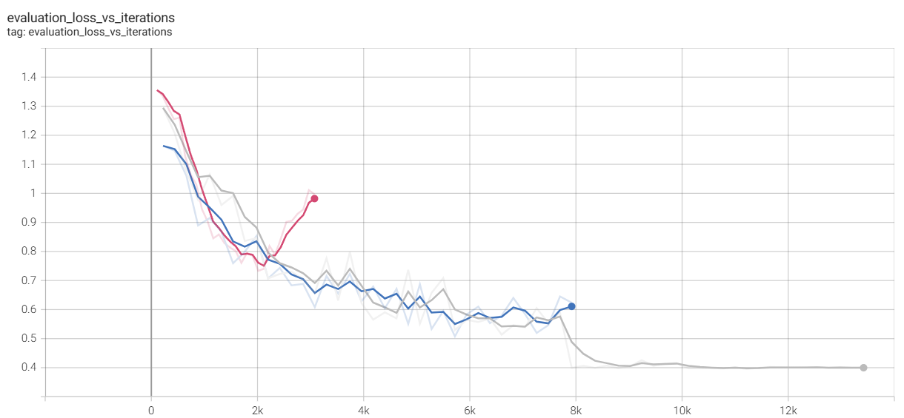
More ResCNN-TransGRU
Red: Multi-CNN-LSTM
Blue: Attention-BiLSTM-CNN
Grey: ResCNN-TransGRU
ResCNN-TransGRU
Best Val_acc: 87.52%
mean acc in test: 86.45%
std acc: 0.6128
Notes:
the ResCNN-TransGRU model, with its residual connections, transformer encoder blocks, and GRU, shows the best performance in both accuracy and loss reduction, making it the most effective model among the three.
The ReduceLROnPlateau callback in deep learning is used to adjust the learning rate during training. Its main purpose is to reduce the learning rate when the model stops improving, which can help the model converge more effectively.

Slide 16
Limitations
Limited Feature Coverage:
Although the model structure integrates frequency, spatial, and temporal features, but it may not fully capture all important information from EEG signals.
Generalizability:
The proposed method achieves high accuracy on the SEED-IV datasets, which are well-structured and controlled. However, the generalizability of the model to more diverse, real-world scenarios remains untested.
Notes:
Although our model's accuracy improved, it still has limitations: it may not fully capture key EEG features,
and training on only the SEED-IV dataset limits its real-world applicability.

Slide 17
Future Research Directions
Exploration of Additional Features:
Investigating other EEG features or expanding the frequency bands could potentially uncover new patterns that improve emotion recognition accuracy.
Real-World Validation:
Applying the proposed model to EEG data collected in real-world, less-controlled environments could demonstrate its robustness and practical applicability.
Integration with Other Modalities:
Combining EEG signals with other physiological or behavioral data (e.g., facial expressions, eye movement) could enhance the overall emotion recognition system.
Notes:
For future work, we plan to explore additional EEG features, validate the model in real-world settings,
and incorporate other physiological data, like eye movement, to enhance the results.

Slide 18
APPENDIX
Code:
GitHub:
https://github.com/BluesRockets/EGG-emotion-recognition
Google Drive: https://drive.google.com/drive/folders/1bC6g0VIuv3Upk6sX8WlgMYT1ptY0oYnz?usp=sharing
Tool:
Tensor board, Microsoft Words, Microsoft PowerPoints, Netron, Latex
Notes:
Here is the code links and the tools we used for graph and data analaysis

