Slide 1

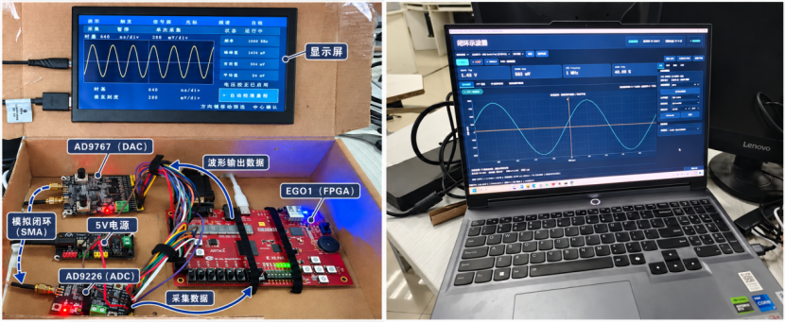

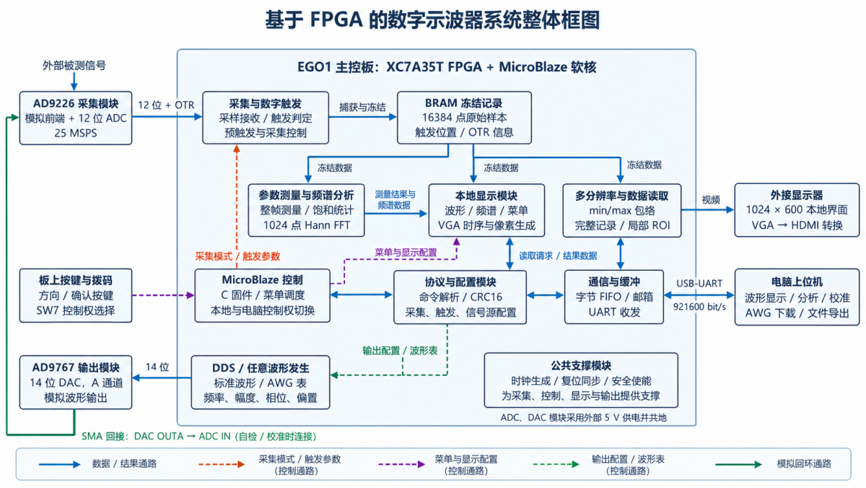
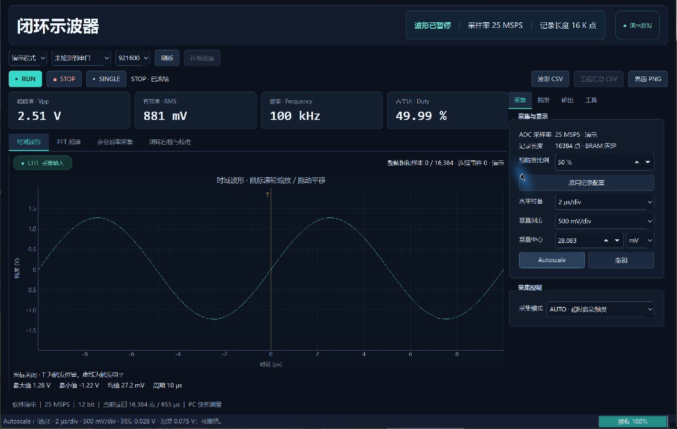
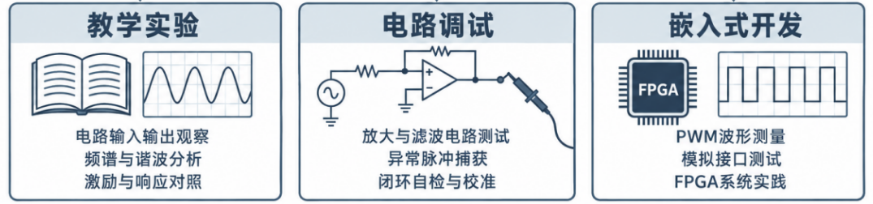
作品概述
李维昊 王佳怡
基于FPGA的数字示波器
淮安大学
江苏省淮安市
EGO1 FPGA · Artix-7 XC7A35T
面向教学实验与电路调试，将信号采集、参数
测量、频谱分析及波形发生集成于同一平台。
支持本地独立操作，并由电脑辅助分析与管理。
系
统
设
计
与
创
新
测
试
结
果
典型应用场景
常见数字示波器由模拟前端、ADC、触发与
存储、处理及显示模块组成。教学实践还需
信号激励、数据留存和重复实验比较，分立
设备与多套操作流程增加了联调负担。因此，
本项目集成采集、分析、输出与自检校准功能。
系统架构与设计特色
同一冻结记录的采集与分析
1. 环形缓存保存触发前后数据，触发后冻结。
2. 波形、测量、FFT与包络对应同一帧。
3. 时间戳与触发索引保证结果可追溯。
4. FPGA并行处理，软核负责调度与交互。
测试结果：100 kHz标准波形回环测频相对差
不超过0.006%；1 MHz正弦回环下，八类触发
各取得4帧，共32帧匹配记录。
性能优势：采集、信号输出与FFT集成于一体，
可独立运行，也可联机分析。包络概览与局部
原始数据按需读取，兼顾尖峰保留和传输效率。
后续改进：完善电压标定；改进板卡固定、线缆整理与接口面板，补充常用实验操作指引，提升复测与维护便利性。
关键信息摘要
1. 单通道12位采集，25 MSPS，采样间隔40 ns。
2. 存储16384点，单帧记录窗口655.36 μs。
3. 标称输入±5 V，预触发比例0～100%。
4. 1024点FFT，支持二至五次谐波分析。
5. 14位DAC，输出标准及1024点任意波形。
6. 测量峰峰值、有效值、频率与占空比。
7. UART 921600 bit/s，采用CRC16校验。
闭环自检与多分辨率保峰传输
1. DAC回接ADC自检，外部参考用于标定。
2. min/max概览配合ROI，减少传输量，
保留已捕获记录中的尖峰。
8.支持本地独立操作、电脑辅助分析及同帧追溯。
Notes:
重新制作：从原始海报模板导入，仅去除黄色填写提示与隐藏编辑网格。保留三条分隔线、两块竖标题底板、介绍标题条及两个圆角框。根据用户后续指示，将队伍信息居中，放大校徽及完整实物合照，将竖排标题连续排列并整体居中。左侧原系统说明重写为项目设计背景，参数区重命名关键信息摘要。内容依据2026-11-04最新版《基于FPGA的数字示波器》：系统与功能见1、2章；测量数据见表3-3、3-4；八类触发32帧见3.3.4；过载见3.3.5。应用图截取图1-2下方三个应用区域，系统图为图2-1，界面为图3-5。实物和校徽为本次用户附件，实物图片保留完整样机与上位机合照。主控板EGO1，Artix-7 XC7A35T。100 kHz回环测频体现所测条件的一致性，不代替独立绝对频率精度；幅度相对差限于约100 kHz及所测幅度，模拟带宽待实测。

Slide 2
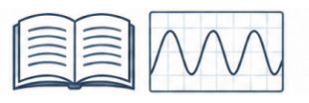


INTRODUCTION
Weihao Li Jiayi Wang
FPGA-Based Digital Oscilloscope
Huai'an University
Huai'an, Jiangsu
FPGA Oscilloscope Architecture
AD9226 ADC
12 bit / 25 MSPS
Artix-7 XC7A35T
Local Display
1024 × 600
EGO1 FPGA · Artix-7 XC7A35T
For teaching and circuit debugging, this FPGA
oscilloscope combines acquisition, measurement,
FFT and waveform output, with local or PC control.
Capture / Trigger
Analog
loopback
16K Frozen Record
D
E
S
I
G
N
&
I
N
N
O
V
A
T
I
O
N
R
E
S
U
L
T
S
Teaching Labs
Circuit Debugging
Embedded Systems
AD9767 DAC
14 bit / DDS / AWG
Measurements / FFT
PC Analysis
USB-UART
MicroBlaze Control
Signals and FFT
Excitation and response
PWM and interfaces
Same frozen record for waveform, measurements and FFT
Typical Applications
Digital oscilloscopes combine an analog front end,
ADC, trigger, memory, processing and display.
Teaching also needs excitation, data storage and
repeatable comparisons. Integration reduces setup
effort when using separate devices and workflows.
System Architecture and Design Features
Capture and Analyze the Same Record
1. Ring buffer retains pre-/post-trigger samples.
2. Waveform, measurements, FFT and envelope
refer to the same frozen capture.
3. Timestamps and trigger indices link results.
4. FPGA runs parallel tasks; MicroBlaze manages
control and interaction.
Test Results: Frequency deviation ≤0.006% in
100 kHz waveform loopback tests; eight trigger
types yielded 32 matched records at 1 MHz sine.
Benefits: Acquisition, output and FFT in one unit;
stand-alone or PC-assisted use. Min/max overviews
and raw ROI reads preserve captured spikes and
reduce data transfer.
Next Steps: Refinevoltage calibration. Improve board fixing, cablingand connectors; add repeatable lab-test guides.
Key Specifications and Functions
1. 12-bit, single-channel ADC; 25 MSPS (40 ns).
2. 16,384 samples; 655.36 μs per record.
3. Nominal input ±5 V; 0–100% pre-trigger.
4. 1024-point FFT; 2nd–5th harmonic analysis.
5. 14-bit DAC; standard and 1024-point AWG.
6. Vpp, RMS, frequency and duty-cycle readings.
7. 921600 bit/s UART with CRC16 checking.
Loopback Test and Peak-Preserving Transfer
1. DAC-to-ADC self-test; external calibration.
2. Min/max overview plus on-demand raw ROI
reduces traffic and retains captured spikes.
Stand-alone use, PC analysis and record traceability.
Notes:
English translation of the Chinese poster on slide 1. User report dated 2026-11-04: sections 1–2 for architecture and features; table 3-4 for 100 kHz loopback frequency deviation; section 3.3.4 for eight trigger types and 32 matched frames at 1 MHz sine. English block diagrams simplify the source architecture without changing task allocation. School logo and annotated prototype photo are original user assets. The GUI and hardware photo retain their original Chinese labels as actual evidence. Closed-loop testing reflects the tested combined DAC–ADC path; it is not an independent absolute frequency calibration. Analog bandwidth remains to be measured.

