Slide 1
解決大角度誤差

Slide 2
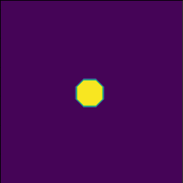
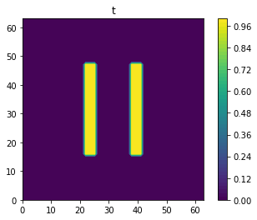
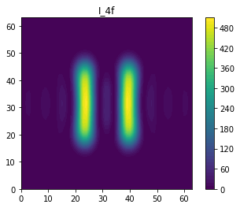
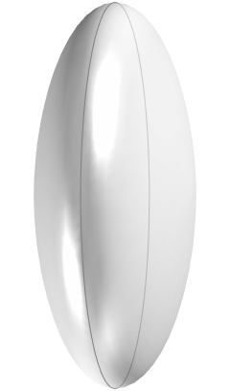
Simulation method
6-f system
Source(f-space)
Mask(x-space)
Pupil(f-space)
Image(x-space)
4-f system
Treating light sources as point sources
Mask(x-space)
Pupil(f-space)
Image(x-space)

Slide 3

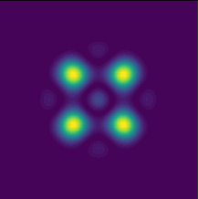

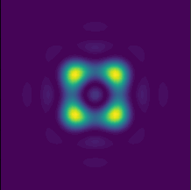
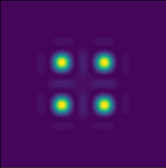
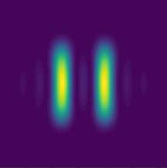
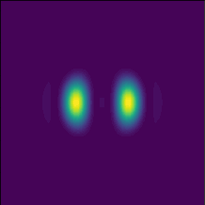
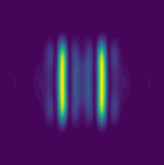




Simulation results
Mask
4-f system
6-f system, $σ=0.2$
6-f system, $σ=0.6$
Image
Mask
4-f system
6-f system, $σ=0.2$
6-f system, $σ=0.6$
Image

Slide 4
Simulation method
Sum of coherent s

