Slide 1
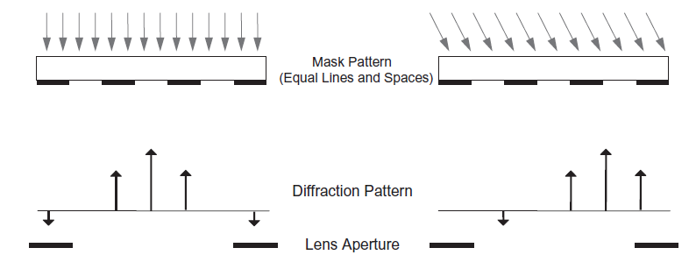
Purpose Statement
Solve distortion problem for the large off-axis illumination.
The algorithm must be SOCS compatible.
The algorithm should be polarization-dependent(vector form).
Current Progress
4-f and 6-f system coding complete.
SOCS coding roughly complete (execute time).
Huygens–Fresnel principle coding has not started yet.

Slide 2
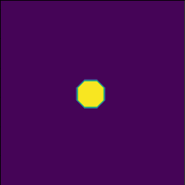
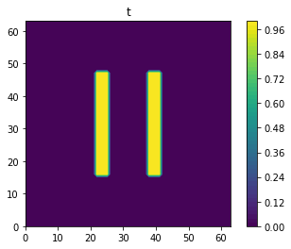
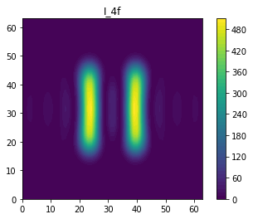
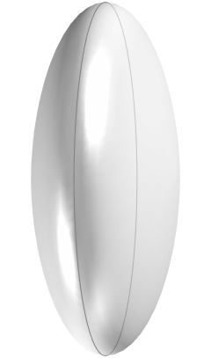
Simulation method
6-f system
Source(f-space)
Mask(x-space)
Pupil(f-space)
Image(x-space)
4-f system
Treating light sources as point sources
Mask(x-space)
Pupil(f-space)
Image(x-space)

Slide 3

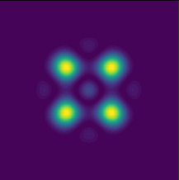

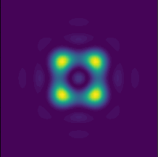
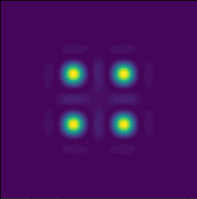
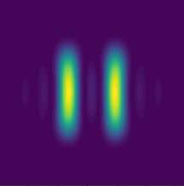
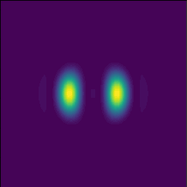
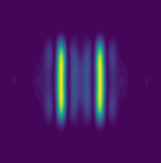




Simulation results
Mask
4-f system
6-f system, $σ=0.2$
6-f system, $σ=0.6$
oblique incident
Mask
4-f system
6-f system, $σ=0.2$
6-f system, $σ=0.6$
oblique incident

Slide 4

Simulation method
Sum of coherent system(SOCS). By first calculating the interaction between the source function and the pupil function, we can achieve shorter computation time.
$$TCC\left(f_{x},{\tilde{f}}_{x}\right)= \int_{−∞}^{∞}{P\left(f_{x}+{f^{′}}_{x}\right)P^{∗}\left({\tilde{f}}_{x}+{f^{′}}_{x}\right)\tilde{S}\left({f^{′}}_{x}\right)d{f^{′}}_{x}}$$
$$I_{total}\left(x\right)= \int_{−∞}^{∞}{\int_{−∞}^{∞}{TCC\left(f_{x},{\tilde{f}}_{x}\right)T_{m}(f){T^{∗}}_{m}({\tilde{f}}_{x})e^{2πi\left(f_{x}−{\tilde{f}}_{x}\right)x}df_{x}}d{\tilde{f}}_{x}}$$
$P\left(∙\right),S\left(∙\right) \text{and} T\left(∙\right)$ represent the pupil function, source function and mask function respectively

