Slide 1
Project 2 Template-based Protein Structure Modeling
Jian Liu, Yanli Wang, Weinan Zhang

Slide 2
Results
Targets and Databases Downloading
Tools used in the project
Templates for each target
Model visualization
Model evaluation and comparison

Slide 3
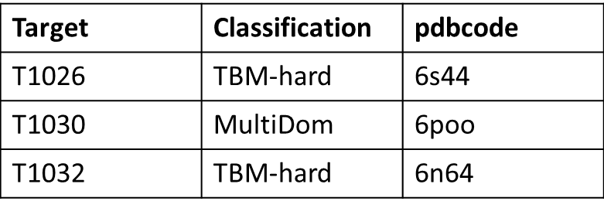
Targets and Databases Downloading
Three template-based targes from CASP14 website (https://predictioncenter.org/casp14/domains_summary.cgi)
One sequence database:
uniref90
Two structure databases
PDB
PDB 70

Slide 4
Tools used in the project
(1) JackHAMMER
MSA
(2) HHsuite
HAMMER
Templates
(3) Modeller
Alphafold
Structure Models
(4) Chimera
Pymol
visualization
(5) Tmscore Tool
MolProbity online Server
Evaluation

Slide 5
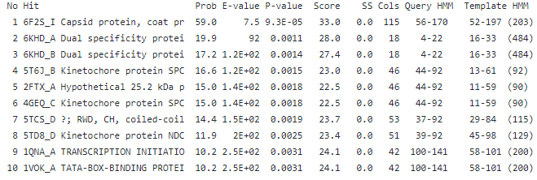
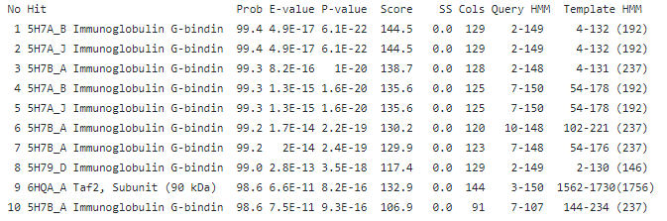
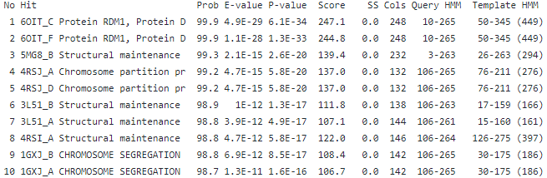
Templates for each target
T1026
Hard
T1030
Medium
T1032
Medium

Slide 6
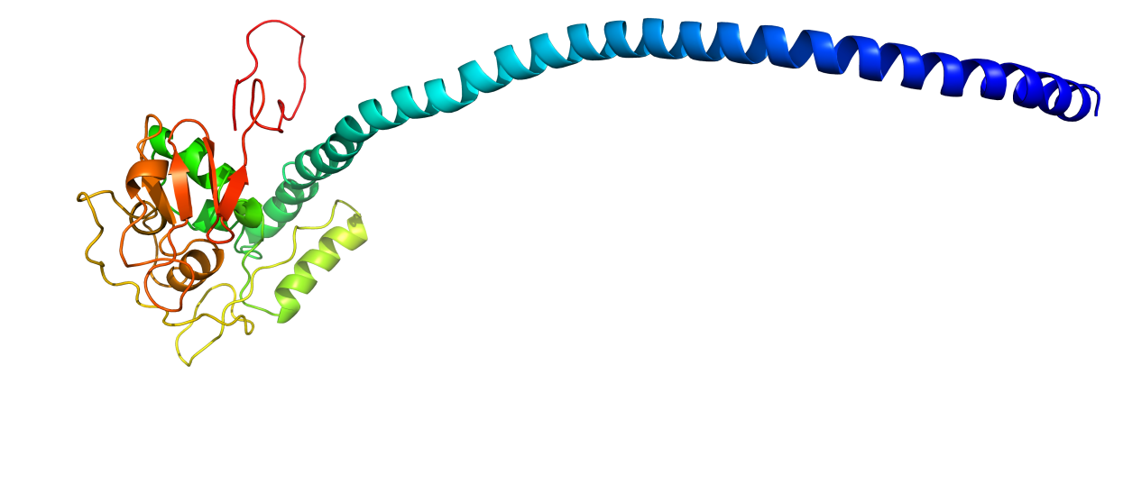
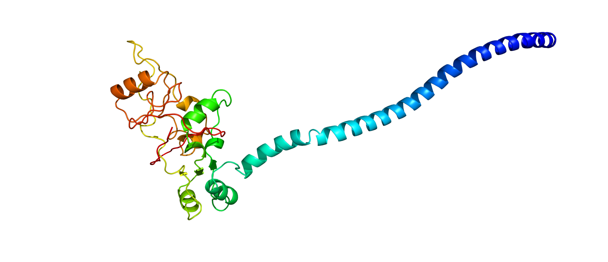
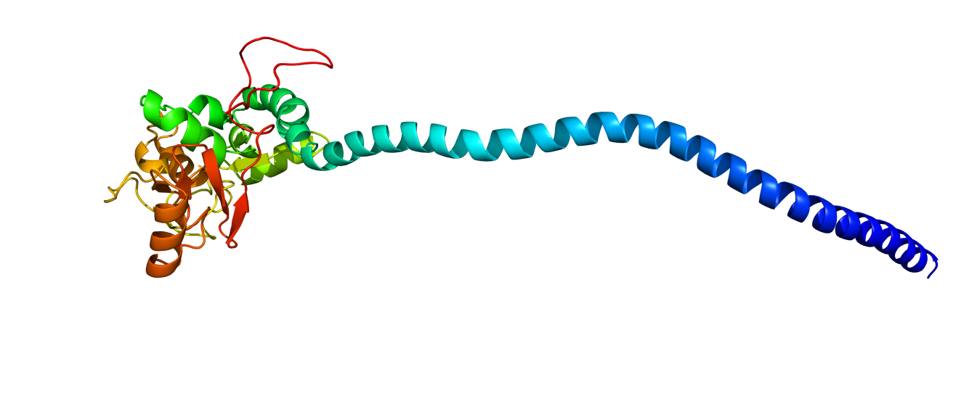
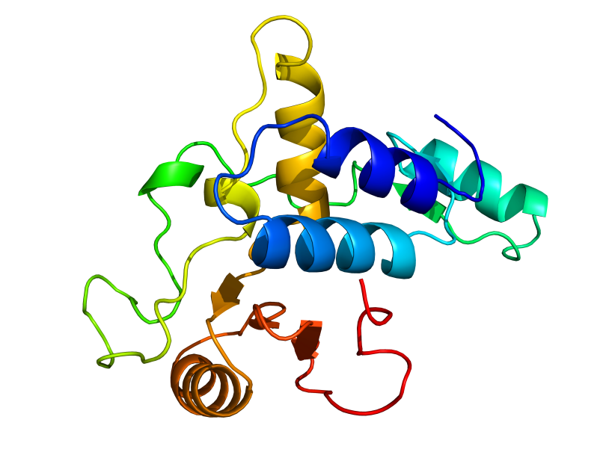
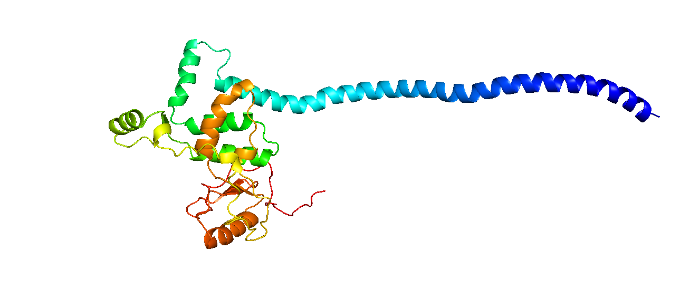
Models Visualization:T1032
1 template
3 templates
2 templates
4 templates
Real T1032

Slide 7
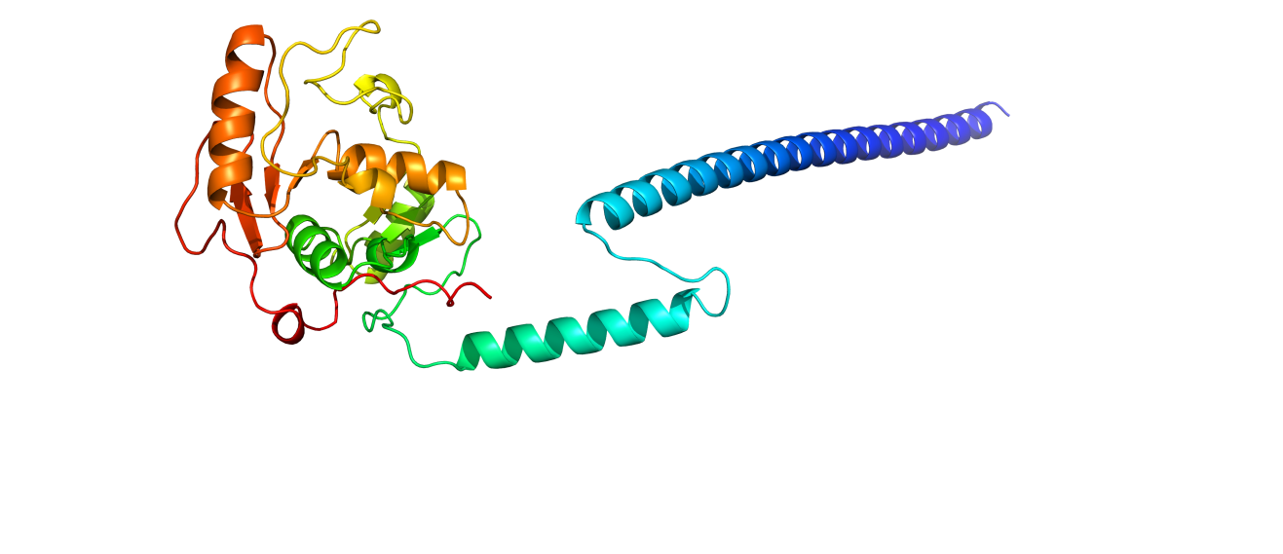
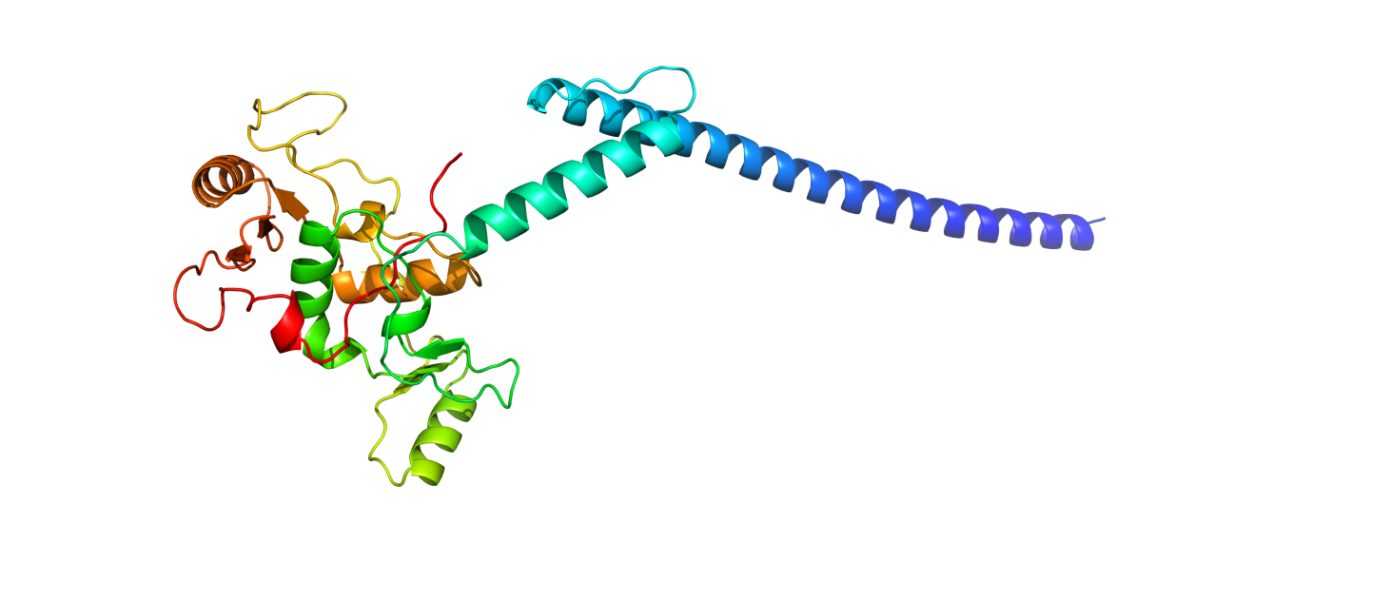
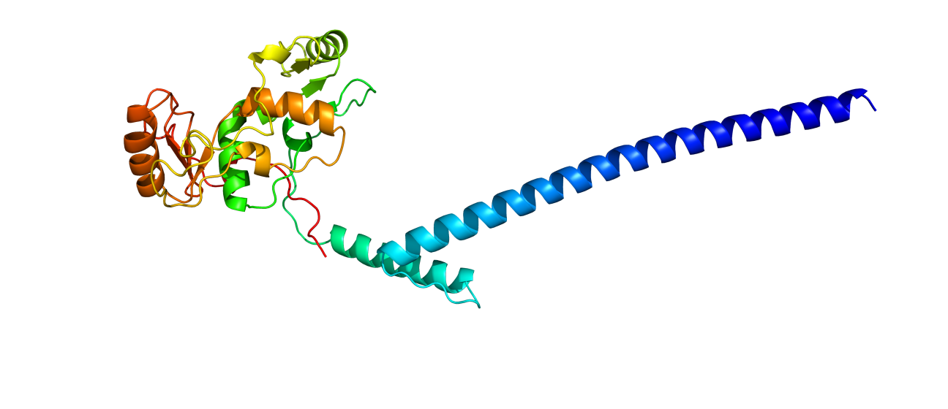
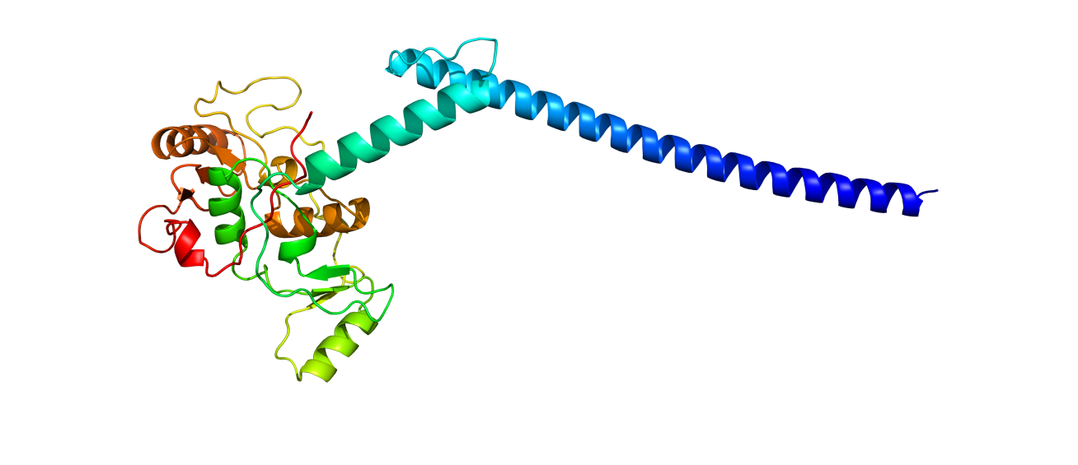
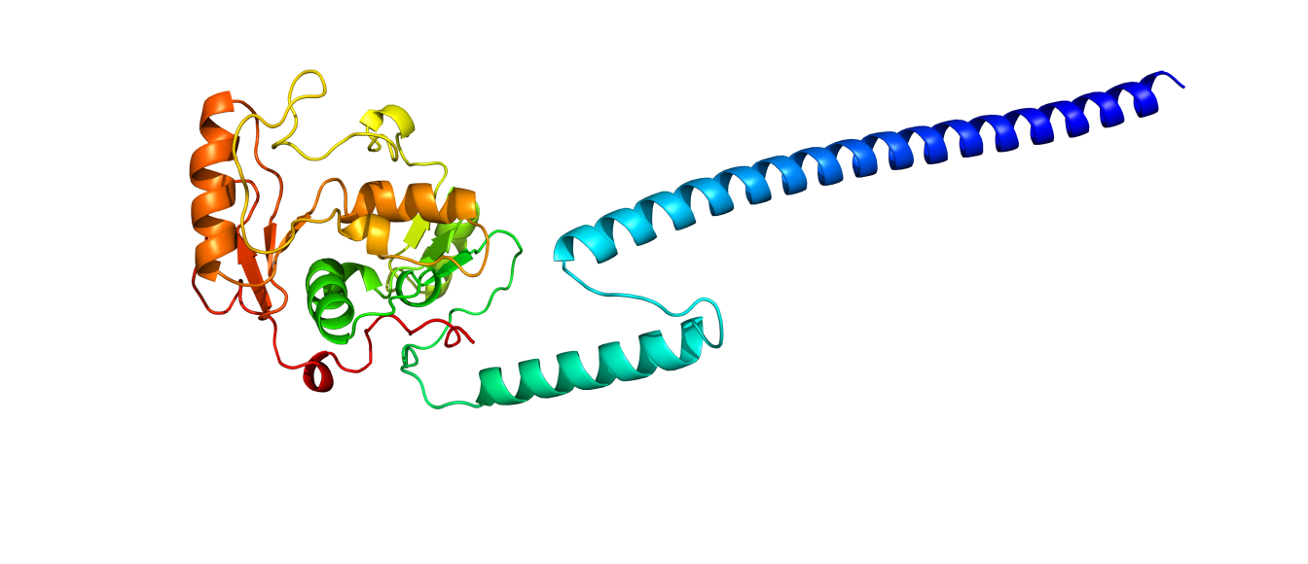
Models Visualization
Top 3
Top 1
Top 4
Top 2
Top 5

Slide 8
Models Evaluation and comparison
 | T1026 |  | T1030 |  | T1032
 | modeller | alphafold | modeller | alphafold | modeller | alphafold
TM-score | 0.9983 | 0.94 | 0.8912 | 0.7219 | 0.9944 | 0.7044
 | 0.6665 | 0.9408 | 0.2229 | 0.7321 | 0.6009 | 0.7041
 | 0.1504 | 0.929 | 0.2406 | 0.7116 | 0.5809 | 0.7008
 | 0.1292 | 0.8934 | 0.214 | 0.721 | 0.5869 | 0.7093
 | 0.1216 | 0.2988 | 0.9083 | 0.611 | 0.5812 | 0.7083
Average | 0.4132 | 0.8004 | 0.4954 | 0.69952 | 0.66886 | 0.70538
GDT-TS | 1 | 0.9127 | 0.7821 | 0.6035 | 0.9971 | 0.6824
 | 0.5702 | 0.9178 | 0.1941 | 0.6108 | 0.5176 | 0.6809
 | 0.1336 | 0.9041 | 0.174 | 0.5989 | 0.4985 | 0.6779
 | 0.1045 | 0.8236 | 0.1722 | 0.6062 | 0.475 | 0.6897
 | 0.0993 | 0.2705 | 0.848 | 0.5192 | 0.4838 | 0.6882
Average | 0.38152 | 0.76574 | 0.43408 | 0.58772 | 0.5944 | 0.68382
RMSD | 0.19 | 1.16 | 2.25 | 2.83 | 0.4 | 1.34
 | 2.17 | 1.15 | 1.11 | 2.68 | 2.24 | 1.35
 | 3.27 | 1.28 | 3.05 | 2.85 | 2.77 | 1.4
 | 2.69 | 1.61 | 1.99 | 2.88 | 2.4 | 1.27
 | 2.56 | 2.96 | 1.97 | 2.32 | 2.49 | 1.28
Average | 2.176 | 1.632 | 2.074 | 2.712 | 2.06 | 1.328
Molprobity | 3.19 | 3.22 | 2.39 | 1.6 | 2.32 | 1.66

Slide 9
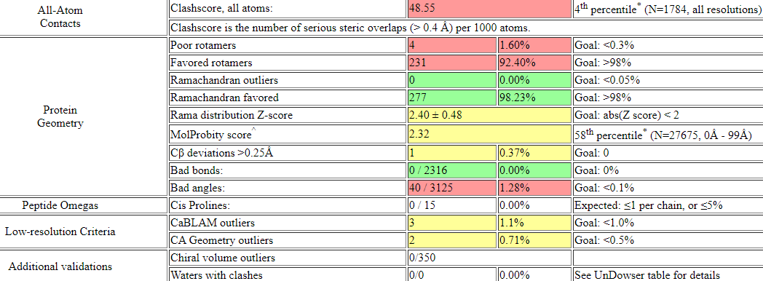
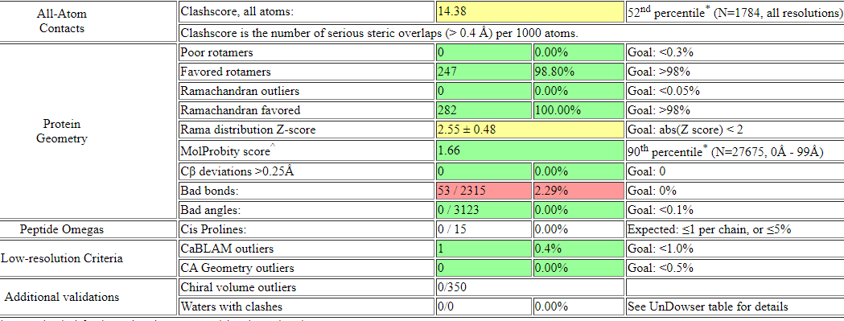
Modeller T1032
Modeller T1032
Alphafold T1032

Slide 10
Thanks !!!

