Slide 1
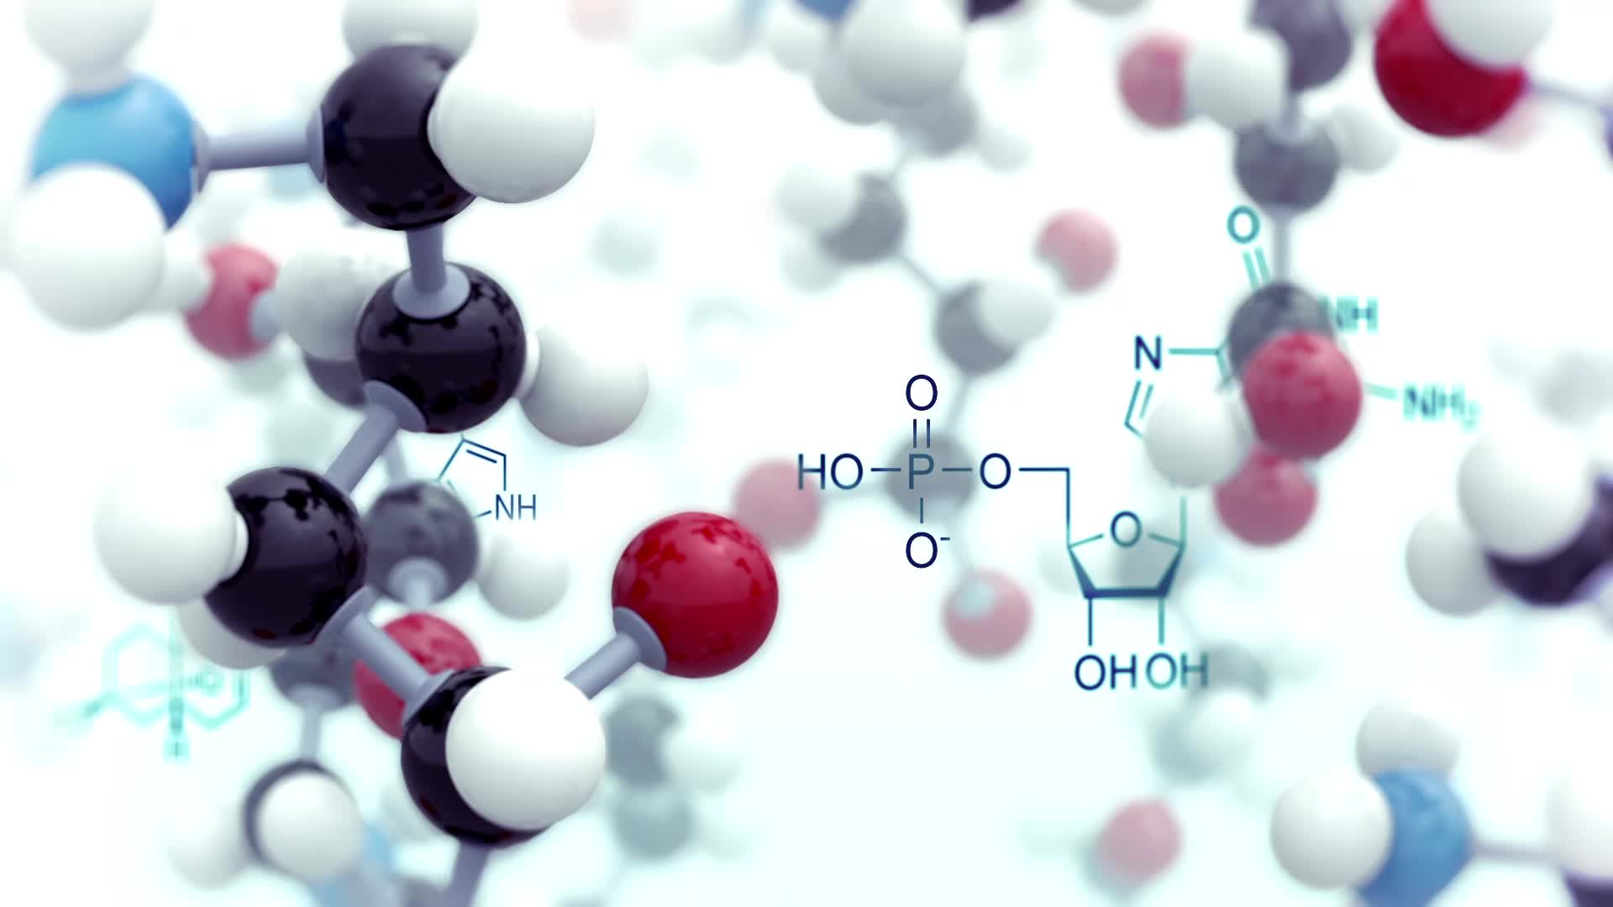
Project 2 Template-based Protein Structure Modeling
Jian Liu, Yanli Wang, Weinan Zhang

Slide 2
Project Plan
1. Data Sharing
2. Targets and Databases Downloading
3. Code Writing (Python, Perl)
4. Models Generation
7. Comparison with Alphafold2
5. Models Visualization
6. Models Evaluation

Slide 3
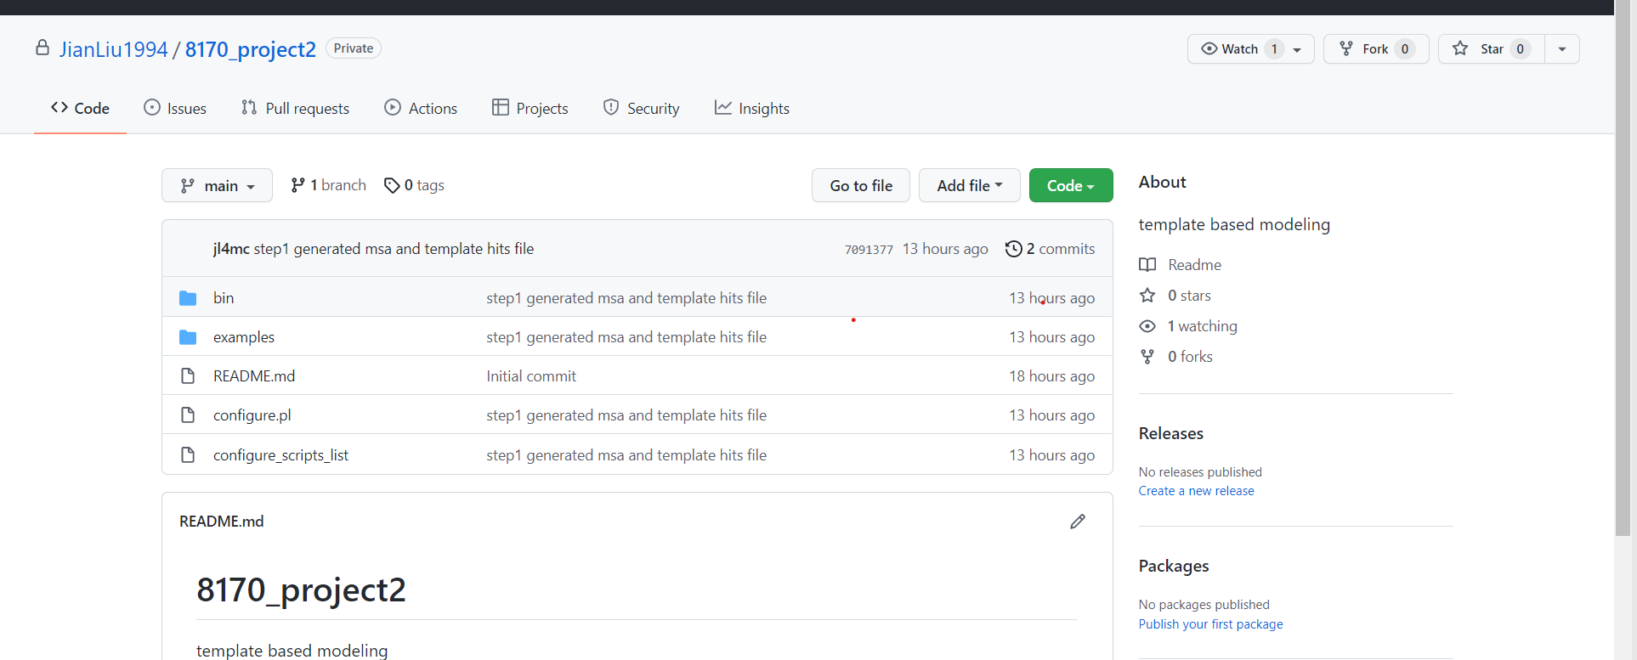
Date Sharing
Codes and testing results are sharing with group member by Github

Slide 4
Targets and Databases Collection
Three template-based targes from CASP14 website (https://predictioncenter.org/casp14/domains_summary.cgi)
Two databases
PDB
PDB 70
Target | Classification | pdbcode
T1026 | TBM-hard | 6s44
T1030 | MultiDom | 6poo
T1032 | TBM-hard | 6n64

Slide 5
Models Generation
JackHMMER
Code
T1026 Sequence (FASTA)
T1026 msa (sto)
T1026 msa (a3m)
PDB 70
HHsearch(HHsuite)
PDB
HMMER
Modeller
Code
3D Structure
Pir
10 Templates
Winner?
3D Structure
AlphaFold2
T1026 Sequence (FASTA)

Slide 6
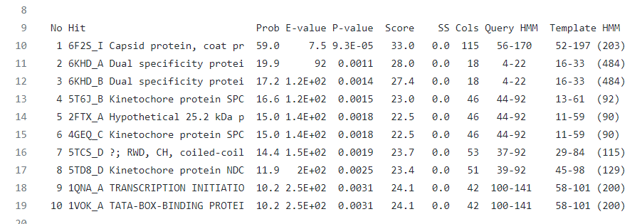
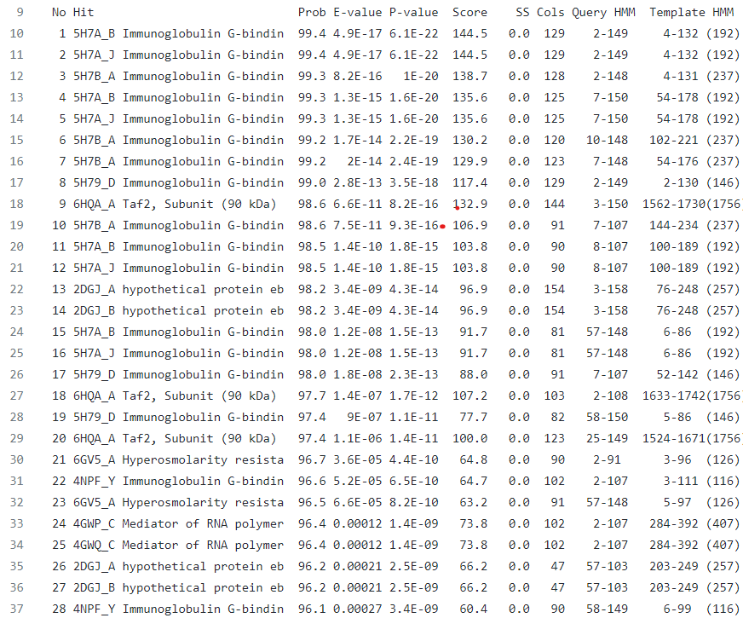
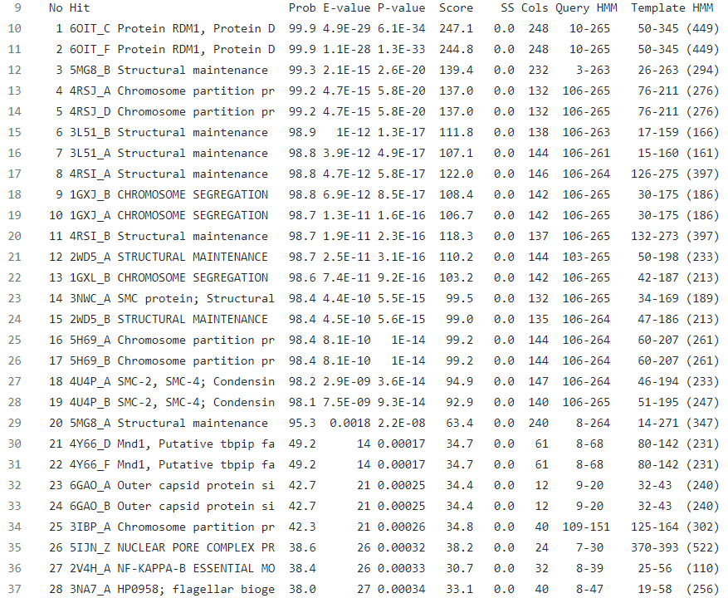
Templates
T1026
T1030
T1032

Slide 7
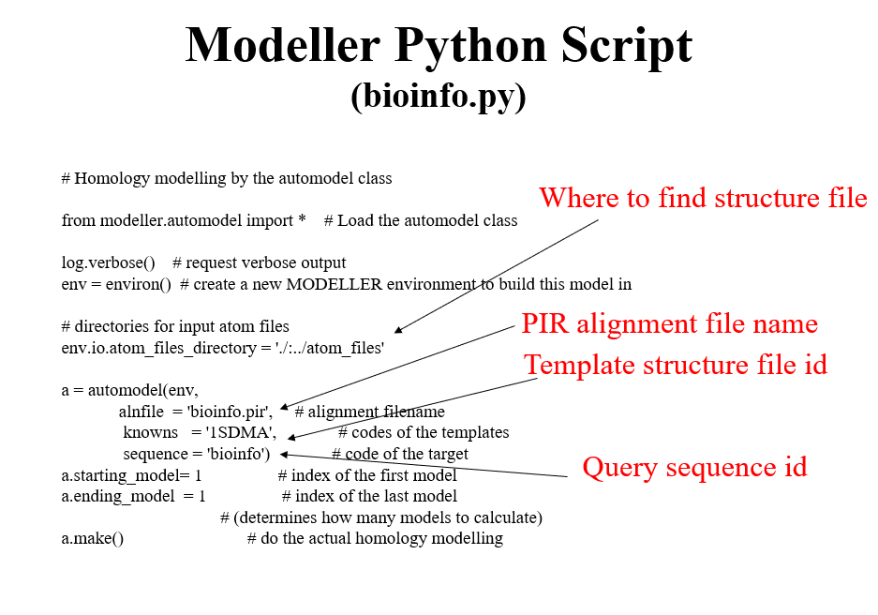
A screenshot of one PPT page from Dr. Chen’s class

Slide 8

Models Evaluation
1. TM-score
2. GDT-TS
3. RMSD
4. Molporbity

Slide 9
Models evaluation
Target | TM-score | GDT-TS | RMSD | Molprobity
T1026(Modeller)
T1032(Modeller)
T1038(Modeller)
T1026(AlphaFold2)
T1032(AlphaFold2)
T1038(AlphaFold2)
Average

Slide 10
Models Visualization
Real Structure
Modeller
AlphaFold2

Slide 11
Comparison of Modeller and AlphaFold2

