Slide 1
Tools for the body (schema）
Authors: Angelo Maravita and Atsushi Iriki
Presenter: Tangxuanang Chen
Discussion: Ruohua Li
Notes:
Hello everyone. I am Tang. I would like to introduce the paper: tool for the body.

Slide 2
What happens in our brain when we use a tool?
Notes:
In this paper, we will solve a problem.

Slide 3
Body Schema
To act efficiently in space, our brain must not only localize any objects of interest in extrapersonal space but also hold a constantly updated status of the body shape and posture.
‘Body Schema’ of classical neurology originally indicated this status as an ongoing, mainly unconscious integration of successive proprioceptive signals.
Notes:
Let’s get started with a common phenomenon in our daily life. If we want to act or move efficiently in space, we always pay attention to the environment and our body shape and postures. For example, if we have a small ball dropped into a narrow and deep hole, we can instantly realize that the hole is too small so we can’t take it out with our hands, although we don’t try or think about it.
The other is that when you want to cross the road, you will stop if a car is approaching to you because you realize it may hurt you.
In classical neurology, this idea is called body schema. It’s an ongoing, mainly unconscious integration of successive proprioceptive signals.
To be simple, body schema means that our brain will tell us what we can do and what we should do in a space, without complex consideration or computation.

Slide 4
Tools
Extend humans' body structure
manipulated objects or items of clothing become ‘incorporated into the body schema’.
Macaque monkeys
Notes:
Although we can’t simply change or extend our body structure since it’s born, we can use tools.
Some theories believe that the manipulated object is another part of the body schema. Different from the extrapersonal space or body shape mentioned previously, manipulated object is a mixture. It means something out of our body, but we can use it to extend our body structure. At this moment, a question was raised. How the manipulated objects, the tools, influence our body schema. As a result, the researchers made some experiments on macaque monkeys.

Slide 5
Macaque
Using tools is the key difference between humans and other animals.
However, macaques can be trained to be dexterous tool users.
Notes:
One of the key differences between humans and other animals in the world is that humans can use tools.
However, a fun fact is that macaque monkeys can be trained to use the tools.
Some researchers trained 30 macaque monkeys to use the tools to get distant objects, like food particles.
They found that all 30 monkeys can learn about this ability after being trained for at least two weeks. And they also discovered some changes in the monkeys’ brain and neurons after this training.

Slide 6
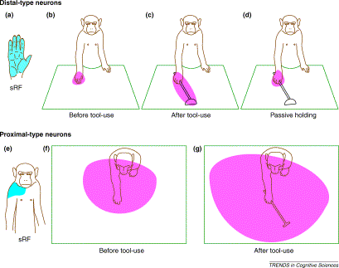
sRF: somatosensory Receptive Field the area of the body surface that, when stimulated, activates a particular neuron in the somatosensory cortex vRF：visual Receptive Field the area of the visual field that, when stimulated, activates a particular neuron in the visual cortex.
Neuronal activity was recorded from the intraparietal cortex, where somatosensory and visual information is integrated. Neurons responding to both somatosensory and visual stimulation, namely ‘bimodal neurons’, were analysed
Notes:
Neuronal activity was recorded from the intraparietal cortex, where somatosensory and visual information is integrated.
In this experiment, the researchers analyzed the bimodal neurons of the monkeys.
sRF means the sense of touch. sRF of the monkeys didn’t change for the whole experiment. However, vRF changed after the monkeys use the tool for about 5 mins.
It means that the monkey takes the tool as an extended part of its body.
From the second part, we also can find this conclusion. After using the tool, the monkey will have a larger vRF when moving hands in space.
One more point we need to notice is that if the monkey just passively holds the tool instead of using it deliberately. Its vRF won’t change. That’s why we say the manipulated object is a mixture of extra personal space and body shape.

Slide 7
During the learning phase, augmented expression of immediate-earlygenes, neurotrophic factors (BDNF, NT-3) and receptor trkB were observed.
Hypothesis: some precursor (or basic building block) of human tool-use ability was already furnished in the brain of our common ancestor with monkeys
Notes:
The researchers also discovered some changes in the monkeys’ neurons after being trained to use the tools.
hypo
The reason why other primates can not use tool was that they had no chance to use tools in the wild. As a result, after being trained, the monkeys can rapidly handle the ability to use tools, because it’s something hiding in the genes.

Slide 8
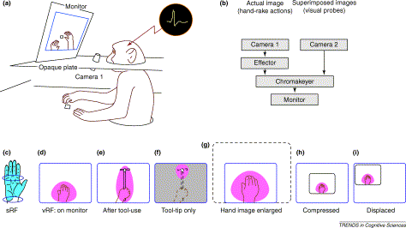
Traditional belief:
monkeys were able to use visual images on a video monitor to guide bodily movements but could not recognize their body parts observed in the monitor as their own
Experiment:
monkeys were able to use visual images on a video monitor to guide bodily movements and recognize the bodies shown on the monitor as their own bodies.
Notes:
tradition, however, it’s refused by the new observation.
IN this experiment, the moneky was set to such a device. This is a camera which records the movements of the monkey’s hands, and reflect it on the monitor. At the same time, the researchers analyzed the monkey’s receptive field.
The surprising fact was that the vRF still works as the previous experiment. Although the researchers changes the video, like enlargering, compressing, or displacing the video, or just presenting a small part of the screen, the monkey always can successfully take the part on the screen as an extension of its body. Why we say extension? Because we can see during the experiment, tthe srf doesn’t change, and he real hands of the monkey were not enlarged, compressed, or displaced, but the vRF changed. The conditioin was just like the previous experiment after using the tools.
As a result, different from the traditional belief, this experiment proves that

Slide 9
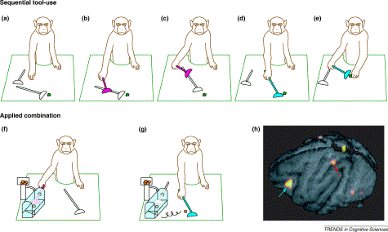
Notes:
The third experiment was a modification to the first one. Remember that, training a monkey to use the tool needs at least two weeks. However, this purpose was achieved in a shorter time in this experiment.

Slide 10
primates could understand the function of given tools or the causal relationship between the intended tool-use and the obtained results.

Slide 11
whether tool-assisted reaching for stimuli presented beyond the hand’s normal or unaided reach would produce similar behavioral effects as direct reaching for nearby stimuli with the hands alone.
Notes:
Inspired by these experiments about monkeys, the researchers investigated the behavioural effects of tool-use in human observers and wanted to identify .

Slide 12
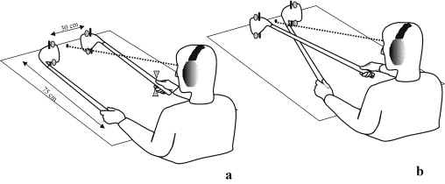
Two golf clubs, with two vibrators on the tail, and two LED distractors on the top. One of the vibrators will vibrate once, and the experimenter will answer which side is vibrating. LED distractor will flash to distract the experiments. Challenges: upper vibration with lower light, or vice-versa visual and tactile stimuli appear on the same side of the space What will happen if crossing?
Crossing hands and crossing tools

Slide 13
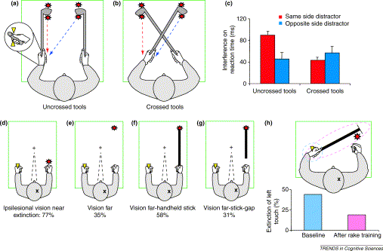
Notes:
The result was surprising. After crossing the tools, even though the hands and LED distractors remains the same, the result changes a lot.
What it tells was that

Slide 14
Neuropsychological effects of tool-use in brain-damaged patients
Neglect patients ---- ignore stimuli contralateral to the side of their brain damage (contralesional stimuli)
Extinction patients ---- detect unilateral stimuli on both sides of space but ignore contralesional stimuli only when presented together with competing ipsilesional ones

Slide 15
Effects of tool-use on neglect
Berti and Frassinetti examined the effect of tool-use in a brain-damaged patient, P.P, whose neglect selectively affected the space close to her body.
Near space: When requested to show the midpoint of a drawn line, P.P. put her mark further toward the right from the objective midpoint, as typically observed in neglect.
Far space: a laser pointer was flawless, but a long stick was the same as the near space.

Slide 16
Effects of tool-use on neglect
Berti and Frassinetti examined the effect of tool-use in a brain-damaged patient, P.P, whose neglect selectively affected the space close to her body.
Near space: When requested to show the midpoint of a drawn line, P.P. put her mark further toward the right from the objective midpoint, as typically observed in neglect.
Far space: a laser pointer was flawless, but a long stick was the same as the near space.
A long stick becomes the extension of the body so that P.P.’s near space neglect happens to the far space condition.

Slide 17
Effects of tool-use on crossmodal extinction

Slide 18
Effects of tool-use on crossmodal extinction
manipulated objects become ‘incorporated into the body schema’.

Slide 19
Conclusion
This review has examined a specific aspect of research on tool use, namely, to what extent the effective use of a tool can induce a plastic modification of the body representation in the brain.
humans might have such neural machinery present in the brain from birth or early in life, but lower primates seem to need a period of training to induce behavioral learning
the possibility of training monkeys to use a simple tool does not imply that any degree of human-like, intelligent tool-use can be obtained in monkeys by training.
Notes:
This review has examined a specific aspect of research on tool use, namely, to what extent the effective use of a tool can induce a plastic modification of the body representation in the brain. This sheds light not only on some basic neural mechanisms of tool-use, but also on some general mechanisms of body representation [4,5] and their relationship with the multimodal representation of extrapersonal space for action
although in the experiments, the monkeys are smart and have the ability to use the tools. It doesn’t mean that they have the ability to evolve into human beings. Humans’ brains are much more complex than the monkeys, that’s also the reason why we can’t simply apply the same experiments and results from the monkeys to humans. The planet of the apes(apps) is still far from us.

Slide 20

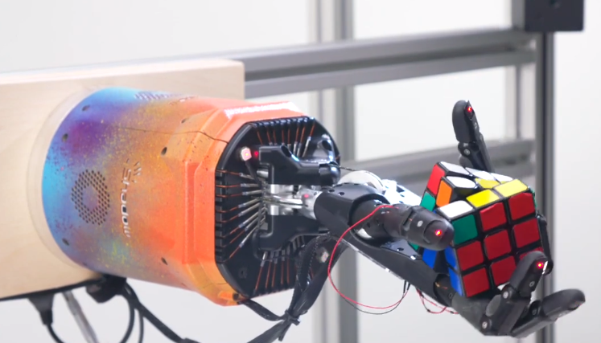
Piazza @102_f3
Experiments with monkeys are very interesting. I am not sure how much progress has been made in the development of robots capable of using objects, but I believe this area is essential for the future of robotics. To put it simply, imagine a robot firmly holding a long stick. When someone tries to push the stick, the robot should be able to recognize that it could be pushed as well, as if the stick has become a part of its body.

Slide 21
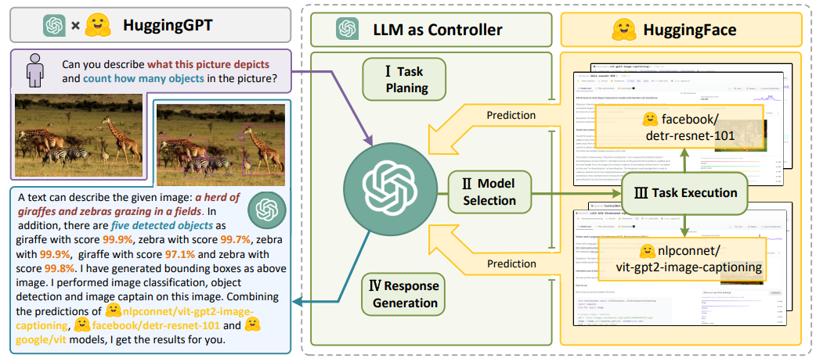
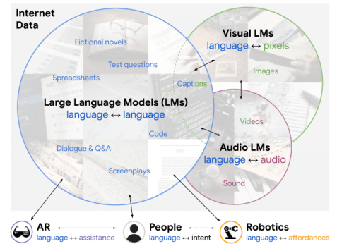
Piazza @102_f5
Recent advances in LLMs has expanded their use cases to API collectors and user for more comprehensive abilities. Should we regard computer programs or APIs as tool uses or not. If so, how should this affect our view of tools and tool using?

