Slide 1
BLE HCI Command Tester
With python
By Wayne Chiu

Slide 2
Structure
App
Serial Driver
Access BT Method
Byte Data Display
BT Command Tracking
Generate Packet
BT Command data
BT Event data
BT Parameter data

Slide 3
File Structure
source -- bt_hci_cmd_test_wc.py
|- dataset -- bt_command.py
|- bt_command_parameter.py
|- bt_error.py
|- bt_event.py
|- bt_event_parameter.py
|- bt_hci_parameter.py
|- bt_packet.py
|- hciresponse.py
|- showlogo.py

Slide 4
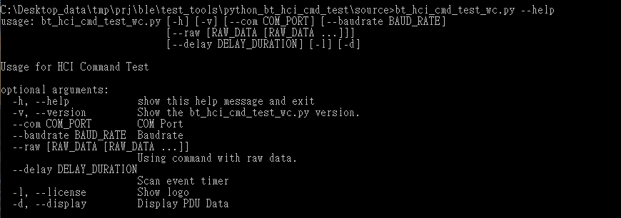
Parameter - [h], [--help]

Slide 5
Raw reference - Parameters
--raw [RAW_DATA [RAW_DATA ...]] Using command with raw data.
--com COM_PORT COM Port
--baudrate BAUD_RATE Baudrate
--delay DELAY_DURATION Scan event timer
-d, --display Display PDU Data

Slide 6
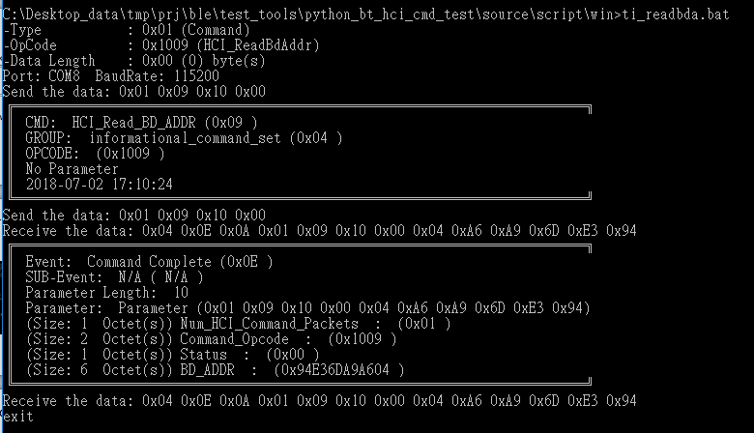
Example-Read BD Addr
bt_hci_cmd_test_wc.py --raw 01 09 10 00 -d

Slide 7
Test Loop Script
ti_schedule_xxtest.bat (outside)
Parameter %1: initial step first (1: do init, 0: not do)
Example: (CMD) ti_schedule_xxtest.bat 0
ti_schedule_xxtest.bat (inside)
Parameter %2: Start Step
Same as %two_pos%
Parameter %3: End Step
Same as % three_pos%

Slide 8
How to create new test
Create a patch file (*.bat)
Add the Line: (refer ti_readbda.bat)
Update goto section
:newtest
if %1a==a goto rbdaddr
Add the raw data and parameter (python) for the new test
%cmdpath%\bt_hci_cmd_test_wc.py --raw xx xx xx xx…. -d

Slide 9
How to add test in loop
Update step number (ex. step7)
if %two_pos% == 7 goto step7
Add Goto section:
:step7
Then add the test item shell( *.bat)
Change Step number for last step
ti_schedule_init.bat 1 1 7 ti_schedule_xxtest
SET /a three_pos = 7

Slide 10
How to add command in code -1
Add command string in test_command_set dictionary type.
bt_hci_cmd_test_wc.py
Item: test_command_set
Ex. red word.
For example description
The first red word: test name which you want to add. (it’s can be any word instead of real command.)
The second word: it is the PDU format for total raw data. (it only support one command.)
'HCI Inquiry1' : b'\x01\x01\x04\x05\x00\x00\x00\x00\x00', #LAP = 0x9E8B33 Len=0x30

Slide 11
How to add command in code -2
Use the routine to execute the command you created before.
hci_command_test_by_inner_string(ser, string)
The ser is serial port at Host. (ex. com8, etc…)
The string is your command description you add in test_command_set.

Slide 12
How to add command in code -3
test_command_set = { ‘this is my Inquiry' : b'\x01\x01\x04\x05\x33\x8B\x9E\x30\x00', #LAP = 0x9E8B33 Len=0x30
…
def main(): global raw_buffer command_for_return_parameter = None parse_args_check() #init... ser = serial.Serial(serial1_port,serial_baudrate,timeout=None, xonxoff=False,rtscts=False,dsrdtr=False) serial_open(ser) hci_command_test_by_inner_string(ser, ' this is my Inquiry') serial_close(ser)

Slide 13
new command in code -1
Add OCF/ OGF in which decision
Command Parameter (type/length/default)
Execute function – hci_command_test(ser, string)

Slide 14
new command in code -2
OGF Set (bt_command.py)
opcode_group_field_set

Slide 15
new command in code -3
OCF – Command set (bt_command.py)
Link Control Commands
link_control_command_set
Link Policy Commands
policy_command_set
Controller & Baseband Commands
host_control_and_baseband_command_set
Informational Parameters
informational_command_set
Status Parameters
status_command_set
Testing commands
test_command_set
LE Controller Commands
le_command_set

Slide 16
new command in code -4
Command parameter
command_parameters_set (bt_command_parameter.py)
add parameter
parameters_configuration_set (bt_hci_parameter.py)
initialization command
Set Parameter length
Set Parameter default value (byte type)

Slide 17
new command in code -5
Use the routine to execute the command you created before.
hci_command_test(ser, string)
The ser is serial port at Host. (ex. com8, etc…)
The string is your command description you add in command set/ group set. (ref. new command in code -2/3)

Slide 18
new command in code – example
link_control_command_set = { 'HCI_Inquiry' : b'\x01',
….
opcode_group_field_set = { 'link_control_command_set' : b'\x01',
…
command_parameters_set = { #LINK CONTROL COMMANDS 'HCI_Inquiry' : ['LAP','Inquiry_Length','Num_Responses'],
…
parameters_configuration_set = { #base_length #Multiple_En #meaningful Type #default value 'Inquiry_Length' : [ 1, 0, 'bytes', b'\x30' ],
…
def main():
hci_command_test(ser, 'HCI_Inquiry')
…

Slide 19
Q & A

Slide 20
Next update

