Slide 1
BLE HCI Command Tester
With python
By Wayne Chiu

Slide 2
Structure
App
Serial Driver
Access BT Method
Byte Data Display
BT Command Tracking
Generate Packet
BT Command data
BT Event data
BT Parameter data

Slide 3
File Structure
source -- bt_hci_cmd_test_wc.py
|- dataset -- bt_command.py
|- bt_command_parameter.py
|- bt_error.py
|- bt_event.py
|- bt_event_parameter.py
|- bt_hci_parameter.py
|- bt_packet.py
|- hciresponse.py
|- showlogo.py

Slide 4
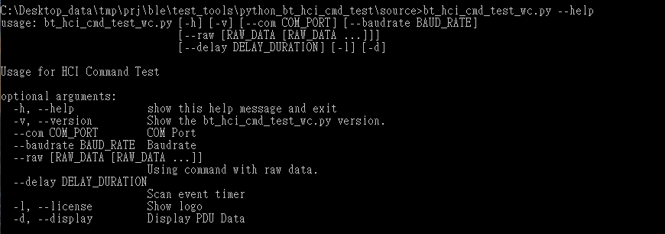
Parameter - [h], [--help]

Slide 5
Raw reference - Parameters
--raw [RAW_DATA [RAW_DATA ...]] Using command with raw data.
--com COM_PORT COM Port
--baudrate BAUD_RATE Baudrate
--delay DELAY_DURATION Scan event timer
-d, --display Display PDU Data

Slide 6
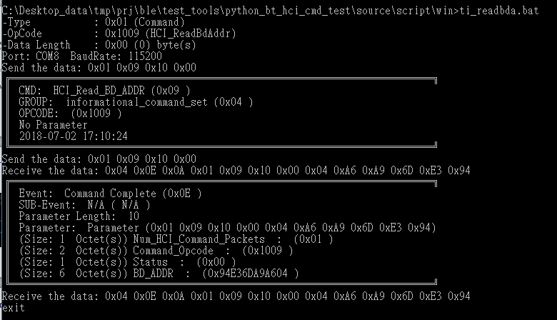
Example-Read BD Addr
bt_hci_cmd_test_wc.py --raw 01 09 10 00 -d

Slide 7
Test Loop Script
ti_schedule_xxtest.bat (outside)
Parameter %1: initial step first (1: do init, 0: not do)
Example: (CMD) ti_schedule_xxtest.bat 0
ti_schedule_xxtest.bat (inside)
Parameter %2: Start Step
Same as %two_pos%
Parameter %3: End Step
Same as % three_pos%

Slide 8
How to create new test
Create a patch file (*.bat)
Add the Line: (refer ti_readbda.bat)
Update goto section
:newtest
if %1a==a goto rbdaddr
Add the raw data and parameter (python) for the new test
%cmdpath%\bt_hci_cmd_test_wc.py --raw xx xx xx xx…. -d

Slide 9
How to add test in loop
Update step number (ex. step7)
if %two_pos% == 7 goto step7
Add Goto section:
:step7
Then add the test item shell( *.bat)
Change Step number for last step
ti_schedule_init.bat 1 1 7 ti_schedule_xxtest
SET /a three_pos = 7

Slide 10
Q & A

Slide 11
Next update

