Slide 1




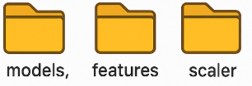

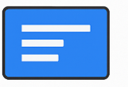
2
Sync
Google Drive
GitHub Repo
Modify
Google Drive Desktop
3
GitHub
Actions
1
-Train
-Update
VS Code
00:00 Daily
Render.com
Google Colab
Display up-to-date Info

