Slide 1




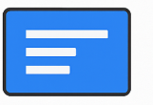
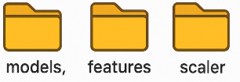
Sync
Google Drive
GitHub Repo
VS Code
Modify
GitHub
Actions
Sync
00:00 Daily
Google Drive Desktop
Render.com
Display up-to-date Info

