Slide 1


Introducing The Haven
One app and one website for ministry life at the Copperbelt University
A ministry of CBU PCM

Slide 2
Why we built The Haven
1
2
3
Everything in one place
Care that reaches people
Less admin for leaders
Events, bands, prayer, counseling, news and merch in one app, instead of scattered posts and forms.
Students can ask for prayer (even anonymously) or book counseling in a minute, privately.
Leaders post events, answer requests and run their band from their phone.

Slide 3
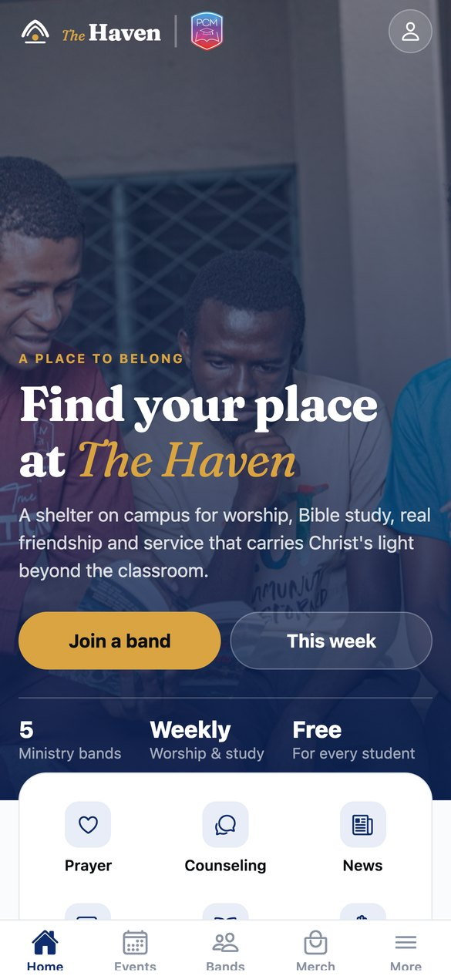
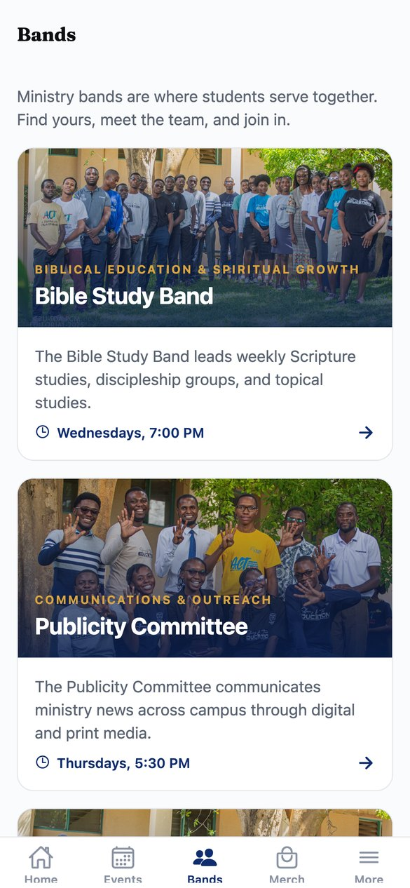
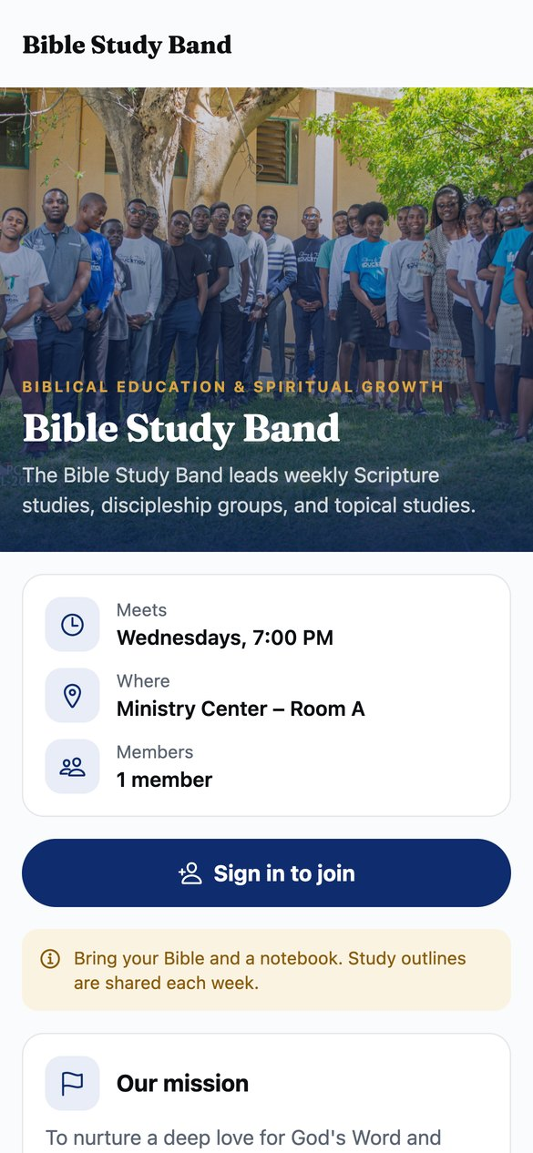
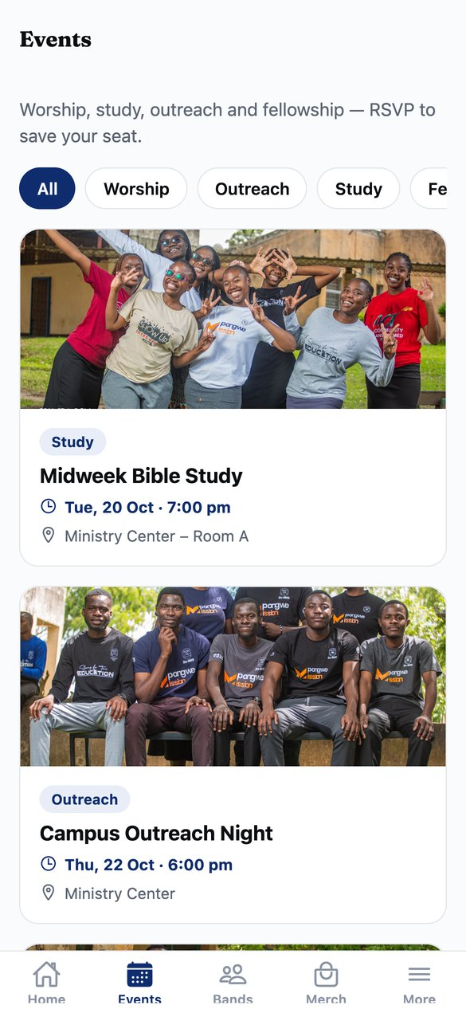
The app: find your place
iPhone and Android. Sign in with Google or email.
Home
Bands
Band page
Events

Slide 4
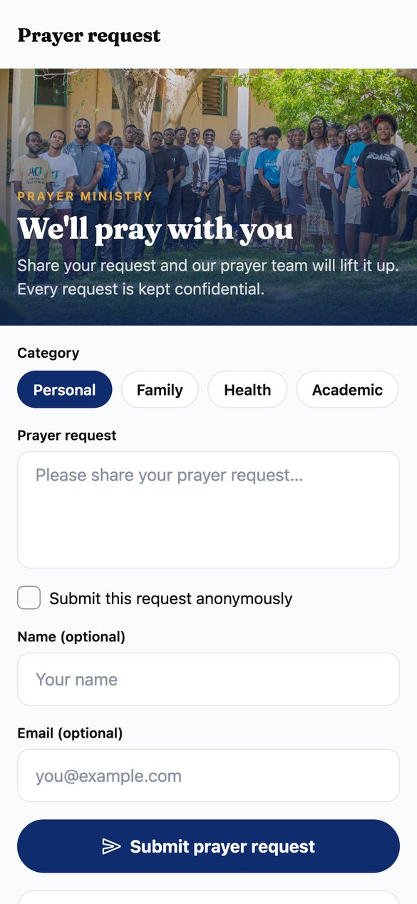
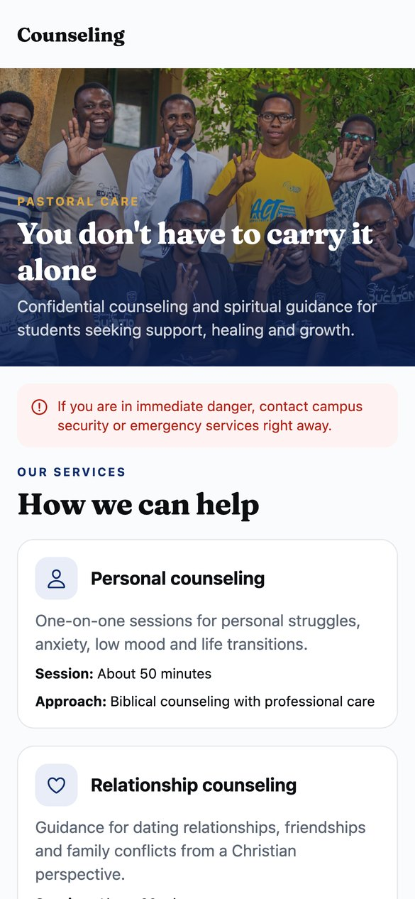
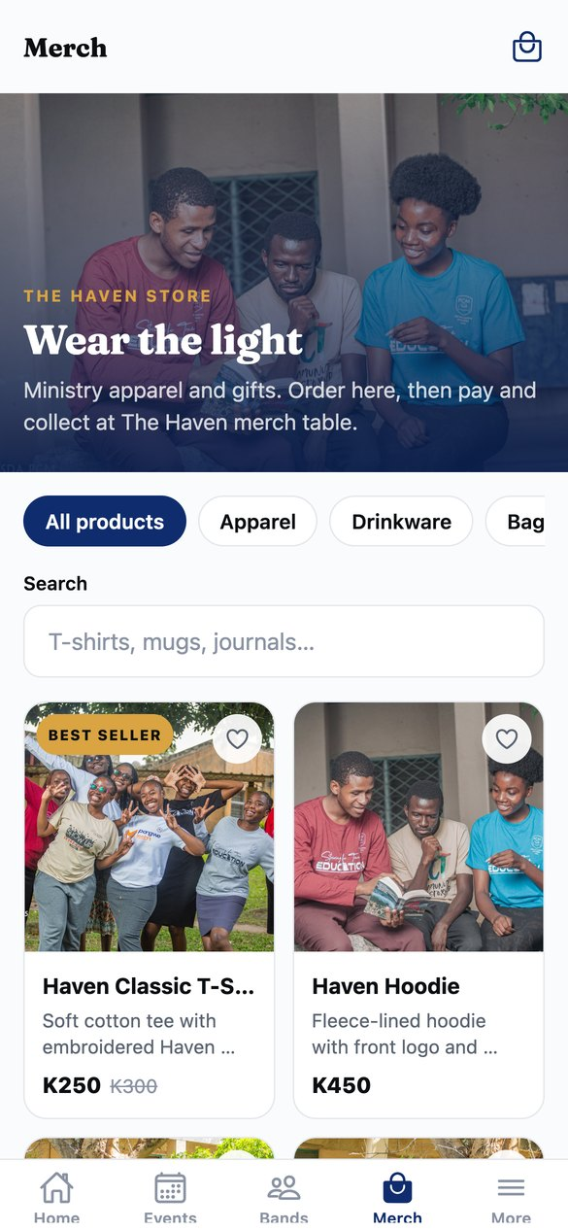
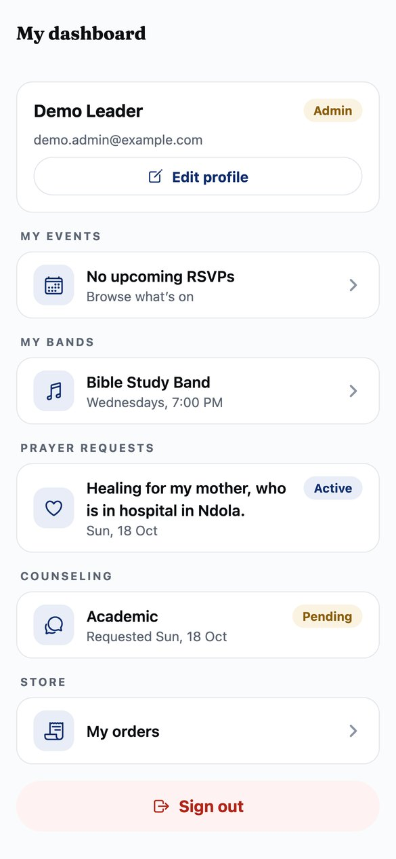
Care, community and the store
Prayer requests
Counseling
Merch store
My dashboard

Slide 5
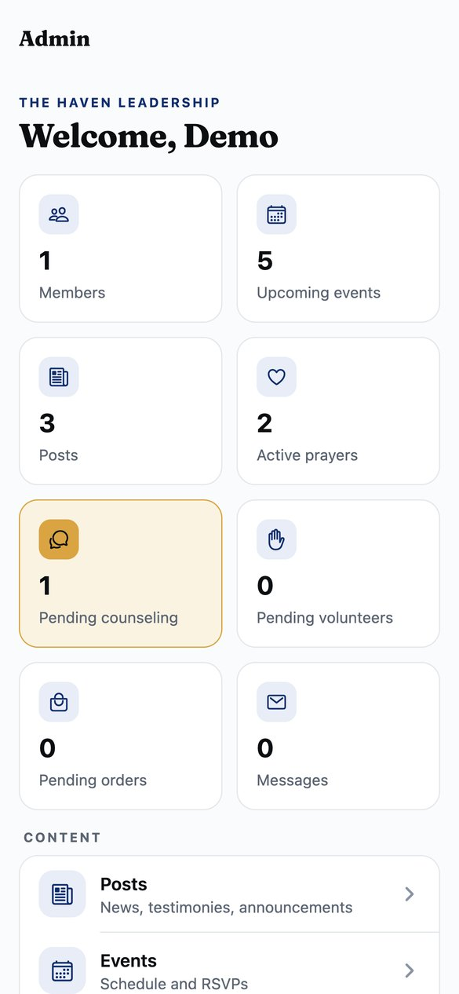
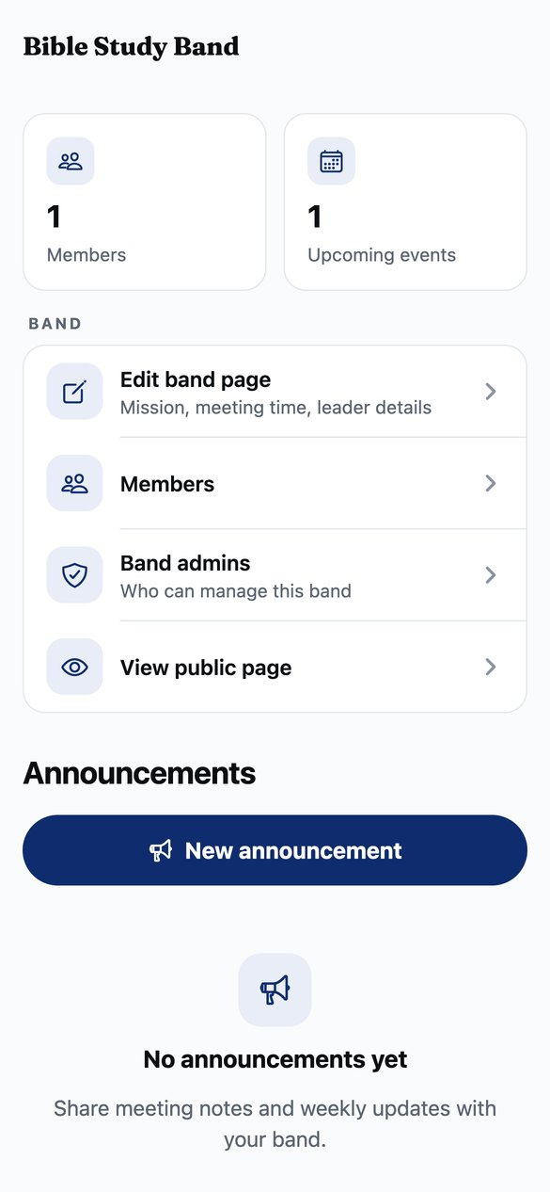
Tools for leaders
Live counts of new prayer requests, counseling, volunteers and orders
Post news and events with photos, straight from a phone
Band admins post announcements, run events and see their members
Only admins can change roles — enforced by the database
Admin dashboard
Band admin

Slide 6
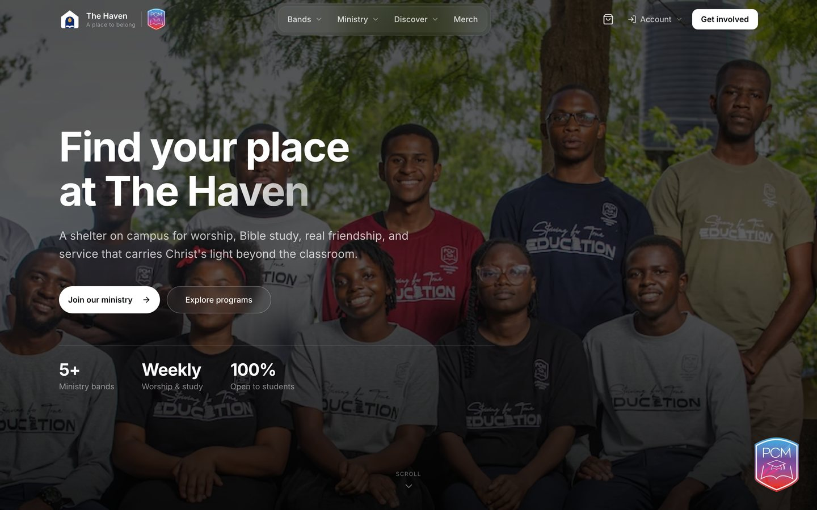
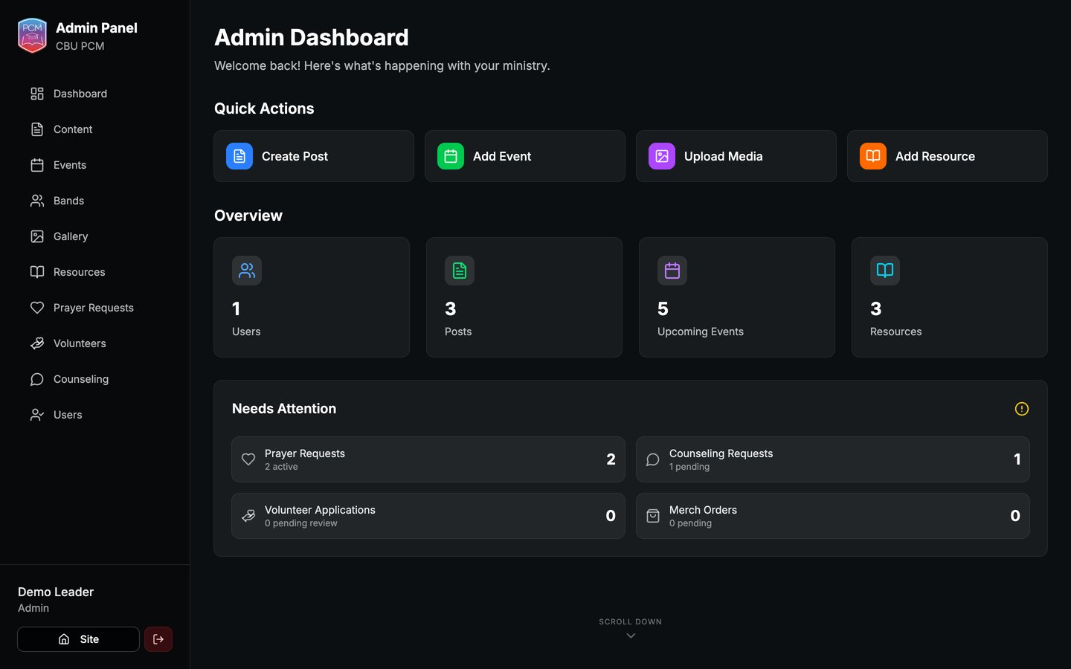
The website
Same content, same account — on any computer.
Home
Admin dashboard

Slide 7
One account, one backend
Mobile app
Supabase
Website
⟷
⟷
Expo · iOS & Android
Database · sign-in · photos
Next.js
Sign up once — the same account works in the app and on the website
Prayer and counseling requests are private to the student and the leaders
Every new account starts as a student; admins grant leader access

Slide 8
What we need from the team
Test it
Fill it
Share it
Install the test build, try every screen, and report anything confusing.
Leaders: add this term’s events, band announcements and resources.
Use the posters in the brand kit to invite students to download the app.
The Haven · A ministry of CBU PCM

